Slide 1

Distributed Order Scheduling and its Application to
Multi-Core DRAM Controllers
Thomas Moscibroda
Distributed Systems Research, Redmond
Onur Mutlu
Computer Architecture Research, Redmond
TexPoint fonts used in EMF.
Read the TexPoint manual before you delete this box.: AAAA

Slide 2

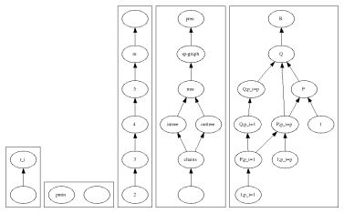

Overview
We study an important problem in
memory request scheduling in multi-core systems.
Maps to a well-known scheduling problem
→ Order scheduling problem
But, in a distributed setting...
→ distributed order scheduling problem
How well can this
scheduling problem be
solved in distributed setting?
How much communication (information exchange) needed for good solution?

Slide 3
Multi-Core Architectures – DRAM Memory
Multi-core systems
→ many cores (processor, caches) on a single chip
→ DRAM memory is typically shared
Core 1
Core 2
Core 3
Core N
L2 Cache
L2 Cache
L2 Cache
L2 Cache
On-Chip
DRAM Memory Controller
DRAM Bus
DRAM Memory
System
DRAM
Bank 1
DRAM
Bank 2
DRAM
Bank 3
DRAM
Bank 8

Slide 4
DRAM Memory Controller
Core 1
Core 2
Core 3
Core N
L2 Cache
L2 Cache
L2 Cache
L2 Cache
On-Chip
DRAM Memory Controller
Core 1
Core 2
Core 3
Core N
DRAM Bus
DRAM Memory
System
L2 Cache
L2 Cache
DRAM
Bank 1
DRAM
Bank 2
DRAM
Bank 3
DRAM
Bank 8
L2 Cache
L2 Cache
On-Chip
DRAM Memory Controller
DRAM Bus
DRAM Memory
System
DRAM
Bank 1
DRAM
Bank 2
DRAM
Bank 3
DRAM
Bank 8

Slide 5
DRAM Memory Controller
Core 1
Core 2
Core 3
Core N
L2 Cache
L2 Cache
L2 Cache
L2 Cache
On-Chip
DRAM Memory Controller
DRAM Bus
DRAM Memory
System
DRAM
Bank 1
DRAM
Bank 2
DRAM
Bank 3
DRAM
Bank 8
DRAM is partitioned into different banks
DRAM Controller consists of
  Request buffers (typically one per bank)
  Request scheduler that decides which request to schedule next.

Slide 6


DRAM Memory Controller - Example
Core 1
Core 2
Core 3
Core N
T2
T2
T2
T2
Memory Request
Buffers:
Bank
Scheduler 1
Bank
Scheduler 2
Bank
Scheduler 3
Bank
Scheduler 4
DRAM
Banks:
Bank 1
Bank 2
Bank 3
Bank 4

Slide 7
DRAM Memory Controller - Example
Core 1
Core 2
Core 3
Core N
Memory Request
Buffers:
T2
T2
T2
T2
Bank
Scheduler 1
Bank
Scheduler 2
Bank
Scheduler 3
Bank
Scheduler 4
DRAM
Banks:
Bank 1
Bank 2
Bank 3
Bank 4

Slide 8
DRAM Memory Controller - Example
Core 1
Core 2
Core 3
Core N
T2
T2
T7
Memory Request
Buffers:
T5
T4
T7
T7
T4
T2
T5
T2
T1
T4
T7
T1
T2
T1
T1
T2
Bank
Scheduler 1
Bank
Scheduler 2
Bank
Scheduler 3
Bank
Scheduler 4
DRAM
Banks:
Bank 1
Bank 2
Bank 3
Bank 4

Slide 9

DRAM Memory Controller
Cores issue memory request (when missing in their cache)
Each memory request is a tuple (Thread_{i}, Bank_{j})
Accesses to different banks can be served in parallel
A thread/core…
  …can run, if no memory request is outstanding
  …is blocked (stalled), if there is at least one request outstanding in the DRAM
  (the above is a significant simplification, but accurate to a first approximation)
In combination with fairness substrate → minimizing avg. stall-times in DRAM greatly improves application performance.
PAR-BS scheduling algorithm… [Mutlu, Moscibroda, ISCA’08]
Goal: Minimize average stall-time of threads!

Slide 10

Overview
Distributed DRAM Controllers → Background & Motivation
Distributed Order Scheduling Problem
Base Cases
→ Complete information
→ No information
Distributed Algorithm:
→ Communication vs. Approximation trade-off
Empirical Evaluation / Conclusions

Slide 11
Customer Order Scheduling
Also known as concurrent open shop scheduling problem
Given a set of n orders (=threads) T={T₁, … , T_{n}}
Given a set of m facilities (=banks) B={B₁,…,B_{m}}
Each thread T_{i} has a set of requests R_{ij} going to bank B_{j}
Let p_{ij} be the total processing time of all requests R_{ij}
R₂₁
R₃₃
p₃₃=3
T2
T2
T3
p₂₁=2
T5
T4
T3
T3
T4
T2
T5
T2
T1
T4
T3
T1
T2
T1
T1
T2

Slide 12
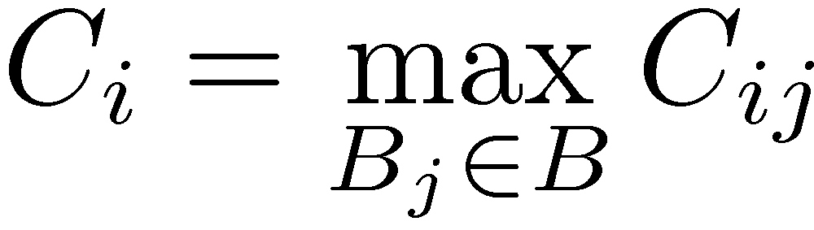
Customer Order Scheduling
Also known as concurrent open shop scheduling problem
Given a set of n orders (=threads) T={T₁, … , T_{n}}
Given a set of m facilities (=banks) B={B₁,…,B_{m}}
Each thread T_{i} has a set of requests R_{ij} going to bank B_{j}
Let p_{ij} be the total processing time of all requests R_{ij}
Let C_{ij} be the completion time of a request R_{ij}
An order/thread is completed when all its requests are served
→ Order completion time
Goal: Schedule all orders/threads in a given order such that
average completion time is minimized.
corresponds to
thread stall time

Slide 13

Example
Baseline Scheduling
(FIFO arrival order)
T3
7
Ordering-based
scheduling
T3
T3
6
T3
T3
T2
T3
T3
5
T3
T3
T3
T3
4
T1
T0
T2
T0
Time
T3
T2
T2
T3
T2
T2
T1
T2
3
T2
T2
T2
T3
T3
T1
T0
T3
2
T1
T1
T1
T2
T1
T3
T2
T3
1
T1
T0
T0
T0
Bank 0
Bank 1
Bank 2
Bank 3
Bank 0
Bank 1
Bank 2
Bank 3
Ranking: T0 > T1 > T2 > T3
T0 | T1 | T2 | T3
4 | 4 | 5 | 7
T0 | T1 | T2 | T3
1 | 2 | 4 | 7
Completion
times:
Completion
times:
→ AVG = (4+4+5+7)/4 = 5
→AVG = (1+2+4+7)/4 = 3.5

Slide 14
Customer Order Scheduling
Distributed
Each bank has its own bank scheduler
→ computes its own schedule
Scheduler only knows requests in its own buffer
Schedulers should exchange information in order to
coordinate their decisions!
Simple Distributed Model:
Time divided into (synchronous) rounds
Initially, only local knowledge
In every round, every scheduler B_{j}2B can broadcast
one message of the form (T_{i}, p_{ij}) to all other schedulers
After n rounds, complete information is exchanged.
Amount of communication
(information exchange)
Trade-off
Quality of resulting
global schedule
Bank
Scheduler 3
Thread 3
has 2 requests for bank 3
Send to all
other schedulers

Slide 15

Related Work
I. Memory Request Scheduling
Existing DRAM memory schedulers typically implement
FR-FCFS algorithm [Rixner et al, ISCA’00]
→ no coordination between bank schedulers!
FR-FCFS potentially unfair and insecure in multi-core systems
[Moscibroda, Mutlu, USENIX Security’07]
Fairnes-aware scheduling algorithms have been proposed
[Nesbit et al, MICRO’06; Mutlu & Moscibroda, MICRO’07; Mutlu & Moscibroda, ISCA’08]
II. Customer Order Scheduling
Problem is NP-hard even for 2 facilities [Sung, Yoon’98; Roemer’06]
Many heuristics extensively evaluated [Leung, Li, Pinedo’05]
16/3-approximation algorithm for weighed version [Wang, Cheng’03]
2-approximation algorithm for unweighted case
  first implicitly contained in [Queyranne, Sviridenko, SODA’00]
  later explicitly stated in [Chen, Hall’00; Leung, Li, Pinedo’07;Garg, Kumar, Pandit’07]

Slide 16
Overview
Distributed DRAM Controllers → Background & Motivation
Distributed Order Scheduling Problem
Base Cases
→ Complete information
→ No information
Distributed Algorithm:
→ Communication vs. Approximation trade-off
Empirical Evaluation / Conclusions

Slide 17
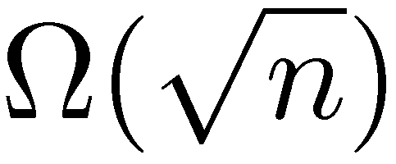
No Communication
Each scheduler only knows its own buffer
Consider only “fair” algorithm
→ every scheduler decides on an ordering based only on processing times (not thread ID’s)
Notice that most DRAM scheduling algorithms used in today’s computer systems are fair and do not use communication.
→ Theorem applies to most currently used algorithms.
Theorem I:
Every (possibly randomized) fair distributed order
scheduling algorithm without communication
has a worst-case approximation ratio of .

Slide 18
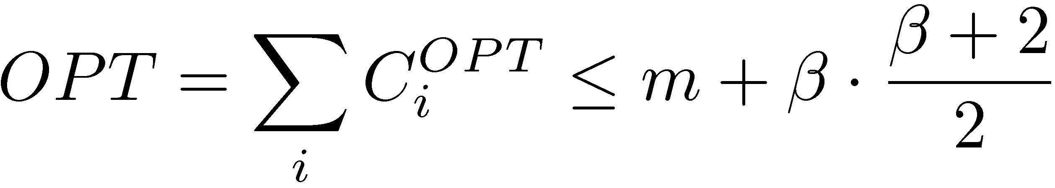
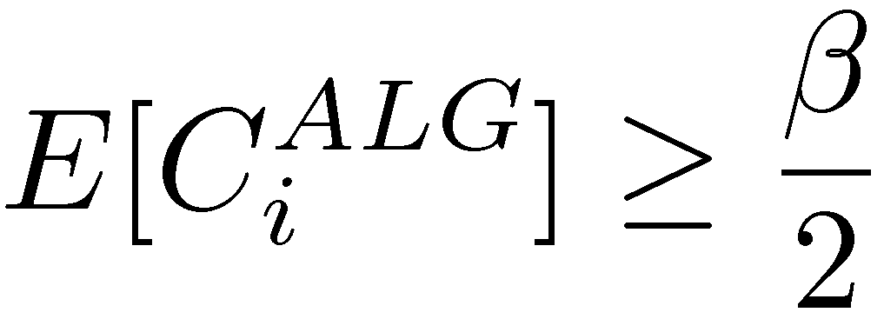
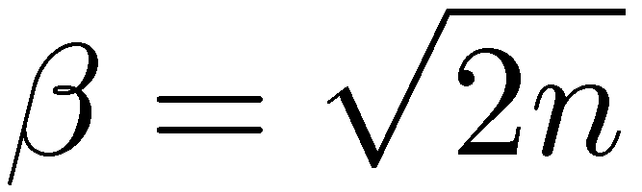
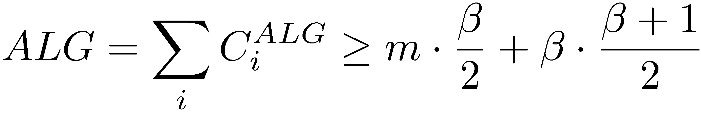
No Communication - Proof
m singleton orders T₁,…,T_{m} with only a single request to B_{i}
¯=n-m orders T_{m+1},…,T_{n} with a request for every bank
OPT is to schedule all singletons first, followed by T_{m+1},…,T_{n}
Fair algorithm: all orders look exactly the same
No better strategy than random order
For any singleton, it holds that
Tn
Tn
Tn
Tn
T{m+3}
T{m+3}
T{m+3}
T{m+3}
T{m+2}
T{m+2}
T{m+2}
T{m+2}
T{m+1}
T{m+1}
T{m+1}
T{m+1}
T1
T2
T3
Tm
Theorem follows
from setting

Slide 19
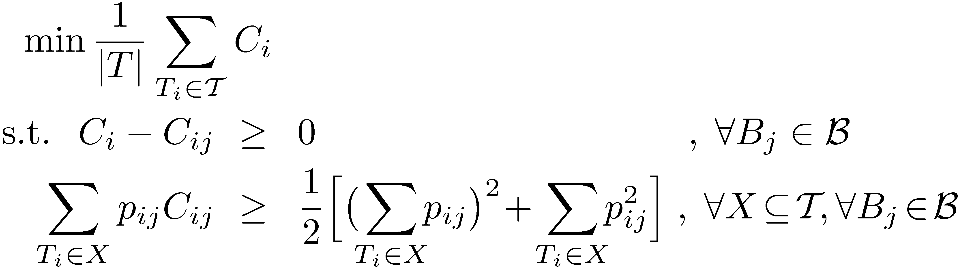
Complete Communication
Every scheduler has perfect global knowledge (centralized case!)
Algorithm:
Solve LP:
Globally schedule threats in non-decreasing order of C_{i} as computed in LP.
Theorem 2: [based on Queyranne, Sviridenko’00]
There is a fair distributed order scheduling
algorithm with communication complexity n and approximation ratio 2.
Machine capacity
constraints

Slide 20
Overview
Distributed DRAM Controllers → Background & Motivation
Distributed Order Scheduling Problem
Base Cases
→ Complete information
→ No information
Distributed Algorithm:
→ Communication vs. Approximation trade-off
Empirical Evaluation / Conclusions

Slide 21
Distributed Algorithm
The 2-approximation algorithm inherently requires
complete knowledge of all p_{ij} for LP.
→ Only this way, all schedulers compute same LP solution…
→ …and same thread ordering
What happens if not all p_{ij} are known ?
Challenge:
  Different schedulers have different views
  Compute different thread orderings
  Suboptimal performance!

Slide 22
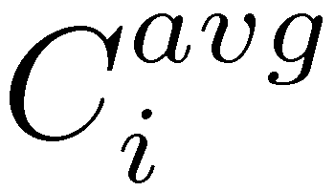
Distributed Algorithm
Input k → algorithm has time complexity t=n/k.
For each bank B_{j}, define L_{j} as the requests with the t longest processing times in this bank, and S_{j} as all other n-t requests
Broadcasts exact information (T_{i}, p_{ij}) about all long requests in L_{j}
Broadcasts average value (T_{i}, P_{j}) of all short requests in S_{j}
Using received information, every scheduler locally computes LP*
→ exact values for long requests
→ per-bank averaged values for all short requests
Let be the resulting completion times in LP*
→ Each scheduler schedules threads according to increasing
Shortest
requests
Longest
requests
n-t requests → S_{j}
t requests → L_{j}
t rounds:
1 round:

Slide 23
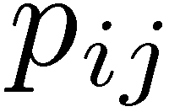
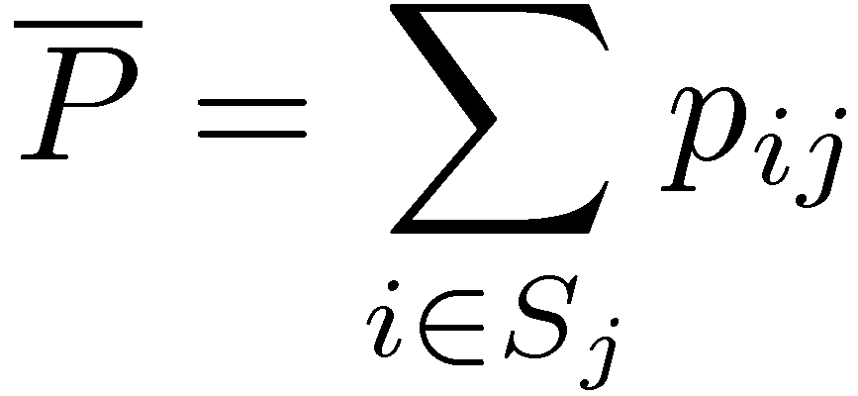

Distributed Algorithm
L_{j}
averages
only
S_{j}
Every scheduler locally invokes LP
using these averaged values. → LP*

Slide 24
Distributed Algorithm - Results
There are examples where algorithm is Ω(k) worse than OPT.
→ our analysis is asymptotically tight
→ see paper for details
Proof is challenging for several reasons…
Theorem 3:
For any k, the distributed algorithm has a
time-complexity of n/k+1 and achieves
an approximation ratio of O(k).

Slide 25
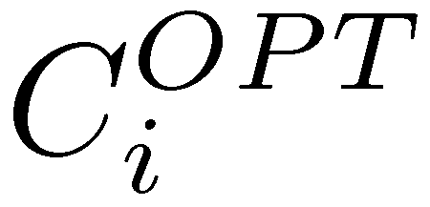

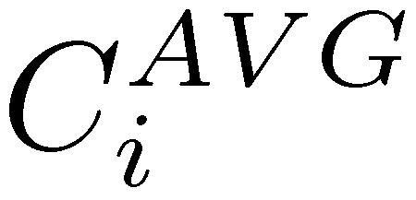
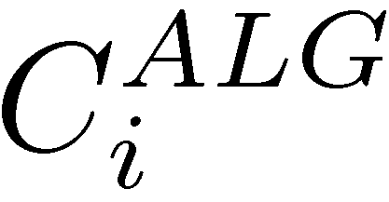

Distributed Algorithm – Proof Overview
Distinguish four completion times
→ : optimal completion time of T_{i}
→ : completion time in original LP
→ : completion time as computed by the averaged LP*
→ : completion times resulting from the algorithm
1) show that averaged LP* is within O(k) of original LP
2) show that algorithm solution is also within O(k) of OPT
See paper

Slide 26
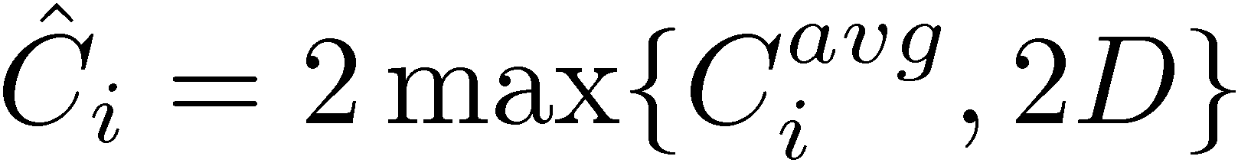


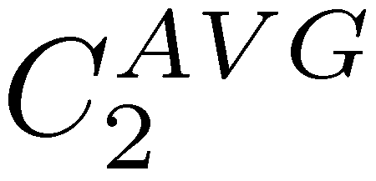

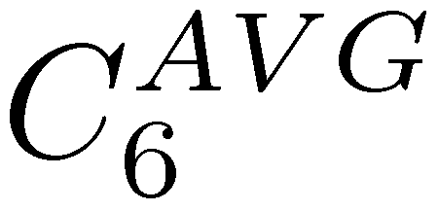
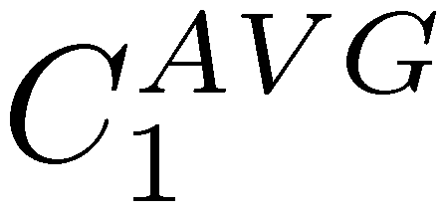

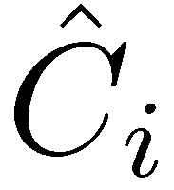
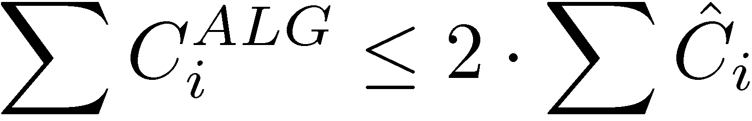
Distributed Algorithm – Proof Overview
Define Q_{h}: t orders with highest completion times in original LP.
Define virtual completion time
Three key lemmas about virtual completion times:
Q_{h}
2D
Defined as average
of all in Q_{h}.
completion
time
1.
Bounds OPT
2. form a feasible solution to (original) LP
Bounds ALG
3.

Slide 27
Empirical Evaluation
We evaluate our algorithm using SPEC CPU2006 benchmarks and two large Windows desktop applications (Matlab, XML parsing app)
Cycle-accurate simulator framework
Models for processors & instr. windows, L2 caches, DRAM memory
See paper for further methodology
Local shortest-job
first heuristic
Max-tot heuristic
[Mutlu, Moscibroda’07]
k=0
k=n-1
k=n

Slide 28
Summary / Future Work
DRAM memory scheduling in multi-core systems
Problem maps to distributed order scheduling problem
Results:
  No communication → Ω(√n)-approximation
  Complete knowledge → 2-approximation
  n/k communication rounds → O(k) approximation
No matching lower bound → better approximations possible?
Distributed computing multi-core computing
So far, mainly new programming paradigms…
(transactional memory, parallel algorithms, etc…)
In this paper: new distributed computing problem arising
in the microarchitecture of multi-core systems
Many more such problems in this space!

