Slide 2
Semantic Reconciliation of Sensor Net Meta-Data
Prashant Doshi
Asst. Professor of Computer Science
University of Georgia

Slide 3
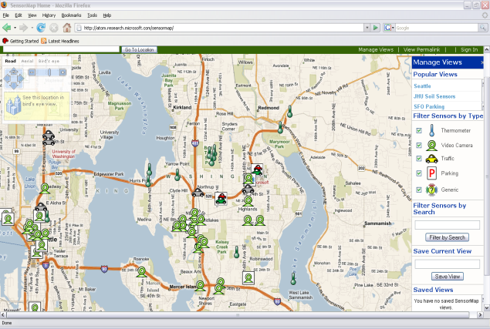
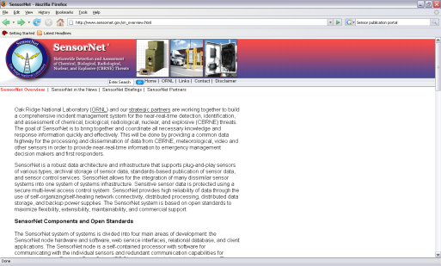
Semantic Reconciliation for Automatic Publication
Generic sensor data
publication portal
e.g. MSR SenseWeb
Personal sensor data
publication portal
Sensor Mashups
Semantic
Middle Layer
Publish
Semantic Querying
and Data Fusion
Semantic Reconciliation
for Publication
Ontology Matching
(MSR SensorMap
Project – PI: Doshi)
Semantic Data Models
e.g. Ontologies
as meta-data
instances
instances
Sensor net data
Sensor net data
Expensive and complex
sensor nets
Utilities for scientific
and educational use

Slide 4
Ontology Matching
Semantic sensor data models
  Ontologies as meta-data
    Tools: SensorML, OWL or RDF(S)
  Sensor data as instances of ontological concepts
Semantic sensor meta-data reconciliation
  Ontology matching and merging
    Match provider-defined meta-data with publisher’s ontology
  Facilitates publication and querying of disparate sensor data
    Transfer sensor data across reconciled ontologies
Our contributions
  New lightweight and scalable method for matching ontologies
    Compares with the state of the art
  Optima: A tool for visual ontology matching
    One of few GUI tools for automatic ontology matching

Slide 5
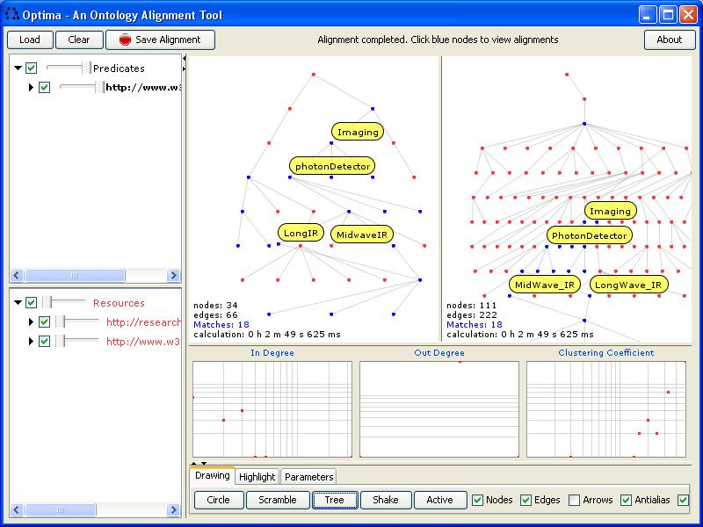
Optima
SenseWeb’s
SensorType
(augmented)
OntoSensor
Based on
MIT’s Welkin
Ontology matching uses Expectation-Maximization
  Exploit structural and lexical similarities
    Graph structure and node labels
  Partition ontologies for scalability
Match Quality
May converge
to local maxima
Space of Matches

Slide 6

© 2008 Microsoft Corporation. All rights reserved. Microsoft, Windows, Windows Vista and other product names are or may be registered trademarks and/or trademarks in the U.S. and/or other countries. The information herein is for informational purposes only and represents the current view of Microsoft Corporation as of the date of this presentation. Because Microsoft must respond to changing market conditions, it should not be interpreted to be a commitment on the part of Microsoft, and Microsoft cannot guarantee the accuracy of any information provided after the date of this presentation. MICROSOFT MAKES NO WARRANTIES, EXPRESS, IMPLIED OR STATUTORY, AS TO THE INFORMATION IN THIS PRESENTATION.

