Slide 2
Scholarly Communications
Paul Ginsparg
CIS and Physics,
Cornell University

Slide 3
Next-Generation Implications of Open Access
Abstract: True open access to scientific publications not only gives readers the possibility to read articles without paying subscription, but also makes the material available for automated ingestion and harvesting by 3rd parties. Once articles and associated data become universally treatable as computable objects, openly available to 3rd party aggregators and value-added services, what new services can we expect, and how will they change the way that researchers interact with their scholarly communications infrastructure? I will discuss straightforward applications of existing ideas and services, including citation analysis, collaborative filtering, external database linkages, interoperability, and other forms of automated markup, and speculate on the sociology of the next generation of users.

Slide 4
Fantasy
Reflect for a moment
Current practice
  Free access articles, background material from authors, slide presentations, video, related software, on-line animations, blog discussions, 3rd party notes
  Course websites, e-mail, course blogs, wiki for notes
New expectations (harvest all related, activity maps,
concept browse)
  Collapse internet resources to subset of unique ideas, authenticated
  Marketplace for pre-research barter of tools, resources, capabilities
  Authoring tools
  New generation of users

Slide 5
Collective Action
Large groups work collectively to synthesize knowledge (feedback mechanisms, Wikipedia, open source software, social-networking sites, bloggers feed news coverage, …)
Frameworks for analyzing online information systems still based on 1990s models for studying collections of hyperlinked documents. Need graph and network algorithms, data mining, natural-language processing, machine learning, probabilistic modeling, human-computer interaction, algorithmic game theory (individuals seek out advantageous positions within the network).
Maps make social network visible to the group itself: feedback loops increase participant awareness of the state of relationships among participants as a whole to increase participation.
Temporal dynamics of aggregate user populations (news cycle, flash crowds, …) follow quantiable laws, leads to design principles.

Slide 6
NIH Public Access Policy Becomes
Mandate in 2007
http://info-libraries.mit.edu/scholarly/open-access-initiatives/
On December 26, 2007, President Bush signed a spending bill that requires the U.S. National Institutes of Health (NIH) to mandate open online access to all research it funds.
This is the first mandate for a major public funding agency in the U.S. that requires research to be openly available; it changes the 2005 NIH Public Access Policy, which requested, but did not require, open access to NIH-funded research.
The new language stipulates that investigators funded by the NIH submit their peer-reviewed manuscripts to the National Library of Medicines open access repository PubMed Central when the manuscript is accepted for publication [additional > 70k/year]. The manuscript would then become openly available via PubMed Central within 12 months of publication in a journal. The policy will be implemented “in a manner consistent with copyright law.”

Slide 7
Harvard To Collect, Disseminate Scholarly
Articles For Faculty
http://www.fas.harvard.edu/home/news and events/releases/scholarly 02122008.html
Cambridge, Mass. - February 12, 2008 - In a move to disseminate faculty research and scholarship more broadly, the Harvard University Faculty of Arts and Sciences voted today to give the University a worldwide license to make each faculty member’s scholarly articles available and to exercise the copyright in the articles, provided that the articles are not sold for a profit.
In proposing the legislation, Professor Stuart M. Shieber said, “… scholarly journals have historically allowed scholars to distribute their research to audiences around the world. But, the scholarly publishing system has become far more restrictive than it need be. Many publishers will not even allow scholars to use and distribute their own work. And, the cost of journals has risen to such astronomical levels that many institutions and individuals have cancelled subscriptions, further reducing the circulation of scholars’ works.”

Slide 8
Why Necessary?
Congress Passes Law Requiring Users to Post to Youtube, Flickr, ...

Slide 9
arXiv.org
E-Mail interface started August 1991
  Download data available from start
  WWW usage logs starting from 1993
456,000 full text documents (with full graphics), as of end 2007
  Physics, mathematics, computer science, non-linear science
  Growing at 60,000 new submissions per year (est. 2008)
> 516,000 at end of year)
  20 references per article (over 9 million total)
Over 50 million full text downloads during calendar year ’07
  Over 600 downloads per article from ’96-’07 (>250M total)
Now managed by CU library (starting roughly 2001)
  http://www.cornell.edu/provost/search-lib.cfm

Slide 10
arXiv.org e-Print archive
Automated e-print archives physics Search Form Interface Catchup Help
11 Nov 2004: New CoRR interface introduced for our cs users.
29 Sep 2004: Search engine for user help pages installed.
For more info, see cumulative "What’s New" pages.
Robots Beware: indiscriminate automated downloads from this site are not permitted.
Physics
  Astrophysics (astro-ph new, recent, abs, find)
  Condensed Matter (cond-mat new, recent, abs, find)
  includes: Disordered Systems and Neural Networks; Materials Science; Mesoscopic Systems
  and Quantum Hall Effect; Other; Soft Condensed Matter; Statistical Mechanics; Strongly
  Correlated Electrons; Superconductivity
  General Relativity and Quantum Cosmology (gr-qc new, recent, abs, find)
  High Energy Physics - Experiment (hep-ex new, recent, abs, find)
  High Energy Physics - Lattice (hep-lat new, recent, abs, find)
  High Energy Physics - Phenomenology (hep-ph new, recent, abs, find)
  High Energy Physics - Theory (hep-th new, recent, abs, find)
  Mathematical Physics (math-ph new, recent, abs, find)
  Nuclear Experiment (nucl-ex new, recent, abs, find)
  Nuclear Theory (nucl-th new, recent, abs, find)
  Physics (physics new, recent, abs, find)
  includes (see detailed description): Accelerator Physics; Atmospheric and Oceanic Physics;
  Atomic Physics; Atomic and Molecular Clusters; Biological Physics; Chemical Physics;
  Classical Physics; Computational Physics; Data Analysis, Statistics and Probability; Fluid
  Dynamics; General Physics; Geophysics; History of Physics; Instrumentation and Detectors;
  Medical Physics; Optics; Physics Education; Physics and Society; Plasma Physics; Popular
  Physics; Space Physics
  Quantum Physics (quant-ph new, recent, abs, find)
Mathematics
  Mathematics (math new, recent, abs, find)
  includes (see detailed description): Algebraic Geometry; Algebraic Topology; Analysis of
  PDEs; Category Theory; Classical Analysis and ODEs; Combinatorics; Commutative Algebra;
  Complex Variables; Differential Geometry; Dynamical Systems; Functional Analysis; General
  Mathematics; General Topology; Geometric Topology; Group Theory; History and Overview;
  K-Theory and Homology; Logic; Mathematical Physics; Metric Geometry; Number Theory;
  Numerical Analysis; Operator Algebras; Optimization and Control; Probability; Quantum
  Algebra; Representation Theory; Rings and Algebras; Spectral Theory; Statistics; Symplectic
  Geometry
Nonlinear Sciences
  Nonlinear Sciences (nlin new, recent, abs, find)
  includes (see detailed description): Adaptation and Self-Organizing Systems; Cellular Automata
  and Lattice Gases; Chaotic Dynamics; Exactly Solvable and Integrable Systems; Pattern
  Formation and Solitons
Computer Science
  Computing Research Repository (CoRR new, recent, abs, find includes (see detailed description): Architecture; Artificial Intelligence; Computation and Language; Computational Complexity; Computational Engineering, Finance, and Science; Computational Geometry; Computer Science and Game Theory; Computer Vision and Pattern Recognition; Computers and Society; Cryptography and Security; Data Structures and Algorithms; Databases; Digital Libraries; Discrete Mathematics; Distributed, Parallel, and Cluster Computing; General Literature; Graphics; Human-Computer Interaction; Information Retrieval; Information Theory; Learning; Logic in Computer Science; Mathematical Software; Multiagent Systems; Multimedia; Networking and Internet Architecture; Neural and Evolutionary Computing; Numerical Analysis; Operating Systems; Other; Performance; Programming Languages; Robotics; Software Engineering; Sound; Symbolic Computation
Quantitative Biology
  Quantitative Biology (q-bio new, recent, abs, find) includes (see detailed description): Biomolecules; Cell Behavior; Genomics; Molecular Networks; Neurons and Cognition; Other; Populations and Evolution; Quantitative Methods; Subcellular Processes; Tissues and Organs
About arXiv
  Some related and unrelated servers (including arXiv mirror sites)
  RSS feeds are now available for individual archives and categories.
  today’s usage for arXiv.org (not including mirrors)
  some info on delivery type [src] and potential problems
arXiv Advisory Board
  Available macros and brief description available help on submitting and retrieving papers some background blurb, including invited talk at UNESCO HQ (Paris, 21 Feb. ’96), update Sep. 96 some info on hypertex arXiv is an e-print service in the fields of physics, mathematics, non-linear science, computer science, and quantitative biology. The contents of arXiv conform to Cornell University academic standards. arXiv is owned, operated andfunded by Cornell University, a private not-for-profit educational institution. arXiv is also partially funded by the National Science Foundation.
  The Cornell University Library acknowledges the support of Sun Microsystems and U.S. Department of Energy’s Office of Scientific and Technical Information (providers of the E-Print Alert Service, which automatically notifies users of the latest information posted on arXiv and other related databases).
  www-admin@arxiv.org

Slide 11
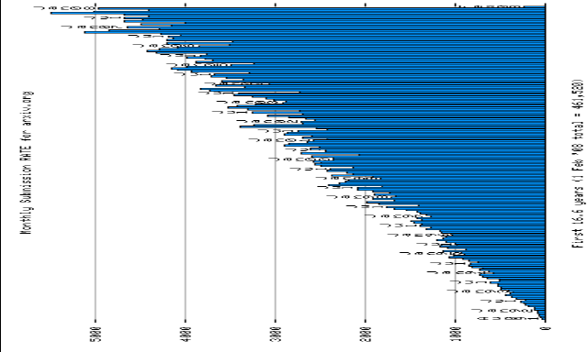
Submissions per Month, ’91 – ’08
Total 490,000 (Jul. 2008)

Slide 12
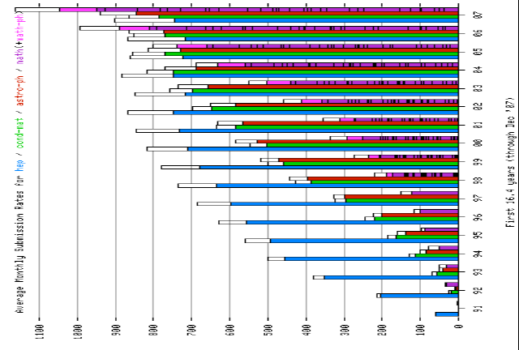
Top Four Subject Areas

Slide 13
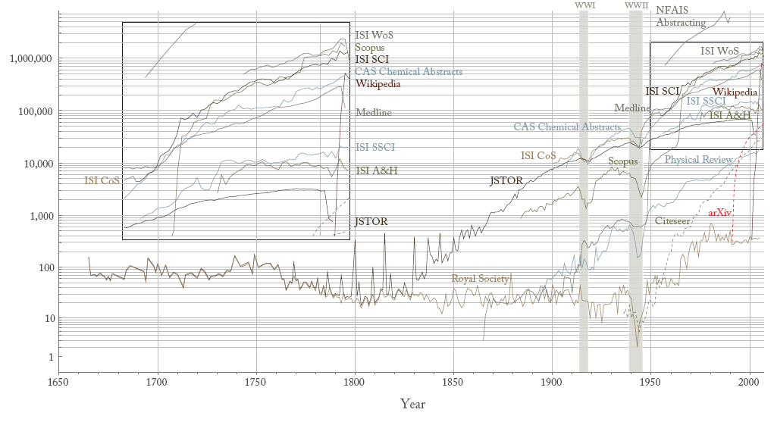
Papers & Wikipedia Entries
“Atlas of Science: Guiding the Navigation and Management of Scholarly Knowledge”, Part I: The Rise of Science and Technology. (2009)
Chart showing the number of papers/wikipedia entries for different databases and publication years.
Contact Katy B¨orner <katy@indiana.edu> or Elisha Hardy <efhardy@indiana.edu> for details.

Slide 14
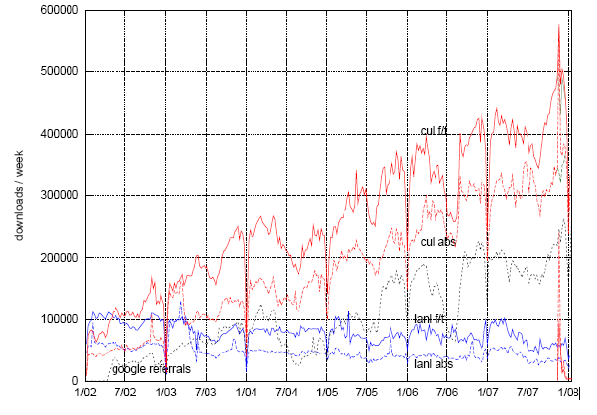
’02-’07

Slide 15
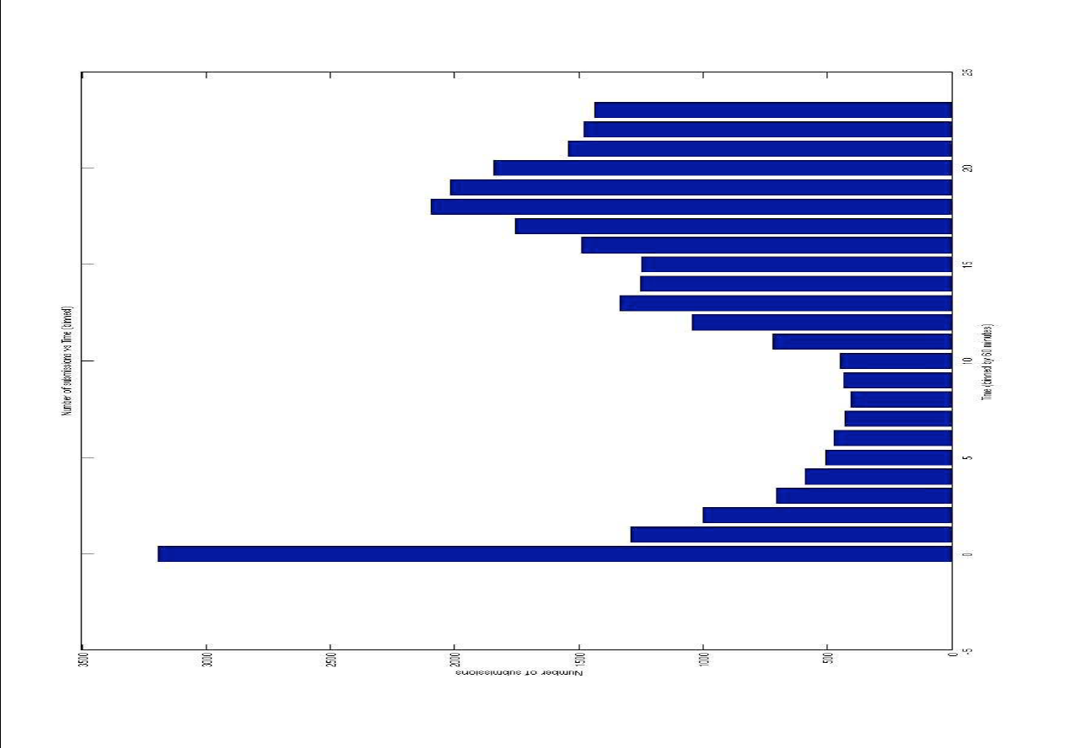

Slide 16
Game Theory
A few percent submitted in first 60 seconds (increasing
with time…)
Dietrich (2008): At or near the top receive more citations by a factor of 2 (first six: 90 +/- 9, 10-40: 45+/-.9)
  Visibility Bias
  Self-promotion Bias
SP highest, but also difference definite VB effect (cited not necessarily due to inherent quality)
Information overload so some overlooked?
Need more tools to sort by relevance

Slide 17
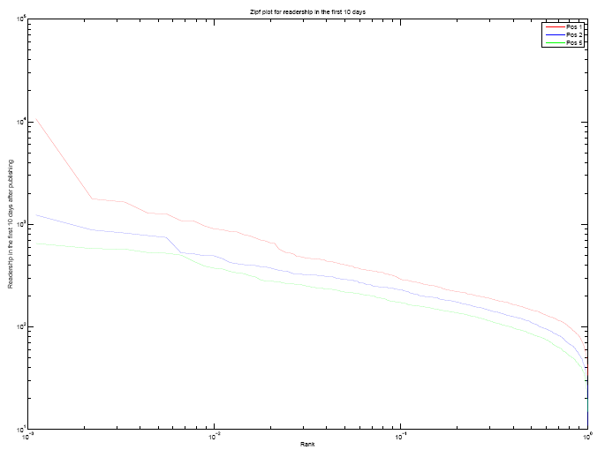

Slide 18
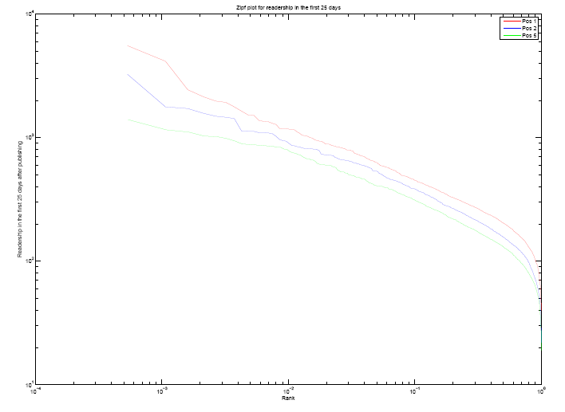

Slide 19
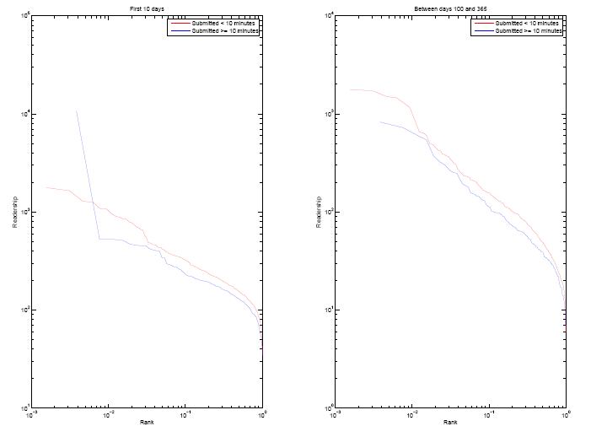

Slide 20
Learning from Logs (Joachims/Radlinski)
Learn ranking function from implicit feedback (which clicked on) — if ranked above, but not clicked on, less relevant
Eliminate presentation bias by flipping adjacent pairs
Query chains: users perform sequence, or chain, of queries with similar information need. New types of preference judgments from search engine logs, taking advantage of user intelligence in reformulating queries (learned rankings outperform static ranking function)
Co-access recommender better than co-citation (and available sooner…)
No firehose, focused community

Slide 21
More on Readership
Different from cites
Almost deterministic
More network effects

Slide 22
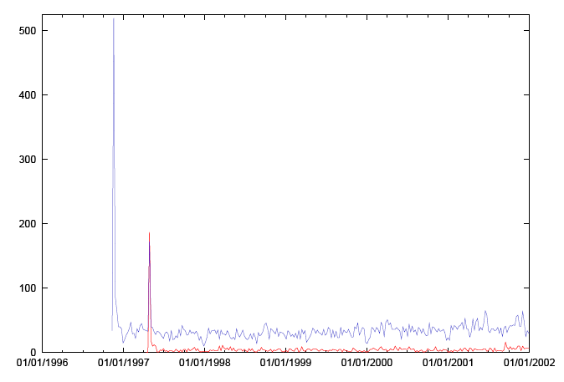

Slide 23
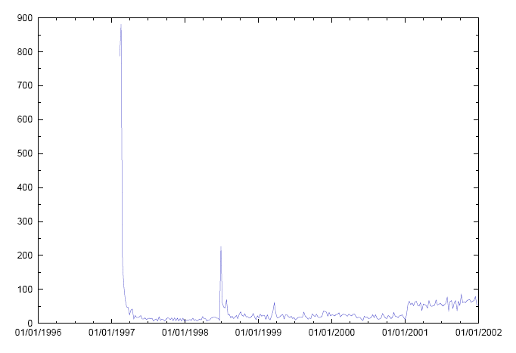

Slide 24
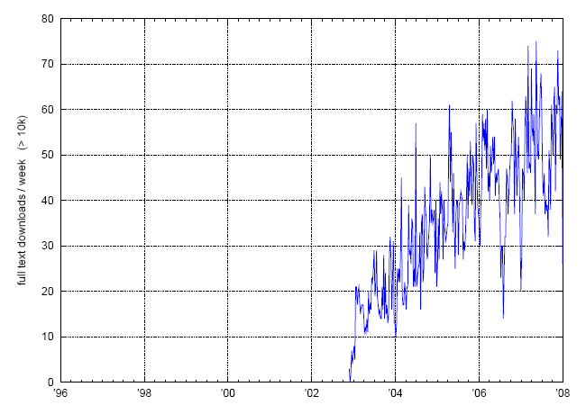

Slide 25
Mining Full Text
Auto-classify
Cluster
Ontological Markup (via API interoperate with PMC)
Plagiarism

Slide 26
Search Results: Display
Summary
Brief
XML
Taxonomy Tree
Cited in Books
CancerChrom Links
Conserved Domain Links
3D Domain Links
GEO DataSet Links
Gene Links
Genome Links
Genome Project Links
GENSAT Links
GEO Profile Links
HomoloGene Links
Nucleotide Links
OMIM Links
Compound Links
Substance Links
PopSet Links
Protein Links
PubMed Links
Cited Articles
SNP Links
Structure Links
Taxonomy Links
UniSTS Links

Slide 27
Article: Related Material
PubMed record
PubMed related arts
PubMed LinkOut
Gene
HomoloGene
Nucleotide
Omim
GEO Profiles
Protein
PubChem Compound
PubChem Substance
Taxonomy
Taxonomy tree

Slide 28
Backdoor Route to Open Access
More than one-third of the high-impact journal articles in a sample of biological/medical journals published in 2003 were found at non-journal web sites (Wren, 2005).
Unsystematic (Ginsparg, 2006, “As We May Read”): 75% of publications from 2000 or later posted at web site of incoming president of Society for Neuroscience available without subscription (preprints, open-access journal sites, copies at non-journal web sites). Perhaps already farther along than most realize?
Expectations of next generation independent of outcome of government mandate debate

Slide 29
What will Open Access Mean?
First survey current generic functionality
  PMC, ADS, Citeseer, PLoS, scholar.google, SLAC-Spires, …
  APS, ISI, Highwire, ScienceDirect, IoP, …
  nytimes, youtube, video.google, amazon, …
Scholarship⬄Shopping⬄Entertainment
  (sniff: we’re no longer the bleeding edge)
Note importance of community building/social networking
Avoid emulating abacus

Slide 30
Item Specific
Standard metadata (title, author(s), submitter)
Browse related items, related keywords
  Local, in 3rd party (e.g., pubmed, ISI, scholar.google…)
Add tags, labels (“flowering of the commons”)
More from this user
Rate this item
Save to favorites
Add to groups
Share, e-mail to friend
Blog this item
Post to 3rd party site (e.g., Myspace)
Flag as inappropriate
Comments, responses, eletters (read, add)

Slide 31
Item Specific, cont’d
Full text
Supplemental data
Show references, citations
Addenda, corrigenda
Related web pages
Export citation; cite or link using DOI
Alert when cited
Same object in 3rd party (e.g., pubmed citation)
Search 3rd party database (e.g., by same authors in scholar.Google, h-index)
Flavors of relatedness by text, co-citation, co-reference, co-usage (also read)

Slide 32
Site Specific
Subscribe
Alert to new issues
Upload
Personalization
  My articles (view collection)
  Add/subtract from private library
(Note: Enhancement for other users, but privacy issues?)

Slide 33
Browse
Groups, categories, subject area
Most recent
Recently featured
Most viewed
Top rated
Most discussed
Top favorites
Most linked
Most honored
Most shared
Most blogged
Most searched

Slide 34
Present
More than a new means of distribution?
Crippled by document format? (TeX, Word!PDF, 70’s methodology)
Implications of next generation open XML document format
[.docx, …] not yet appreciated. (Commercial tools for authoring in
NLM/NCBI DTD?
Article authoring add-in for MS Word 2007)
Paradox of physics: some well-established areas could fit into a semantic web context, amenable to a “commons” approach via open ontologies and sets of relationships; (More generally, tie semantic content in existing centralized literature databases to distributed network databases using relevant ontologies and machine-readable document standards)

Slide 35
Present
Challenge from Word developers to Scientists: Suggest 20 functions to provide optimal environment for scientific authorship (handshakes to networked databases, etc.)
Active + Passive user participation in bottom-up approach to QC
  Actively add tags, links; contribute to ontologies, correct wiki entries
  Passively ingest readership, bookmarking, annotation behavior
Incentive Question: Expertise-intensive efforts beyond conventional journal publication (annotation, linkage, …) = scholarly achievement?
  Articles + blog commentary ➔ more modular objects
  Glue databases together into knowledge structure
Navigation via synthesized concepts, w/o redundancy/ambiguity, highlighted for novelty
Obvious

Slide 36
Obvious
Automated Markup (genomes, proteins, organisms, glossary items)
Missing refs? Superfluous refs?
Example: AdS Collaborative filtering
  Recent: Keyword search gives recent articles on a subject
  Popular: Usage data gives most read
  Useful: Citation data gives most referred
  Pedagogical: Citation data gives most referring
User tagging (e.g., flagged review articles)
Interoperability with [blog/news/wiki]-space
Systematically mine and bookmark interiors (relatedness tree),
Modular components
• NVO, Mathworld, etc.
Embarrassments: a) plagiarism, b) not yet public

Slide 37
Essential Question
How will the analog of NCBI/PubMedCentral be provided for other communities? (Who? With whose money?)
Common web service protocols, common languages (e.g., for manipulating, visualizing data), data interchange standards
Distributed version for other fields
Qualitatively new research and cognitive methodologies, with academic community as role model for the creation and dissemination of knowledge to the public

