Slide 1
Interactive Machine Learning: Challenges, Methods and Applications
Ashish Kapoor
Researcher
Microsoft Research, Redmond

Slide 2
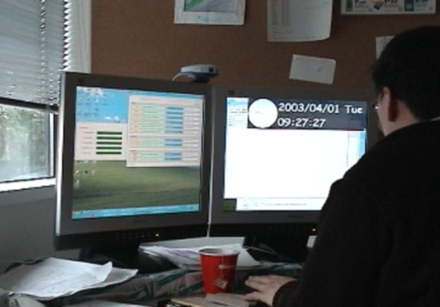
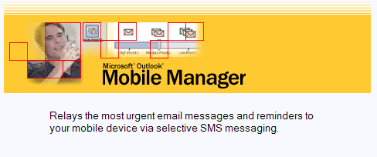
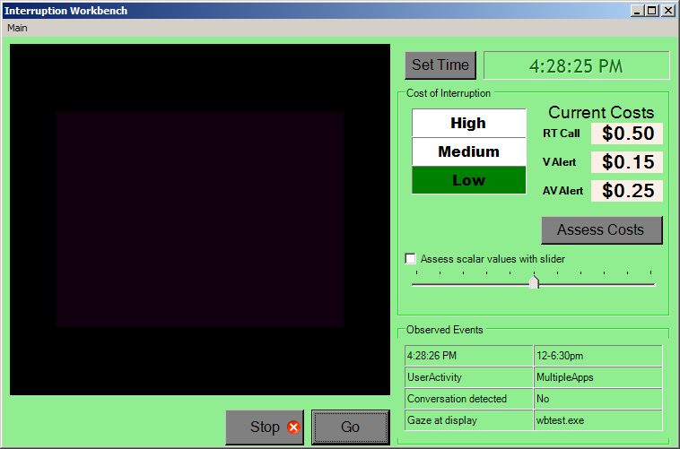
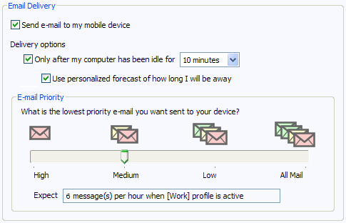

Machine Learning for Adaptive User Models
Key Challenge: Acquiring labeled cases, Dynamic contexts
  e.g., User intentions, needs, preferences, cognitive states
Approach 1: Offline bulk assessment
  Interruption Workbench Outlook Mobile Manager

Slide 3
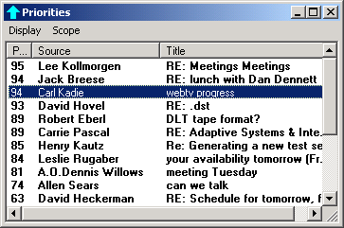
Machine Learning for Adaptive User Models
Approach 2: In-stream supervision
  Cases labeled implicitly by watching activity
  Lookout Priorities

Slide 4
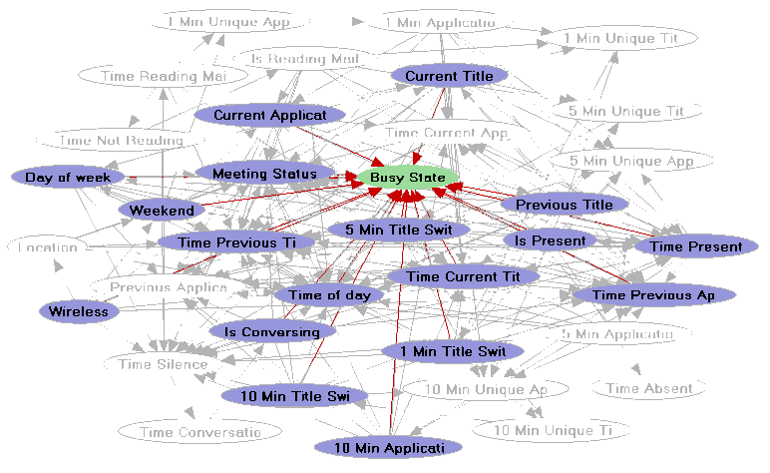
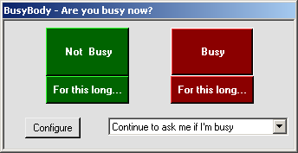
Machine Learning for Adaptive User Models
Approach 3: Experience sampling
  Probe in real time
  e.g. BusyBody (CSCW 2004)

Slide 5
Decision Theoretic Selective Supervision
Traditional Machine Learning Systems
Cost =
Misclassification Cost
Misclassification
Cost
+ Cost to Obtain Labeled Training Data
Our Aim
Label Cost
Goal: Maximize Accuracy with Minimum Effort
Decision theoretic perspective on learning:
Value of Information = Reduction in Expected Cost

Slide 6
ESM and Active Learning
Pool Based
(Offline ESM)
Stream Based
(Online ESM)
Pool of Data
Stream of Data
Current
Data
?
User
Provides
a Label
User
Provides
a Label
Training
Training
Active Set
User
Active Learning
Heuristic
Classifier
User
Active Learning
Heuristic
Classifier

Slide 7
Towards Lifelong Learning
Develop dynamic learning systems that adapt to people and context over time
t_{o}
Decisions about querying humans / oracle
?
Current
Data
Value of Information Computations
Cache
Active Set
Context Buffer

Slide 8
Adaptive Classifiers to Handle Dynamic Context
Time

Slide 9
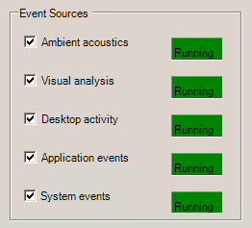
BusyBody: Learning When to Interrupt

Slide 10
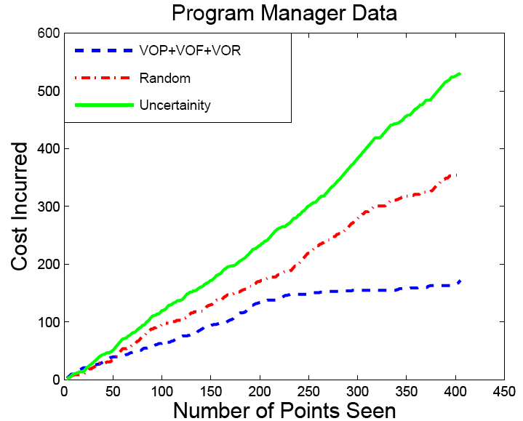
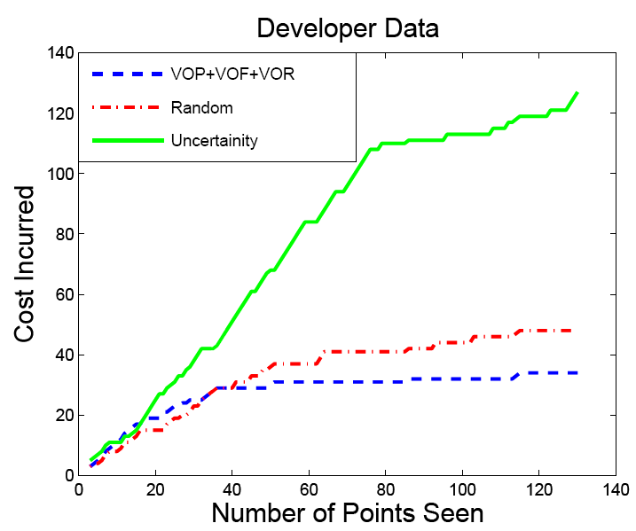
Manager Data:
DT-dyna = 68.29% (35 Probes)
DT = 66.19% (109 Probes)
Random = 57.75% (50 Probes)
DT-dyna
Uncertainty
Kapoor & Horvitz UAI 2007
DT-dyna
Uncertainty
Uncertainty
Developer Data:
DT-dyna = 85.59% (12 Probes)
DT = 89.01% (39 Probes)
Random = 78.69% (8 Probes)

Slide 12
VPriorities
Voicemail Management Systems
  Provide tags / classification / summarization
  Very hard to build a system that would work out of the box
    Need personalized training
    Dynamic context as preferences might change with time
Our approach:
  User driven
    Guide the user instead of actively probing
    VOP / VOF / VOR provides a nice way to replace an out-of-box model with a more personal one

Slide 13
VPriorities: Classification of Voice Messages
Classify Voice Messages
  Caller Knows Well? Yes / No
  Urgent / Non-Urgent
  Bulk / Non-Bulk
  Mobile / Non-Mobile
  Other classes
Summarize
  Display on the Subject Line
Speech
Recognizer
(Keyword
Spotting)
Pitch Tracker
(Syllable Rate,
Pauses etc)
Gaussian
Process
Classification
Vmail
Classification
Result
Meta Data
Extractor
(Date, Time,
Size etc)

Slide 14
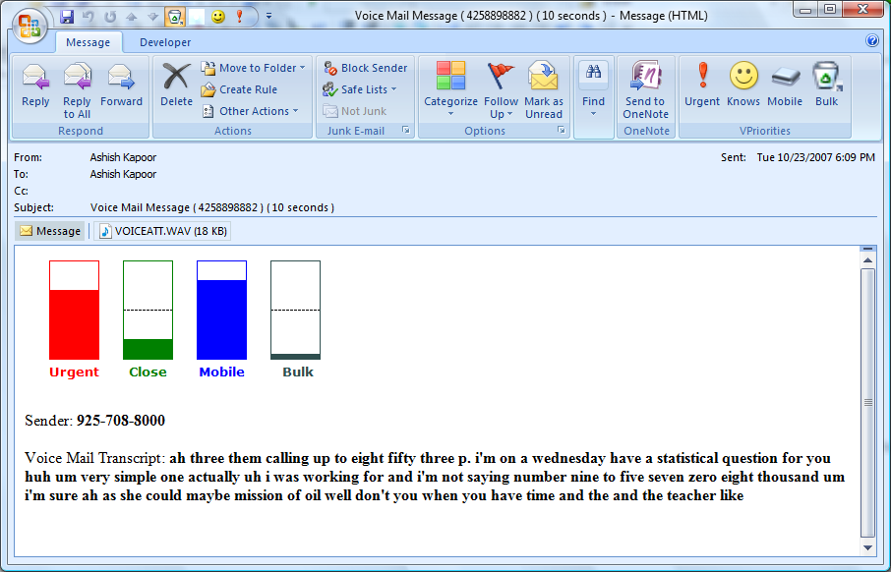
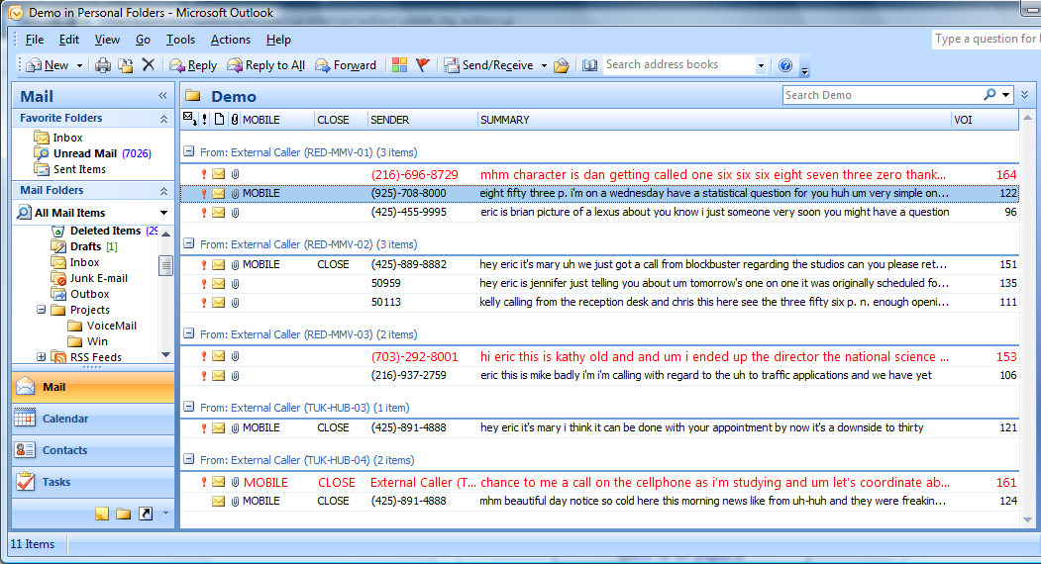
Vpriorities
Classification
Probabilities
Annotation
tool

Slide 15
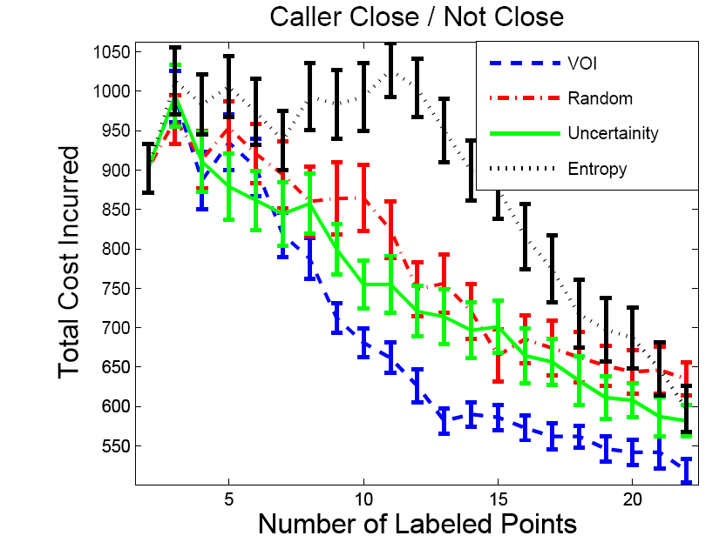
VPriorities: Results
Knows Well / Does Not Know Well
207 Voice Messages Collected over
8 Months
Misclassification Cost = 10 USD
Label Cost = 0.01 USD * Length
Selective Supervision
Accuracy with 22 labels
Random
Accuracy with 22 labels
  Knows Well? Yes / No : 72.9% using 518.5$
  Mobile / Not Mobile : 66.9% using 632.2$
  Urgent / Non-Urgent : 53.2% using 899.5$
  67.8% using 635.0$
  63.0% using 727.6$
  53.2% using 913.0$

Slide 16

VPriorities: Features
Prosodic
Features
max_dur_voice
min_dur_voice
mean_dur_voice
var_dur_voice
max_dur_sil
min_dur_sil
mean_dur_sil
var_dur_sil
max_dur_prod
min_dur_prod
mean_dur_prod
var_dur_prod
max_dur_pause
min_dur_pause
mean_dur_pause
var_dur_pause
max_delta_pit
min_del_pit
mean_del_pit
var_del_pit
syllable_rate
sil_rate
prod_rate
pause_rate
Extracted Features
Well Acquainted
Not Urgent
Key Words
bye
five
from
mhm
right
seven
six
three
uh-huh
you
Unacquainted
Urgent
Meta Data
isExternal
isWeekend
am_office
pm_office
after_hrs
Size
length_VM

Slide 17
VPriorities: Results
Prosodic
Features
max_dur_voice
min_dur_voice
mean_dur_voice
var_dur_voice
max_dur_sil
min_dur_sil
mean_dur_sil
var_dur_sil
max_dur_prod
min_dur_prod
mean_dur_prod
var_dur_prod
max_dur_pause
min_dur_pause
mean_dur_pause
var_dur_pause
max_delta_pit
min_del_pit
mean_del_pit
var_del_pit
syllable_rate
silence_rate
prod_rate
pause_rate
Top features for discriminating
knows well vs. does not know well
Well Acquainted
Not Urgent
Key Words
mhm
uh-huh
right
you
that
and
to
know
me
they
Unacquainted
Urgent
Meta Data
isExternal
isWeekend
am_office
pm_office
after_hrs
Size
length_VM

Slide 18
VPriorities: Results
Prosodic
Features
max_dur_voice
min_dur_voice
mean_dur_voice
var_dur_voice
max_dur_sil
min_dur_sil
mean_dur_sil
var_dur_sil
max_dur_prod
min_dur_prod
mean_dur_prod
var_dur_prod
max_dur_pause
min_dur_pause
mean_dur_pause
var_dur_pause
max_delta_pit
min_del_pit
mean_del_pit
var_del_pit
syllable_rate
sil_rate
prod_rate
pause_rate
Top features for discriminating
knows well vs. does not know well
Well Acquainted
Not Urgent
Key Words
five
six
three
bye
seven
from
you
four
go
zero
Unacquainted
Urgent
Meta Data
isExternal
isWeekend
am_office
pm_office
after_hrs
Size
length_VM

Slide 19
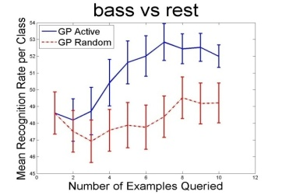
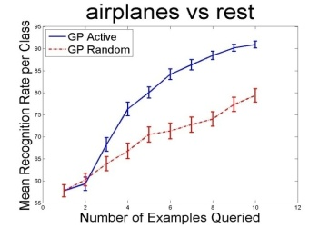
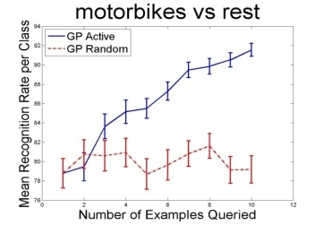
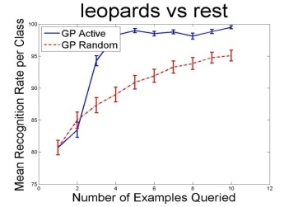
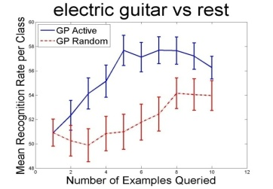
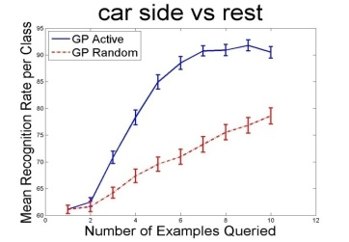
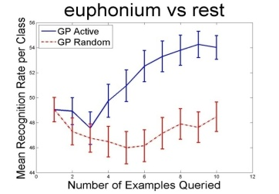
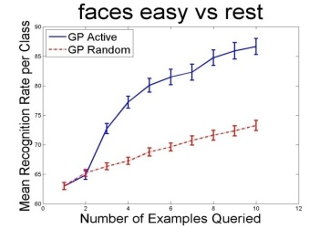
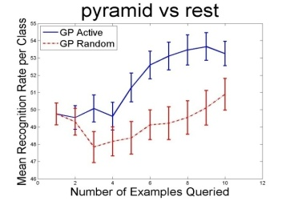
Active Learning for Object Categorization
Choose best training examples to learn object recognition models
Joint work with: K. Grauman (UT Austin), R. Urtasun (MIT) and T. Darrell (MIT)
Appeared in: ICCV 2007

Slide 20
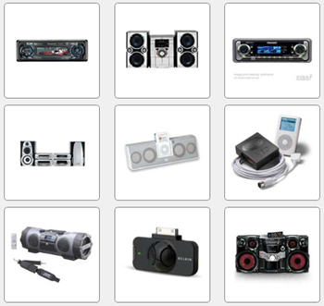
Interactive Concept Learning
Problem:
  Keyword-based image search insufficient for finding images
Our Solution:
  User defines visual rules by examples
Joint work with: J. Fogarty (UW) and D. Tan (VIBE) and S. Winder (IVM)
Appeared in: CHI 2008

Slide 21
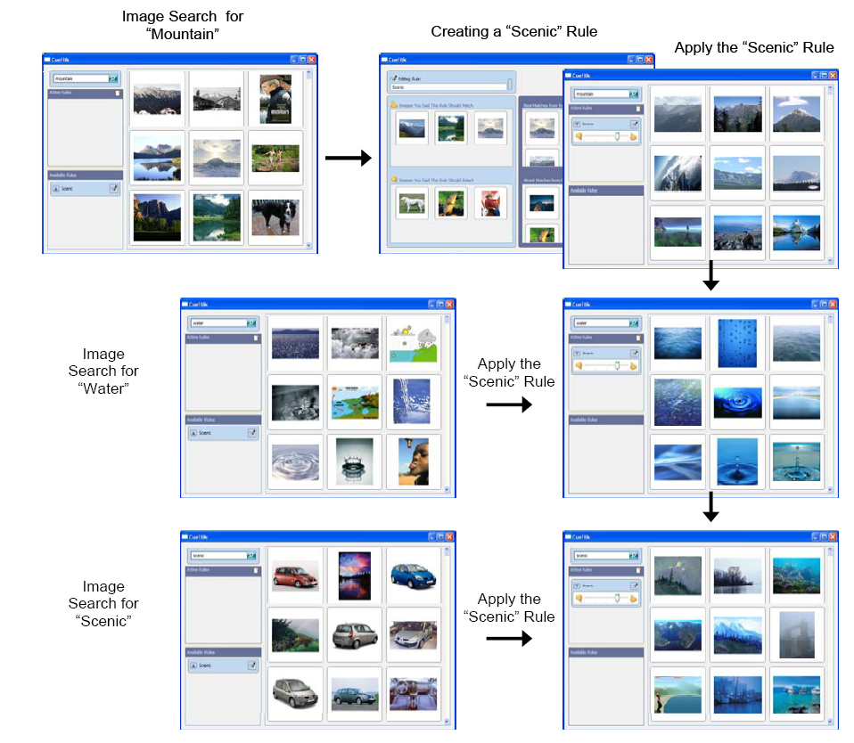

Slide 22
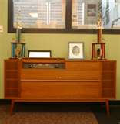
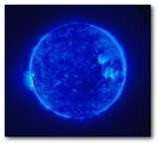
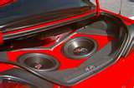
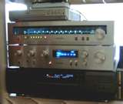

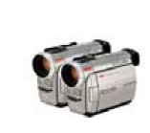
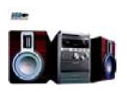


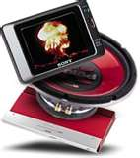
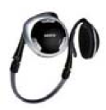

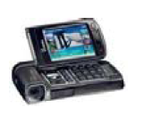
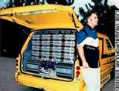
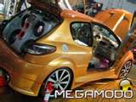
CueFlik: Learning a concept
Product Photo
Learning a concept →Learning a distance metric

Slide 23
CueFlik: Learning a concept
Product Photo
Learning a concept →Learning a distance metric
Convex function, fast minimization

Slide 24


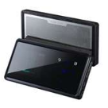
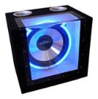



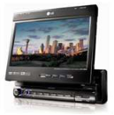
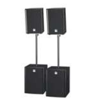


Sample Results
Learning the concept “product photo”
Positive examples provided by the user
Negative examples provided by the user

Slide 25
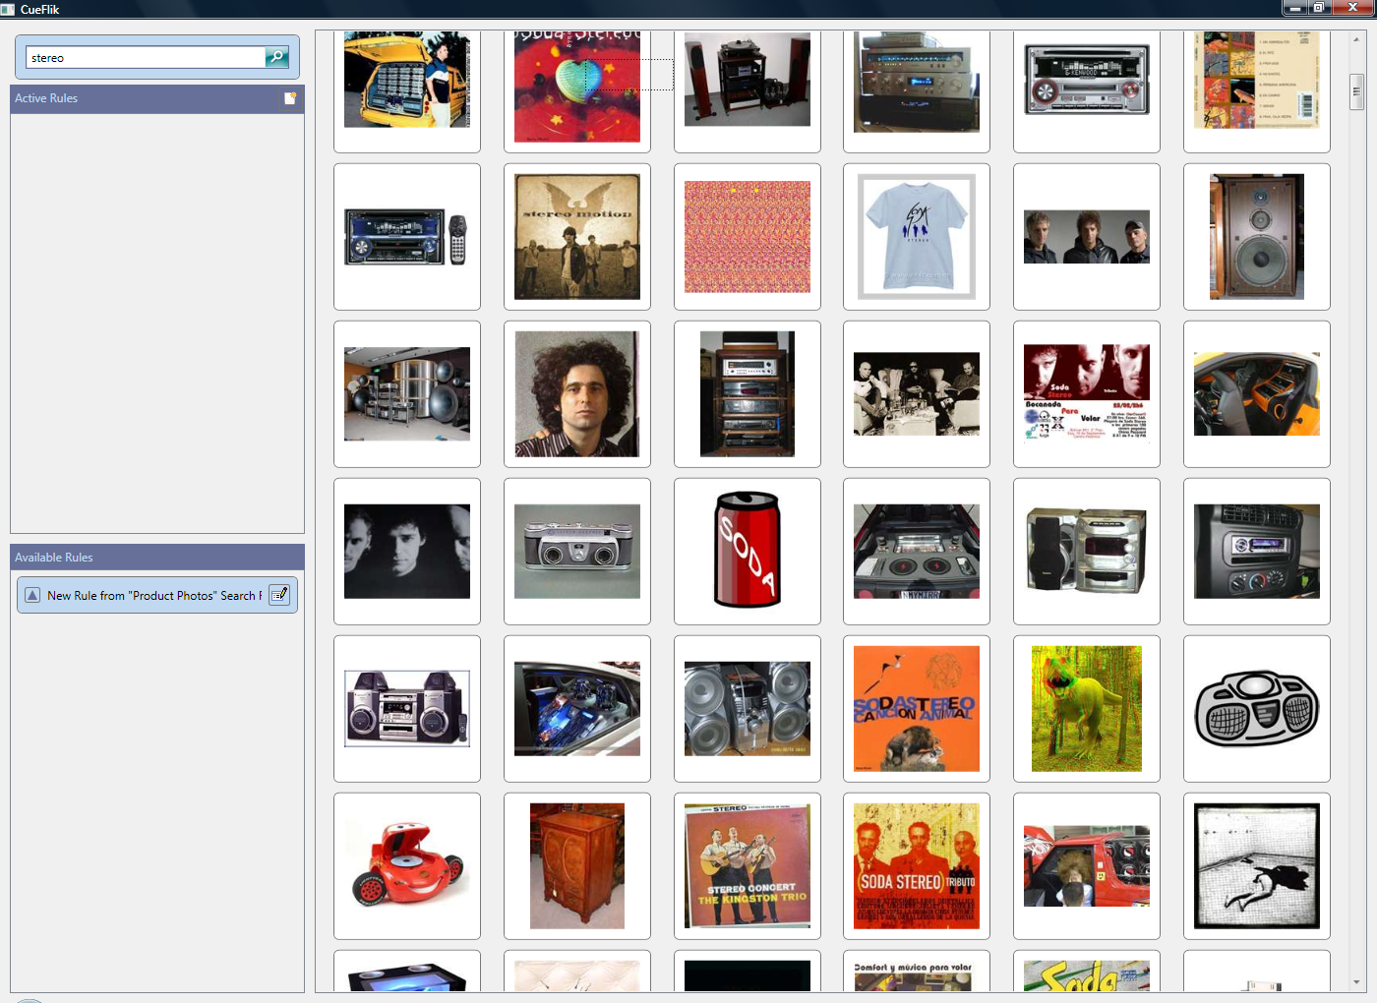

Slide 26
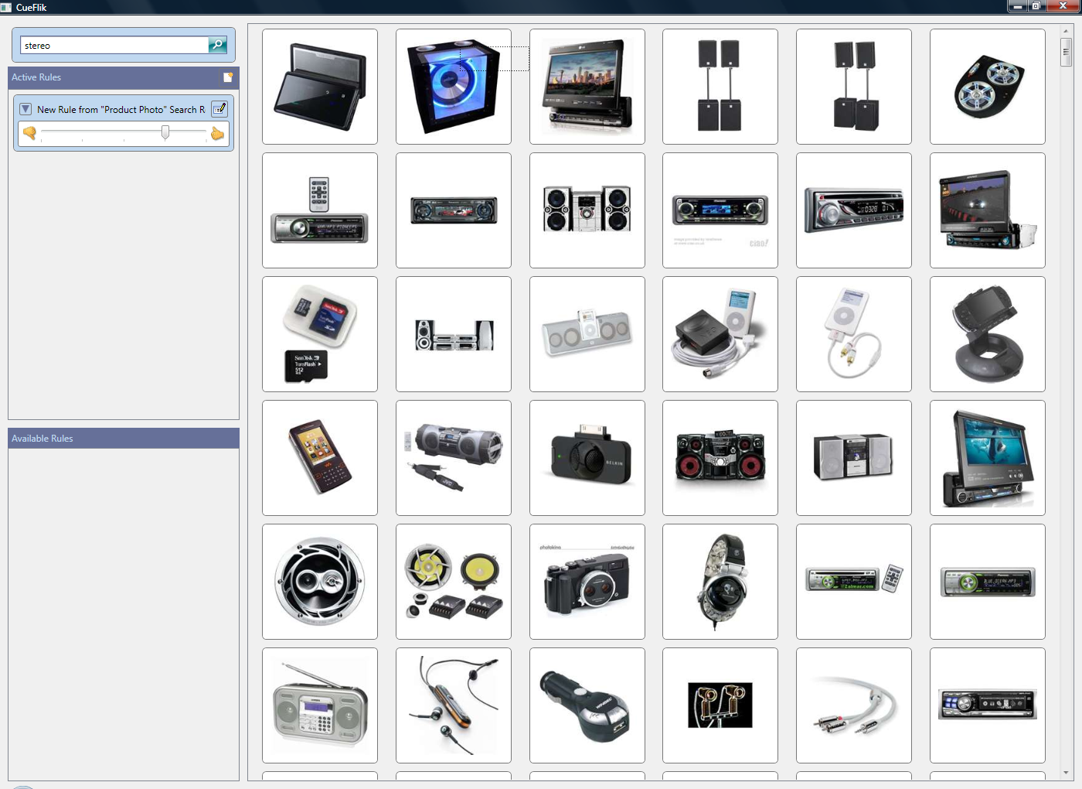
Results: Applying learnt concept “product photo”

Slide 27
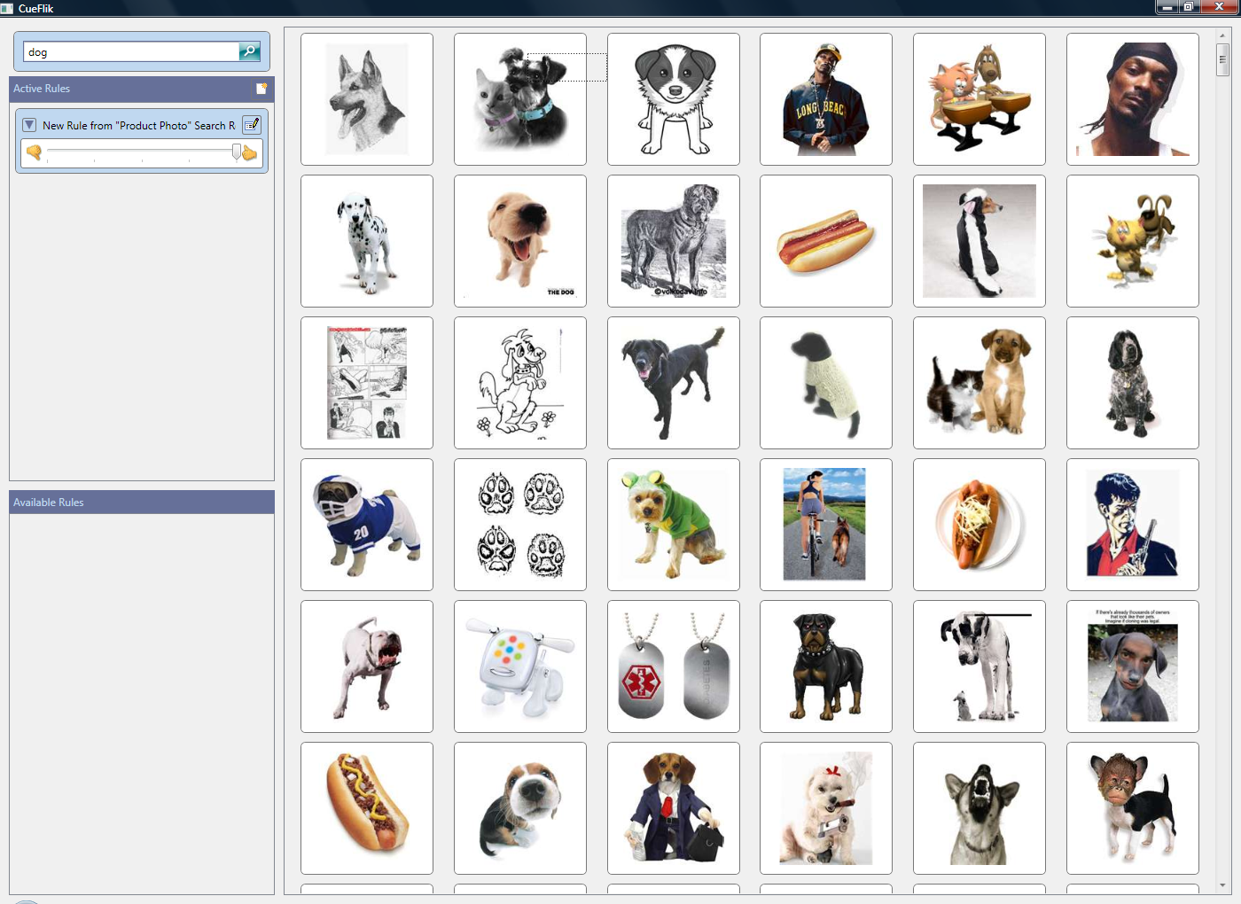

Slide 28
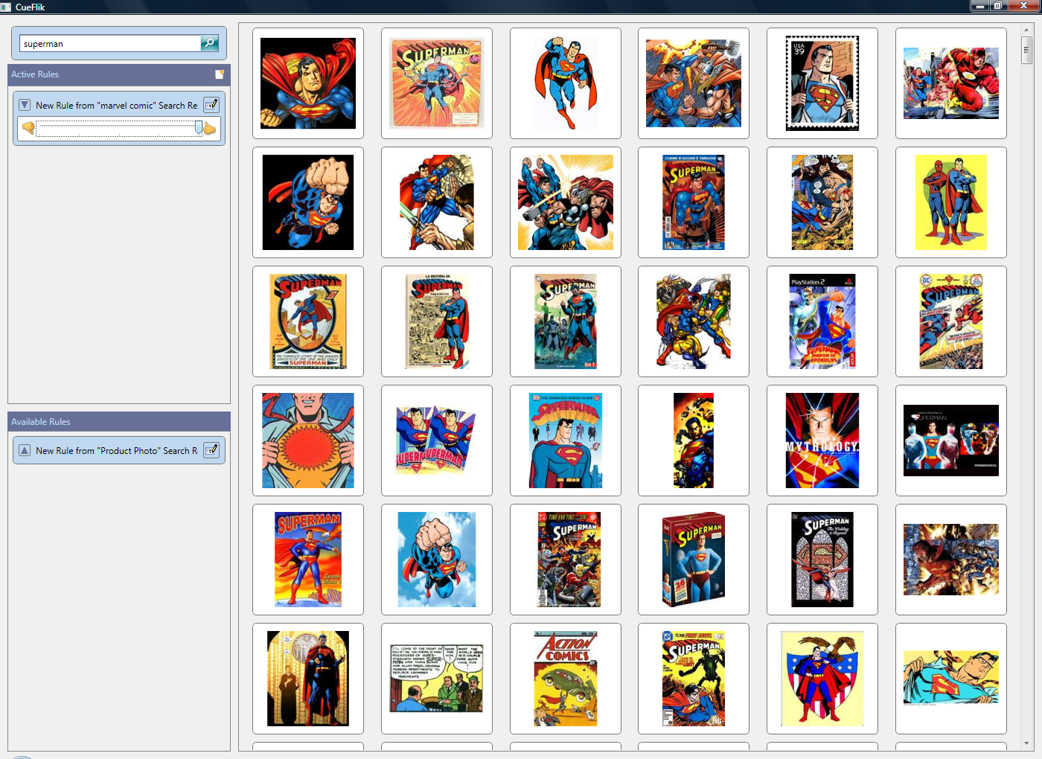

Slide 29
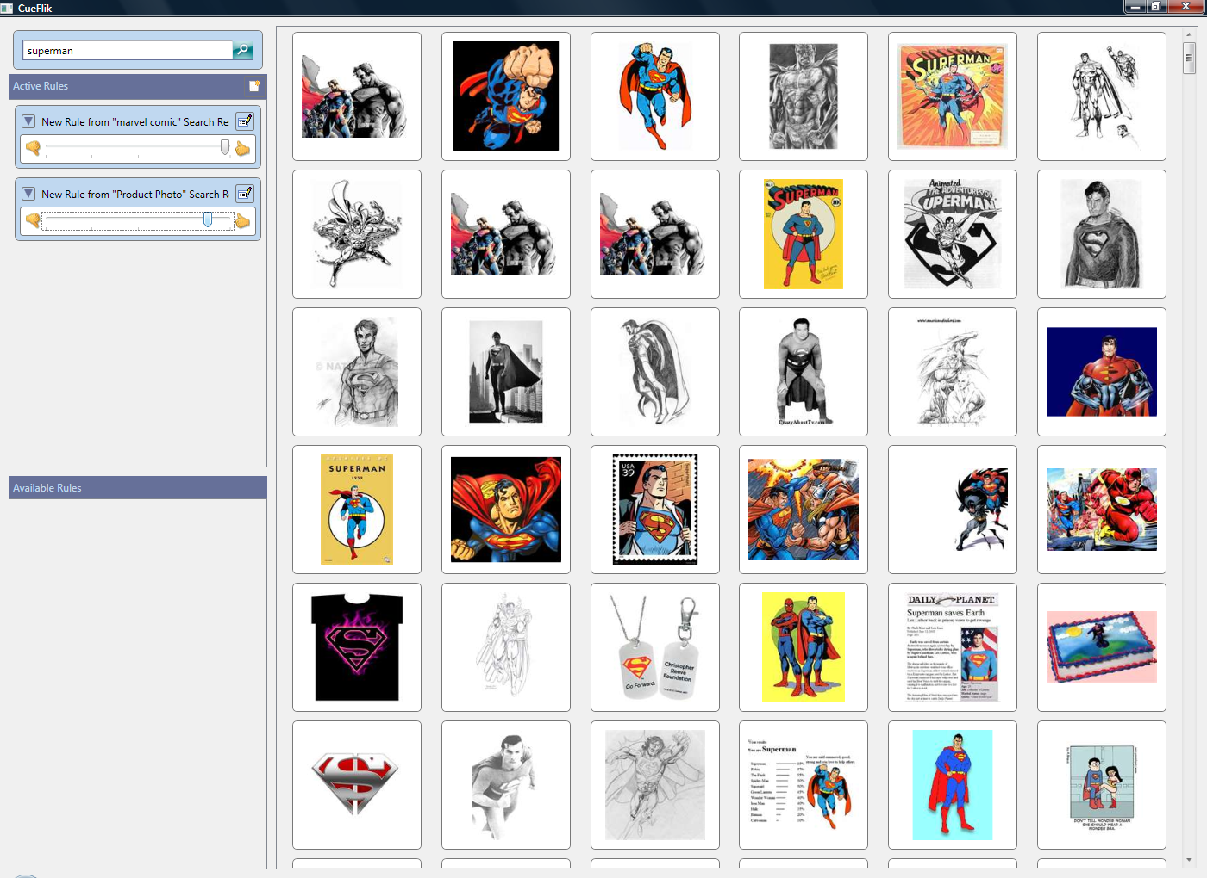

Slide 30




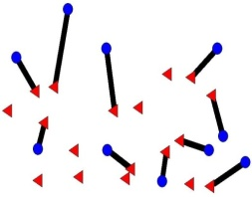
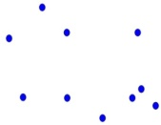




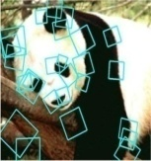
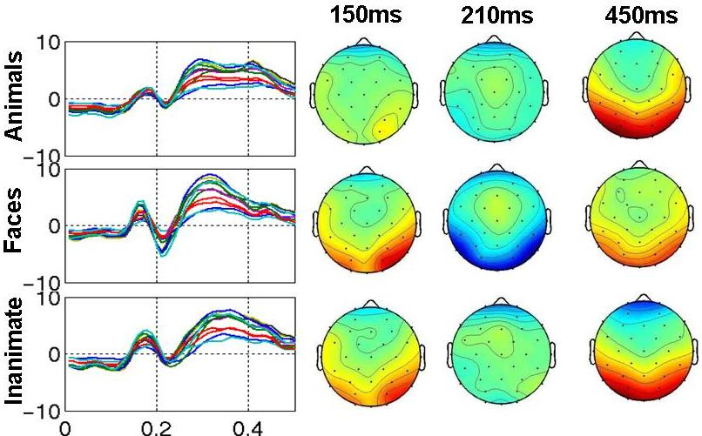
Computer Vision + BCI
optimal partial matching between sets of features
Computer vision based processing
+
Better objects recognition models
Processing by human brain
Combination based on Kernel Alignment (fast, convex optimization)
Joint work with: P. Shenoy (UW) and D. Tan (VIBE)
CVPR 2008

Slide 31
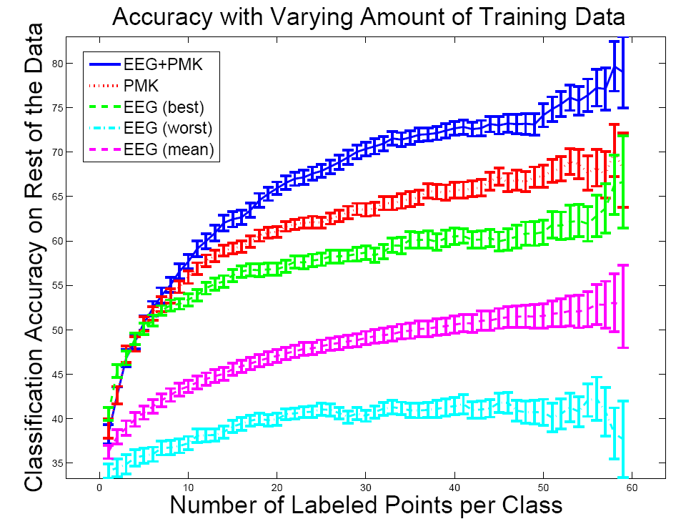
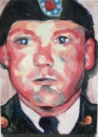





Computer Vision + BCI
Errors made by Vision only method
Errors made by EEG only method
All the errors shown here were correctly classified by Vision + BCI method

Slide 32

Distributive Computing with Human Computation

Slide 33
















Training Computer Vision Algorithms with BCI
Training
Vision system
Car
Cow
Classifier
Labeled Images
BCI
Classification
Unlabeled Images
Sub 1
Sub K

Slide 34
Future Directions
Beyond explicit feedback
  Mixed-initiative
  Brain-computer Interfaces
Non-myopic selective supervision
Learning exogenous variables
  Cyclic Patterns
  Unmodeled Context
Other applications

Slide 35

© 2008 Microsoft Corporation. All rights reserved. Microsoft, Windows, Windows Vista and other product names are or may be registered trademarks and/or trademarks in the U.S. and/or other countries. The information herein is for informational purposes only and represents the current view of Microsoft Corporation as of the date of this presentation. Because Microsoft must respond to changing market conditions, it should not be interpreted to be a commitment on the part of Microsoft, and Microsoft cannot guarantee the accuracy of any information provided after the date of this presentation. MICROSOFT MAKES NO WARRANTIES, EXPRESS, IMPLIED OR STATUTORY, AS TO THE INFORMATION IN THIS PRESENTATION.

