Slide 1

Social Visualization
communication signal or cue?
Karrie Karahalios
Social Spaces Group
UIUC 2008

Slide 2
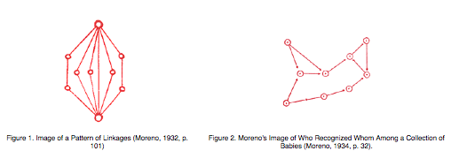
Freeman, Visualizing Social Networks

Slide 3
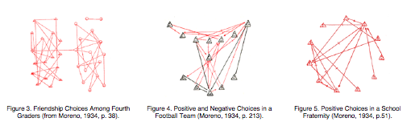

Slide 4
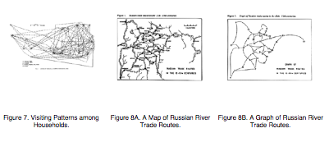
Festinger, Schachter and Back, 1950
Pitts, 1979

Slide 5
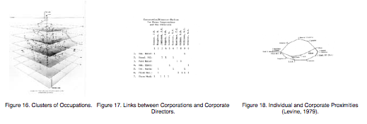
60’s, 70’s computers introduced
Laumann and Guttman, 1966
Levine, 1979

Slide 6
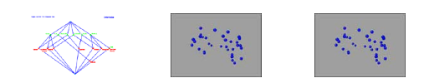
80’s, 90’s color, motion
Freeman and Freeman, 1980

Slide 7
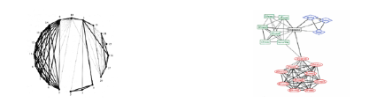
Late 90’s on… 3d, web
Mitchell
Krackpot, 1996

Slide 8
What about…..
Reciprocity?
Signals, cues?
Time information, history

Slide 9
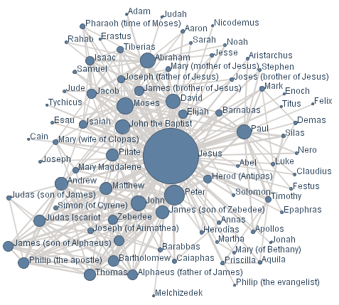

Slide 10
Signals and Cues
Cues are always 'on' while signals are switched between 'off' and 'on’
Once a cue has been produced it costs nothing more to express it while the same is not true of signals
(Hauser, 1996).

Slide 11
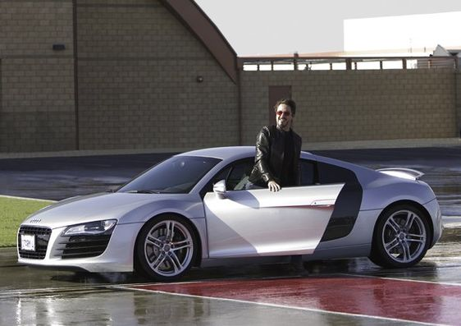
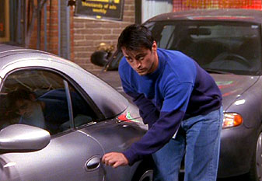
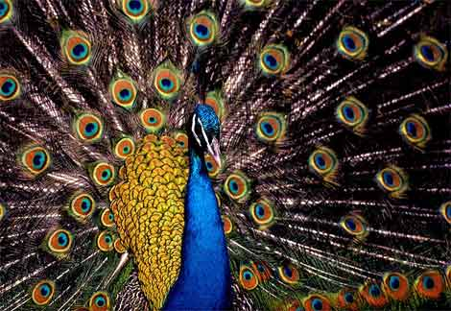

Slide 12
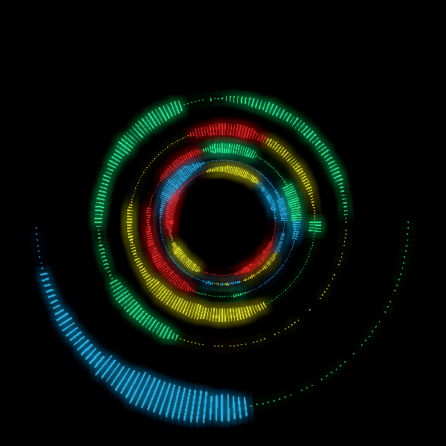

Slide 13
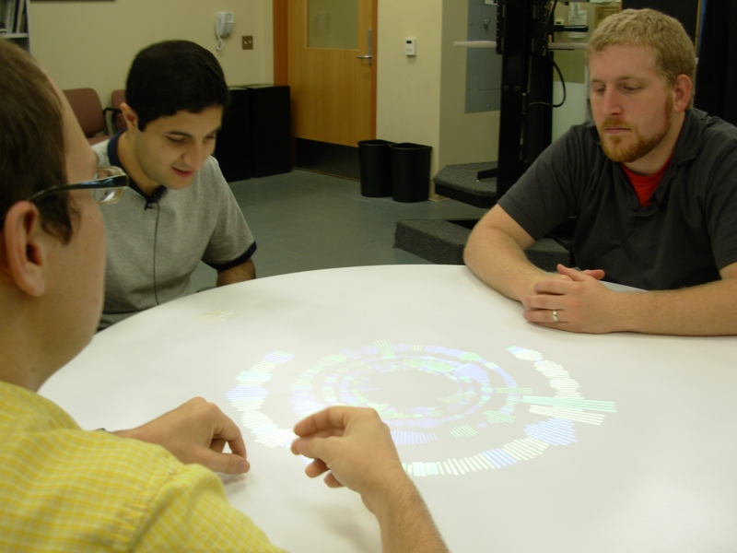
Augmented Social Cues
Turn Taking
Interruption
Conversational Dominance
Silence
Agreement
Aural Back-channels
Mimicry
Rhythm and Flow
Time Span

Slide 14

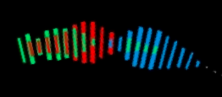

Augmented Social Cues
Turn Taking
Interruption

Slide 15
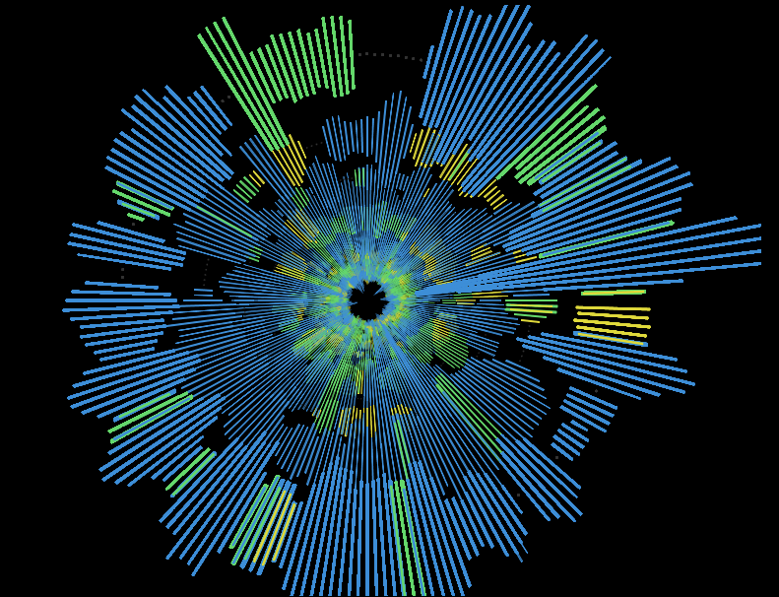
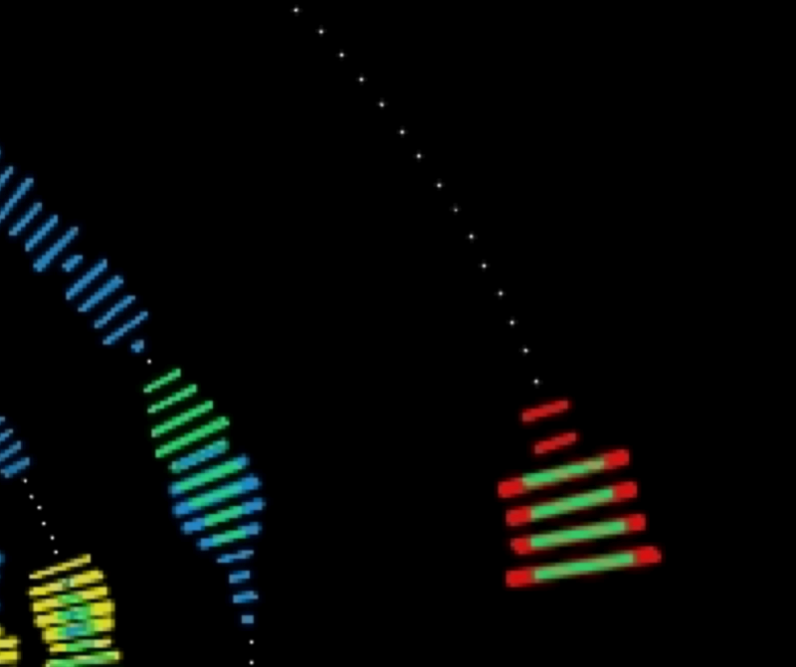
Augmented Social Cues
Conversational Dominance
Silence

Slide 16

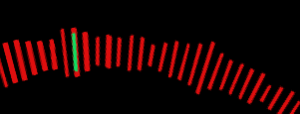
Augmented Social Cues
Agreement
Aural Back-channels

Slide 17
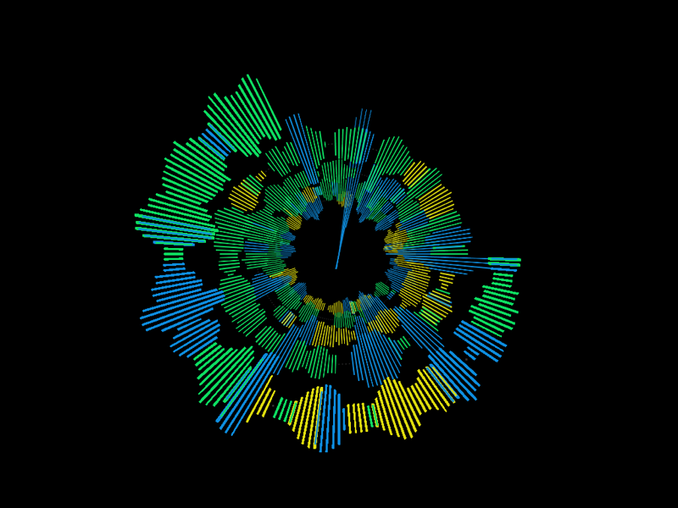
Augmented Social Cues
Mimicry
Rhythm and Flow
Time Spans

Slide 18
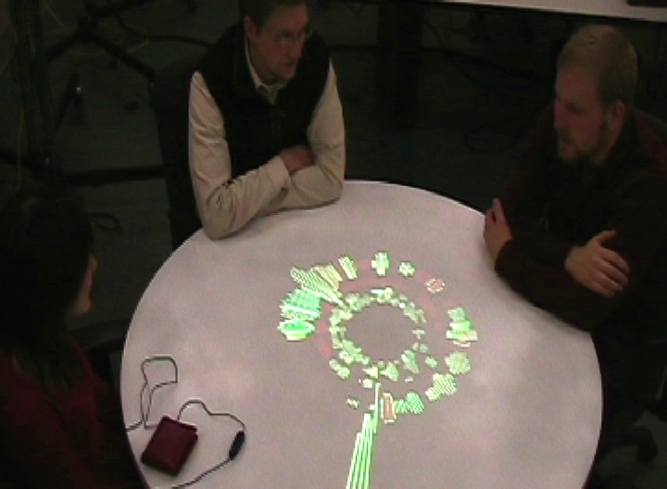
Social Mirror
Reflection of Interaction
  Everyone sees the same thing
  Reveal Patterns that are not apparent otherwise.

Slide 19
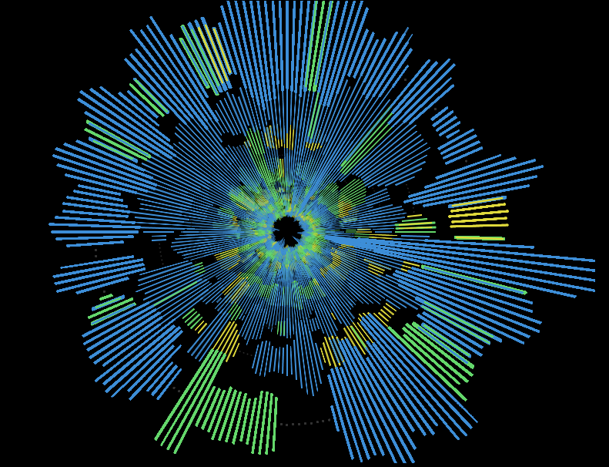
Social Mirror
Self Reflection
  Third person viewpoint
  Realtime Feedback

Slide 20
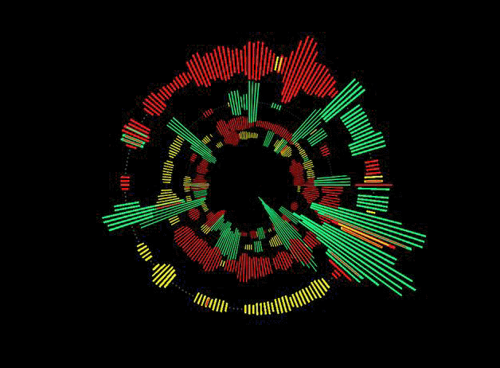
Social Mirror
Persistent History
  Cues occur over time
  Structured and Interpretable at a glance

Slide 21
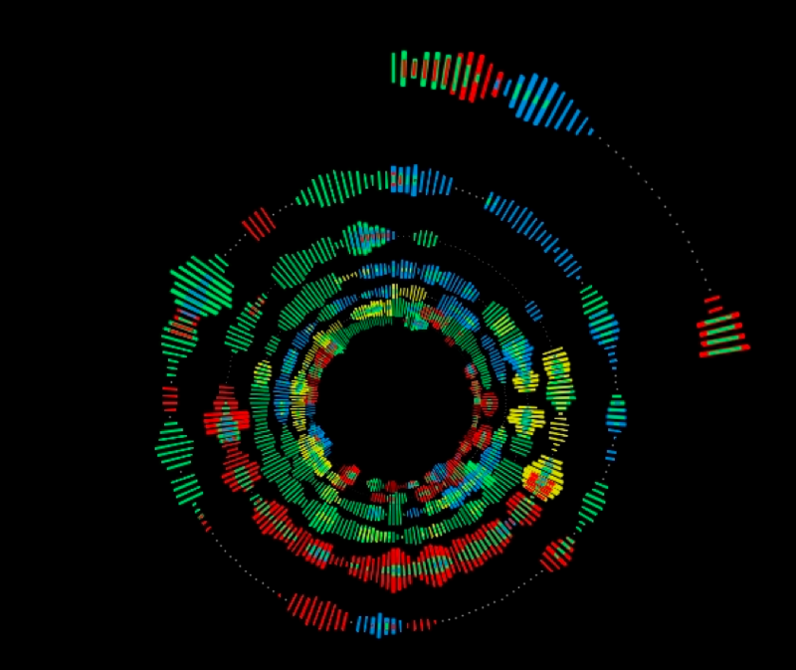
Social Mirror
Context of Conversation
  Evocative artifact for participants
  Varied interpretations

Slide 22
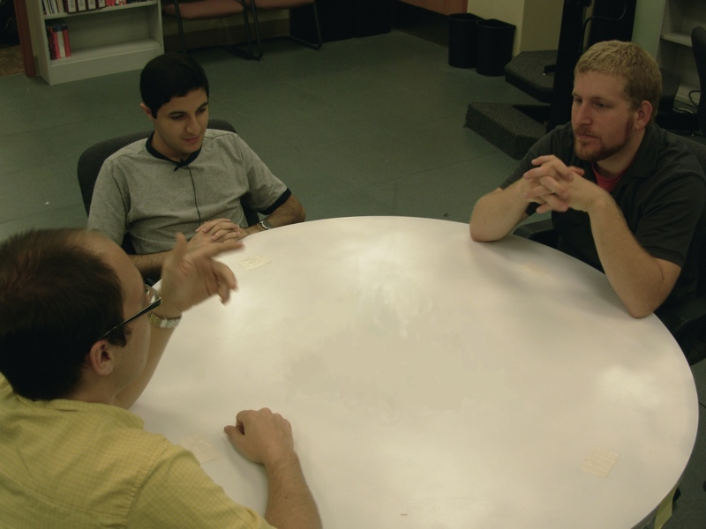
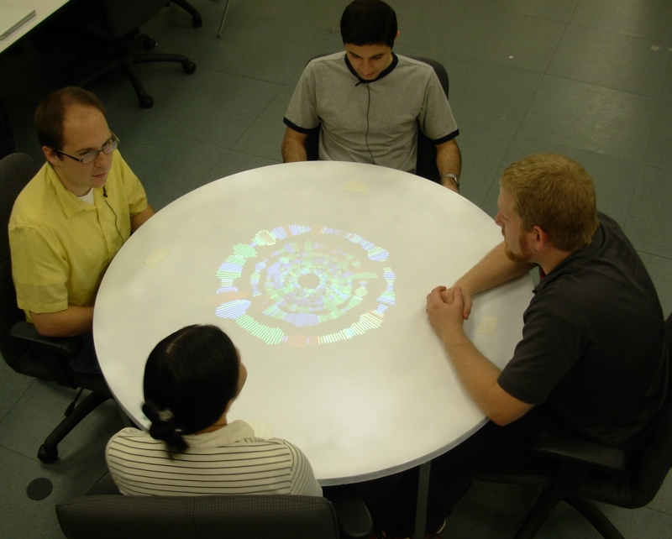
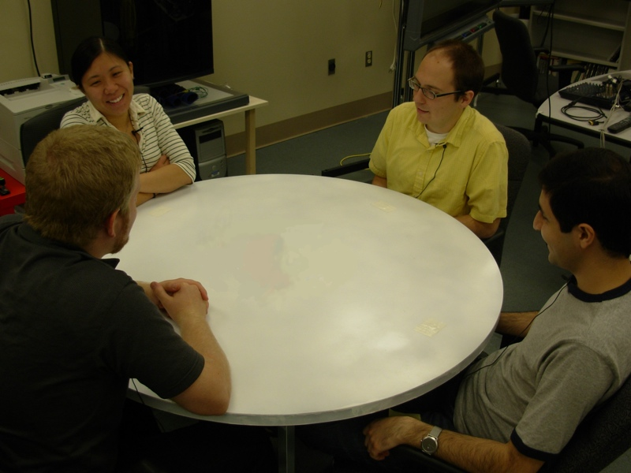
User Study Methodology
Before
With
After

Slide 23
User Study Methodology
Measurements
  turns
  length of speech
  leads
  glances
  gestures
  surveys
  interview

Slide 24
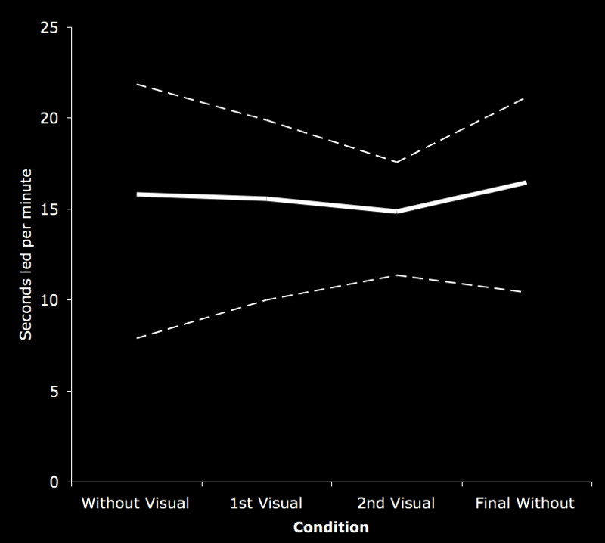
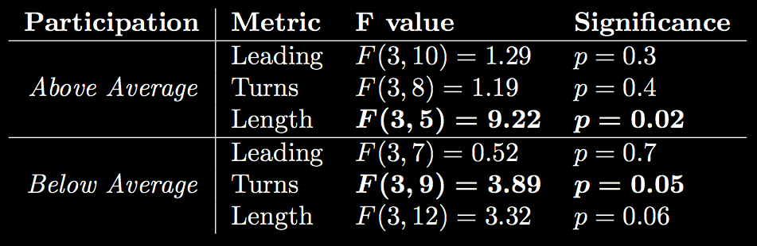

Notable Observations

Slide 25
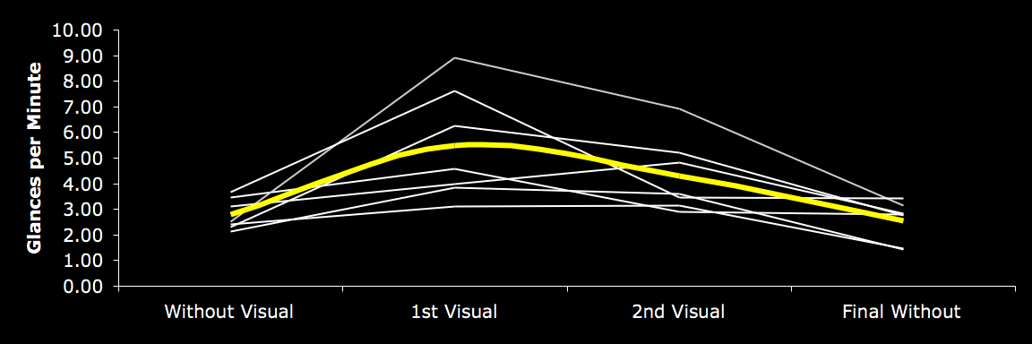
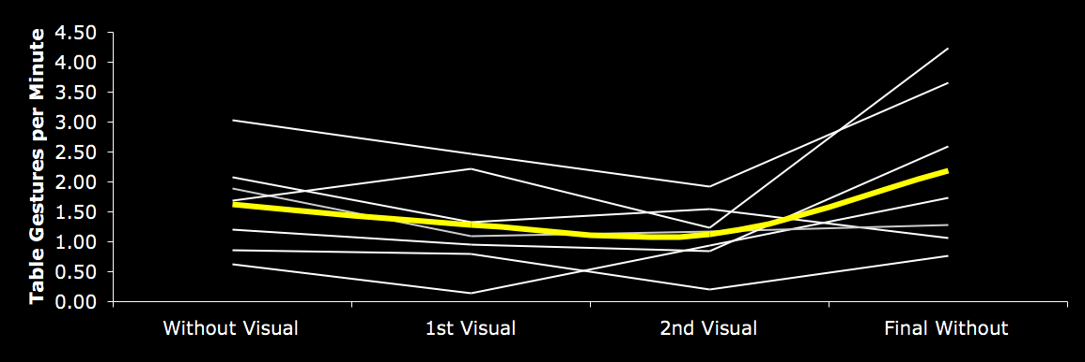
Notable Observations
Glances
Gestures

Slide 26
Qualitative Feedback
“It was easy to judge who is driving conversation.”
“I was trying to look at the circle to see whether we were balanced”
“I realized that I could monitor my speech patterns by watching the colors. It was interesting to train myself not to say ‘umm’ as much or pause.”

Slide 27
Qualitative Feedback
“I noticed when you’re the one talking, you want to stop. But if you’re mid-topic you couldn’t stop, because you had to finish your topic. But as soon as you finished your topic you’d shut up.”
“It became all red; should green or yellow speak next?” -Yellow

Slide 28
Results Summary
Participants found the visualization to be revealing of their interaction
People glance, not focus, on visualization
Above and Below average participants react differently to the same visualization
Participants showed extensive interest in themselves

Slide 29
Results Summary
Interpret participant roles in interaction

Slide 30
Quality of Conversation
Few Groups reported unnatural conversation
Visualization was viewed as mildly distracting

Slide 31
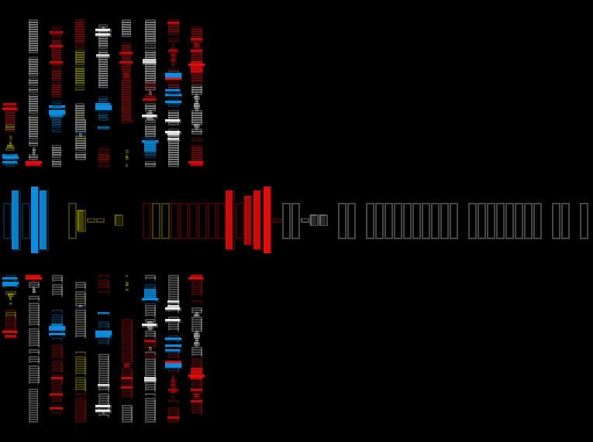

Slide 32
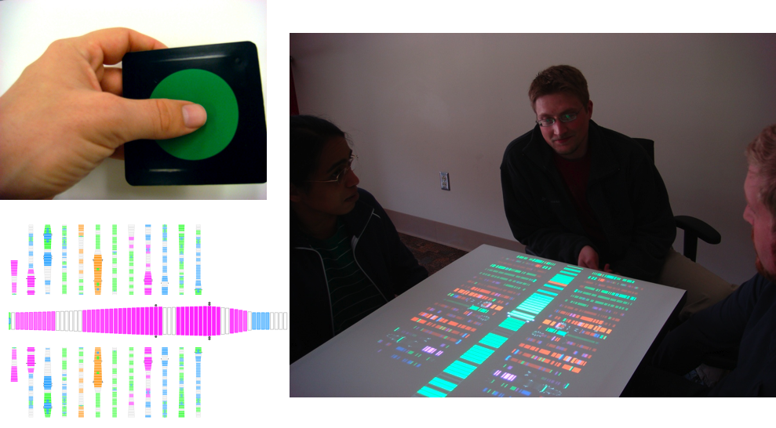

Slide 33
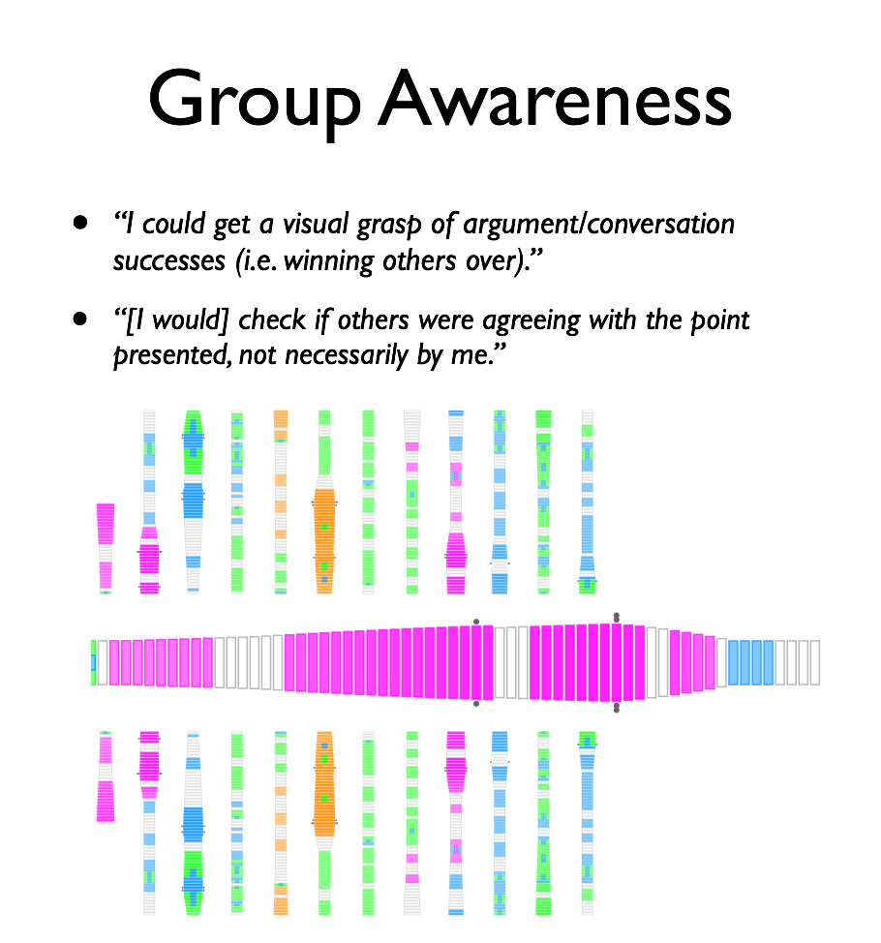
“I could get a visual grasp of argument/conversation successes (i.e. winning others over).”
“[I would] check if others were agreeing with the point presented, not necessarily by me.”

Slide 34
Why ?

Slide 35
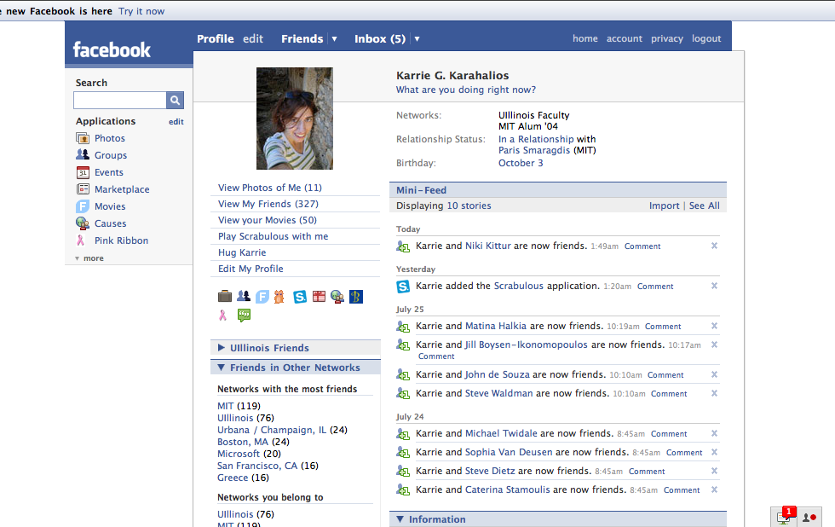

Slide 36
social.cs.uiuc.edu

Slide 37
Social Visualization
communication signal or cue?
Karrie Karahalios
Social Spaces Group
UIUC 2008

