Slide 1
Tools for Scalable Genome Haplotying in the Windows Azure Cloud
- Girish Subramanian (subramag@umail.iu.edu)
- Yogesh Simmhan (yoges@microsoft.com)

Slide 2
Genome Haplotyping
Goal
  Separating out the two haplotype chromosome for an individual using their assembled sequence fragments
  Also known as Phasing
  Used for making inferences about human evolutionary history
  Find out genetic factors of diseases among individual
Phasing algorithm
  We use the HapCUT algorithm which uses the graph MaxCut algorithm to separate the two haplotypes.

Slide 3
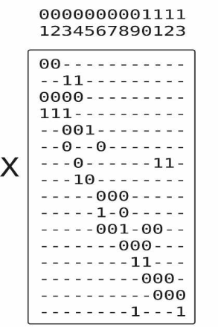
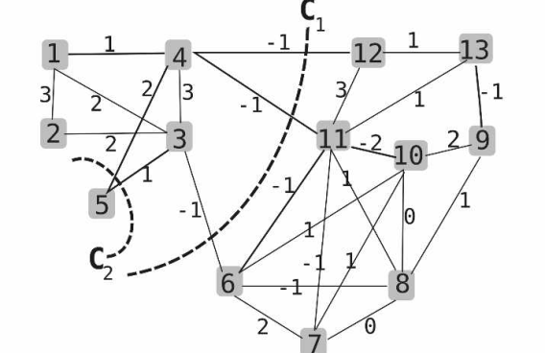
HapCUT algorithm
ACTCAC-----GTATGGTG
ACGCAC-----GTATCGTGC
TATCGTGC-----ACACTCT
ACTCAC--------------------ACAGTCT
ACGCA----------------------------------------------------------AGCGTTA
GAAGAT---AGCATT
Sequenced Fragments for each chromosome
--T------------G---
--G------------C----
---C------------C---
--T--------------------------G---
--G---------------------------------------------------------------G---
--A--------A--
Remove Non SNP values
Remove Consistent values
Remove Fragments which have less than 2 alleles
Compare the Fragments with the consensus fragment and convert it into bits (1 or 0)
Construct a graph for the fragments spanning the SNP locations
Apply MaxCUT
Convert the bits back to alleles.
------T------------G------------G--------------A---------A-----
------G------------C------------C--------------T---------G-----
The two separate haplotypes.

Slide 4
HapCUT Algorithm
DoInitialize
TrimSparseFragments
SplitSparseContig
ContigToFragment
For each contig
ContigToFragment
………
DoHapCut
DoHapCut
HaplotypesFromFragment
HaplotypesFromFragment
TestHaplotypeMatch
TestHaplotypeMatch
MergeHaplotypes

Slide 5
Bio.Net and HapCUT algorithm
Main data structures
  Contig
  Contig.AssembledSequence
  SparseSequence
Parsers and Formatters
  ISnpReader , BufferedSnpReader – read the SNP reference file
  XsvContigFormatter/Parser – serialize/deserialize each chromosome
  XsvSparseFormatter/Parser – serialize/deserialize each SparseSequence

Slide 6
Time taken in local machine
hours
Chromosome #
The performance numbers are baseline numbers. The tests were run on a Windows Vista 32bit/2.2GHz dual-core (only single used for this)/4GB RAM/4MB L2 Cache. The longest chromosome 13 required 116 MB to store in the disk. All chromosome took less than 2GB of virtual memory

Slide 7
Why Distributed Computing?
Scalable for large number of individual on all 22 chromosomes.
Embarrassingly parallel algorithm.
Reasonably small data size – data can be moved to remote resource.
Can be made available as service.
Distributed Computing choices :
Windows Azure
DryadLINQ
Windows HPC

Slide 8
Windows Azure

Slide 9
Basic Architecture of azure Application
Web Role Instances
Worker Role Instances
Load Balancer
Windows Azure Fabric
Compute
Storage
Fabric
a
b
d
e
c
f
Tables
Queues
Blobs

Slide 10
Basic Architecture of azure Application (contd.)
Web Role
  Web application can be accessed by http/https from the public network
Worker Role
  Background processes which do not expose public endpoints
  Can only communicate through storage services
Storage Services
  Queue – for communicating messages between the roles
  Blobs – for storing unstructured data (files)
  Tables – for storing named value(s) pairs in (non relational) tables
  All the storage services can be accessed from the public network using REST interface.

Slide 11
Technical Specs of Azure instances
Each worker role or web role instance runs on a separate Virtual Machine.
Each Web role instance and Worker role instance has its own dedicated processor core.
Workers having different roles can run different code bases (applications)
Each instance has 250 GB of local disk.
Each instance has1.5-1.7GHZ AMD processor and runs Windows 2008 Server x64 with 1.7 GB RAM.
Instances (Virtual Machines) are transient.

Slide 12
Fault Tolerance
All data is replicated at least 3 times
  Replicas are geographically spread out.
  All of Storage (Blobs, Tables and Queues)
  is built on this replication layer
Efficient Failover
  Data served immediately from available replicas located elsewhere in the data centre
Dynamic replication to maintain a healthy number of replicas
  Recover from a lost/unresponsive Drive or Node
  Recover from data bit rot

Slide 13
Availability And Scalability
Automatic Load Balancing of Hot Data
  Monitor the usage patterns and load balance access to
    Blob Containers, Table Partitions and Queues
  Distribute access to the hot data over the data center according to traffic
Caching of Hot Blobs, Entities and Queues
  Hot Blobs are cached to scale out access to them
  Hot Entity and Queue data pages are cached and served from memory

Slide 14
Tools for Azure

Slide 15
Why Required ?
Deploying existing application to cloud requires writing wrapper code.
Adding new worker role for each application is a management challenge.
Clients have to use Azure Queues to communicate with applications.
Porting non .Net windows applications is a challenge.

Slide 16
DLL , EXE, MATLAB, JAR files.
Register
Azure Table Storage
Azure Blob Storage
Registry Tables
Application Binaries
2. Get the application information .
3. Download the application binaries
4 .Unbind the input parameter.
5.Start execution.
Azure Workers
6. Bind the output parameters.
7. Put the result item in result Queue
1. Azure Worker gets the work item from the work queue

Slide 17
Generic Framework architecture.
In order to build such a framework , we require :
Registry Tables
  To store the application information such as application binaries required, their location, etc.
  Input parameter required by these application.
  Application’s output information
Generic Worker
  We need generic workers that will download the required application binaries from registry and starting the application execution.
  Thus providing an elasticity across various application.

Slide 18
Generic Framework and HapCut
We deployed 10 worker roles in Azure and used the Generic Framework to deploy the HapCut application.
Each worker works on an individual chromosome.
Time taken to phase 10 chromosome is equal to the time taken by the longest ones.

Slide 19
Thank you
Questions ?

