Slide 1
Post-Rank Reordering: Resolving Preference Misalignments between Search Engines and End Users
Chao Liu Mei Li Yi-Min Wang
Microsoft Research Microsoft Bing Search Microsoft Research

Slide 2

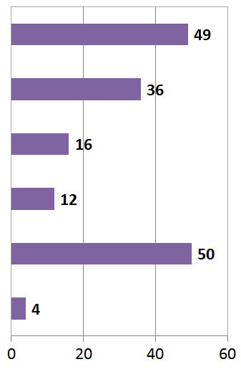
Motivation
Search Results for “CIKM”
# of clicks received
Notes:
Snapshot taken on bing.com on Oct 14, 2009
Suppose each URL receives # clicks as shown on the right

Slide 3
Motivation
Adapt ranking to user clicks?
# of clicks received

Slide 4
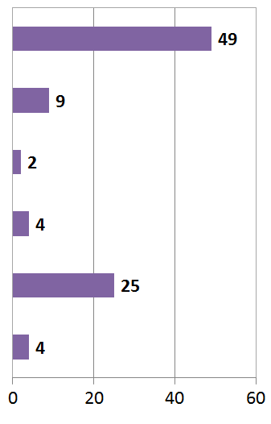

Motivation
Tools needed for non-trivial cases
# of clicks received
Notes:
This scenario is more tricky than the prev one, shall we move it to the top 1st?2nd?
http://www.sidfaiwu.com/blog/wp-content/uploads/2007/09/question_mark_3d.png
Similarly, should we swap 3 and 4?

Slide 5
Idea: Post-rank Reordering
Reorder search results pairs based on user preferences as cast through clicks
  Respect the original ranking
  Unless clicks strongly indicate the other way
Requirements
  Deriving preference from user clicks
  Efficient preference computation at runtime
  Threshold: when to swap
Notes:
In this study, we will show to accomplish this in a principled way using click modeling

Slide 6
Outline
A Primer on Click Chain Model
Preference Probability from CCM and its approximation at runtime
Experiments
Conclusion
Notes:
In particular, we will use CCM, which is what we derived in last-year WWW

Slide 7
Outline
A Primer on Click Chain Model
Preference Probability from CCM and its approximation at runtime
Experiments
Conclusion

Slide 8
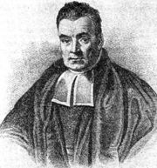



A Refresher on Bayesian Statistics
Prior
Posterior
0.8
1
1
0
1
0
1
Frequentist
Bayesian
Notes:
As a matter of fact, you can draw an analogy between the coin and URL. A coin being head is equavalent to this URL being clicked. And the head probability is simply the user-perceived relevance for this URL. Here from heads/tails, we adjust the head probability, and there is really not much difference from adjust the user-perceived relevance from clicks.

Slide 9
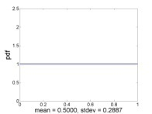
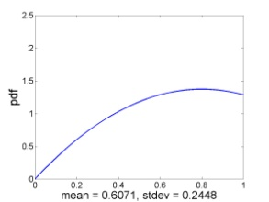
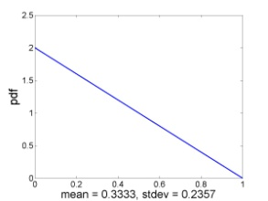
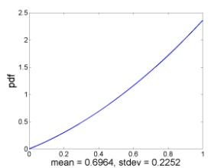
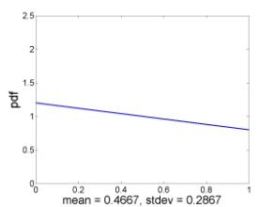
Click Chain Model [Guo et al., WWW09]
User-perceived relevance
query
URL₁
URL₂
URL₃
URL₄
…
S₁
S₂
S₃
S₄
…
E₁
E₂
E₃
E₄
…
C₁
C₂
C₃
C₄
…
http://ards/ccm.aspx
Notes:
So just a quick …

Slide 10
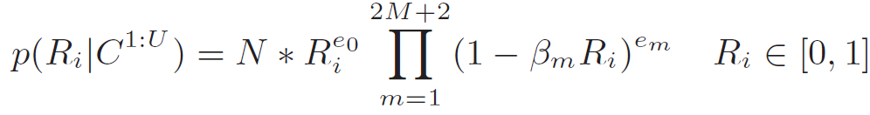
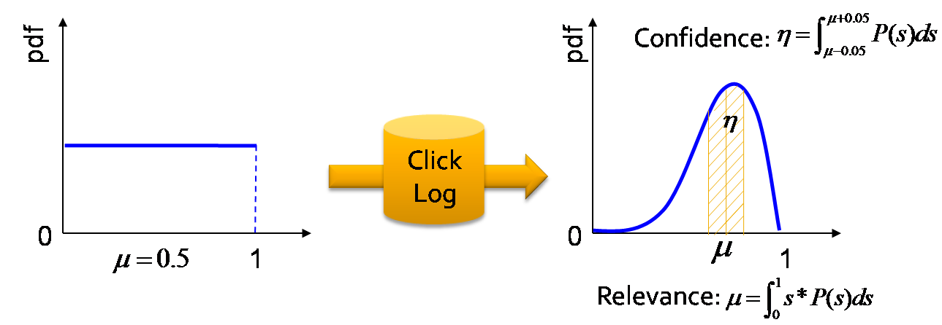
Key Results from CCM
Consider both positional bias and dependencies between clicks
Posterior in closed-form
One log scan suffices and MapReducible

Slide 11
Outline
A Primer on Click Chain Model
Preference Probability from CCM and its approximation at runtime
Experiments
Conclusion

Slide 12
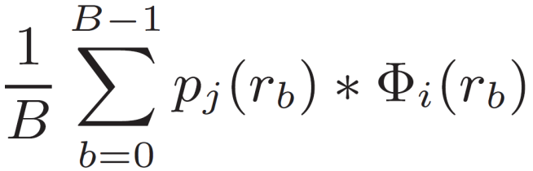
Preference Probability
Preference probability of URL2 to URL1?
  The probability of URL2 being better than URL1
t: URL2
s: URL1
0
1
Notes:
Besides giving a relevance measure for each (q, url) pair, what could be equally important is an estimation about how more relevant a URL is better than another URL for the given query.
We say that this is an important measure, because search is essentially a business of learning preferences. If we could quantitatively derive the preferences from clicks, it can be used in many applications. For example, the RankNet algorithm essentially try to approximate the preference specified by the HRS data, so it would be interesting to see how the ranker performs if we ask it to approximate the preference probability derived here.
We will talk more about it later.
actually derive such probability from HRS labels, and to my best knowledge, this is the first principled approach to get this preference measure.

Slide 13
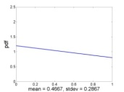
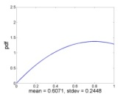
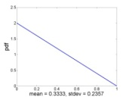
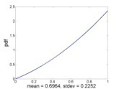
Preferences at Runtime
Query: q
Result 1
Result 2
Result3
Result10
Result 1
Result 2
Result10
Result3
Swap if PP >
…
…
…
Notes:
So it must be efficient

Slide 14
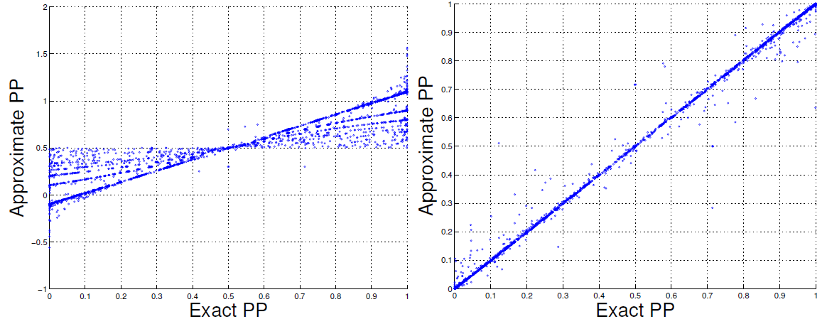
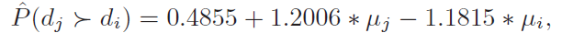
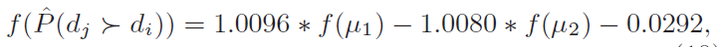
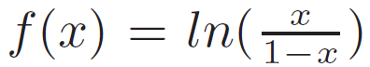
Regression Model (Supervised)
Regress PP on posterior means

Slide 15
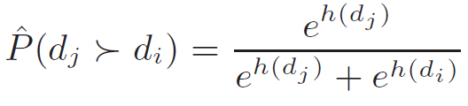
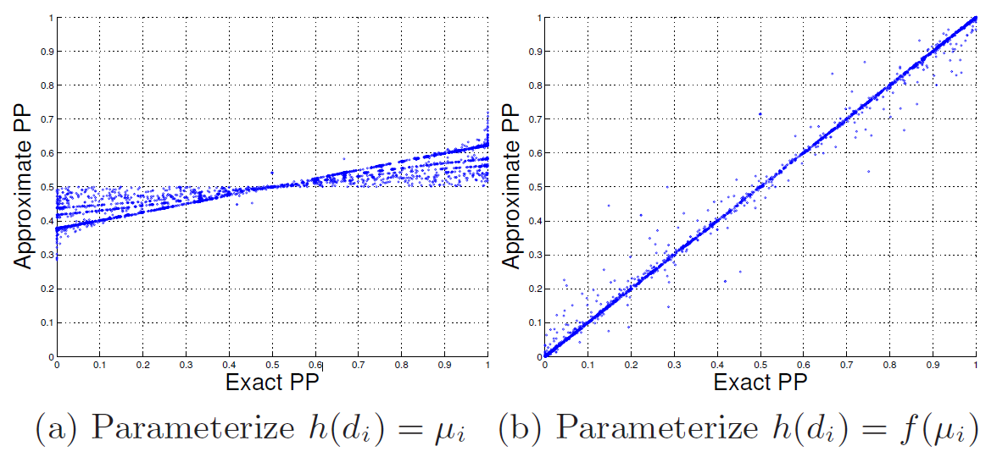
Bradley-Terry Model (Unsupervised)
Notes:
We also show that the two models are the same

Slide 16
Outline
A Primer on Click Chain Model
Preference Probability from CCM and its approximation at runtime
Experiments
Conclusion

Slide 17
Experiment Data Set
2826 distinct queries from a commercial search engine
Top 10 results for each query
Metrics: NDCG changes * 100

Slide 18
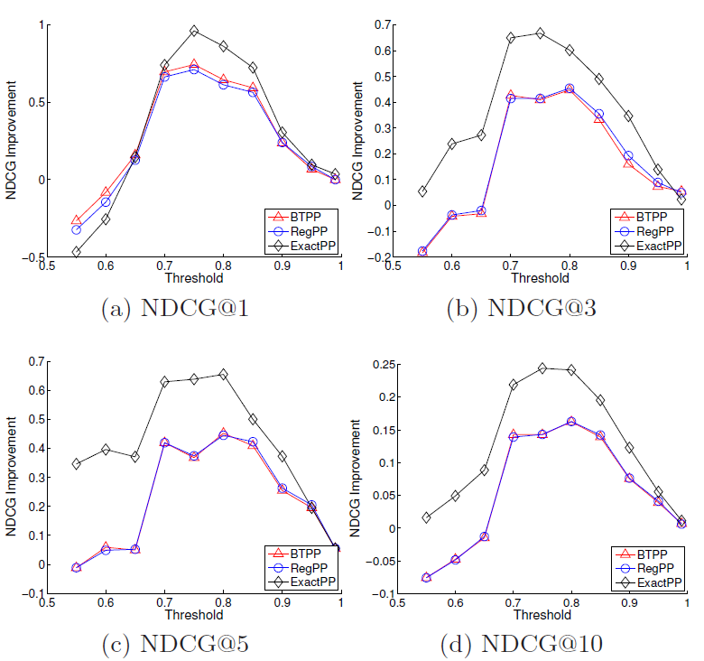
Reordering Threshold
Best around 0.75
Smaller threshold
  Too aggressive
Larger threshold
  Too conservative
Notes:
We need to first determine the

Slide 19
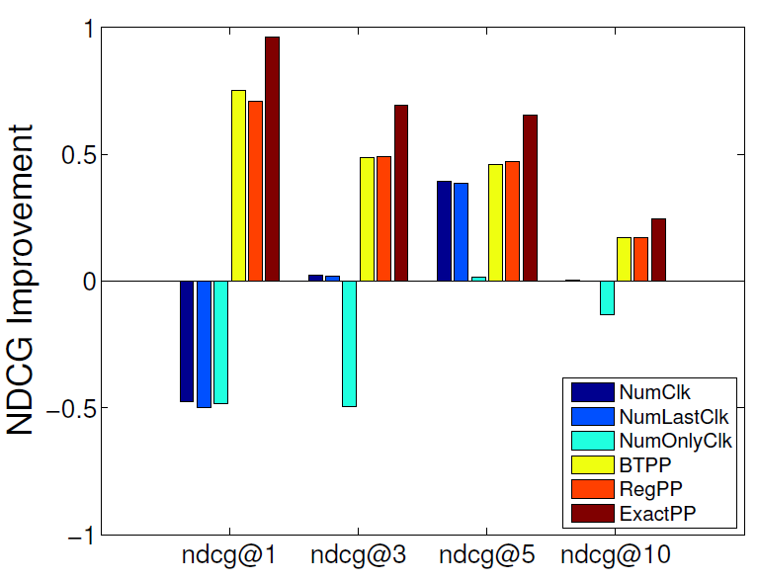
Effective Comparison
Comparison with sort-based approaches

Slide 20
Conclusion
Post-rank reordering: an “always-on” component to resolve misalignments between search engines and end users.
A CCM preference probability-based approach gives good results
Two approximation schemes for the efficiency of computing PP at runtime
Orthogonal to click modeling

