Slide 1
Multi-Modal Text Entry and Selection on a Mobile Device
David Dearman¹, Amy Karlson², Brian Meyers² and Ben Bederson³
¹University of Toronto
²Microsoft Research
³University of Maryland

Slide 2
Text Entry on Mobile Devices
Many mobile applications offer rich text features that are selectable through UI components
  Word completion and correction
  Descriptive formatting (e.g., font, format, colour)
  Structure formatting (e.g., bullets, indentation)
Selecting these features typically requires the user to touch the display or use a directional pad
  Slows text input because the user has to interleave selection and typing
Notes:
Text entry isn’t just for sending SMS or email anymore.
Although these methods are natural, they require the user to interleave selection and typing, slowing their rate of input.

Slide 3
Alternative Types of Input
Modern smart devices can support alternative types of input
  Accelerometers (sense changes in orientation)
  Speech recognition (talk to our devices)
  Even the foot (Nike+ iPod sport kit)
These alternative methods can potentially be used to provide parallel selection and typing
  The user can keep typing while making selections
Notes:
- Although a touch screen and a directional pad are common methods of input, modern smart devices can support alternative types of input
- Allowing the user to keep their fingers on the keypad, enabling them to typing while making a selection

Slide 4
Evaluating Alternate Input Types
What performance benefit to the expressivity and throughput of text entry can these alternate types of input offer?
We compare 3 alternate Input Types against selecting on-screen widgets (Touch):
  Tilt – the orientation of the device
  Speech – voice recognition
  Foot – foot tapping

Slide 5
Two Experiments
Experiment 1: Target Selection
  Stimulus response task
  Evaluate the selection speed and accuracy of the Input Types in isolations
Experiment 2: Text Formatting
  Text entry and formatting task
  Evaluate the selection speed and accuracy of the Input Types during text entry
  Identify influences affecting the flow and throughput of text entry
Notes:
Exp 1 – provide a baseline for how fast selections can be made with each Input Type
Exp 2 – We chose a form

Slide 6
Expressivity Limits
Tilt, Touch, Speech and Foot vary greatly in the granularity of expression they support
  Voice supports a large unconstrained space
  Hand tilt is a much smaller input space [Rahman et al. 09]
We limit the selections to 4 options to ensure parity across the alternative methods of input
  Placement of targets differs across Input Type
  Placement corresponds to the physical action required to perform the selection
Notes:
- Our intent is to evaluate the trade-off between each technique, not comparing their limits

Slide 7
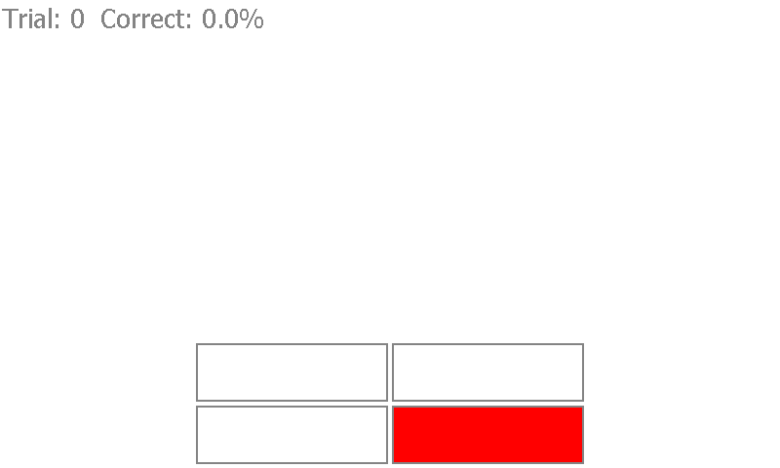
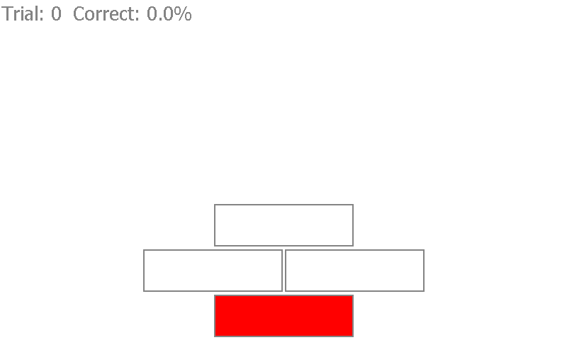
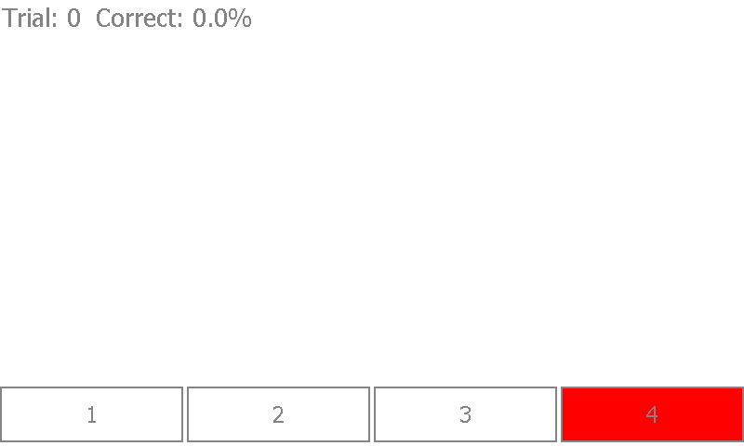
Target Selection (Task)
Foot
Tilt
Touch & Voice
Participants were required to select the red target as quickly and accurately as possible
Notes:
- The

Slide 8
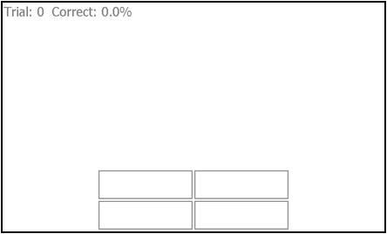
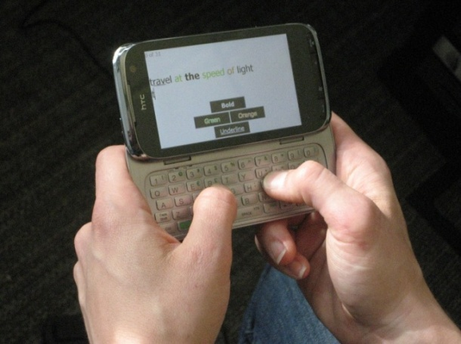
Target Selection (Task)
Press the ‘F’ and ‘J’ key

Slide 9
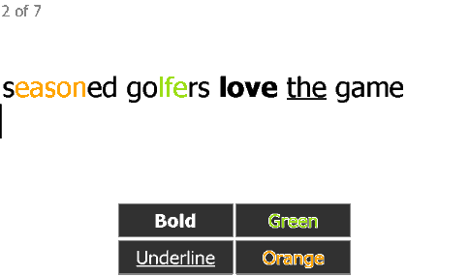
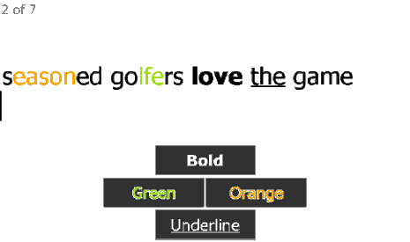
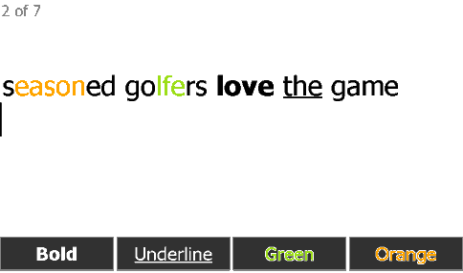
Text Formatting (Task)
Foot
Tilt
Touch & Voice
Participants were required to reproduce the text and visual format; and correct their errors
  Text from MacKenzie’s phrase list [MacKenzie 03]
  Three different format positions {Start, Middle, End}

Slide 10
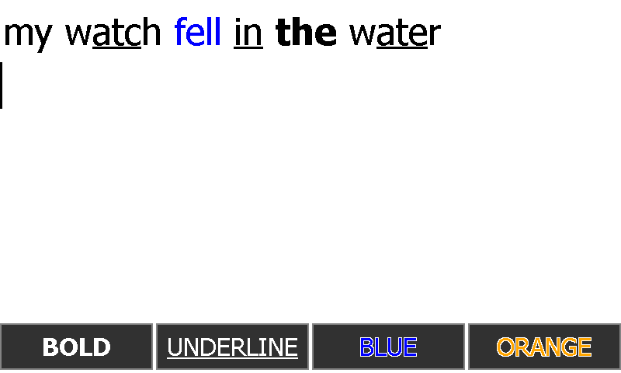
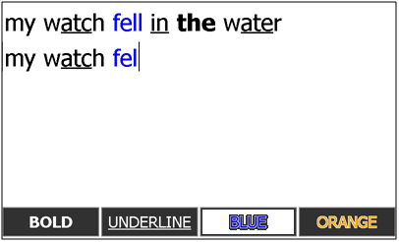
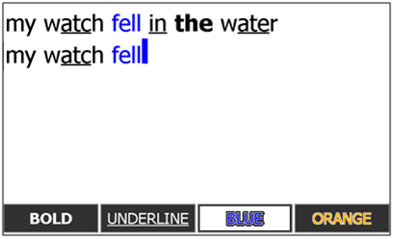
Text Formatting (Task)
Start
Blue selected
Format error

Slide 11
Implementation
Experimental software implemented on an HTC Touch Pro 2 running Windows Mobile 6.1

Slide 12
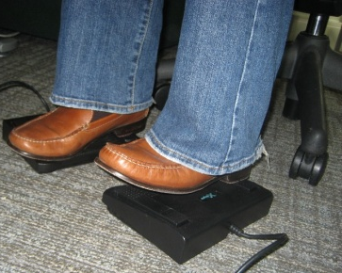
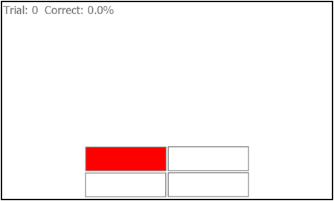
Implementation (Foot)
Selection is performed using two X-keys 3 switch foot pedals wirelessly connected to the handheld
A selection occurs when the heel or ball of the foot lifts off the respective switch

Slide 13
Implementation (Speech)
Wizard of Oz implementation
Participant says the label to select
Wizard listens to the command and pressed the corresponding button on a keyboard
  Keyboard is connected to a desktop that is wirelessly relaying selection to the handheld
Notes:
Rather than implementing a fully functional voice recognition system, we implemented a WoZ simulation.
Systems we tested for desktop and mobile incurred significant lag

Slide 14
Implementation (Tilt)
Sample the integrated 6 DOF accelerometer
Identify Left, Right, Forward and Backward gestures exceeding 30º
Forward
Right
Left
Backward

Slide 15

Implementation (Touch)

Slide 16
Participants
24 participants
  11 female and 13 males
  Median age of 26
All owned a mobile device that has a physical or on-screen QWERTY keyboard
All enter text on their mobile device daily

Slide 17
Experimental Design & Procedure
Target Selection experiment was conducted before the Text Formatting experiment
  Input Types were counterbalanced within each
Target Selection (4 x 4 design)
  Input Type {Touch, Tilt, Foot, Speech}
  Target Position {1, 2, 3, 4}
    6 blocks of trials (first is training)
    20 trials per block
  Overall: 400 trials

Slide 18
Experimental Design & Procedure
Text Formatting (4 x 3 x 4 design)
  Input Type {Touch, Tilt, Foot, Speech}
  Format Position {Start, Middle, End}
  Target Position {1, 2, 3, 4}
    5 blocks of trials (first is training)
    48 trials per block
  Overall: 768 trials and 3,111 characters of text

Slide 19
Results: Target Selection (Time)
Tilt resulted in the fastest selection time
Speech resulted in the slowest selection time
Notes:
I’m not going to present the results for the Target Positions. Please see the paper if you are interested in those results and our encompassing discussion.

Slide 20
Results: Target Selection (Error)
Overall error rate of 2.47%
The error rate for Touch and Speech is lower than Tilt and Foot
Notes:
Despite being the two slowest Input Types, the error rate for Touch and Speech is lower than Tilt and Foot

Slide 21
Results: Text Formatting
Selection Time (ms)
  The time between typing a character and selecting a subsequent text format
Resumption Time (ms)
  The time between selecting a text format and typing the following character

Slide 22
Results: Text Formatting (Time)
Selection Time (S): Tilt is faster than Touch, and Speech is slower than all Input Types
Resumption Time (R): Speech is faster than all Input Types, and Touch is faster than Tilt

Slide 23
Results: Text Formatting (Position)
Toggling a format at the End of a word is faster than the Start and Middle of a word
  Selection (S) and Resumption (R) Time

Slide 24
Results: Text Formatting (Errors)
Error rate of 14.9% (overall)
Touch resulted is the least number of format selection errors

Slide 25
Results: Text Throughput
 | Characters Per Second (N/s)
Tilt | 1.32
Touch | 1.45
Speech | 1.37
Foot | 1.31
Average of 1.36 characters per second
  2.56 CPS for mini-QWERTY [Clarkson et al. 05]
The characters per second throughput for Touch is greater than Tilt and Foot

Slide 26
Results: Corrections
 | Backspace (N) | Corrected Error Rate (N/s)
Tilt | 1062 | 0.0522
Touch | 1048 | 0.0506
Speech | 1619 | 0.0770
Foot | 1451 | 0.0702
Use of the backspace button and the corrected error rate is lowest with Tilt and Touch
  Suggests participants had difficulty coordinating selection and typing with Speech and Foot

Slide 27
Discussion
A fast selection time does not necessarily imply a high character per second text throughput
  Tilt and Foot resulted in the fastest target selection times, but a slower characters per second throughput than Speech and Touch
  The accumulated time to correct the errors for Tilt and Touch significantly impacted their throughput

Slide 28
Discussion
The sequential ordering of text entry and selection was a benefit to Touch
  “I would find myself typing the word that was supposed to be green ... before saying green”
However, we believe it is possible to improve parallel input
  Format could be activated at any point in a word
  Format characters when the utterance was started rather than when it was recognized

Slide 29
Discussion
Making a selection at the End of a word allows for faster selection and resumption time

Slide 30
Conclusion
Tilt resulted in the fastest selection time, but participants had difficulty coordinating parallel entry and selection making it highly erroneous
Touch resulted in the greatest characters per second text throughput because it allowed for sequential text entry and selection
David Dearman
dearman@dgp.toronto.edu

Slide 31
Future Work
Methods to limit the impact of difficulty coordinating text entry and selection
Will greater exposure to the Input Types improve throughput

