Slide 1


Building Taxonomy of Web Search Intents for Name Entity Queries
Xiaoxin Yin¹, Sarthak Shah²
¹Internet Services Research Center (ISRC)
Microsoft Research Redmond
http://research.microsoft.com/en-us/groups/isrc
²Microsoft Corporation

Slide 2
Internet Services Research Center (ISRC)
Advancing the state of the art in online services
Dedicated to accelerating innovations in search and ad technologies
Representing a new model for moving technologies quickly from research projects to improved products and services
Thursday, 04/29/2010 | Friday, 04/30/2010
10:30~12:00pm: Data Analysis & Efficiency Distributed Nonnegative Matrix Factorization for Web-Scale Dyadic Data Analysis on MapReduce | 11:00~12:30pm: Query Analysis Exploring Web Scale Language Models for Search Query Processing (Come see our live demos at exhibition!) Building Taxonomy of Web Search Intents for Name Entity Queries Optimal Rare Query Suggestion With Implicit User Feedback
1:30~3:00pm: Information Extraction Automatic Extraction of Clickable Structured Web Contents for Name Entity Queries | 1:30~3:00pm: Infrastructure 2 0-Cost Semisupervised Bot Detection for Search Engines
Notes:
In the past several years, we have been dedicated to accelerating …
We work closely with product teams, representing a new model for …
Most of these papers have been shipped into products

Slide 3
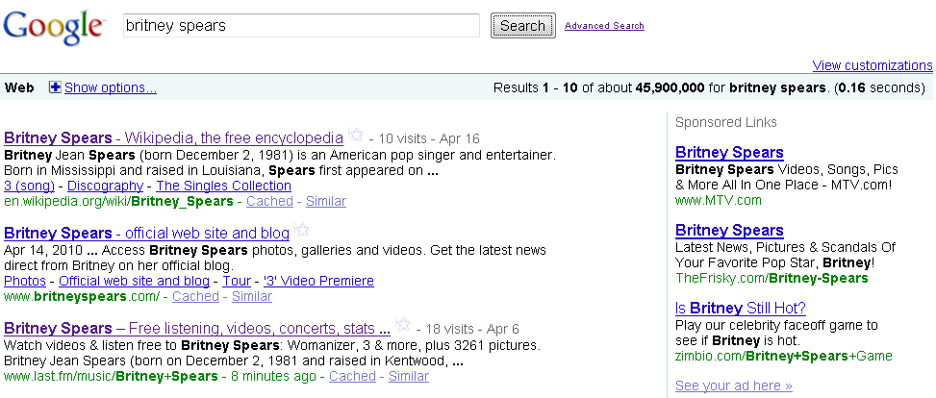

Traditional Web Search Result Page
“Ten blue links” (faked from Google results)

Slide 4
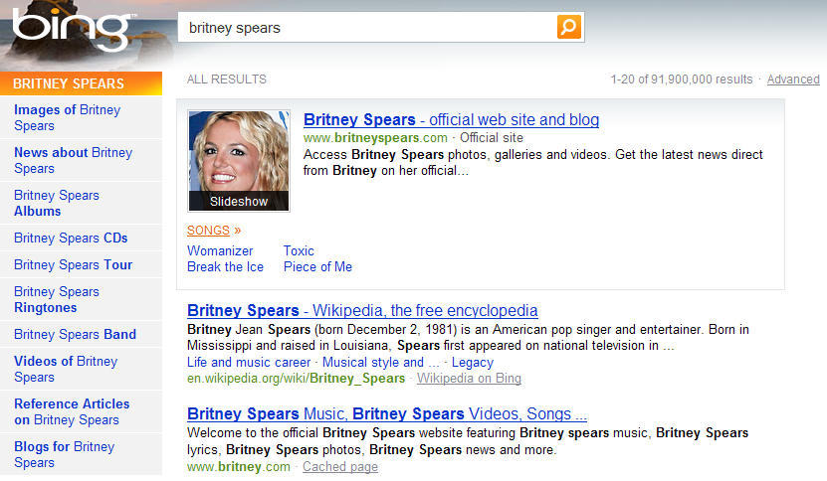
Richer Search Result Page
Bing
Official Web site
Images
Related intents
Songs

Slide 5
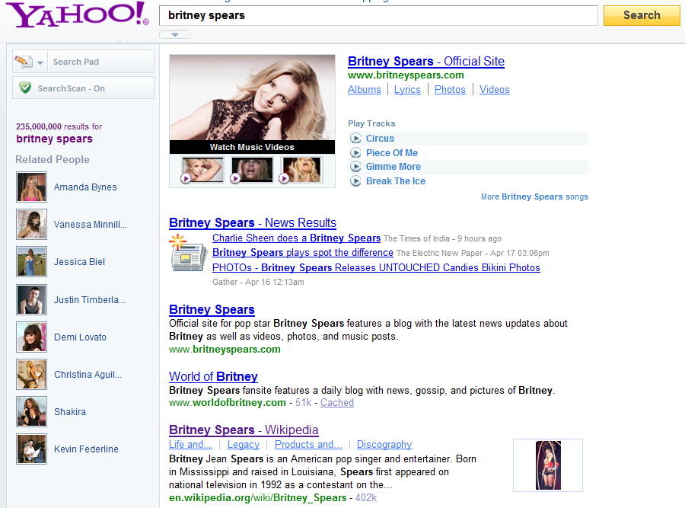
Richer Search Result Page
Yahoo!
Official Web site
Music videos
Related intents
Songs
News

Slide 6
Richer Search Result Page
Richer information are shown on the result page of Britney Spears
  Verticals
    Images
    Videos
    News
  Related intents
    Albums
    Songs
    Lyrics
Rather consistent for any popular musician
How to decide what to show and how to organize them?
  By UI designer?

Slide 7
Goal of this study
Build a taxonomy of search intents
  For queries consisted of a category of name entities
    E.g., Musicians, Actors, Cities, Car brands, etc.
song, albums
song lyrics
lyrics for
youtube
discography
lyrics
cd
hits
music, videos
music videos
tv
show
downloads
root
videos de
pictures, photos, images
mp3
listen to
pics, pictures of
movie
tour
band
concert
tickets
tour dates
concert schedule, concert dates
fan club
fan
biography, bio
wikipedia, wiki
who is
singer
death

Slide 8
Potential Applications
A tree of related queries
Help arrange rich contents on result page
Madonna images
Madonna songs
Madonna music
Madonna albums
{Madonna}
Madonna concerts
Madonna lyrics
Madonna biography
Madonna mp3
Albums
Lyrics
More user clicks
Songs
Music Videos
Official Web site
Images
Biography
Less user clicks
Tour dates
Concert tickets

Slide 9
Overview of Our Approach
Entities of a category
Tree of intents
Common Search Intents
Relationships between intents
Britney spears
Madonna
Josh Groban
Beyonce
T. I.
……
music
lyrics
songs
albums
biography……
songs → music
albums → music
albums = CDs
wiki→ biography
……
root
music
biography
lyrics
songs
wiki

Slide 10
Road Map
Introduction
How to represent search intents?
How to model relationships between intents?
How to build a taxonomy of intents?
Experiment results

Slide 11
Represent Search Intents
How to represent search intents?
  User query words/phrases can represent search intents
    Especially the popular words/phrases appearing together with many name entities of a category
Why work on name entities of a category?
  Why not work on individual queries?
  It is difficult to accurately infer the relationships between two queries
  By aggregating information for different entities of same category, we can greatly reduce noise level in our results

Slide 12
Most Popular Intent Phrases
  Intent phrases co-appearing with most entities
Actors | Cities | Musicians | Universities
actor | city | lyrics | library
photos | city of | music | employment
biography | news | youtube | jobs
pictures | real estate | wikipedia | bookstore
imdb | hospital | songs | address
bio | apartments | Wiki | athletics
wikipedia | jobs | discography | alumni
movies | map | biography | tuition

Slide 13
Road Map
Introduction
How to represent search intents?
How to model relationships between intents?
How to build a taxonomy of intents?
Experiment results

Slide 14
How to model intent(s) of a query?
A user express intent by clicking on result URLs
  Distribution of intents of query {Seattle}
The relevance of a URL w.r.t. a query is the probability it is clicked when viewed for the query
www.seattle.gov
(official site of city)
13%
en.wikipedia.org/wiki/seattle
3.4%
www.visitseattle.org
(convention and visitor’s bureau)
6%
Seattle
14.9%
www.seattle.gov/html/visitor
(visiting seattle)
www.seattle.com
(hotels, attractions, restaurants)
1.5%

Slide 15
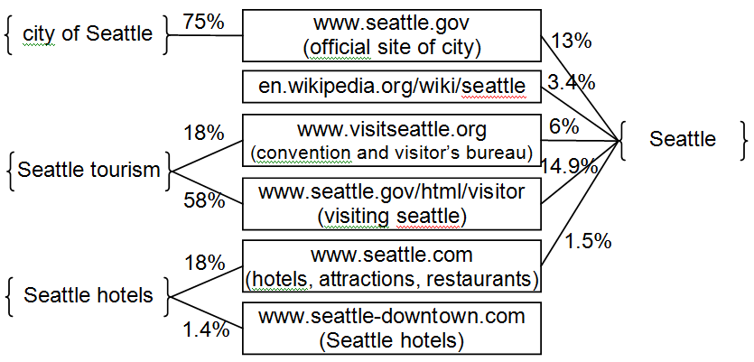
Relationship between Queries
Clicks on URLs for four queries involving “Seattle”
For query q₁ and q₂, if most clicks of q₁ are on URLs highly relevant to q₂, then with high confidence
Belong relationship between queries is defined as

Slide 16
Relationship between intent phrases
An intent word/phrase is represented by the set of queries containing it
“Belongness” between two intent phrases is defined as
Two intent phrases are considered equivalent if each has high belongness to the other
Britney Spears songs
Britney Spears music
songs
Madonna songs
Madonna music
music
Josh Groban songs
Josh Groban music

Slide 17
Building Taxonomy of Intent Phrases
Desired output
  A tree of intent phrases, with one or multiple phrases on each node
  Intent phrases on each node should carry equivalent intents
  Intent phrases on a child node should be sub-concepts of intent phrases of its parent node
Three approaches: Directed Maximum Spanning Tree, Hierarchical Agglomerative Clustering, and Pachinko Allocation Models

Slide 18
Approach 1: Directed Maximum Spanning Tree
Build a graph of intent phrases
  Each node is an intent phrase
  Weight of each directed edge is the belongness between two intent phrases
    If two intent phrases are equivalent, the weight of an edge between them is the sum of their belongness to each other
Goal: Find a spanning tree that maximize belongness on all edges
  All nodes connected by “equivalent” edges are considered equivalent

Slide 19
(continued)
Use Edmond’s algorithm
  J. Edmonds. Optimum branching. J. Research of the National Bureau of Standards, 71(B), pp.233-240, 1967.
Main idea: Find maximum edge to each node, and break cycles by replacing edges, until a tree is built
Can find the maximum spanning tree in O(nm) time for n nodes and m edges

Slide 20
Approach 2: Hierarchical Agglomerative Clustering
Build a graph of intent phrases with two types of edges
  Merging edge: Two phrases belong to each other
    For two phrases w₁ and w₂, if
    (0.5 < r < 1)
  Belonging edge: Only one phrase belong to the other

Slide 21
(continued)
Algorithm of agglomerative clustering
  build a cluster for each node
  do
  find the edge with max weight connecting two individual clusters
  if it is a merging edge, merge these two clusters
  if it is a belonging edge, put one cluster as the child of the other
  compute weight of edges from newly merged cluster to every other cluster
  until no edge with sufficient weight can be found

Slide 22
Comparison of DMST and HAC
Directed Maximum Spanning Tree
  Pros: Can find optimal solution
  Cons: Vulnerable to noise, as it may merge two groups of nodes because of a single strong link
Hierarchical Agglomerative Clustering
  Pros: Consider aggregated relationships between different clusters
  Cons: Greedy algorithm

Slide 23
Baseline Approach: Pachinko Allocation Models
An approach for building a two-level topic model
  W. Li and A. McCallum. Pachinko Allocation: DAG-structured mixture models of topic correlations. ICML’06
  The upper level contains more general topics, and the lower level contains more specific topics
Convert our problem into topic modeling
  Consider each URL u as a document d
  All intent phrase in queries clicking on u are the content of d
  Apply Pachinko Allocation Models to generate a taxonomy of intent phrases

Slide 24
Experiments
We test on 10 classes of entities
Use query-click logs of the year of 2008
Class of entity | Num. Entity | Wikipedia categories or Web source
car models | 859 | 2000s_automobiles
U.S. clothing stores | 103 | clothing_retailers_of_the_united_states
film actors | 19432 | *_film_actors
musicians | 21091 | *_female_singers, *_male_singers, music_groups
restaurants | 694 | *_restaurants
universities / colleges | 7191 | universities_and_colleges_*
U.S. cities | 246 | www.mongabay.com/igapo/US.htm
U.S. presidents | 57 | presidents_of_the_united_states
U.S. retail companies | 180 | retail_companies_of_the_united_states
U.S. TV networks | 276 | american_television_networks

Slide 25
Method of Evaluation
Given two queries or intent phrases, there are four situations
  They are (almost) equivalent
  One belongs to the other (two possibilities)
  Otherwise, which indicates they are not tightly related
We use Mechanical Turk for evaluation
  Accuracy of Mechanical Turk: 0.83
    Inferred from a manually labeled set of 100 query pairs
 | Precision | Recall | F₁
Unrelated | 1.000 | 0.727 | 0.842
Belongs | 0.680 | 0.895 | 0.773
Equivalent | 0.944 | 0.919 | 0.931

Slide 26
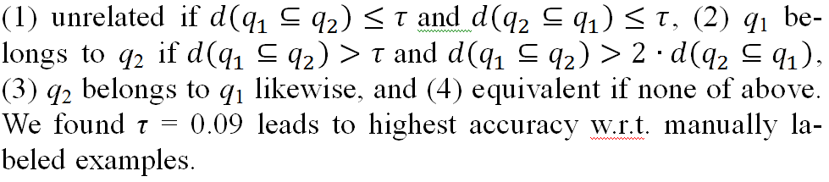
Relationships between Queries
Use “belongness” between queries to predict their relationships
Relationships between queries
 | By manually labeled data (2500 cases) |  |  | By Mechanical Turk data (100 cases)
Accuracy | 0.540 |  |  | 0.543
 | prec | rec'l | F₁ | prec. | rec'l | F₁
unrelated | 0.763 | 0.659 | 0.707 | 0.698 | 0.789 | 0.741
belongs | 0.125 | 0.211 | 0.157 | 0.195 | 0.180 | 0.187
equivalent | 0.700 | 0.568 | 0.627 | 0.623 | 0.564 | 0.592

Slide 27
Accuracy of Taxonomies
Use the taxonomies built by each approach to predict the relationships between pairs of queries
  With Mechanical Turk judgments (2500 cases)
  With Manually labeled data (100 cases)
 | PAM (baseline) |  |  | DMST |  |  | HAC
Accuracy | 0.532 |  |  | 0.560 |  |  | 0.675
 | prec | rec'l | F₁ | prec. | rec'l | F₁ | prec | rec’l | F₁
unrelated | .497 | .924 | .646 | .678 | .817 | .741 | .727 | .867 | .791
belongs | .220 | .050 | .082 | .308 | .405 | .350 | .389 | .198 | .262
equivalent | .807 | .549 | .653 | .854 | .379 | .525 | .723 | .873 | .791
 | PAM (baseline) |  |  | DMST |  |  | HAC
Accuracy | 0.586 |  |  | 0.610 |  |  | 0.760
 | prec | rec'l | F₁ | prec. | rec'l | F₁ | prec | rec’l | F₁
unrelated | .609 | .824 | .700 | .854 | .796 | .824 | .848 | .886 | .867
belongs | 0 | 0 | 0 | .500 | .737 | .596 | .625 | .263 | .370
equivalent | .684 | .542 | .605 | .857 | .324 | .470 | .762 | .865 | .810

Slide 28
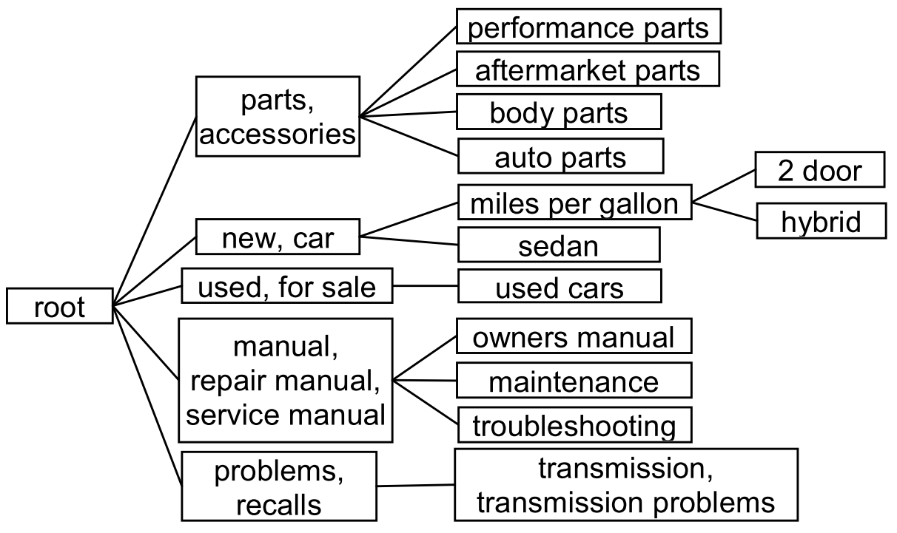
Example Taxonomy
For Car Models, by HAC

Slide 29
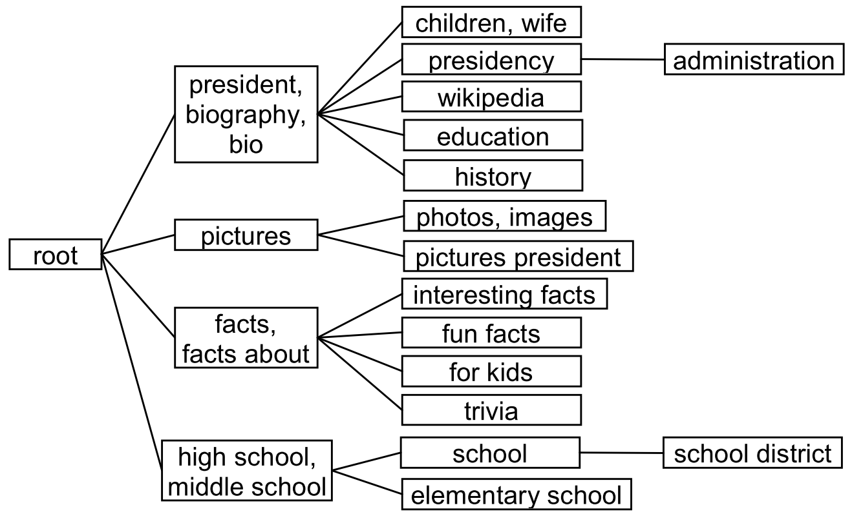
Example Taxonomy
For US Presidents, by HAC

Slide 30
Example Taxonomy
For Universities, by HAC
basket ball, mens basketball
womens basketball
baseball,
baseball camp
basketball schedule
athletics, football
softball, volleyball, swimming
school
sports
hockey
jobs, employment
human resources, job openings
root
careers
career services
bookstore, store
apparel, merchandise
faculty, staff
map, campus map
directory
library
calendar, academic calendar, events
catalog,
course catalog
hospital, medical center
school of medicine
admissions, application

Slide 31

Thank you!

