Slide 1


Automatically Extracting Structured Data for Web Search
Xiaoxin Yin, Wenzhao Tan, Xiao Li, Ethan Tu
Internet Services Research Center (ISRC)
Microsoft Research Redmond
http://research.microsoft.com/en-us/groups/isrc

Slide 2
Internet Services Research Center (ISRC)
Advancing the state of the art in online services
Dedicated to accelerating innovations in search and ad technologies
Representing a new model for moving technologies quickly from research projects to improved products and services
Thursday, 04/29/2010 | Friday, 04/30/2010
10:30~12:00pm: Data Analysis & Efficiency Distributed Nonnegative Matrix Factorization for Web-Scale Dyadic Data Analysis on MapReduce | 11:00~12:30pm: Query Analysis Exploring Web Scale Language Models for Search Query Processing (Come see our live demos at exhibition!) Building Taxonomy of Web Search Intents for Name Entity Queries Optimal Rare Query Suggestion With Implicit User Feedback
1:30~3:00pm: Information Extraction Automatic Extraction of Clickable Structured Web Contents for Name Entity Queries | 1:30~3:00pm: Infrastructure 2 0-Cost Semisupervised Bot Detection for Search Engines
Notes:
In the past several years, we have been dedicated to accelerating …
We work closely with product teams, representing a new model for …
Most of these papers have been shipped into products

Slide 3
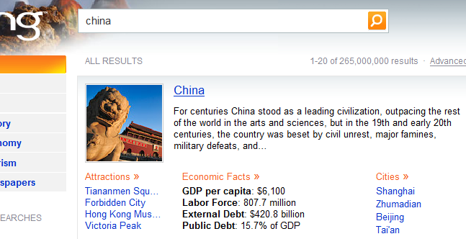
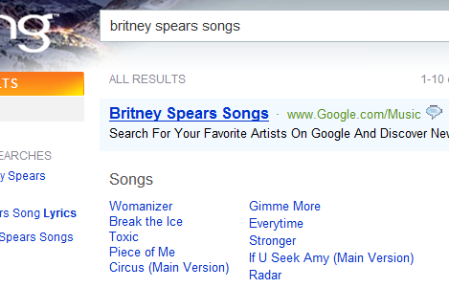
Structured Web Search
Structured Data has become more and more popular in web search results
Entity-Card
Main line answers
Manual labeling is involved in generating these data. Here we will show a fully automatic approach.

Slide 4
Existing Approaches
Wrapper induction
  Based on manually labeled web pages
Automatic information extraction
  Convert HTML into XML, with no semantics
Unsolved challenge: How to associate web pages contents with users’ search intents
  This can only be done using logs
Our goal: Automatically extract data to answer web queries
  Use search logs to identify useful web sites
  Use browsing logs to extract structured data from page contents and get semantics from user queries

Slide 5
StruClick System: Inputs
Entities of certain categories
  E.g., musicians, cities
  Can be retrieved from Wikipedia or specialized web sites such as last.fm or imdb.com
Search trails: Search logs + post-search browsing behaviors
  E.g., a user queries {Britney Spears songs}, clicks http://www.last.fm/music/Britney+Spears, and then clicks a song on it
Web pages (from Bing’s index)

Slide 6
StruClick System: Output
Structured information for queries consisted of an entity and an “intent word”
  E.g., {Britney Spears songs}
Most popular intent words:
Query: {Britney Spears songs}
Baby One More Time
  http://www.kissthisguy.com/1874song-Baby-One-More-Time.htm
  http://www.poemhunter.com/song/baby-one-more-time/
  http://new.music.yahoo.com/britney-spears/tracks/baby-one-more-time--1486500
  http://album.lyricsfreak.com/b/britney+spears/baby+one+more+time_20001894.html
  http://www.mtv.com/lyrics/spears_britney/baby_one_more_time/1492102/lyrics.jhtml
  http://www.lyred.com/lyrics/Britney%20Spears/%7E%7E%7EBaby+One+More+Time/
Oops I Did It Again
Circus
(You Drive Me) Crazy
Lucky
Satisfaction
Everytime
Piece of Me
Radar
Toxic
Actors | Musicians | Cities | National parks
pictures | lyrics | craiglist | lodging
movies | songs | times | map
songs | pictures | hotels | pictures
wallpaper | live | university | camping
thriller | 2009 | airport | hotels
■ : Can be answered by existing verticals
■ : Can be answered by StruClick
■ : Neither

Slide 7
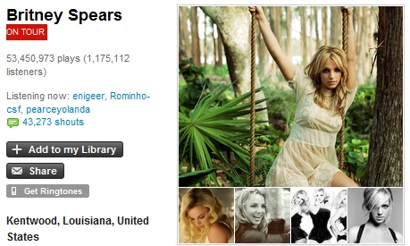
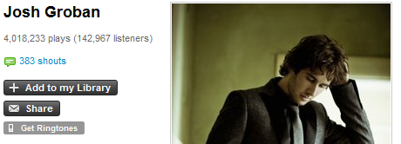
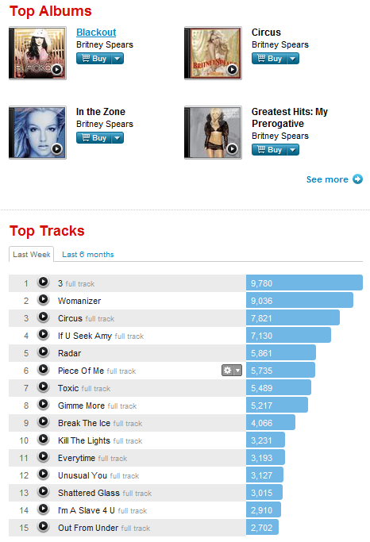
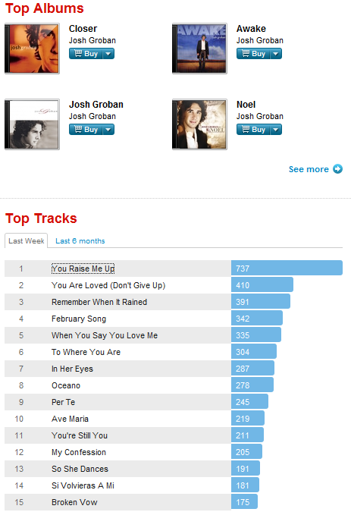
Get Semantics from Users’ Search Trails
Query:
Url:
Result Page:
{Britney Spears songs}
http://www.last.fm/music/Britney+Spears
{Josh Groban songs}
http://www.last.fm/music/Josh+Groban
Entity names
User click
User click

Slide 8
Overview of StruClick
System Architecture
Name entities of a category
Web pages
Sets of uniformly formatted URLs
Structured data from each web site
URL Pattern Summarizer
Information Extractor
Authority Analyzer
Structured data for answering queries
User clicked result URLs
Post-search clicks

Slide 9
Challenge 1: Finding Pages of Same Format
Reason: The automatically built wrappers can only be applied to pages of same format
We adopt a URL-based approach
  Page content analysis is very expensive on web scale
  URL-based approach is accurate enough
Definition of URL patterns
  A list of tokens separated by {“/”, “.”, “&”, “?”, “=”}, each being a string or wildcard “*”.
  Examples:
  http://www.imdb.com/name/nm*: people’s pages on IMDB
  http://www.last.fm/music/*: musicians’ pages on last.fm

Slide 10
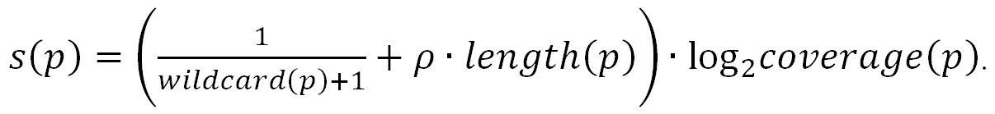
(continued)
Procedure for finding URL patterns
  Iterate through a large sample of URLs in a domain
  For each URL u, if u cannot be matched with a pattern with at most one wildcard, generate new patterns with u and by compromising u with existing patterns
  Prefer URL patterns that have high coverage and are specific
http://www.imdb.com/name/nm0000*
http://www.imdb.com/name/nm*
http://www.imdb.com/name/nm2067953

Slide 11
(continued)
Coverage of URL patterns
Precision of URL patterns – If a pair of URLs belong to same pattern, how likely they have same format
Category of queries | #URLs | #Patterns | Coverage
actor movies | 70750 | 83 | 89.72%
musician songs | 55057 | 153 | 83.76%
city tourism | 3234 | 19 | 52.50%
national park lodging | 2383 | 13 | 50.10%
Total | 131424 | 268 | 85.46%
Category of queries | #pairs | #correct | Accuracy
actor movies | 20 | 20 | 100%
musician songs | 20 | 20 | 100%
city tourism | 20 | 18 | 90%
national park lodging | 20 | 19 | 95%
Total | 80 | 77 | 96.25%

Slide 12
Challenge 2: Extracting Information
Building wrappers for clicked items
  Adopt a HTML tag-path based approach
    Proposed by G. Miao et al. in WWW’09
  Given all clicked items in pages of a URL pattern
    Build a candidate wrapper for each clicked item
    Merge identical wrappers
    Only keep wrappers that can be applied to majority of pages, and can cover a significant portion of clicked items (>5%)
Building wrappers for entity names
  Adopt a similar approach

Slide 13
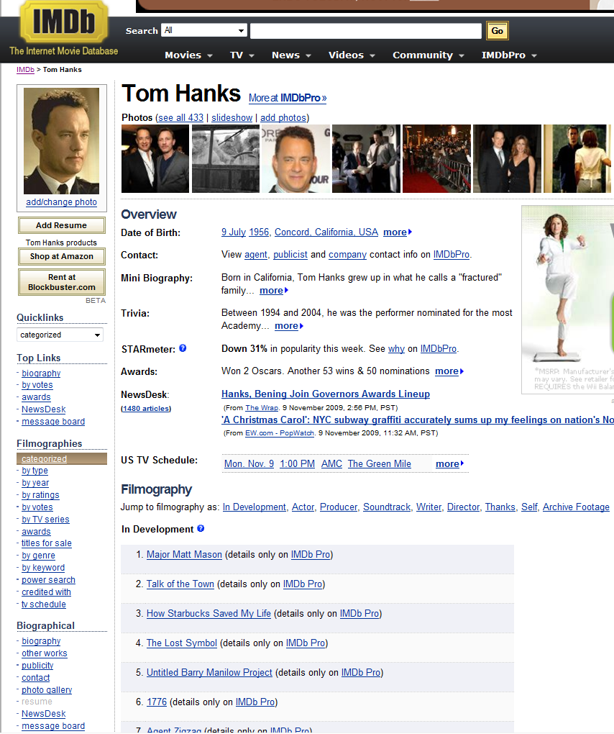
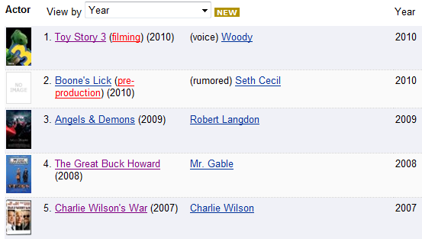
Challenge 3: Noises in User Clicks
Users may change their minds
How to distinguish relevant and irrelevant items?
User clicks for {Tom Hanks movies}

Slide 14
Key Observations
Two items extracted by same wrapper are usually both relevant or both irrelevant
  Items extracted by same wrapper are usually of same type
An item is likely to be relevant if clicked for a relevant query
  There is a good chance users don’t change their minds
Different web sites often have same item for same entity
  Especially the most popular or latest items

Slide 15
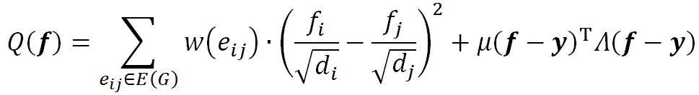
Our Approach
Authority Analyzer using graph regularization
  Build a graph with each node being an item
  An edge between each two items from same wrapper
  Some items are clicked (usually <1%)
Assign a relevance score to each node and minimize
i₄
i₆
i₁
i₃
W₁
i₅
W₃
i₂
W₂
Discrepancy between neighbor nodes
Discrepancy between nodes and labels

Slide 16

(continued)
Our formula is similar to Graph Regularization proposed by D. Zhou et al. in NIPS’03
  Their formula:
  Our formula:
  Major difference: We assign weight to each item according to #click it receives, because a heavily clicked item is more important
  Weights of items are stored in Λ

Slide 17

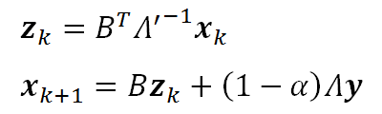

(continued)
An iterative approach is proved to converge to optimal solution
  Proof is similar to that by D. Zhou et al.
  Suppose there are n wrappers w₁, …, w_{n}, and m items t₁, …,t_{m}. Each wrapper w provides a set of items T(w), and let W be a matrix so that W_{ik} equals 1 if t_{i} is in T(w_{k}) and 0 otherwise. Let B = D^{–½}W.
  Algorithm:

Slide 18
Experiments
Search trails: From Bing’s search logs from April to August, 2009
Entities
Class of entity | Num. Entity | Wikipedia categories or Web source
actors | 19432 | *_film_actors
musicians | 21091 | *_female_singers, *_male_singers, music_groups
cities | 1000 | www.tiptopglobe.com/biggest-cities-world
national parks | 2337 | *_national_parks, national_parks_*

Slide 19
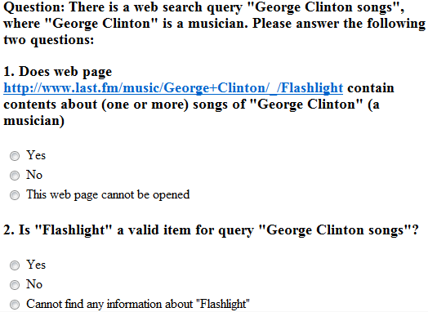
Measured by Mechanical Turk
An example question

Slide 20
Accuracy & Data Amount
> 97% average accuracy of top items
Extract 100 – 10000 times data than those clicked by users
  especially useful for tail queries
Top-k avg. | Actor movies | Musician songs | City tourism | National park lodging
1 | .970 | .978 | 1.00 | 1.00
2 | .964 | .984 | 1.00 | .978
3 | .959 | .982 | 1.00 | .978
4 | .962 | .981 | .990 | .960
5 | .967 | .978 | .992 | .954
User clicked | .713 | .527 | .770 | .842
Extracted | .735 | .747 | .780 | .932
 | Actor movies |  | Musician songs |  | City tourism |  | National park lodging
 | entity | item | entity | item | entity | item | entity | item
User clicked | 1834 | 27906 | 962 | 10562 | 170 | 1097 | 18 | 68
Final result | 1.23M | 11.7M | 97232 | 1.75M | 20789 | 285K | 23338 | 955K

Slide 21
Examples
Query: {Britney Spears songs} Baby One More Time http://www.kissthisguy.com/1874song-Baby-One-More-Time.htm http://www.poemhunter.com/song/baby-one-more-time/ http://new.music.yahoo.com/britney-spears/tracks/baby-one-more-time--1486500 http://album.lyricsfreak.com/b/britney+spears/baby+one+more+time_20001894.html http://www.mtv.com/lyrics/spears_britney/baby_one_more_time/1492102/lyrics.jhtml http://www.lyred.com/lyrics/Britney%20Spears/%7E%7E%7EBaby+One+More+Time/ Oops I Did It Again Circus (You Drive Me) Crazy Lucky Satisfaction Everytime Piece of Me Radar Toxic
Query: {Mount Rainier National Park lodging} Crystal Mountain Village Inn http://www.tripadvisor.com/Hotel_Review-g143044-d1146125-Reviews-Crystal_Mt_Hotels-Mount_Rainier_National_Park_Washington.html Cougar Rock Campground Alta Crystal Resort at Mount Rainier Travelodge Auburn Suites Holiday Inn Express Puyallup (Tacoma Area) Tayberry Victorian Cottage B&B Crest Trail Lodge Auburn Days Inn Paradise Inn Copper Creek Inn

Slide 22
Examples
Query: {Leonardo DeCaprio movies} Body of Lies http://www.netflix.com/Movie/Body_of_Lies/70101694 http://movies.yahoo.com/movie/1809968047/info http://www.hollywood.com/movie/Penetration/3482012 http://us.imdb.com/title/tt0758774/ http://movies.msn.com/movies/movie/body-of-lies/ http://www.imdb.com/title/tt0758774/ Shutter Island (2009) Revolutionary Road (2008) Catch Me If You Can Blood Diamond The Departed The Aviator Conspiracy of Fools Confessions of Pain (Warner Bros.) The Low Dweller
Query: {Los Angeles tourism} Universal Studios http://www.planetware.com/los-angeles/universal-studios-us-ca-uns.htm http://www.igougo.com/attractions-reviews-b80978-Universal_City-Universal_Studios_Hollywood.html J. Paul Getty Center Hollywood - Sunset Strip Hollywood - Grauman's Chinese Theatre / Mann Theaters Bunker Hill El Pueblo de Los Angeles Historical Monument Farmers Market J Paul Getty Museum Hollywood - Walk of Fame Map of Los Angeles – Downtown

Slide 23

Thank you!

