Slide 1
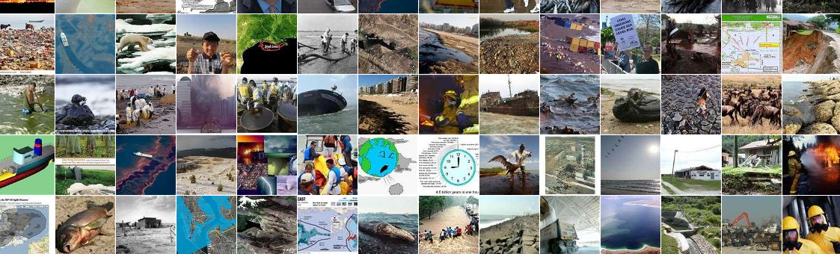
Can a new kind of ecology change the way we manage the planet?
Drew Purves and the CEES group Microsoft Research Cambridge

Slide 2
Demos here
http://www.microsoft.com/presspass/presskits/collegetour/Default.aspx

Slide 3
Why science at Microsoft Research?
Science is a key driver of our times
* Global challenges
* 21st century economy
* Healthcare, Agriculture, Energy, Nanotech, Biotech
A new kind of science
* Complex, interacting, non-linear, multi-scale
* Computational and scientific barriers not separable
Business case
* Emerging markets
* Ecosystem engineering
* Pushing the envelope
* Spin-offs
* Moral imperative

Slide 4
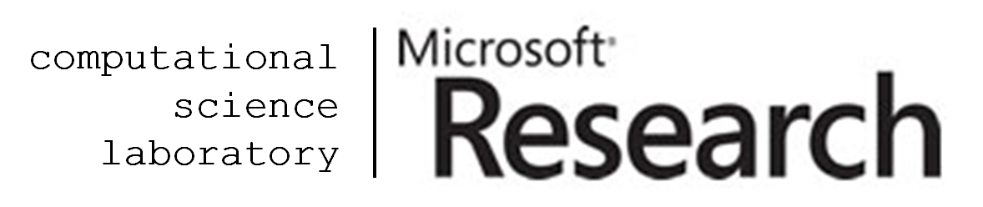
CSL and CEES
A unique melting pot of scientists and software engineers with single common aim – to research and develop novel computational approaches to tackle fundamental problems in science in areas of societal importance and develop the software tools that implement those methods to enable fundamentally new science to be undertaken *
The goal of CEES is to develop the methods and tools necessary to predict the behaviour of ecological systems at a variety of spatial and temporal scales
* Carbon-Climate Feedback Project
* Global Biodiversity Modelling Project (UNEP-WCMC)
*Stephen Emmott internal email March 2010

Slide 5
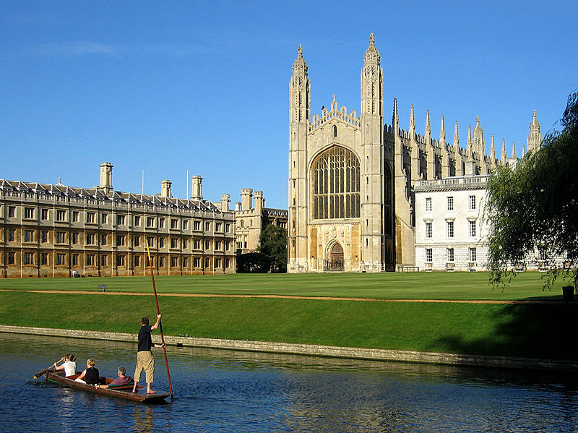
What is ecology?
So why is that important?
And why Microsoft!?
the study of how the interactions among organisms and their environment, leads to the distribution and abundance of organisms

Slide 6
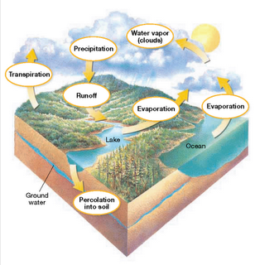
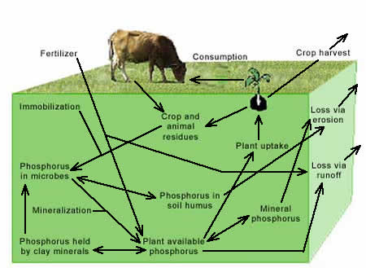
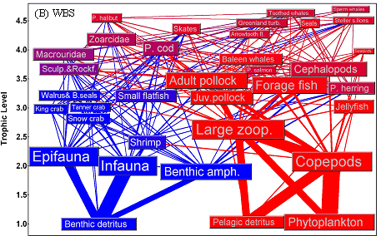
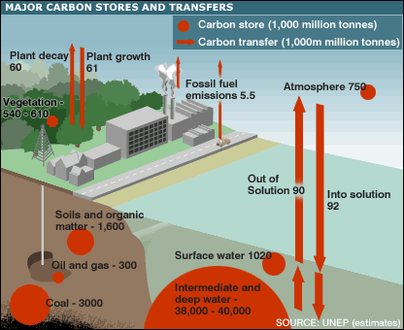
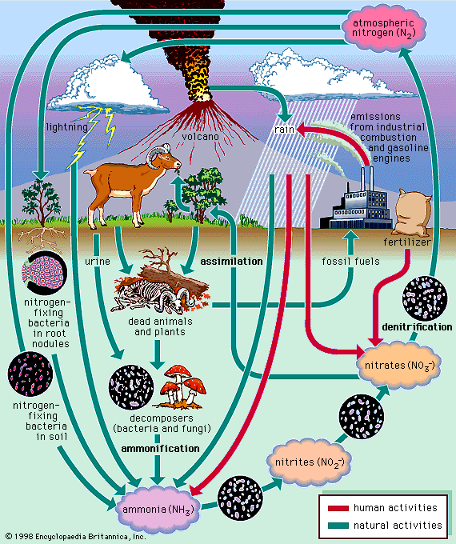
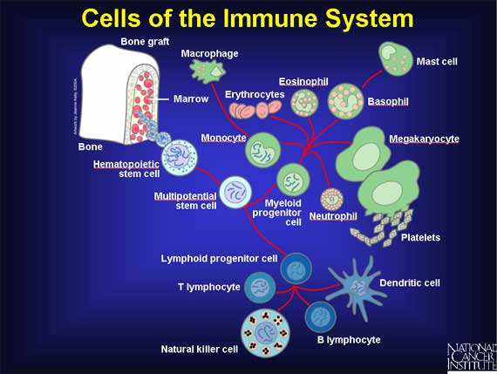
Earth’s (life) support systems
Hydrology
Farming
Fisheries
Carbon
Nitrogen
Immune system

Slide 7
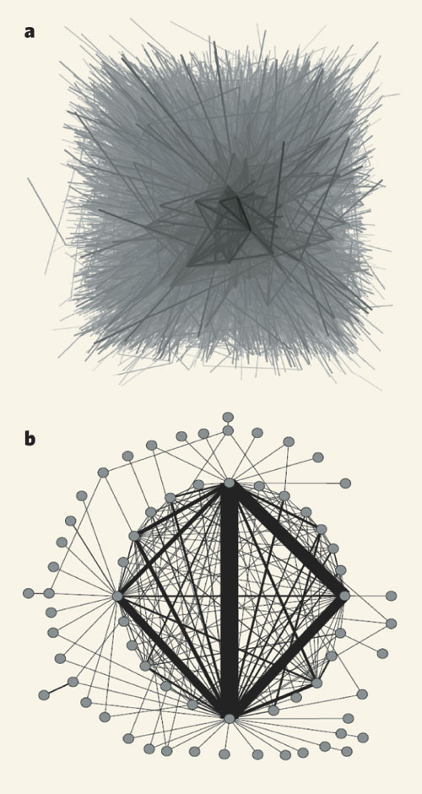
Not just the natural: ‘ecology for bankers’

Slide 8
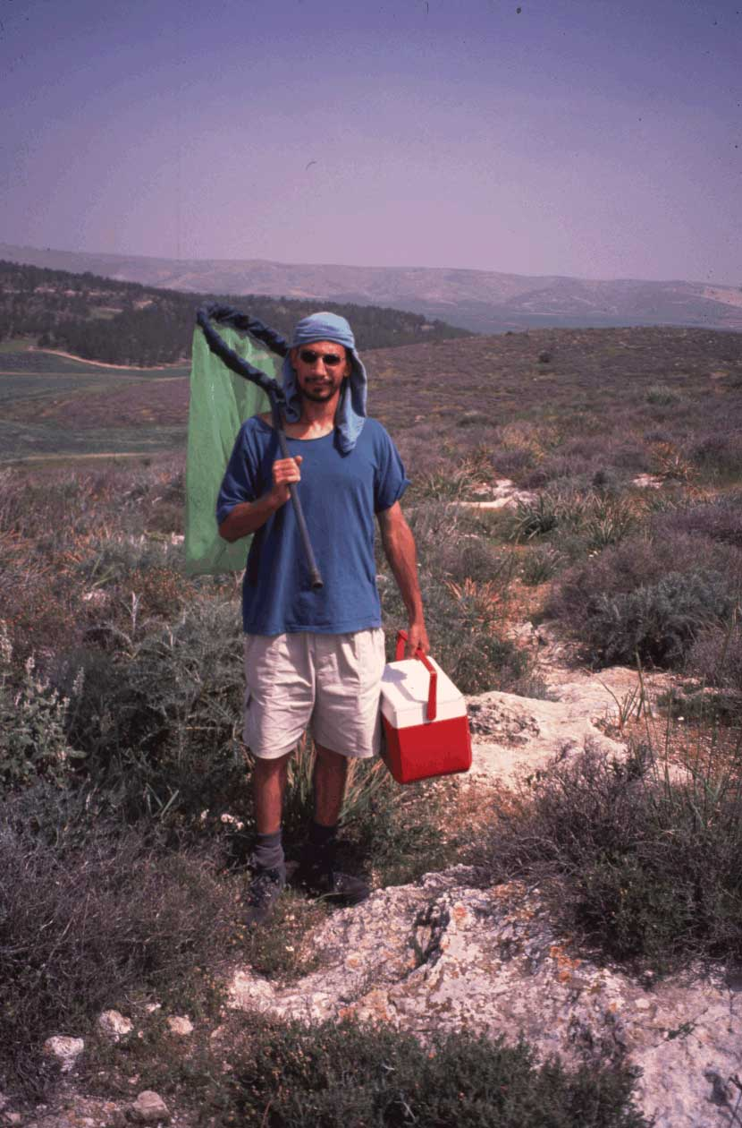
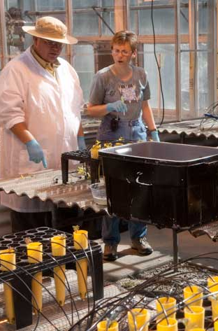

The trouble with traditional ecology
Field work
Experiments
Theorizing

Slide 9
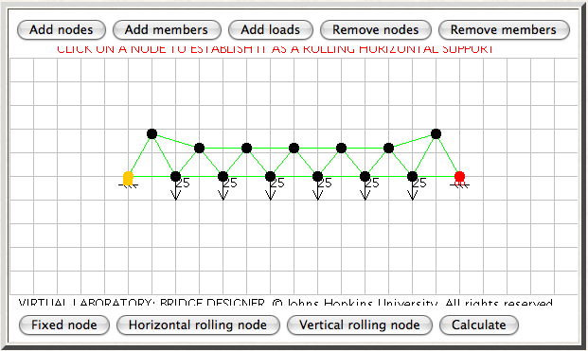
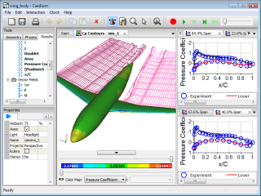
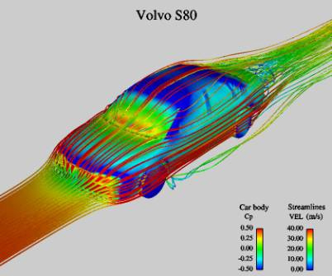
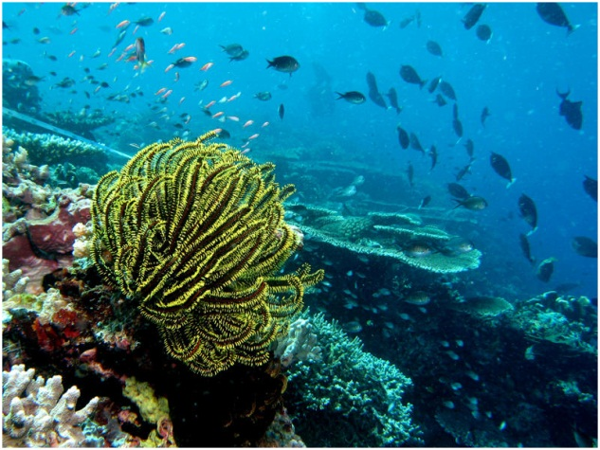
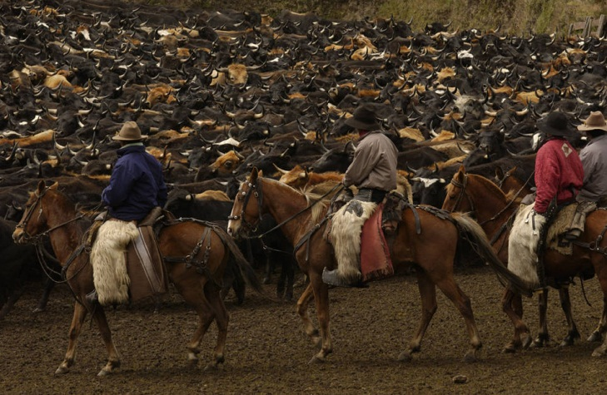
Questions we can’t answer
Bridges
Planes
Cars
Which ecosystems will collapse?
Which species will invade?
Which species will survive?
Which ecosystem is optimal for x?

Slide 10
Some huge questions we can’t answer
Will forests accelerate or slow climate change?
What would we do if a new disease hit wheat? Or the pollinators died out?
How can we safely genetically engineer crops?
How can we feed 9+ billion humans, with less water, less oil and less phosphorous?
How can we optimize supply chains to minimize environmental impact?
Is there enough to water for both agriculture, and industry, in the future?
Will the world become more fire prone as the climate changes?
How many species are there on Earth? How can we predict them?

Slide 11
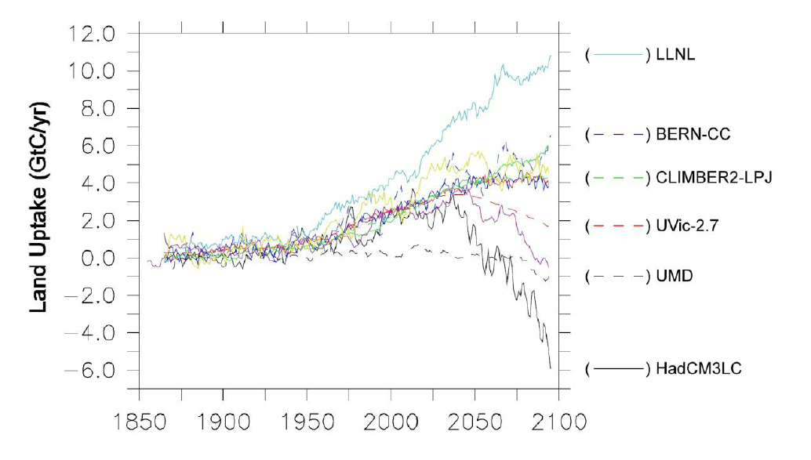
Will forests accelerate, or decelerate, climate change?
* Purves & Pacala Science 2008, based on Friedlingstein et al. 2006

Slide 12
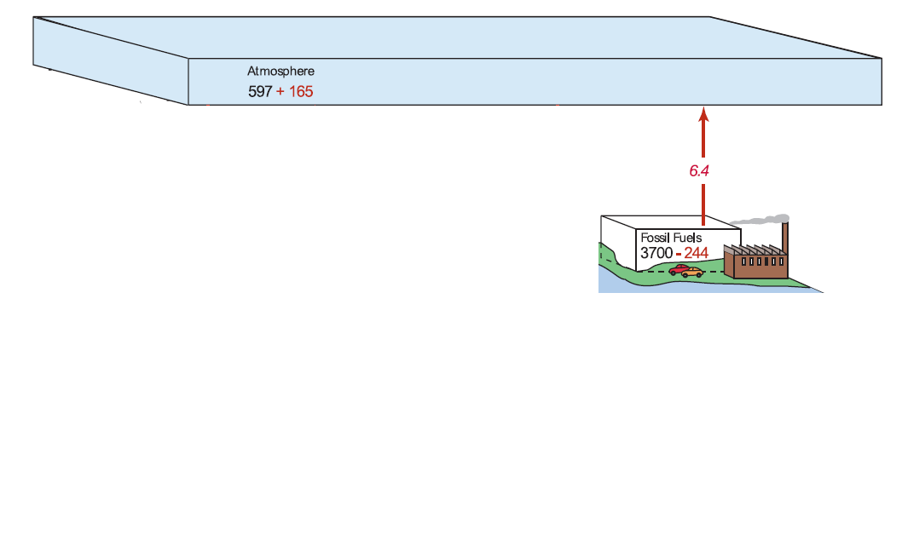
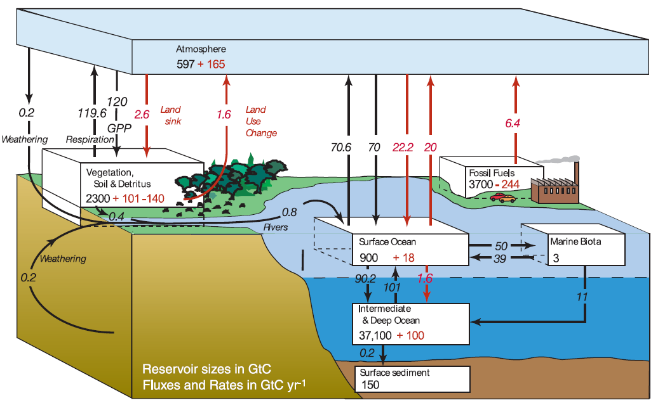
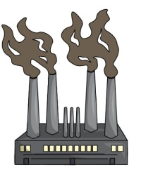
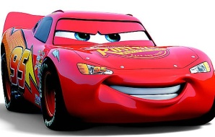
The carbon-climate problem
CO2

Slide 13
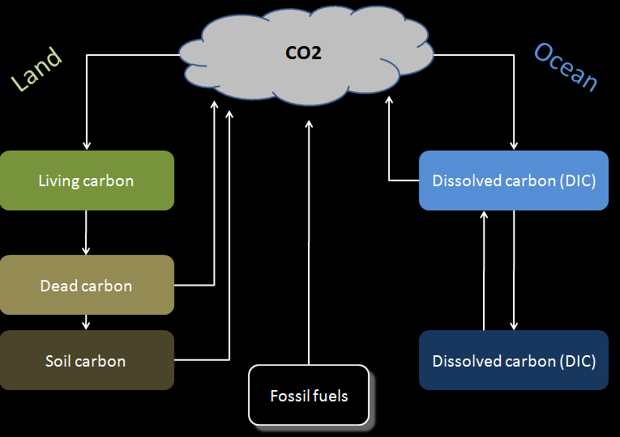
Why Climate-Carbon Feedback?
Climate
Human behaviour

Slide 14
Enter a new kind of ecology?
Traditional Ecology | Joined up Ecology
Qualitative insights | Quantitative predictions
Driven by academic curiosity | Driven by society’s needs
Fragmented into subdisciplines, divorced from other fields of study | Integrated across subdisciplines, and with other fields of study
Divorced from policy | Connected to policy
Huge shortage of all data | Huge abundance of some data, huge shortage of other data
Computation and statistics an afterthought – a necessary evil! | Computational and statistics central – and exciting!
A disparate set of software tools | An interoperable suite of software tools

Slide 15

‘Right Brain Ecology’?
Right brain
Big picture
Open minded
Negative feedbacks (gets bored)
Draws unusual parallels
Left brain
Details
Selects what it wants
Positive feedbacks (gets obsessed)
Ignores contrary evidence
Scientists are, and therefore science is, left-brain dominated
Fine for sciences that make their own world
Not fine for sciences that seek to understand the actual world
Right → Left → Right

Slide 16
Now we’re not the only ones trying this…
Ecology and environmental science are exciting!
Bayesian statistics enabling model-data joining
Some really exciting data-gathering (LiDAR, tracking, satellites, genetics)
Some very good models: forestry, fisheries, single species, diseases
Ecologists wading into policy debates
Climate modelling, ecology and computational power
Exciting research centres (SAGE, E3, NCAR, UKMO, CCI)

Slide 17
The CEES group
Five years old this spring
Real Scientists
PhDs in ecology
Mainly academic histories
Pursue our own scientific research questions
We’re all surprised we’re here!
60+ articles in international peer-review journals inc. Science, PNAS
Now grown considerably
3 permanents, 4 postdocs, several joint postdocs, 10+ co- supervised PhD students, frequeny contractors, interns, visitors
Now recognized as a leading group for 21st century ecology
Technical progress beginning
Earth System and Agriculture projects in ‘Science Studio’
Suite of software & hardware tools for environmental science

Slide 18
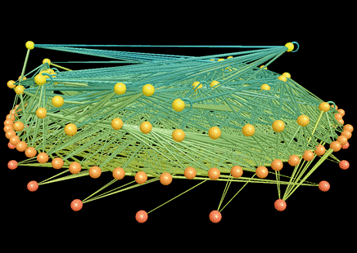
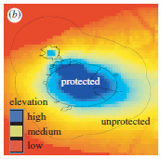
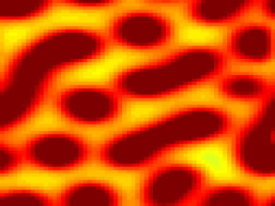
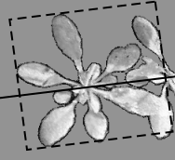
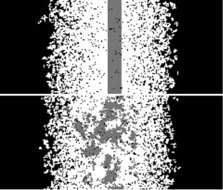

Lots of CEES projects…
Network ecology 11 papers | Agriculture Mundie College Tour Two important collaborators (Barford, Palmer) | Animal Movement 4 papers. Cool Hardware!
Conservation 8 papers | Misc Lots of papers! | Plant ecology 4 papers
Biogeography 5 papers | Epidemiology 8 papers 1 major review | Forest Ecology 10 papers

Slide 19
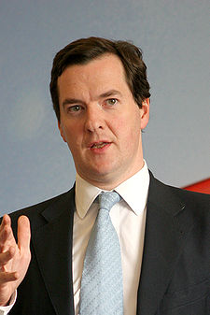
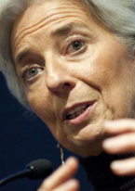
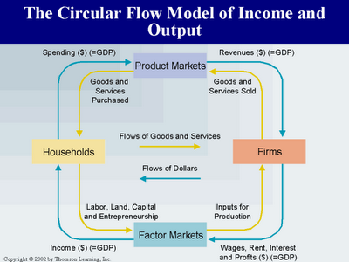
Why need models of global ecosystem function
Metrics
GDP, economic growth, inflation
Models
Keynesian economics
Circular flow models
Policy levers
Interest rates,
Tax rates,
Quantitative easing

Slide 20
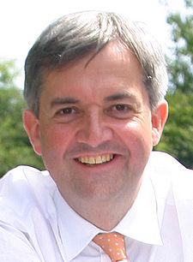
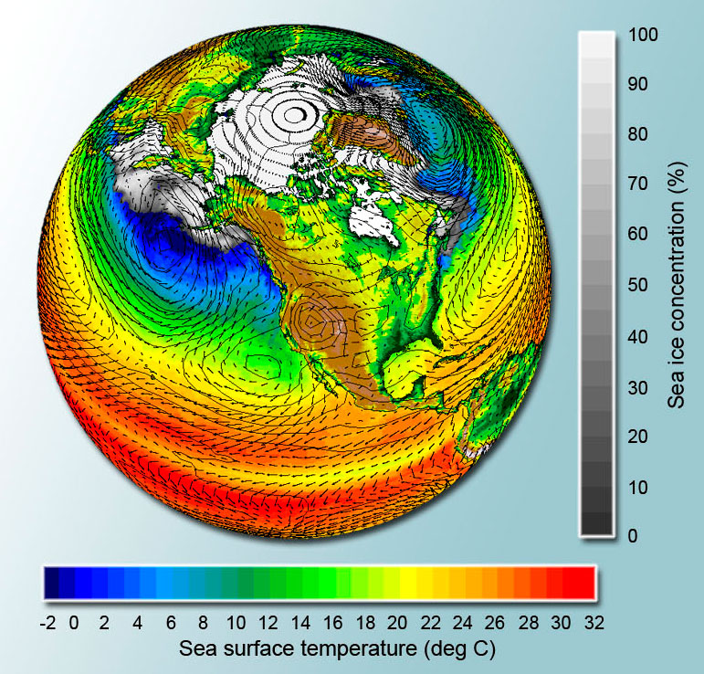
We need models of global ecosystem function
Metrics
CO2 emissions, climate change, impacts
Models
Emissions scenarios, GCMs,
Impact models
Policy levers
Carbon tax, REDD,
R&D

Slide 21
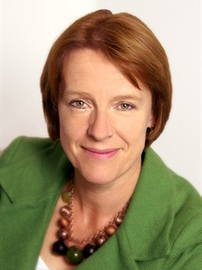




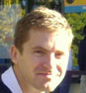
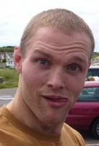
We need models of global ecosystem function
Metrics
no. species? area of habitat?
Models
GLOBIO? IMAGE?
Policy levers
Protected areas, CITES, redlisting, agricultural policies, taxes, R&D, REDD…
Tim Newbold
Derek Tittensor
Mike Harfoot

Slide 22
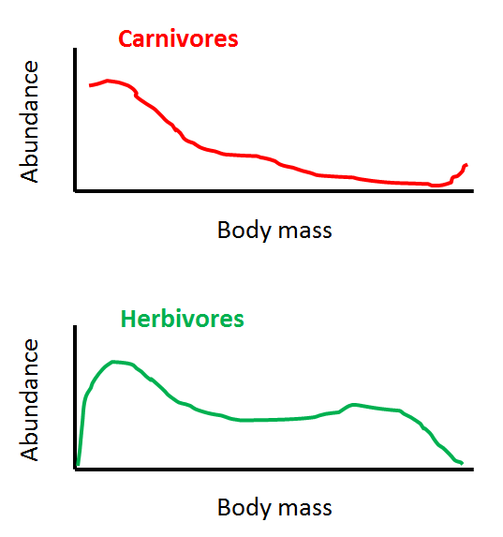
We need models of global ecosystem function
Metrics Models Levers
Ignore species, focus on traits…
Total biomass of key groups (e.g. herbivores)
Within groups, traits (e.g. average body mass, variation in body mass)
Key ecosystem rates (e.g. transfer rate of Nitrogen Herbivores to Carnivores)
Which species? Hard to say, and only of secondary importance

Slide 23

We need models of global ecosystem function
Metrics Models Levers

Slide 24
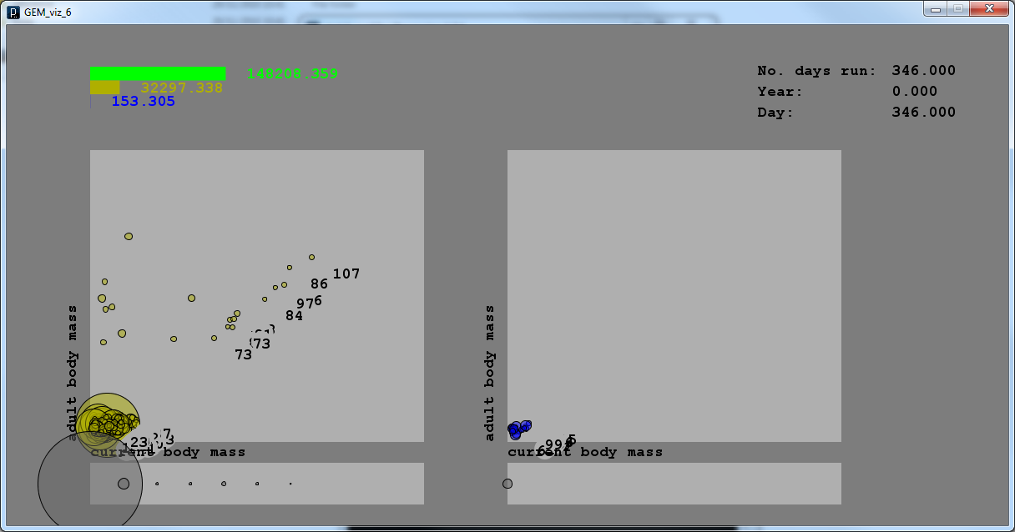
Demo here, if we have time…
… otherwise come to Meet The Ecologists!

Slide 25
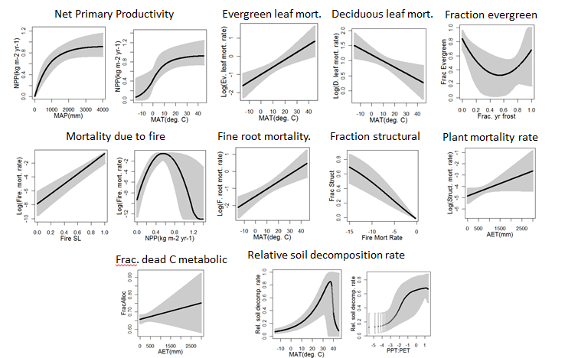
Start simple and build out: the climate dependency of the equilibrium carbon cycle…
Careful and transparent data constraints
Switching submodels, data
Hold-out data, folding, error propagation
A baseline in two ways
Sharing everything with the community

Slide 26
How we’re doing it: our tools mission
Filzbach: easy, rapid, robust parameter estimation for complex biological models
Matthew’s carbon modelling
Fb
data tables
Sd
Scientific Data Set: format free data handling for large, complex, live updating scientific data
Dv
DataSet Viewer: easy, rapid, painless, generic visualization
Fc
FetchClimate: rapid retrieval for complex environmental data queries over the cloud
Not just libraries
Standalone mode, GUI, examples, webpages
Not a framework – yet
Tying together with Visual Studio
Mf
Multiscale Modelling Framework: automatic assembly of nested, interrelated, arbitrary models

Slide 27
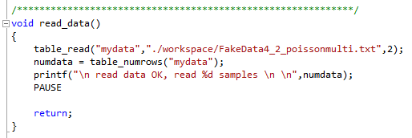
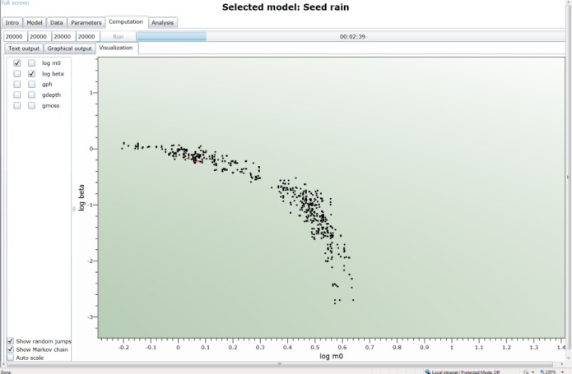
CCF: how we’re doing it – using our prototype tools
Fb
Filzbach: easy, rapid, robust parameter estimation for complex biological models
Sd
Scientific Data Set: format free data handling for large, complex, live updating scientific data
Web-delivered (Silverlight) ‘taster’, and WPF ‘Filzbach Lite’
Dv
DataSet Viewer: easy, rapid, painless, gorgeous
Fc
FetchClimate: rapid retrieval for complex environmental data queries over the cloud
Papers using Filzbach
PNAS, Proc Roy Soc, Ecology, etc.
Filzbach workshops
Mf
Multiscale Modelling Framework: automatic assembly of nested, interrelated, arbitrary models

Slide 28
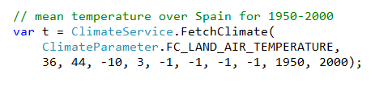
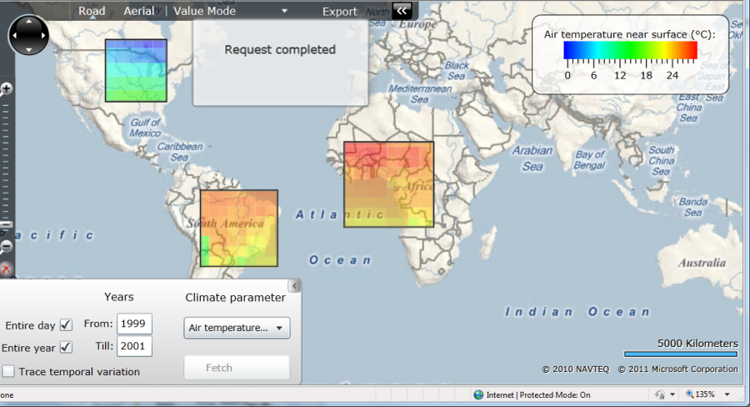
How we’re doing it: our tools mission
Fb
Filzbach: easy, rapid, robust parameter estimation for complex biological models
Sd
Scientific Data Set: format free data handling for large, complex, live updating scientific data
Cloud application (Azure) with GUI
Dv
DataSet Viewer: easy, rapid, painless, gorgeous
Fc
FetchClimate: rapid retrieval for complex environmental data queries over the cloud
Mf
Multiscale Modelling Framework: automatic assembly of nested, interrelated, arbitrary models
Papers using FetchClimate
watch this space!

Slide 29
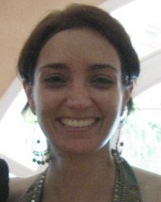
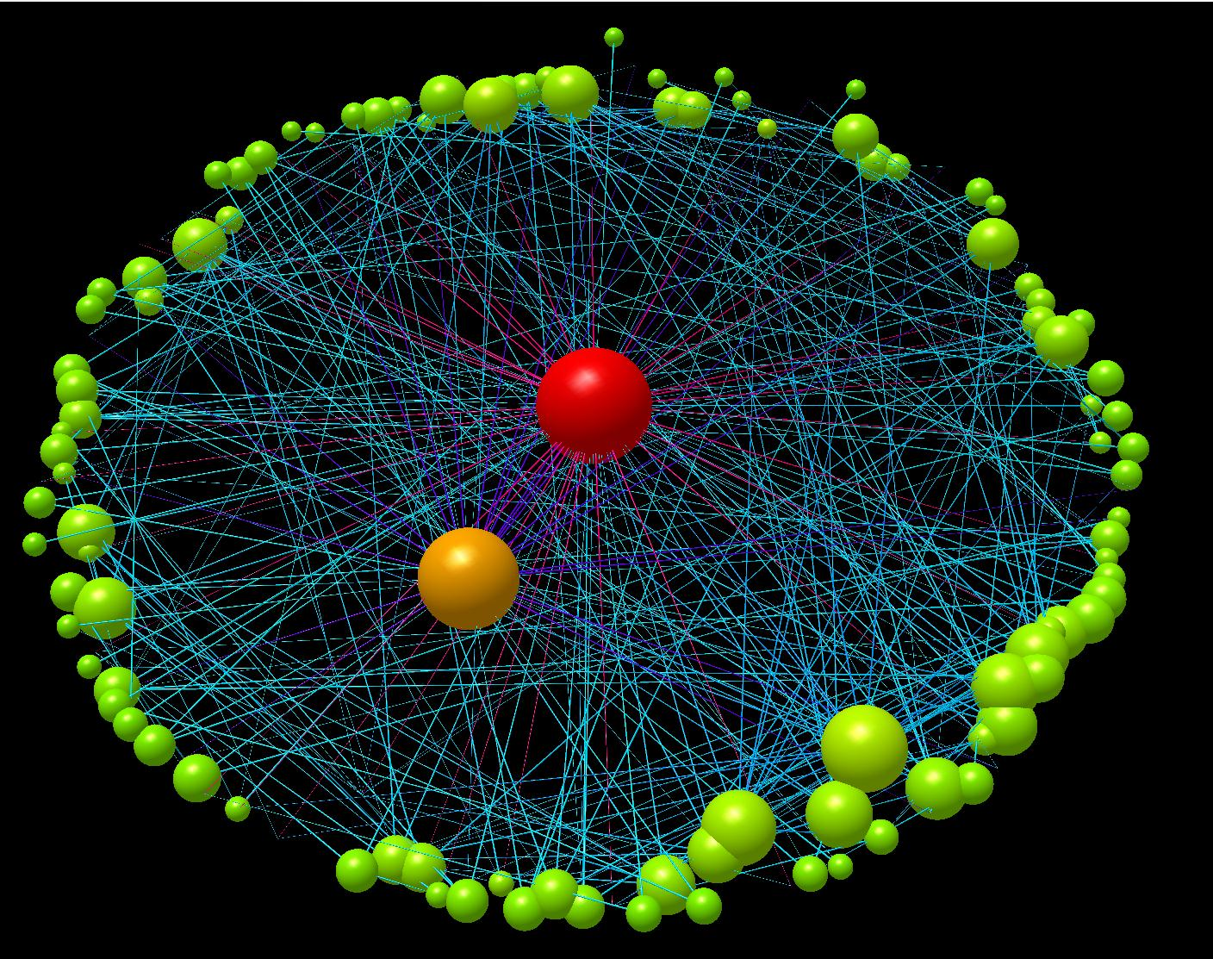


We’re explicitly researching software sociology…
Lara Salido
Greg McInerny
Lucas Joppa

Slide 30
So returning to the original question…
Can a new kind of ecology change the way we manage the planet?
Yes, because it has to, and yes, because it’s within reach
What would this mean?
Next time there’s an issue like biofuels…
A more pertinent question: what will be CEES’ contribution?
And that’s why we have the TAB!

Slide 31
A hint of things to come?: Digital Yellow River
In 1997, the Yellow river symbolised everything that was wrong with China's environment: 40% of its waters were off the scale for pollution, and the lower reaches were so choked with sediment that the river bed stood several metres above the surrounding farmland, raising the risks of floods. But the biggest problem was seemingly terminal dormancy. The river was so overexploited that it failed to reach the sea for 226 days a year.
For most of the past 30 years, the Chinese government has focused on engineered solutions to the country's water problems that increase supply. When water ran out or became polluted, they drilled deeper wells or built longer diversion channels to tap fresh resources.
But the Yellow river, which has been the main artery of Chinese civilisation for thousands of years, has shown the limitations of that approach and forced a different way of thinking that blends science, conservation, old-style communist centralised control and modern market cap-and-trade mechanisms.

