Slide 1
F# Today & Future
Functional Programming meets Information-rich World
Don Syme, Principal Researcher, Microsoft Research, Cambridge, UK

Slide 2
Today’s talk is very simple

Slide 3
Proposition 1
The world is information-rich

Slide 4
Proposition 2
Modern applications are information-rich

Slide 5
Proposition 3
Our languages are information-sparse

Slide 6
Proposition 4
This is a problem

Slide 7
The future of F# is about fixing this

Slide 8
The magic we’re adding to F# is called Type Providers

Slide 9
Type Providers + LINQ
=
Language Integrated Data and Services

Slide 10
But first…
What is F# and why should I care?

Slide 11
F# is…
...a practical, functional-first programming language that allows you to write simple code to solve complex problems.

Slide 12
F# and Open Source
F# 2.0 compiler+library open source drop
Apache 2.0 license
www.tryfsharp.org
http://blogs.msdn.com/dsyme

Slide 13

F# 2.0 ships with Visual Studio 2010

Slide 14
Simple Code, Strongly Typed

Slide 15
Simplicity: Functions as Values
abstract class Command
{
public virtual void Execute();
}
abstract class RoverCommand : Command
{
protected Rover Rover { get; private set; }
public RoverCommand(MarsRover rover)
{
this.Rover = rover;
}
}
class BreakCommand : RoverCommand
{
public BreakCommand(Rover rover)
: base(rover)
{
}
public override void Execute()
{
Rover.Rotate(-5.0);
}
}
class TurnLeftCommand : RoverCommand
{
public TurnLeftCommand(Rover rover)
: base(rover)
{
}
public override void Execute()
{
Rover.Rotate(-5.0);
}
}
OO
F#
type Command = Command of (Rover -> unit)
let BreakCommand =
Command(fun rover -> rover.Accelerate(-1.0))
let TurnLeftCommand =
Command(fun rover -> rover.Rotate(-5.0<degs>))

Slide 16
Simplicity: Functional Data
C#
Tuple<U,T> Swap<T,U>(Tuple<T,U> t)
{
return new Tuple<U,T>(t.Item2, t.Item1)
}
ReadOnlyCollection<Tuple<T,T,T>> Rotations<T>(Tuple<T,T,T> t)
{
new ReadOnlyCollection<int>
(new Tuple<T,T,T>[]
{ new Tuple<T,T,T>(t.Item1,t.Item2,t.Item3);
new Tuple<T,T,T>(t.Item3,t.Item1,t.Item2);
new Tuple<T,T,T>(t.Item2,t.Item3,t.Item1); });
}
int Reduce<T>(Func<T,int> f,Tuple<T,T,T> t)
{
return f(t.Item1) + f(t.Item2) + f (t.Item3);
}
let swap (x, y) = (y, x)
let rotations (x, y, z) =
[ (x, y, z);
(z, x, y);
(y, z, x) ]
let reduce f (x, y, z) =
f x + f y + f z
F#

Slide 17
Simplicity: Functional Data
C#
F#
public abstract class Expr { }
public abstract class UnaryOp :Expr {
public Expr First { get; private set; }
public UnaryOp(Expr first) { this.First = first; }
}
public abstract class BinExpr : Expr
{
public Expr First { get; private set; }
public Expr Second { get; private set; }
public BinExpr(Expr first, Expr second) {
this.First = first;
this.Second = second;
}
}
public class TrueExpr : Expr { }
public class And : BinExpr {
public And(Expr first, Expr second) : base(first, second) { }
}
public class Nand : BinExpr {
public Nand(Expr first, Expr second) : base(first, second{ }
}
public class Or : BinExpr {
public Or(Expr first, Expr second) : base(first, second) { }
}
public class Xor : BinExpr {
public Xor(Expr first, Expr second) : base(first, second) { }
}
public class Not : UnaryOp {
public Not(Expr first) : base(first) { }
}
type Expr =
| True
| And of Expr * Expr
| Nand of Expr * Expr
| Or of Expr * Expr
| Xor of Expr * Expr
| Not of Expr

Slide 18
The Big Trends
THE WEB
MULTICORE
DATA

Slide 19
Async.Parallel [ httpAsync "www.google.com" httpAsync "www.bing.com" httpAsync "www.yahoo.com" ]
Parallel I/O
|> Async.RunSynchronously

Slide 20
Async.Parallel [ for i in 0 .. 200 -> computeTask i ]
Parallel CPU
|> Async.RunSynchronously

Slide 21
Demo

Slide 22
F# can be used for everything, but excels at data-rich or parallel analytical engines

Slide 23
Example #1 (Power Company)
I have written an application to balance the national power generation schedule … for an energy company.
...the calculation engine was written in F#.
The use of F# to address the complexity at the heart of this application clearly demonstrates a sweet spot for the language … algorithmic analysis of large data sets.
Simon Cousins (Eon Powergen)

Slide 24
Example #2: Biotech
...F# rocks - building algorithms for DNA processing
and it's like a drug. 12-15 at Amyris use F#...
F# has been phenomenally useful. I would be writing a lot of this in Python otherwise and F# is more robust, 20x - 100x faster to run and faster to develop.
Darren Platt, Amyris BioTechnologies

Slide 25
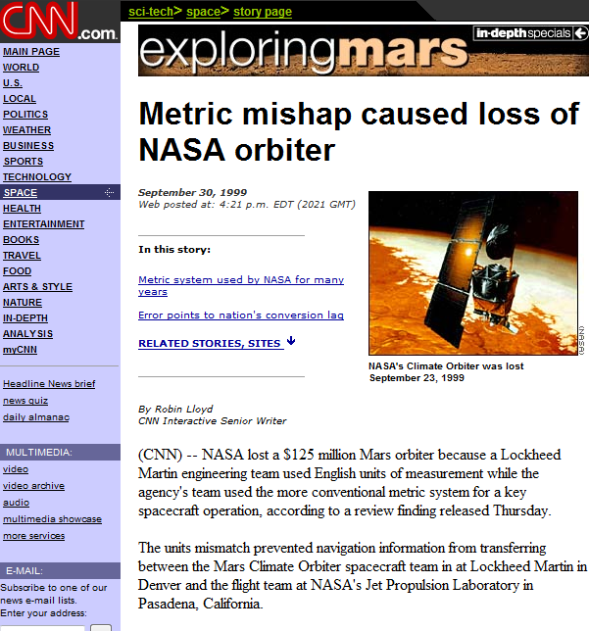
No Strongly Typed Numbers?

Slide 26
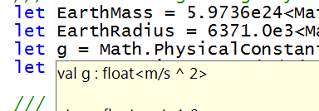
Units of Measure!
let EarthMass = 5.9736e24<kg>
// Average between pole and equator radii
let EarthRadius = 6371.0e3<m>
// Gravitational acceleration on surface of Earth
let g = PhysicalConstants.G * EarthMass / (EarthRadius * EarthRadius)

Slide 27

Async
C# is joining us too!
let! ≈ await
async { let! res = <async-event>
... }
React to a GUI Event
React to a Timer Callback
React to a Query Response
React to a HTTP Response
React to a Web Service Response
React to a Disk I/O Completion
Agent reacts to Message

Slide 28
F# async + immutable
Parallel
Server
Agents

Slide 29
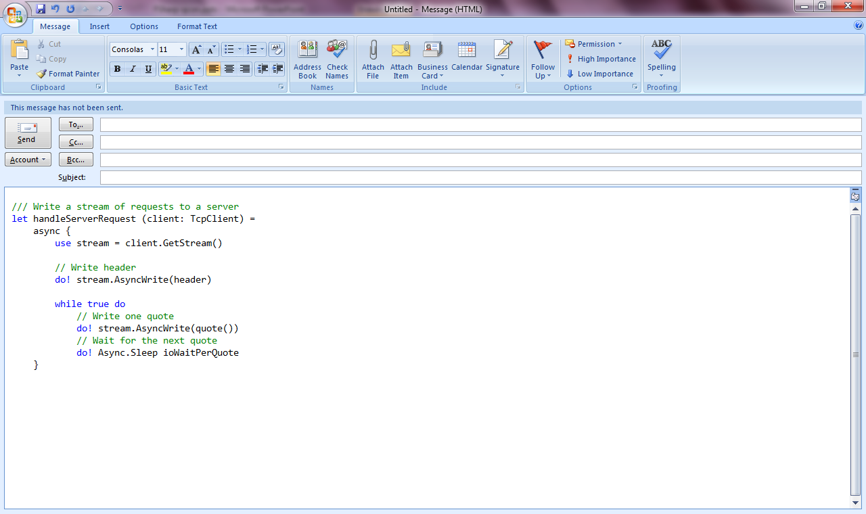
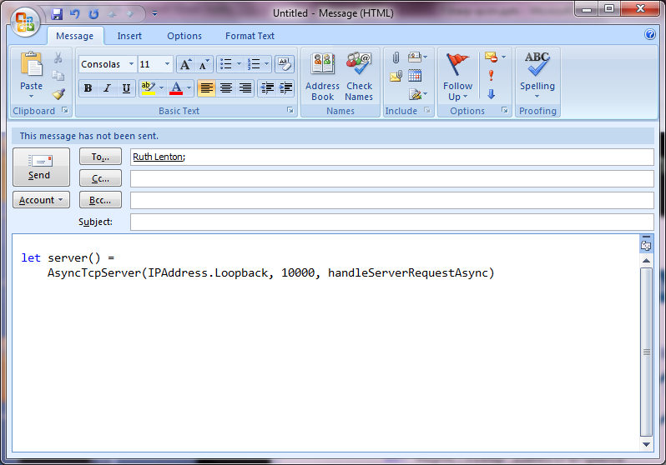
F# example: Serving 50,000+ simultaneous TCP connections with ~10 threads
Await!
Await!
Await!

Slide 30
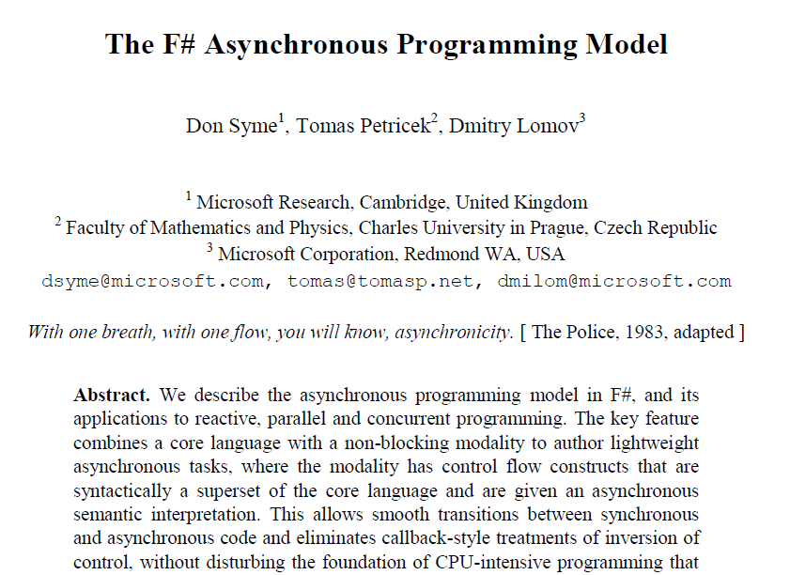
Interested in async/parallel?
Expert F# 2007
PADL 2011

Slide 31
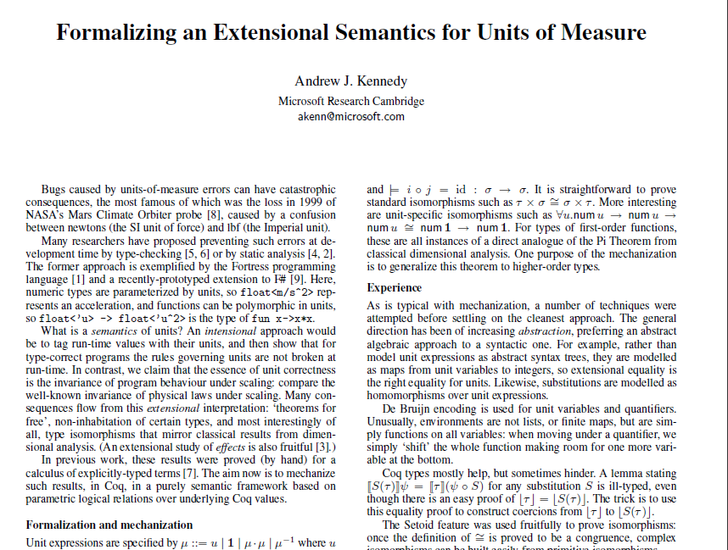
Interested in units of measure?
Kennedy, WMM 2008
search for “kennedy units”

Slide 32
Part #2 – Functional Programming Meets Information Rich World

Slide 33
A Coding Challenge
Task #1: The names of the Amino Acids, as data
Task #2: A Chemical Elements Class Library
Task #3: Repeat for all Sciences, Sports, Businesses, …

Slide 34
Language Integrated Web Data
demo

Slide 35
// Freebase.fsx
// Example of reading from freebase.com in F#
// by Jomo Fisher
#r "System.Runtime.Serialization"
#r "System.ServiceModel.Web"
#r "System.Web"
#r "System.Xml"
open System
open System.IO
open System.Net
open System.Text
open System.Web
open System.Security.Authentication
open System.Runtime.Serialization
[<DataContract>]
type Result<'TResult> = {
[<field: DataMember(Name="code") >]
Code:string
[<field: DataMember(Name="result") >]
Result:'TResult
[<field: DataMember(Name="message") >]
Message:string
}
[<DataContract>]
type ChemicalElement = {
[<field: DataMember(Name="name") >]
Name:string
[<field: DataMember(Name="boiling_point") >]
BoilingPoint:string
[<field: DataMember(Name="atomic_mass") >]
AtomicMass:string
}
let Query<'T>(query:string) : 'T =
let query = query.Replace("'","\"")
let queryUrl = sprintf "http://api.freebase.com/api/service/mqlread?query=%s" "{\"query\":"+query+"}"
let request : HttpWebRequest = downcast WebRequest.Create(queryUrl)
request.Method <- "GET"
request.ContentType <- "application/x-www-form-urlencoded"
let response = request.GetResponse()
let result =
try
use reader = new StreamReader(response.GetResponseStream())
reader.ReadToEnd();
finally
response.Close()
let data = Encoding.Unicode.GetBytes(result);
let stream = new MemoryStream()
stream.Write(data, 0, data.Length);
stream.Position <- 0L
let ser = Json.DataContractJsonSerializer(typeof<Result<'T>>)
let result = ser.ReadObject(stream) :?> Result<'T>
if result.Code<>"/api/status/ok" then
raise (InvalidOperationException(result.Message))
else
result.Result
let elements = Query<ChemicalElement array>("[{'type':'/chemistry/chemical_element','name':null,'boiling_point':null,'atomic_mass':null}]")
elements |> Array.iter(fun element->printfn "%A" element)
How would we do this today?

Slide 36
Note: F# still contains no data
Open architecture
You can write your own type provider

Slide 37
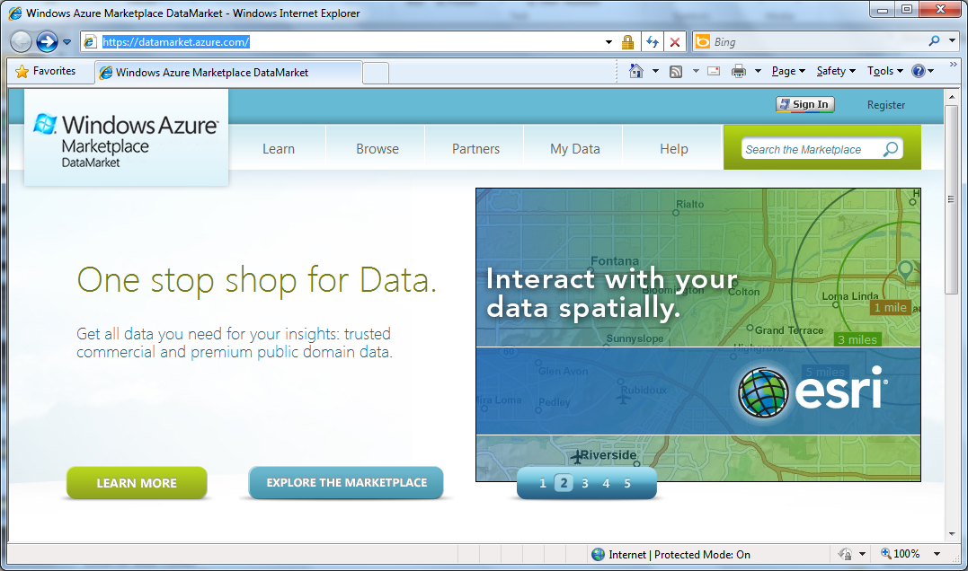

Slide 38
Language Integrated Data Market Directory
demo

Slide 39
OData
type Netflix = ODataService<"http://odata.netflix.com">
Fluent, Typed Access To OData

Slide 40
SQL
type SQL = SqlDataConnection<"Server='.\\SQLEXPRESS'..">
Fluent, Typed Access To SQL

Slide 41
SharePoint
type EmeaSite = SharePointSite<"http://myemea/">
Fluent, Typed Access To SharePoint Lists

Slide 42
Type Providers + LINQ
=
Language Integrated Data and Services

Slide 43
F# Futures: Queries
let avatarTitles =
query { for t in netflix.Titles do
where (t.Name.Contains "Avatar")
select t }

Slide 44
F# Futures: Queries
let avatarTitles =
query { for t in netflix.Titles do
where (t.Name.Contains "Avatar")
sortBy t.Name
select t }

Slide 45
F# Futures: Queries
let avatarTitles =
query { for t in netflix.Titles do
where (t.Name.Contains "Avatar")
sortBy t.Name
select t
take 100 }

Slide 46
Type Providers: Applications
…web data
…data markets
…network management
…a spreadsheet
…web services
…CRM data
…social data
…SQL data
…XML data
...
strongly typed
without explicit codegen
extensible, open

Slide 47
Type Providers
~50+ lines to implement
Map information sources into the .NET type system
type ITypeProvider ~=
// Static semantics
GetType : string -> Type
// Erasure of static semantics
GetErasedType : Type -> Type
// Dynamic semantics
GetErasedExpression : Method * Parameters[] -> Expression
// Schema change
Invalidate : IEvent<unit>
// Exploration
GetTypes : unit -> Type[]

Slide 48
Summary
The world is information rich
Our programming needs to be information-rich too
The Type Provider Manifesto?
Consume anything! Directly!
Strongly typed! No walls!

Slide 49
In Summary
F#
Ready for supported use in VS2010
F# greatly simplifies parallelism
An amazing data-rich future ahead
Simple, expressive, productive language

Slide 50
Questions

