Slide 1
Cloud Computing for Science
Dr Kenji Takeda
Solution Architect & Technical Manager EMEA
kenjitak@microsoft.com

Slide 2

Introduction
Cloud computing
Architecting for the Cloud
Clouds for Science
Conclusions
King Cloud by akakamu

Slide 3
What is Cloud Computing?

Slide 4
What is Cloud Computing?
"Cloud computing is a model for enabling convenient, on-demand network access to a shared pool of configurable computing resources (e.g., networks, servers, storage, applications, and services) that can be rapidly provisioned and released with minimal management effort or service provider interaction.”
http://csrc.nist.gov/publications/drafts/800-146/Draft-NIST-SP800-146.pdf

Slide 5
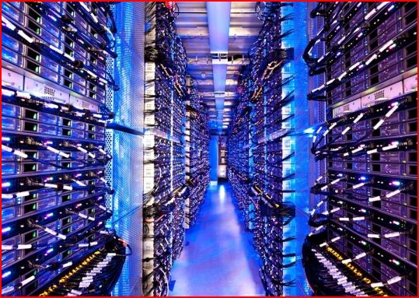

The Cloud
A model of computation and data storage based on “pay as you go” access to “unlimited” remote data center capabilities
A cloud infrastructure provides a framework to manage scalable, reliable, on-demand access to applications
A cloud is the “invisible” backend to many of our mobile applications
Historical roots in today’s Internet apps and previous DCI computing (Cluster, Grid etc.)

Slide 6

Why Cloud Computing?
Burst capability
Massive scalability
Reducing development life cycle
Disparate data aggregation or dissemination

Slide 7
Cloud Computing?
Windows Live Hotmail
Bing Maps
Windows Live SkyDrive
Microsoft Office 365
Facebook
Twitter
Flickr
Dropbox
YouTube
Salesforce.com
TicketDirect

Slide 8
Flavours of Cloud
IaaS
PaaS
SaaS

Slide 9
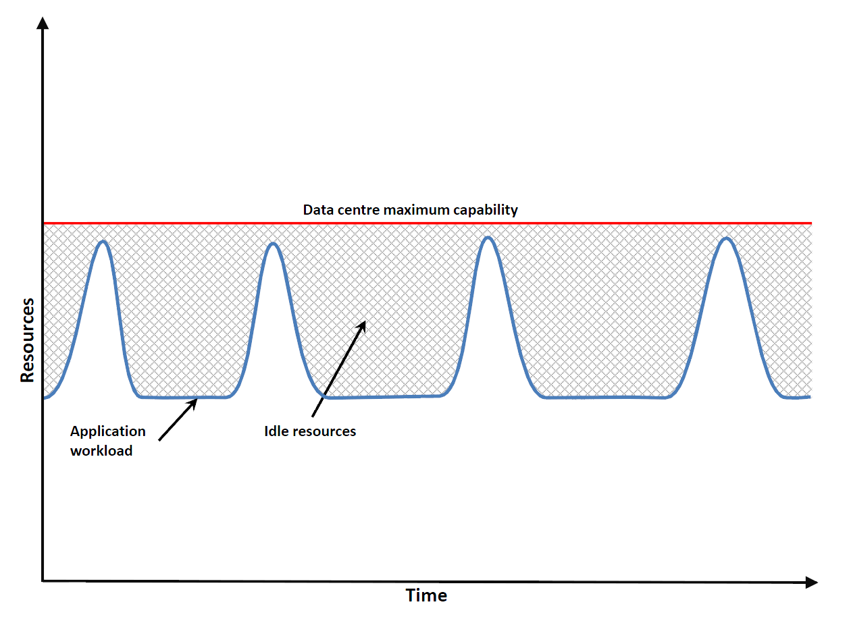
Burst Capability
Diagrams courtesy of Dr Steven Johnston, University of Southampton (http://stevenjohnston.co.uk/)

Slide 10
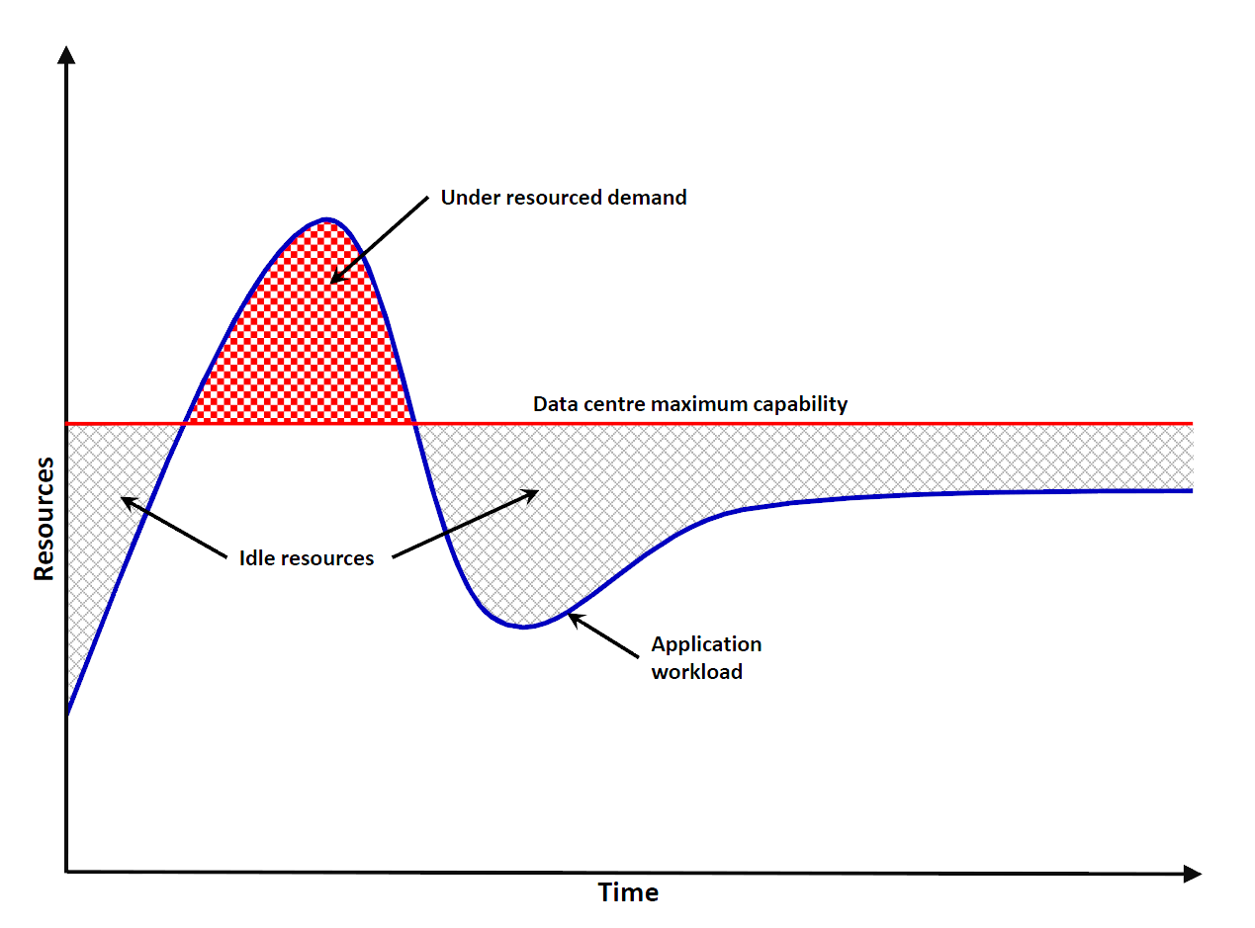
Dynamic Scalability
Diagrams courtesy of Dr Steven Johnston, University of Southampton (http://stevenjohnston.co.uk/)

Slide 11
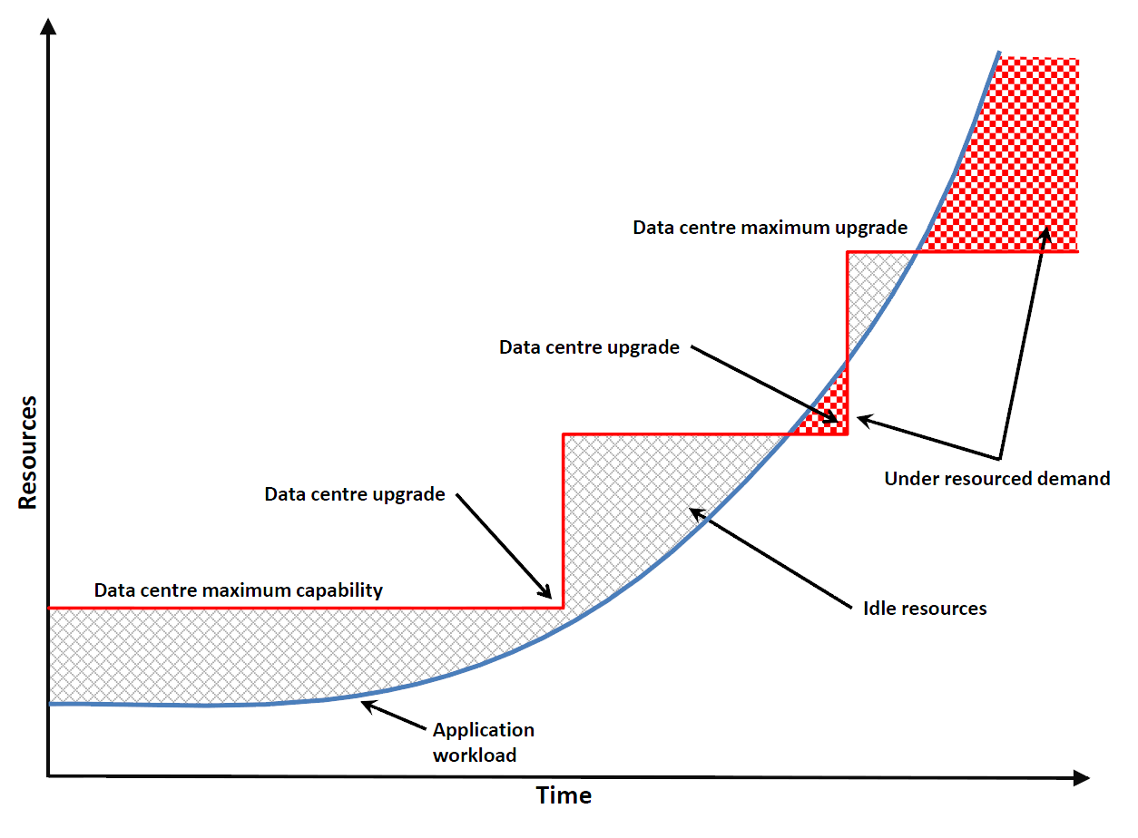
Capacity Matching
Diagrams courtesy of Dr Steven Johnston, University of Southampton (http://stevenjohnston.co.uk/)

Slide 12
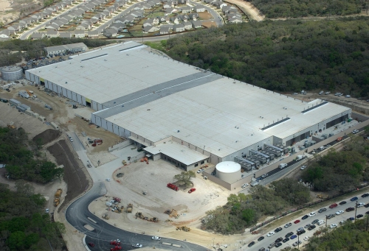
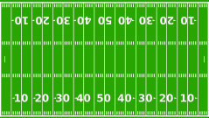
The Cloud is built on massive data centers
Essentially driven by economies of scale
Approximate costs for a small size center (1K servers) and a larger, 100K server center.
Technology | Cost in small-sized Data Center | Cost in Large Data Center | Ratio
Network | $95 per Mbps/ Month | $13 per Mbps/ month | 7.1
Storage | $2.20 per GB/ Month | $0.40 per GB/ month | 5.7
Administration | ~140 servers/ Administrator | >1000 Servers/ Administrator | 7.1
Each data center is
11.5 times
the size of a football field

Slide 13

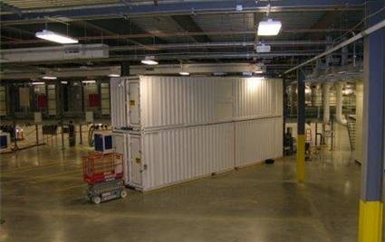
Major Motivations
Environmental responsibility
  - Managing energy efficiently
  - Adaptive systems management
Provisioning 100,000 servers
  - Hardware: at most one week after delivery
  - Software: at most a few hours
Resilience during a blackout/disaster
  - Service rollover for millions of customers
Software and services
  - End-to-end communication
  - Security, reliability, performance, reliability

Slide 14
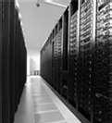
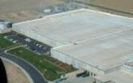
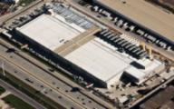
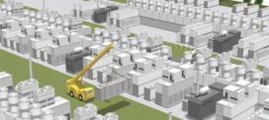


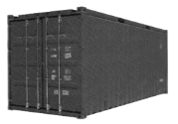
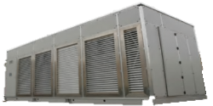
Microsoft’s Data Center Evolution And Economics
  Data Center Co-Location Generation 1
  Quincy and San Antonio Generation 2
  Chicago and Dublin Generation 3
  Modular Data Center Generation 4
  Deployment Scale Unit
Server
Rack
Containers
IT PAC
Capacity
Density & Deployment
Scalability &
Sustainability
Time to Market
Lower TCO

Slide 15

Microsoft’s Data Center Evolution And Economics
  Data Center Co-Location Generation 1
  Quincy and San Antonio Generation 2
  Chicago and Dublin Generation 3
  Modular Data Center Generation 4
  Deployment Scale Unit
Server
Rack
Containers
IT PAC
Capacity
Density & Deployment
Scalability &
Sustainability
Time to Market
Lower TCO
http://youtu.be/nIliMskAHro
http://www.youtube.com/watch?v=nIliMskAHro

Slide 16
DCs vs Grids, Clusters and Supercomputer Apps
Supercomputers
    - High parallel, tightly synchronized MPI simulations
Clusters
    - Gross grain parallelism, single administrative domains
Grids
    - Job parallelism, throughput computing, heterogeneous administrative domains
Cloud
    - Scalable, parallel, resilient web services
HPC Supercomputer
Data Center based Cloud
MPI communication
Map Reduce Data Parallel
Internet

Slide 17
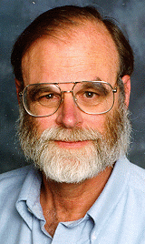
Orders of Magnitude Always Matter
  Tools must empower, not frustrate
These are systemic problems
An insight from Jim Gray …
A computation task has four characteristic demands:
  Networking
  Computation
  Data access
  Data storage
  Delivering questions
  and answers
  Transforming information to produce new information
  Access to information needed by the computation
  Long term storage
  of information
  The ratios among these and their costs are critical

Slide 18
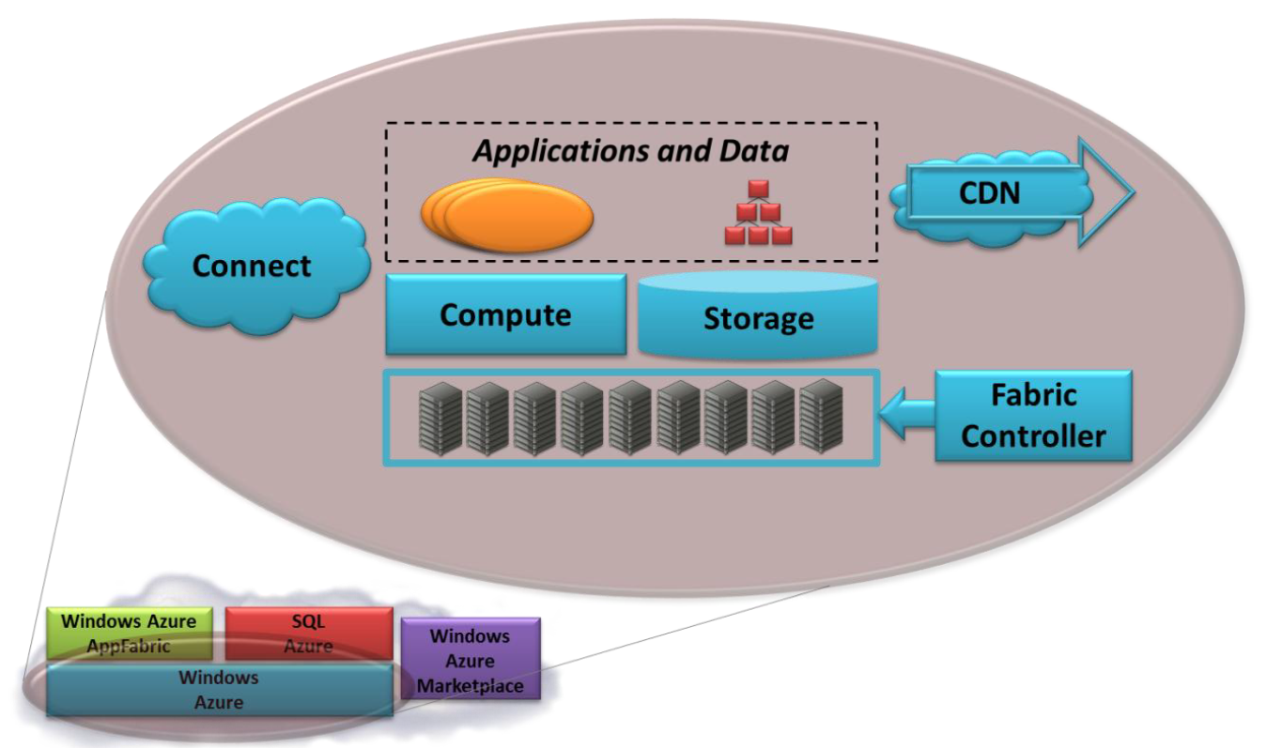
Windows Azure
INTRODUCING THE AZURE SERVICES PLATFORM, David Chapell, Oct 2008
http://www.davidchappell.com/writing/white_papers.php

Slide 19

Architecting for the Cloud
Scale-out
  Compute
  Tables vs. RDB
Guaranteed failure
  Idempotency
Performance
Not cost

Slide 20
Science

Slide 21
Cloud Computing for Science
Cloud computing as an emerging approach to computational science
Distributed Computing in Europe massively supported by EU FPs over the last 10 years (following from earlier massive investment in HPC and parallel computing)
Funding in excess of 1 Billion Euros over the last 10 years
VENUS-C (FP7 Computing Infrastructure 7th call) funded for exploring the complementary/alternative role of industrial cloud computing in the present DCI EU infrastructure

Slide 22
Reaching Out: MSR Azure Research Engagement project
In the U.S.
Memorandum of Understanding with the National Science Foundation (NYT article February 5th, 2010)
13 projects selected through peer-review process
In Asia
Agreement with National Institute of Informatics (NII) in Japan
In Europe
Direct engagement with science leading institutes in the U.K., France and Germany
EC engagement in FP7: VENUS-C

Slide 23
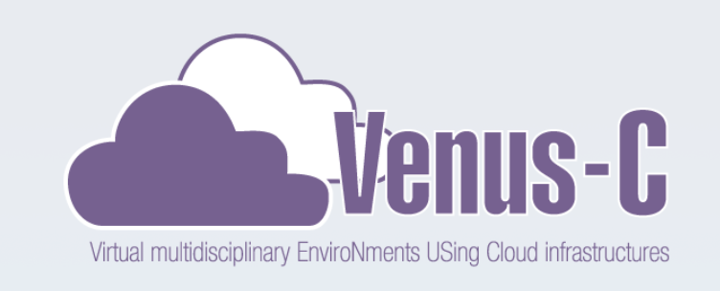
www.venus-c.eu

Slide 24
Virtual multidisciplinary EnviroNments USing Cloud infrastructures
VENUS-C¹ is developing and deploying a Cloud computing service for research and industry communities in Europe by offering an industrial-quality, service-oriented platform based on virtualisation technologies facilitating a range of research fields through easy deployment of end-user services.
VENUS-C aims at supporting user communities with the development and deployment of user-friendly services to support the production of successful cloud applications.
(1) VENUS-C is co-funded by the GÉANT and e-Infrastructures Unit, DG Information Society and Media, European Commission. VENUS-C brings together 14 partners from Europe. Microsoft invests in Azure resources and manpower through Redmond and its European research centres.

Slide 25












VENUS-C Partnership
Software Architecture Development.
EMIC – MICGR - MRL
Cloud Infrastructure
Dissemination, Cooperation, Training.
User Scenarios

Slide 26



Seven Pilot Scenarios
T5.1
Structural Analysis for Civil Engineering
T5.2
Building Information Management
T5.3
Data for Science - AquaMaps
T5.4
Civil Protection and Emergencies
T5.5
Bioinformatics
T5.6
System Biology
T5.7
Drug Discovery
  To adapt legacy bioinformatics tools to VENUS-C for speeding-up this task in Research, providing a seamlessly interface to alignment (BLAST, BWA).
  Stochastic simulations of biological processes, including multiple simulations for statistical analysis and parameter scan for solution space exploration.
  To provide Green Prefab user community with a friendly procedure to create an architectural rendered image using SketchUp components.
  Prediction of fire risk and fire propagation simulation, assisting in wildfire early warning, control and civil protection, dealing with different unpredictable or predictable workload situations that are being faced within a civil protection system
  To predict future distribution of species by extrapolating the known species occurrences and its relation with environmental conditions.
  Realistic 3D static and dynamic analysis of large scale structures for a wide community of professionals (architects, structural and civil engineers, …) from companies and research.

Slide 27

Open Call for New Pilots
Aims: Extend the current scenarios with new pilots leveraging VENUS-C
  - 400K € for around 15 pilots
  - Access to Microsoft’s Azure resources (6 million of CPU hours yearly in total).
  - Access to part of the resources provided by Barcelona Supercomputing Center, Royal Institute of Technology – Sweden and Engineering.
  - Support porting of applications and Training.
60 valid applications received
Selection and kick-off by June 10th

Slide 28
Results of the Open Call
60 Submissions from 18 different scientific areas
  - Main areas are
  ICT, Molecular, Cellular and Genetic Biology and Earth Sciences

Slide 29
Open Call for Projects
17 Different countries
Mainly from Academia and Research Centres but also from some start-ups

Slide 30
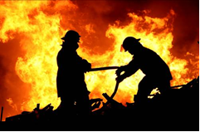
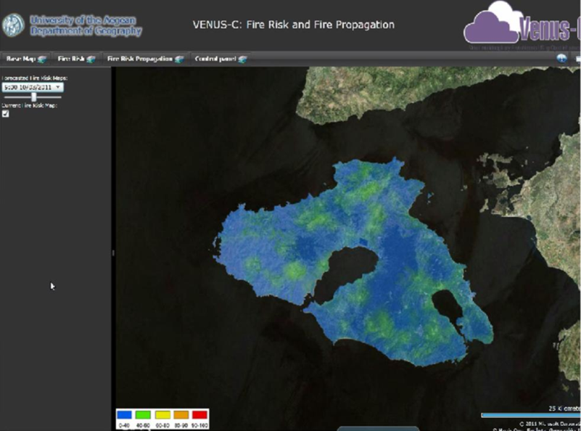

Example – Civil Protection
Interactive computation of fire risk and fire propagation estimation
Access to burst-scalable cloud compute and storage
Web-based GIS based on Bing Maps

Slide 31
Civil Protection on VENUS-C
Three prototypes: fire risk calculation based on weather forecast (daily), fire risk calculation based on current weather (unpredicted) and fire propagation deployment (unpredicted and interactive)
CLI Interface
Job Submission Client
Cloud
Drive
Web Interface
Alignment worker
Cloud
Drive
Program Model Enactment
Alignment worker
Local
Drive
Alignment worker
FireRisk worker
Cloud
Storage
Interface
FirePropagation worker
Cloud
Drive
FirePropagation worker
Local
Drive

Slide 32
Civil Protection on VENUS-C
App-specific Processing Engine
Three prototypes: fire risk calculation based on weather forecast (daily), fire risk calculation based on current weather (unpredicted) and fire propagation deployment (unpredicted and interactive)
CLI Interface
VENUS-C specific porting
Job Submission Client
Cloud
Drive
Web Interface
Alignment worker
Cloud
Drive
Program Model Enactment
Alignment worker
Local
Drive
Alignment worker
VENUS-C Standard component
FireRisk worker
Cloud
Storage
Interface
FirePropagation worker
Cloud
Drive
External Standard Dependency
FirePropagation worker
Local
Drive

Slide 33
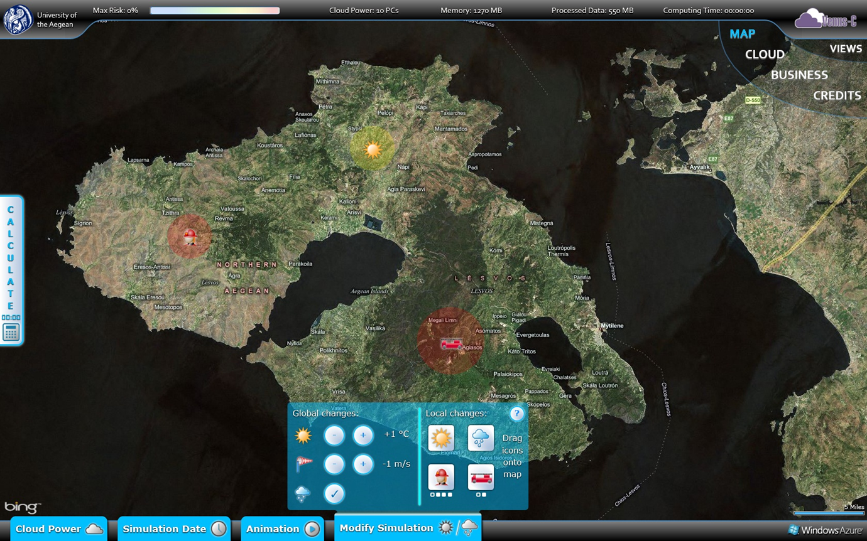
Civil Protection

Slide 34
Cloud Computing for Research
“VENUS-C will ease some of the difficulty of earthquake impact assessment by offering a prime opportunity to access unprecedented resources only when and where necessary without worrying about maintaining the infrastructure and operational tools”
  Costas Papadachos from the Geophysics Lab at Aristotle University in Greece.
“VENUS-C will enable us to do in a few weeks molecular computations that would have taken a year to complete on our own servers. Computer resources can be scaled as required without committing to large capital purchases, which is critical to the success of our small business”
  Vladimir Sykora, Molplex

Slide 35
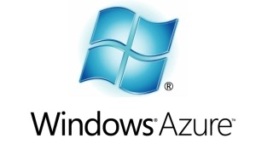
Fighting Cancer with Cloud Computing
University of Helsinki researchers
  Searching 25,000 genes
15 years to process normally
How long did it take on 1200 Azure processor cores?
  5 months
    5 weeks
      5 days
Sampsa Hautaniemi,
University of Helsinki

Slide 36
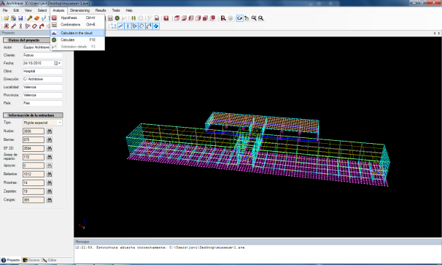
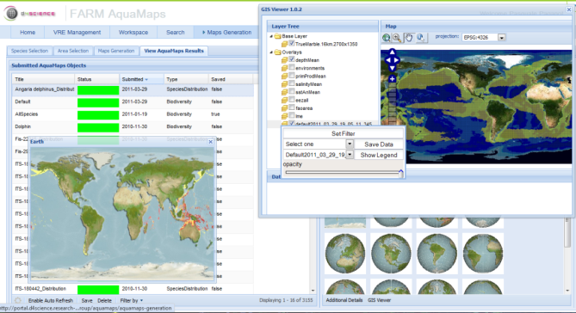
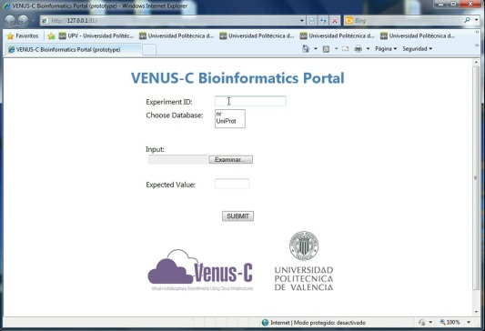
Cloud Computing: Adaptable & Scalable
Sustainable buildings
Trending analysis
Earthquake analysis
Intensive care
Brain image analysis
Maritime monitoring
Cosmology
Bioinformatics

Slide 37
Conclusions
Cloud computing provides many opportunities as a new model for software and services
Cloud computing is a powerful enabler for computational science by removing traditional obstacles and lowering the access cost to massive computing and data processing
Easy to use for non-CS scientists, affordable also for remote institutes in less developed countries
Huge opportunities are emerging – it can be a game changer
Great for startups!
Windows Azure @ http://www.microsoft.com/windowsazure/
Microsoft free software @ https://www.dreamspark.com/
Project Hawaii @ http://research.microsoft.com/en-us/um/redmond/projects/hawaii/
kenjitak@microsoft.com

Slide 38
Thank you
kenjitak@microsoft.com

Slide 39

Notes:
© 2010 Microsoft Corporation. All rights reserved. Microsoft, Windows, Windows Vista and other product names are or may be registered trademarks and/or trademarks in the U.S. and/or other countries.
The information herein is for informational purposes only and represents the current view of Microsoft Corporation as of the date of this presentation. Because Microsoft must respond to changing market conditions, it should not be interpreted to be a commitment on the part of Microsoft, and Microsoft cannot guarantee the accuracy of any information provided after the date of this presentation.
MICROSOFT MAKES NO WARRANTIES, EXPRESS, IMPLIED OR STATUTORY, AS TO THE INFORMATION IN THIS PRESENTATION.

Slide 40

© 2011 Microsoft Corporation. All rights reserved. Microsoft, Windows, Windows Vista and other product names are or may be registered trademarks and/or trademarks in the U.S. and/or other countries.
The information herein is for informational purposes only and represents the current view of Microsoft Corporation as of the date of this presentation. Because Microsoft must respond to changing market conditions, it should not be interpreted to be a commitment on the part of Microsoft, and Microsoft cannot guarantee the accuracy of any information provided after the date of this presentation.
MICROSOFT MAKES NO WARRANTIES, EXPRESS, IMPLIED OR STATUTORY, AS TO THE INFORMATION IN THIS PRESENTATION.
Notes:
© 2010 Microsoft Corporation. All rights reserved. Microsoft, Windows, Windows Vista and other product names are or may be registered trademarks and/or trademarks in the U.S. and/or other countries.
The information herein is for informational purposes only and represents the current view of Microsoft Corporation as of the date of this presentation. Because Microsoft must respond to changing market conditions, it should not be interpreted to be a commitment on the part of Microsoft, and Microsoft cannot guarantee the accuracy of any information provided after the date of this presentation.
MICROSOFT MAKES NO WARRANTIES, EXPRESS, IMPLIED OR STATUTORY, AS TO THE INFORMATION IN THIS PRESENTATION.

