Slide 1
Activity Recognition from
Trajectory Data
Yin Zhu, Vincent Zheng and Qiang Yang
HKUST
November 2011

Slide 2
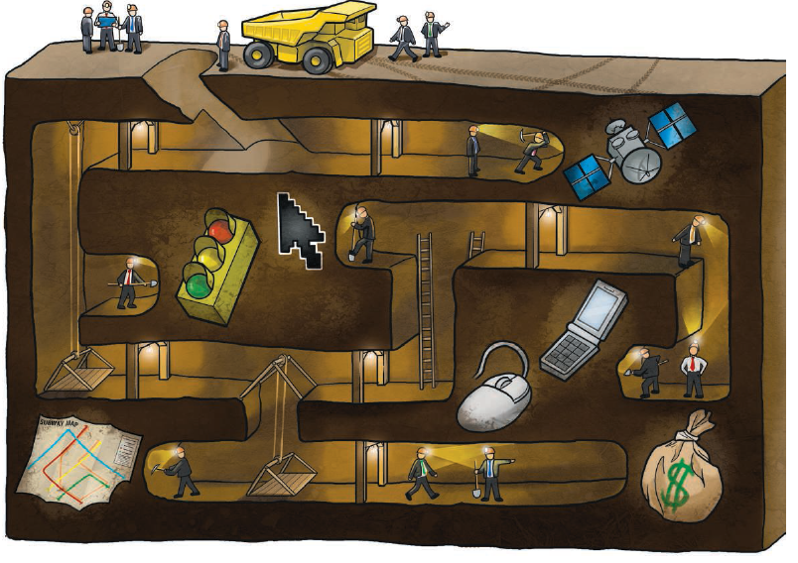
Activity recognition from trajectory data
Activity recognition (AR)
Trajectory data
    Location
    Sensor data
    Online/social data

Slide 3
Outline
Getting trajectories from location estimation
Single user activity recognition
Multiple user activity recognition
Summary and looking forward

Slide 4
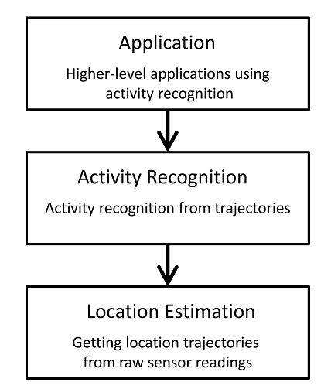
A workflow for trajectory-based AR

Slide 5



Getting trajectories/location estimation
Outdoor: GPS and WiFi [ , ]
Fine-grained Indoor : RFID [LANDMARC] and WiFi [RADAR]
Research problem with WiFi/RFID localization:
Calibrating a localization model$f:signal vector→location$

Slide 6
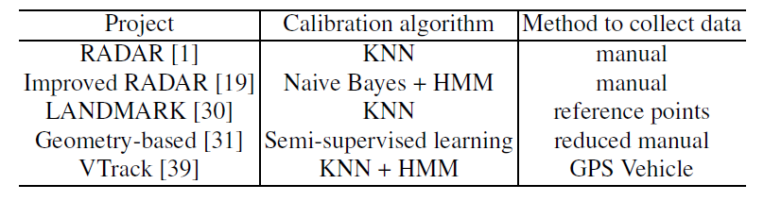
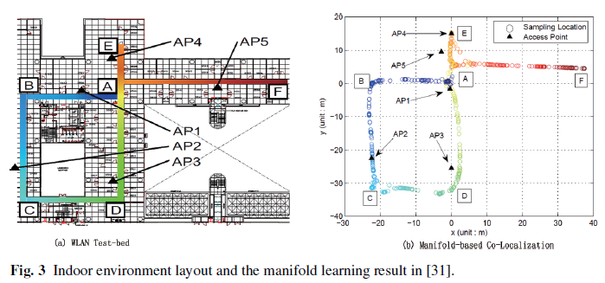
Learning-based methods for localization
Selected work on calibrating a localization model:

Slide 7
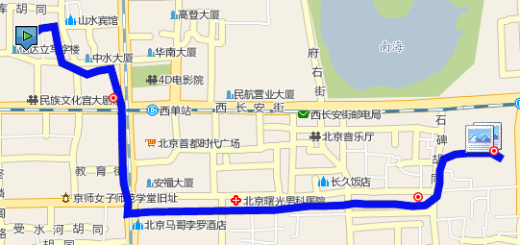
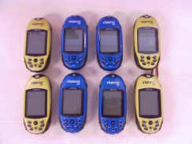
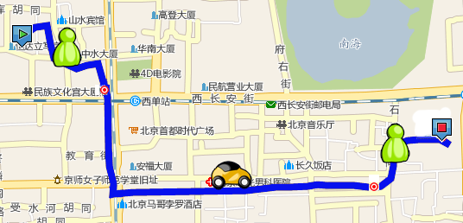
Trajectory-based activity recognition:
Geolife project as an example
Goal & Results: Inferring transportation modes from raw GPS data
    Differentiate driving, riding a bike, taking a bus and walking
    Achieve a 0.75 inference accuracy (independent of other sensor data)
GPS log
Infer model

Slide 8
Problem definition
Problem: trajectory-based Activity Recognition (AR)
Input: sensor trajectories
    Location trajectories
      GPS or raw WiFi signals
    Accelerometer signal trajectory/sequence
    Twitter message streams
Output:
    Activity labels/ Goals/ Activity patterns, e.g. transportations
Challenges:
    Heterogeneous sensor streams
    Sensing noise
    User difference
    Large scale
    Data sparsity

Slide 9
A categorization for trajectory-based AR
 | Supervised | Unsupervised | Frequent pattern
Single | Classifier with smoothing Dynamic Bayesian Networks Conditional random fields | Principle Component Analysis Latent Diricchlet allcation | Frequent locations and patterns
Multiple | Transfer learning Coupled HMM Factorial CRF Latent Aspect Model | ? | ?
Single user vs. multiple users: Differ on whether the trajectory data are collected by multiple users and the user difference is modeled.

Slide 10
Classifier with smoothing: Transportation mode [Zheng, UbiComp’08]
Illustration for Heading change rate
Domain-specific feature design for
classifiers, e.g. decision trees
Significant features
Distance of a segment
The ith maximal velocity of a segment
The ith maximal acceleration of a segment
Average velocity of a segment
Expectation of velocity of GPS points in a segment
Variance of velocity of GPS points in a segment
Heading Change Rate
Stop Rate
Velocity Change Rate
Illustration for velocity change rate

Slide 11
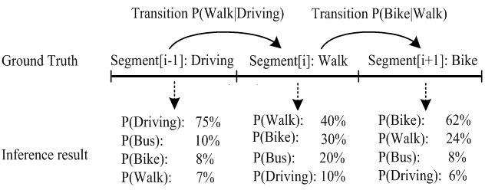
Smoothing, HMM inference algorithm
Segment[i].P(Bike) = Segment[i].P(Bike) $×$ P(Bike|Car)
Segment[i].P(Walk) = Segment[i].P(Walk) $×$ P(Walk|Car)

Slide 12
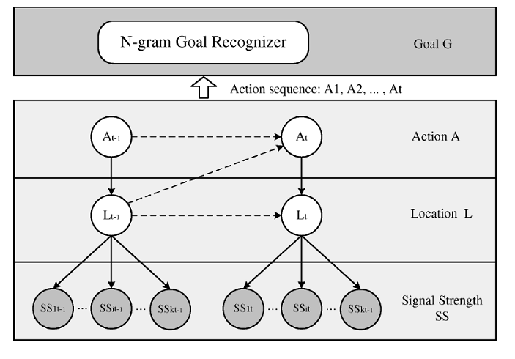
Dynamic Bayesian Networks (DBN): Goal recognition [Yin, AAAI’04&05]

Slide 13
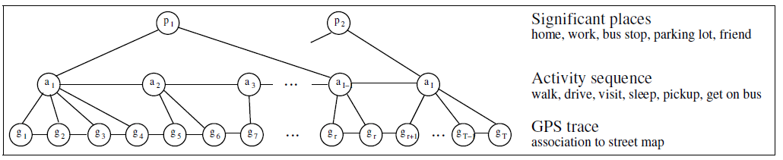
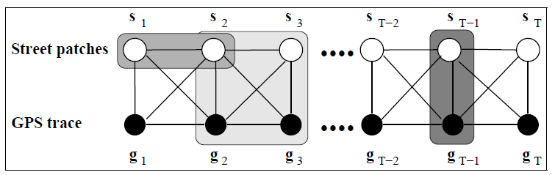
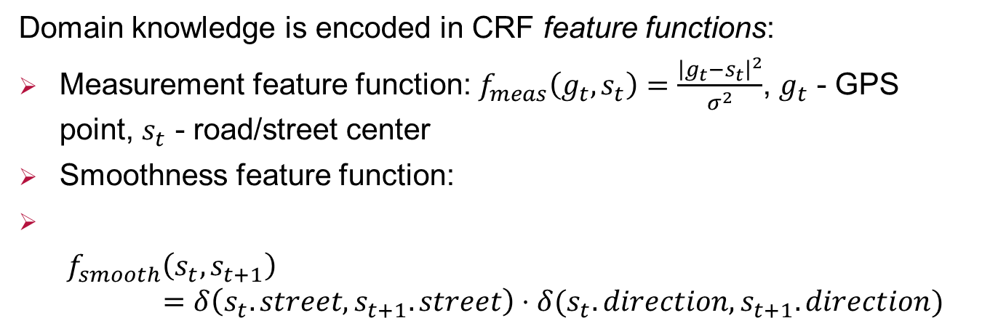
Conditional Random Fields (CRF): map matching & outdoor activities [Liao, I. J. Robotics. 2007]
Domain knowledge is encoded in CRF feature functions:
Measurement feature function: $f_{meas}\left(g_{t},s_{t}\right)=\frac{{\left|g_{t}−s_{t}\right|}^{2}}{σ^{2}}$, $g_{t}$ - GPS point, $s_{t}$ - road/street center
Smoothness feature function:
$$f_{smooth}\left(s_{t}, s_{t+1}\right)=δ\left(s_{t}.street,s_{t+1}.street\right)⋅δ(s_{t}.direction,s_{t+1}.direction)$$

Slide 14
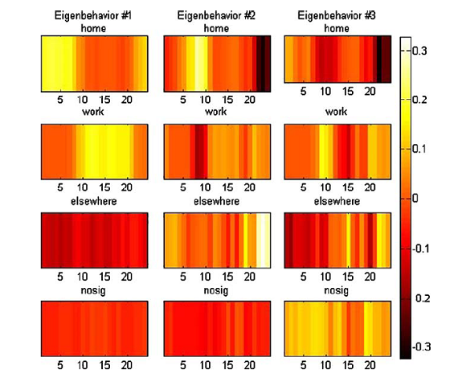
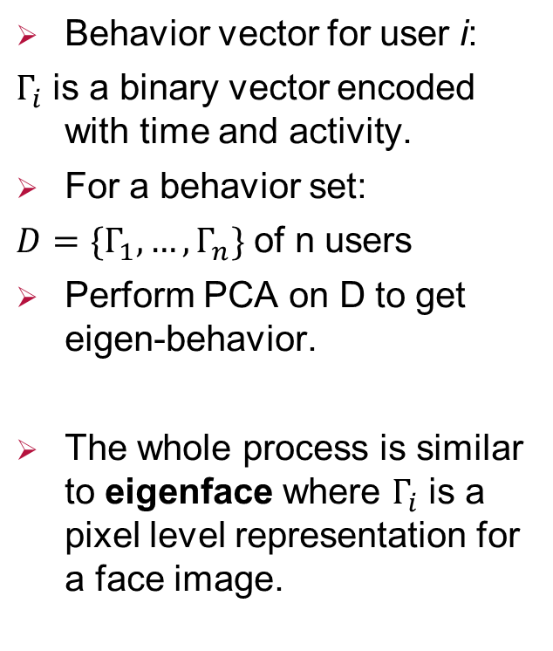
Principle Component Analysis (PCA): Eigen-behavior, [Eagle, MIT RealityMining]
Behavior vector for user i:
$Γ_{i}$ is a binary vector encoded with time and activity.
For a behavior set:
$D=\{Γ_{1},…,Γ_{n}\}$ of n users
Perform PCA on D to get eigen-behavior.
The whole process is similar to eigenface where $Γ_{i}$ is a pixel level representation for a face image.

Slide 15
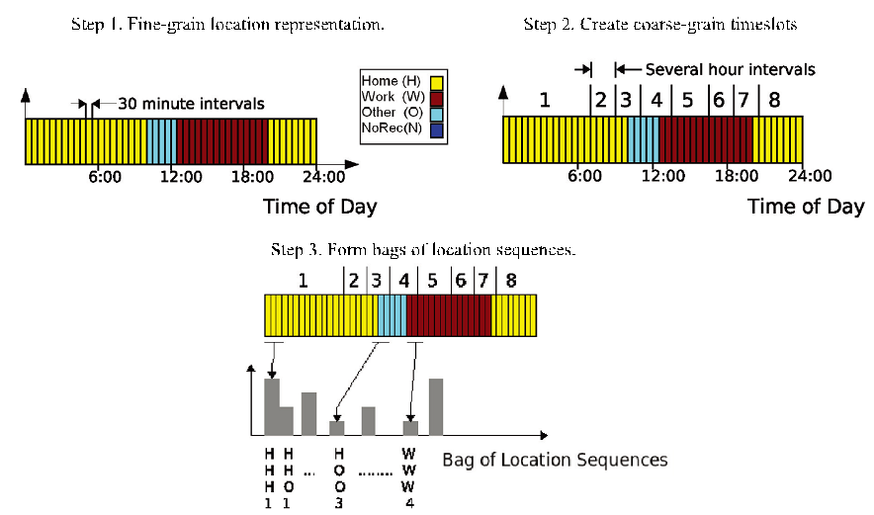
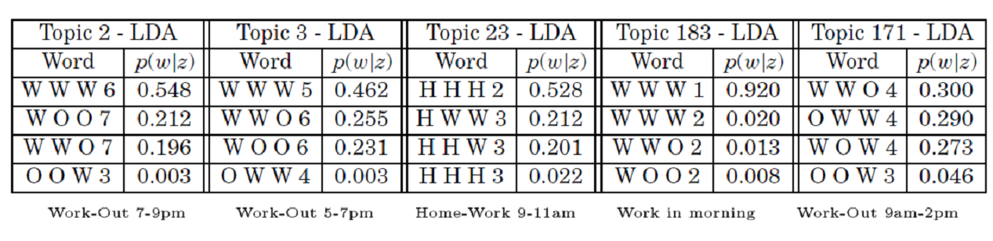
Latent Dirichlet Allocation (LDA): topic modeling over activities [Farrahi, UbiComp’08]
Main trick:
Encode sequential information into “activity words”
Each day forms a “document”
Use LDA to extract activity topics.

Slide 16

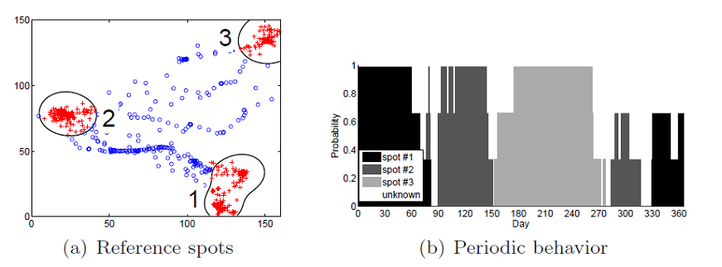
Frequent pattern mining: periodic activity pattern of an eagle [Li, ACM-TIST’10]
Reference spot density:
Patterns:
For each day, calculate the distribution over different references spots.
Quebec
Great Lakes
NY

Slide 17
Summary and outlook in single-user AR
Abundant research work in this area.
Looking for mature and software/device used in real world.

Slide 18
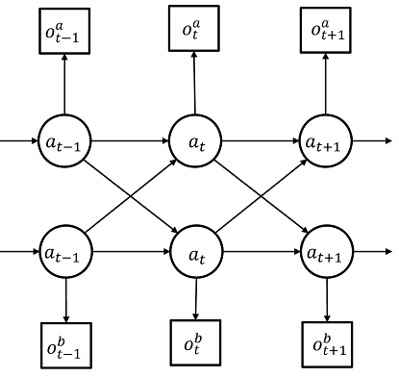
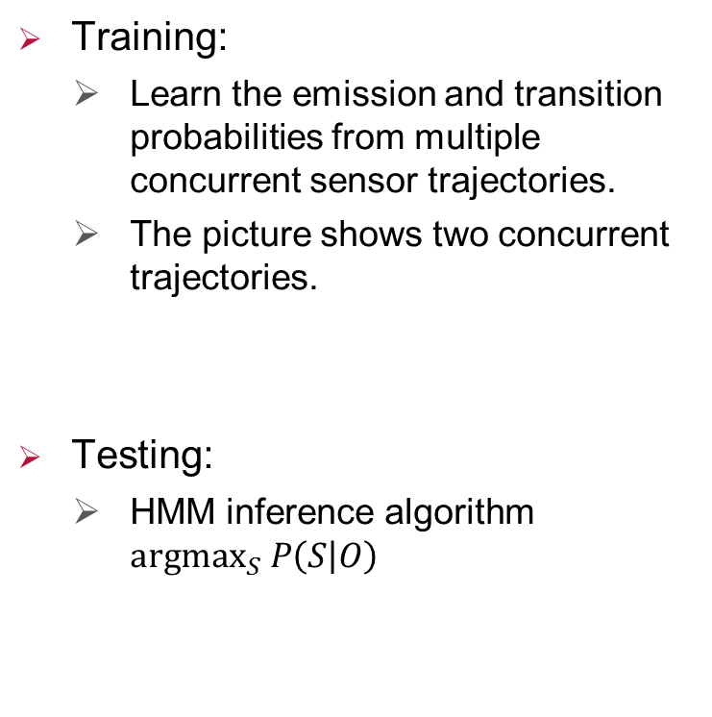
Coupled HMM for concurrent AR [Wang, Perva. Comp. 2010]
Training:
    Learn the emission and transition probabilities from multiple concurrent sensor trajectories.
    The picture shows two concurrent trajectories.
Testing:
    HMM inference algorithm $argmax_{S} P\left(S | O\right)$
Two HMMs
Coupled via ➔
states chain

Slide 19
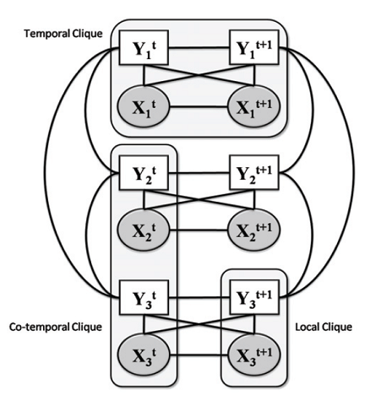
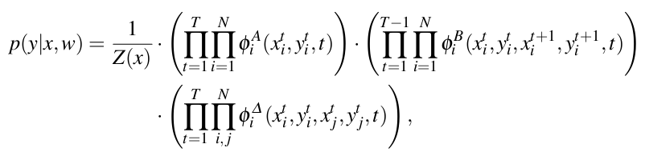
Factorial CRF [Lian, IJCAI’09]
The Model: similar to Coupled HMM, the undirected graph version.
Three kinds of potential functions:

Slide 20
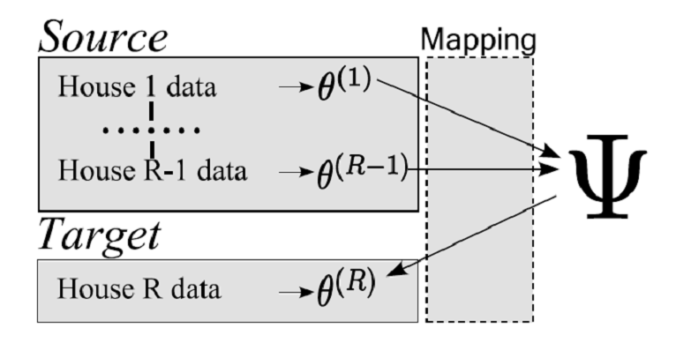

Transfer learning for AR in smart home [Kasteren, Pervasive’10]
The AR model for house $i$is an HMM $θ^{(i)}=\left\{π_{i},A_{i},B_{i}\right\}.$
All the houses share the same hyper-parameter/prior $Ψ$ over $θ^{(i)}:$
    $Dir\left(π | η\right)=\frac{Γ(Σ_{k=1}^{K}η_{k})}{Γ\left(η_{1}\right)…Γ\left(η_{K}\right)}\prod_{k=1}^{K}{π_{k}^{η_{k}−1}}$

Slide 21

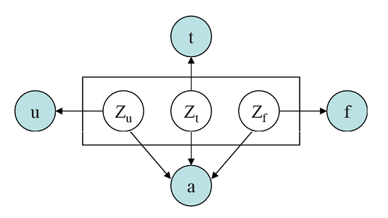


Latent Aspect Model, [Zheng, IJCAI’11]
Introduce user aspect variables to capture user grouping information.
Data tuples: ${\left\{a_{i}, u_{i}, t_{i}, f_{i}\right\}}_{i=1}^{L}$ , user $u_{i}$ performs activity $a_{i}$ at time $t_{i}$ and her WiFi device receives access points $f_{i}$.
The basic block for ML estimation:

Slide 22
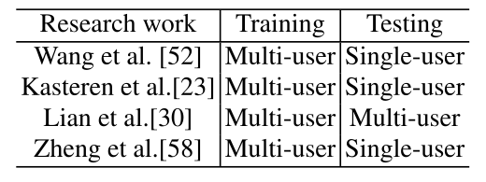
Summary and outlook in multi-user AR
User | Supervised | Unsupervised | Association rule
Multiple | Transfer learning Coupled HMM Factorial CRF Latent Aspect Model | ? | ?
Future work:
Fill ? in unsupervised and association rule.
Joint inference for activities.

Slide 23
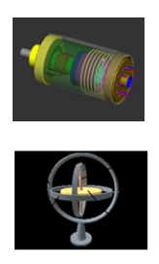


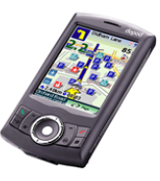


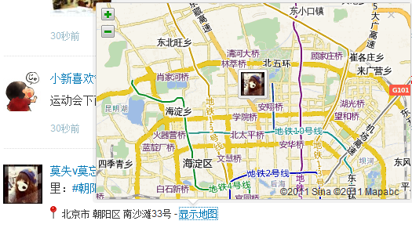
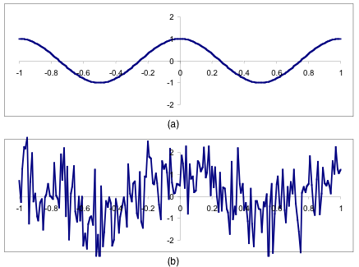
Emerging application area: AR in social networks
From physical sensors to virtual sensors

Slide 24
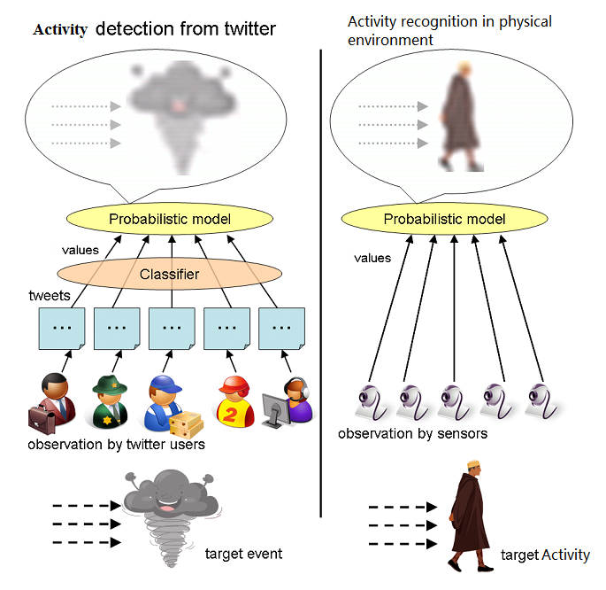
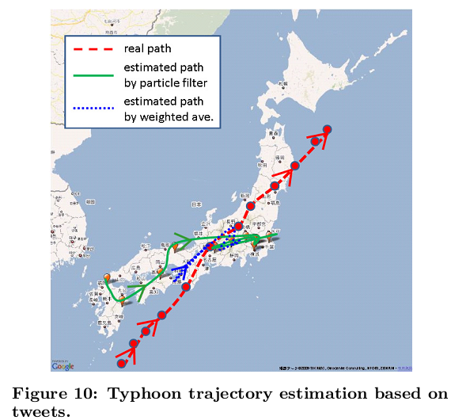
Environmental AR: Earthquakes shake Twitter users [Sakaki, WWW’10]

Slide 25
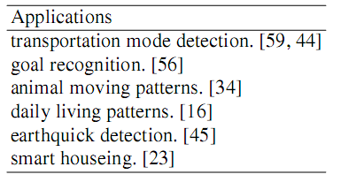
Activity summarization

Slide 26
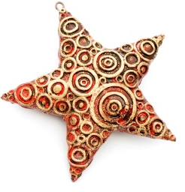
Conclusion and outlook
Mature in research: single-user AR
Research:
    multi-user AR, especially unsupervised methods
    AR in social networks: more paradigms, more applications
Physical AR
from ubiquitous
devices, e.g. smartphones
Social AR
from social
information
streams

