Slide 1
Microsoft Academic Search
Search | Explore | Discover
Alex D. Wade
Director - Scholarly Communication

Slide 2
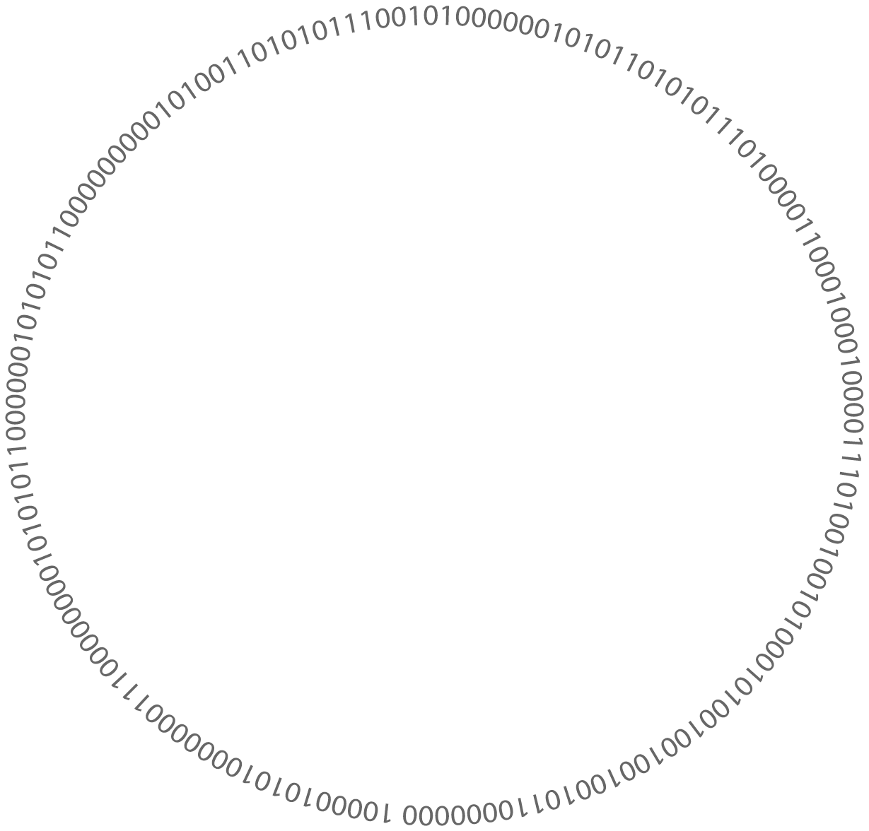
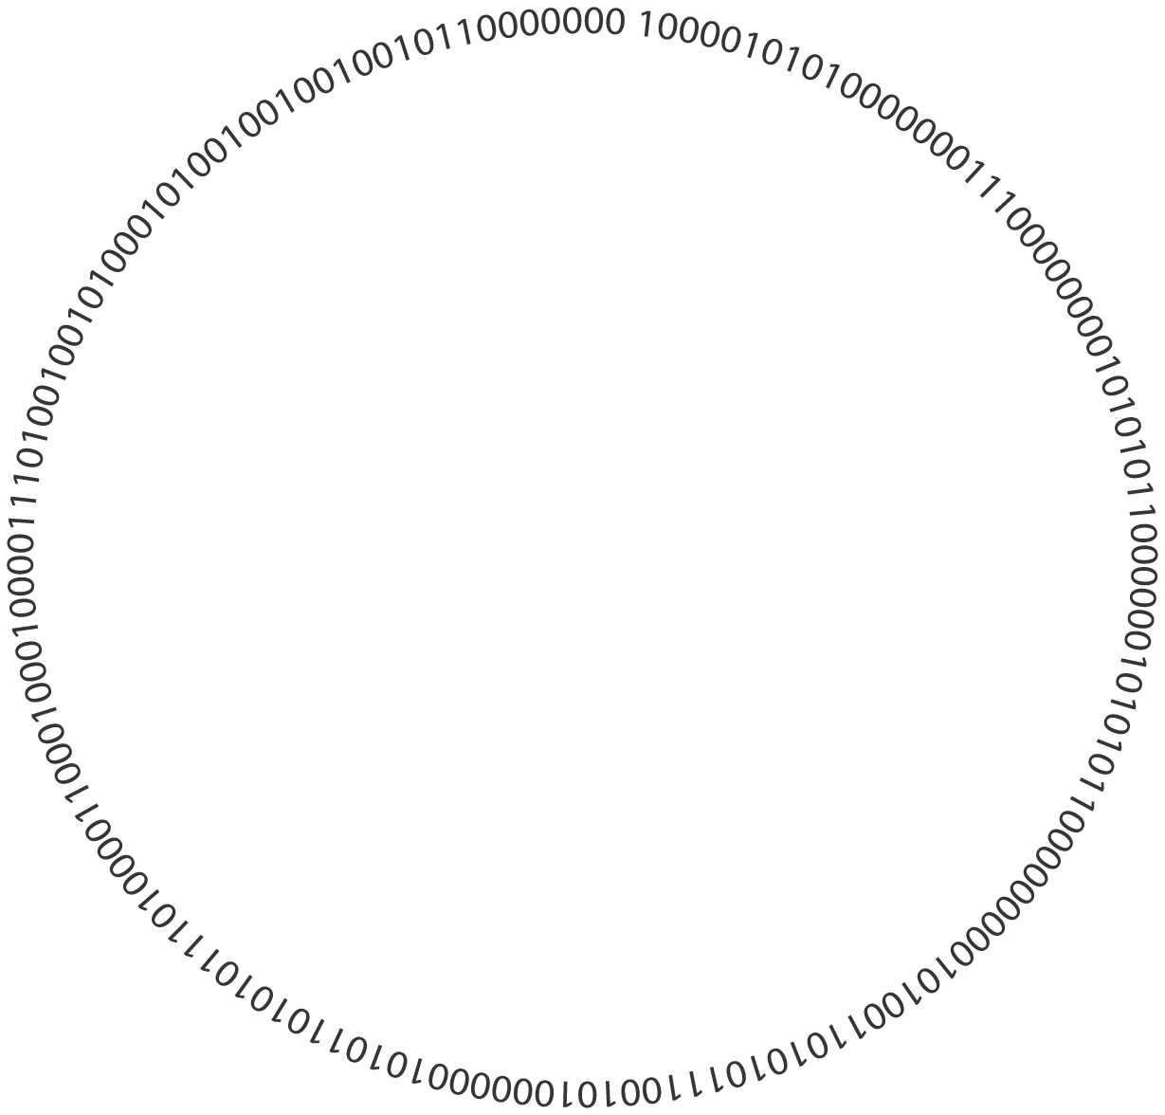

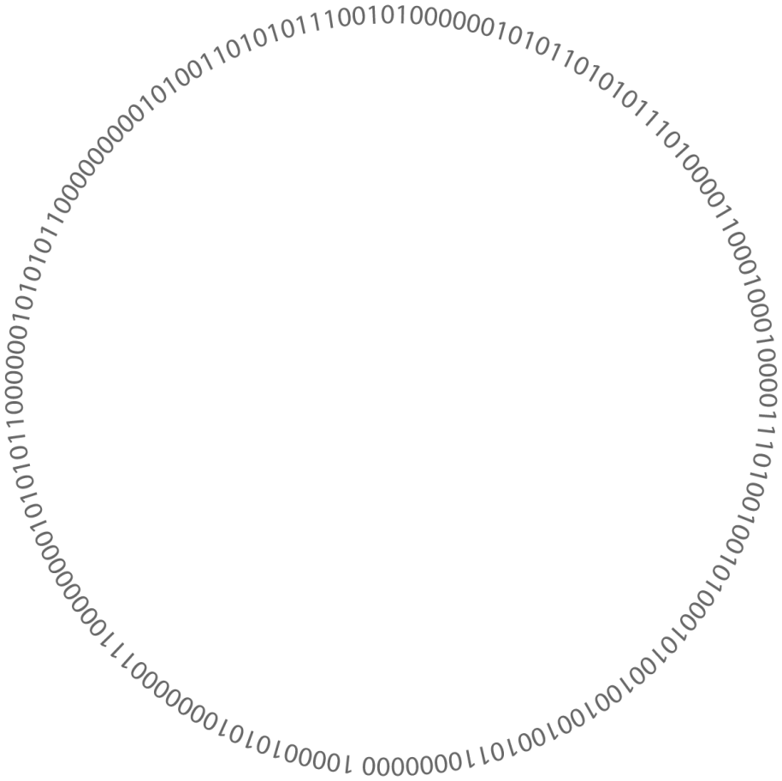
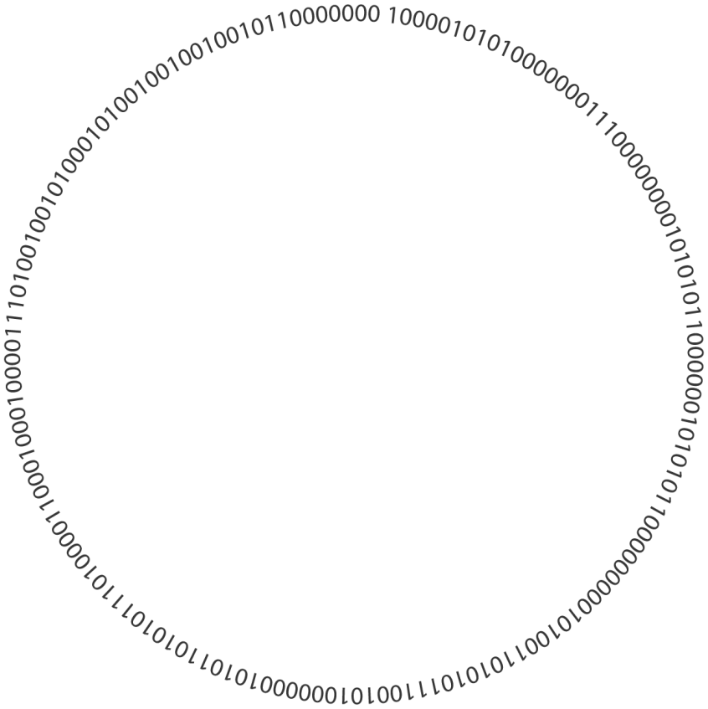











Israel Labs
Computer
Systems & Devices
India Labs
Rich Media Labs
Computational
Linguistics
Security &
Privacy
Live Labs
Product
Groups
Mobile Labs
Computational
Sciences
Human-Computer
Interaction
Product
Groups
Microsoft
Labs
Microsoft
Research
Startup Business
Accelerator
Startup Labs
Machine
Learning
Hardware
& Devices
Search Labs
E&D Labs
Information Retrieval
& Management
Graphics &
Multimedia
Office Labs
Communication
& Collaboration
Present
2-4 years
5-10 years +

Slide 3


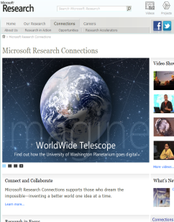
Microsoft Research Connections
Advance the
State of the Art
Work with the worldwide academic research community to speed research, improve education, and foster innovation.
Inspire Researchers & Scientists
Accelerate Discovery and Exploration

Slide 4







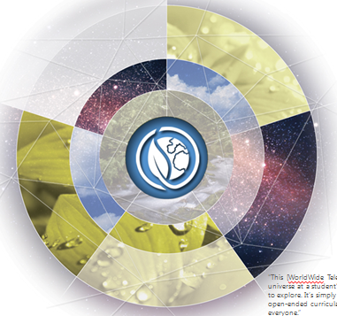
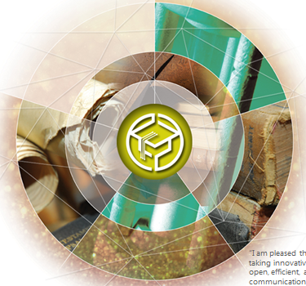

Engagement and Collaboration Focus
Core Computer
Science
Natural User
Interface
Earth,
Energy &
Environment
Education & Scholarly
Communication
Health &
Wellbeing

Slide 5

Research Accelerators
Publishing
Scientific
Computing
Research Management
Discovery and Exploration
http://research.microsoft.com/accelerators

Slide 6
How many of you use…
Discovery tools
  IEEE Xplore or ACM Digital Library
  DBLP
  Google Scholar
  Scopus or ScienceDirect
  Web of Knowledge
Paper/citation management tools
  Endnote
  Mendeley
  ReadCube
  Zotero
  Other?

Slide 7

Explore over 38 million publications
http://academic.research.microsoft.com

Slide 8

Citation Semantics
Paper B cites Paper A
Paper F
Paper B
Paper D
Paper A
Paper C
Paper E
Time

Slide 9






Derived Semantics
Organization
hasAffiliation
Person
Journal
Domain
isAuthorOf
isPartOf
Paper
isPartOf
Conference

Slide 10
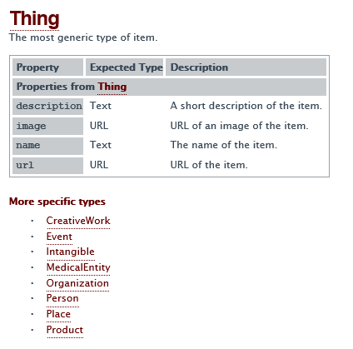
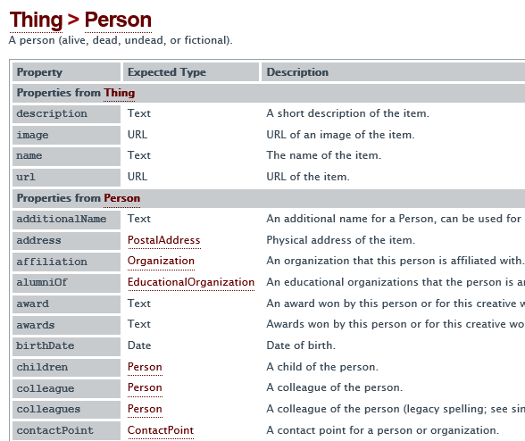
Schema.org

Slide 11
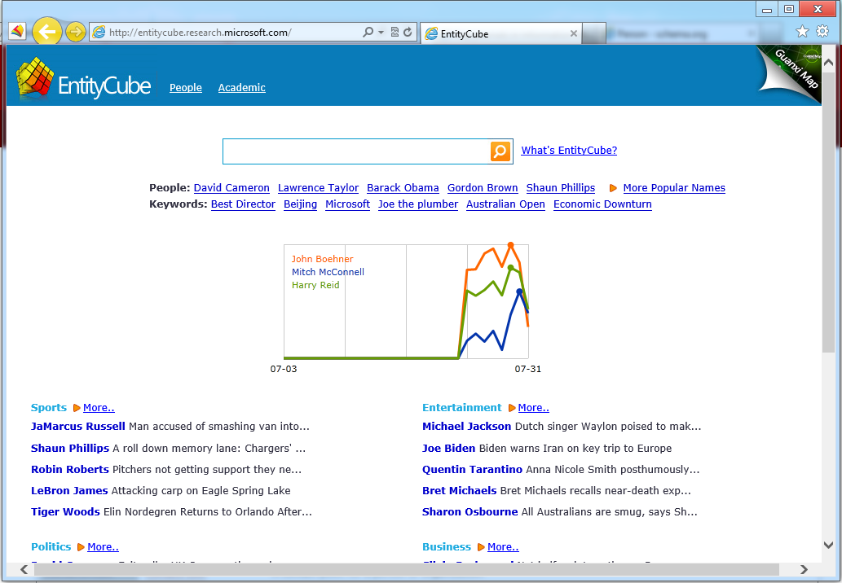
http://entitycube.research.microsoft.com

Slide 12
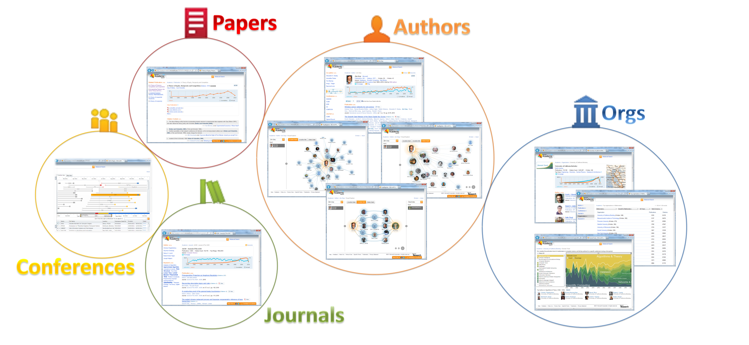
MSR Academic Search data comes from open access repositories, publishers, and web crawls
  Currently 38M papers across 14 domains
    100M papers in the queue
  More improvements to come…

Slide 13
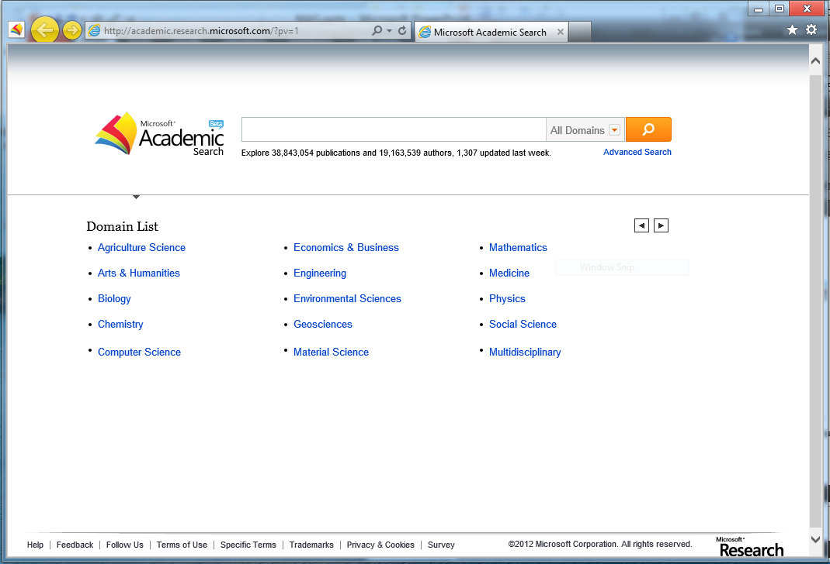
search

Slide 14
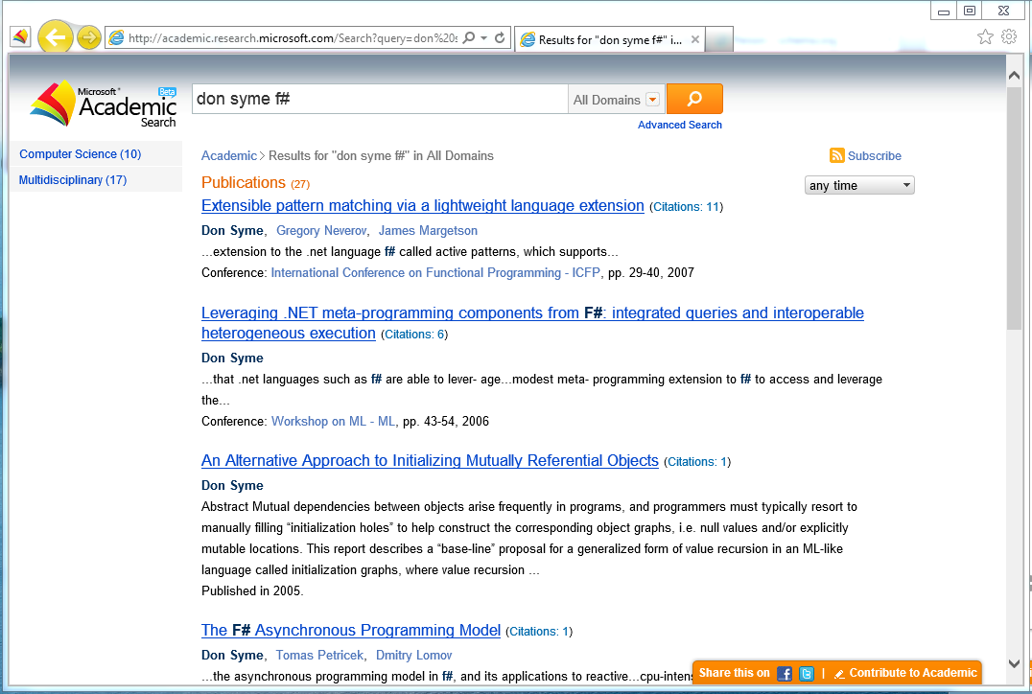

Slide 15
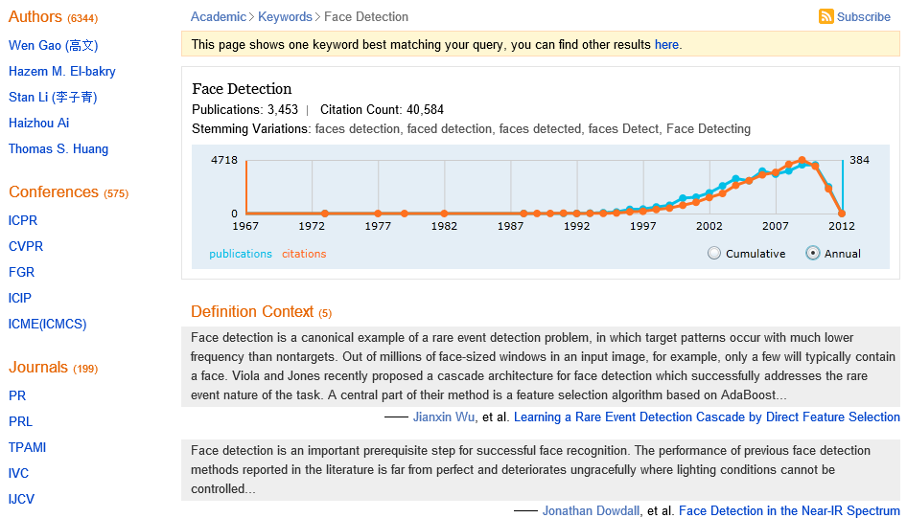
keyword
Alerts
Top …
Top …
Usage History
Definitions
Notes:
Examples
Latent Semantic Analysis
Granulocyte Colony Stimulating Factor
Trending
Definitions
Related entities
Authors
Conferences
Journals
Keywords

Slide 16
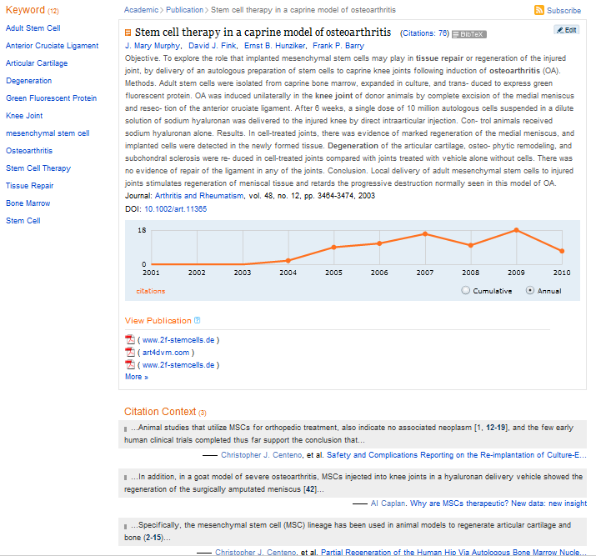
Papers
Alerts
Edit
Export
publication
Links to fulltext
Citation History
and Context
Citation History
and Context
References & Citing Papers
Notes:
Actions:
View | Subscribe | Edit
Twitter | Facebook
Pivot your search
Extracted keyword / phrases
Authors
Journal
References
Citations & Citation Context

Slide 17
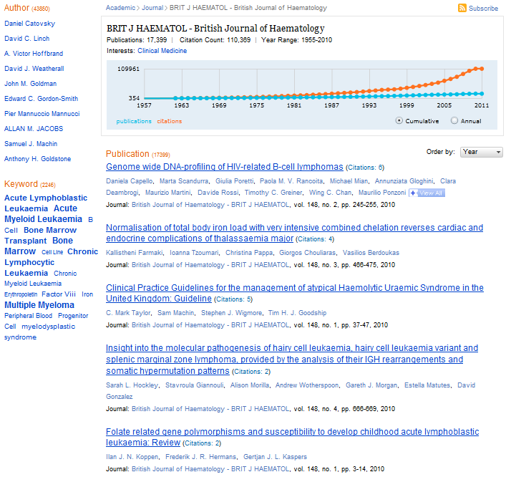
Top …
Top …
Sort
journal
Notes:
Who are they?
What have they published?
Where have they published?
Who are their co-authors?
Who has cited their works?

Slide 18
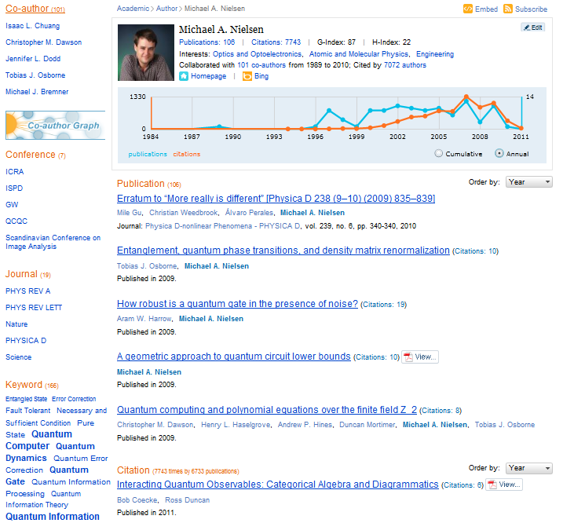
Embed
Author network
author
Citing Papers
Notes:
Who are they?
What have they published?
Where have they published?
Who are their co-authors?
Who has cited their works?

Slide 19
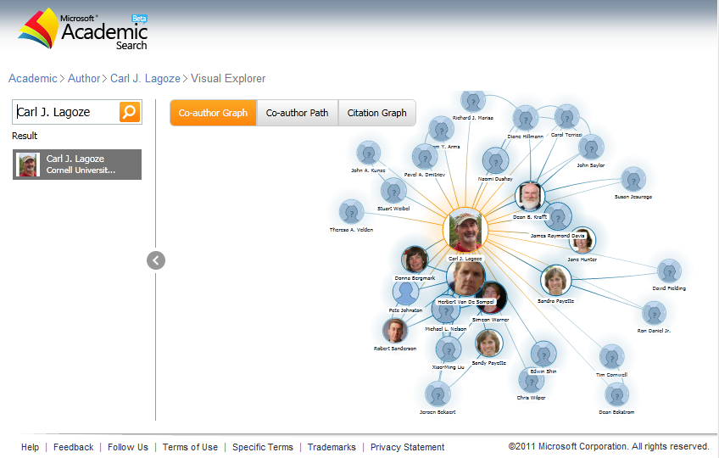

Slide 20
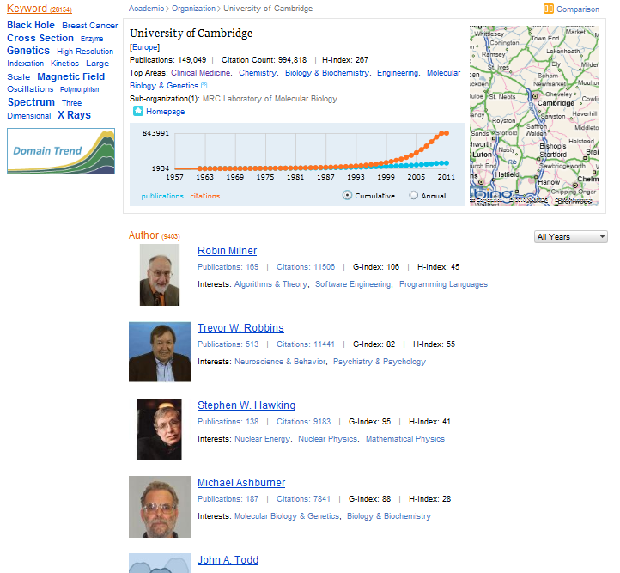
Compare
Domain Trends
organization
Notes:
Who are they?
What have they published?
Where have they published?
Who are their co-authors?
Who has cited their works?

Slide 21
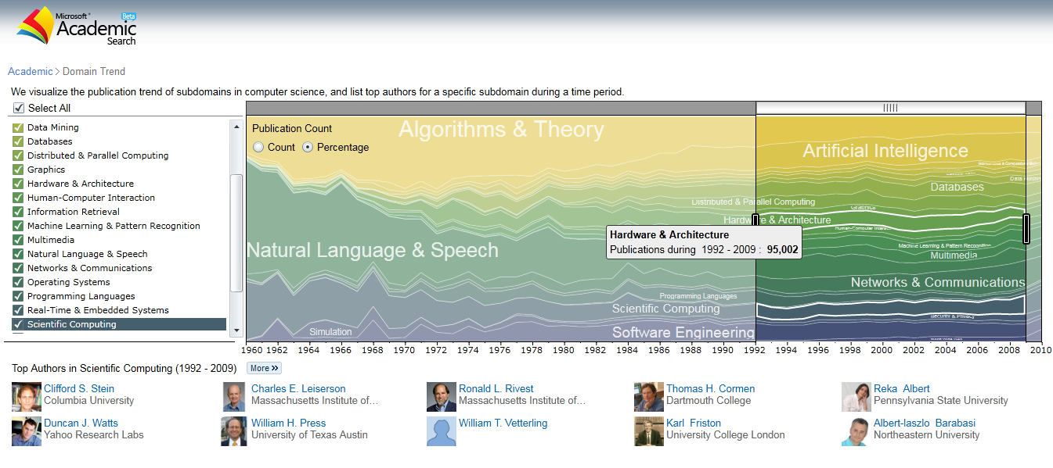

Slide 22
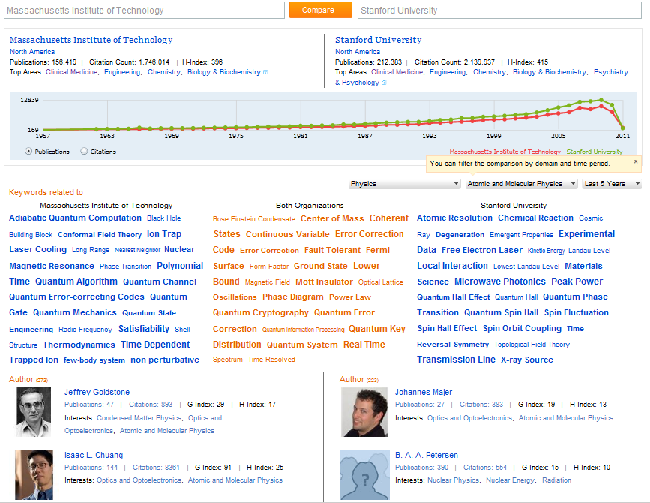

Slide 23
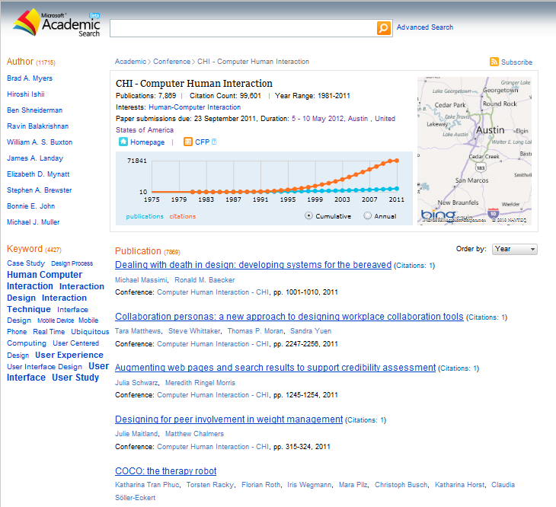
Call for Papers
conferences
Notes:
Who are they?
What have they published?
Where have they published?
Who are their co-authors?
Who has cited their works?

Slide 24
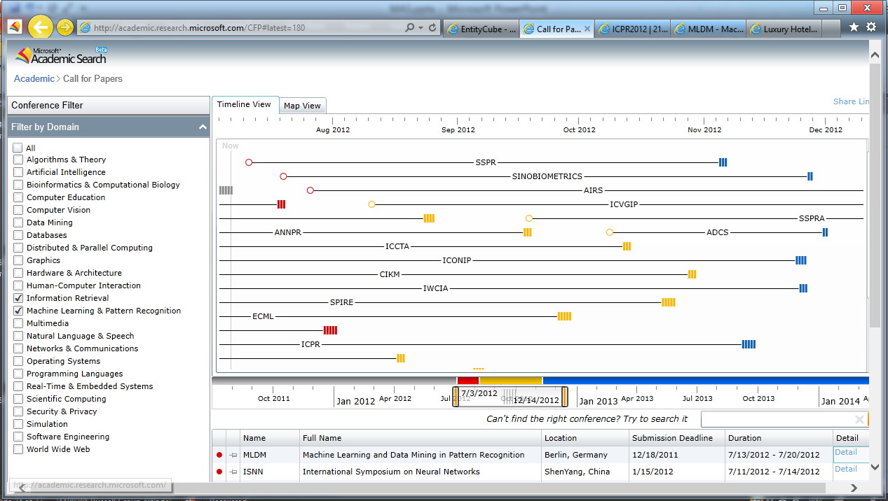
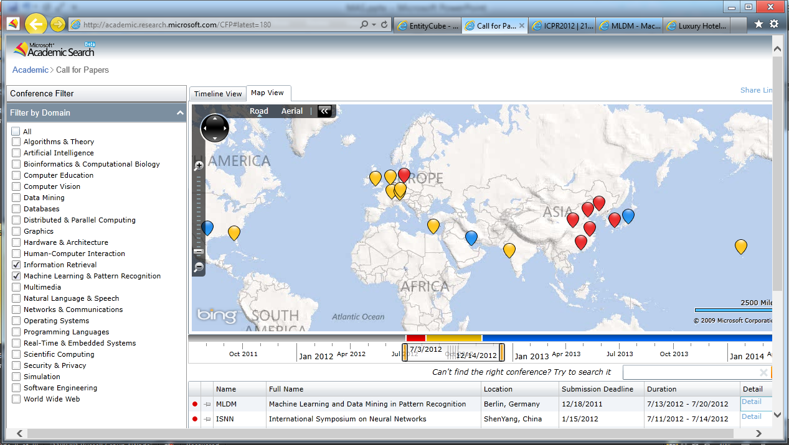
Conference Call for Papers

Slide 25
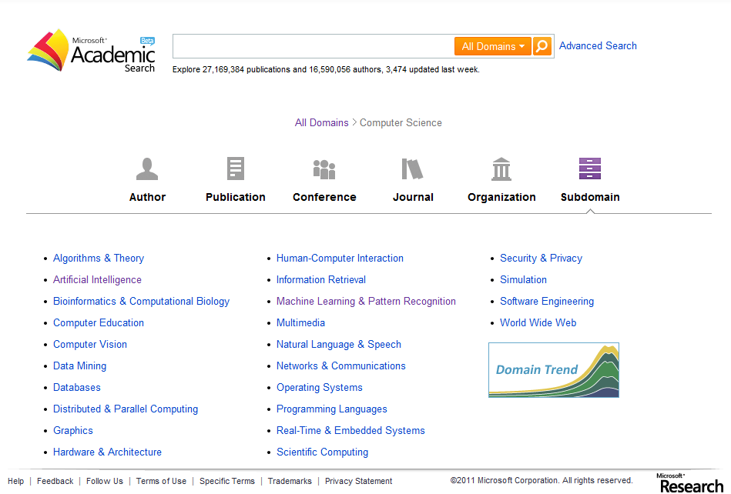
explore

Slide 26
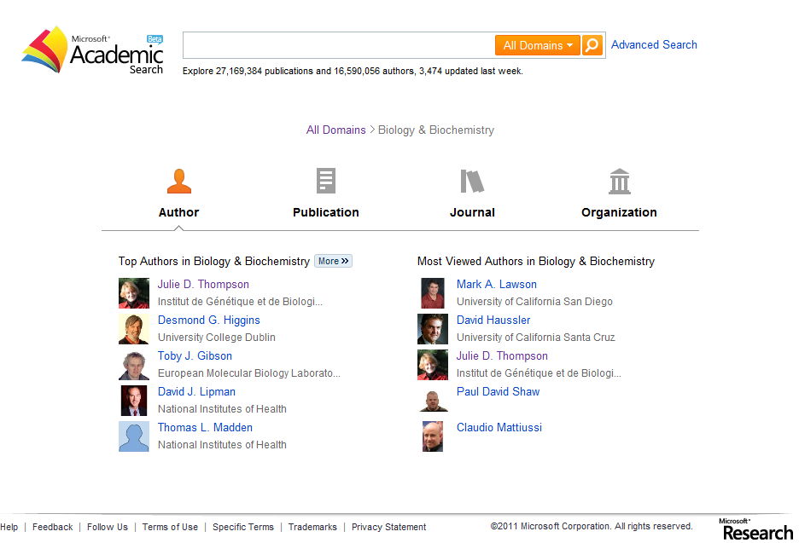

Slide 27
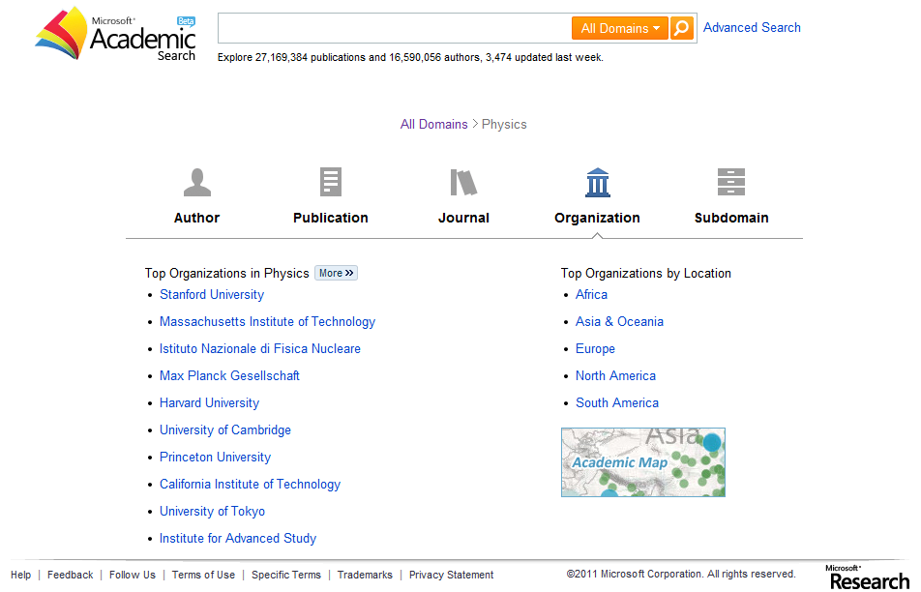

Slide 28
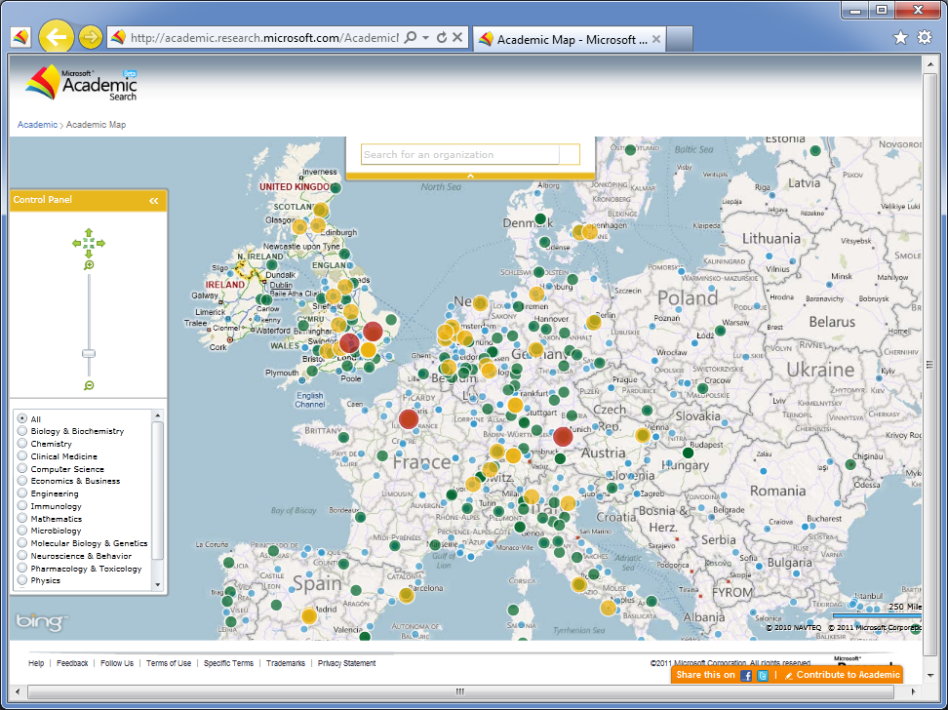

Slide 29
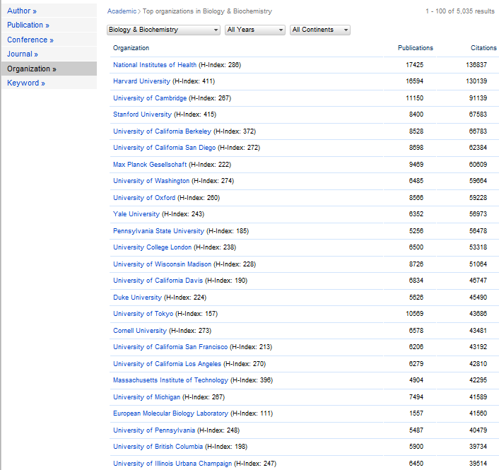
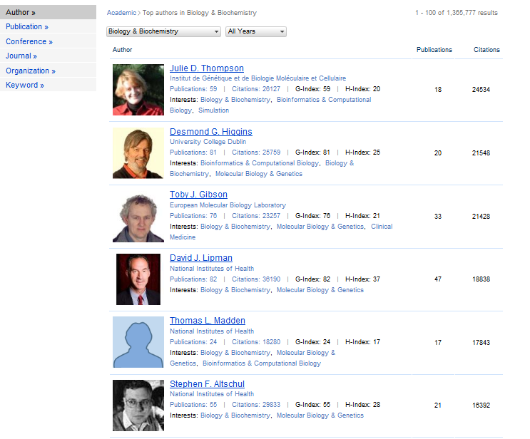
Ranking Lists

Slide 30
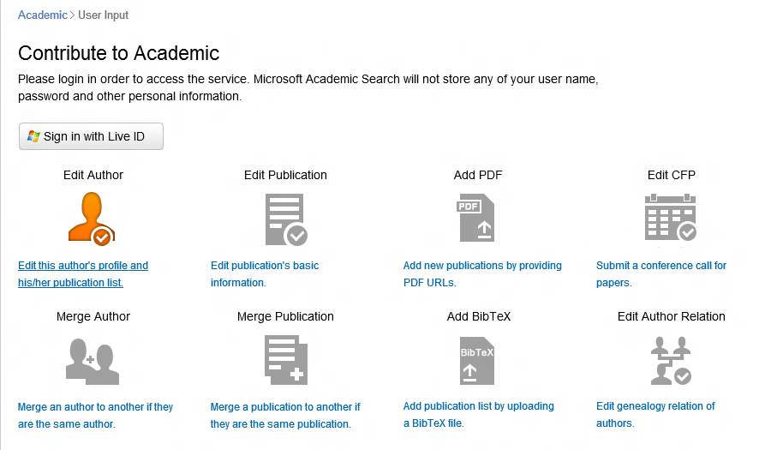
Editing

Slide 31
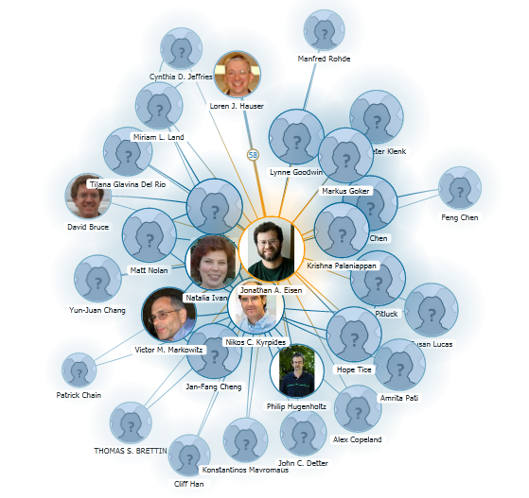
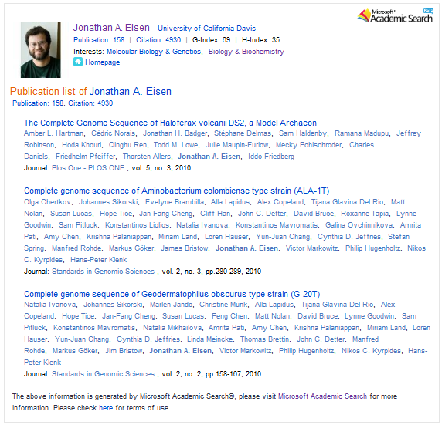
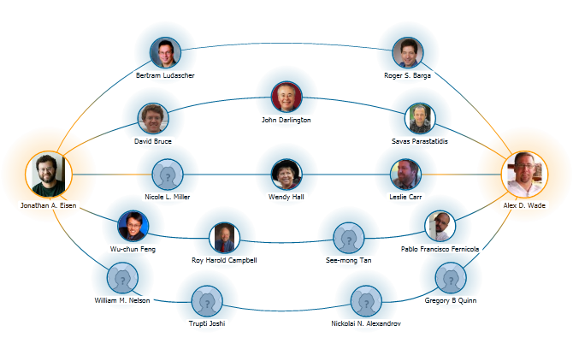
Embedding

Slide 32
Public API
Application Programming Interface
  Supports queries against all academic entities and their basic info
  REST / JSON
  SOAP / XML
With the API, you can
  Work with others to share info
  Help users to build useful clients
All openly available to everyone
  Targeting the academic community
  API is available for non-commercial use only
API details at http://aka.ms/acadapi

Slide 33

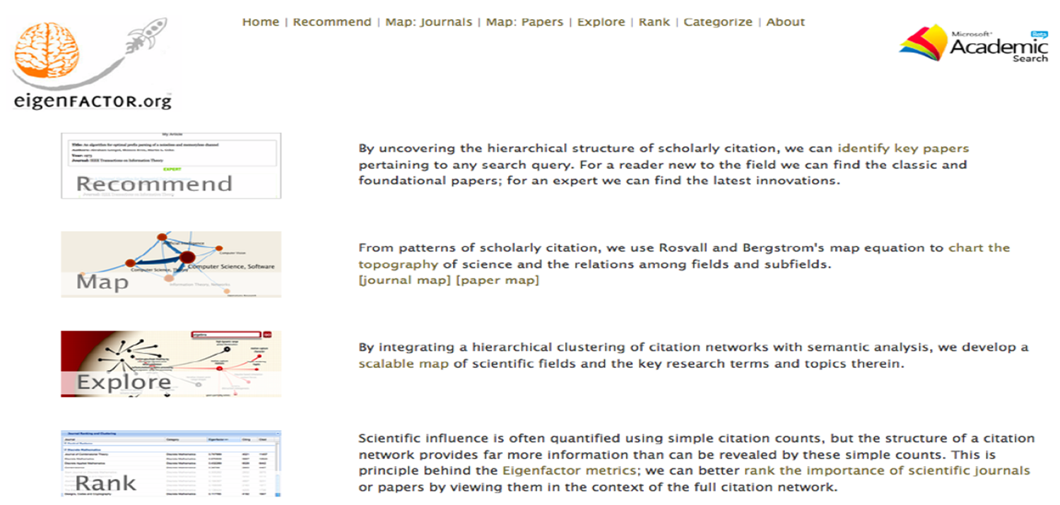

Slide 34
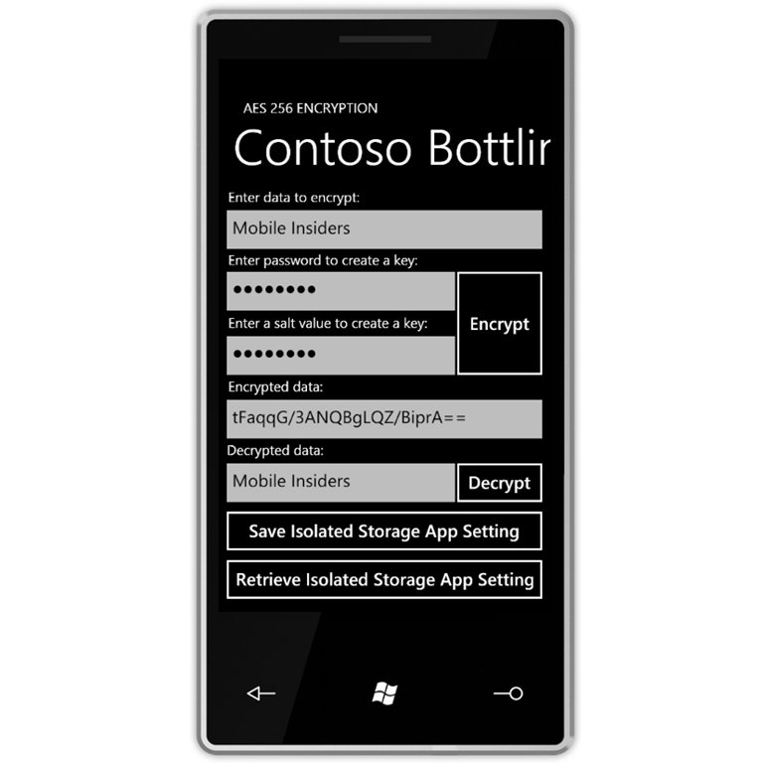
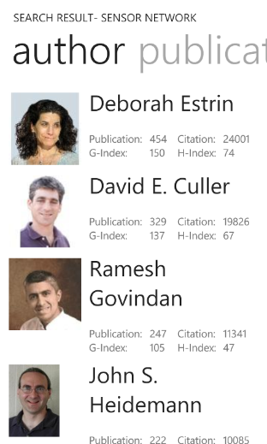
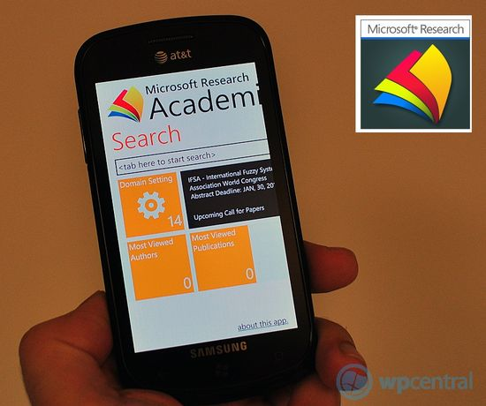
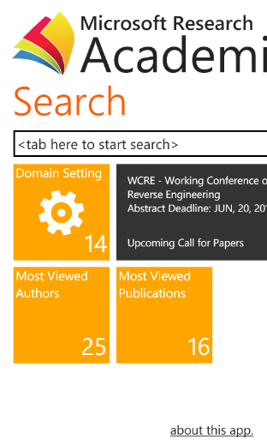
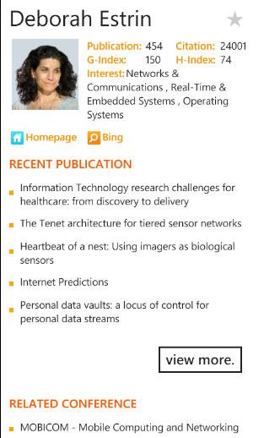
Windows Phone 7 – MAS Application
Available at http://aka.ms/maswp7

Slide 35
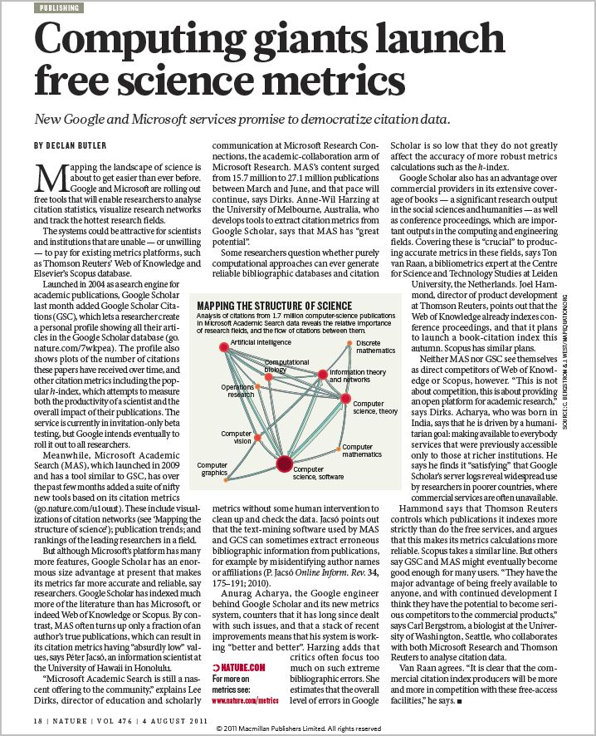

4 August 2011 | Nature 476, 18 (2011)
(doi:10.1038/476018a)
“…Meanwhile, Microsoft Academic Search (MAS), which launched in 2009 and has a tool similar to Google Scholar, has over the past few months added a suite of nifty new tools based on its citation metrics (go.nature.com/u1ouut). These include visualizations of citation networks (see 'Mapping the structure of science'); publication trends; and rankings of the leading researchers in a field.”

Slide 36
Call to action…
Use it!
  http://academic.research.microsoft.com
Look up your record (edit it!)
Use the API (request an AppID)
  http://aka.ms/acadapi
Spread the word – tell your friends
Follow us on Twitter
  @MSFTAcademic

Slide 37
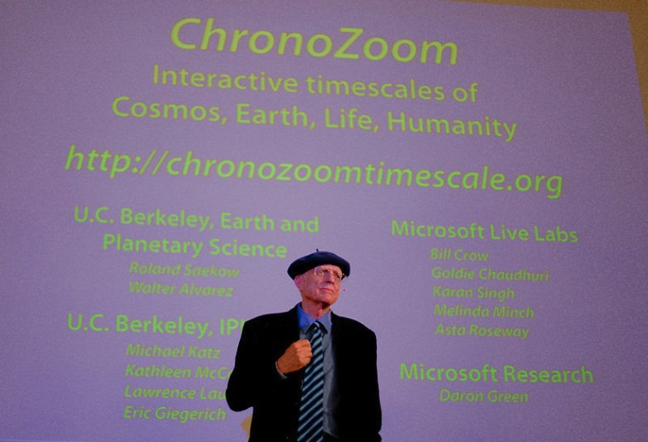

big history
with
big data
http://www.chronozoomproject.org/

Slide 38
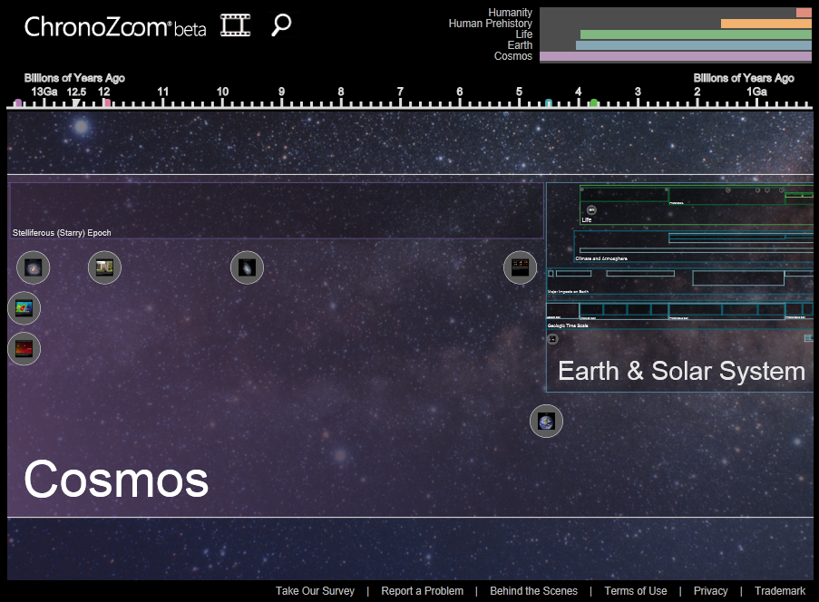

Slide 39
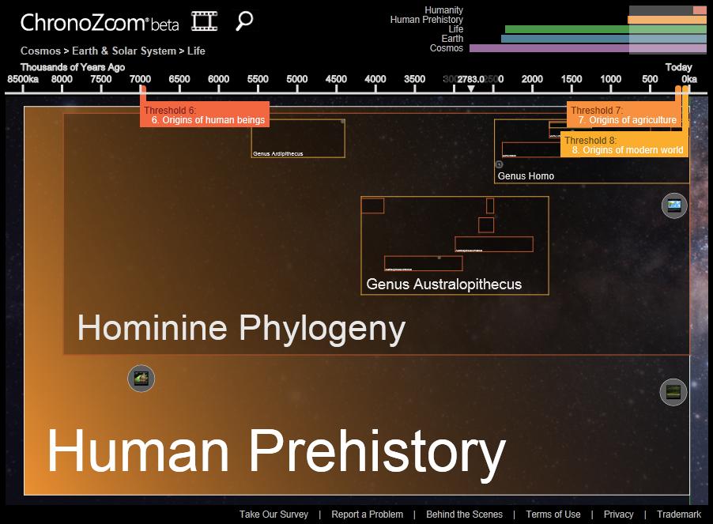

Slide 40
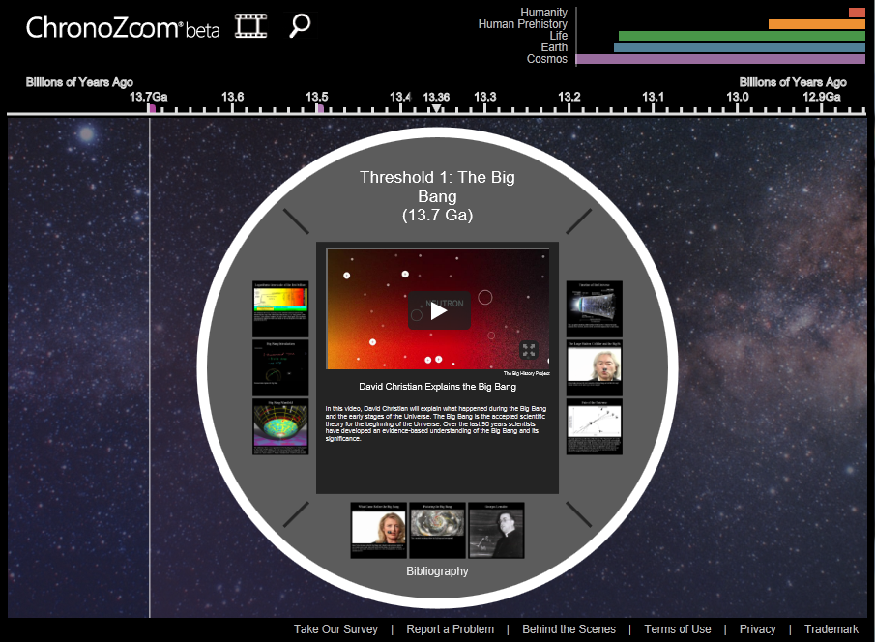

Slide 41

demo

Slide 42
What you need to remember about ChronoZoom http://www.chronozoomproject.org/
“Zoomable” interface that allows users to navigate quickly through multiple rich media sources, sifting though astounding amounts of embedded data in a variety of different formats
  Mash-up of video (YouTube, Vimeo); PDF; scanned documents; photos; maps; charts/figures; live documents, etc.
  Coming soon – an open authoring platform
    Limited, trusted partners now
    Opening up to curated sets in V1.0
    Broad public access in ~1 year
Facilitates learning across traditional silos
  Simultaneous learning, across time, across geographies, and spanning domains
  Opportunity to glean new insights
  In the near future, more powerful tools for permitting comparative research
Enhances discovery: make bookmarks, build tours, powerful search
  Upload your content into private Chronozoom spaces – for individuals, domains, families, organization, etc.
A free web service (all HTML5), as well as an open source project managed through the Outercurve Foundation at http://www.outercurve.org/Galleries/ResearchAccelerators/ChronoZoom

Slide 43
Thank you!
Alex D. Wade
Director—Scholarly Communication
awade@microsoft.com | http://research.microsoft.com/people/awade
URL – http://www.microsoft.com/scholarlycomm/
Facebook: Scholarly Communication at Microsoft

