Slide 1
Towards Predictable Data Centers
Why Johnny can’t use the cloud and what we can do about it?
Hitesh Ballani, Paolo Costa, Thomas Karagiannis,
Greg O’Shea and Ant Rowstron
Microsoft Research, Cambridge

Slide 2
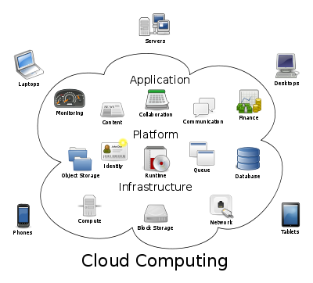

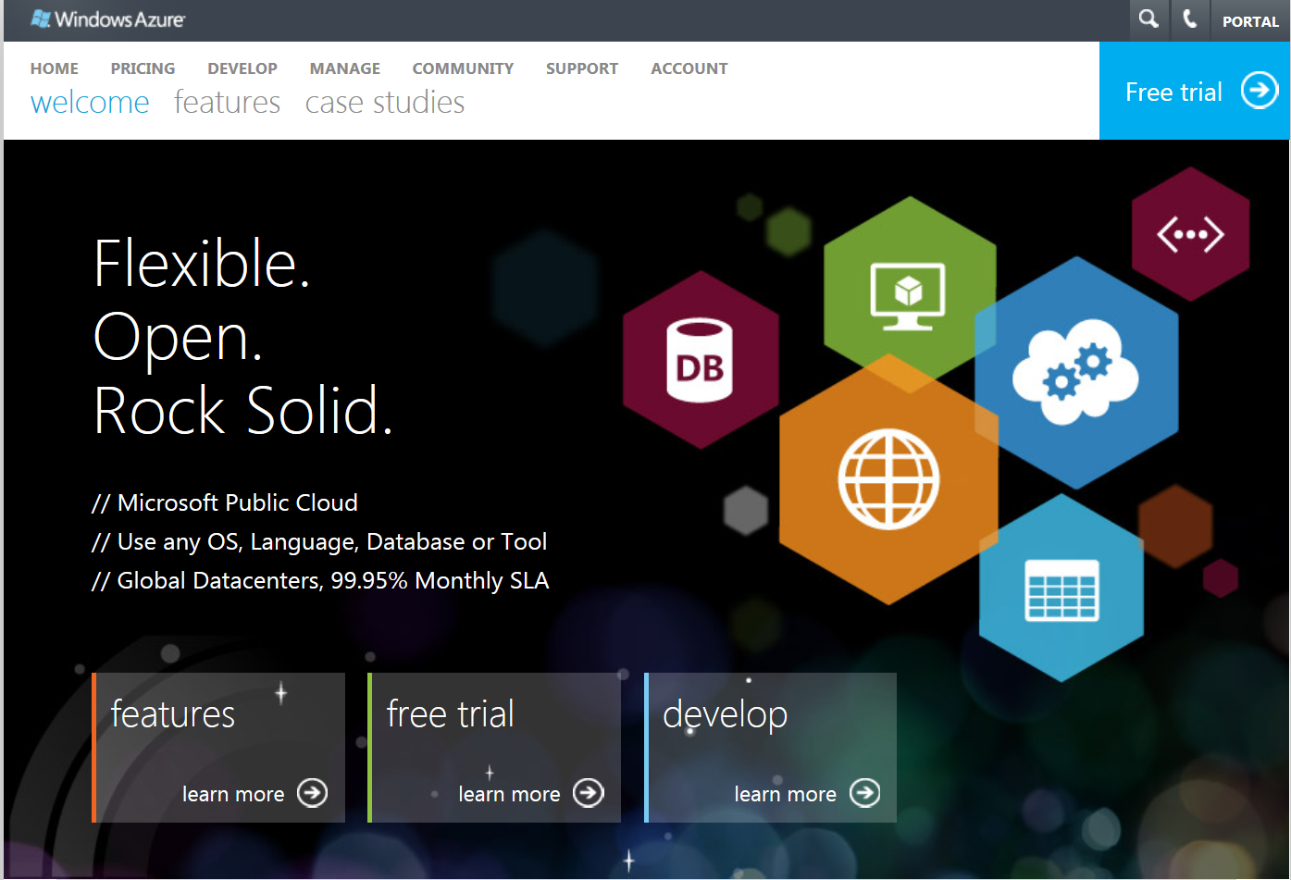
Cloud computing

Slide 3
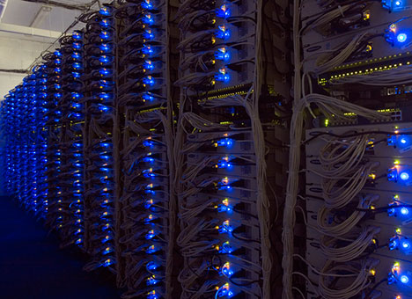
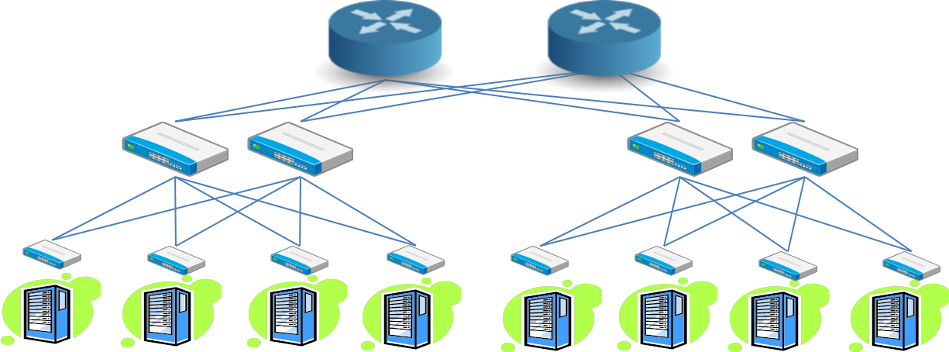

Data centers

Slide 4
Predictable Data Centers
Project goal: Enable predictable application performance in multi-tenant datacenters
Multi-tenant data center is a data center with multiple (possibly competing) tenants
Multi-tenant datacenters
Private datacenters
  Run by organizations like Facebook, Intel, etc.
  Tenants: Product groups and applications
Cloud datacenters
  Amazon EC2, Microsoft Azure, Rackspace, etc.
  Tenants: Users renting virtual machines

Slide 5
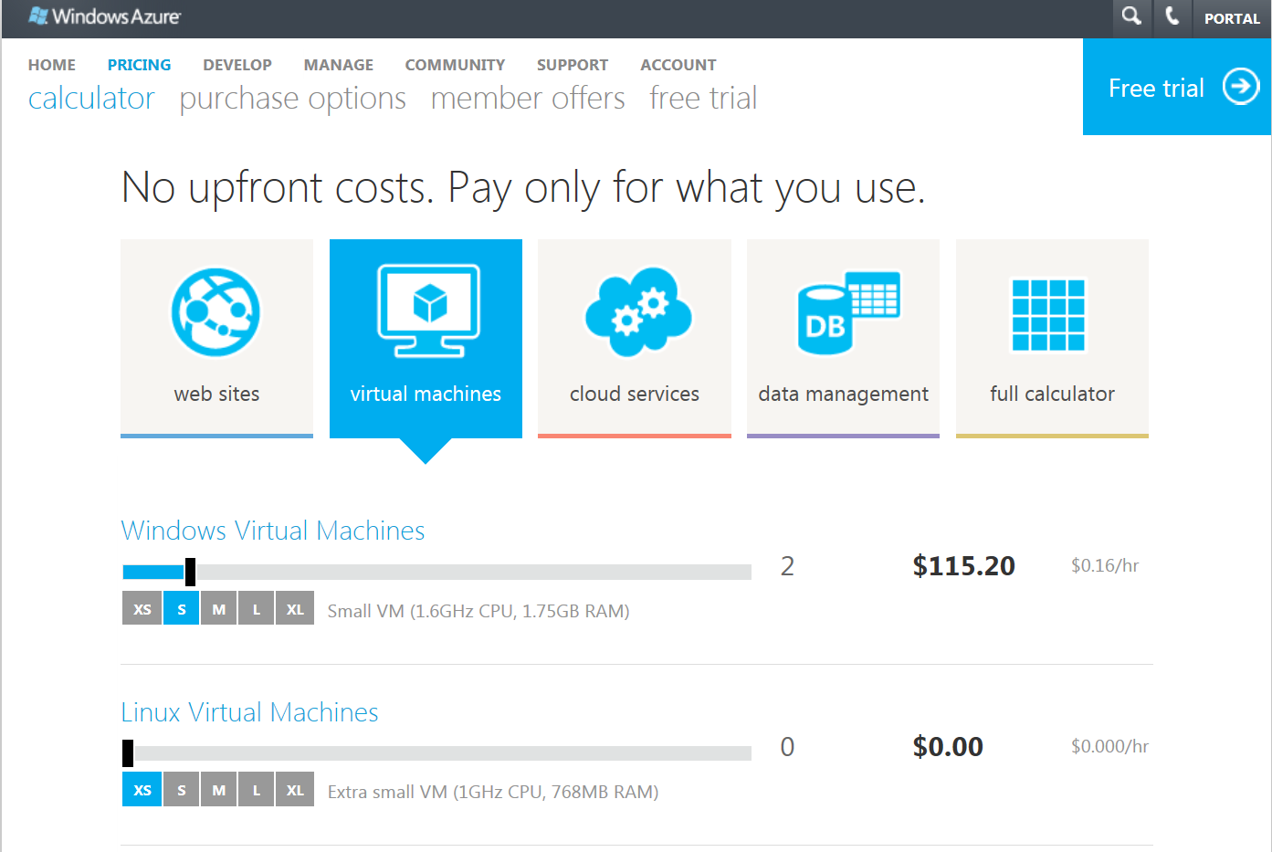


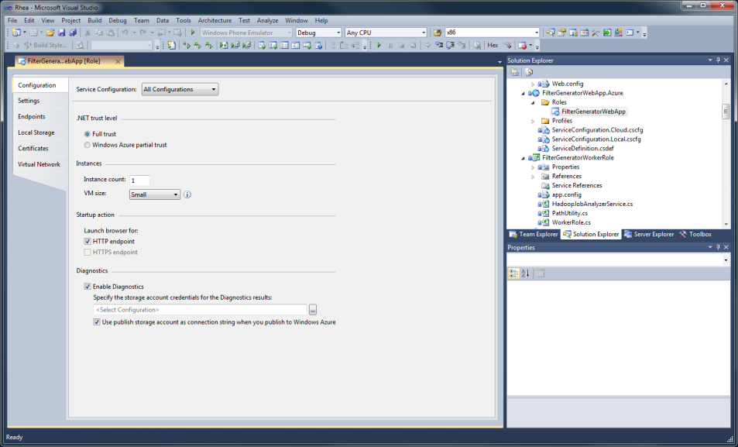
Cloud datacenters 101
Simple interface: Tenants ask for a set of VMs
  Tenants are charged for Virtual Machines (VMs) per hour
    Microsoft Azure small VMs: $0.08/hour
  Tenant
  Web Interface
  Request
  VMs
Problem
Application performance in cloud settings is unpredictable!

Slide 6




The problem of unpredictability
Data analytics on an isolated cluster
Map Reduce
Job
Results
Completion
Time
4 hours
Enterprise
Unpredictability of application performance and tenant costs is a key hindrance to cloud adoption
Data analytics in a multi-tenant datacenter
Map Reduce
Job
Results
Completion
Time
10-16 hours
Datacenter
Variable costs
Expected cost (based on 4 hour completion time) = $100
Actual cost = $250-400
Variable network performance can inflate the job completion time

Slide 7

Why is tenant performance unpredictable?
Internal network is shared amongst tenants
Network bandwidth between virtual
machines can vary significantly
Key contributor to unpredictable
application performance

Slide 8
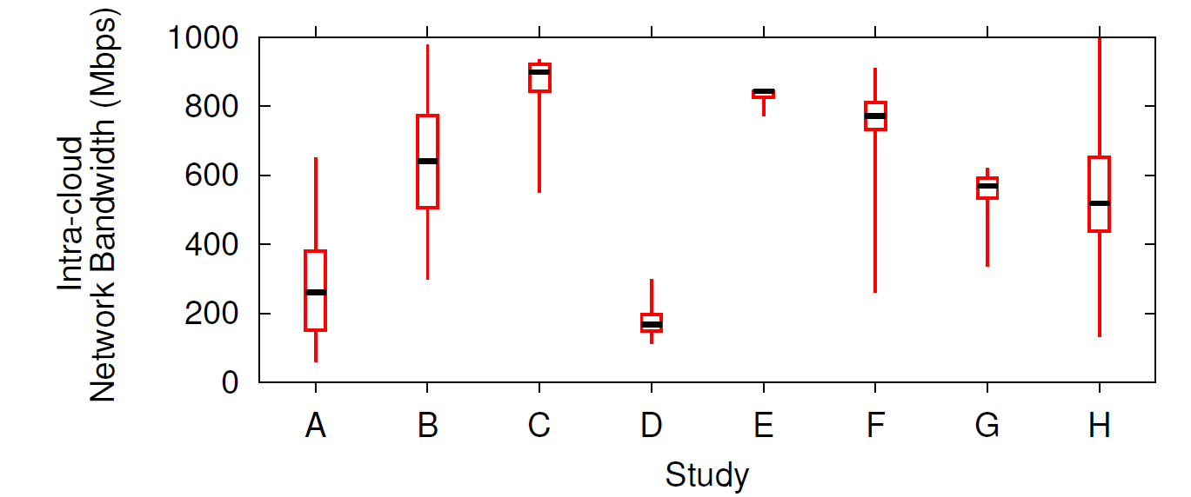
Performance variability in the wild
Up to 5x variability
Study | Study | Provider | Duration
A | [Giurgui’10] | Amazon EC2 | n/a
B | [Schad’10] | Amazon EC2 | 31 days
C/D/E | [Li’10] | (Azure, EC2, Rackspace) | 1 day
F/G | [Yu’10] | Amazon EC2 | 1 day
H | [Mangot’09] | Amazon EC2 | 1 day
Notes:
Which instances??

Slide 9
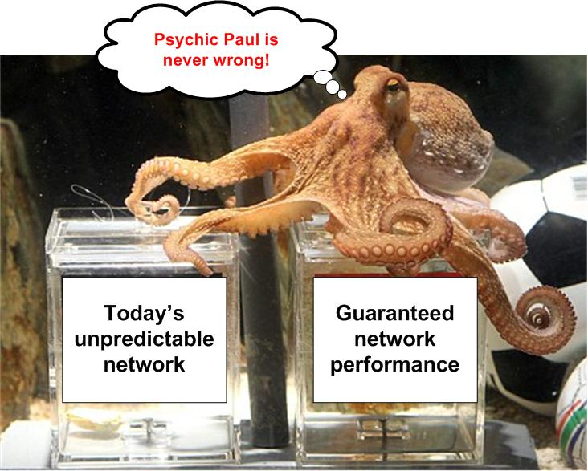
Oktopus
Enable guaranteed network performance

Slide 10
Oktopus
Extend the tenant-provider interface to account for the network
Contributions-
Virtual network abstractions
  To capture tenant network demands
Oktopus: Proof of concept system
  Implements virtual networks in multi-tenant datacenters
  Can be incrementally deployed today!
  Request
Virtual Network
  Request
  # of VMs and
  network demands
  # of VMs and network demands
  Tenant
VM₁
VM₂
VM_{N}
Key Idea: Tenants are offered a virtual network that gurantees network bandwidth across their VMs
This decouples tenant performance from provider infrastructure

Slide 11
Key takeaway
Exposing tenant network demands to providers enables a symbiotic tenant-provider relationship
Tenants get predictable performance (and lower costs)
Provider revenue increases

Slide 12
Talk Outline
  Introduction
  Virtual network abstractions
  Oktopus
    Allocating virtual networks
    Enforcing virtual networks
  Evaluation

Slide 13
What should the virtual network look like?
Goal 1: Easier transition for tenants
  Tenants should be able to predict the performance of applications
Goal 2: Provider flexibility
  Providers should be able to multiplex many tenants in their infrastructure
  These are competing design goals
  Our abstractions strive to strike a balance between them
  Request
Virtual Network
  Virtual to
  Physical
  Tenant
VM₁
VM₂
VM_{N}

Slide 14
Abstraction 1: Virtual Cluster (VC)
Motivation: In enterprises, tenants run applications on dedicated Ethernet clusters
Virtual Switch
B Mbps
Request <N, B>
N VMs. Each VM can send and receive at B Mbps
VM 1
VM 2
VM N
Virtual cluster resembles typical enterprise networks
Easier transition to the cloud for tenants
Moderate provider flexibility

Slide 15
Abstraction: Virtual Cluster
Physical
Network
VM 1
VM 2
VM N
B Mbps
Virtual cluster
A “virtual” network guarantees network performance
Consider a tenant renting N virtual machines
VMs are connected by physical data center network
Each VM gets an aggregate bandwidth guranty – VMs can send and receive at B Mbps
Incoming flows for VM1
Aggregate rate should not exceed B Mbps
Outgoing flows for VM1
Aggregate rate should not exceed B Mbps

Slide 16
Abstraction 2: Virtual Oversubscribed Cluster (VOC)
VMs can send traffic to group members at B Mbps
Root
Virtual Switch
B * S / O Mbps
Group
Virtual Switch
B Mbps
B Mbps
B Mbps
…
…
….
…
VM 1
VM S
VM 1
VM S
VM N
VM 1
VM S
Group 1
Group 2
Group N/S
Request <N, B, S, O>
N VMs in groups of size S. Oversubscription factor O.
Motivation: Many applications moving to the cloud have localized communication patterns
Applications are composed of groups with more traffic within groups than across groups
VOC capitalizes on tenant communication patterns
Suitable for typical applications (though not all)
Improved provider flexibility
No oversubscription for intra-group communication
Intra-group communication is the common case!
Oversubscription factor O for inter-group communication
(captures the sparseness of inter-group communication)

Slide 17
Oktopus in operation
Step 1: Admission control + VM placement
  Can network guarantees for the request be met?
Step 2: Enforce virtual networks
  Ensure bandwidth guarantees are actually met
  Request
  # of VMs and network demands
  Tenant

Slide 18
Talk Outline
  Introduction
  Virtual network abstractions
  Oktopus
    VM Placement
    Enforcing virtual networks
  Evaluation

Slide 19

Allocating Virtual Clusters
100 Mbps
Request : <3 VMs, 100 Mbps>
Max Sending Rate =
2*100 = 200
Max Receive Rate =
1*100 = 100
B/W needed on link =
Min (200, 100) = 100Mbps
VM for an existing tenant
What bandwidth needs to be reserved for the tenant on this link?
For a virtual cluster <N,B>, bandwidth needed on a link that connects m VMs to the remaining (N-m) VMs is = Min (m, N-m) * B
For a valid allocation:
Bandwidth needed <= Link’s Residual Bandwidth
How to find a valid allocation?
Datacenter Physical Topology
4 physical machines, 2 VM slots per machine
Tenant Request
Tenant asks for 3 VMs arranged in a virtual cluster with 100 Mbps each, i.e. <3 VMs, 100Mbps>
An allocation of tenant VMs to physical machines
Tenant traffic traverses the highlighted links
Link divides virtual tree into two parts
Consider all traffic from the left to right part

Slide 20
Allocation Algorithm
100 Mbps
Request : <3 VMs, 100 Mbps>
1000
1000
How many VMs can be allocated to this machine?
Solution
At most 1 VM for this tenant can be allocated here
1000
1000
200
200
2 VMs
2 VMs
2 VMs
1 VM
1 VM
Allocation is fast and efficient
Packing VMs together motivated by the fact that datacenter networks are typically oversubscribed
Allocation can be extended for goals like failure resiliency, etc.
Constraints for # of VMs (m) that can be allocated to the machine-
VMs can only be allocated to empty slots ⇨ m <= 1
3 VMs are requested ⇨ m <= 3
Enough b/w on outbound link ⇨ min (m, 3-m)*100 <= 200
Key intuition
Validity conditions can be used to determine the number of VMs that can be allocated to any level of the datacenter; machines, racks and so on
3 VMs
Greedy allocation algorithm
Traverse up the hierarchy and determine the lowest level at which all 3 VMs can be allocated

Slide 21
Talk Outline
  Introduction
  Virtual network abstractions
  Oktopus
    Allocating virtual networks
    Enforcing virtual networks
  Evaluation

Slide 22
Enforcing Virtual Networks
Allocation algorithms assume
No VM exceeds its bandwidth guarantees
Enforcement of virtual networks
  To satisfy the above assumption
  Limit tenant VMs to the bandwidth specified by their virtual network
  Irrespective of the type of tenant traffic (UDP/TCP/...)
  Irrespective of number of flows between the VMs

Slide 23
Abstraction: Virtual Cluster
Physical
Network
VM 1
VM 2
VM N
Challenge: Control the rate of all sources sending to VM 1
Can be achieved by controlling the source sending rate
B Mbps
Incoming flows for VM1
Aggregate rate should not exceed B Mbps
Outgoing flows for VM1
Aggregate rate should not exceed B Mbps

Slide 24
Enforcement in Oktopus: Key highlights
Oktopus enforces virtual networks at end hosts
Use egress rate limiters at end hosts
Oktopus can be deployed today
  No changes to tenant applications
  No network support
  Tenants without virtual networks can be supported
    Good for incremental roll out

Slide 25
Talk Outline
  Introduction
  Virtual network abstractions
  Oktopus
    Allocating virtual networks
    Enforcing virtual networks
  Evaluation

Slide 26
Evaluation
Oktopus deployment
  On a 25-node testbed
  Benchmark Oktopus implementation
  Cross-validate simulation results
Large-scale simulation
  Allows us to quantify the benefits of virtual networks at scale
The use of virtual networks benefits
both tenants and providers

Slide 27
Datacenter Simulator
Flow-based simulator
  16,000 servers and 4 VMs/server ⇨ 64,000 VMs
  Three-tier network topology (10:1 oversubscription)
Tenants submit requests for VMs and execute jobs
  Job: VMs process and shuffle data between each other
Baseline: representative of today’s setup
  Tenants simply ask for VMs
  VMs are allocated in a locality-aware fashion
Virtual network request
  Tenants ask for Virtual Cluster (VC) or Virtual Oversubscribed Cluster (VOC)

Slide 28
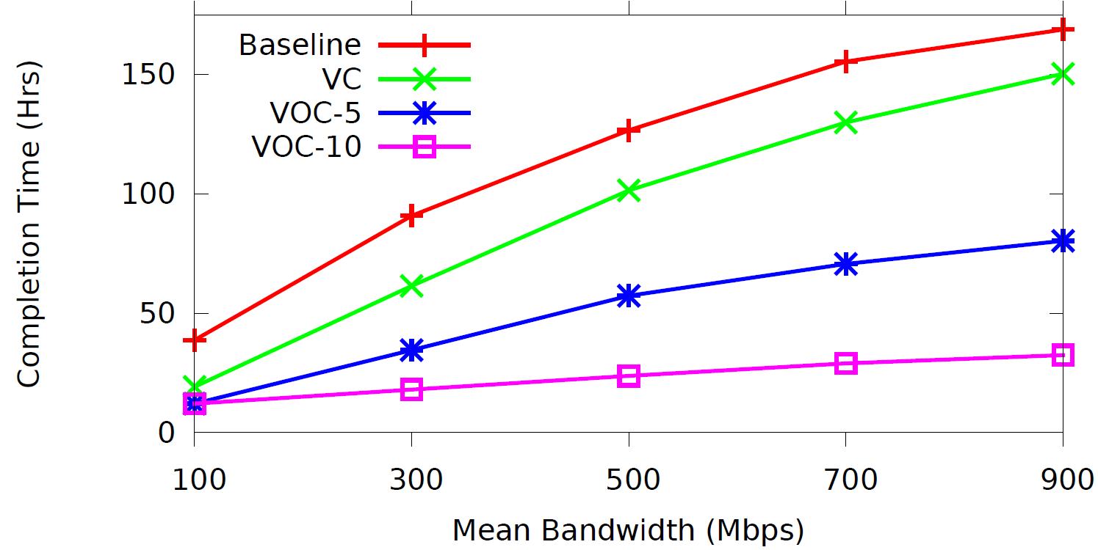
Private datacenters
VC is Virtual Cluster
VOC-10 is Virtual Oversubscribed Cluster with oversubscription=10
Worse
Execute a batch of 10,000 tenant jobs
Jobs vary in network intensiveness
(bandwidth at which a job can generate data)
Better
Virtual networks improve completion time
VC: 50% of Baseline
VOC-10: 31% of Baseline
Jobs become more network intensive

Slide 29
Private datacenters
With virtual networks, tenants get guaranteed network b/w
  Job completion time is bounded
With Baseline, tenant network b/w can vary significantly
  Job completion time varies significantly
    For 25% of jobs, completion time increases by >280%
  Lagging jobs hurt datacenter throughput
Virtual networks benefit both tenants and provider
Tenants: Job completion is faster and predictable
Provider: Higher datacenter throughput

Slide 30
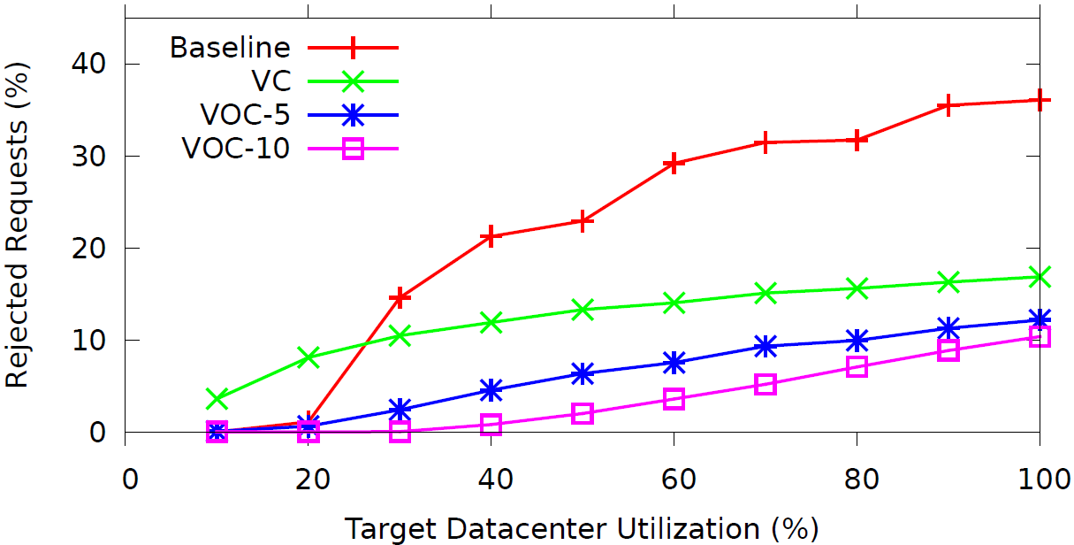
Cloud Datacenters
Amazon EC2’s reported target
utilization
Worse
Tenant job requests arrive over time
Jobs are rejected if they cannot be accommodated on arrival (representative of cloud datacenters)
Better
Rejected Requests
Baseline: 31%
VC: 15%
VOC-10: 5%
Job requests arrive faster

Slide 31
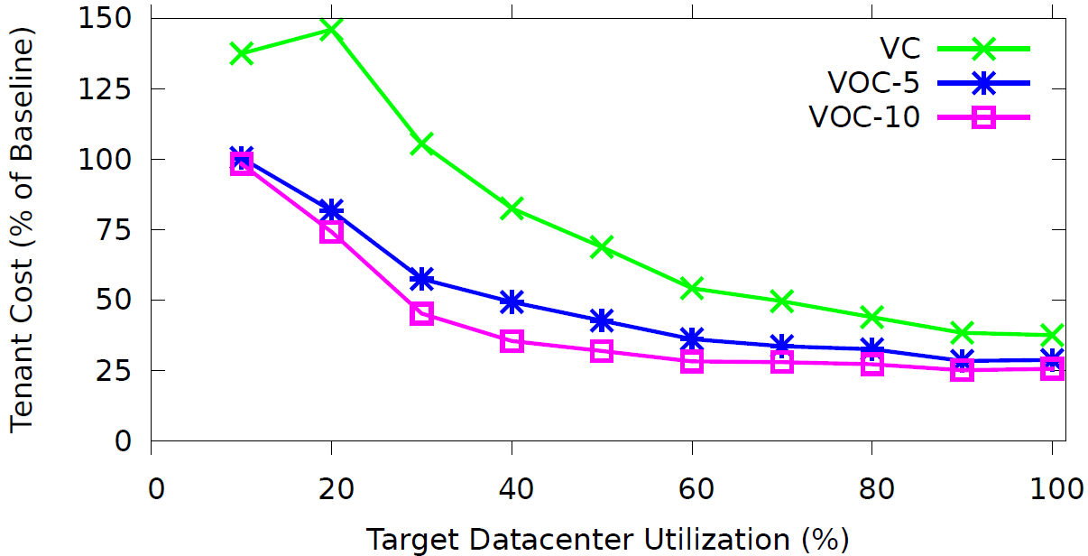
Tenant Costs
What should tenants pay to ensure provider revenue neutrality, i.e. provider revenue remains the same with all approaches
Based on today’s EC2 prices, i.e. $0.085/hour for each VM
Provider revenue increases while tenants pay less
At 70% target utilization, provider revenue increases by 20% and median tenant cost reduces by 42%

Slide 32
Oktopus Deployment
Implementation scales well and imposes low overhead
  Allocation of virtual networks is fast
    In a datacenter with 10⁵ machines, median allocation time is 0.35ms
  Enforcement of virtual networks is cheap
    Use Traffic Control API to enforce rate limits at end hosts
Deployment on testbed with 25 end hosts
  End hosts arranged in five racks

Slide 33
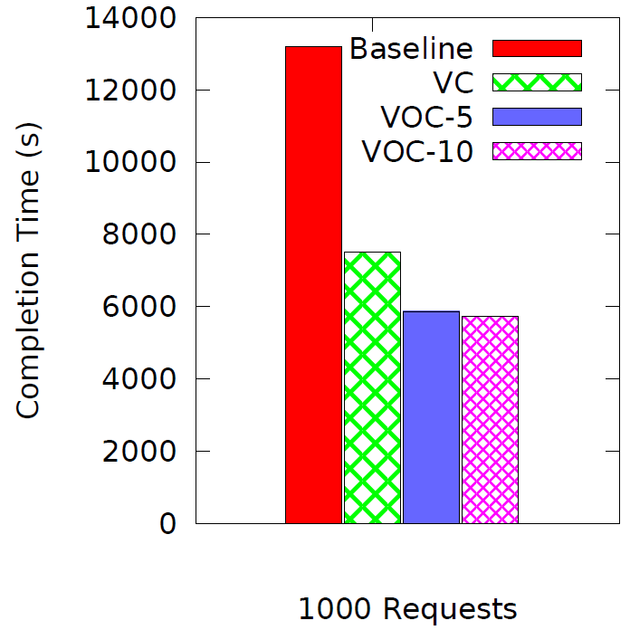
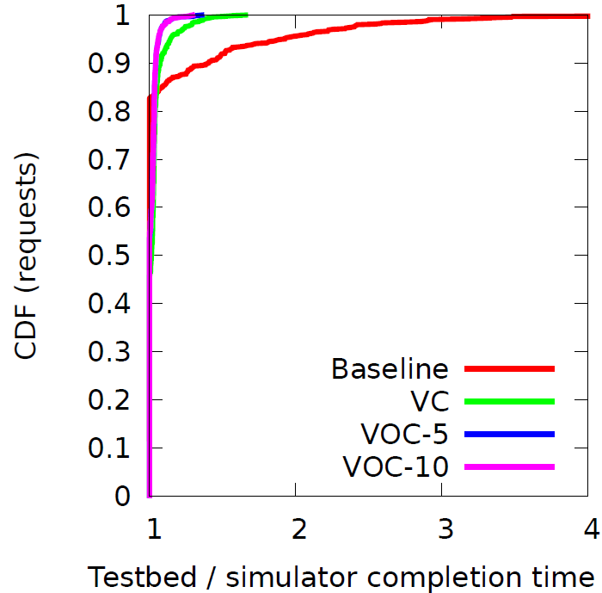
Oktopus Deployment
Cross-validation of simulation results
Completion time for jobs in the simulator matches that on the testbed

Slide 34
Summary
Proposal: Offer virtual networks to tenants
  Virtual network abstractions
    Resemble physical networks in enterprises
    Make transition easier for tenants
Proof of concept: Oktopus
  Tenants get guaranteed network performance
  Sufficient multiplexing for providers
  Win-win: tenants pay less, providers earn more!
How to determine tenant network demands?

Slide 35
Bazaar
Enables predictable performance and cost
  Resources
  Required
  Job Request
Bazaar
  Perf/Cost
  constraints
  VMs and
  network
  Tenant
  Provider
  Resource Utilization
  Job Cost
Bazaar:
Determines resources needed
i.e., 25 VMs & 300 Mbps
Today’s pricing: Resource-based
Bazaar enables job-based pricing!
Tenant says:
“Finish the job in 5 hours at a cost of £400”

Slide 36
Thank you

Slide 37
Backup slides
©2011 Microsoft Corporation. All rights reserved.
This material is provided for informational purposes only. MICROSOFT MAKES NO WARRANTIES, EXPRESS OR IMPLIED, IN THIS SUMMARY. Microsoft is a registered trademark or trademark of Microsoft Corporation in the United States and/or other countries.

Slide 38
Other Abstractions
“These are my abstractions and if you don’t like them, I have others ”
… paraphrasing Groucho Marx
  Amazon EC2 Cluster Compute
    Guaranteed 10Gbps bandwidth (at a high cost though)
    Tenants get a <N, 10Gbps> Virtual Cluster
  Virtual Datacenter Networks
    Eg., SecondNet offers tenants pairwise bandwidth guarantees
    Tenants get a clique virtual network
    Suitable for all tenants, but limited provider flexibility
  Virtual Networks from the HPC world
    Many direct connect topologies, like hypercube, Butterfly networks, etc.

Slide 39
Tenant Guarantees vs. Provider Flexibility

Slide 40
Allocation algorithms
Goals for allocation
  Performance: Bandwidth between VMs
  Failure resiliency: VMs in different failure domains
  Energy efficiency: Packing VMs to minimize power
  ...
  Oktopus allocation protocols can be extended to account for goals beyond bandwidth requirements

Slide 41
Oktopus: Nits and Warts 1
Oktopus focuses on guaranteed internal network bandwidth for tenants and is a first step towards predictable datacenters
Other contributors to performance variability
  Bandwidth to storage tier
  External network bandwidth
Virtual networks provide a concise means to capture tenant demands for such resources

Slide 42
Oktopus: Nits and Warts 2
Oktopus semantics: Tenants get the bandwidth specified by their virtual network (nothing less, nothing more!)
Spare network capacity
  Used by tenants without virtual networks
Work conserving solution
Tenants get guarantees for minimum bandwidth
Spare network capacity shared amongst tenants who can use it
Can be achieved through work-conserving enforcement mechanisms

Slide 43
Hose Model
Flexible expression of tenant demands in VPN settings
  Same as the virtual cluster abstraction
  Better than pipe model
  [Sigcomm 1999]
Allocation problem is different
  Virtual clusters: VMs can be allocated anywhere
  Hose model: Tenant locations are fixed. Need to determine the mapping of virtual to physical links

Slide 44
Oktopus
Offers virtual networks to tenants in datacenters
Two main components
  Management plane: Allocation of tenant requests
    Allocates tenant requests to physical infrastructure
    Accounts for tenant network bandwidth requirements
  Data plane: Enforcement of virtual networks
    Enforces tenant bandwidth requirements
    Achieved through rate limiting at end hosts

