Slide 1
PhD Summer School 2012
Welcome
Scarlet Schwiderski-Grosche
Senior Program Manager
Microsoft Research Ltd
Notes:
7th PhD Summer School
Fire exits
© 2010 Microsoft Corporation. All rights reserved. Microsoft, Windows, Windows Vista and other product names are or may be registered trademarks and/or trademarks in the U.S. and/or other countries.
The information herein is for informational purposes only and represents the current view of Microsoft Corporation as of the date of this presentation. Because Microsoft must respond to changing market conditions, it should not be interpreted to be a commitment on the part of Microsoft, and Microsoft cannot guarantee the accuracy of any information provided after the date of this presentation.
MICROSOFT MAKES NO WARRANTIES, EXPRESS, IMPLIED OR STATUTORY, AS TO THE INFORMATION IN THIS PRESENTATION.

Slide 2
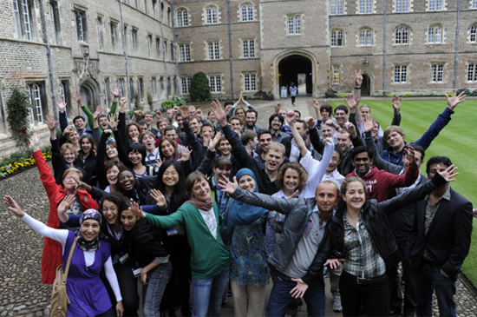
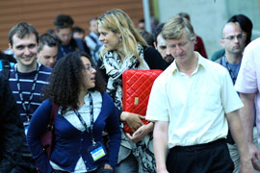
Welcome
To the 7th MSR PhD Summer School!
Who are we?
Who are you?
Agenda
Poster sessions
Microsoft Research
Connections
PhD Summer School 2012
Notes:
Feedback forms
What you have in your pack

Slide 3
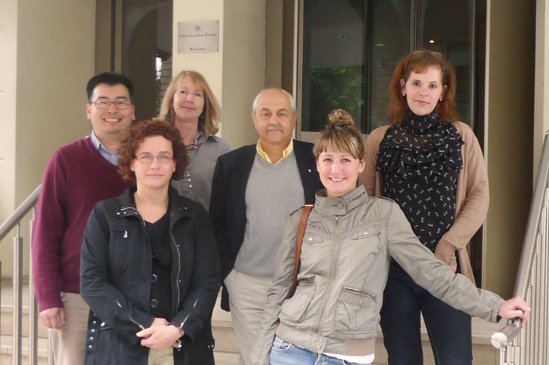
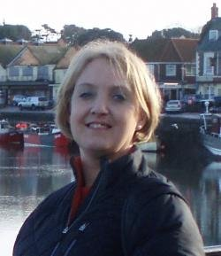
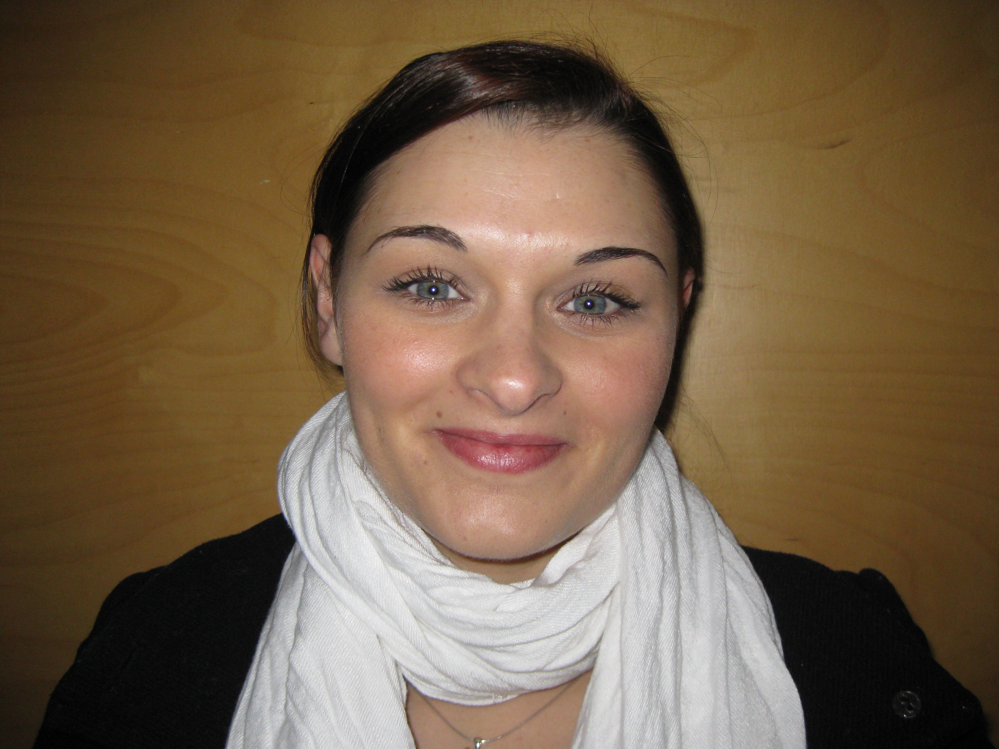
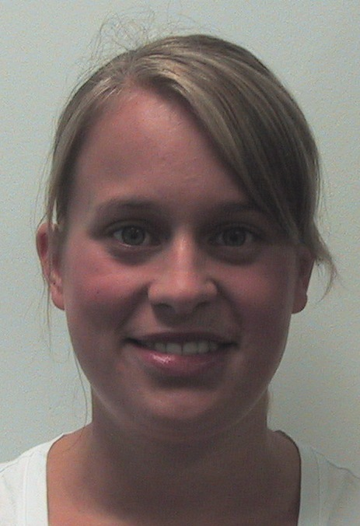
Who are we?
MRC EMEA:
Julia Brading
Gemma Crawley
Fabrizio Gagliardi
Luisa Marie Menon
Scarlet Schwiderski-Grosche
Kenji Takeda
MSR Cambridge:
Cara Freeman
Sarah Nightingale
Notes:
You’ll get to meet many researchers in the course of the week!
GrassRoots

Slide 4
Who are you?
32 PhD Scholars
(Austria, Denmark, Finland, France, Germany, Ireland, Israel, Spain, Turkey)
16 students from Cambridge Computer Lab
9 students from Russia
11 students from Germany (mostly Max Planck Institutes)
Also: 10 TRANSFORM
1 or 2 students each from Egypt, France, Greece Saudi Arabia, Slovakia, Spain, and Switzerland

Slide 5
Microsoft Research:
Computer Vision Contest
Held in Russia earlier this year.
Students were encouraged to apply their imagination and passion to create novel technological solutions using Kinect for Windows
5 winners won a trip to the Summer School
See http://summerschool2011.graphicon.ru/en/contest/results

Slide 6
TRANSFORM Visitors
Marie-Curie Initial Training Network
Theoretical Foundations of Transactional Memory
Parallel TRANSFORM sessions on Tuesday and Wednesday afternoon
See
http://www.ics.forth.gr/~faturu/transform.html
Notes:
There are TRANSFORM training activities co-located with the School and specific TRANSFORM sessions indicated accordingly.

Slide 7
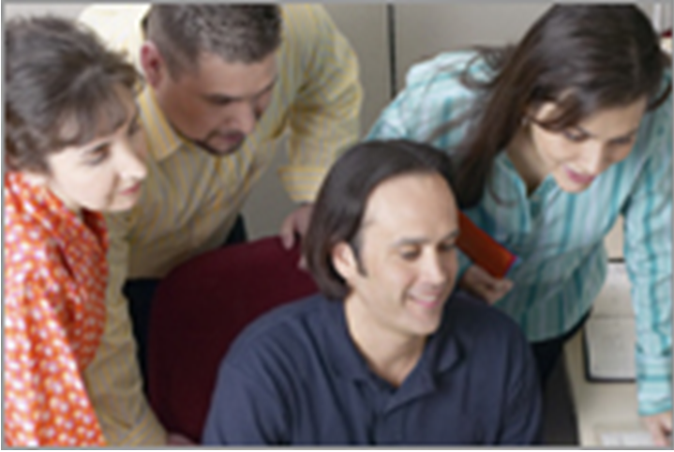
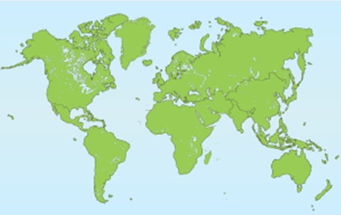
Regional Outreach: Faculty and Grad Students
MSRC Intellectual Capital Development
PhD Summer School
PhD Scholarships
eScience PostDoc Positions
Post Professional Conferences
Graduate Women Scholarship
Microsoft Faculty Fellows
European Fellowships
Asia-Pacific Fellows
India Fellows
LATAM Fellows
Japan New Faculty Award

Slide 8
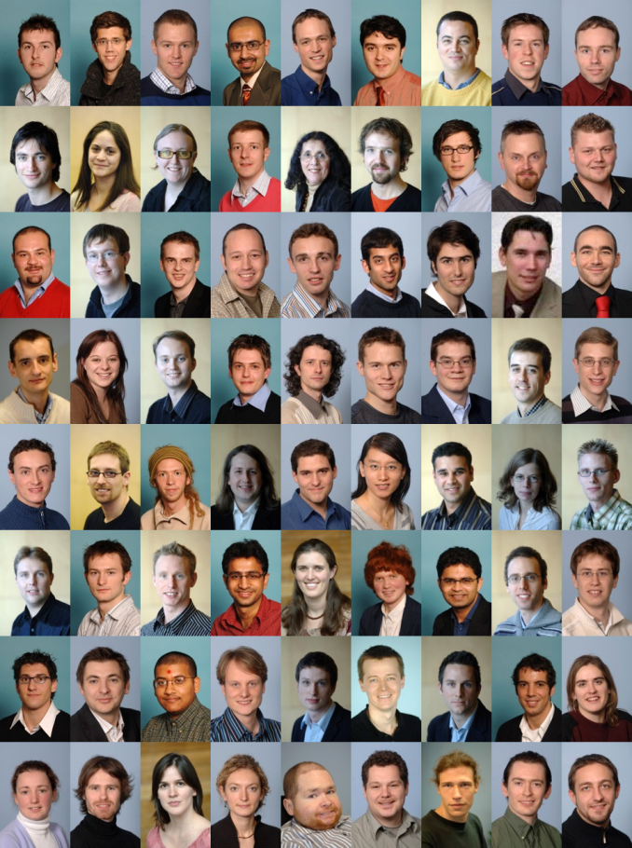

PhD Scholarship Programme
EMEA-wide
Since 2004
Around 25 students a year
  ~100 active students
  ~200 in total
More than funding
  Co-supervisions by
  MSR researchers
  Internship
  Summer School
Notes:
Goals:
Recognise & support bright students
Advance state of the art
Create community of Microsoft ambassadors
Advance research
Help bring new ideas to MSR
Identify potential interns & employees
Entry point for collaboration requests
Open & competitive
Application by research supervisors
Average selection ratio 20%
Up to one year to find best possible students

Slide 9
Tuesday, 3rd July
10:15 Welcome
Scarlet Schwiderski-Grosche (Microsoft Research)
10:30 Microsoft Research Cambridge Lab Overview
Ken Woodberry (Microsoft Research)
11:00 Functional First Programming in an Information Rich World
Kenji Takeda (Microsoft Research)
12:00 Lunch and Poster Session 1
14:00 Parallel session:
  Realising Touchless Interaction in the Operating Theatre
  Helena Mentis (Microsoft Research)
  Planetary Prediction Services for Society
  Matthew Smith (Microsoft Research)
  Small Lecture Theatre
  TRANSFORM Session
  How Do Multicore Machines Actually Behave? (Part 1)
  Peter Sewell (University of Cambridge)
  Primrose Room

Slide 10
Tuesday, 3rd July (cont.)
15:15 Parallel session
  Machine Learning for Medical Image Analysis
  Antonio Criminisi (Microsoft Research)
  Towards Predictable Data Centres – Why Johnny Can’t Use the Cloud and What Can We Do About It?
  Thomas Karagiannis (Microsoft Research)
  Small Lecture Theatre
  TRANSFORM Session
  How Do Multicore Machines Actually Behave? (Part 2)
  Peter Sewell (University of Cambridge)
  Primrose Room
16:15 Break
16:45 Parallel session:
  Proving that Programs Eventually Do Something Good
  Byron Cook (Microsoft Research)
  Human Computing and Crowdsourcing in Search
  Gabriella Kazai (Microsoft Research)
  Small Lecture Theatre
  TRANSFORM Session
  STM in the Small: Trading Generality for Performance in Software Transactional Memory
  Aleksandar Dragojevic (Microsoft Research)
  Primrose Room

Slide 11
Tuesday, 3rd July (cont.)
17:45 Bus transportation to punting
location
18:00 Punting on the River Cam
19:30 Dinner at The Riverside Restaurant

Slide 12
Wednesday, 4th July
09:30 Microsoft Academic Search
Alex Wade (Microsoft Research)
10:30 Break
11:00 How to Write a Great Research Paper
Simon Peyton-Jones (Microsoft Research)
12:00 Lunch and Poster Session 2
14:00 How to Give a Great Research Talk
Simon Peyton-Jones (Microsoft Research)
15:00 Parallel session:
  Microsoft Research Connections and Cloud Computing for Science
  Fabrizio Gagliardi (Microsoft Research)
  TRANSFORM Session
  From Transactions to Data Flow and Back Again (Part 1)
  Mikel Lujan (University of Manchester)
  Small Lecture Theatre
16:00 Break

Slide 13
Wednesday, 4th July (cont.)
16:30 Parallel session:
  .NET Gadgeteer: A Platform for Custom Devices
  Scarlet Schwiderski-Grosche (Microsoft Research)
  TRANSFORM Session
  From Transactions to Data Flow and Back Again (Part 2)
  Mikel Lujan (University of Manchester)
  Small Lecture Theatre
17:00 Parallel session:
  .NET Gadgeteer Workshop
  Steven Johnston (University of Southampton)
  Primrose Room
  F# Tutorial
  Tomas Petricek (Cambridge University)
19:00 Bus transportation to Selwyn College

Slide 14
Thursday, 5th July
09:30 Body Part Recognition: Making Kinect Robust
Jamie Shotton (Microsoft Research)
10:30 Break
11:00 Rough Guide to Being an Entrepreneur
Jack Lang (University of Cambridge)
12:00 Lunch and Poster Session 3
NETWORKING AFTERNOON
14:00 Strategic Thinking for Researchers
Andy Gordon (Microsoft Research)
14:30 Can Computers Understand Their Own Programs?
Tony Hoare (Microsoft Research)
15:00 The EDSAC Replica Project
Andrew Herbert
16:15 DemoFest
17:45 Bus transportation to Jesus College
18:00 Drinks, more drinks and group photo
19:15 Dinner at Jesus College

Slide 15
Friday, 6th July
09:30 Intellectual Property at Microsoft Research
Pablo Tapia (Microsoft Research)
10:30 Break
11:00 How to Present a Poster at an International Conference?
Sue Duraikan (Duraikan Training)
12:00 BBQ
In parallel: one-to-one poster sessions with Sue Duraikan

Slide 16
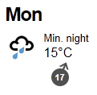
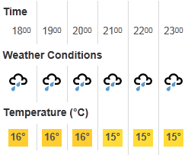
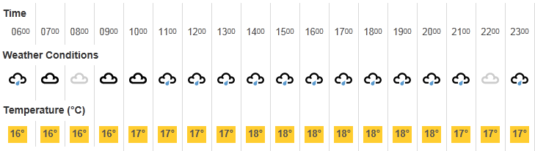
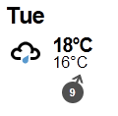
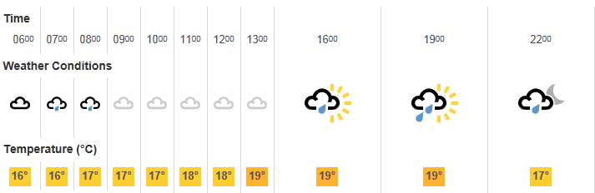
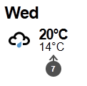
The weather forecast

Slide 17
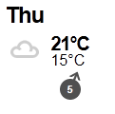
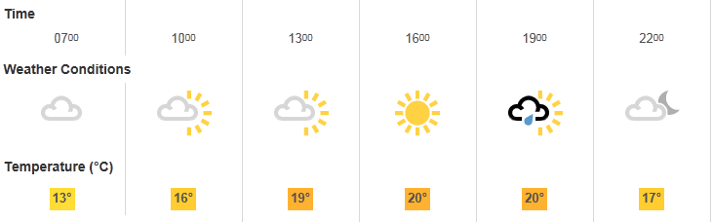
The weather forecast
Jesus College
Drinks and photographs

Slide 18
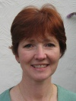
Poster sessions and training
Sue Duraikan
(Duraikan Training)
Three poster sessions:
Sue will be hovering in the room,
watching, listening and providing feedback.
Friday talk:
“How to Present a Poster at an International Conference”
Friday pm:
one-to-one feedback sessions
Notes:
Duraikan Training, a consultancy which aims to help individuals and organisations develop. Duraikan Training provides support in designing and delivering learning strategies.
She will then prepare to highlight on the final day the key thought-processes as well as the verbal and non-verbal skills you need to give a powerful poster presentation.

Slide 19
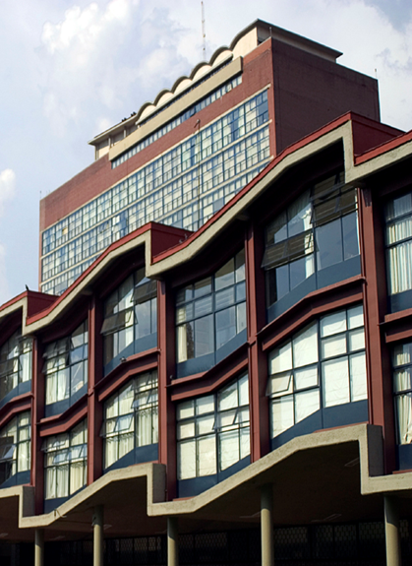

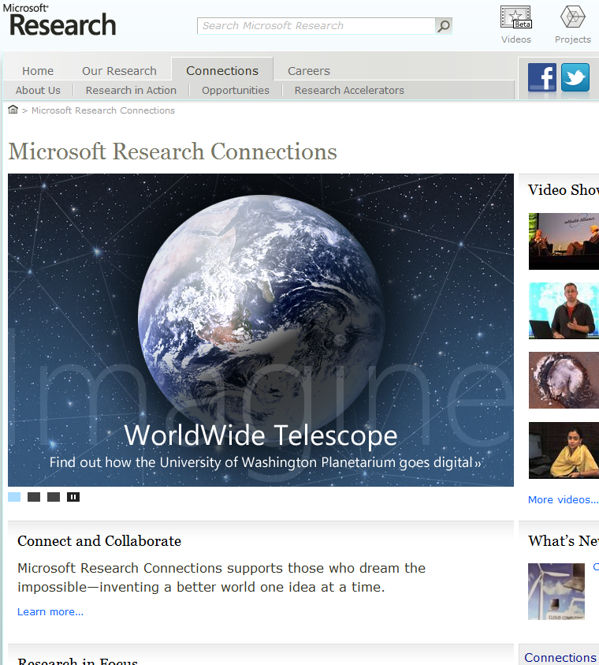
Microsoft Research Connections
Advance the State of the Art
Work with the worldwide academic research community to speed research, improve education, and foster innovation
Inspire Computer Scientists
Accelerate Discovery and Exploration

Slide 20





Engagement and Collaboration Focus
Core Computer
Science
Natural User
Interface
Earth
Energy
Environment
Education and Scholarly
Communication
Health and
Wellbeing
Research Accelerators
Global Partnerships
External Researchers
WorldWide Telescope
MS Biology Foundation
Chemistry Add-in for Word
Zentity
Trident Workflow Workbench
Centre for Computational and Systems Biology
Microsoft Research-INRIA Joint Centre
Microsoft Research Asia (MSRA) Joint Lab Program
Microsoft & FAPESP
Faculty Fellows
Graduate Women Scholars
Jim Gray eScience Award
Student Internships
ACM Student Research Competition

Slide 21
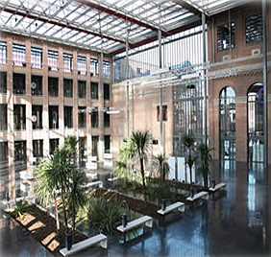
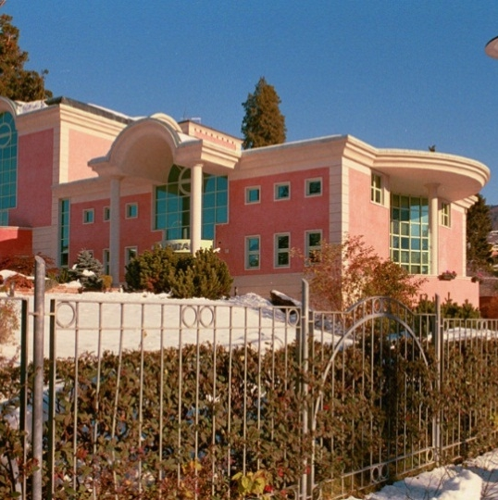
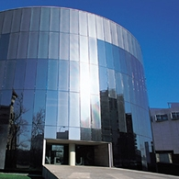
Regional Collaborations at Joint Institutes
INRIA, FRANCE
UNIVERSITY OF TRENTO, ITALY
BARCELONA SUPERCOMPUTING CENTRE, SPAIN
SOFTWARE SECURITY
SCIENTIFIC INFORMATION
INTERACTION
COMPUTATIONAL TOOLS FOR SYSTEMS BIOLOGY
MULTI CORE SYSTEMS
ARCHITECTURES AND
PROGRAMMING
LANGUAGE RUNTIMES
WWW.MSR-INRIA.INRIA.FR
WWW.COSBI.EU
WWW.BSCMSRC.EU

Slide 22
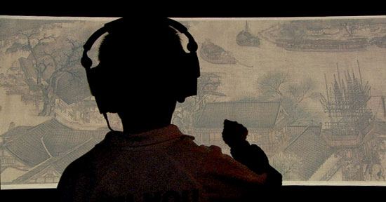
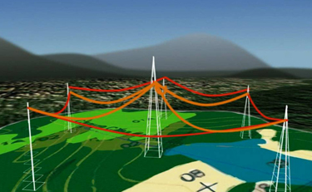

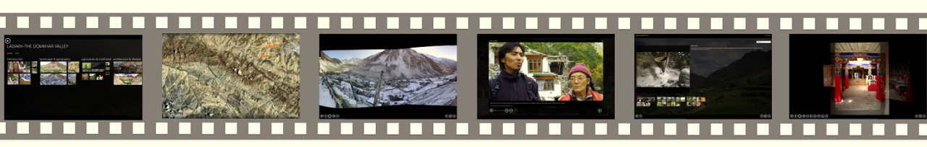
Regional Research Projects
Asia - eHeritage
Brazil - Rainforest Sensors
EMEA – Venus-C
India - Rich Interactive Narratives

Slide 23

Notes:
© 2010 Microsoft Corporation. All rights reserved. Microsoft, Windows, Windows Vista and other product names are or may be registered trademarks and/or trademarks in the U.S. and/or other countries.
The information herein is for informational purposes only and represents the current view of Microsoft Corporation as of the date of this presentation. Because Microsoft must respond to changing market conditions, it should not be interpreted to be a commitment on the part of Microsoft, and Microsoft cannot guarantee the accuracy of any information provided after the date of this presentation.
MICROSOFT MAKES NO WARRANTIES, EXPRESS, IMPLIED OR STATUTORY, AS TO THE INFORMATION IN THIS PRESENTATION.

Slide 24

© 2011 Microsoft Corporation. All rights reserved. Microsoft, Windows, Windows Vista and other product names are or may be registered trademarks and/or trademarks in the U.S. and/or other countries.
The information herein is for informational purposes only and represents the current view of Microsoft Corporation as of the date of this presentation. Because Microsoft must respond to changing market conditions, it should not be interpreted to be a commitment on the part of Microsoft, and Microsoft cannot guarantee the accuracy of any information provided after the date of this presentation.
MICROSOFT MAKES NO WARRANTIES, EXPRESS, IMPLIED OR STATUTORY, AS TO THE INFORMATION IN THIS PRESENTATION.
Notes:
© 2010 Microsoft Corporation. All rights reserved. Microsoft, Windows, Windows Vista and other product names are or may be registered trademarks and/or trademarks in the U.S. and/or other countries.
The information herein is for informational purposes only and represents the current view of Microsoft Corporation as of the date of this presentation. Because Microsoft must respond to changing market conditions, it should not be interpreted to be a commitment on the part of Microsoft, and Microsoft cannot guarantee the accuracy of any information provided after the date of this presentation.
MICROSOFT MAKES NO WARRANTIES, EXPRESS, IMPLIED OR STATUTORY, AS TO THE INFORMATION IN THIS PRESENTATION.

