Slide 1








Outlier Detection for Temporal Data
Manish Gupta
Jing Gao
Charu Aggarwal
Jiawei Han
Microsoft
SUNY
IBM
UIUC

Slide 2
Tutorial Outline
10 min
40 min
20 min
20 min
30 min
25 min
30 min
25 min
10 min
Introduction
Outlier Detection for Time Series Data
Outlier Detection for Stream Data
Outlier Detection for Stream Data in Distributed Scenarios
Break
Outlier Detection for Spatio-temporal Data
Outlier Detection for Temporal Networks
Applications of Temporal Outlier Detection Techniques
Summary, Q&A
Part 1
Part 2

Slide 3
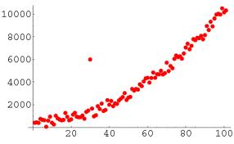
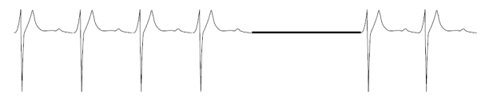




Outlier Detection
Introduction
Basic Introduction
Also called anomaly detection, event detection, novelty detection, deviant discovery, change point detection, fault detection, intrusion detection or misuse detection
Three types
Techniques: classification, clustering, nearest neighbor, density, statistical, information theory, spectral decomposition, visualization, depth, and signal processing
Outlier packages:
Data types: high-dimensional data, uncertain data, stream data, network data, time series data
Normal
Outlier
Point Outliers
Contextual Outliers
Collective Outliers

Slide 4
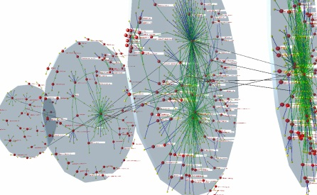
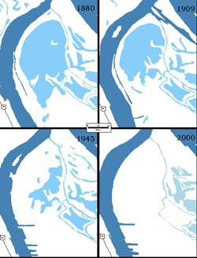
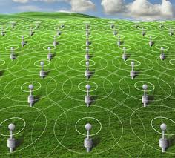

Time Series and other Temporal Data
Introduction
Temporal Data
First work on outlier detection: [Fox, 1972]
ARIMA, ARMA, VAR, VARMA, CUSUM, etc.
[Barnett and Lewis, 1978; Hawkins, 1980; Rousseeuw and Leroy, 1987]
Temporal data: Social network data, astronomy data, sensor data, computer network traffic, commercial transactions, medical records, judicial records, ...
New temporal data types
Additive Outlier
Innovative Outlier
Temporary Change
Level Shift
Time Series
Spatio-temporal
Data
Distributed Data Streams
Temporal
Databases
EmpID | Name | Department | Valid Start Time | Valid End Time
10 | Eric | CS | 1985 | 2001
20 | Bill | ECE | 1990 | 2000
30 | Sam | Biochem | 1987 | 1999
40 | Marina | Civil | 1997 | 2004
Temporal Networks
Data Streams

Slide 5
Challenges for Outlier Detection for Temporal Data
Introduction
Temporal Data
Definition of outliers such that it captures
  Properties of the data
  Properties of the network
  Space and time dimensions
Massive scale
Data trend drift detection and handling
Time efficient, single scan
Distributed data streams
  Minimize communication overhead
  Minimize computational load

Slide 6
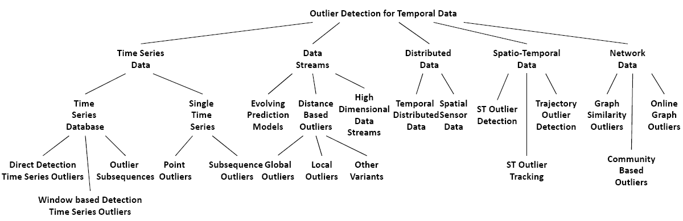
Tutorial Organization
Introduction
Organization
40 min
20 min
20 min
25 min
30 min

Slide 7
Outlier Detection for Time Series Data
Outlier Detection for Time Series Data
Outline
Outliers in Time Series Databases
  Direct Detection of Outlier Time Series
    Unsupervised Discriminative Approaches
    Unsupervised Parametric Approaches
    Supervised Approaches
  Window-based Detection of Outlier Time Series
  Outlier Subsequences in a Test Time Series
Outliers Within a Given Time Series
  Points as Outliers
  Subsequences as Outliers

Slide 8
Time Series vs. Discrete Sequences
Outlier Detection for Time Series Data
Time series data
  Numeric data across time
  Studied more in the statistics community
  Techniques include AR, VAR, ARIMA models, etc.
  Outliers are mainly detected based on forecasts
Discrete Sequences
  Labels across time
  Studied more in the data mining community
  Techniques include Markov models, etc.
  Outliers are defined in various ways like distance outliers, etc.
Some techniques like clustering are shared for both types of data
Some techniques discretize time series to sequences

Slide 9
Unsupervised Discriminative Approaches
Outlier Detection for Time Series Data
Outliers in Time Series Databases
Direct Detection of Outlier Time Series
Problem: Given a time series database, find anomalous time series sequences
Compute the clustering space (features)
Define a similarity function to compare two time series
Cluster the sequences using some clustering algo
Anomaly score = distance to closest centroid
Most popular similarity measure: length of the longest common subsequence
  t₁=XMJYAUZ and t₂=MZJAWXU, LCS=MJAU, nLCS=4

Slide 10
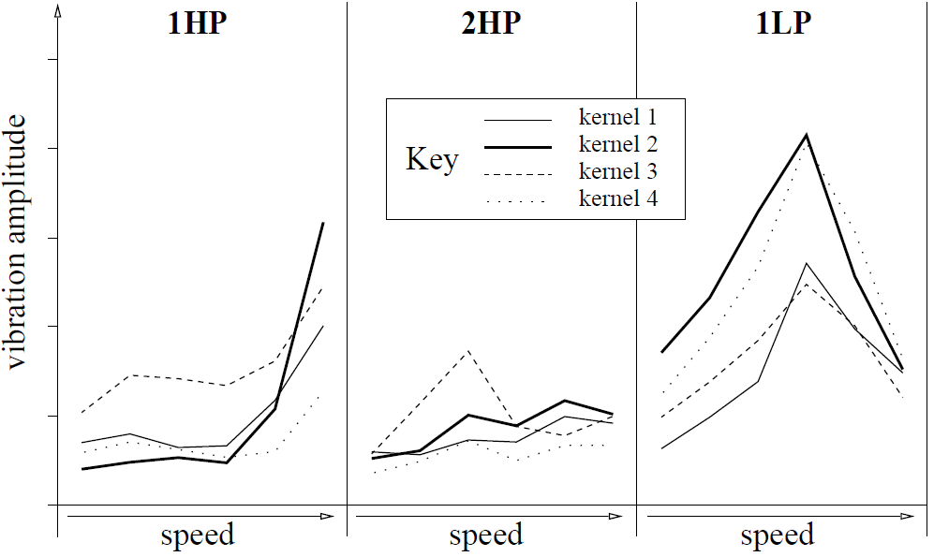
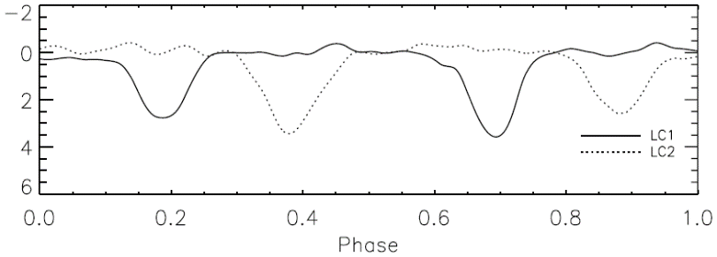
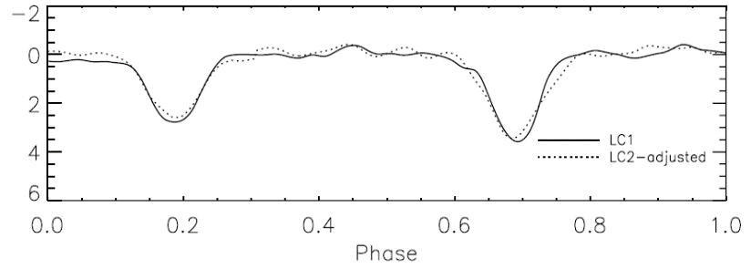
Unsupervised Discriminative Approaches
Outlier Detection for Time Series Data
Outliers in Time Series Databases
Direct Detection of Outlier Time Series
nLCS with kmedoids [Budalakoti et al., 2006; Budalakoti et al., 2009]
nLCS with a variant of kNN [Chandola et al., 2008]
  Anomaly score = Distance to the k^{th} closest sequence
Windowed subsequences with match count based sequence similarity with a threshold [Lane et al., 1997]
Windowed subsequences with K-Means [Nairac et al., 1999]
Duration, protocol type, #bytes for TCP connection with Euclidean distance and single-linkage clustering [Portnoy et al., 2001]
Phased K-Means [Rebbapragada et al., 2009]

Slide 11
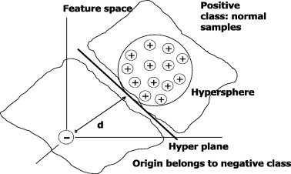
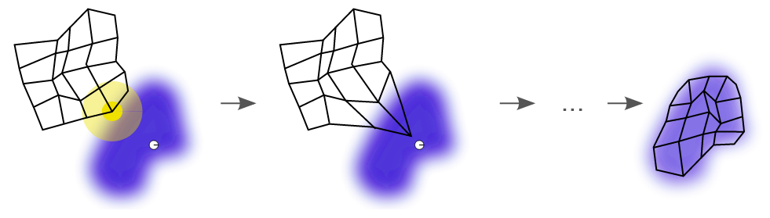
Unsupervised Discriminative Approaches
Outlier Detection for Time Series Data
Outliers in Time Series Databases
Direct Detection of Outlier Time Series
1-class SVM with discretized data [Szymanski and Zhang, 2004]
Kernel-based feature maps of raw data with kNN or 1-class SVM [Eskin et al., 2002]
1-class SVM [Evangelista et al., 2005; Ma and Perkins, 2003b]
Self organizing maps with windowed subsequences [González and Dasgupta, 2003]

Slide 12
Unsupervised Parametric Approaches
Outlier Detection for Time Series Data
Outliers in Time Series Databases
Direct Detection of Outlier Time Series
Value at any time point in the series depends on the values at previous few time points
Anomaly score for time series is a function of the anomaly score of its values at each time point
Markov models
  Fixed history size
  Variable history size
  Selective history (Sparse Markovian)
Hidden Markov models

Slide 13
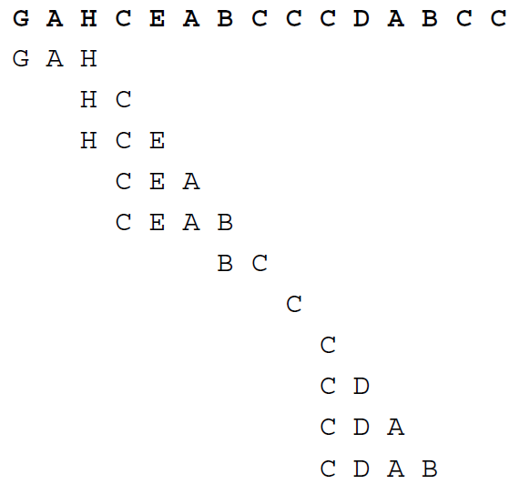
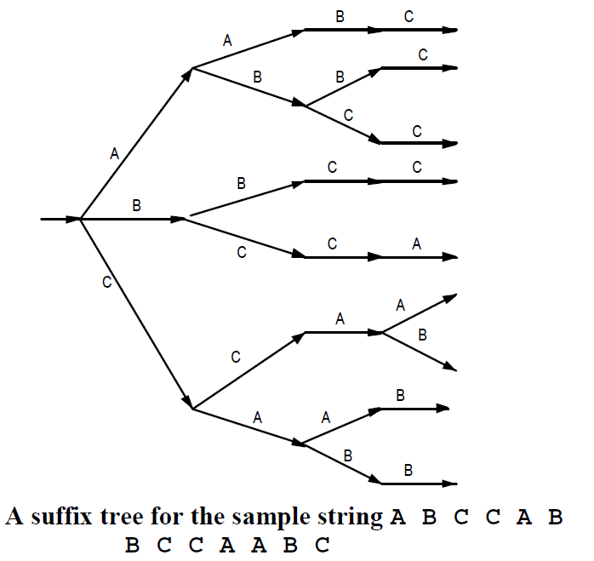
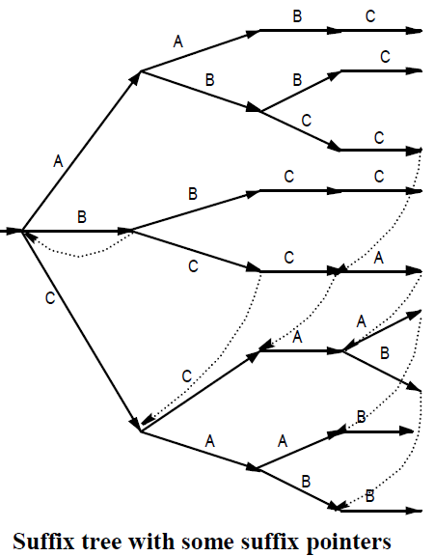
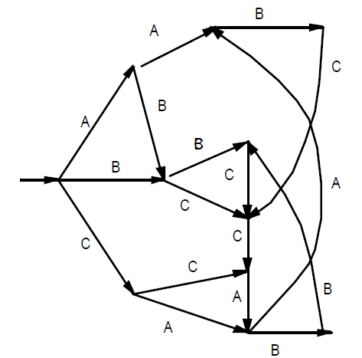
Unsupervised Parametric Approaches
Outlier Detection for Time Series Data
Outliers in Time Series Databases
Direct Detection of Outlier Time Series
Markov model with k=1 [Ye, 2000]
Finite state automaton (FSA) [Marceau, 2000]
  N-grams (length-N system call sequences)
FSA is also used by [Salvador and Chan, 2005; Chandola et al., 2008; Michael and Ghosh, 2000]
Multiple sub-sequences
Automaton resulting from
compression

Slide 14
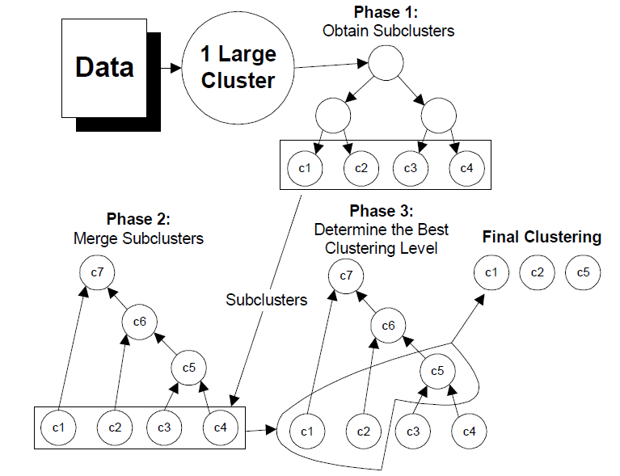
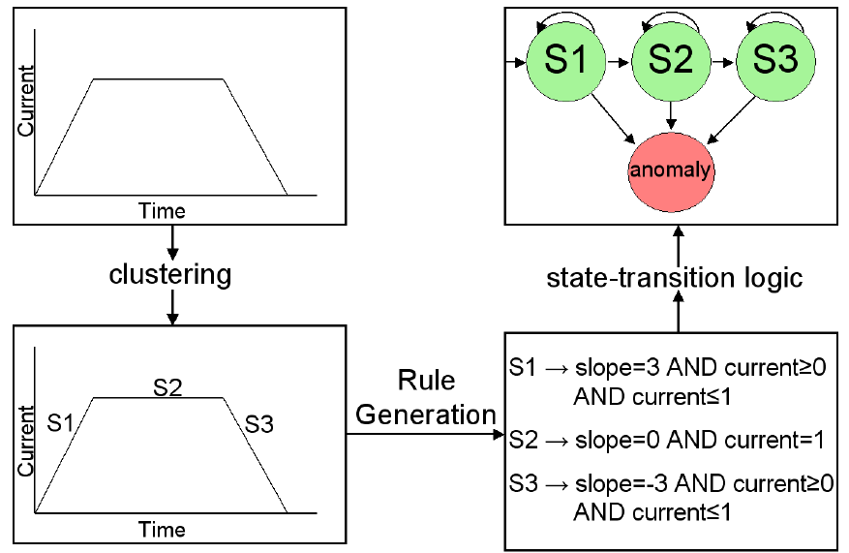
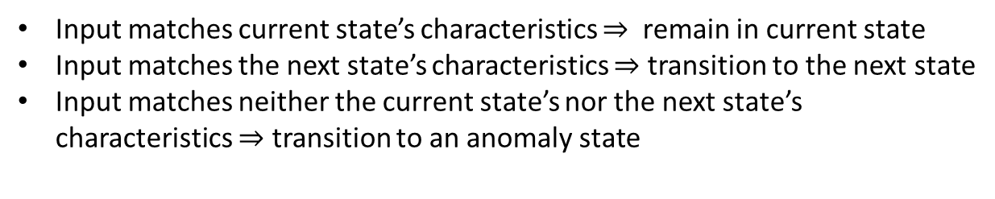
Unsupervised Parametric Approaches
Outlier Detection for Time Series Data
Outliers in Time Series Databases
Direct Detection of Outlier Time Series
Finite state automaton (FSA) [Salvador and Chan, 2005]
L-Method
RIPPER
Main steps in anomaly detection
Clustering methodology
Input matches current state’s characteristics $⇒$ remain in current state
Input matches the next state’s characteristics $⇒$ transition to the next state
Input matches neither the current state’s nor the next state’s
characteristics $⇒$ transition to an anomaly state

Slide 15
Supervised Approaches
Outlier Detection for Time Series Data
Outliers in Time Series Databases
Direct Detection of Outlier Time Series
Positional system calls features with the RIPPER classifier [Lee and Stolfo, 1998]
Subsequences of positive and negative strings of behavior as features with
  String matching classifier [Cabrera et al., 2001; González and Dasgupta, 2003]
  Neural networks [Dasgupta and Nino, 2000; Endler, 1998; Gosh et al., 1998; Ghosh et al., 1999a; Ghosh and Schwartzbard, 1999]
  Elman network [Ghosh et al., 1999a]
Motion features with SVMs [Li et al., 2006]
Bag of system calls features with decision tree, Naive Bayes, SVMs [Kang et al., 2005]
Sliding window subsequences with
  SVMs [Tian et al., 2007; Wang et al., 2006],
  Rule based classifiers (Classification using Hierarchical Prediction Rules (CHIP)) [Li et al., 2007]
  HMMs [Gao et al., 2002]

Slide 16
Outlier Detection for Time Series Data
Outlier Detection for Time Series Data
Outline
Outliers in Time Series Databases
  Direct Detection of Outlier Time Series
  Window-based Detection of Outlier Time Series
    Normal Pattern Database Approaches
    Negative/Mixed Pattern Database Approaches
  Outlier Subsequences in a Test Time Series
Outliers Within a Given Time Series
  Points as Outliers
  Subsequences as Outliers

Slide 17




Introduction
Outlier Detection for Time Series Data
Outliers in Time Series Databases
Window-based Detection of Outlier Time Series
Test
Sequence s
Normal
or Abnormal
Windows
Database
Windows
$$AS(w_{1})$$
$$AS(w_{2})$$
$$AS(w_{T})$$
$$AS(s)$$
Advantage: Better localization of anomalies compared to techniques that compute time series outlier score directly
Disadvantage: New parameter -- window length parameter
Windows: Also called fingerprints, pattern fragments, detectors, sliding windows, motifs, n-grams

Slide 18
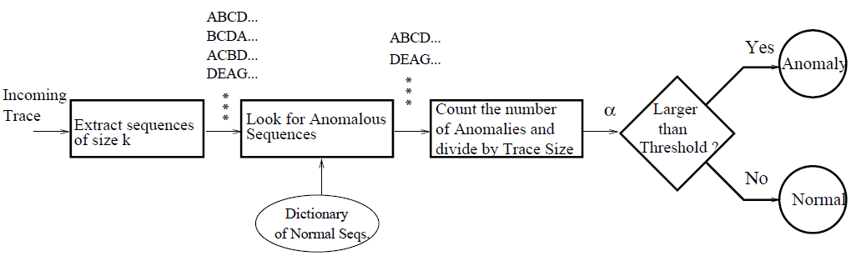
Normal Pattern Database Approaches
Outlier Detection for Time Series Data
Outliers in Time Series Databases
Window-based Detection of Outlier Time Series
Sequence TIme-Delay Embedding (STIDE) [Hofmeyr et al., 1998]
  Normal sequences are divided into size k overlapping windows
  For a test sequence, again size k subsequences are obtained and those subsequences that do not occur in normal database are considered as mismatches
  If a test sequence has large number of mismatches, it is marked as an anomaly
  If a subsequence is not in the database, the mismatch score is computed as the minimum Hamming distance between the window and any of the subsequences in normal database normalized by k
Also used in [Cabrera et al., 2001; Endler, 1998; Gao et al., 2002; Ghosh et al., 1999a; Ghosh et al., 1999b]
Train sequence
(open, read, mmap, mmap, open, read, mmap)
Normal Database
1. open, read, mmap 2. read, mmap, mmap
3. mmap, mmap, open 4. mmap, open, read
Test sequence
(open, read, mmap, mmap, open, mmap, mmap)
2 mismatches
1. mmap, open, mmap 2. open, mmap, mmap

Slide 19
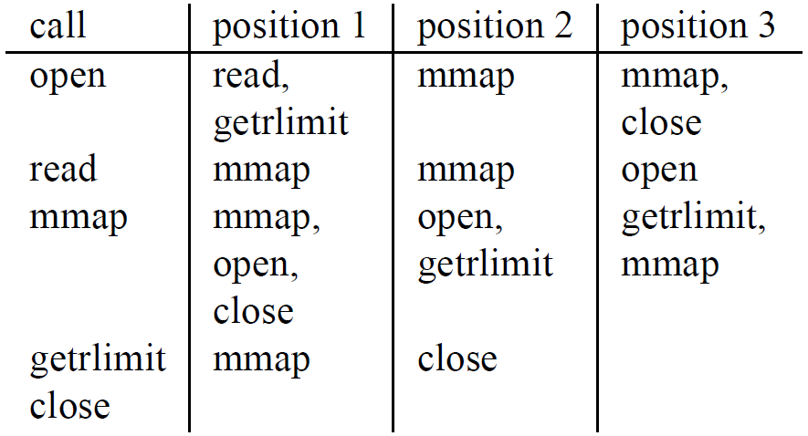
Normal Pattern Database Approaches
Outlier Detection for Time Series Data
Outliers in Time Series Databases
Window-based Detection of Outlier Time Series
TIme-Delay Embedding (TIDE) [Forrest et al., 1996]
  For every element in every normal sequence, the elements occurring at distance 1,2,. . ., k in the sequence are noted
  A normal database of such occurrences is created
  Given a new test sequence, again a lookahead of the same size k is used
  Each pair of element occurrence is checked with the normal database and the number of mismatches is computed
  Anomaly score of the test sequence is the number of mismatches normalized by the total number of such occurrence pairs
Train: open, read, mmap, mmap, open, getrlimit, mmap, close
Test: open, read, mmap, open, open, getrlimit, mmap, close
4 mismatches
open is not followed by open at position 3
read is not followed by open at position 2
open is not followed by open at position 1
open is not followed by getrlimit at position 2

Slide 20
Negative and Mixed Pattern DB Approaches
Outlier Detection for Time Series Data
Outliers in Time Series Databases
Window-based Detection of Outlier Time Series
Anomaly dictionaries are used in [Dasgupta and Nino, 2000; Dasgupta and Majumdar, 2002; D’haeseleer et al., 1996; Forrest et al., 1994; González and Dasgupta, 2003]
Normal
Sequences
Optional Processing
like DWT [Dasgupta
and Nino, 2000]
Processed
Sequences
Length-w windows
Test Sample
Normal Samples
Classifier/
Negative Profile
Detectors
Anomaly Score

Slide 21
Negative and Mixed Pattern DB Approaches
Outlier Detection for Time Series Data
Outliers in Time Series Databases
Window-based Detection of Outlier Time Series
Finding detectors or negative subsequences
  Not in the normal set
  Differ in at least r contiguous positions [D’haeseleer et al., 1996; Dasgupta and Majumdar, 2002]
    Naïve [Forrest et al., 1994]
    Dynamic programming algorithm
    Greedy algorithm
  Differ in at least r contiguous chunks [Dasgupta and Nino, 2000]
  Real-valued space: Detector is a hypersphere in n-dimension space with radius <1 [González and Dasgupta, 2003]
Self (Normal)
Strings
Generate
Random
Strings
no
Detector
Set
Match
yes
Reject
Detectors can be generated randomly or using some domain knowledge of situations that are not expected to occur in normal sequences
  Should be far from normal
  Should maximize the covering of non-self space [González and Dasgupta, 2003]

Slide 22
Outlier Detection for Time Series Data
Outlier Detection for Time Series Data
Outline
Outliers in Time Series Databases
  Direct Detection of Outlier Time Series
  Window-based Detection of Outlier Time Series
  Outlier Subsequences in a Test Time Series
Outliers Within a Given Time Series
  Points as Outliers
  Subsequences as Outliers

Slide 23
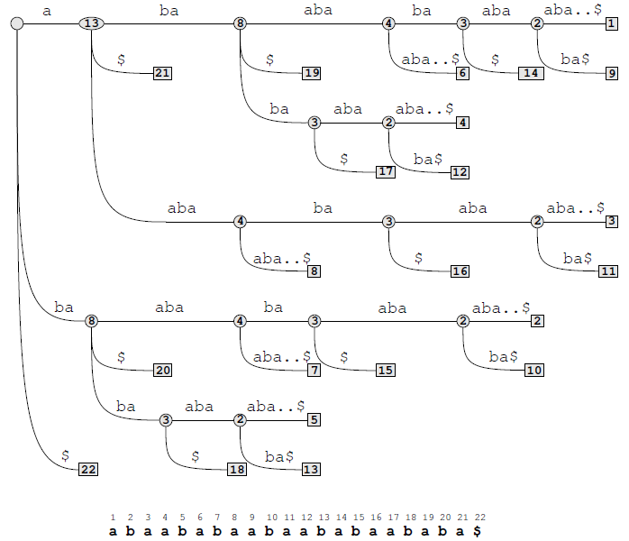
Outlier Subsequences in a Test Time Series
Outlier Detection for Time Series Data
Outliers in Time Series Databases
Given a test time series, a subsequence p is reported as an outlier if its frequency in the test time series t is substantially different from its expected frequency estimated using a time series database D
TARZAN algorithm exploits suffix trees [Keogh et al., 2002; Lin et al., 2003; Lin et al., 2007]
  Discretize time series
  Build the suffix tree for the reference string and test string
  For each substring in test string, calculate its frequency of occurrence in both reference string and test string
  Adjust the frequency in reference string to get estimated frequency in test string
  If substring w in test string does not occur in reference string, use suffix tree for reference string to look for the longest set of strings from reference string that cover w and then use Markov method to estimate its freq in test string
  If the difference is greater than threshold, mark the substring as anomaly

Slide 24
Outlier Subsequences in a Test Time Series
Outlier Detection for Time Series Data
Outliers in Time Series Databases
[Keogh et al., 2002] define a soft match version of the problem where the frequency of pattern p in the database D is defined using the largest number l such that every subsequence of p of length l occurs at least once in D
Another form of soft match is defined in [Atallah et al., 2004] where rather than a match of pattern p, any permutation of p is also considered to be a match
[Gwadera et al., 2005b; Gwadera et al., 2005a] have proposed Interpolated Markov Models (IMM) to efficiently compute the match score of a pattern or its permutations with any time series
Notes:
Variable-length Markov models are Markov models where the number of model parameters can be significantly reduced by merging equivalent states (contexts of length k) that have identical conditional probabilities
The interpolated model is a variable-length Markov chain where a conditional probability of order k is a combination of equal and lower order probabilities weighted by interpolation parameters, giving high weight to probability estimates corresponding to high frequency contexts and lower weight to estimates corresponding to low frequency contexts

Slide 25
Outlier Detection for Time Series Data
Outlier Detection for Time Series Data
Outline
Outliers in Time Series Databases
  Direct Detection of Outlier Time Series
  Window-based Detection of Outlier Time Series
  Outlier Subsequences in a Test Time Series
Outliers Within a Given Time Series
  Points as Outliers
    Prediction Models
    Profile Similarity-based Approaches
    Deviants
  Subsequences as Outliers

Slide 26
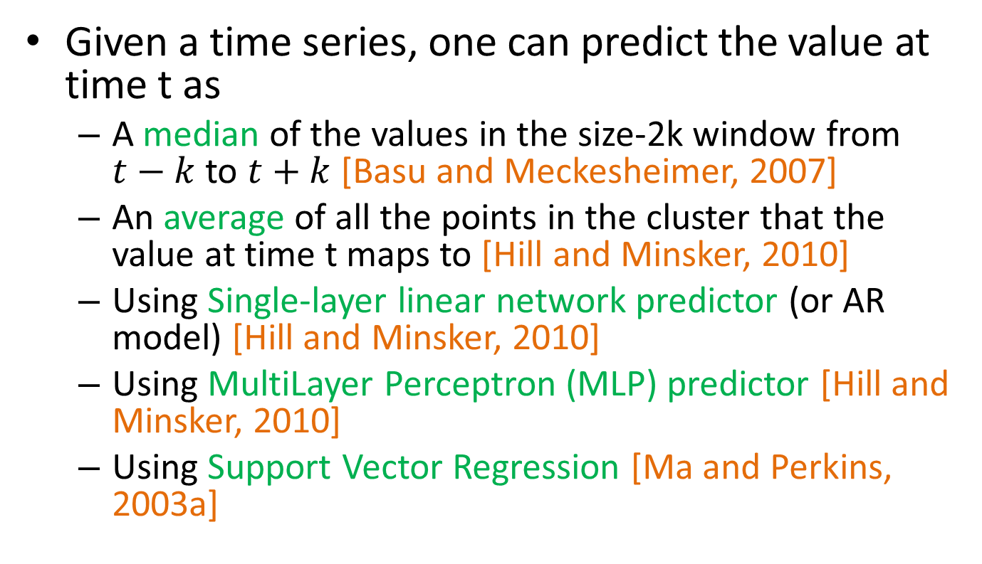
Prediction Models
Outlier Detection for Time Series Data
Outliers Within a Given Time Series
Points as Outliers
Given a time series, one can predict the value at time t as
  A median of the values in the size-2k window from $t−k$ to $t+k$ [Basu and Meckesheimer, 2007]
  An average of all the points in the cluster that the value at time t maps to [Hill and Minsker, 2010]
  Using Single-layer linear network predictor (or AR model) [Hill and Minsker, 2010]
  Using MultiLayer Perceptron (MLP) predictor [Hill and Minsker, 2010]
  Using Support Vector Regression [Ma and Perkins, 2003a]

Slide 27
Profile Similarity-based Approaches
Outlier Detection for Time Series Data
Outliers Within a Given Time Series
Points as Outliers
These approaches maintain a normal profile and then compare a new time point against this profile to decide whether it is an outlier
For multiple OS performance metric time series, the Tiresias system [Williams et al., 2007] maintains a normal profile and also a variance vector
  Any new data point is compared both with the normal profile and the variance vector to compute its anomaly score
  Profile is the actual smoothed time series data from past datasets
In [Silvestri et al., 1994], a neural network is used to maintain the normal profile and an estimation is made for the next value in the sensor stream based on this profile

Slide 28
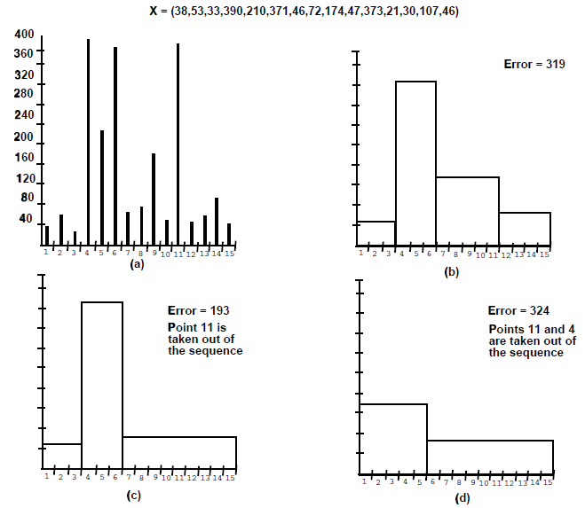
Deviant Detection
Outlier Detection for Time Series Data
Outliers Within a Given Time Series
Points as Outliers
The problem is to find points in a given time series whose removal from the series results in a histogram representation with a lower error bound than the original, even after the number of buckets has been reduced to account for the separate storage of these deviant points [Jagadish et al., 1999]
They propose a dynamic programming mechanism to solve the problem
[Muthukrishnan et al., 2004]
  For any bucket, the optimal set of k deviants within the bin always consists of the l highest and remaining k-l lowest values for some l <= k
  Propose an approximation to the dynamic programming based solution that maintains a partial solution only for a few interspersed indexes of the time series rather than for each value
390 and 373 are deviants

Slide 29
Outlier Detection for Time Series Data
Outlier Detection for Time Series Data
Outline
Outliers in Time Series Databases
  Direct Detection of Outlier Time Series
  Window-based Detection of Outlier Time Series
  Outlier Subsequences in a Test Time Series
Outliers Within a Given Time Series
  Points as Outliers
  Subsequences as Outliers
    Discords
    Multi-Scale Anomaly Detection

Slide 30
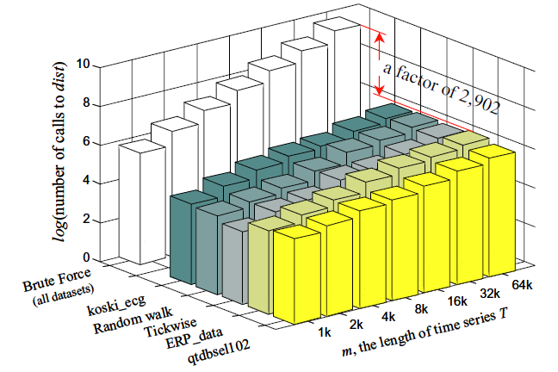
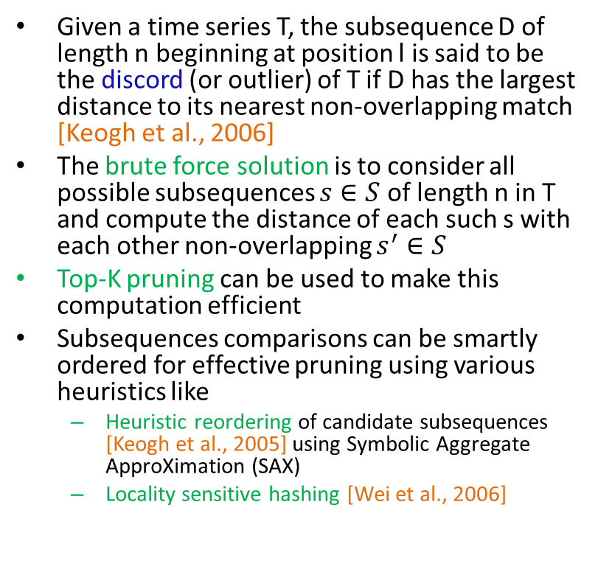
Discord Discovery: Outlier Subsequences
Outlier Detection for Time Series Data
Outliers Within a Given Time Series
Subsequences as Outliers
Given a time series T, the subsequence D of length n beginning at position l is said to be the discord (or outlier) of T if D has the largest distance to its nearest non-overlapping match [Keogh et al., 2006]
The brute force solution is to consider all possible subsequences $s∈S$ of length n in T and compute the distance of each such s with each other non-overlapping $s^{′}∈S$
Top-K pruning can be used to make this computation efficient
Subsequences comparisons can be smartly ordered for effective pruning using various heuristics like
  Heuristic reordering of candidate subsequences [Keogh et al., 2005] using Symbolic Aggregate ApproXimation (SAX)
  Locality sensitive hashing [Wei et al., 2006]
The number of calls to the Euclidean distance function required by brute force and heuristic search over a range of data sizes for 5 representative datasets

Slide 31
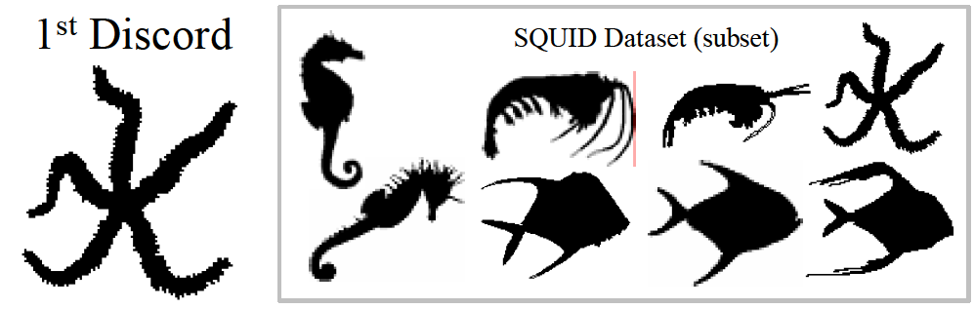
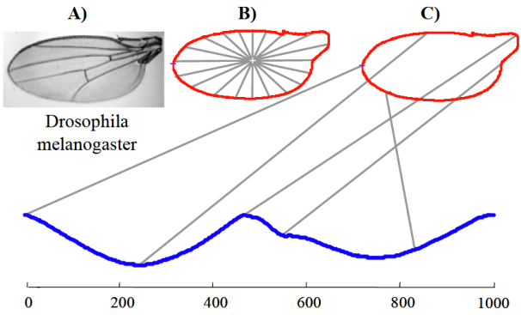
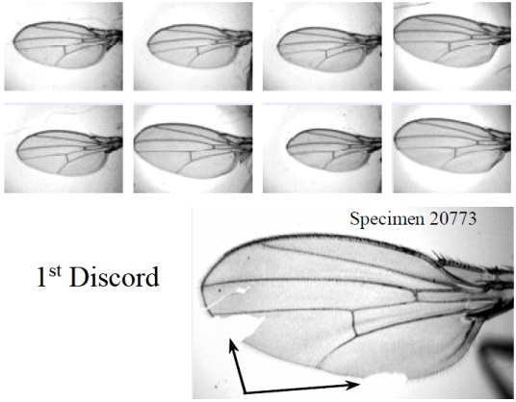
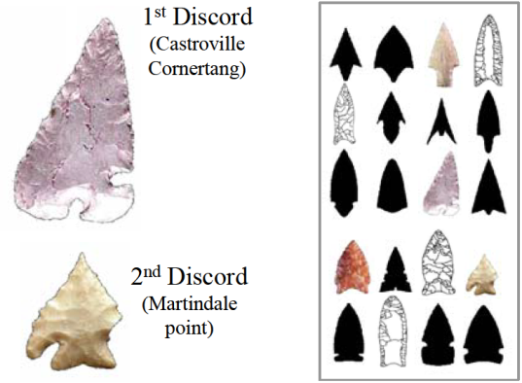
Shape Discords [Wei et al., 2006]
Outlier Detection for Time Series Data
Outliers Within a Given Time Series
Subsequences as Outliers
Problem of finding shape discords, the most unusual shapes in a collection
Rotation invariant Euclidean Distance between images
Locality-Sensitive Hashing
  Estimation of similarity based on sparse sampling of positions from feature vectors has been used in diverse areas for different purposes
  Define a rotation invariant locality-sensitive hash (LSH) function
  Similar shapes (even with different orientations) are more likely to be mapped together to same LSH value

Slide 32
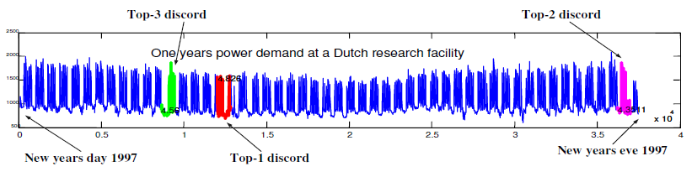
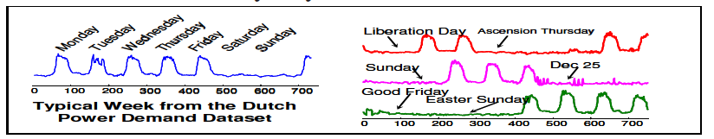
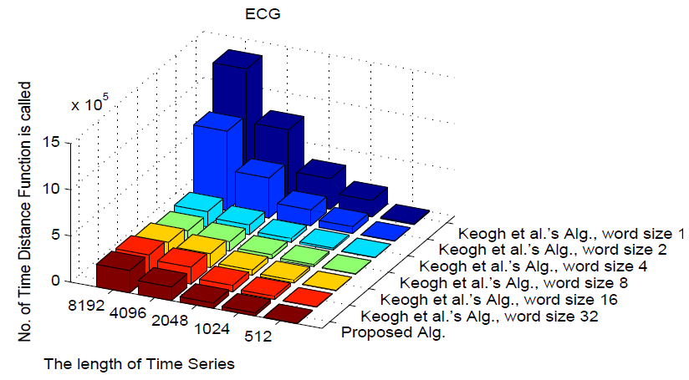
Discords: Haar Wavelet & Augmented Tries
Outlier Detection for Time Series Data
Outliers Within a Given Time Series
Subsequences as Outliers
[Bu et al., 2007; Fu et al., 2006]
A Haar wavelet and augmented trie based algorithm to mine the top-K discords from a time series database
Haar wavelet tranform
  provides better pruning power
  can dynamically determine the word size (unlike SAX)
Steps
  Time series
  Haar wavelet transform
  Normalize Haar wavelet coefficients
  Identify cutpoints by treating this distribution as Gaussian such that area between any 2 cutpoints is same
  Map Haar coefficients to symbols based on cutpoints
  Construct a trie from these words
  Use the trie to perform appropriate ordering of subsequences to use as candidates and compare
Top-3 discords in power consumption history of a Dutch research facility in year 1997

Slide 33
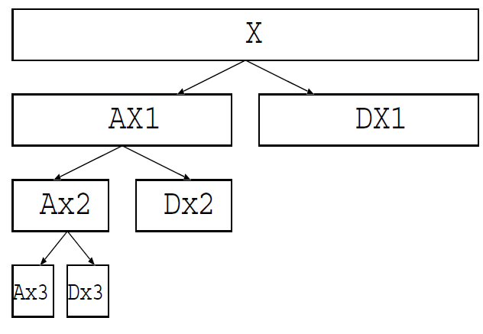
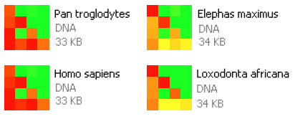
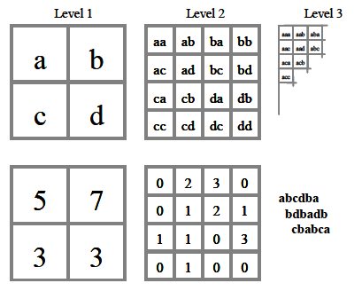
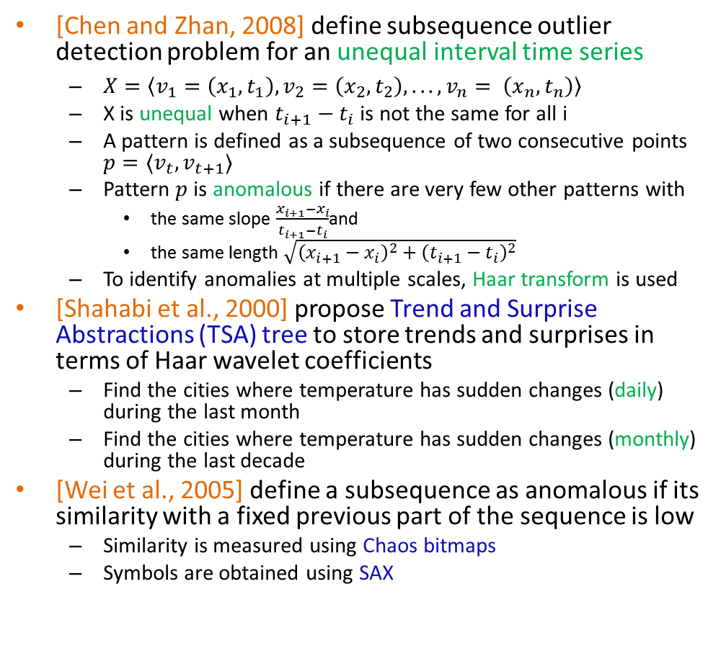
Multi-scale Anomaly Detection
Outlier Detection for Time Series Data
Outliers Within a Given Time Series
Subsequences as Outliers
[Chen and Zhan, 2008] define subsequence outlier detection problem for an unequal interval time series
  $X=〈v_{1}=\left(x_{1}, t_{1}\right), v_{2}=\left(x_{2}, t_{2}\right), . . ., v_{n}= \left(x_{n}, t_{n}\right)〉$
  X is unequal when $t_{i+1}−t_{i}$ is not the same for all i
  A pattern is defined as a subsequence of two consecutive points $p=〈v_{t}, v_{t+1}〉$
  Pattern $p$ is anomalous if there are very few other patterns with
    the same slope $\frac{x_{i+1}−x_{i}}{t_{i+1}−t_{i}}$and
    the same length $\sqrt{{\left(x_{i+1}−x_{i}\right)}^{2}+{\left(t_{i+1}−t_{i}\right)}^{2}}$
  To identify anomalies at multiple scales, Haar transform is used
[Shahabi et al., 2000] propose Trend and Surprise Abstractions (TSA) tree to store trends and surprises in terms of Haar wavelet coefficients
  Find the cities where temperature has sudden changes (daily) during the last month
  Find the cities where temperature has sudden changes (monthly) during the last decade
[Wei et al., 2005] define a subsequence as anomalous if its similarity with a fixed previous part of the sequence is low
  Similarity is measured using Chaos bitmaps
  Symbols are obtained using SAX
TSA-tree
Chaos Bitmaps

Slide 34
Outlier Detection for Stream Data
Outlier Detection for Stream Data
Outline
Evolving Prediction Models
  Online Sequential Discounting Algorithms
  Dynamic Bayesian Networks
Distance Based Outliers
  Global Outliers
  Local Outliers
  Other Variants

Slide 35
SmartSifter - Sequential Discounting for Categorical Variables
Outlier Detection for Stream Data
Evolving Prediction Models
[Yamanishi and Takeuchi, 2002; Yamanishi et al., 2004]
Online Sequential Discounting Algorithms
  Incrementally learn the probabilistic model of the data source every time a data item is input
  The model forgets the effect of past data gradually
  Outlier score is high for a data point if its score based on the learned model is high
  For categorical variables
  SDLE (Sequential Discounting Laplace Estimation)
    Cells are created by partitioning the space of all values of all categorical variables
    The probability p(x) of a cell is the number of values in that cell divided by total data points with the Laplace smoothing
    When a new data point arrives, the count for all the cells are adjusted with temporal discounting and appropriate Laplace smoothing is applied

Slide 36
SmartSifter - Sequentially Discounting Model for Continuous Variables
Outlier Detection for Stream Data
Evolving Prediction Models
Independent Model
  Parametric case
    Gaussian mixture model
    Sequentially Discounting EM (SDEM) algorithm
      Incremental EM with discounting of effect of past examples
      Iteratively learns coefficients of the mixture and the mean and variance of Gaussians
      [Guo et al., 2006] propose a variant for computer network data
  Non-parametric case
    Kernel mixture model
    Sequentially Discounting Prototype Updating (SDPU) algorithm
      Coefficients of the mixture and the variance matrix are fixed
      Iteratively learns only the means of the kernels or the prototypes
Time Series Model
  Sequentially Discounting AR (SDAR) algorithm
    Learns the AR model parameters iteratively with time discounting
    [Jiang et al., 2006] propose an ARX variant for computer network data

Slide 37
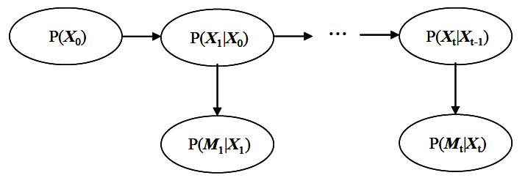
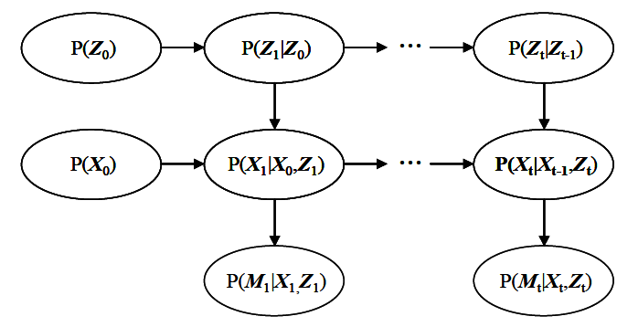
Dynamic Bayesian Networks
Outlier Detection for Stream Data
Evolving Prediction Models
The model can be changed by itself to incorporate drifts in the data stream
[Hill et al., 2007] present an approach that uses Dynamic Bayesian networks which are Bayesian networks with network topology that evolves over time, adding new state variables to represent the system state at the current time t
Kalman filtering used for inference
Posterior distribution of the observed state variables is then used to construct a Bayesian credible interval (BCI)
Measurements outside of the p% BCI are anomalies
Status (e.g. normal/anomalous) of each measurement is also modeled as a hidden state
Maximum a posteriori measurement status (MAP-ms) of hidden state variable is used to classify the measurement as normal or anomalous

Slide 38
Outlier Detection for Stream Data
Outlier Detection for Stream Data
Outline
Evolving Prediction Models
  Online Sequential Discounting Algorithms
  Dynamic Bayesian Networks
Distance Based Outliers
  Global Outliers
  Local Outliers
  Other Variants

Slide 39
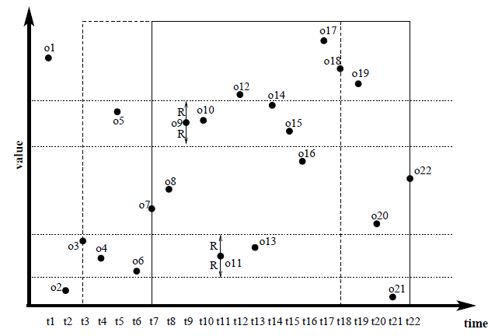
Distance based Outliers in Data Streams
Outlier Detection for Stream Data
Distance-based Outliers for Sliding Windows
Distance-based Global Outliers
Given a data stream, the problem is to find distance based outliers at any time window [Angiulli and Fassetti, 2007; Yang et al., 2009]
As stream evolves
  Old objects expire, new come in
  #preceding neighbors of any object decreases
  Object could become an outlier
Since any object will expire before its succeeding neighbors, inliers having at least k succeeding neighbors will be always safe inliers
[Angiulli and Fassetti, 2007] propose an exact algorithm to efficiently compute such outliers using a new data structure called Indexed Stream Buffer (ISB) which supports a range query search
Exploit two heuristics
  It is sufficient to retain in ISB only a fraction of safe inliers
  Rather than storing the list of k most recent preceding neighbors, it is enough to store only the fraction of preceding neighbors which are safe inliers to the total number of safe inliers

Slide 40
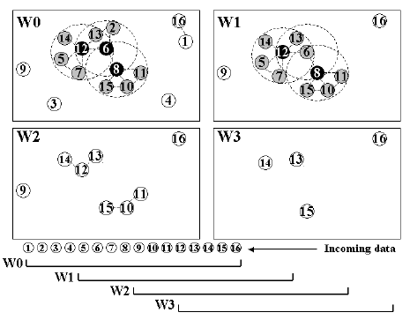
Exploiting Predictability of Object Expiration
Outlier Detection for Stream Data
Distance-based Outliers for Sliding Windows
Distance-based Global Outliers
[Yang et al., 2009] propose that maintaining all neighbor relationships across time may be very expensive
So abstracted neighbor relationships can be maintained
But maintaining such cluster abstractions is expensive too
So, they exploit the “predictability” of the expiration of existing objects
Based on expiration of objects, they create “predicted views” of each future window
Abstract-C algorithm makes use of the predicted views to compute distance based outliers

Slide 41
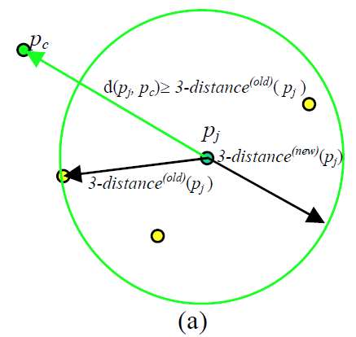
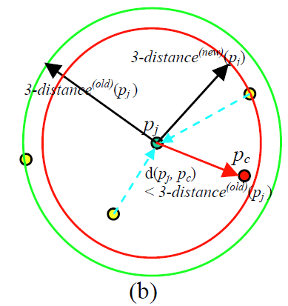
Incremental Local Outlier Detection for Streams
Outlier Detection for Stream Data
Distance-based Outliers for Sliding Windows
Distance-based Local Outliers
Static Local Outlier Factor (LOF) [Breunig et al., 2000] can be applied to the incremental LOF problem as
  Periodic LOF: Apply LOF on entire data set periodically
  Supervised LOF: Compute the k-distances, local reachability density (LRD) and LOF using training data and use them to find outliers in test data
  Iterated LOF: Re-apply static LOF every time a new data record is inserted into the data set
[Pokrajac et al., 2007] propose an incremental LOF algorithm
When a new data point arrives
  Insertion of new record
    Compute reachability distance, LRD and LOF of new point
  Maintenance
    Update k-distances, reachability distance, LRD and LOF for affected existing points (which is independent of #objects)
Maintained statistics are used to instantly determine whether inserted data record is outlier
Update of kNN distance on insertion of new record (k=3) (a) 3NN does not change (b) 3NN changes

Slide 42
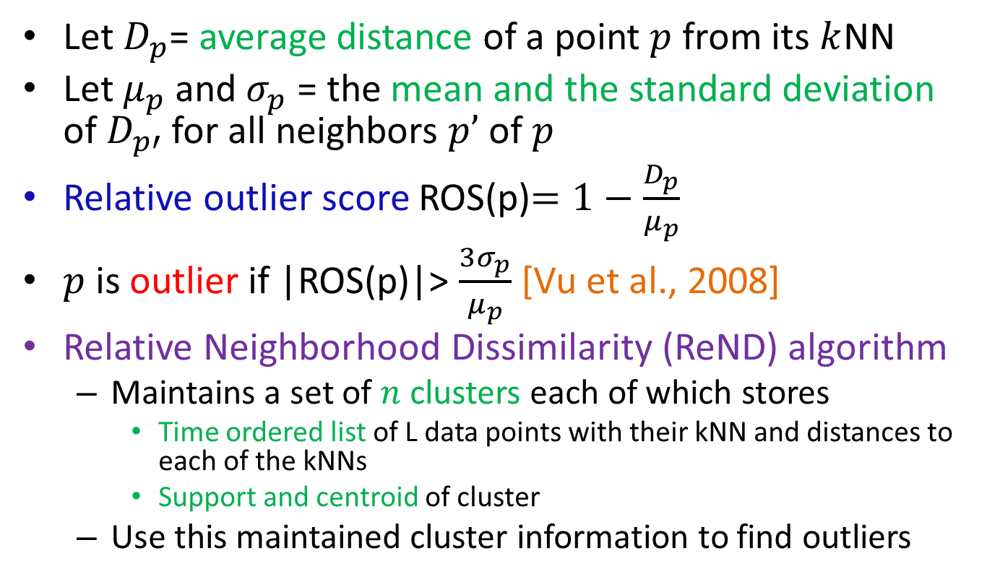
Relative Neighborhood Dissimilarity
Outlier Detection for Stream Data
Distance-based Outliers for Sliding Windows
Distance-based Local Outliers
Let $D_{p}$= average distance of a point $p$ from its $k$NN
Let $μ_{p}$ and $σ_{p}$ = the mean and the standard deviation of $D_{p′}$ for all neighbors $p’$ of $p$
Relative outlier score ROS(p)$=1−\frac{D_{p}}{μ_{p}}$
$p$ is outlier if |ROS(p)|> $\frac{3σ_{p}}{μ_{p}}$ [Vu et al., 2008]
Relative Neighborhood Dissimilarity (ReND) algorithm
  Maintains a set of $n$ clusters each of which stores
    Time ordered list of L data points with their kNN and distances to each of the kNNs
    Support and centroid of cluster
  Use this maintained cluster information to find outliers

Slide 43
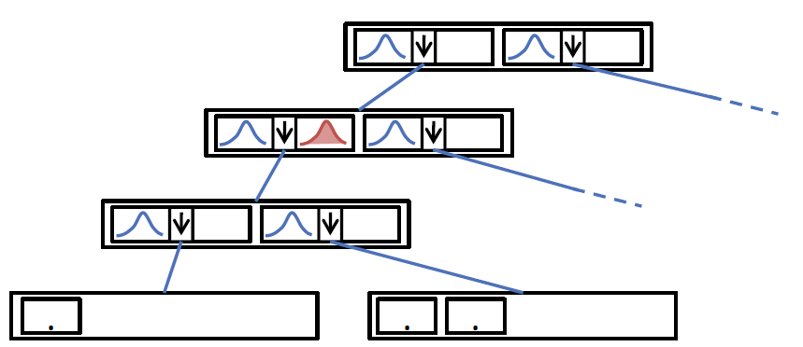
AnyOut
Outlier Detection for Stream Data
Distance-based Outliers for Sliding Windows
Other Variants
[Assent et al., 2012] present AnyOut algorithm based on a hierarchical cluster tree
The cluster tree is maintained in an incremental way
  Each cluster stores the cluster feature: CF = (n, LS, SS)
As long as time is available, the hierarchy is traversed to determine
  Mean Outlier Score: Deviation between the object and a cluster center
  Density Outlier Score: Gaussian probability density for the object
Until interrupted, more fine grained resolution of the clustering structure is analyzed
ClusTree: Node entries represent clusters (descriptor, child pointer, buffer); child nodes are more fine grained clusters of the parent data

Slide 44
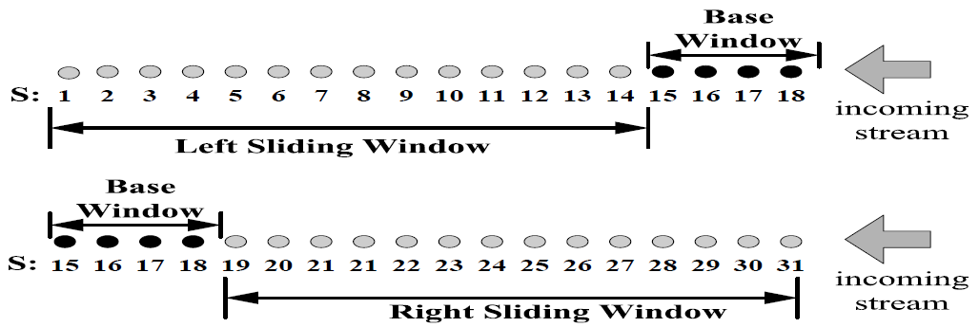
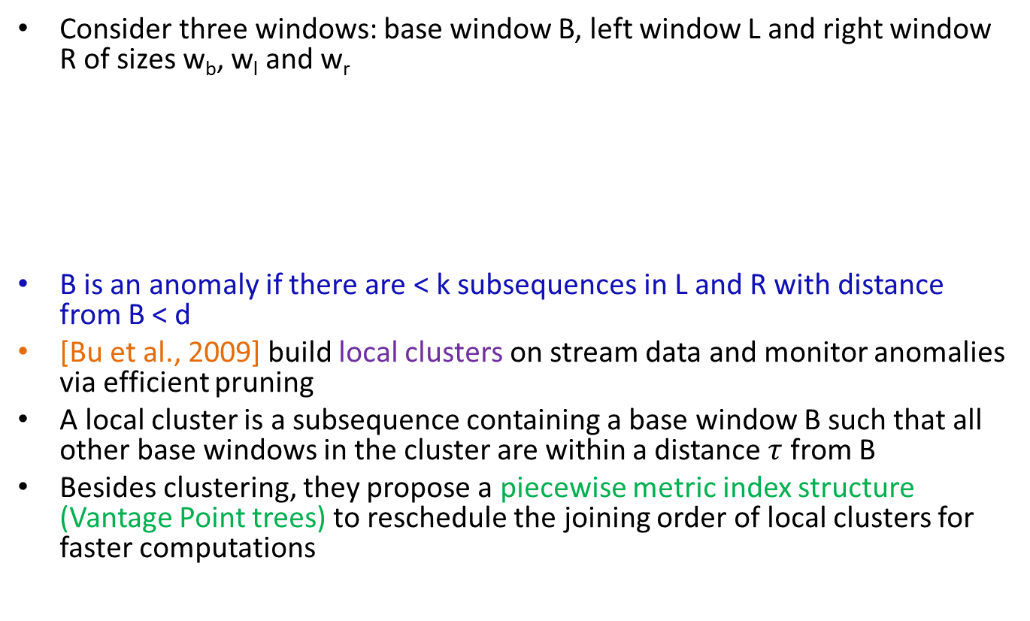
Discords in Data Streams
Outlier Detection for Stream Data
Distance-based Outliers for Sliding Windows
Other Variants
Consider three windows: base window B, left window L and right window R of sizes w_{b}, w_{l} and w_{r}
B is an anomaly if there are < k subsequences in L and R with distance from B < d
[Bu et al., 2009] build local clusters on stream data and monitor anomalies via efficient pruning
A local cluster is a subsequence containing a base window B such that all other base windows in the cluster are within a distance $τ$ from B
Besides clustering, they propose a piecewise metric index structure (Vantage Point trees) to reschedule the joining order of local clusters for faster computations

Slide 45
Outlier Detection for Stream Data in Distributed Scenarios
Outlier Detection for Stream Data in Distributed Scenarios
Outline
Challenges and Introduction
Outliers in Temporal Distributed Data
  By Sharing Data
  By Sharing Outliers
  By Sharing Distributions
Outliers in Spatial Sensor Data

Slide 46
Challenges
Outlier Detection for Stream Data in Distributed Scenarios
Resource constraints: Energy, memory, computational capacity and communication bandwidth
High communication cost: Communication cost is orders of magnitude more than computation costs
Distributed streaming data: Processing data online coming at different rates from multiple distributed sensors
Dynamic nature: Dynamic network topology, frequent communication failures, mobility and heterogeneity of nodes
Large-scale deployment: Scalability issues with traditional outlier detection algorithms
Identifying outlier sources: Make distinction between errors, events and malicious attacks

Slide 47
Introduction
Outlier Detection for Stream Data in Distributed Scenarios
In a distributed stream setting, points are distributed across various nodes (sensors)
Each sensor has an associated stream of incoming points
The aim is to find top few outliers based on the global data
  With least amount of communication between nodes
In the distributed spatio sensor setting, the position of sensors is also important when computing outliers

Slide 48
Outlier Detection for Stream Data in Distributed Scenarios
Outlier Detection for Stream Data in Distributed Scenarios
Outline
Challenges and Introduction
Outliers in Temporal Distributed Data
  By Sharing Data
  By Sharing Outliers
  By Sharing Distributions
Outliers in Spatial Sensor Data

Slide 49
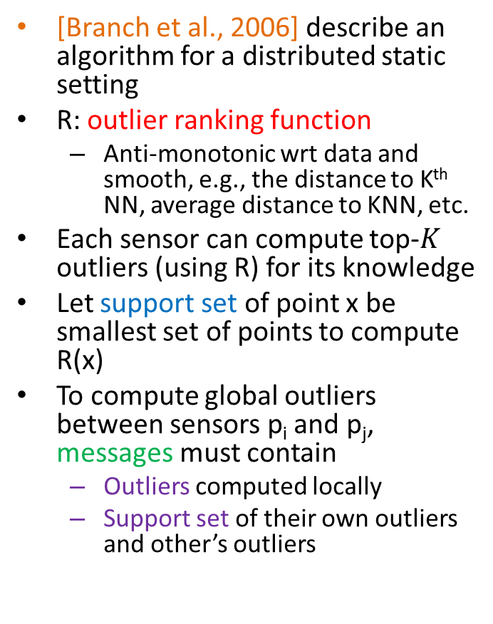
Outlier Computation by Sharing Data
Outlier Detection for Stream Data in Distributed Scenarios
Distributed Temporal Data
[Branch et al., 2006] describe an algorithm for a distributed static setting
R: outlier ranking function
  Anti-monotonic wrt data and smooth, e.g., the distance to K^{th} NN, average distance to KNN, etc.
Each sensor can compute top-$K$ outliers (using R) for its knowledge
Let support set of point x be smallest set of points to compute R(x)
To compute global outliers between sensors p_{i} and p_{j}, messages must contain
  Outliers computed locally
  Support set of their own outliers and other’s outliers
Dataset P
Sensor2
Sensor1
Sensor3
Knowledge of
sensor1

Slide 50
Outlier Computation by Sharing Data
Outlier Detection for Stream Data in Distributed Scenarios
Distributed Temporal Data
In a streaming setting, when a new point is sampled, data changes at the local sensor itself
  Change in knowledge of the sensor just like when it receives a new message
  Recompute R on new knowledge and hence topK local outliers
Sliding window scenario
  Each node can retire old points regardless of where they were sampled and at no communication cost at all
  Addition of sensors during system operation is possible
  If sensors are removed then their contribution to the computation gets annulled when those points retire with time

Slide 51
Outlier Computation by Sharing Outliers
Outlier Detection for Stream Data in Distributed Scenarios
Distributed Temporal Data
Transmitting the entire data or even the model to every node could be expensive [Otey et al., 2006]
Only the local outliers be exchanged between nodes
If all nodes agree that a point is an outlier, then we can assume that the point is a global outlier
The sites only communicate when some user-specified event occurs
Events include
  a user’s query for the global outliers
  when a node finishes processing a fixed number of points
  when a node finds a fixed number of outliers

Slide 52
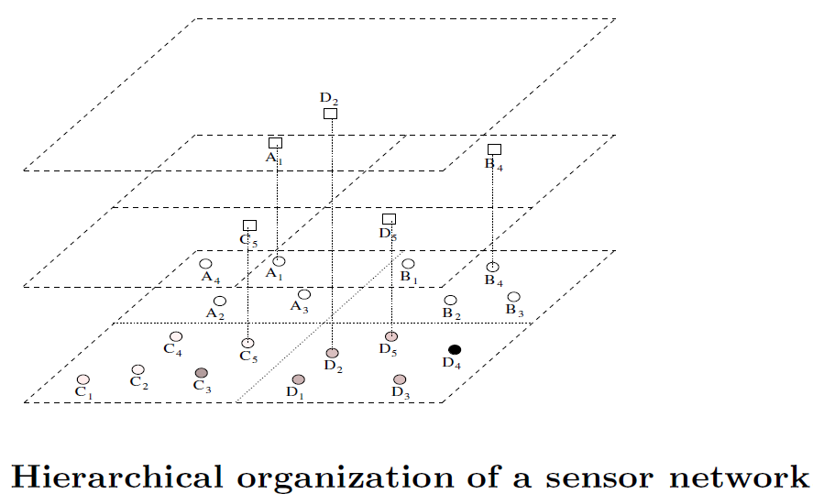
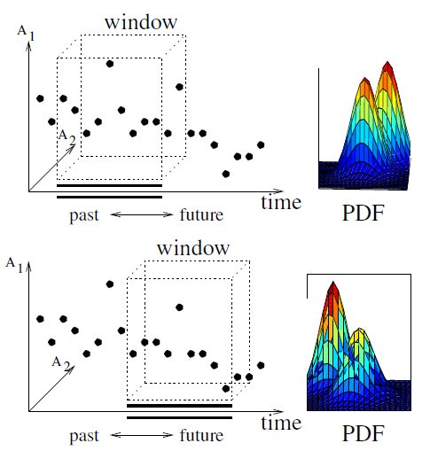
Outlier Computation by Sharing Distributions
Outlier Detection for Stream Data in Distributed Scenarios
Distributed Temporal Data
[Subramaniam et al., 2006] compute distance-based or density-based outliers in a hierarchical sensor network
  Global distance based outliers
  For density based method, Multi Granularity Deviation Factor (MDEF) of point p is a measure of how the neighborhood count of p compares with that of the values in its sampling neighborhood
[Palpanas et al., 2003] also propose a hierarchical architecture
Parent
Local Model +
Local Outliers
Sensor
Parent
Parent
New point
with prob p
New Model
Sensor
Sensor
Estimation of data distribution
in the sliding window

Slide 53
Outlier Detection for Stream Data in Distributed Scenarios
Outlier Detection for Stream Data in Distributed Scenarios
Outline
Challenges and Introduction
Outliers in Temporal Distributed Data
  By Sharing Data
  By Sharing Outliers
  By Sharing Distributions
Outliers in Spatial Sensor Data

Slide 54
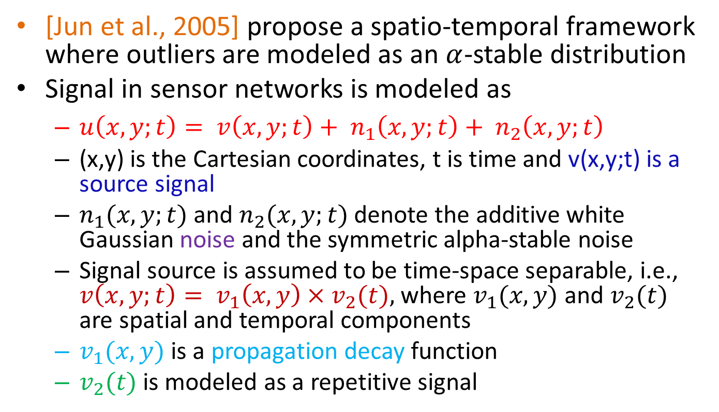
Distributed Spatio-temporal Outlier Detection
Outlier Detection for Stream Data in Distributed Scenarios
Distributed Spatio-temporal Data
[Jun et al., 2005] propose a spatio-temporal framework where outliers are modeled as an $α$-stable distribution
Signal in sensor networks is modeled as
  $u\left(x,y;t\right)= v\left(x, y;t\right)+ n_{1}\left(x, y;t\right)+ n_{2}\left(x, y;t\right)$
  (x,y) is the Cartesian coordinates, t is time and v(x,y;t) is a source signal
  $n_{1}(x, y;t)$ and $n_{2}(x, y;t)$ denote the additive white Gaussian noise and the symmetric alpha-stable noise
  Signal source is assumed to be time-space separable, i.e., $v\left(x, y;t\right)= v_{1}\left(x, y\right)×v_{2}(t),$where $v_{1}(x, y)$ and $v_{2}(t)$ are spatial and temporal components
  $v_{1}(x, y)$ is a propagation decay function
  $v_{2}(t)$ is modeled as a repetitive signal

Slide 55

Distributed Spatio-temporal Outlier Detection
Outlier Detection for Stream Data in Distributed Scenarios
Distributed Spatio-temporal Data
Outlier detection process consists of four phases
  Clustering of sensors
  Temporal outlier detection with sensors in parallel
  Removal of the spatial variation
    Signal power gets weaker in proportion to the distance from the source
    If this bias is not accounted properly, sensors near to the source, that receive more energy, might be falsely regarded as outliers, even though they are not
    If the data has some effect, the distribution might be heavily tailed with outliers located near the tail of the distribution
    The min and max values are removed as outliers iteratively using the property of $α$-stable distributions
  Spatial outlier detection using the variogram method
    Variogram method shows the spatial variance between sensors
    Outliers are ones that deviate remarkably from other normal data
Notes:
A random variable is said to be stable (or to have a stable distribution) if it has the property that a linear combination of two independent copies of the variable has the same distribution

Slide 56
Break

Slide 57
Outlier Detection for Spatio-Temporal Data
Outlier Detection for Spatio-Temporal Data
Outline
ST-Outlier Detection
ST-Outlier Tracking
Trajectory Outlier Detection

Slide 58
DBSCAN based ST-Outlier
Outlier Detection for Spatio-Temporal Data
Techniques for ST-Outlier Detection
A spatio-temporal outlier (ST-Outlier) is a spatio-temporal object whose thematic (non-spatial and non-temporal) attributes are significantly different from those of other objects in its spatial and temporal neighborhoods
[Birant and Kut, 2006] propose a density based ST-Outlier detection mechanism with 3 steps
  Cluster using a modified DBSCAN [Ester et al., 1996]
    To support the temporal aspect, a tree is traversed to find both spatial and temporal neighbors of any object within a given radius
    To find outliers when clusters have different densities, the algorithm assigns a density factor to each cluster and compares the average value of a cluster with the new coming value
  Check the spatial neighbors to verify whether these potential outliers are spatial outliers too
  Check the temporal neighbors of the spatial outliers

Slide 59

ST-Outliers using Cluster Differentiation
Outlier Detection for Spatio-Temporal Data
Techniques for ST-Outlier Detection
[Cheng and Li, 2004; Cheng and Li, 2006] propose a four step approach to detect ST-Outliers
(1) Classification (Clustering) to form regions
(2) Aggregation: Spatial resolution (scale) of the data is reduced for clustering
(3) Comparison (Detecting): Results obtained at two spatial scales are compared in order to detect the potential spatial outliers
  Objects found in step 1 but not in Step 2 are potential ST-Outliers
  Comparison can be done either by exploratory visualization analysis or visual data mining
(4) Verification (Checking): The temporal neighbors of the suspected ST-Outliers detected in the previous step are checked to detect ST-Outliers

Slide 60
PCA, Rough Set and Temporal Logic
Outlier Detection for Spatio-Temporal Data
Techniques for ST-Outlier Detection
Principal component analysis has been used to extract ST-Outliers [Lasaponara, 2006]
[Drosdowsky, 1993] use the rotated PCA (RPCA) method in both S and T modes
[Albanese et al., 2011] describe a rough set approach called Rough Outlier Set Extraction (ROSE)
[Jakkula and Cook, 2008] propose various temporal logic rules to capture normal activities
  Temporal relations for anomaly detection: before, contains, overlaps, meets, starts, started-by, finishes, finished-by, and equals
  Conditional probability of an event Z given an event Y is P(Z|Y ) = (|Before(Z,Y)| + |Contains(Z,Y)| + |Overlaps(Z,Y)| + |Meets(Z,Y)| + |Starts(Z,Y)| + |StartedBy(Z,Y)| + |Finishes(Z,Y)| + |FinishedBy(Z,Y)| + |Equals(Z,Y)|)/|Y|
  Likelihood of event Z occurring can be computed based on every event observed on a given day to that point in time
  Anomaly score for event Z can be computed as 1-P(Z)

Slide 61
Outlier Detection for Spatio-Temporal Data
Outlier Detection for Spatio-Temporal Data
Outline
ST-Outlier Detection
ST-Outlier Tracking
Trajectory Outlier Detection

Slide 62

OutStretch Algorithm to Detect Outlier Solids
Outlier Detection for Spatio-Temporal Data
Tracking of ST-Outliers
An ST-Outlier could be considered as a solid with its base in the XY space dimension and volume across the time dimension
  If there is higher than average precipitation in Peru over the years 1998-2002, then the solid in three dimensional (X, Y and time) space is an outlier
Outstretch [Wu et al., 2010] tracks the outlier movement patterns of the top-K spatial outliers over several time periods
Input: Top-K spatial outliers for each year and a variable r, the region stretch, which is the number of grids to 'stretch' by on each side of an outlier
For all the years, each of the outliers from the current year are examined to see if they are framed by any of the stretched regions from the previous year
If they are, the item is added to the end of the previous years child list
As a result, all possible sequences over all years get stored into the outlier tree and can be retrieved for analysis

Slide 63

Wavelets for Tracking ST Outliers
Outlier Detection for Spatio-Temporal Data
Tracking of ST-Outliers
[Lu and Liang, 2004]
Wavelet transform is applied to meteorological data to bring up distinct patterns that might be hidden within the original data
Edge detection with competitive fuzzy classifier, is extended to identify the boundary of region outlier
To determine the center of the region outlier, the fuzzy-weighted average of the longitudes and latitudes of the boundary locations is computed
By linking the centers of the outlier regions within consecutive frames, the movement of a region outlier can be captured and traced
3-D center trajectory for the detected region outlier within each time frame at 0 AM -18 PM, September 18, 2003

Slide 64
Outlier Detection for Spatio-Temporal Data
Outlier Detection for Spatio-Temporal Data
Outline
ST-Outlier Detection
ST-Outlier Tracking
Trajectory Outlier Detection

Slide 65



TRAjectory Outlier Detection (TRAOD)
Outlier Detection for Spatio-Temporal Data
Trajectory Outliers
Given a set of trajectories, find the most anomalous trajectories
[Lee et al., 2008] propose TRAjectory Outlier Detection (TRAOD) algorithm which consists of two phases
  2-level Partitioning Phase
  Detection Phase
    A trajectory partition is outlying if it does not have sufficient number of similar neighbors
    A trajectory is an outlier if sum of length of its outlying partitions is at least F times the sum of lengths of all of its partitions
Three components of distance function
for line segments

Slide 66

Evolving Trajectory Outliers (TOP-EYE)
Outlier Detection for Spatio-Temporal Data
Trajectory Outliers
TOP-EYE [Ge et al., 2010], an evolving trajectory outlier detection method continuously computes the outlying score for each trajectory in an accumulating way
A decay function enables the evolving computation of accumulated outlying scores along the trajectories
They consider two types of outlying trajectories: outliers in terms of direction and outliers in terms of density
The continuous space is discretized into small grids
Direction based Outliers
  A probabilistic model is used to turn the direction information of trajectories in a grid into a vector with eight values to indicate the probabilities of moving towards eight directions within this grid
Density based Outliers
  The trajectory density within each grid is estimated as the number of trajectories across this grid

Slide 67
Outlier Road Segments
Outlier Detection for Spatio-Temporal Data
Trajectory Outliers
[Li et al., 2009] propose a method for detecting temporal outliers with an emphasis on historical similarity trends between data points (rather than spatial continuity)
At each time step, each road segment checks its similarity vs. other road segments, and historical similarity values are recorded in a temporal neighborhood vector at each road segment
Outliers are calculated from drastic changes in these vectors
Each edge is given an exponential reward or penalty each day based on
  Whether it is historically similar to other road segments
  Whether it is instantaneously similar to other road segments
The outlier score of an edge on a particular day is then equal to the sum of rewards and penalties
The power of this method vs. a method that measures only the singular road segment is that it is robust to population shifts

Slide 68


Motif based Trajectory Outliers
Outlier Detection for Spatio-Temporal Data
Trajectory Outliers
[Li et al., 2006] propose motion-classifier for trajectory outlier detection with 3 steps
(1) Motif (feature, time , location) extraction from the object paths
(2) Motif-based generalization to cluster similar object movement fragments
(3) Objects are classified by a classifier that can handle high-dimensional generalized motif feature space to discriminate anomalous trajectories from normal ones
Extracting motif expressions in raw paths
Motif Oriented Database

Slide 69
Outlier Detection for Temporal Network Data
Outlier Detection for Temporal Network Data
Outline
Graph Similarity Outliers
Community Based Outliers
Online Graph Outliers

Slide 70

Introduction
Outlier Detection for Temporal Network Data
Graph Similarity-based Outlier Detection
Algorithms
Given a series of graph snapshots
Time series of graph distance metrics can be individually modeled using univariate autoregressive moving average (ARMA) model
Outliers are time points where the actual and predicted values differ greater than a threshold
A large variety of similarity/distance measures have been proposed to compare two graph snapshots
Notations
  $V_{G}$ and $V_{H}$are vertex sets for G and H resp. If $V_{G}=V_{H}$, V is used
  $E_{G}$ and $E_{H}$ are edges in graphs G and H

Slide 71

Graph Similarity/Distance Measures (1)
Outlier Detection for Temporal Network Data
Graph Similarity-based Outlier Detection
Algorithms
Weight Distance [Papadimitriou et al., 2010; Pincombe, 2005]
$d\left(G,H\right)=\frac{\sum_{u,v∈V}{\frac{\left|w_{E}^{G}\left(u,v\right)−w_{E}^{H}\left(u,v\right)\right|}{\max\left(w_{E}^{G}\left(u,v\right),w_{E}^{H}\left(u,v\right)\right)}}}{\left|E_{G}∪E_{H}\right|}$
MCS Weight Distance [Pincombe, 2005]
  Same as weight distance but only for edges in MCS where the maximum common subgraph (MCS) F of G and H is the common subgraph with the most vertices
MCS Edge Distance [Pincombe, 2005]
$d\left(G,H\right)=1−\frac{|mcs(E_{G},E_{H})|}{max(|E_{G}|, |E_{H}|)}$

Slide 72

Graph Similarity/Distance Measures (2)
Outlier Detection for Temporal Network Data
Graph Similarity-based Outlier Detection
Algorithms
4. MCS Vertex Distance [Pincombe, 2005]
$$d\left(G,H\right)=1−\frac{|mcs(V_{G},V_{H})|}{max(|V_{G}|, |V_{H}|)}$$
5. Median Graph Edit Distance [Dickinson et al., 2002; Pincombe, 2005]
6. Modality Distance [Pincombe, 2005]
  Absolute value of the difference between the Perron vectors (principal eigen vector of adjacency matrix) of these graphs

Slide 73




Graph Similarity/Distance Measures (3)
Outlier Detection for Temporal Network Data
Graph Similarity-based Outlier Detection
Algorithms
7. Graph Edit Distance [Papadimitriou et al., 2008; Pincombe 2005; Shoubridge et al., 1999]
d(G,G′) = |V|+|V′|−2|V∩V′|+|E|+|E′|−2|E∩E′|
C_{nd}(n)=cost of deleting node n
C_{ni}(n)=cost of inserting node n
C_{es}(n)=cost of substituting an edge weight for edge e
C_{ed}(n)=cost of deleting edge e
C_{ei}(n)=cost of inserting edge e
C=tradeoff parameter
$β$(e)=weight of edge e
$ε$=smoothing parameter (set to 1)

Slide 74




Graph Similarity/Distance Measures (4)
Outlier Detection for Temporal Network Data
Graph Similarity-based Outlier Detection
Algorithms
8. Diameter Distance [Gaston et al., 2006; Pincombe, 2005]
  difference in the diameters for each graph
9. Entropy Distance [Gaston et al., 2006; Pincombe, 2005]
where
10. Spectral Distance [Gaston et al., 2006; Pincombe, 2005]

Slide 75
Graph Similarity/Distance Measures (5)
Outlier Detection for Temporal Network Data
Graph Similarity-based Outlier Detection
Algorithms
11. Umeyama graph distance [Dickinson and Kraetzl, 2003]
12. The Euclidean distance between the principal eigenvectors of the graph adjacency matrices (Vector Similarity) [Papadimitriou et al., 2008]
13. Spearman’s correlation coefficient [Papadimitriou et al., 2010]
  rank correlation between sorted (based on PageRank) lists of vertices of the two graphs

Slide 76
Graph Similarity/Distance Measures (6)
Outlier Detection for Temporal Network Data
Graph Similarity-based Outlier Detection
Algorithms
14. Sequence similarity [Papadimitriou et al., 2010; Papadimitriou et al., 2008]
  Similarity of vertex sequences of the graphs that are obtained through a graph serialization algorithm
15. Signature similarity [Papadimitriou et al., 2010; Papadimitriou et al., 2008]
  Hamming distance between appropriate fingerprints of two graphs
16. Vertex/edge overlap (VEO) [Papadimitriou et al., 2010]
17. Vertex ranking (VR) [Papadimitriou et al., 2010]
w is PageRank value, $π$ is the vertex rank, D is normalization constant

Slide 77
Outlier Detection for Temporal Network Data
Outlier Detection for Temporal Network Data
Outline
Graph Similarity Outliers
Community Based Outliers
Online Graph Outliers

Slide 78



Evolutionary Community Outliers (ECOutliers)
Outlier Detection for Temporal Network Data
Community-based Outlier Detection Algorithms

Slide 79




ECOutlier: Definitions
Outlier Detection for Temporal Network Data
Community-based Outlier Detection Algorithms
Belongingness Matrix
Community-Community Correspondence Matrix
DM IR ML DB
K₁
K₂
Databases (DB)
K₂
Information
Retrieval (IR)
Machine
Learning (ML)
X
$$≈$$
S
K₁
Data Mining (DM)
N
P
N
Q
$P∈{\left[0,1\right]}^{N×K_{1}}$ $Q∈{\left[0,1\right]}^{N×K_{2}}$
$$\sum_{i=1}^{K_{1}}{p_{oi}}=1 \sum_{j=1}^{K_{2}}{q_{oj}}=1$$
$$S∈{\left[0,1\right]}^{K_{1}×K_{2}}$$
$$\sum_{j=1}^{K_{2}}{s_{ij}}=1$$

Slide 80





TwoStage ECOutlier Detection Framework
Outlier Detection for Temporal Network Data
Community-based Outlier Detection Algorithms
Community
Detection
Community Matching
Outlier Detection
Evolutionary
Clustering
X₁
P
$$×$$
$$≈$$
P
S
Q
A=Q-PS
X₂
Q

Slide 81


OneStage ECOutlier Detection Framework
Outlier Detection for Temporal Network Data
Community-based Outlier Detection Algorithms
Outlierness Matrix: ${A∈[0,1]}^{N×K_{2}}$
Community
Detection
Community Matching
Outlier Detection
X₁
P
$$×$$
$$≈$$
P
S
Q
$$\sum_{o,j}{a_{oj}}$$
= $μ=1$
X₂
A=Q-PS
Q

Slide 82









OneStage$μ$ ECOutlier Detection Framework
Outlier Detection for Temporal Network Data
Community-based Outlier Detection Algorithms
Community
Detection
Community Matching
Outlier Detection
Community Matching
Outlier Detection
X₁
P
$$×$$
$$≈$$
$$×$$
$$≈$$
P
S
Q
P
S
Q
X₂
A
$$\sum_{o,j}{a_{oj}}$$
= $μ=1$
A
$$\sum_{o,j}{a_{oj}}$$
= $μ$
Q
Estimate $μ$

Slide 83



ECOutlier: Community Matching and
Outlier Detection Together
Outlier Detection for Temporal Network Data
Community-based Outlier Detection Algorithms
$$P×S≈Q$$
Given P and Q, estimate S and A
Minimize element-wise distance between Q and PS wrt outlier-weighted elements
N = #objects
K₁ = #clusters in X₁
$\text{K}\text{2 }\text{= \#}\text{clusters} \text{in} X2$
P^{NXK1} = belongingness matrix for X₁
Q^{NXK2} = belongingness matrix for X₂
S^{K1XK2} = correspondence matrix
A^{NXK2} = outlierness matrix
$μ$= maximum level of overall outlierness
$subject to the following constraints$
Correspondence matrix should be right stochastic
Maximum amount of outlierness should be controlled

Slide 84






ECOutlier: Community Matching and
Outlier Detection Together
Outlier Detection for Temporal Network Data
Community-based Outlier Detection Algorithms
$$P×S≈Q$$
Given P and Q, estimate S and A
$\min{\sum_{o=1}^{N}{\sum_{j=1}^{K2}{\log\left(\frac{1}{aoj}\right)(q_{oj}−\vec{po.}.\vec{s.j})2}}}$
N = #objects
K₁ = #clusters in X₁
$\text{K}\text{2 }\text{= \#}\text{clusters} \text{in} X2$
P^{NXK1} = belongingness matrix for X₁
Q^{NXK2} = belongingness matrix for X₂
S^{K1XK2} = correspondence matrix
A^{NXK2} = outlierness matrix
$μ$= maximum level of overall outlierness
$subject to the following constraints$
$\sum_{j=1}^{K2}{sij=1} \left(∀i=1…K1\right)$
Inequality
$\sum_{o=1}^{N}{\sum_{j=1}^{K2}{aoj=μ}}$
$\sum_{o=1}^{N}{\sum_{j=1}^{K2}{aoj≤μ}}$
$$sij≥0 \left(∀i=1…K1, ∀j=1…K2\right)$$
$1≥a_{oj}≥0 \left(∀o=1…N, ∀j=1…K2\right)$

Slide 85
ECOutlier: Community Matching and
Outlier Detection Together
Outlier Detection for Temporal Network Data
Community-based Outlier Detection Algorithms
Negative log in a_{oj}
Hence, convex in a_{oj}
Convex Optimization
Log ensures outliers will
be within small range
Quadratic in s_{ij}
Hence, convex in s_{ij}
$$P×S≈Q$$
Given P and Q, estimate S and A
$\min{\sum_{o=1}^{N}{\sum_{j=1}^{K2}{\log\left(\frac{1}{aoj}\right)(q_{oj}−\vec{po.}.\vec{s.j})2}}}$
N = #objects
K₁ = #clusters in X₁
$\text{K}\text{2 }\text{= \#}\text{clusters} \text{in} X2$
P^{NXK1} = belongingness matrix for X₁
Q^{NXK2} = belongingness matrix for X₂
S^{K1XK2} = correspondence matrix
A^{NXK2} = outlierness matrix
$μ$= maximum level of overall outlierness
$subject to the following constraints$
$\sum_{j=1}^{K2}{sij=1} \left(∀i=1…K1\right)$
$\sum_{o=1}^{N}{\sum_{j=1}^{K2}{aoj=μ}}$
$$sij≥0 \left(∀i=1…K1, ∀j=1…K2\right)$$
$1≥a_{oj}≥0 \left(∀o=1…N, ∀j=1…K2\right)$

Slide 86




ECOutliers: Derivation of Update Rules
Outlier Detection for Temporal Network Data
Community-based Outlier Detection Algorithms
Differentiate wrt a_{oj} and set it to 0
Differentiate wrt s_{ij} and set it to 0
Community Matching Error for the (o,j)^{th} entry
Total outlierness in the snapshot
Outlierness for the (o,j)^{th} entry
$aoj=\frac{\left(q_{oj}−\vec{p_{o.}}.\vec{s_{.j}}\right)2 μ}{\sum_{o^{′}=1}^{N}{\sum_{j^{′}=1}^{K2}{{\left(q_{o^{′}j^{′}}−\vec{p_{o^{′}.}}.\vec{s_{.j^{′}}}\right)}^{2}}}}$
Total Matching Error
Part of q_{o’j} that needs to be explained by p_{o’i} s_{ij}
Correspondence for community i in X₁ and j in X₂
$sij=\frac{\sum_{o^{′}=1}^{N}{2\log\left(\frac{1}{ao′j}\right)po′i[qo′j−\sum_{\begin{aligned}k=1 \\ k≠i\end{aligned}}^{K1}{po′kskj}]−βi}}{\sum_{o^{′}=1}^{N}{2\log\left(\frac{1}{ao′j}\right)}p_{o^{′}i}^{2} }$
Normalization to make sure that $\sum_{j}{sij=1}$
Normalization to make sure that $\sum_{j}{sij=1}$
Give outliers lower weight when matching

Slide 87


ECOutlier Detection Algorithm (OneStage$μ$)
Outlier Detection for Temporal Network Data
Community-based Outlier Detection Algorithms
Input: P and Q
Output: Estimates of S and A
Initialize $μ$, all s_{ij} to $\frac{1}{K_{2}}$ and all a_{oj} to $\frac{1}{NK_{2}}$
While (not converged)
  Compute A (Outlier Detection step)
  Compute S (Community Matching step)
Estimate$μ=\frac{\sum_{o^{′}=1}^{N}{\sum_{j^{′}=1}^{K2}{(q_{o^{′}j^{′}}−\vec{po′.}.\vec{s.j′})2}}}{\begin{aligned}max \\ o, j\end{aligned}\left(q_{oj}^{2}\right)}$
While (not converged)
  Compute A (Outlier Detection step)
  Compute S (Community Matching step)
Two pass algorithm
Coordinate descent iterative computation of S and A
Evolutionary Community
Outlier
Detection
Community
Matching
O(NK₁²K₂t)
N=#objects
K₁=#clusters in X₁
K₂=#clusters in X₂
t=#iterations

Slide 88



Community Trend Outliers (CTOutliers)
Outlier Detection for Temporal Network Data
Community-based Outlier Detection Algorithms
Normal
Anomalous
Community Trend Outliers: Nodes for which evolutionary behaviour across a series of snapshots is quite different from that of its community members

Slide 89


CTOutliers: Soft Sequence Representation
Outlier Detection for Temporal Network Data
Community-based Outlier Detection Algorithms
Every object has a distribution associated with it across time
  In a co-authorship network, an author has a distribution of research areas associated with it across years
Soft sequence for object denoted by $(→)$
<1: (A:0.1 , B:0.8 , C:0.1) , 2: (D:0.07 , E:0.08 , F:0.85) , 3: (G:0.08 , H:0.8 , I:0.08 , J:0.04)>
Hard sequence is <1:B, 2:F, 3:H>
Outliers: ■ and 

Slide 90
CTOutliers: Problem Formulation
Outlier Detection for Temporal Network Data
Community-based Outlier Detection Algorithms
Problem
  Input: Soft sequences (each of length T) for N objects, denoted by matrix S
  Output: Set of CTOutlier objects
SubProblems
  Pattern Extraction
    Input: Soft sequences (S)
    Output: Frequent soft patterns (P)
  Outlier Detection
    Input: Frequent soft patterns (P)
    Output: Set of CTOutlier objects

Slide 91




CTOutliers: Benefits of Soft Patterns
Outlier Detection for Temporal Network Data
Community-based Outlier Detection Algorithms
Data loss
DB
DM
Hard Pattern
DB:0.5
Sys:0.3
Arch:0.2
DM:0.5
DB:0.3
Sys:0.2
Soft
Patterns
DB:0.9
Sys:0.1
DM:0.9
DB:0.1
0
1
Time

Slide 92



CTOutliers: Support for Soft Patterns
Outlier Detection for Temporal Network Data
Community-based Outlier Detection Algorithms
Notation | Meaning
min_sup | Minimum Support
t | Index for timestamps
o | Index for objects
p | Index for patterns
N | Total number of objects
T | Total number of timestamps
$$S_{t_{o}}$$ | Distribution for object o at time t
$$P_{t_{p}}$$ | Distribution for pattern p at time t
$$TS_{p}$$ | Set of timestamps for pattern p
$$sup\left(P_{t_{p}}\right)=\sum_{o=1}^{N}{\left[1−\frac{Dist\left(S_{t_{o}}, P_{t_{p}}\right)}{maxDist\left(P_{t_{p}}\right)}\right]}$$
For longer patterns
Candidate generation
uses Apriori
$$sup\left(p\right)=\sum_{o=1}^{N}{\prod_{t∈TS_{p}}{\left[1−\frac{Dist\left(S_{t_{o}}, P_{t_{p}}\right)}{maxDist\left(P_{t_{p}}\right)}\right]}}$$

Slide 93


CTOutlier Detection
Outlier Detection for Temporal Network Data
Community-based Outlier Detection Algorithms
Given: Set of soft patterns (P) and set of sequences (S)
Output: Find outlier sequences
$score\left(o,p\right)=\sum_{t∈θ_{po}}{\left[\sup\left(P_{t_{p}}\right)×\frac{Dist(S_{t_{o}}, P_{t_{p}})}{maxDist(P_{t_{p}})}\right]}$
$score\left(o\right)=\sum_{p∈P}{\sup\left(p\right)×score(o,p)}$
  But object o may follow only one pattern! So, sum may be incorrect
$score\left(o\right)=\min\left[\sup\left(p\right)×score(o,p)\right]$
  But generally $\sup\left(p\right)×score\left(o,p\right)$ will be min for very short pattern $p$ mostly of length 2
Gapped Pattern
1 | 2 | 3 | 4 | 5 | 6 | 7 | 8 | 9 | 10
Pattern p
$φpo$ (Match): {1,2,5,7,8}
$θpo$ (Mismatch): {4,10}
Sequence o

Slide 94

CTOutlier Score using Pattern Configurations
Outlier Detection for Temporal Network Data
Community-based Outlier Detection Algorithms
Divide pattern space into different “projections” called configurations
A configuration is a set of timestamps of size>1
E.g., {1,3,4} is a configuration
T=4
$$score\left(o\right)=\sum_{c=1}^{|C|}{score(c,o)}=\sum_{c=1}^{|C|}{score(bmp_{oc},o)}$$
where bmp_{oc} is the best matching pattern for object o given the configuration c, and C is the set of all configurations

Slide 95

CTOutlier: Finding Best Matching Pattern
Outlier Detection for Temporal Network Data
Community-based Outlier Detection Algorithms
Find all patterns that are defined exactly for configuration c
For each such pattern
Match Score is high if
  Timestamps where the o and p match are high
  p has higher support
  p represents compact clusters
  o is close to the cluster centroid of p across the various timestamps
Best matching pattern for o is pattern with highest match(o,p)
$$match\left(o,p\right)=\sum_{t∈φ_{po}}{\frac{\sup\left(P_{t_{p}}\right)×sup⁡(P_{t_{p}},S_{t_{o}})}{avgDist(P_{t_{p}})}}$$

Slide 96

CTOutlier Score (Sequence, Best Matching Pattern)
Outlier Detection for Temporal Network Data
Community-based Outlier Detection Algorithms
Given a sequence s and a configuration c
  Compute best matching pattern q=bmp_{oc}
  Next, we compute outlier score as
Outlier score is high if
  Mismatch for a large number of timestamps
  Sequence is “far away” from patterns for many timestamps, especially if the pattern is compact for those timestamps
$score\left(o,q\right)=$ $\sup\left(q\right)×\sum_{t∈θ_{qo}}{\left[\sup\left(P_{t_{q}}\right)×\frac{Dist(S_{t_{o}}, P_{t_{q}})}{maxDist(P_{t_{q}})}\right]}$
Mismatch between q and o at time t

Slide 97
Outlier Detection for Temporal Network Data
Outlier Detection for Temporal Network Data
Outline
Graph Similarity Outliers
Community Based Outliers
Online Graph Outliers

Slide 98

Eigenspace-based Anomaly Detection
Outlier Detection for Temporal Network Data
Online Graph Outlier Detection Algorithms
[Ide and Kashima, 2004]
Left
Singular
Vector

Slide 99

Outliers in Mobile Communication Graphs
Outlier Detection for Temporal Network Data
Online Graph Outlier Detection Algorithms
[Akoglu and Faloutsos, 2010]

Slide 100
Structural Outlier Detection
Outlier Detection for Temporal Network Data
Online Graph Outlier Detection Algorithms
[Aggarwal et al., 2011] propose the problem of structural outlier detection in massive network streams
Outliers are graph objects which contain unusual bridging edges
The network is dynamically partitioned in order to construct statistically robust models of the connectivity behavior
For robustness, multiple such partitionings are maintained
These models are maintained with the use of an innovative reservoir sampling approach for efficient structural compression of the underlying graph stream
Using these models, edge generation probability is defined and then graph object likelihood fit is defined as the geometric mean of the likelihood fits of its constituent edges
Those objects for which this fit is t standard deviations below the average of the likelihood probabilities of all objects received so far are reported as outliers

Slide 101
Applications of Temporal Outlier Detection Techniques
Applications of Temporal Outlier Detection Techniques
Outline
Environmental Sensor Data
Industrial Sensor Data
Surveillance/Trajectory Data
Computer Networks Data
Biological Data
Astronomy Data
Web Data
Information Networks Data
Economics Time Series Data

Slide 102


Wind Speed Measurement Errors
Applications of Temporal Outlier Detection Techniques
Environmental Sensor Data
Temperature and humidity sensors: to detect climate change events
[Hill and Minsker, 2010; Hill et al., 2007] identify measurement errors in a wind speed data stream from WATERS Network Corpus Christi Bay testbed, provided by the Shoreline Environmental Research Facility (SERF), Texas
Data exhibiting errors resulting from short duration faults
Data exhibiting errors resulting from long duration faults

Slide 103


Hydrology Datasets
Applications of Temporal Outlier Detection Techniques
Environmental Sensor Data
[Sun et al., 2005] explore a 0.5 degree grid dataset over South China area monthly from 1992 to 2002 with five variables: cloud cover percentage, diurnal temperature range, precipitation, temperature, vapor and pressure
  Outliers: locations with different temperature from their neighborhoods in recent 10 years
  They find droughts and flood outliers like flood in Yangzi River Valley in 1998
[Wu et al., 2010] find extreme precipitation events from South American precipitation data set obtained from the NOAA (Hydrology) for Peru over 1998-2002
  They also compare the behavior of the outlier regions to the El Ni$\tilde{n}$o and La Ni$\tilde{n}$o phases of the El Ni$\tilde{n}$o Southern Oscillation (ENSO) phenomenon

Slide 104


Rain, Precipitation, Wave Heights
Applications of Temporal Outlier Detection Techniques
Environmental Sensor Data
[Angiulli and Fassetti, 2007] study the rain, sea surface temperature, relative humidity, precipitation time series obtained from the Pacific Marine Environmental Laboratory of the U.S. National Oceanic and Atmospheric Administration (NOAA)
[Birant and Kut, 2006] work with the wave height values of four seas: the Black Sea, the Marmara Sea, the Aegean Sea, and the east of the Mediterranean Sea. Outliers are locations with significantly high wave height values on a particular date compared to its spatiotemporal neighbors
The region circled in dashed lines contains
S-Outliers (January 24, 1998).
Wave height values of the same region on the
same day, but in different years

Slide 105


Water Height based Spatio-temporal Outliers
Applications of Temporal Outlier Detection Techniques
Environmental Sensor Data
[Cheng and Li, 2006] compute spatio-temporal outliers from the water height data obtained from Ameland, a barrier island in the north of the Netherlands. They classify the coastal areas into foreshore, beach and foredune based on observed water height across multiple years and then find outliers
Digital Elevation Model (DEMs) of Ameland
in six consecutive years
Verified ST-Outliers (those circled with dashed lines are not ST-Outliers)

Slide 106


Hurricanes, Floods and Rainfall Anomalies
Applications of Temporal Outlier Detection Techniques
Environmental Sensor Data
The areas indicated in the black boxes were affected by large fires that occurred during the 1998 and 1999 fire seasons (Sicily Island) [Lasaponara, 2006]
Detected boundary of Hurricane Isabel using Wavelet power distribution of Global water vapor at 18 PM, Sep. 18, 2003 [Lu and Liang, 2004]
Anomalies in Australian seasonal rainfall [Drosdowsky, 1993] using RPCA

Slide 107


Aircraft Time Series Data
Applications of Temporal Outlier Detection Techniques
Industrial Sensor Data
Two different signals obtained from a flight data recorder (FDR): altitude of the aircraft and roll angle have been used to find anomalies [Basu and Meckesheimer, 2007]
Outliers
  During cruise a change in altitude similar to one that is normally observed during take-off and landing, may indicate an outlier.
  Roll angles of ±100 degrees are not realistic.
Altitude time series signal
Roll Angle time series signal

Slide 108


Jet Engine Vibration Data
Applications of Temporal Outlier Detection Techniques
Industrial Sensor Data
Anomalies in jet engines have been discovered by analyzing the high/low pressure shaft harmonic frequencies in jet engine vibration data [Nairac et al., 1999]
The 1HP, 2HP and 1LP tracked orders have been extracted from the Zmod plot
The Zmod plot for the acceleration phase of a vibration pass-off test. The straight lines visible on the Zmod plot correspond to the main harmonics of the rotation frequency of the high pressure (HP) shaft, while the curved lines correspond to the low pressure (LP) shaft.
The 4 kernel centres

Slide 109


Tool Breakage Detection
Applications of Temporal Outlier Detection Techniques
Industrial Sensor Data
Anomalies like tool breakage detection have been discovered using cutting force data [Dasgupta and Forrest, 1996]
Milling industries need online monitoring of tool conditions
Cutting parameters include temperature, cutting force, torque, vibration, acoustic emission, motor current
Normally, cutting force periodically varies with tooth frequency which depends on spindle speed
One tooth is broken after 1500 time steps

Slide 110






Trajectory Outliers
Applications of Temporal Outlier Detection Techniques
Surveillance/Trajectory Data
[Li et al., 2009] discover anomalies from average daily speed and average daily load dataset for taxicabs in San Francisco during July 2006.
[Ge et al., 2010] find anomalies like vehicle moving to the left side of the road (wrong way), vehicle taking a short cut to drive to the wrong way, people crossing the street illegally.

Slide 111


Trajectory Discords
Applications of Temporal Outlier Detection Techniques
Surveillance/Trajectory Data
[Yankov et al., 2008] also find discords from trajectory data
Trajectory data can also be used for monitoring the movement of patients and senior citizens (for example, to discover events such as taking a wrong bus, having a bad fall, encountering a sudden slow-down and getting lost [Bu et al., 2009]
Surveillance data can be useful in smart homes to discover anomaly situations like the resident turned on the bathwater, but has not turned it off before going to bed [Jakkula and Cook, 2008]
The number one discord found in a trajectory data (bold line) with 50 trajectories
An Elder Monitoring Application

Slide 112


Incremental LOF based Trajectory Discords
Applications of Temporal Outlier Detection Techniques
Surveillance/Trajectory Data
Surveillance videos can be explored to discover outliers like appearance of a new object, zooming objects to camera and novel video content [Pokrajac et al., 2007]
They study trajectories from surveillance videos to identify anomalous behavior like person walking right and then back left and person walking very slowly
Outliers: appearance of a new object (frame 21), zooming objects to camera (frame 31) & novel video content (frames 41, 61, 71, 91)
Unusual trajectories in motion videos

Slide 113
Intrusion Detection
Applications of Temporal Outlier Detection Techniques
Computer Networks Data
Techniques for outlier detection from temporal data have been widely used for intrusion detection [Angiulli and Fassetti, 2007; Hofmeyr et al., 1998; Lane and Brodley, 1997; Lane and Brodley, 1998; Sequeira and Zaki, 2002; Warrender et al., 1999]
[Ye, 2000] use the audit data of a Sun Solaris system from MIT Lincoln lab to detect intrusion scenarios like password guessing, using symbolic links to gain root privileges, attempts to gain an unauthorized access remotely, etc.

Slide 114


Origin-destination flow Anomalies
Applications of Temporal Outlier Detection Techniques
Computer Networks Data
[Lakhina et al., 2004] discover anomalies like High rate point to point byte transfer, denial of service (DOS), distributed denial of service (DDOS) attacks, Flash crowd (large demand for a resource/service), scanning a host for a vulnerable port or scanning network for a target port, WORM, outage events, etc.
An illustration of the PCA method on the three types of OD flow traffic. Top row: timeseries of state vector squared magnitude (${\left\|x\right\|}^{2}$); middle row: timeseries of the PCA residual vector squared magnitude (${\left\|\hat{x}\right\|}^{2}$); bottom row: $t^{2}$ vector

Slide 115


Electrocardiogram Anomalies
Applications of Temporal Outlier Detection Techniques
Biological Data
An ECG that has been annotated by a cardiologist as containing one premature ventricular contraction [Keogh et al., 2005]
An excerpt of an ECG that has been annotated by a cardiologist as containing 3 various anomalies [Keogh et al., 2005]

Slide 116


Unusual Butterfly
Applications of Temporal Outlier Detection Techniques
Biological Data
An example of Heliconius melpomene and not Heliconius erato [Wei et al., 2006]
Six examples of butterflies, ostensibly all Heliconius erato (Red Passion Flower) Butterflies
[Wei et al., 2006]

Slide 117


Shape Discords [Wei et al., 2006]
Applications of Temporal Outlier Detection Techniques
Biological Data
Some spores produced by a fungus. One spore is different because it has a germ tube (Image by Charles Mims, University of Georgia)
Wei et al. discover teardrop shaped cell, or dacrocyte, which is indicative of several blood disorders

Slide 118




Space Telemetry, Star Light, Gamma Rays
Applications of Temporal Outlier Detection Techniques
Astronomy Data
[Keogh et al., 2005] discover discords from Space telemetry data (Space Shuttle Marotta Valve time series)
[Yankov et al., 2008] find discords from star light-curve data consisting of light-curves produced by three classes of star objects: Eclipsed Binaries, Cepheids and RR Lyrae variables
[Zhu and Shasha, 2003] find high gamma ray bursts from Milagro Gamma Ray data stream which consists of time series of the number of photons observed (events) every 0.1 second
Typical examples from 3 classes of lightcurves: Left) Eclipsed Binary, Right Top) Cepheid, Bottom) RR Lyrae
Examples of an annotated Marotta Valve time series [Keogh et al., 2005]
Top light-curve discords in each class

Slide 119

Outlier Web Crawl Snapshot
Applications of Temporal Outlier Detection Techniques
Web Data
Given multiple crawls of the web graph, [Papadimitriou et al., 2008; Papadimitriou et al., 2010] find a crawl graph with anomalies.
These anomalies refer either to failures of web hosts that do not allow the crawler to access their content or to hardware/software problems in the search engine infrastructure that can corrupt parts of the crawled data.
Signature Similarity turned out to be most important measure
[Yankov et al., 2008] study the MSN query logs to discover both anticipated and unanticipated web queries as discords. E.g., “Full moon”

Slide 120
Graph Outliers in Graph Streams
Applications of Temporal Outlier Detection Techniques
Information Network Data
[Aggarwal et al., 2011] discover graphs representing inter-disciplinary research papers as outliers from the DBLP dataset. They also discover movies with a cast from multiple countries as outliers from the IMDB dataset
(DBLP) Yihong Gong, Guido Proietti, Christos Faloutsos, Image Indexing and Retrieval Based on Human Perceptual Color Clustering, CVPR 1998: 578-585
  Yihong Gong: computer vision and multimedia processing
  Christos Faloutsos: database and data mining
(DBLP) Natasha Alechina, Mehdi Dastani, Brian Logan, John-Jules Ch Meyer, A Logic of Agent Programs, AAAI 2007: 795-800
  Natasha Alechina: United Kingdom
  John-Jules Ch Meyer: Netherlands
(IMDB) Movie Title: Cradle 2 the Grave (2003)
  Jet Li: Chinese actor
  DMX (I): American actor

Slide 121
Community Trend Outliers
Applications of Temporal Outlier Detection Techniques
Information Network Data
[Gupta et al., 2012b] discover authors outliers from DBLP co-authorship network such that they show a change in their research areas quite different from other authors.
DBLP: Georgios B. Giannakis
  X₁ conferences: CISS, ICC, GLOBECOM, INFOCOM
  X₂ conferences: ICASSP, ICRA
They also discover outlier actors from IMDB such that they show a very unusual change in their movie genre distribution
IMDB: Kelly Carlson (I)
  Changed community from Sports, Thriller, Action to Drama and Music

Slide 122

Outliers based on Scan Statistics
Applications of Temporal Outlier Detection Techniques
Information Network Data
[Priebe et al., 2005] study the communication graph of the Enron data with respect to the maximum degree and digraph size scan statistics. Excessive communication outliers which can suggest insider trading scenarios are discovered.
Using “outdegree at level 2” as scan statistic, k.allen turns out as outlier
To discover excessive chatter based outliers, they propose a composite 2nd order scan statistic which ensures
  Some minimum level of recent activity
  Order 0 and order 1 scan statistics do not yield detections

Slide 123
Distribution Change Outliers [Gupta et al., 2012a]
Applications of Temporal Outlier Detection Techniques
Economics Time Series Data
Unusual GDP Distribution Change in 1985 for Uganda
Uganda, Canada,
France, Iceland
National Resistance Army (NRA) came to power and made economic reforms (1985-86)
Consumption | Net Exports
45% | 45%
Uganda
Canada,
France, Iceland
Consumption | Net Exports
80% | 1-2%
Consumption | Net Exports
45% | 45%

Slide 124

Distribution Change Outliers [Gupta et al., 2012a]
Applications of Temporal Outlier Detection Techniques
Economics Time Series Data
Unusual Budget Distribution for the past decade for Arkansas
Distributions of Budget Spending for AK
Average trend of 5 states with distributions
close to that of AK for 2004-2009

Slide 125
Outliers in Mixed Attribute Space
Applications of Temporal Outlier Detection Techniques
Economics Time Series Data
[Otey et al., 2006]
US Census Bureau’s Income data set
  A 39 year old self-employed male with a doctorate, working in a clerical position making less than 50,000 dollars per year
  A 42 year old self-employed male from Iran, with a bachelors degree, working in an Executive position making less than 50,000 dollars per year
  A 38 year old Canadian female with an Asian Pacific Islander origin working for the US Federal Government for 57 hrs per week and making more than 50,000 dollars per year
US Congressional Voting Data
  A Republican congressman who voted significantly differently from his party on four bills

Slide 126
Summary
We presented an organized overview of the various techniques proposed for outlier detection on temporal data
Specifically, we discussed techniques for
  Time series data
  Data streams
  Distributed data streams
  Network data
  Spatio-temporal data
For each of these forms of data, we presented various outlier definitions proposed in the literature and introduced in brief corresponding techniques
Finally, we also discussed various applications for which these techniques have been successfully used
http://dais.cs.uiuc.edu/manish/pub/gupta12_temporalOutlierDetectionSurvey.pdf

Slide 127

Further Reading
Outlier Analysis (Springer) Authored by Charu Aggarwal, January 2013
Time Series Outliers
  Varun Chandola, Arindam Banerjee, and Vipin Kumar. Anomaly Detection for Discrete Sequences: A Survey. IEEE Transactions on Knowledge and Data Engineering (TKDE), 24(5):823–839, May 2012
Novelty Detection
  Markos Markou and Sameer Singh. Novelty Detection: A Review - Part 1: Statistical Approaches. Signal Processing, 83(12):2481–2497, 2003
  Markos Markou and Sameer Singh. Novelty Detection: A Review - Part 2: Neural Network Based Approaches. Signal Processing, 83(12):2499–2521, 2003
http://dais.cs.uiuc.edu/manish/pub/gupta12_temporalOutlierDetectionSurvey.pdf

Slide 128
Thanks!

