Slide 1
Outlier Detection for Information Networks
Manish Gupta
Univ of Illinois at Urbana Champaign
PhD Final Exam
Committee
Prof. Jiawei Han | Prof. Tarek Abdelzaher
Prof. ChengXiang Zhai | Dr. Charu Aggarwal

Slide 2
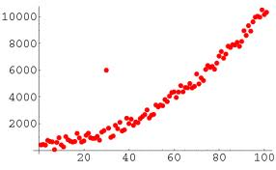
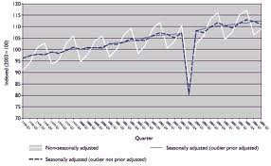
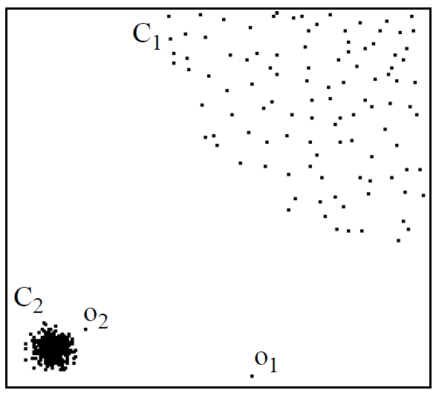
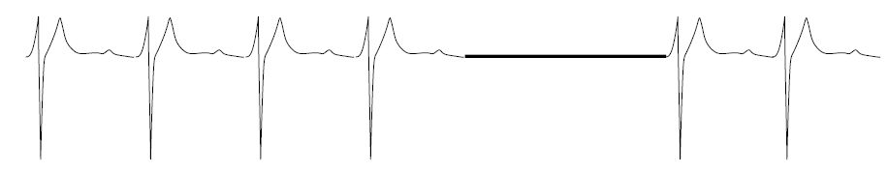
Outlier Detection
Outliers in Time Series
Distance based Outliers
Outliers in Statistics
Normal
Outlier
Contextual Outliers
Local Outliers
Collective Outliers

Slide 3

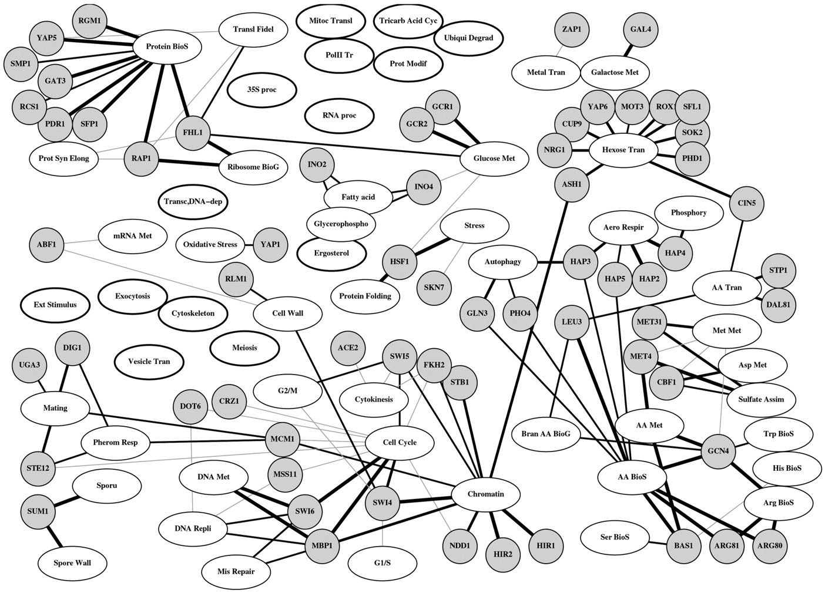
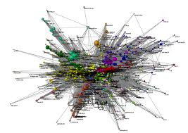
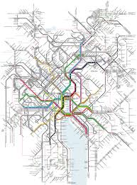
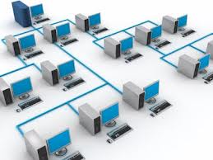
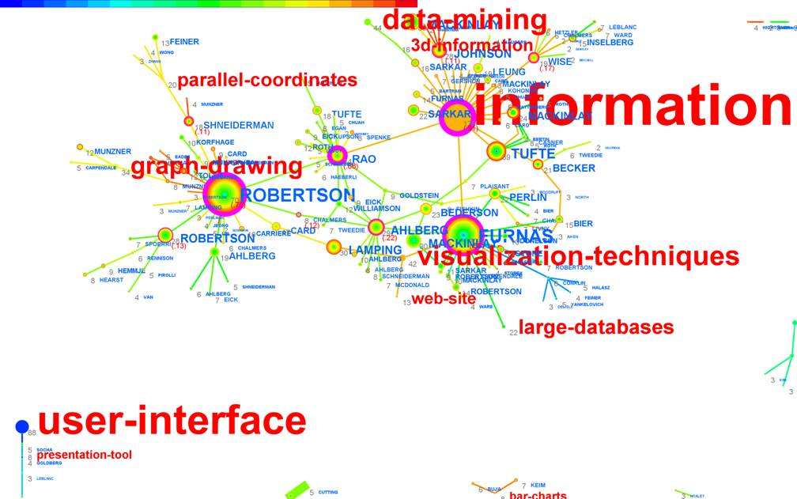
Network Data is Omnipresent
Social Networks
Protein Interaction Networks
The World Wide Web
Transportation Networks
Bibliographic Networks
Computer Networks

Slide 4

New Area: Outlier Detection for Information Networks
Network Analysis
Outlier
Detection
Outlier
Detection
For
Networks

Slide 5

Thesis Outline
Community Based Outlier Detection
Query Based Outlier Detection
10 min
15 min
PRELIM
Evolutionary Community Outliers
Association-based Clique Outliers
15 min
Community Trend Outliers
10 min
Query-Based Subgraph Outliers
Community Distribution Outliers

Slide 6
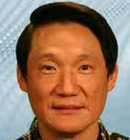


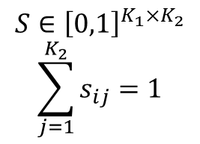
Evolutionary Community Outliers
(EC-Outliers)
Belongingness Matrix
Community-Community Correspondence Matrix
DM IR ML DB
K₁
K₂
Databases (DB)
K₂
Information
Retrieval (IR)
Machine
Learning (ML)
X
$$≈$$
S
K₁
Data Mining (DM)
N
P
N
Q
$P∈{\left[0,1\right]}^{N×K_{1}}$ $Q∈{\left[0,1\right]}^{N×K_{2}}$
$$\sum_{i=1}^{K_{1}}{p_{oi}}=1 \sum_{j=1}^{K_{2}}{q_{oj}}=1$$
$$S∈{\left[0,1\right]}^{K_{1}×K_{2}}$$
$$\sum_{j=1}^{K_{2}}{s_{ij}}=1$$
ECOutliers: Objects that evolve against community change trends (S)

Slide 7
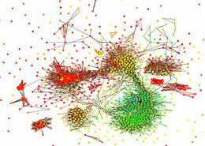




TwoStage Evolutionary Outlier Detection Framework
Community
Detection
Community Matching
Outlier Detection
Evolutionary
Clustering
X₁
P
$$×$$
$$≈$$
P
S
Q
A=Q-PS
X₂
Q

Slide 8

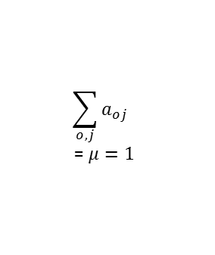
OneStage Evolutionary Outlier Detection Framework
Outlierness Matrix: ${A∈[0,1]}^{N×K_{2}}$
Community
Detection
Community Matching
Outlier Detection
X₁
P
$$×$$
$$≈$$
P
S
Q
$$\sum_{o,j}{a_{oj}}$$
= $μ=1$
X₂
A=Q-PS
Q

Slide 9


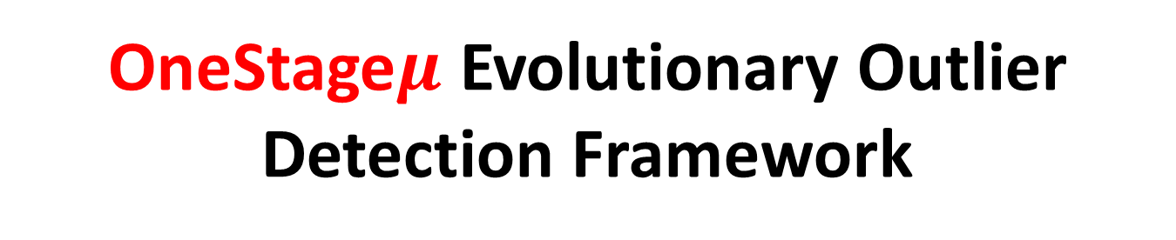
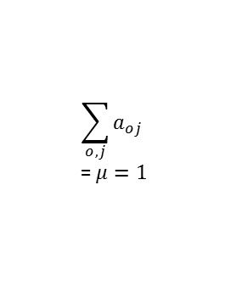

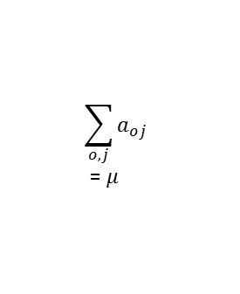



OneStage$μ$ Evolutionary Outlier Detection Framework
Community
Detection
Community Matching
Outlier Detection
Community Matching
Outlier Detection
X₁
P
$$×$$
$$≈$$
$$×$$
$$≈$$
P
S
Q
P
S
Q
X₂
A
$$\sum_{o,j}{a_{oj}}$$
= $μ=1$
A
$$\sum_{o,j}{a_{oj}}$$
= $μ$
Q
Two pass algorithm
Coordinate descent iterative computation of S and A
Estimate $μ$

Slide 10
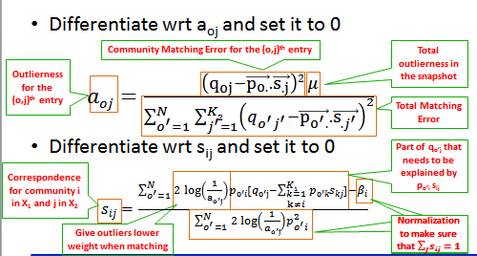
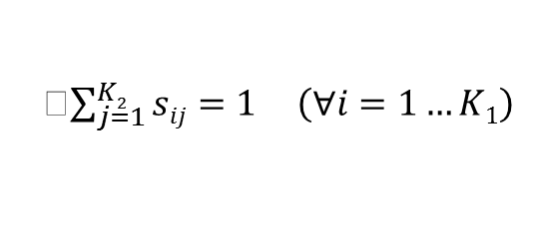
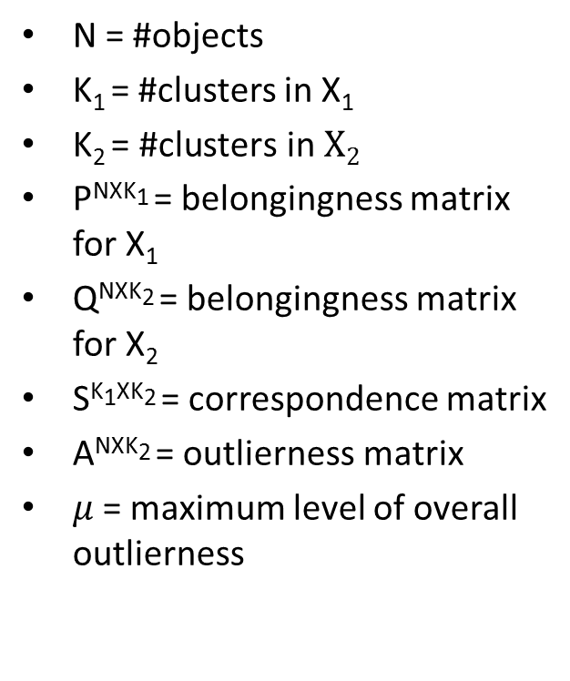

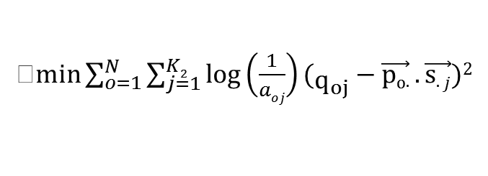


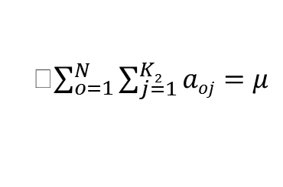
Community Matching and
Outlier Detection Together
X
$$≈$$
$\min{\sum_{o=1}^{N}{\sum_{j=1}^{K2}{\log\left(\frac{1}{aoj}\right)(q_{oj}−\vec{po.}.\vec{s.j})2}}}$
S
$subject to the following constraints$
P
Q
Given P and Q, estimate S and A
$\sum_{j=1}^{K2}{sij=1} \left(∀i=1…K1\right)$
$\sum_{o=1}^{N}{\sum_{j=1}^{K2}{aoj=μ}}$
N = #objects
K₁ = #clusters in X₁
$\text{K}\text{2 }\text{= \#}\text{clusters} \text{in} X2$
P^{NXK1} = belongingness matrix for X₁
Q^{NXK2} = belongingness matrix for X₂
S^{K1XK2} = correspondence matrix
A^{NXK2} = outlierness matrix
$μ$= maximum level of overall outlierness
$$sij≥0 \left(∀i=1…K1, ∀j=1…K2\right)$$
$1≥a_{oj}≥0 \left(∀o=1…N, ∀j=1…K2\right)$

Slide 11
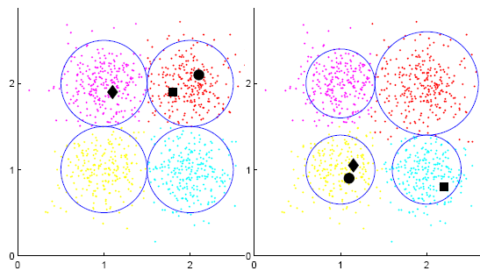
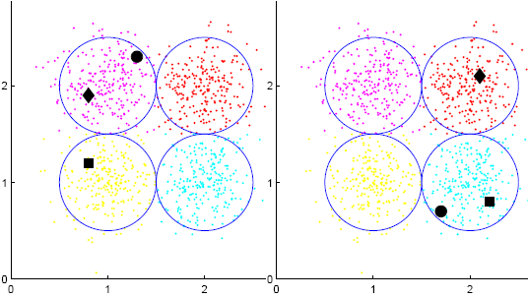
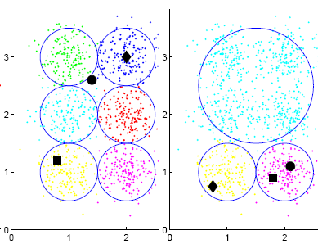
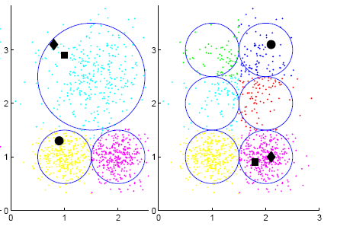
Synthetic Datasets
Expansion/Contraction
No Evolution
Cluster Merge
Cluster Split

Slide 12
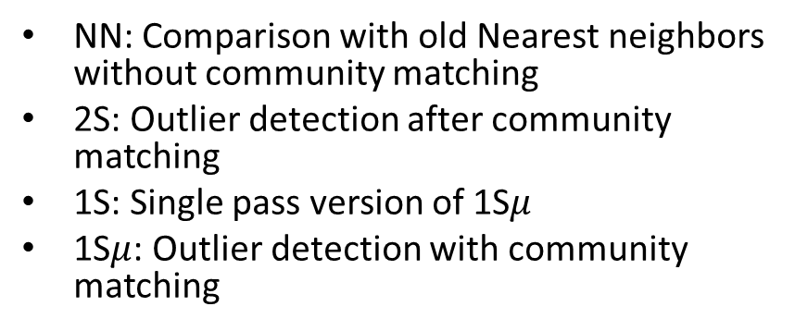
Synthetic Dataset Results Summary
N | Ψ | SynContractExpand |  |  |  | SynNoEvolution |  |  |  | SynMerge |  |  |  | SynSplit |  |  |  | SynMix
 | (%) | NN | 2S | 1S | 1Sµ | NN | 2S | 1S | 1Sµ | NN | 2S | 1S | 1Sµ | NN | 2S | 1S | 1Sµ | NN | 2S | 1S | 1Sµ
1000 | 1 | 0.755 | 0.947 | 0.966 | 0.966 | 0.832 | 0.791 | 0.853 | 0.965 | 0.72 | 0.774 | 0.835 | 0.926 | 0.786 | 0.918 | 0.929 | 0.931 | 0.606 | 0.891 | 0.904 | 0.925
 | 2 | 0.729 | 0.92 | 0.948 | 0.957 | 0.812 | 0.733 | 0.789 | 0.961 | 0.702 | 0.715 | 0.781 | 0.908 | 0.779 | 0.865 | 0.92 | 0.924 | 0.675 | 0.823 | 0.86 | 0.915
 | 5 | 0.71 | 0.853 | 0.913 | 0.956 | 0.726 | 0.712 | 0.752 | 0.928 | 0.645 | 0.654 | 0.719 | 0.849 | 0.697 | 0.799 | 0.891 | 0.92 | 0.631 | 0.77 | 0.817 | 0.92
 | 10 | 0.619 | 0.766 | 0.833 | 0.96 | 0.657 | 0.684 | 0.706 | 0.881 | 0.58 | 0.617 | 0.656 | 0.801 | 0.63 | 0.749 | 0.832 | 0.918 | 0.594 | 0.73 | 0.776 | 0.917
5000 | 1 | 0.778 | 0.945 | 0.97 | 0.97 | 0.938 | 0.793 | 0.848 | 0.971 | 0.713 | 0.762 | 0.801 | 0.928 | 0.796 | 0.913 | 0.942 | 0.942 | 0.691 | 0.881 | 0.895 | 0.918
 | 2 | 0.756 | 0.93 | 0.947 | 0.961 | 0.864 | 0.772 | 0.815 | 0.962 | 0.677 | 0.752 | 0.791 | 0.903 | 0.768 | 0.885 | 0.938 | 0.94 | 0.646 | 0.862 | 0.876 | 0.919
 | 5 | 0.689 | 0.901 | 0.929 | 0.964 | 0.742 | 0.75 | 0.779 | 0.941 | 0.626 | 0.698 | 0.749 | 0.827 | 0.689 | 0.806 | 0.913 | 0.924 | 0.608 | 0.831 | 0.86 | 0.921
 | 10 | 0.622 | 0.778 | 0.829 | 0.964 | 0.656 | 0.73 | 0.747 | 0.912 | 0.579 | 0.643 | 0.679 | 0.795 | 0.624 | 0.762 | 0.834 | 0.929 | 0.593 | 0.783 | 0.824 | 0.919
10000 | 1 | 0.769 | 0.949 | 0.973 | 0.974 | 0.926 | 0.807 | 0.856 | 0.974 | 0.707 | 0.788 | 0.817 | 0.933 | 0.789 | 0.938 | 0.955 | 0.96 | 0.665 | 0.882 | 0.897 | 0.921
 | 2 | 0.752 | 0.937 | 0.949 | 0.963 | 0.851 | 0.788 | 0.828 | 0.964 | 0.681 | 0.762 | 0.796 | 0.898 | 0.758 | 0.898 | 0.948 | 0.951 | 0.67 | 0.869 | 0.881 | 0.916
 | 5 | 0.695 | 0.9 | 0.93 | 0.964 | 0.738 | 0.763 | 0.788 | 0.951 | 0.627 | 0.719 | 0.756 | 0.826 | 0.683 | 0.807 | 0.914 | 0.922 | 0.604 | 0.847 | 0.871 | 0.919
 | 10 | 0.622 | 0.771 | 0.825 | 0.965 | 0.66 | 0.753 | 0.769 | 0.926 | 0.583 | 0.645 | 0.681 | 0.795 | 0.621 | 0.769 | 0.827 | 0.934 | 0.584 | 0.812 | 0.845 | 0.917
1S (5%)
2S (8%)
NN (36%)
1S (15%)
2S (25%)
NN (21%)
1S (11%)
2S (22%)
NN (33%)
1S (3%)
2S (10%)
NN (30%)
1S (6%)
2S (10%)
NN (46%)
NN: Comparison with old Nearest neighbors without community matching
2S: Outlier detection after community matching
1S: Single pass version of 1S$μ$
1S$μ$: Outlier detection with community matching
1S (8%)
2S (15%)
NN (33%)

Slide 13
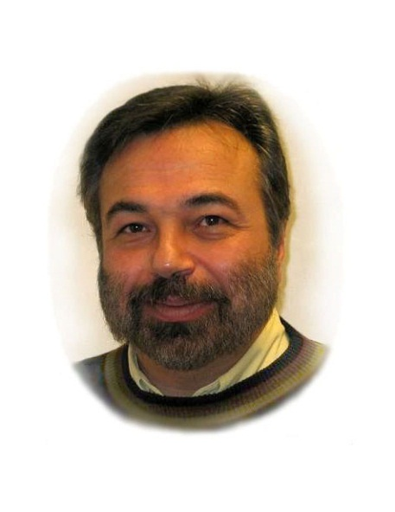
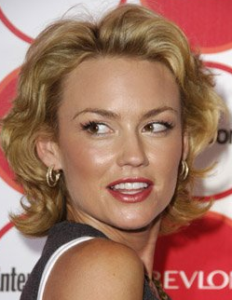
Real Dataset Case Studies
DBLP Authors Network
Georgios B. Giannakis
  X₁ conferences: CISS, ICC, GLOBECOM, INFOCOM
  X₂ conferences: ICASSP, ICRA
IMDB
Kelly Carlson (I)
  X₁: Many Sport, Thriller, and Action movies
  X₂: Many Drama, Music, Reality-TV movies

Slide 14
Thesis Outline
Community Based Outlier Detection
Query Based Outlier Detection
PRELIM
Evolutionary Community Outliers
Association-based Clique Outliers
Community Trend Outliers
Query-Based Subgraph Outliers
Community Distribution Outliers

Slide 15
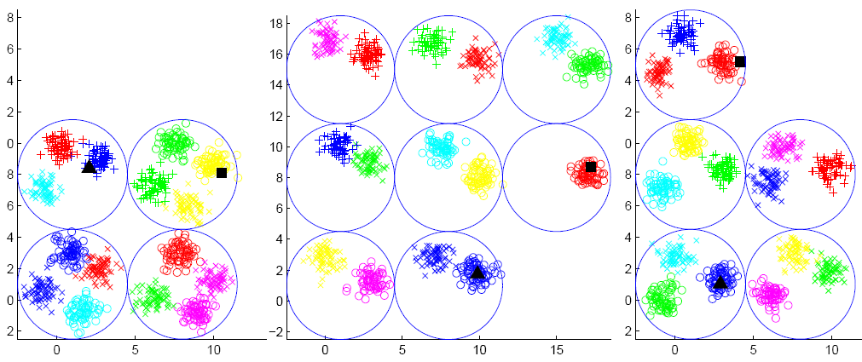


Community Trend Outliers
(CT-Outliers)
Normal
Anomalous
Community Trend Outliers: Nodes for which evolutionary behaviour across a series of snapshots is quite different from that of its community members
Notes:
Trajectory based outliers [Alon et al.,2003][Basharat et al., 2008]
General patterns could be gapped and multi-level, unlike trajectories.
Patterns in our case are soft clustering results rather than locations
We don’t have features such as speed or direction of motion of objects.

Slide 16
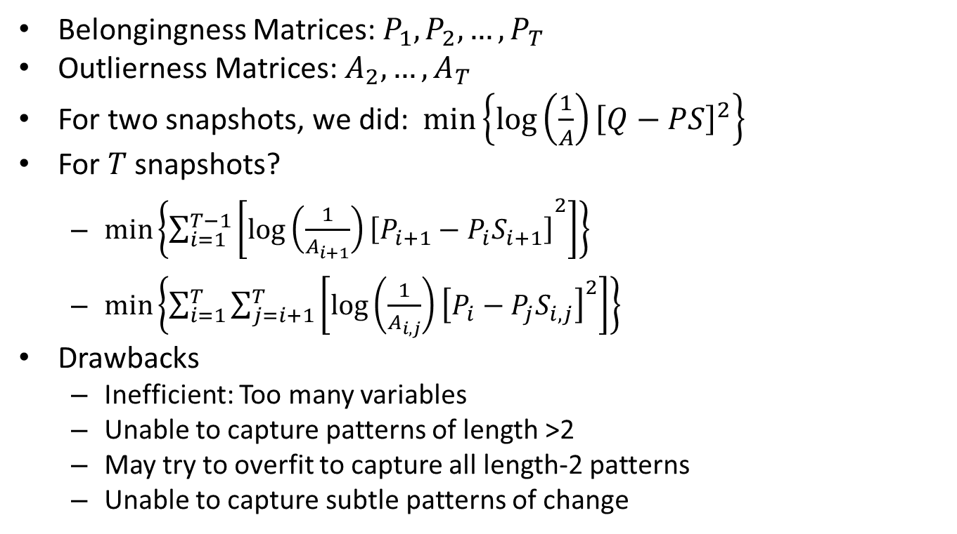
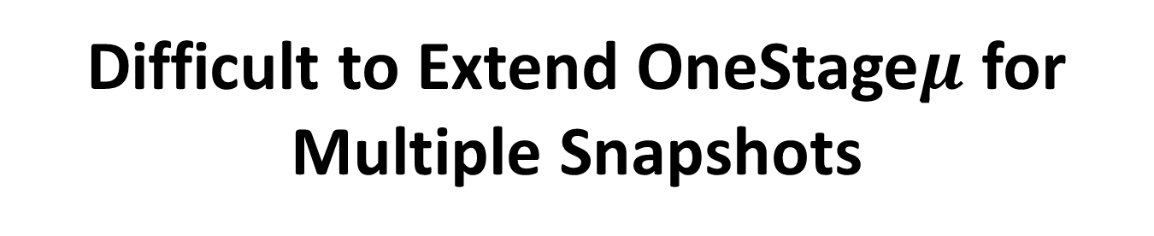
Difficult to Extend OneStage$μ$ for Multiple Snapshots
Belongingness Matrices: $P_{1}, P_{2}, …,P_{T}$
Outlierness Matrices: $A_{2},…, A_{T}$
For two snapshots, we did: $min\left\{log\left(\frac{1}{A}\right){\left[Q−PS\right]}^{2}\right\}$
For $T$ snapshots?
  $\min\left\{\sum_{i=1}^{T−1}{\left[{\log\left(\frac{1}{A_{i+1}}\right)\left[P_{i+1}−P_{i}S_{i+1}\right]}^{2}\right]}\right\}$
  $\min\left\{\sum_{i=1}^{T}{\sum_{j=i+1}^{T}{\left[\log\left(\frac{1}{A_{i,j}}\right){\left[P_{i}−P_{j}S_{i,j}\right]}^{2}\right]}}\right\}$
Drawbacks
  Inefficient: Too many variables
  Unable to capture patterns of length >2
  May try to overfit to capture all length-2 patterns
  Unable to capture subtle patterns of change

Slide 17
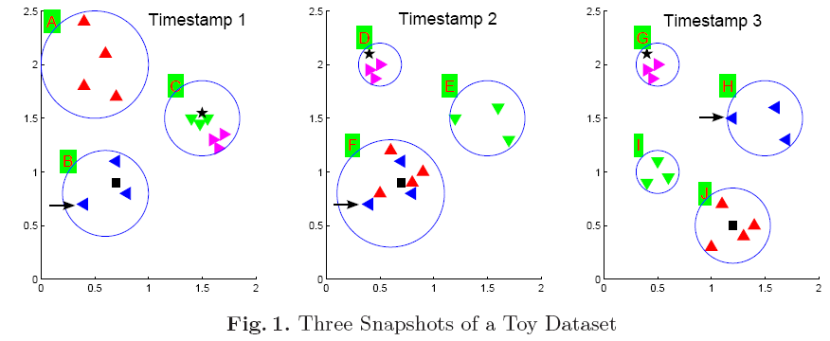
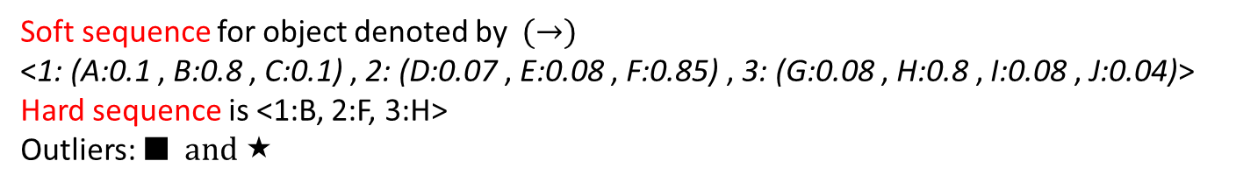
Soft Sequence and Soft Pattern Representation
Every object has a distribution associated with it across time
  In a co-authorship network, an author has a distribution of research areas associated with it across years
Soft sequence for object denoted by $(→)$
<1: (A:0.1 , B:0.8 , C:0.1) , 2: (D:0.07 , E:0.08 , F:0.85) , 3: (G:0.08 , H:0.8 , I:0.08 , J:0.04)>
Hard sequence is <1:B, 2:F, 3:H>
Outliers: ■ and 

Slide 18
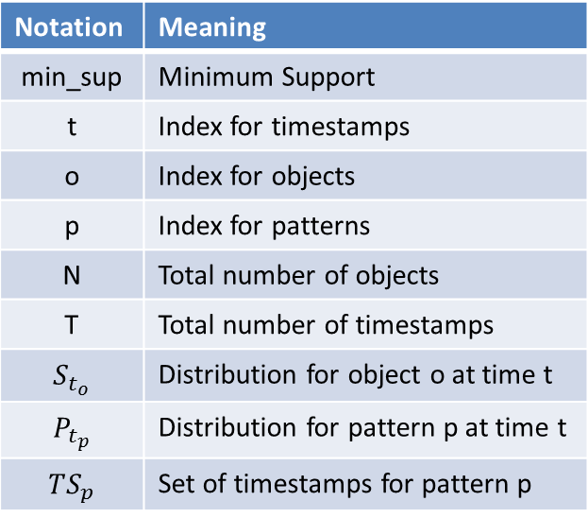
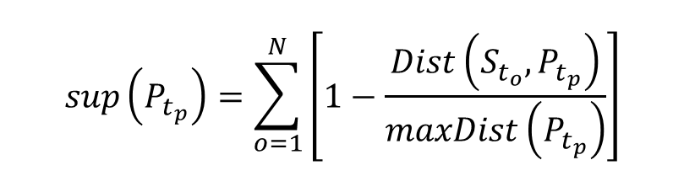
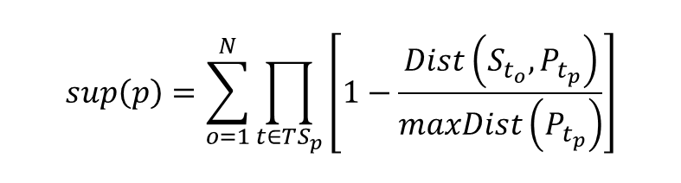
Support Computation for Soft Patterns
Notation | Meaning
min_sup | Minimum Support
t | Index for timestamps
o | Index for objects
p | Index for patterns
N | Total number of objects
T | Total number of timestamps
$$S_{t_{o}}$$ | Distribution for object o at time t
$$P_{t_{p}}$$ | Distribution for pattern p at time t
$$TS_{p}$$ | Set of timestamps for pattern p
$$sup\left(P_{t_{p}}\right)=\sum_{o=1}^{N}{\left[1−\frac{Dist\left(S_{t_{o}}, P_{t_{p}}\right)}{maxDist\left(P_{t_{p}}\right)}\right]}$$
For longer patterns
Candidate generation
uses Apriori
$$sup\left(p\right)=\sum_{o=1}^{N}{\prod_{t∈TS_{p}}{\left[1−\frac{Dist\left(S_{t_{o}}, P_{t_{p}}\right)}{maxDist\left(P_{t_{p}}\right)}\right]}}$$

Slide 19
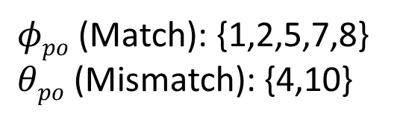
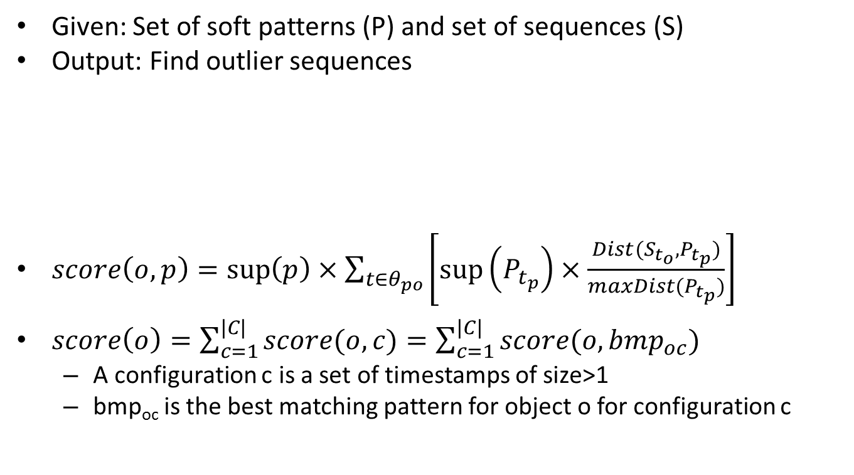
CT-Outlier Detection
Given: Set of soft patterns (P) and set of sequences (S)
Output: Find outlier sequences
$score\left(o,p\right)=\sup\left(p\right)×\sum_{t∈θ_{po}}{\left[\sup\left(P_{t_{p}}\right)×\frac{Dist(S_{t_{o}}, P_{t_{p}})}{maxDist(P_{t_{p}})}\right]}$
$score\left(o\right)=\sum_{c=1}^{|C|}{score(o,c)}=\sum_{c=1}^{|C|}{score(o,bmp_{oc})}$
  A configuration c is a set of timestamps of size>1
  bmp_{oc} is the best matching pattern for object o for configuration c
Gapped Pattern
1 | 2 | 3 | 4 | 5 | 6 | 7 | 8 | 9 | 10
Pattern p
$φpo$ (Match): {1,2,5,7,8}
$θpo$ (Mismatch): {4,10}
Sequence o

Slide 20
Synthetic Dataset Results
N | Outliers | Outlier Degree=0.8
 | (%) | |P|=5 |  |  | |P|=10 |  |  | |P|=15
 |  | CTO | BL1 | BL2 | CTO | BL1 | BL2 | CTO | BL1 | BL2
 | 1 | 95.5 | 85.5 | 92 | 83 | 76.5 | 84 | 92 | 77 | 86
1000 | 2 | 98.2 | 94.5 | 96.5 | 91.2 | 86.5 | 90 | 95.5 | 76 | 94
 | 5 | 99 | 95.7 | 97.3 | 96.3 | 91 | 95.9 | 97.4 | 79.3 | 96.7
 | 1 | 95.8 | 83.5 | 89.8 | 84.4 | 76.6 | 84.4 | 88.4 | 73.1 | 86.1
5000 | 2 | 97.9 | 89.6 | 94 | 89.4 | 85.6 | 88.4 | 95.4 | 79.8 | 93.1
 | 5 | 98.8 | 95.4 | 97.6 | 95 | 90.5 | 94.7 | 97.7 | 79.7 | 96.9
 | 1 | 95.6 | 84.2 | 89.5 | 81.8 | 76.4 | 82.8 | 91.8 | 76.5 | 87.6
10000 | 2 | 98 | 91.1 | 95 | 89.9 | 86.9 | 90.7 | 95.8 | 80.6 | 93.3
 | 5 | 99.1 | 95.8 | 98 | 95.3 | 90.1 | 95.3 | 97.3 | 76.4 | 96.6
Runtime
(seconds)
83
BL1 (7.4%)
BL2 (2.3%)
116
184
CTO=The Proposed Algorithm CTODA
BL1=Consecutive Baseline
BL2=No-gaps Baseline

Slide 21
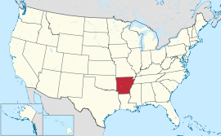
Real Dataset Case Studies (Budget)
41545 patterns (20% support)
State of Arkansas
Distributions of Budget Spending for AK
Average trend of 5 states with distributions
close to that of AK for 2004-2009
Notes:
For states with 6% pension, 16% heathcare, 32% education, 16% other spending in 2006, it has been observed that heathcare increased by 4-5% in 2009-2010 while other spending decreased by 4%. But in the case of AK which followed a similar distribution in 2006, heathcare decreased by 3% and other spending increased by 5% in 2009-2010.
States with 16% healthcare, 30% education, 10% transportation and 16% other spending in 2005 and 2008 generally show a similar distribution with around 13% other spending in 2001. But AK shows a clear peak of 43% in other spending for 2001.

Slide 22
Thesis Outline
Community Based Outlier Detection
Query Based Outlier Detection
PRELIM
Evolutionary Community Outliers
Association-based Clique Outliers
Community Trend Outliers
Query-Based Subgraph Outliers
Community Distribution Outliers

Slide 23
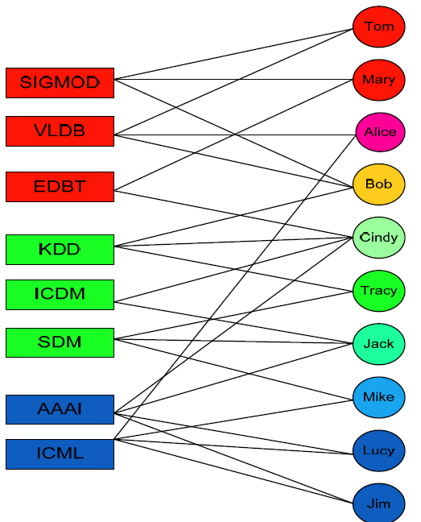
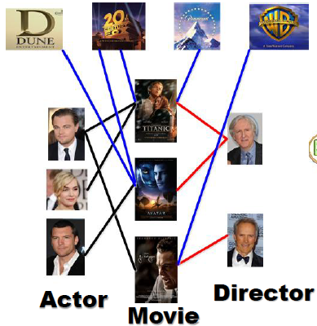
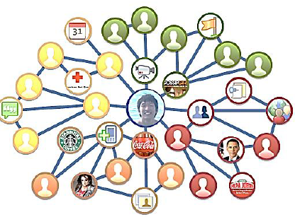




Heterogeneous Networks are Ubiquitous
Studio
IMDB Network
DBLP Network
Facebook Network
Actor
Movie
Studio
Director
Notes:
MultiMediaN E-Culture
By linking the collections and vocabularies from multiple museums together the E-Culture project constructed a graph of cultural heritage data. Within the MultimediaN E-Culture team I investigated how keyword search can be applied to this heterogeneous graph to find artworks that are semantically related artworks to a keyword query?

Slide 24
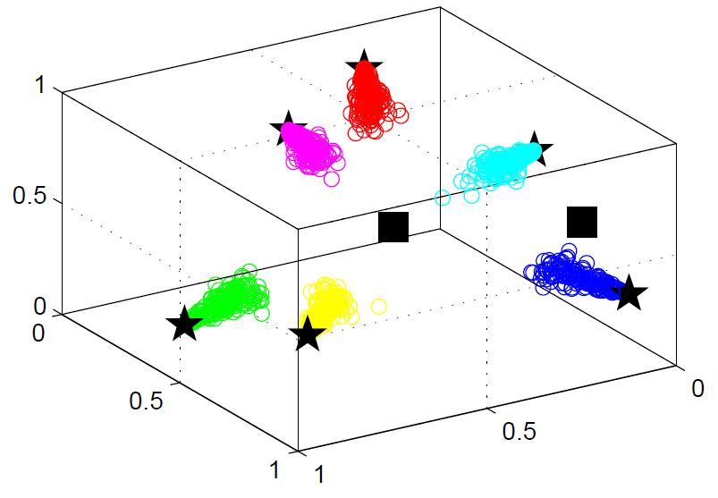
Community Distribution Outliers
(CD-Outliers)
z
Type | x | y | z
Pattern “b” | 0.8 | 0.0 | 0.2
Pattern “g” | 0.2 | 0.8 | 0.0
Pattern “r” | 0.0 | 0.2 | 0.8
Pattern “c” | 0.4 | 0.0 | 0.6
Pattern “m” | 0.0 | 0.4 | 0.6
Pattern “y” | 0.4 | 0.6 | 0.0
Outlier 1 | 0.6 | 0.0 | 0.4
Outlier 2 | 0.33 | 0.33 | 0.34
y
x
Distribution Pattern for a Type
  A cluster obtained by grouping rows of a belongingness matrix of that type
  Can be represented using cluster centroids
Community Distribution Outliers: Objects whose community distribution does not follow any of the popular community distribution patterns

Slide 25





CD-Outlier Examples
EXPERT
User
Tag
URL
Fashion
Arts
Science
Sports
MARKETER
User
Tag
Video
Fashion
Arts
Science
Sports

Slide 26



Our Approach in Brief
Pattern Discovery
Outlier Detection
H₁
Top $κ$ Outliers
T₁
W₁
Joint NMF
H₂
W₂
Top $κ$ Outliers
T₂
H₃
Top $κ$ Outliers
W₃
T₃
Remove Outliers from T_{i}

Slide 27
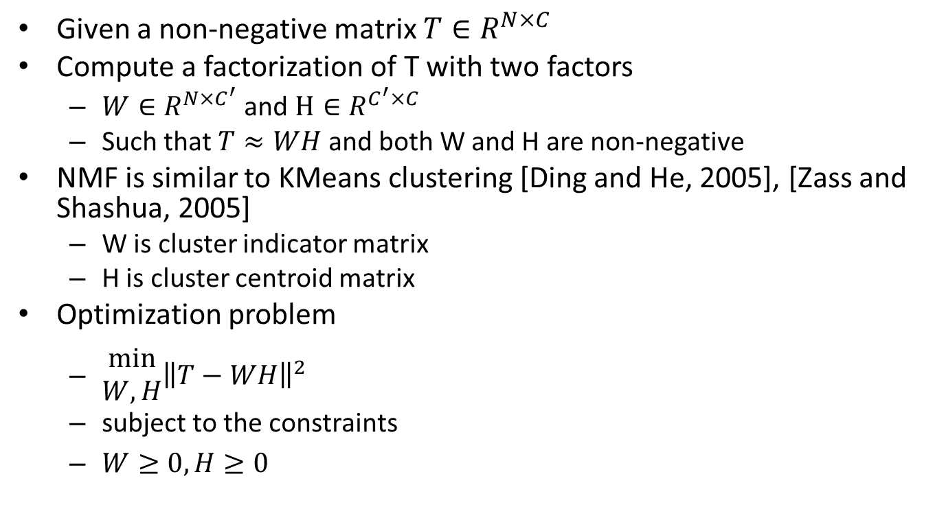
Brief Overview of NMF
Given a non-negative matrix $T∈R^{N×C}$
Compute a factorization of T with two factors
  $W∈R^{N×C^{′}}$ and $H∈R^{C^{′}×C}$
  Such that $T≈WH$ and both W and H are non-negative
NMF is similar to KMeans clustering [Ding and He, 2005], [Zass and Shashua, 2005]
  W is cluster indicator matrix
  H is cluster centroid matrix
Optimization problem
  $\begin{aligned}min \\ W,H\end{aligned}{{\left\|T−WH\right\|}^{2}}$
  subject to the constraints
  $W≥0, H≥0$

Slide 28
Discovery of Distribution Patterns
Each of the T matrices can be clustered individually
But the membership matrices T
  Are defined for objects that are connected to each other
  Represent objects in the same space of C dimensions
Hidden structures across types should be consistent with each other
Divergence between any two clusterings should be small

Slide 29
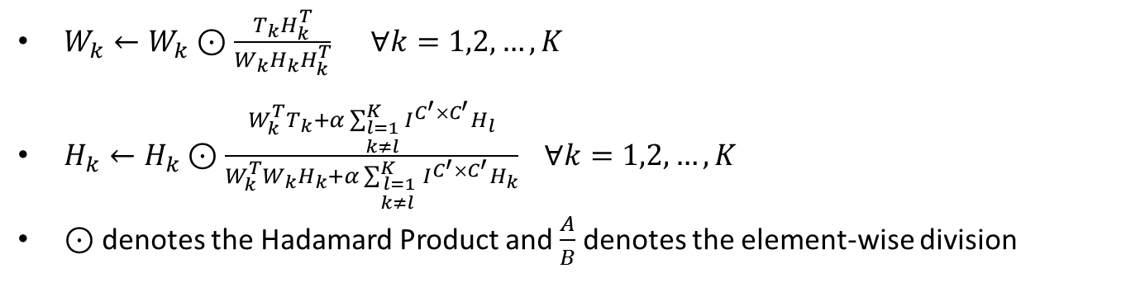
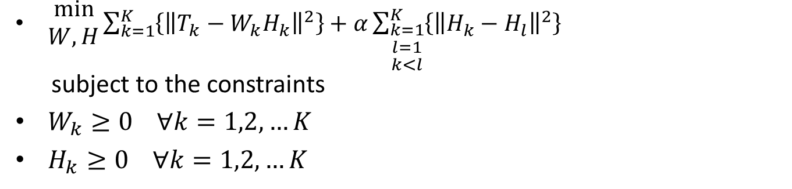
Optimization & Iterative Update Rules
  $\begin{aligned}min \\ W,H\end{aligned}{{\sum_{k=1}^{K}{\left\{{\left\|T_{k}−W_{k}H_{k}\right\|}^{2}\right\}}+α\sum_{\begin{aligned}k=1 \\ l=1 \\ k<l\end{aligned}}^{K}{\left\{{\left\|H_{k}−H_{l}\right\|}^{2}\right\}}}^{}}$
subject to the constraints
$W_{k}≥0 ∀k=1,2,…K$
$H_{k}≥0 ∀k=1,2,…K$
$W_{k}←W_{k}⊙\frac{T_{k}H_{k}^{T}}{W_{k}H_{k}H_{k}^{T}} ∀k=1,2,…, K$
$H_{k}←H_{k}⊙\frac{W_{k}^{T}T_{k}+α\sum_{\begin{aligned}l=1 \\ k≠l\end{aligned}}^{K}{I^{C^{′}×C^{′}}H_{l}}}{W_{k}^{T}W_{k}H_{k}+α\sum_{\begin{aligned}l=1 \\ k≠l \end{aligned}}^{K}{I^{C^{′}×C^{′}}H_{k}}} ∀k=1,2,…, K$
$⊙$denotes the Hadamard Product and $\frac{A}{B}$ denotes the element-wise division

Slide 30
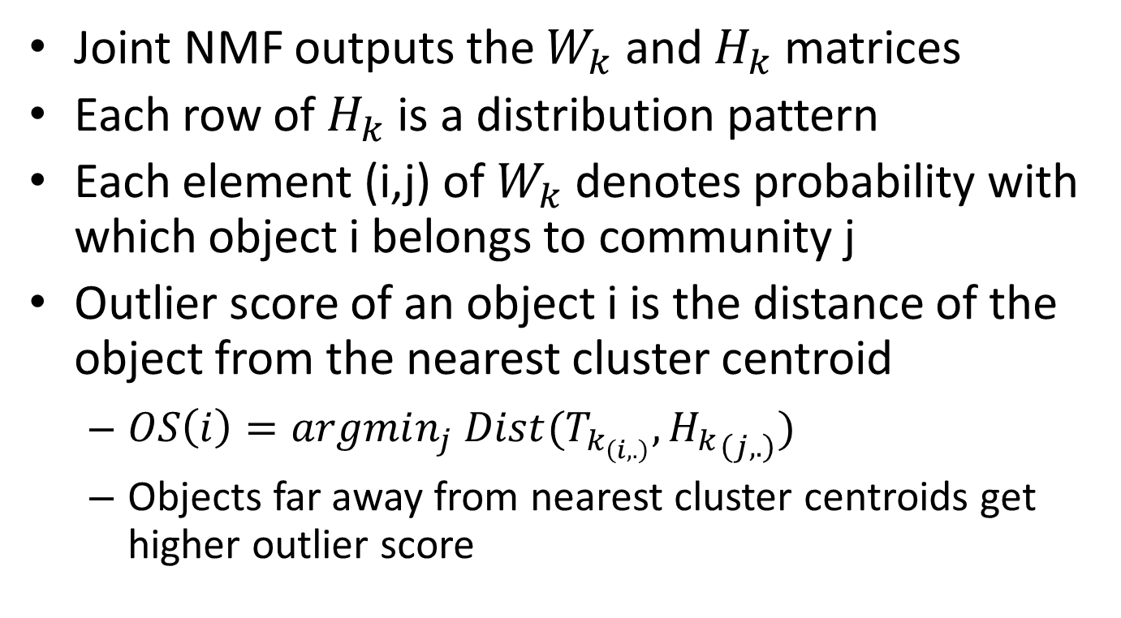
Community Distribution Outlier Detection
Joint NMF outputs the $W_{k}$ and $H_{k}$ matrices
Each row of $H_{k}$ is a distribution pattern
Each element (i,j) of $W_{k}$ denotes probability with which object i belongs to community j
Outlier score of an object i is the distance of the object from the nearest cluster centroid
  $OS\left(i\right)=argmin_{j} Dist(T_{k_{\left(i,.\right)}}, {H_{k}}_{\left(j,.\right)})$
  Objects far away from nearest cluster centroids get higher outlier score

Slide 31
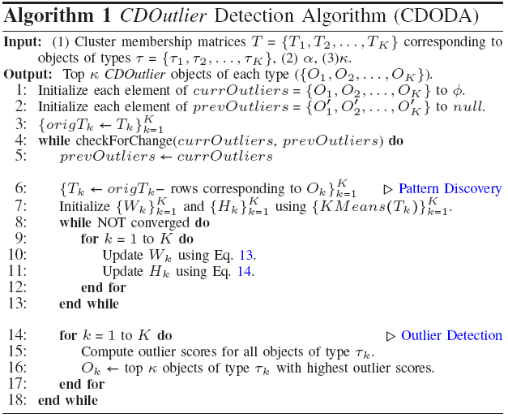




Iterative Refinement Algorithm
$$O(NI^{′}K[KIC^{′2}+log⁡(κ)])$$
Linear in
number of
objects
$$O(K^{2}INC^{′2})$$
$$O(N{KC}^{′2})$$
$$O(KNlog(κ))$$

Slide 32
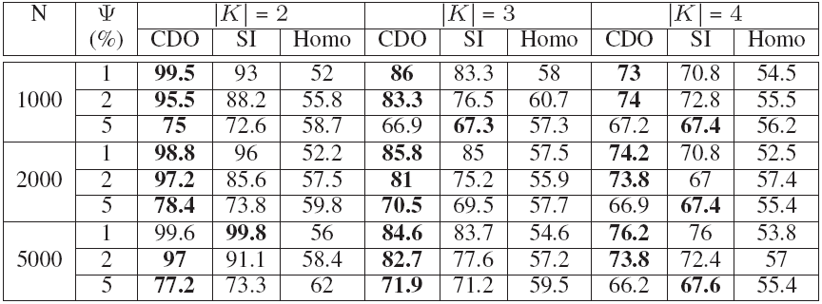
Synthetic Dataset Results Summary
Synthetic Dataset Results (CDO =The Proposed Algorithm CDODA, SI = Single Iteration Baseline, Homo = Homogenous (Single NMF) Baseline) for C=6
SI: Single iteration version of CDO
Homo: Treats all objects to be of the same type
SI (2.9%)
Homo(21%)

Slide 33
Running Time and Convergence
Convergence of joint-NMF
Running Time (sec) for CDO (Scalability)

Slide 34
Real Dataset Case Studies (DBLP)
Each research area appears as a pattern and then there are other patterns with distributions across multiple areas. E.g., “Data Mining” and “Computational Biology” is a pattern
Some patterns are specific to particular types
  “Software engineering” and “Operating systems” for conferences
  “Concurrent Distributed and Parallel Computing” and “Security and privacy” for authors
  “Security and privacy” and “Education” for terms
Top Outlier Author: Giuseppe de Giacomo - Algorithms and Theory (0.25), Databases (0.47), Artificial Intelligence (0.13), Human Computer Interaction (0.06)
Top conference outlier: From integrated publication and information systems to virtual information and knowledge environments - Databases (0.5), Artificial Intelligence (0.09), Human Computer interaction (0.4)
Top terms outlier: military - Algorithms and theory (0.02), Security and Privacy (0.37), Databases (0.22), Computer Graphics (0.37)

Slide 35



Summary of Community based Outlier Detection
Introduced three community-based outlier definitions
  EC-Outliers for two snapshot case
  CT-Outliers for the case of multiple snapshots
  CD-Outliers for static heterogeneous networks
Proposed novel approaches
  Two pass coordinate descent method to perform community matching and EC-Outlier detection simultaneously
  Two-step CT-Outlier detection using soft pattern mining
  CD-Outlier detection using a joint-NMF optimization framework to learn distribution patterns across multiple object types together
Experimented with multiple real and synthetic datasets
Evolutionary Community
Outliers
Community Distribution
Outliers
Community Trend Outliers
NMF
Cluster
Pattern
Apriori

Slide 36
Thesis Outline
Community Based Outlier Detection
Query Based Outlier Detection
PRELIM
Evolutionary Community Outliers
Association-based Clique Outliers
Community Trend Outliers
Query-Based Subgraph Outliers
Community Distribution Outliers

Slide 37
Association-Based Clique Outliers (ABC-Outliers)
A conjunctive select query on a network consists of (type, predicate) pairs
Expected result are cliques ranked by outlierness
ABCOutliers: Cliques containing rare and interesting associations between constituent entities
Applications
  Discovering interesting relationships
  Data de-noising (removing incorrect data attributes or entity associations)
  Explaining the future behavior of objects participating in such associations
Research
Area
Author
Conference
Energy and
Sustainability
Computer Networking
Author
Data engineering
Conference

Slide 38





Concept Definitions: A Network
Network G
A
Actors
B
Locations
2
5
8
A
B
C
11
3
6
9
A
A
B
C
1
B
4
7
10
B
C
B
A
Query Q
Outlier
Movie
Vietnamese
Actor
American
Country
China
Notes:
$G=〈V,E,F_{1},F_{2}〉$
$F_{1}:V→Τ$ where $Τ$ is set of entity types
$F_{2}$ maps every node to attribute vector
Each node has multiple attributes each with a different data type ($A_{i}=(A_{i_{1}},A_{i_{2}}, …,A_{i_{D_{i}}})$ such that $|A_{i}|=D_{i}$)
Attributes could be numeric, categorical, sets of strings, time durations
Edges are not typed for our work
Person and movie; Edge could be actor, producer, director
Conjunctive Select Query (Q) of length L on a network
$$〈\left(T_{1}, P_{1}\right),\left(T_{2}, P_{2}\right), …, \left(T_{L} , P_{L}\right)〉$$
$P_{i}$ is defined only for type $T_{i}$
Match C for set query Q
$$C_{i}=〈e_{i_{1}}^{D_{1}×1}, …,e_{i_{L}}^{D_{L}×1}〉$$
Contains the same number and type of nodes as mentioned in the query
All nodes in C are connected to each other in G and satisfy the predicates in Q
Association-Based Clique Outlier
Outlierness of a clique =f(outlierness of associations between the attributes of these nodes)
Outlierness of association ${(v}_{1},v_{2})$ for attributes $a_{1}$ and $a_{2}$ is high if
$v_{1}$ and $v_{2}$ are frequent
Co-occurrence of $v_{1}$ and $v_{2}$ is rare
High correlation between $a_{1}$ and $a_{2}$
Association-Based Clique Outlier Detection Problem
Given: a network G and a query Q
Find: top K cliques that satisfy the query with highest outlier scores.

Slide 39

Q=<(T₁,P₁), (T₂,P₂), …, (T_{L},P_{L})>
Q₁=<(T₁,P₁)> | Q₂=<(T₂,P₂)> | … | Q_{L}=<(T_{L},P_{L})>
Matching
…
L₁
Network G
T₁
T₂
L₂
T_{T}
Candidate Computation by Matching
T₃
⋮
L_{L}
Score Computation for a Query Edge
Cluster Computation for an Attribute
$$C_{1}=<e_{1_{1}}^{D_{1}×1}, …,e_{1_{L}}^{D_{L}×1}>$$
⋮
$$C_{M}=<e_{M_{1}}^{D_{1}×1}, …,e_{M_{L}}^{D_{L}×1}>$$
TopK Quit?
No
TopK ABCOutliers
Yes
Outlier Detection

Slide 40

Candidate Computation by Matching
Graph Indexing
Relational database: Attribute information associated with each of the vertices (entities) in G
Memory: Connectivity information of the graph
Shared neighbors index: For each entity, store the number of shared neighbors of each type, shared between the entity and its neighbors of a particular type
T₁
T₂
T_{T}
 | A |  |  | B |  |  | C
 | A | B | C | A | B | C | A | B | C
1 | 0 | 0 | 1 | 0 | 0 | 0 | 1 | 0 | 0
2 | 0 | 0 | 0 | 0 | 0 | 0 | 0 | 0 | 0
3 | 0 | 0 | 0 | 0 | 0 | 1 | 0 | 1 | 0
4 | 0 | 1 | 0 | 1 | 0 | 0 | 0 | 0 | 0
5 | 0 | 0 | 0 | 0 | 0 | 0 | 0 | 0 | 0
6 | 0 | 0 | 0 | 0 | 0 | 0 | 0 | 0 | 0
7 | 0 | 0 | 1 | 0 | 0 | 0 | 1 | 0 | 0
8 | 0 | 0 | 1 | 0 | 0 | 0 | 1 | 0 | 0
9 | 0 | 2 | 1 | 2 | 0 | 0 | 1 | 0 | 0
10 | 0 | 0 | 0 | 0 | 0 | 1 | 0 | 2 | 0
11 | 0 | 0 | 0 | 0 | 0 | 1 | 0 | 1 | 1
12 | 0 | 0 | 1 | 0 | 0 | 0 | 2 | 0 | 0
2
5
8
Network G
A
B
C
11
3
6
9
A
A
B
C
1
B
B
4
7
10
C
B
A
$$O(NT^{2})$$

Slide 41

Candidate Computation by Matching
Candidate Filtering
Given: $L$ lists $L_{1},L_{2},…, L_{L}$
Find: Cliques of size $L$ such that each clique has a node from each list
Start with size 1 cliques and grow them
$L_{min}$ is list of min size and has type $T_{min}$
Prune $L_{min}$
  Prune the node if its typed neighbors cannot satisfy the requirements of the query
  Prune the node if its typed neighbors do not have enough shared neighbors

Slide 42

Candidate Computation by Matching
Generating Candidates
Size 1 cliques: Elements of list $L_{min}$
Grow each length-$l$ clique to length-$l+1$ cliques
  Randomly choose next type $t’$
  A node $n$ of type $t’$ is added to length-$l$ clique if it is connected to all nodes in clique
Length-$l$ clique is pruned off if it cannot grow
Algorithm terminates when $l=L$

Slide 43


Outlier Score Computation
Scoring Attribute Value Pairs (1)
Outlier score between values $v_{i}$ and $v_{j}$ should be high if
  Values $v_{i}$ and $v_{j}$ co-occur rarely
  Values $v_{i}$ and $v_{j}$ are individually frequent
  $∃s_{j}|$co-occur freq($v_{i},s_{j}$) > $γ×$freq($v_{i}$) and $v_{j}∉s_{j}$
  $∃s_{i}|$co-occur freq($v_{j},s_{i}$) > $γ×$freq($v_{j}$) and $v_{i}∉s_{i}$
Computation for individual values may be noisy
  Compute clusters for every attribute
    KMeans for numbers, time durations
    Category label for categorical attributes
    Sets of strings: create network and then partition (METIS)
$$0≤γ≤1$$
Hindi
China
Mandarin Mongolian
Southern
India Pakistan

Slide 44

Outlier Score Computation
Scoring Attribute Value Pairs, Edges, Cliques
Peakedness of Cluster Co-occurrence Curves
  $peakedness(c_{i_{k}}, A_{j_{l}})=max⁡(0, 1−β×(|c_{j}|−1))$
Outlier Score of an Association
  $score(v_{i}, v_{j})=\frac{freq\left(c_{i_{k}}\right)×freq\left(c_{j_{l}}\right)}{freq\left(c_{i_{k}}, c_{j_{l}}\right)}×\frac{peakedness(c_{j_{l}}, A_{i_{k}})+peakedness(c_{i_{k}}, A_{j_{l}})}{2}$
$score\left(edge e\right)=\frac{\sum_{a=1}^{D_{i}}{\sum_{b=1}^{D_{j}}{score(v_{a}, v_{b})}}}{D_{i}D_{j}}$
$score\left(clique c\right)=\sum_{e∈c}{score(edge e)}$
Hindi
Country
Peaked
1983
Latitude
Non-Peaked

Slide 45
Synthetic Dataset Results
 | N | #Attributes=4 |  | #Attributes=6 |  | #Attributes=10
 | (%) | ABC | EBC | ABC | EBC | ABC | EBC
10000 | 2 | 95.4 | 75.4 | 97 | 71.2 | 95 | 69.1
 | 5 | 96.7 | 72.3 | 97.6 | 72.4 | 95.2 | 69.7
 | 10 | 95.6 | 73 | 97.8 | 72.8 | 95.7 | 73.2
20000 | 2 | 90.4 | 71.8 | 95.9 | 73.8 | 97.3 | 68.8
 | 5 | 93.8 | 64 | 94.8 | 71.4 | 95.2 | 75.2
 | 10 | 94.4 | 73.3 | 97 | 74.5 | 95.6 | 73.6
50000 | 2 | 91.5 | 71.2 | 96.2 | 73.3 | 94.8 | 70.8
 | 5 | 94.1 | 69.2 | 97.5 | 73.2 | 95.2 | 67.7
 | 10 | 96.4 | 72.6 | 97.7 | 73.7 | 95.4 | 75.6
 | N | #Attributes=4 |  | #Attributes=6 |  | #Attributes=10
 | (%) | ABC | EBC | ABC | EBC | ABC | EBC
10000 | 2 | 86.6 | 75.8 | 91.6 | 74.7 | 95.5 | 68
 | 5 | 93.7 | 77.6 | 93 | 79.9 | 94.2 | 72
 | 10 | 93.4 | 73.8 | 93.1 | 76.5 | 96 | 72.3
20000 | 2 | 96.9 | 72.7 | 94.6 | 73 | 92.3 | 64.4
 | 5 | 97.3 | 75.1 | 94.4 | 78.6 | 90.9 | 75.1
 | 10 | 97.4 | 74.8 | 96.7 | 76.7 | 94.5 | 74.7
50000 | 2 | 90.3 | 69.5 | 95.8 | 76.9 | 95.5 | 65.8
 | 5 | 92.9 | 68.8 | 94.5 | 73.1 | 95.5 | 77.6
 | 10 | 90.8 | 79.3 | 97.5 | 78 | 94.9 | 66.5
#Types = 5
#Types = 10
Min support = 1%
ABC=Association Based Clique Outlier Detection
EBC=Entity Based Clique Outlier Detection
Variances: 2% and 3% for ABC and EBC resp
Average #matches: 2136, 4252 and 10621 for N=10000, 20000 and 50000 resp

Slide 46


Experiments
Running Time and Data Size for Multiple Queries
Outlier Scores for Multiple Queries
#Nodes | #Edges | #Types | Index Size (MB) | Time (sec)
10K | 100K | 5 | 0.1 | 1
10K | 100K | 10 | 0.4 | 1.5
20K | 200K | 5 | 0.2 | 1.8
20K | 200K | 10 | 0.7 | 2.3
50K | 500K | 5 | 0.5 | 4.1
50K | 500K | 10 | 1.8 | 5.5
760K | 4.1M | 10 | 22 | 96.7
Index Sizes and Index Construction Times

Slide 47

Case Study
Query: $〈$(film, country=“us”), (person, true), (settlement, true)$〉$
(film="the road to el dorado", person="hernan cortes", settlement="seville")
No. | Type1 | Attribute1 | Type2 | Attribute2 | Value1 | Value2
1 | settlement | subdivision_type3 | film | screenplay | comarca | ted elliott, terry rossio
2 | settlement | subdivision_type3 | person | birth_place | comarca | Castile
3 | settlement | coordinates_region | film | screenplay | es | ted elliott, terry rossio
4 | settlement | subdivision_type3 | person | death_date | comarca | 1485
5 | settlement | subdivision_type1 | film | studio | autonomous community | dreamworks animation, stardust pictures

Slide 48
Thesis Outline
Community Based Outlier Detection
Query Based Outlier Detection
PRELIM
Evolutionary Community Outliers
Association-based Clique Outliers
Community Trend Outliers
Query-Based Subgraph Outliers
Community Distribution Outliers

Slide 49
























Real World Problems
Computer Networks
Network Bottlenecks
Discovery
Organization Networks
Team Selection
Interestingness = Lowest Bandwidth
Interestingness = Highest Historical Compatibility
Social Networks
Suspicious Relationships
Discovery
Battlefield Networks
Resource Allocation
Interestingness = Highest Negative Association
Strength of Attribute Values
Interestingness = Lowest Distance between Entities

Slide 50
The Basic Underlying Problem
Network Bottlenecks
Discovery
Team Selection
Given
  Edge-weighted Typed Network G
  Typed Subgraph Query Q
  Edge Interestingness measure
Find
  TopK matching subgraphs
Interestingness =
Lowest Bandwidth
Interestingness = Highest Historical Compatibility
Suspicious Relationships
Discovery
Resource Allocation
Interestingness = Highest Negative Association
Strength
Interestingness = Lowest Distance

Slide 51










Naïve Solution: Ranking After Matching
Match | Score
$$M_{2}$$ | 2.2
$$M_{4}$$ | 2.2
$$M_{9}$$ | 2.1
$$M_{7}$$ | 2.0
$$M_{8}$$ | 1.8
$$M_{1}$$ | 1.8
$$M_{5}$$ | 1.7
$$M_{6}$$ | 1.6
$$M_{3}$$ | 1.4
12
13
Network G
C
0.2
C
Query Q
6
5
0.4
0.5
0.4
0.3
2
3
4
3
2
1
B
A
A
A
A
B
A
A
Ranking
0.6
0.8
0.8
0.7
0.2
0.9
Why compute all matches?
We need only top-2!
0.1
0.7
0.1
1
4
10
9
8
7
11
A
A
A
B
C
A
B
0.3
0.6
0.5
0.2
6
5
Matching
$$M_{1}$$
B
A
10
9
8
7
4
3
2
0.6
5
A
A
4
0.9
A
0.3
A
0.6
A
0.5
B
A
A
A
0.8
10
9
0.8
0.7
A
A
$$M_{3}$$
0.1
0.9
0.1
0.3
6
5
4
3
7
$$M_{6}$$
9
$$M_{8}$$
7
5
B
A
B
4
3
2
B
A
A
A
6
5
0.6
0.8
0.8
A
$$M_{7}$$
A
A
A
$$M_{4}$$
B
A
$$M_{9}$$
0.8
0.7
4
3
2
1
0.9
0.6
0.7
9
8
7
0.9
$$M_{2}$$
7
A
A
A
B
A
A
B
9
8
B
0.8
0.7
0.2
0.6
0.5
A
A
$$M_{5}$$
0.6

Slide 52
System Overview
Network G
Breadth First Traversal
from each Node
up to Distance D
2
Graph
Topology
Index
Offline Index Construction
Distance D
Sort Edges
3
Graph Maximum
Path Weight
Index
1
Sorted Edge Lists
Find Candidate Nodes
Query Q
Candidate Nodes
Top-K Computation
Online Query Processing
Top-K Subgraphs

Slide 53




Index Structures
12
13
Network G
C
0.2
C
AA | BB | CC | AB | AC | BC
(5,9):0.9 |  | (12,13):0.2 | (2,7): 0.7 | (3,12): 0.5 | (7,11): 0.2
(3,4):0.8 |  |  | (5,6): 0.6 | (4,12): 0.4 | (1,11): 0.1
(4,5):0.8 |  |  | (8,7): 0.5 | (3,13): 0.4
(2,3):0.7 |  |  | (2,1): 0.2 | (2,13): 0.3
(8,9):0.6 |  |  | (4,7): 0.1
(9,10):0.3
6
5
0.4
0.5
0.4
0.3
4
3
2
1
B
A
A
A
A
B
0.6
0.8
0.8
0.7
0.2
0.9
0.1
0.7
0.1
10
9
8
7
11
A
0.3
A
0.6
A
0.5
B
0.2
C
d$→$ | 1 |  |  | 2
Node Id$↓$ | A | B | C | AA | BA | CA | AB | BB | CB | AC | BC | CC
1 | 1 |  | 1 | 1 |  |  | 1 |  | 1 | 1
2 | 1 | 2 | 1 | 1 | 2 |  |  |  |  | 1 | 1 | 1
3 | 2 |  | 2 | 1 |  |  | 2
4 | 2 | 1 | 1 | 2 | 2 |  | 1 |  |  | 1 | 1 | 1
5 | 2 | 1 |  | 3 |  |  | 1 |  |  | 1
6 | 1 |  |  | 2
7 | 3 |  | 1 | 3 |  |  | 1 |  | 1 | 2
8 | 1 | 1 |  | 2 | 2 |  |  |  |  |  | 1
9 | 3 |  |  | 1 |  |  | 2
10 | 1 |  |  | 2
11 |  | 2 |  |  | 3
12 | 2 |  | 1 | 2 |  | 1 | 1
d$→$ | 1 |  |  | 2
Node Id$↓$ | A | B | C | AA | BA | CA | AB | BB | CB | AC | BC | CC
1 | 0.2 |  | 0.1 | 0.9 |  |  | 0.9 |  | 0.3 | 0.5
2 | 0.7 | 0.7 | 0.3 | 1.5 | 1.2 |  |  |  |  | 1.2 | 0.9 | 0.5
3 | 0.8 |  | 0.5 | 1.6 |  |  | 1.4
4 | 0.8 | 0.1 | 0.4 | 1.7 | 0.8 |  | 1.4 |  |  | 1.2 | 0.3 | 0.6
5 | 0.9 | 0.6 |  | 1.6 |  |  | 0.9 |  |  | 1.2
6 | 0.6 |  |  | 1.5
7 | 0.7 |  | 0.2 | 1.4 |  |  | 0.9 |  | 0.3 | 1
8 | 0.6 | 0.5 |  | 1.5 | 1.2 |  |  |  |  |  | 0.7
9 | 0.9 |  |  | 1.7 |  |  | 1.5
10 | 0.3 |  |  | 1.2
11 |  | 0.2 |  |  | 0.9
12 | 0.5 |  | 0.2 | 1.2 |  | 0.5 | 0.5
Index | Time Complexity | Space Complexity
Sorted edge lists | $$O\left[|E|log\left(\frac{2|E|}{T^{2}}\right)\right]$$ | $$O(|E|)$$
Index | Time Complexity | Space Complexity
Sorted edge lists | $$O\left[|E|log\left(\frac{2|E|}{T^{2}}\right)\right]$$ | $$O(|E|)$$
Graph topology index | $$O(\left|V\right|B^{D})$$ | $$O(\left|V\right|D^{T})$$
Index | Time Complexity | Space Complexity
Sorted edge lists | $$O\left[|E|log\left(\frac{2|E|}{T^{2}}\right)\right]$$ | $$O(|E|)$$
Graph topology index | $$O(\left|V\right|B^{D})$$ | $$O(\left|V\right|D^{T})$$
Graph max path weight index | $$O(\left|V\right|B^{D})$$ | $$O(\left|V\right|D^{T})$$
G=(V,E), B=avg #neighbors, T=#types

Slide 54




Find Candidate Nodes
Graph
Topology
Index
Query Q
Graph Topology Index
Query Q
$$Q_{1}$$ | $$Q_{2}$$ | $$Q_{3}$$ | $$Q_{4}$$
2 | 2 | 2 | 1
3 | 3 | 3 | 6
4 | 4 | 4 | 7
5 | 5 | 5
8 | 8 | 8
9 | 9 | 9
10 | 10 | 10
$$Q_{1}$$ | $$Q_{2}$$ | $$Q_{3}$$ | $$Q_{4}$$
2 | 2 | 2 | 1
3 | 3 | 3 | 6
4 | 4 | 4 | 7
5 | 5 | 5
8 | 8 | 8
9 | 9 | 9
10 | 10 | 10
d$→$ | 1 |  |  | 2
Node Id$↓$ | A | B | C | AA | BA | CA | AB | BB | CB | AC | BC | CC
1 | 1 |  | 1 | 1 |  |  | 1 |  | 1 | 1
2 | 1 | 2 | 1 | 1 | 2 |  |  |  |  | 1 | 1 | 1
3 | 2 |  | 2 | 1 |  |  | 2
4 | 2 | 1 | 1 | 2 | 2 |  | 1 |  |  | 1 | 1 | 1
5 | 2 | 1 |  | 3 |  |  | 1 |  |  | 1
6 | 1 |  |  | 2
7 | 3 |  | 1 | 3 |  |  | 1 |  | 1 | 2
8 | 1 | 1 |  | 2 | 2 |  |  |  |  |  | 1
9 | 3 |  |  | 1 |  |  | 2
10 | 1 |  |  | 2
11 |  | 2 |  |  | 3
12 | 2 |  | 1 | 2 |  | 1 | 1
2
3
A
A
1
4
A
B
Query Topology
d$→$ | 1 |  |  | 2
Node Id$↓$ | A | B | C | AA | BA | CA | AB | BB | CB | AC | BC | CC
1 | 1 |  |  | 1
2 | 2 |  |  |  |  |  | 1
3 | 1 | 1 |  | 1
4 | 1 |  |  | 1

Slide 55





Finding and Scoring Matches
Key Idea
Query Q
Top-K Computation
(5,9):0.9 | (2,7): 0.7
(3,4):0.8 | (5,6): 0.6
(4,5):0.8 | (8,7): 0.5
(2,3):0.7 | (2,1): 0.2
(8,9):0.6 | (4,7): 0.1
(9,10):0.3
Start
2
3
A
A
A
B
Y
A
A
More valid edges?
Generate a Size-1 Candidate
N
1
4
Y
A
B
TopK Quit?
Compute Actual and UB Score
N
Y
N
Candidate Size==|Q|?
Grow Candidates
N
Y
Top-K Heap
Y
TopK Quit?
Compute Actual and UB Score
$$M_{1}$$
Update Heap
$$M_{4}$$
$$M_{2}$$
N
Compute Max UB Score
Y
$$M_{3}$$
$$M_{5}$$
Done!
TopK Quit?

Slide 56
Finding and Scoring Matches
Generating Size-1 Candidates
(5,9):0.9 | (2,7): 0.7
(3,4):0.8 | (5,6): 0.6
(4,5):0.8 | (8,7): 0.5
(2,3):0.7 | (2,1): 0.2
(8,9):0.6 | (4,7): 0.1
(9,10):0.3
A
A
A
B
Query Q
Size-1 Candidates
2
3
9
9
5
5
5
9
A
A
A
A
A
A
A
A
A
A
1
4
5
9
A
B
A
B
A
B
A
B
A
B
Multiple query edges of the same type
Query Edge with both endpoints of same type
Candidate Growth
9
5
9
5
A
A
A
A
Order
(5,9)
(3,4)
(4,5)
(2,3)
(2,7)
…
Prune?
Grow?
Heapify?
Discard?
9
5
8
A
A
8
6
Prune?
Grow?
A
B
A
B
9
5
9
5
A
B
A
A
A
A
Prune?
Grow?
Heapify?
Discard?
10
10
6
A
B
A
B

Slide 57
Finding and Scoring Matches
Actual Score and Upper Bound Score
Candidate Growth
9
5
9
5
9
5
A
A
Prune?
Grow?
A
A
Prune?
Grow?
A
A
Heapify?
Discard?
8
8
6
A
B
A
B
A
B
9
5
(5,9):0.9 | (2,7): 0.7
(3,4):0.8 | (5,6): 0.6
(4,5):0.8 | (8,7): 0.5
(2,3):0.7 | (2,1): 0.2
(8,9):0.6 | (4,7): 0.1
(9,10):0.3
A
A
A
B
A
A
Actual Score= 0.9
UB Score = 0.9+ UB(NonConsidered Edges)
= 0.9+ (0.6+0.6) = 2.1
A
B
Partially grown candidate
  Prune if UBScore< min(heap)
  Grow otherwise
Fully grown candidate
  Discard if UBScore< min(heap)
  Update heap otherwise
Useful Edge Lists

Slide 58
Finding and Scoring Matches
Global Top-K Quit
12
13
(5,9):0.9 | (2,7): 0.7
(3,4):0.8 | (5,6): 0.6
(4,5):0.8 | (8,7): 0.5
(2,3):0.7 | (2,1): 0.2
(8,9):0.6 | (4,7): 0.1
(9,10):0.3
Network G
0.2
A
A
A
B
C
C
Query Q
6
5
0.4
0.5
0.4
0.3
4
3
2
1
2
3
B
A
A
A
A
B
A
A
0.6
0.8
0.8
0.7
0.2
0.9
0.1
0.7
0.1
1
4
10
9
8
7
11
A
A
A
B
C
A
B
0.3
0.6
0.5
0.2
K=2
TopK Heap
(4,3,2,7): 2.2
(3,4,5,6): 2.2
0.7+0.6+0.7 = 2 <2.2
Stop

Slide 59


Faster Query Processing using Graph Maximum Path Weight Index
Slight complication
1
1
1
C
3
4
5
C
3
4
5
C
A
B
C
A
B
C
2
2
2
C
Query $Q′$
C
6
C
7
1
UB Score = Actual Score(1-2)
+ UB(1-3) + UB(2-3)
+ UB(3-4) + UB(4-5)
Query $Q′′$
B
C
Partial
Instantiation
C
1
2
C
3
4
5
C
A
B
C
4
B
Partial Candidate
3
7
A
C
6
7
1
UB Score = Actual Score(1-2)
+ UB(1-3-4-5)
+ UB(2-3)
2
B
C
C
3
4
5
C
Paths to cover
Non-Considered
Edges
Edges to
Consider
Separately
A
B
C
3
A
Paths to cover
Non-Considered
Edges
UB Score = Actual Score(1-2)
+ UB(1-3-4-5-7) + UB(2-3)
+ UB(4-6) +UB(6-7)
2
Using MPW Index!
C

Slide 60

Faster Query Processing using Graph Maximum Path Weight Index
(5,9):0.9 | (2,7): 0.7
(3,4):0.8 | (5,6): 0.6
(4,5):0.8 | (8,7): 0.5
(2,3):0.7 | (2,1): 0.2
(8,9):0.6 | (4,7): 0.1
(9,10):0.3
A
A
A
B
5
A
A
d$→$ | 1 |  |  | 2
Node Id$↓$ | A | B | C | AA | BA | CA | AB | BB | CB | AC | BC | CC
1 | 0.2 |  | 0.1 | 0.9 |  |  | 0.9 |  | 0.3 | 0.5
2 | 0.7 | 0.7 | 0.3 | 1.5 | 1.2 |  |  |  |  | 1.2 | 0.9 | 0.5
3 | 0.8 |  | 0.5 | 1.6 |  |  | 1.4
4 | 0.8 | 0.1 | 0.4 | 1.7 | 0.8 |  | 1.4 |  |  | 1.2 | 0.3 | 0.6
5 | 0.9 | 0.6 |  | 1.6 |  |  | 0.9 |  |  | 1.2
6 | 0.6 |  |  | 1.5
7 | 0.7 |  | 0.2 | 1.4 |  |  | 0.9 |  | 0.3 | 1
8 | 0.6 | 0.5 |  | 1.5 | 1.2 |  |  |  |  |  | 0.7
9 | 0.9 |  |  | 1.7 |  |  | 1.5
10 | 0.3 |  |  | 1.2
11 |  | 0.2 |  |  | 0.9
12 | 0.5 |  | 0.2 | 1.2 |  | 0.5 | 0.5
Prune?
Grow?
9
A
B
Edge-based UBScore
0.9+0.8+0.7
=2.4 > 2.0
Grow
K=2
TopK Heap
(8,9,5,6): 2.1
(5,9,8,7): 2.0
Path-based UBScore
0.9+UB(5-A-B)
=0.9+0.9
=1.8 < 2.0
Prune
MPW Index

Slide 61
Low-cost Index Structures
Index Construction Time
Size Comparison of Various Indexes

Slide 62

Faster Query Execution
 | |Q|=2 | |Q|=3 | |Q|=4 | |Q|=5
RAM | 245 | 2004 | 14628 | 169328
RWM0 | 19 | 36 | 98 | 178
RWM1 | 20 | 40 | 442 | 6887
RWM2 | 218 | 1733 | 2337 | 3933
RWM3 | 18 | 34 | 42 | 118
 | |Q|=2 | |Q|=3 | |Q|=4 | |Q|=5
RAM | 144 | 8698 | 34639 | 174992
RWM0 | 13 | 446 | 16754 | 200065
RWM1 | 12 | 562 | 19088 | 201708
RWM2 | 156 | 2277 | 17182 | 161533
RWM3 | 11 | 346 | 13547 | 199617
Query Execution Time (msec) for Path
Queries (Graph G2 and indexes with D=2)
Query Execution Time (msec) for Clique
Queries (Graph G2 and indexes with D=2)
 | |Q|=2 | |Q|=3 | |Q|=4 | |Q|=5
RAM | 158 | 3186 | 39294 | 469962
RWM0 | 12 | 195 | 1022 | 5891
RWM1 | 12 | 212 | 3135 | 27363
RWM2 | 111 | 1486 | 3978 | 9972
RWM3 | 12 | 165 | 791 | 4518
QuerySize $→$ QueryType $↓$ | |Q|=2 |  | |Q|=3 |  | |Q|=4 |  | |Q|=5
 | CFT | TET | CFT | TET | CFT | TET | CFT | TET
Path | 8 | 10 | 10 | 24 | 10 | 32 | 12 | 106
Clique | 5 | 6 | 8 | 338 | 9 | 13538 | 9 | 199608
Subgraph | 6 | 6 | 9 | 156 | 10 | 781 | 12 | 4506
Query Execution Time (msec) for Subgraph
Queries (Graph G2 and indexes with D=2)
Running Time (msec) Split between Candidate
Filtering (CFT) and Top-K Execution (TET)
for graph G2

Slide 63

Good Scalability
Good Scalability thanks to Effective Pruning
QuerySize $→$ Graph $↓$ | |Q|=2 |  | |Q|=3 |  | |Q|=4 |  | |Q|=5
 | CFT | TET | CFT | TET | CFT | TET | CFT | TET
G1 | 2 | 5 | 1 | 18 | 2 | 77 | 7 | 382
G2 | 5 | 10 | 10 | 90 | 10 | 407 | 59 | 2267
G3 | 48 | 52 | 65 | 396 | 86 | 2794 | 504 | 18412
G4 | 348 | 362 | 556 | 4907 | 729 | 28600 | 4461 | 184523
Running Time (msec) Split between Candidate Filtering (CFT) and Top-K Execution (TET) for Different Graph Sizes
 | |Q|=2 | |Q|=3 | |Q|=4 | |Q|=5
#Candidates of Size 2 | 9.54 | 7.86 | 4.38 | 1.63
#Candidates of Size 3 |  | 28.28 | 18.31 | 7.94
#Candidates of Size 4 |  |  | 24.42 | 25.5
#Candidates of Size 5 |  |  |  | 13.61
Number of Candidates as Percentage of Total
Matches for Different Query Sizes
and Candidate Sizes
Query Execution Time for Different Values of K

Slide 64
Real Dataset Case Studies
Dataset | DBLP | Wikipedia
#Nodes | 138K | 670K
#Edges | 1.6M | 4.1M
#Types | 3 | 10
Edge List Index Size | 50 MB | 261 MB
Edge List Construction Time | 12 sec | 23 sec
Topology Index Size | 5.8 MB | 148 MB
MPW Index Size | 11.4 MB | 249 MB
SPath Index Size | 4.3 GB | 13.7 GB
Topology+MPW Construction Time | 461 minutes | 1094 minutes
Avg Query Time | 100 sec | 42 sec
Queries
1
2
4
Author
Conf
Keyword
3
Author
Q1
1
2
4
Person
Company
Settlement
3
Person
Q2

Slide 65
Real Dataset Case Studies
DBLP
  1: Jimeng Sun, 2: Operating Systems Review (SIGOPS), 3: Christos Faloutsos, 4: mining
    Jimeng Sun and Christos Faloutsos -- Data and Information Systems, Artificial intelligence, and Computational biology
    "mining" -- Data and Information Systems
    "Operating Systems Review (SIGOPS)" -- Operating systems, Computer architecture, Computer networking
Wikipedia
  1: Medha Patkar, 2: BBC, 3: Felix D’Alviella, 4: Mogilino
    Medha Patkar -- Indian social activist -- won Best International Political Campaigner by BBC
    Felix D’Alviella -- Belgian actor in the BBC soap opera Doctors
    Mogilino -- village in Bulgaria -- BBC showed the popular film "Bulgaria’s Abandoned Children" in 2007
    British company rewarding an Indian woman, covering a place in Bulgaria or linked to a person from Belgium is rare

Slide 66
Summary of Query based Outlier Detection
Motivated the idea of query-based outlier detection for information networks
Proposed a methodology to compute outlierness of a clique based on association outlierness of the attributes of the nodes within the clique
Proposed three new graph indexes and exploited them for building a top-K solution to perform ranking while matching
Showed efficiency, scalability and effectiveness on multiple synthetic and real datasets

Slide 67
Related Work
Community Matching
  Hard matching [Dimitriadou et al., Dudoit and Fridlyand, 2003]
  Soft matching [Long et al., 2005]
  Computer vision: position, intensity, shape and average gray-scale difference [Kottke and Sun, 1994], and degree of match between surrounding clusters [Miller et al., 1984]
  Words-based clusters could be matched using TF-IDF similarity [Cohen and Richman, 2002]
Community Detection for Heterogeneous Networks
  Star Network Schema: [Sun et al., 2009]
  General Network Schema: [Xu and Deng, 2011]
  Locally Heterogeneous Networks: [Aggarwal et al., 2011a]
  Evolutionary Networks: [Sun et al., 2010; Gupta et al, 2010]
Graph Query Processing
  Theory literature on subgraph isomorphism [Cordella et al., 2004; McKay, 1981; Ullmann, 1976]
  Exact subgraph matching [Cheng et al., 2008; He and Singh, 2008; Sun et al., 2012; Zhang et al., 2007; Zhang et al., 2009; Zhao and Han, 2010; Zou et al., 2009]
  Approximate subgraph matching [Zou et al., 2007; Zeng et al., 2012; Tian et al., 2007; Zhang et al., 2010]
  Matching in graph databases [Ranu and Singh, 2009; Yan et al., 2005; Zhu et al., 2012]
  Matching for RDF graphs [Liu et al., 2012], probabilistic graphs [Yuan et al., 2012] and temporal graphs [Bogdanov et al., 2011]
Top-K graph queries
  h-hop aggregate queries [Yan et al., 2010]
  K most frequent patterns [Yang et al., 2012; Zhu et al., 2011]
  Top-K keyword queries on RDF graphs [Tran et al., 2009]
  Top-K similarity queries [Zou et al., 2007]
  Twig queries [Gou and Chirkova, 2008]
Trajectory based outliers
  Features such as speed or direction of motion of objects [Alon et al.,2003, Basharat et al., 2008]
Outlier Detection [Chandola et al., 2009; Aggarwal et al., 2013]

Slide 68
Overall Conclusion and Future Work
Presented two outlier detection mechanisms for information networks
  Community based outlier detection
  Query based outlier detection
Future Work
  Further explorations on community based outliers: integrating clustering, watching effects of different forms of clustering
  Further explorations on query based outliers: defining outlierness based on neighborhood of matches or some properties of matches, temporal scenarios
  Outlier Detection under the Influence of Events on Networks
  Outlier Detection for Multiple Networks with Shared Objects

Slide 69
Other Research Work
HubRank: Query optimization and index management for graphs [WWW 2008, ICDE 2008, VLDB Journal 2011]
Trustworthiness
  Cluster based trust analysis [WWW 2011]
  Mining incredible events from Twitter [SDM 2012]
  [IPSN 2011, Fusion 2011, SIGKDD Explorations 2011]
Bio-medical domain
  An Alignment-Free Method for Classification of Protein Sequences [Protein and Peptide Letters 2007]
  Shallow Information Extraction from Medical Forum Data [COLING 2010]
Prediction
  Predicting Future Popularity Trend of Events in Microblogging Platforms [ASIS&T 2012]
  A Unified Framework for Link Recommendation Using Random Walks [ASONAM 2010, WWW 2010]
  Predicting CTR for job listings [WWW 2009]
Evolutionary network analysis
  Evolutionary Clustering and Analysis of Bibliographic Networks [ASONAM 2011 (Best paper), MLG 2010]
  Finding Top-k Shortest Path Distance Changes in an Evolutionary Network [SSTD 2011]

Slide 70































Acknowledgments
Besides friends and family,
I would like to thank
Our DM Group
The DAIS group
My collaborators
My thesis committee
The funding agencies
Admin staff at Siebel

Slide 71
Thanks!

Slide 72
References
[Fox, 1972] Fox, A. J. (1972). Outliers in Time Series. Journal of the Royal Statistical Society. Series B (Methodological), 34(3):350-363.
[Gao et al., 2010] Gao, J., Liang, F., Fan, W., Wang, C., Sun, Y., and Han, J. (2010). On Community Outliers and their Efficient Detection in Information Networks. KDD, page 813-822.
[Gupta et al., 2012a] Gupta, M., Gao, J., Sun, Y., and Han, J. (2012a). Community Trend Outlier Detection using Soft Temporal Pattern Mining. ECML PKDD, page 692-708.
[Gupta et al., 2012b] Gupta, M., Gao, J., Sun, Y., and Han, J. (2012b). Integrating Community Matching and Outlier Detection for Mining Evolutionary Community Outliers. KDD, page 859-867.
[Knorr et al., 2000] Knorr, E. M., Ng, R. T., and Tucakov, V. (2000). Distance-Based Outliers: Algorithms and Applications. The VLDB Journal, 8:237-253.
[Long et al., 2005] Long, B., Zhang, Z. M., and Yu, P. S. (2005). Combining Multiple Clusterings by Soft Correspondence. ICDM, page 282-289. IEEE Computer Society.
[Pokrajac et al., 2007] Pokrajac, D., Lazarevic, A., and Latecki, L. J. (2007). Incremental Local Outlier Detection for Data Streams. In IEEE Symposium on Computational Intelligence and Data Mining (CIDM), page 504-515. IEEE.
[Sun et al., 2009a] Sun, Y., Han, J., Gao, J., and Yu, Y. (2009a). iTopicModel: Information Network-Integrated Topic Modeling. ICDM, page 493-502. IEEE Computer Society.
[Sun et al., 2009b] Sun, Y., Yu, Y., and Han, J. (2009b). Ranking-Based Clustering of Heterogeneous Information Networks with Star Network Schema. KDD, page 797-806. ACM.
[Zhao et al., 2010] P. Zhao and J. Han. On Graph Query Optimization in Large Networks. PVLDB, 3(1):340–351, 2010.

Slide 73
Applications of Community Based Outliers
To personalize or not?
Trace back the trend setters
Predicting new community formation
Sociology studies
Explain particular behavior
Detect anomalous environmental changes
Trigger corrective actions in monitoring systems
Notes:
1. To decide whether to personalize or not. Usually personalization depends on clustering. You personalize for a cluster and then you assign every person to a cluster. But if some person does not follow any temporal cluster, you better not personalize for him even if he seems to belong to a cluster for now. His evolutionary pattern is not stable and so it just means that he is more dynamic.
2. Post-processing of such outliers. If some temporal change becomes a trend far in the future. One could use these outliers to track back who were the trend setters which led to the recent temporal change trend.
3. New community formation. If a reasonable number of the outliers are displaying a simlar community change trend and of this number increases over snapshots, one can guess that this is giving rise to a new trend which could be very important for many applications, especially if the objects are highly influential.
4. Sociology studies. E.g., distributions could be as follows. For each employee, one can record the amount of time spent in Office work, Household work, Watching TV, Recreation and Eating, for a month. This could be across various states in US. If some new distribution change is observed in some particular state, we might identify that something special is happening in that state.
Outlier detection may be useful to explain future behavior of outlier sequences. E.g., one may analyze the diet proportion of carbohydrates, proteins and fats for a city across time. A city showing trends of increasing fats proportion in diet, may have a population with larger risk of heart attacks.
5. Anomalous Environmental changes: A city with a very different sequence of land use proportion (agriculture, residential, commercial, open space) changes across time, compared to change patterns for other cities can be a CTOutlier. E.g., most of the cities show an increase in residential and commercial areas and reduction in agriculture areas over time. However, some cities may get devastated by natural calamities disturbing the land use drastically.
6. CTOutlier detection may be used to trigger action in monitoring systems. E.g., in a chemical process, one may expect to observe a certain series of distribution of elements across time. Unexpected deviations from such a series, may be used to trigger a corrective action.
Communities could be any hashtag (events) on Twitter, group on flickr, a category on bulletin boards,

