Slide 1



Local Learning for Mining Outlier Subgraphs from Network Datasets
Manish Gupta
Microsoft, India
Arun Mallya, Subhro Roy
Jason Cho, Jiawei Han
UIUC

Slide 2
Motivation (1)
Query based subgraph outlier detection
  A security officer may like to find some tiny but suspicious activity clubs from a massive social network, such as Facebook
  Network security companies might be interested in discovering a group of computers running malicious software as botnets
  Based on the intelligence obtained so far, an analyst would like to gather information about a terrorist ring with particular features.
How does one define the outlierness of a subgraph?

Slide 3
Motivation (2)
Subgraph instantiations of a user query, can be marked as outliers with respect to their connectivity structure within and in the neighborhood of subgraph
User query:
3-author clique
Data Mining Author
Theory Author
Normal
Anomalous
Anomalous

Slide 4
Contributions
Propose the problem of finding subgraph outliers that adhere to an input subgraph template query
Present a max-margin framework to compute outlierness score of a subgraph match
Compare local, partition-wide and global strategies to learn outlier score
Show interesting results on both synthetic and real datasets

Slide 5
Relationship with Previous Work
Previous work has studied
  Outlier detection of single nodes from a network [GLF+10], [GGSH12a], [GGSH12b]
    We perform subgraph outlier detection
  Context used to define an outlier is usually the entire network or a latent community
    We allow the user to define the context using a subgraph type query
  Finding matching subgraphs for a given subgraph query [ZH10]
    We discover ranked matching subgraphs

Slide 6
Solution Overview
For a subgraph consider the dataset of linked node pairs and non-linked node pairs over all nodes in the subgraph and its neighborhood
A max-margin hyperplane can be learned such that it best separates the linked node pairs from non-linked ones
The features could be the dissimilarity scores between the attribute values of the nodes in the node pair
Negative margin of the max-margin hyperplane can be used as an outlier score

Slide 7

The System
Subgraph Query
Top K
Outlier Score
Outlier Score
Outlier Score
Outlier Score
Outlier Score
Outlier Score

Slide 8
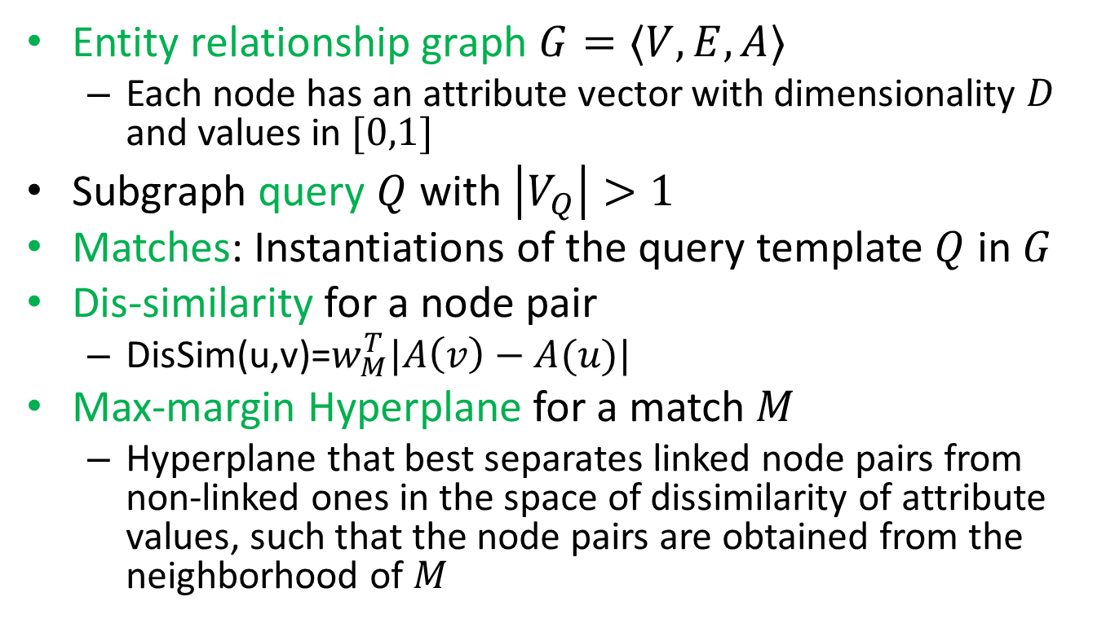
Definitions (1)
Entity relationship graph $G=〈V,E,A〉$
  Each node has an attribute vector with dimensionality $D$ and values in $[0,1]$
Subgraph query $Q$ with $\left|V_{Q}\right|>1$
Matches: Instantiations of the query template $Q$ in $G$
Dis-similarity for a node pair
  DisSim(u,v)=$w_{M}^{T}|A\left(v\right)−A(u)|$
Max-margin Hyperplane for a match $M$
  Hyperplane that best separates linked node pairs from non-linked ones in the space of dissimilarity of attribute values, such that the node pairs are obtained from the neighborhood of $M$

Slide 9
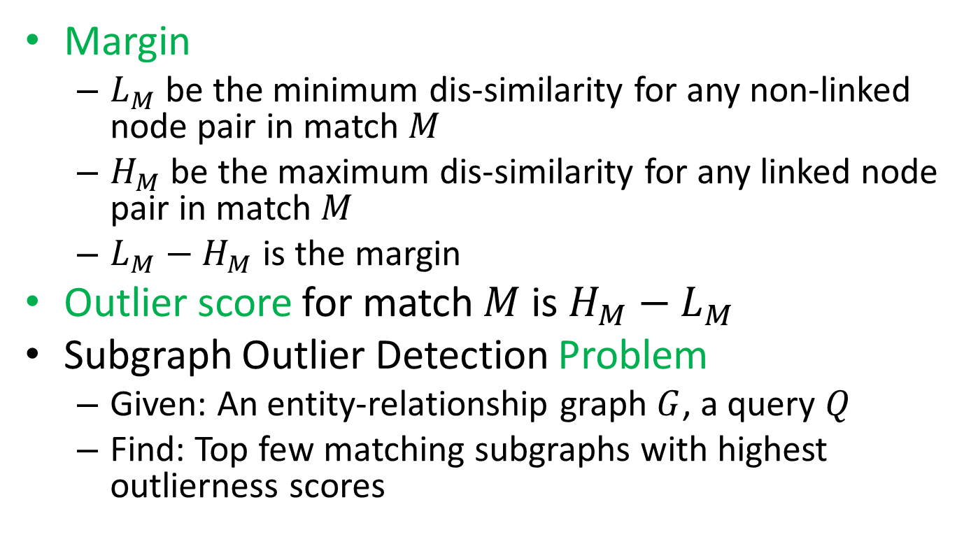
Definitions (2)
Margin
  $L_{M}$ be the minimum dis-similarity for any non-linked node pair in match $M$
  $H_{M}$ be the maximum dis-similarity for any linked node pair in match $M$
  $L_{M}−H_{M}$ is the margin
Outlier score for match $M$ is $H_{M}−L_{M}$
Subgraph Outlier Detection Problem
  Given: An entity-relationship graph $G$, a query $Q$
  Find: Top few matching subgraphs with highest outlierness scores

Slide 10
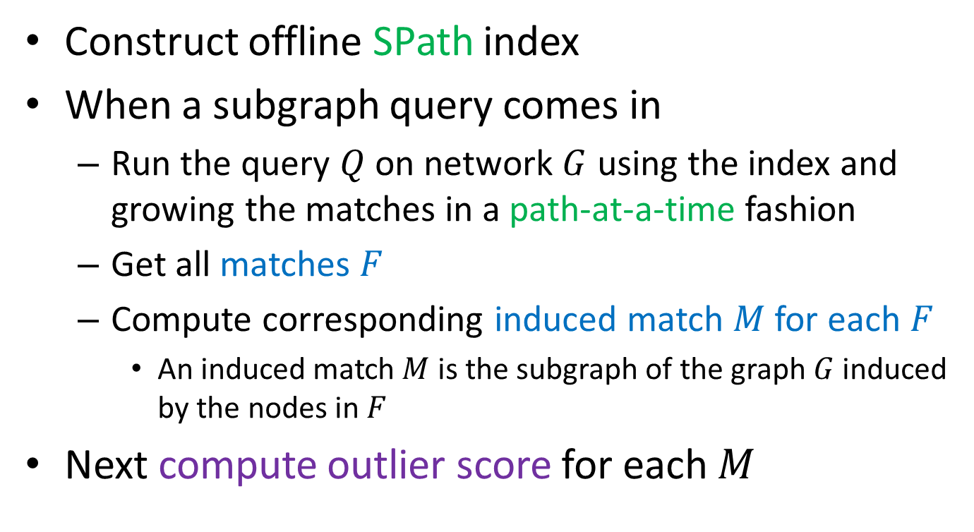
Computation of Subgraph Matches
Construct offline SPath index
When a subgraph query comes in
  Run the query $Q$ on network $G$ using the index and growing the matches in a path-at-a-time fashion
  Get all matches $F$
  Compute corresponding induced match $M$ for each $F$
    An induced match $M$ is the subgraph of the graph $G$ induced by the nodes in $F$
Next compute outlier score for each $M$

Slide 11
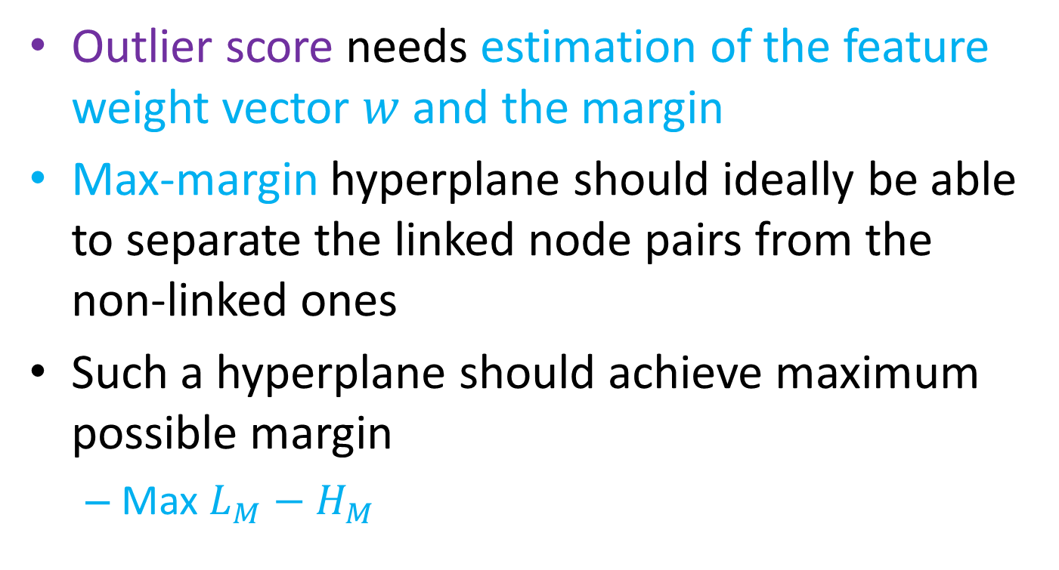
Estimating the Weight Vector (1)
Outlier score needs estimation of the feature weight vector $w$ and the margin
Max-margin hyperplane should ideally be able to separate the linked node pairs from the non-linked ones
Such a hyperplane should achieve maximum possible margin
  Max $L_{M}−H_{M}$

Slide 12
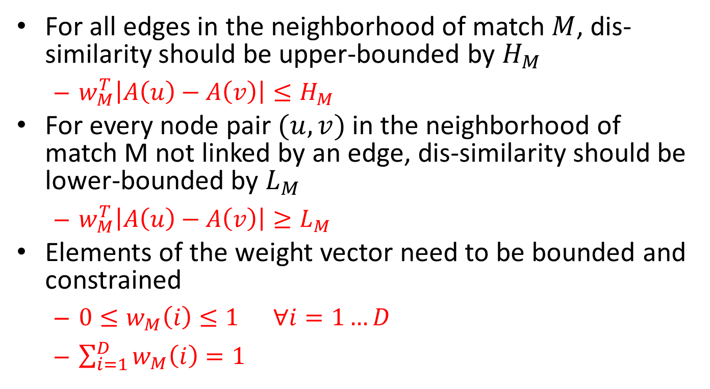
Estimating the Weight Vector (2)
For all edges in the neighborhood of match $M$, dis-similarity should be upper-bounded by $H_{M}$
  $w_{M}^{T}\left|A\left(u\right)−A\left(v\right)\right|≤H_{M}$
For every node pair $(u,v)$in the neighborhood of match M not linked by an edge, dis-similarity should be lower-bounded by $L_{M}$
  $w_{M}^{T}\left|A\left(u\right)−A\left(v\right)\right|≥L_{M}$
Elements of the weight vector need to be bounded and constrained
  $0≤w_{M}\left(i\right)≤1 ∀i=1…D$
  $\sum_{i=1}^{D}{w_{M}\left(i\right)=1}$

Slide 13
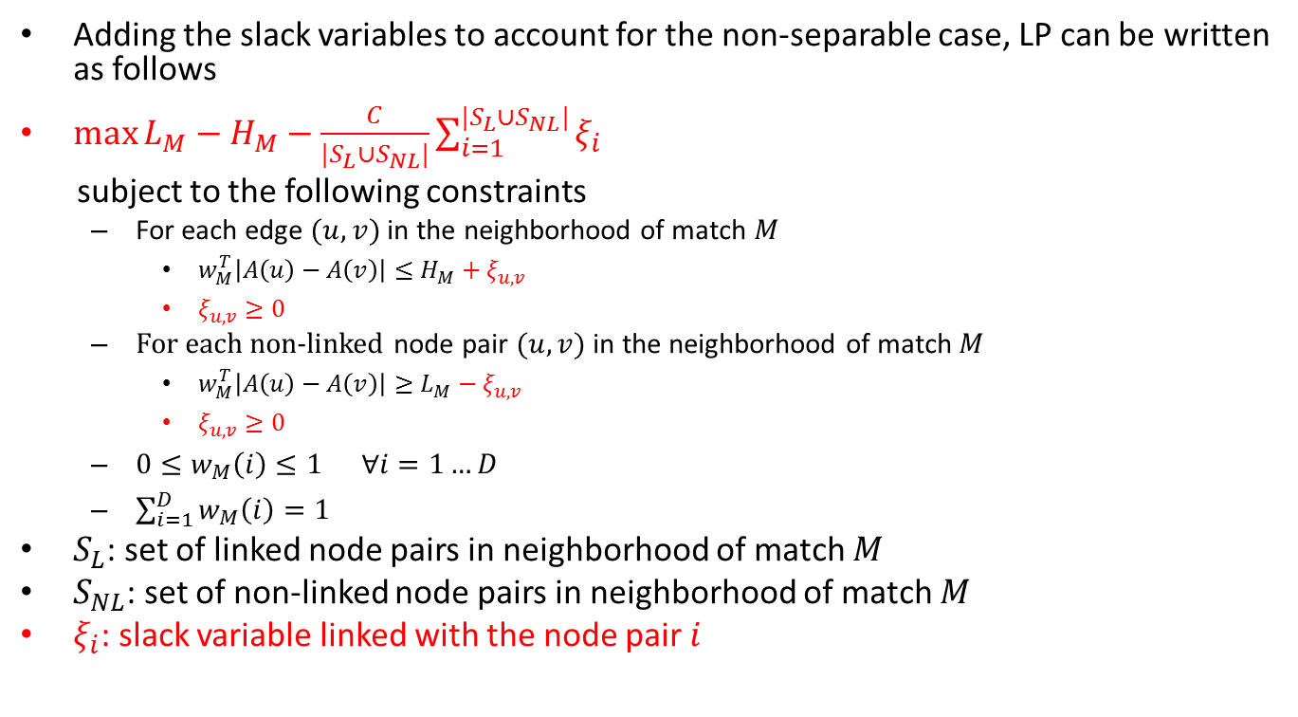
Estimating the Weight Vector (3)
Adding the slack variables to account for the non-separable case, LP can be written as follows
$\max{L_{M}−H_{M}−\frac{C}{|S_{L}∪S_{NL}|}\sum_{i=1}^{|S_{L}∪S_{NL}|}{ξ_{i}}}$
subject to the following constraints
  For each edge $(u,v)$in the neighborhood of match $M$
    $w_{M}^{T}\left|A\left(u\right)−A\left(v\right)\right|≤H_{M}+ξ_{u,v}$
    $ξ_{u,v}≥0$
  For each non-linked node pair $(u,v)$ in the neighborhood of match $M$
    $w_{M}^{T}\left|A\left(u\right)−A\left(v\right)\right|≥L_{M}−ξ_{u,v}$
    $ξ_{u,v}≥0$
  $0≤w_{M}\left(i\right)≤1 ∀i=1…D$
  $\sum_{i=1}^{D}{w_{M}\left(i\right)=1}$
$S_{L}$: set of linked node pairs in neighborhood of match $M$
$S_{NL}$: set of non-linked node pairs in neighborhood of match $M$
$ξ_{i}$: slack variable linked with the node pair $i$

Slide 14
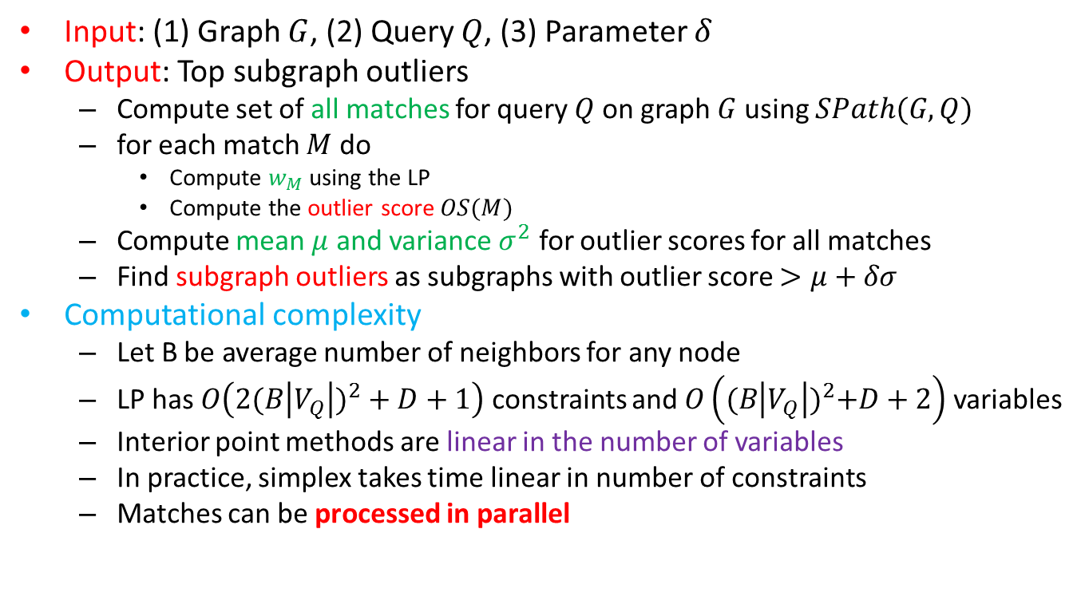
Subgraph Outlier Detection Algorithm (SODA)
Input: (1) Graph $G$, (2) Query $Q$, (3) Parameter $δ$
Output: Top subgraph outliers
  Compute set of all matches for query $Q$ on graph $G$ using $SPath(G, Q)$
  for each match $M$ do
    Compute $w_{M}$ using the LP
    Compute the outlier score $OS(M)$
  Compute mean $μ$ and variance $σ^{2}$ for outlier scores for all matches
  Find subgraph outliers as subgraphs with outlier score $>μ+δσ$
Computational complexity
  Let B be average number of neighbors for any node
  LP has $O\left({2(B\left|V_{Q}\right|)}^{2}+D+1\right)$ constraints and $O\left({(B\left|V_{Q}\right|)}^{2}+D+2\right)$ variables
  Interior point methods are linear in the number of variables
  In practice, simplex takes time linear in number of constraints
  Matches can be processed in parallel

Slide 15
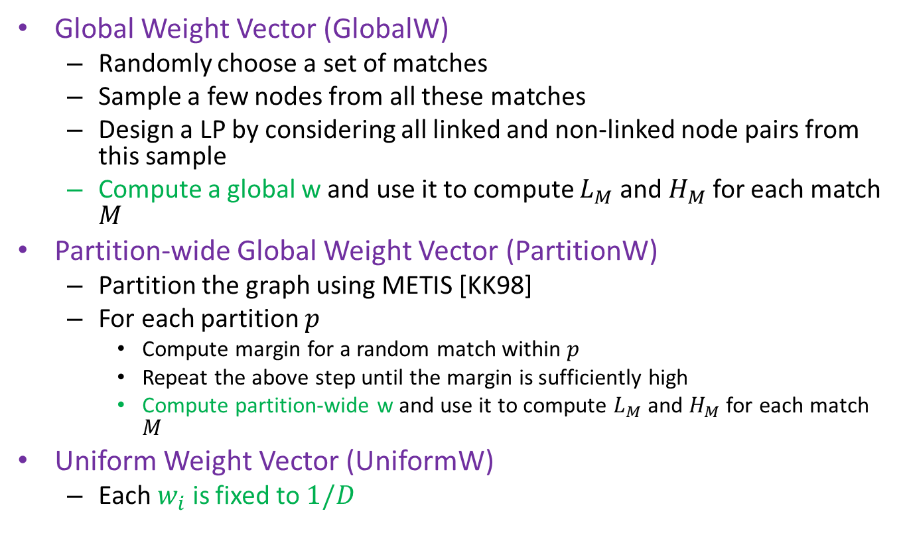
Experiments (Baselines)
Global Weight Vector (GlobalW)
  Randomly choose a set of matches
  Sample a few nodes from all these matches
  Design a LP by considering all linked and non-linked node pairs from this sample
  Compute a global w and use it to compute $L_{M}$ and $H_{M}$ for each match $M$
Partition-wide Global Weight Vector (PartitionW)
  Partition the graph using METIS [KK98]
  For each partition $p$
    Compute margin for a random match within $p$
    Repeat the above step until the margin is sufficiently high
    Compute partition-wide w and use it to compute $L_{M}$ and $H_{M}$ for each match $M$
Uniform Weight Vector (UniformW)
  Each $w_{i}$ is fixed to $1/D$

Slide 16
Synthetic Dataset Results
N | Ψ(%) | |D| = 4 |  |  |  | |D| = 6 |  |  |  | |D| = 10
 |  | SODA | PW | GW | UW | SODA | PW | GW | UW | SODA | PW | GW | UW
1000 | 1 | 85.7 | 91.1 | 12.4 | 67 | 86.2 | 77.2 | 11.1 | 76.9 | 81.4 | 80.3 | 19.5 | 66.2
 | 2 | 83 | 82.3 | 22.5 | 71.4 | 89.7 | 75.4 | 15.2 | 73.1 | 77 | 79.2 | 27.8 | 65.5
 | 5 | 81.7 | 75.4 | 23.6 | 76.8 | 92.1 | 79.3 | 29.7 | 84.6 | 77.3 | 82.8 | 31.7 | 68.9
2000 | 1 | 85 | 78 | 14 | 80.1 | 93.4 | 76.1 | 13.3 | 79.8 | 87.9 | 67.6 | 21.5 | 69.5
 | 2 | 90.2 | 77.1 | 24.5 | 79.5 | 87.9 | 79 | 31.6 | 80.5 | 92.9 | 74.3 | 29.7 | 77.1
 | 5 | 91.2 | 84.7 | 36.6 | 84.7 | 93.6 | 80.1 | 40.4 | 86 | 96 | 78 | 45.7 | 82.9
5000 | 1 | 90 | 84.7 | 21.2 | 87.7 | 85.6 | 76.4 | 19.3 | 75.3 | 89.2 | 69.4 | 28.8 | 77.7
 | 2 | 79.3 | 82.7 | 40.3 | 70.5 | 90.3 | 81 | 24.3 | 80 | 91.5 | 73.9 | 38.1 | 79.7
 | 5 | 92.2 | 83.7 | 53.3 | 86.3 | 93.7 | 82.7 | 32.7 | 84.2 | 95 | 77.4 | 52.2 | 86.9
Experimented with wide variety of experimental settings
Dataset was generated by first generating the network such that nodes with low dissimilarity values are connected by an edge
Query-based outliers were injected by setting attribute vectors of selected nodes to random values
SODA has better accuracy than PartitionW which is better than GlobalW
Average accuracy of the four methods
  SODA: 88.1%, PartitionW: 78.9%, GlobalW: 28.2%, and UniformW: 77.7%

Slide 17
Real Datasets
Number of Nodes, Edges and Attributes in each Dataset
 | Four Area | DBLP | Yeast Network
Nodes | 27199 | 30599 | 3112
Edges | 66832 | 146647 | 12519
Attributes | 4 | 14 | 183
Number of Subgraph Template Matches in each Dataset
 | Four Area | DBLP | Yeast Network
3-Clique | 86390 | 153336 | 6590
4-Clique | 130389 | 112851 | 3134
5-Clique | 272900 | 352389 | 1937
5-Subgraph | 4082687 | 9472728 | 264593
Execution Time for SODA (in seconds)
 | Four Area | DBLP | Yeast Network
3-Clique | 89 | 385 | 76
4-Clique | 140 | 265 | 35
5-Clique | 269 | 796 | 22
5-Subgraph | 4524 | 23314 | 3045

Slide 18
Real Datasets
Outlier Score Variation for the Four Area
Dataset for four Different Queries
Yeast Protein Interaction Network

Slide 19
Case Studies (1)
3-Clique Query on Four Area Dataset
Top outlier is (Sepandar D. Kamvar, Taher H. Haveliwala, Gene H. Golub)
These authors and their neighborhood mainly consists of IR and ML authors
The outlierness comes in because of a few links with some database authors (Hector Garcia-Molina, Piotr Indyk) and also a data mining author (Aristides Gionis)
Inter-disciplinary collaborations cause outlierness
Aristides Gionis
Piotr Indyk
Taher H. Haveliwala
Gene H. Golub
Dan Klein
Christopher D. Manning
Sepandar D. Kamvar
Mario T. Schlosser
Hector Garcia-Molina

Slide 20
Case Studies (2)
4-Clique Query on Yeast Network 1
Top outlier is (ydl147w, ydr394w, ydr427w, yfr010w)
These four proteins and other interacting proteins contain a large percentage of the following dipeptides: LK, LL, EL, LS, LE, SL, SS, AL, EE, KL, LA, EK, DL, KE, VL, IL, AA, LI, DE, IS.
A few proteins (like ydr201w, yhr027c, yfr052w, ynl250w, ydl147w, ymr308c, ylr106c) contain very small amounts of these dipeptides.
Instead their sequences contain high percentages of other dipeptides like IE, LD, KK, KS, LN, NL, AS, DA, EN, LQ.

Slide 21
Related Work
Outlier Detection for Static Networks
  Minimum Description Length (MDL) [NC03, Cha04]
  Egonets [AMF10, HERF+10]
  Random walks [SQCF05, MT06]
  Random field models [QAH12, GLF+10]
Outlier Detection for Temporal Networks
  Graph Similarity based Outlier Detection Algorithms [DK03, PDGM10, Pin05]
  Evolutionary Community Outlier Detection Algorithms [GGSH12a, GGSH12b]
  Online Graph Outlier Detection Algorithms [AZY11, IK04]

Slide 22
Conclusions
Proposed the problem of identifying subgraph outliers that adhere to an input subgraph query template based on deviations in linkage compared to the neighborhood
Discussed a methodology to compute the outlierness of a subgraph match based on a max-margin framework
Using several synthetic datasets, we observed that a local method outperforms a partition-wide approach which in turn is more accurate than a global strategy in extracting the injected outliers across a wide variety of experimental settings
Showed interesting and meaningful outliers detected from the Four Area and DBLP co-authorship graphs, and the Yeast protein interaction graph

Slide 23
Acknowledgments
The work was supported in part by the U.S. Army Research Laboratory under Cooperative Agreement No. W911NF-11-2-0086 (Cyber-Security) and W911NF-09-2-0053 (NSCTA), the U.S. Army Research Office under Cooperative Agreement No. W911NF-13-1-0193, and U.S. National Science Foundation grants CNS-0931975, IIS-1017362, and IIS-1320617.
We would also like to thank the Institute for Genomic Biology at University of Illinois, Urbana Champaign for their equipment.

Slide 24
Thanks!

Slide 25
References (1)
[AMF10] Leman Akoglu, Mary McGlohon, and Christos Faloutsos. Oddball: Spotting anomalies in weighted graphs. In Proc. of the 14th Pacific-Asia Conf. on Advances in Knowledge Discovery and Data Mining (PAKDD), pages 410–421. Springer, 2010.
[AZY11] Charu C. Aggarwal, Yuchen Zhao, and Philip S. Yu. Outlier Detection in Graph Streams. In Proc. of the 27th Intl. Conf. on Data Engineering (ICDE), pages 399–409, 2011.
[CCCX11] K. Chakrabarti, S. Chaudhuri, T. Cheng, and D. Xin. EntityTagger: Automatically Tagging Entities with Descriptive Phrases. In Proc. of the 20th Intl. World Wide Web Conf. (WWW), pages 19–20, 2011.
[CFSV04] Luigi P. Cordella, Pasquale Foggia, Carlo Sansone, and Mario Vento. A (Sub)Graph Isomorphism Algorithm for Matching Large Graphs. IEEE Transactions on Pattern Analysis and Machine Intelligence (TPAMI), 26(10):1367–1372, 2004.
[Cha04] Deepayan Chakrabarti. AutoPart: Parameter-free Graph Partitioning and Outlier Detection. In Proc. of the 8th European Conf. on Principles and Practice of Knowledge Discovery in Databases (PKDD), pages 112–124, 2004.
[CYD+08] Jiefeng Cheng, Jeffrey Xu Yu, Bolin Ding, Philip S. Yu, and Haixun Wang. Fast Graph Pattern Matching. In Proc. of the 24th Intl. Conf. on Data Engineering (ICDE), pages 913–922, 2008.
[DDGM12] Abir De, Maunendra Sankar Desarkar, Niloy Ganguly, and Pabitra Mitra. Local Learning of Item Dissimilarity using Content and Link Structure. In Proc. of the 6th ACM Conf. on Recommender Systems (RecSys), pages 221–224, 2012.
[DK03] P. Dickinson and M. Kraetzl. Novel Approaches in Modelling Dynamics of Networked Surveillance Environment. In Proc. of the 6th Intl. Conf. of Information Fusion, volume 1, pages 302–309, 2003.
[FSNW13] Yaping Feng, Judith A. Syrkin-Nikolau, and Eve S. Wurtele. Creating Subnetworks from Transcriptomic Data on Central Nervous System Diseases informed by a Massive Transcriptomic Network. Interdisciplinary Bio Central (IBC), 5(1):1–8, Jan 2013.
[GGSH12a] Manish Gupta, Jing Gao, Yizhou Sun, and Jiawei Han. Community Trend Outlier Detection using Soft Temporal Pattern Mining. In Proc. of the European Conference on Machine Learning and Knowledge Discovery in Databases (ECML PKDD), pages 692–708, 2012.
[GGSH12b] Manish Gupta, Jing Gao, Yizhou Sun, and Jiawei Han. Integrating Community Matching and Outlier Detection for Mining Evolutionary Community Outliers. In Proc. of the 18th ACM SIGKDD Intl. Conf. on Knowledge Discovery and Data Mining (KDD), pages 859–867, 2012.
[GLF+10] Jing Gao, Feng Liang, Wei Fan, Chi Wang, Yizhou Sun, and Jiawei Han. On Community Outliers and their Efficient Detection in Information Networks. In Proc. of the 16th ACM SIGKDD Intl. Conf. on Knowledge Discovery and Data Mining (KDD), pages 813–822, 2010.

Slide 26
References (2)
[HERF+10] Keith Henderson, Tina Eliassi-Rad, Christos Faloutsos, Leman Akoglu, Lei Li, Koji Maruhashi, B. Aditya Prakash, and Hanghang Tong. Metric Forensics: A Multi-level Approach for Mining Volatile Graphs. In Proc. of the 16th ACM SIGKDD Intl. Conf. on Knowledge Discovery and Data Mining (KDD), pages 163–172, 2010.
[HS08] Huahai He and Ambuj K. Singh. Graphs-at-a-time: Query Language and Access Methods for Graph Databases. In Proc. of the 2008 ACM SIGMOD Intl. Conf. on Management of Data (SIGMOD), pages 405–418, 2008.
[IK04] Tsuyoshi Id´e and Hisashi Kashima. Eigenspace-based Anomaly Detection in Computer Systems. In Proc. of the 10th ACM Intl. Conf. on Knowledge Discovery and Data Mining (KDD), pages 440–449, 2004.
[KK98] George Karypis and Vipin Kumar. A Fast and High Quality Multilevel Scheme for Partitioning Irregular Graphs. SIAM Journal on Scientific Computing, 20(1):359–392, Dec 1998.
[KSB+09] Martin I Krzywinski, Jacqueline E Schein, Inanc Birol, Joseph Connors, Randy Gascoyne, Doug Horsman, Steven J Jones, and Marco A Marra. Circos: An Information Aesthetic for Comparative Genomics. Genome Research, 2009.
[KT09] R. Kumar and A. Tomkins. A Characterization of Online Search Behavior. IEEE Data(base) Engineering Bulletin, 32(2):3–11, 2009.
[LZ11] L. L¨u and T. Zhou. Link prediction in complex networks: A survey. Physica A Statistical Mechanics and its Applications, 390:1150–1170, Mar 2011.
[McK81] Brendan D. McKay. Practical Graph Isomorphism. Congressus Numerantium, 30:45–87, 1981.
[MT06] H. D. K. Moonesignhe and Pang-Ning Tan. Outlier Detection Using Random Walks. In Proc. of the 18th IEEE Intl. Conf. on Tools with Artificial Intelligence (ICTAI), pages 532–539, 2006.
[NC03] Caleb C. Noble and Diane J. Cook. Graph-Based Anomaly Detection. In Proc. of the 9th ACM SIGKDD Intl. Conf. on Knowledge Discovery and Data Mining (SIGKDD), pages 631–636. ACM, 2003.
[PDGM10] Panagiotis Papadimitriou, Ali Dasdan, and Hector Garcia-Molina. Web Graph Similarity for Anomaly Detection. Journal of Internet Services and Applications, 1(1):19–30, 2010.
[Pin05] Brandon Pincombe. Anomaly Detection in Time Series of Graphs using ARMA Processes. ASOR Bulletin, 24(4):2–10, 2005.

Slide 27
References (3)
[QAH12] Guo-Jun Qi, Charu C. Aggarwal, and Thomas S. Huang. On Clustering Heterogeneous Social Media Objects with Outlier Links. In Proc. of the 5th ACM Intl. Conf. on Web Search and Data Mining (WSDM), pages 553–562, 2012.
[SQCF05] Jimeng Sun, Huiming Qu, Deepayan Chakrabarti, and Christos Faloutsos. Neighborhood Formation and Anomaly Detection in Bipartite Graphs. In Proc. of the 5th IEEE Intl. Conf. on Data Mining (ICDM), pages 418–425, 2005.
[SWW+12] Zhao Sun, Hongzhi Wang, Haixun Wang, Bin Shao, and Jianzhong Li. Efficient Subgraph Matching on Billion Node Graphs. Proc. of the VLDB Endowment (PVLDB), 5(9):788–799, May 2012.
[TMS+07] Yuanyuan Tian, Richard C. Mceachin, Carlos Santos, David J. States, and Jignesh M. Patel. SAGA: A Subgraph Matching Tool for Biological Graphs. Bioinformatics, 23(2):232–239, Jan 2007.
[Ull76] J. R. Ullmann. An Algorithm for Subgraph Isomorphism. Journal of the ACM, 23(1):31–42, Jan 1976.
[WSP07] Chao Wang, Venu Satuluri, and Srinivasan Parthasarathy. Local Probabilistic Models for Link Prediction. In Proc. of the 7th IEEE Intl. Conf. on Data Mining (ICDM), pages 322–331, 2007.
[ZCL07] Lei Zou, Lei Chen, and Yansheng Lu. Top-K Subgraph Matching Query in a Large Graph. In Proc. of the ACM 1st Ph.D. Workshop in CIKM (PIKM), pages 139–146, 2007.
[ZCO09] Lei Zou, Lei Chen, and M. Tamer ¨Ozsu. Distance-join: Pattern Match Query in a Large Graph Database. Proc. of the VLDB Endowment (PVLDB), 2(1):886–897, Aug 2009.
[ZCYF12] Xianggang Zeng, Jiefeng Cheng, Jeffrey Xu Yu, and Shengzhong Feng. Top-K Graph Pattern Matching: A Twig Query Approach. In The 13th Intl. Conf. on Web-Age Information Management (WAIM), pages 284–295, 2012.
[ZH10] Peixiang Zhao and Jiawei Han. On Graph Query Optimization in Large Networks. Proc. of the Very Large Databases (PVLDB), 3(1):340–351, 2010.
[ZHY07] Shijie Zhang, Meng Hu, and Jiong Yang. Treepi: A novel graph indexing method. In Proc. of the 23rd Intl. Conf. on Data Engineering (ICDE), pages 966–975, 2007.
[ZLY09] Shijie Zhang, Shirong Li, and Jiong Yang. GADDI: Distance Index Based Subgraph Matching in Biological Networks. In Proc. of the 12th Intl. Conf. on Extending Database Technology: Advances in Database Technology (EDBT), pages 192–203, 2009.
[ZYJ10] Shijie Zhang, Jiong Yang, and Wei Jin. Sapper: Subgraph indexing and approximate matching in large graphs. Proc. of the VLDB Endowment (PVLDB), 3(1):1185–1194, 2010.

