Slide 1
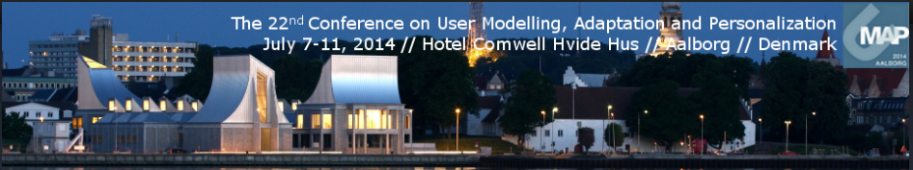

Exploiting Wikipedia Categorization for Predicting Age and Gender of Blog Authors
K Santosh Aditya Joshi Manish Gupta Vasudeva Varma
santosh.kosgi@research.iiit.ac.in

Slide 2
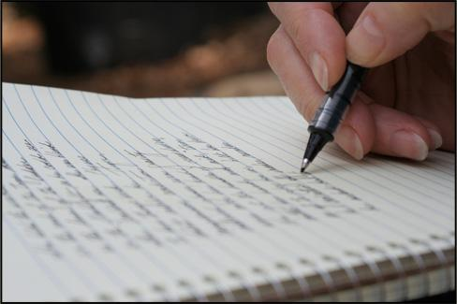
Real World Problems
Gender?
Age?
Personality?
Native
Language?
Profession?
Predicting Latent User Attributes from Text

Slide 3
Why?
Forensics : Language as evidence.
Marketing : Recommend products.
Query Expansion : Suggest queries based on attributes.
Mapping different social media profiles of a user : Latent attributes can be used as evidence.

Slide 4
Attributes considered
Age?
Gender?

Slide 5
Previous Approaches
Explored contextual and stylistic differences between different classes.
Content based features (word n-grams) and style based features (Parts of Speech n-grams) were used.

Slide 6
Drawbacks
Ignored semantic relation between words.
Could not handle polysemy.

Slide 7
Our Contributions
Enhanced the document representation using two new features.
Wikipedia concepts found in the text
Parent categories of these Wikipedia concepts

Slide 8
System Overview
Training Docs
Test Doc
Preprocess
Preprocess
Entity Linking
Entity Linking
Age
Gender
Category Extraction
Category Extraction
Extract Profiles
Feature Representation
Feature Representation
KNN or SVM Model
Top K
Documents

Slide 9
Semantic Representation of Documents (1)
Preprocessing Data
  The text from blogs is preprocessed to remove unwanted content.
Entity Linking
  TAGME is used to find Wikipedia concepts in text.
  It uses anchor text found in Wikipedia as spots and pages linked to them in Wikipedia as their possible senses.
  Polysemy problem is handled

Slide 10
Semantic Representation of Documents (2)
Finding Parent Categories for Wikipedia Concepts
  Parent categories of wikipedia concepts up to five levels are extracted.
  Wikipedia category network using Wikipedia category corpus is created.
  Semantically related words get mapped to the same Wikipedia categories at various levels

Slide 11
Age and Gender Prediction
Two Machine Learning classification models used
K Nearest Neighbour (KNN).
Support Vector Machines (SVM).

Slide 12
Dataset
Datasets used for training and testing are provided by PAN 2013.
Datasets are available at link

Slide 13
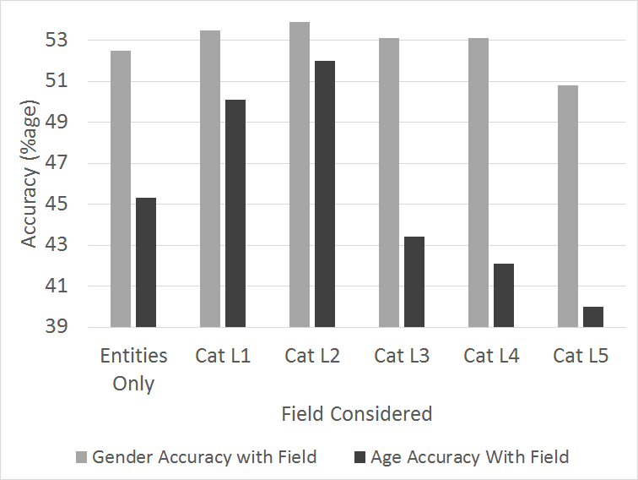
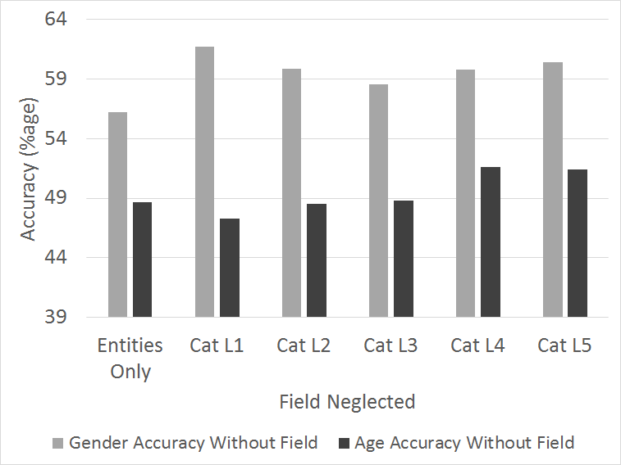
KNN
Boost factor for each field c is learnt using

Slide 14
KNN
Figures on the previous slide show that each of the features are important for the prediction task.
On validation data, we obtained best accuracy at k=5 for gender prediction and k=7 for age prediction. Hence, these values of k are used for testing.

Slide 15
SVM
Along with Wikipedia concepts and categories found in text, the following features are also used
  Content based features: n-gram words upto tri-grams are used.
  Style features: POS n-gram upto tri-grams are used.

Slide 16
Results
Features | Classifier | Gender | Age
Wikipedia semantic | KNN | 56.42 | 61.38
Wikipedia semantic | SVM | 56.61 | 61.85
Word n-grams | SVM | 53.21 | 56.79
POS n-grams | SVM | 54.56 | 57.37
Wikipedia semantic + Word n-grams | SVM | 57.27 | 62.67
Wikipedia semantic + POS n-grams | SVM | 58.39 | 63.29
Wikipedia semantic + Word n-grams + POS n-grams | SVM | 62.12 | 66.51
Meina et al. | Random Forests | 59.21 | 64.91

Slide 17
Conclusion
Document representation is leveraged using Wikipedia concepts and category information
Experimental results show that the proposed approach beats the best approach for a similar task at CLEF 2013.

Slide 18
Conclusion
By enhancing the entity linking part of the proposed system, overall accuracy of the age and gender prediction can be further improved.

