Slide 1
CharBoxes: A System for Automatic Discovery of
Character Infoboxes from Books
Char
Boxes
Manish Gupta, Piyush Bansal, Vasudeva Varma
8th July 2014

Slide 2
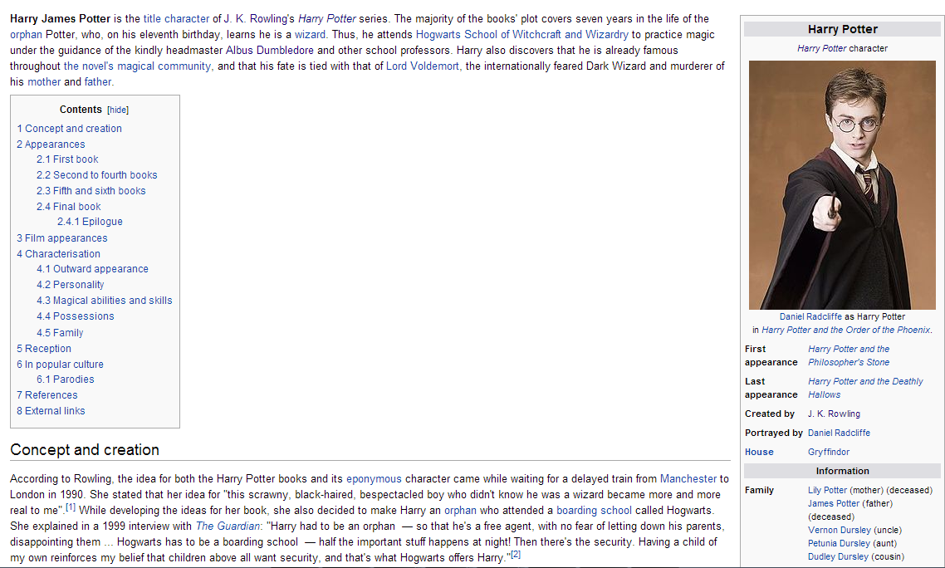
Motivation (1)
We live in an entity-centric world.
Structured data about book characters is not easily available.
State-of-the-art (Harry Potter Example)

Slide 3
Motivation (2)
Automatic discovery of character infoboxes can help in
  Effective summarization
  Effective marketing of books
  Aid understanding
Challenges
  Automatic discovery of important characters given a book
  Automatic social graph construction relating the discovered characters
  Automatic Summarization of text most related to each of the characters
  Automatic infobox extraction from such summarized text for each character

Slide 4
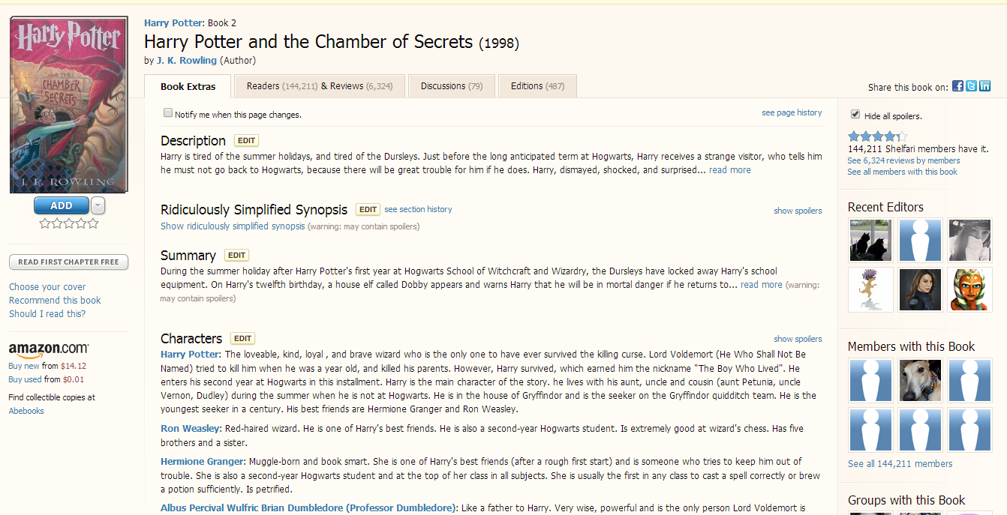
Shelfari does it (manually?)

Slide 5
Goal of CharBoxes
For every character, show me
  Most related persons (along with the relationship preferably)
  Most related places and organizations (along with verbs indicating relation preferably)
  Personality traits of the person
  Overall sentiment of the person
  Frequently mentioned dress, actions, looks
  Sociability of the person
  Books in which appeared
  Character-centric text summary

Slide 6
Comparison with Related Work
Analysis of books or multi-documents
  Most of the work is on summarization
  A blog on integrating locations in books with points on Maps
Extracting structured data from free text
  Widely studied
  But we focus on using this to extract infoboxes from books
  Novelty
    Sentiment-based summarizer
    Character-specific summary based on subject-predicate-object facts
    Heuristic patterns to extract attribute values for characters

Slide 7
Book text
POS Tagging + NER+ Cleaning Person Names
Chapter Boundary Detection
Co-reference Resolution + Dependency Analysis
Characters
Linguistically Analyzed Book text
Person-person Interaction Network
Most related places and organizations
Character Centric Text
Extracting Character-Centric Facts
Summarization (Fact triplet extraction + Sentiment Analysis)
Character
Infoboxes

Slide 8
System Diagram
Book text
POS Tagging + NER+ Cleaning Person Names
Chapter Boundary Detection
Co-reference Resolution + Parse Tree Analysis
Characters
Linguistically Analyzed Book text
Person-person Interaction Network
Most related places and organizations
Character Centric Text
Extracting Character-Centric Facts
Summarization (Fact triplet extraction + Sentiment Analysis)
Character
Infoboxes

Slide 9
Character Extraction
Harry: 1083
Ron: 347
Hagrid: 290
Hermione: 201
Snape: 151
Dumbledore: 131
Dudley: 120
Neville: 104
Quirrell: 93
Vernon: 83
McGonagall: 83
Malfoy: 83
Potter: 81
Dursley: 46
Weasley: 40
Wood: 34
Petunia: 34
Percy: 31
Voldemort: 30
Norbert: 22
Input: Book text
Extract authors and year of publication, if available
Post-process POS Tagged data to obtain names
  Post-process to merge tokens
  Clean names
    Sort by frequency
    Merge names using simple rules
Handle diminutives
Maps parts of names to canonical name
Maintain list of ambiguous names
Output: List of popular characters in the book

Slide 10
System Diagram
Book text
POS Tagging + NER+ Cleaning Person Names
Chapter Boundary Detection
Co-reference Resolution + Parse Tree Analysis
Characters
Linguistically Analyzed Book text
Person-person Interaction Network
Most related places and organizations
Character Centric Text
Extracting Character-Centric Facts
Summarization (Fact triplet extraction + Sentiment Analysis)
Character
Infoboxes

Slide 11
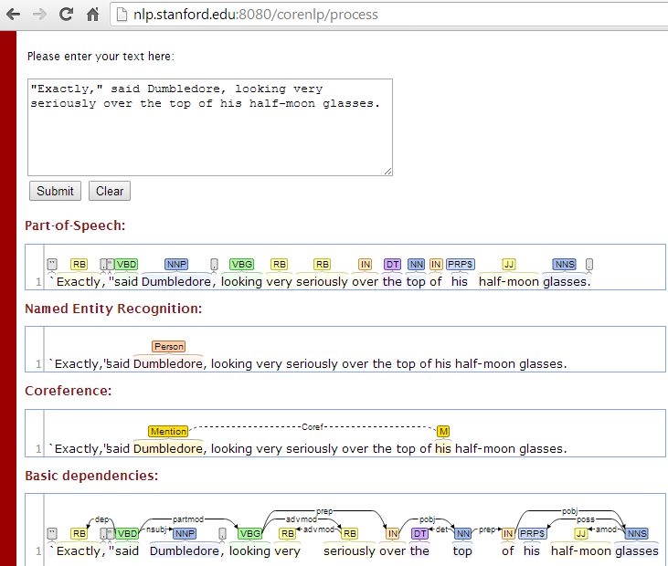
Linguistic Analysis
Chapter Boundary Detection
  Clues like “Chapter X”, “Lesson X”, “Section X”
  Hints from table of contents
  If no clear chapters, use topic shift detection
Co-reference Resolution
  On each chapter
  Resolve pronouns or short names to full names
    'Uncle Vernon': [('Vernon', 83), ('Uncle Vernon', 16), ('Vernon Dursley', 1)]
Parse Tree Analysis
  Understand dependencies
  Understand subject-predicate-object

Slide 12
System Diagram
Book text
POS Tagging + NER+ Cleaning Person Names
Chapter Boundary Detection
Co-reference Resolution + Parse Tree Analysis
Characters
Linguistically Analyzed Book text
Person-person Interaction Network
Most related places and organizations
Character Centric Text
Extracting Character-Centric Facts
Summarization (Fact triplet extraction + Sentiment Analysis)
Character
Infoboxes

Slide 13
Person-Person Graph Construction (1)
Build an interaction graph between characters using
  Non-ambiguous mentions and dialogue extraction
  Keywords like said, told, say, tell, says, screamed, etc.
Perform disambiguation of ambiguous mentions
  E.g., “Weasley” in “Harry Potter and the Philosopher’s Stone”
  Using
    Context words
    Mention of full name in vicinity
    Frequency of co-occurrence with other entities in the vicinity based on the graph
Use disambiguated mentions to refine interaction graph
Annotate the graph with relationships (if extracted using word clues)
  Mother, father, sibling
  Friend, enemy

Slide 14
Person-Person Graph Construction (2)
['Dumbledore', 'Professor McGonagall'] Professor McGonagall shot a sharp look at Dumbledore and said , `` The owls are nothing next to the rumors that are flying around .
['Dumbledore', 'Hagrid', 'Professor McGonagall'] `` But I c-c-can ' t stand it -- Lily an ' James dead -- an ' poor little Harry off ter live with Muggles - '' `` Yes , yes , it 's all very sad , but get a grip on yourself , Hagrid , or we 'll be found , '' Professor McGonagall whispered , patting Hagrid gingerly on the arm as Dumbledore stepped over the low garden wall and walked to the front door.
  “Identifying set of people participating in a text conversation” is a hard problem.

Slide 15
System Diagram
Book text
POS Tagging + NER+ Cleaning Person Names
Chapter Boundary Detection
Co-reference Resolution + Parse Tree Analysis
Characters
Linguistically Analyzed Book text
Person-person Interaction Network
Most related places and organizations
Character Centric Text
Extracting Character-Centric Facts
Summarization (Fact triplet extraction + Sentiment Analysis)
Character
Infoboxes

Slide 16
Related Places and Organizations Extraction
Given a character
  Most relevant places and organizations associated with the character are discovered
    Frequency and proximity of mentions
  Use linking verb to establish relationship between person and place/organization
    For example, “studies” could be the most frequent verb linking “Harry Potter” with “Hogwarts.”

Slide 17
System Diagram
Book text
POS Tagging + NER+ Cleaning Person Names
Chapter Boundary Detection
Co-reference Resolution + Parse Tree Analysis
Characters
Linguistically Analyzed Book text
Person-person Interaction Network
Most related places and organizations
Character Centric Text
Extracting Character-Centric Facts
Summarization (Fact triplet extraction + Sentiment Analysis)
Character
Infoboxes

Slide 18
Character-centric Summary Generation
Consider all sentences containing the character
Remove sentences which also contain other characters
Remove sentences with quotations
Rank sentences with more entities higher
Rank longer sentences higher
Rank sentences which introduce a new entity higher
Rank sentences with dress description or looks of the character higher
Rank sentences with extreme sentiments higher

Slide 19
System Diagram
Book text
POS Tagging + NER+ Cleaning Person Names
Chapter Boundary Detection
Co-reference Resolution + Parse Tree Analysis
Characters
Linguistically Analyzed Book text
Person-person Interaction Network
Most related places and organizations
Character Centric Text
Extracting Character-Centric Facts
Summarization (Fact triplet extraction + Sentiment Analysis)
Character
Infoboxes

Slide 20
Character-Centric Facts Extraction
Extract the following for every person
  Year of birth/death
    Using time clues
  Looks, qualities of the person
    Either direct text mentions or inferred from the spoken sentences
  Overall sentiment of the person (hero/villian)
    Based on sentences containing mentions
  Frequently mentioned facts
    Like relation between “Harry Potter” and “quidditch” linked by the verb “plays”)
  Sociability of the person
    Based on number of other characters it interacts with

Slide 21
Conclusion
CharBoxes is a system which is expected to take book text as input and output structured Infoboxes for various characters in the book.
The system would utilize deep natural language processing techniques complemented by domain specific heuristics.
The system can be very useful in summarizing books in a structured way in terms of insights about characters discussed in the book.

