Slide 1

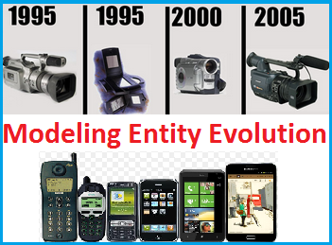
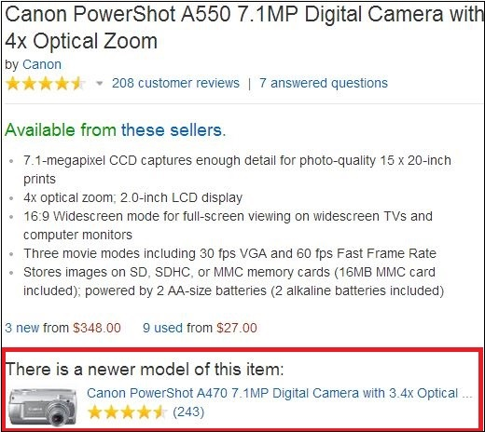


Modeling the Evolution of Product Entities
Priya Radhakrishnan
IIIT, Hyderabad, India
priya.r@research.iiit.ac.in
Manish Gupta*
Microsoft, Hyderabad, India
gmanish@microsoft.com
Vasudeva Varma
IIIT, Hyderabad, India
vv@iiit.ac.in
Problem Overview
Motivation
Modeling evolution of a product using versions
Windows (3.0 > 95 > 98 > 2000 > XP > 7.0 > 8.0)
Ubuntu (Warty > Hoary > Breezy > Dapper > Edgy )
Problem
Predict the previous version of a product entity
Link various versions of a product in a temporal order, as in Windows 7.0 > Windows 8.0
Challenges
Product mentions occur in unstructured natural language
No common naming convention for versions or products
“Newer Model" Feature on Amazon
Approach
Step 1
Dataset
Label
Cluster
Dataset
Crawled ~462K product description pages from www.amazon.com
Labelled 500 from camera & photo category
40 out of the 500 product titles had predecessor version
Step 2
Query
Classify
Predecessor Version
Experiments
Stage 1
Leica D-Lux 6 digital camera
Stage 2
Leica D-Lux 6 digital camera
Leica D-Lux 4 digital camera
Digital camera Leica D-Lux 5
Input
Input
Output
Leica
D-Lux
6
digital camera
Leica
Output
4
D-Lux
5
6
Parse the product title and label the words as brand, product, version and other
Train a supervised CRF tagger using the features
    Description: Product description words
    Context: Contextual patterns surrounding the labels
    Linguistic: POS patterns frequently associated with labels
After labelling, group product entities that have same brand and product, forming clusters.
Predict Predecessor Version: Each version member of the group is classified for being predecessor version of query entity's version. Features used
    Lexical: Candidate lexically precedes given version
    Review Date: Candidate is older than the given query product version based on review date
    Mentions: Candidate was mentioned in the query product’s description or reviews
Results: CRF Accuracy on Product Title
Parsing
LABEL | P | R | F
Brand name | 0.98 | 0.65 | 0.77
Product name | 0.89 | 0.58 | 0.69
Version name | 0.69 | 0.48 | 0.55
Product / Version name | 0.88 | 0.55 | 0.67
Others | 0.84 | 0.98 | 0.91
Results: Classifier Accuracy for Positive Class for Version Prediction
FEATURE | TP | FP | P | R | F
Lexical + Review-Date | 0.63 | 0.05 | 0.53 | 0.63 | 0.58
All features | 0.58 | 0.05 | 0.51 | 0.58 | 0.54
Review-Date | 0.58 | 0.06 | 0.46 | 0.58 | 0.51
Review-Date + Mentions | 0.55 | 0.05 | 0.51 | 0.55 | 0.53
Lexical + Mentions | 0.50 | 0.05 | 0.48 | 0.50 | 0.49
Lexical | 0.50 | 0.06 | 0.44 | 0.50 | 0.47
Mentions | 0.45 | 0.05 | 0.46 | 0.45 | 0.46
Applications
Product search engine ranking
Recommendation systems
Comparing product versions
Acknowledgements
Future Plans
This paper is supported by SIGIR Donald B. Crouch grant
Enhancements to build product version trees and study evolution of features in product entities
* Author is Senior Applied Researcher at Microsoft and Adjunct Faculty at IIIT Hyderabad
Source Code and Dataset: https://github.com/priyaradhakrishnan0/EntityRanking
Search and Information Extraction Lab
IIIT-Hyderabad
http://search.iiit.ac.in

