Slide 1


Traffic Prediction in a Bike-Sharing System
Yexin Li, Yu Zheng, Huichu Zhang, Lei Chen
The Hong Kong University of Science and Technology
Microsoft Research, Beijing, China

Slide 2

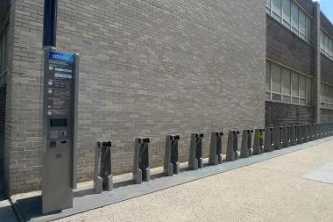
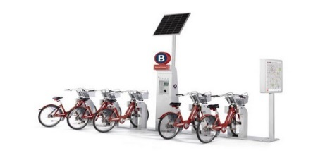
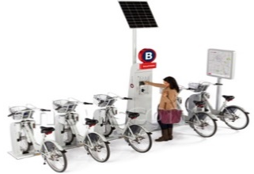
Bike-sharing systems are widely available
Bike-Sharing System
Current Problem
  Check out a bike
Skewed distributions of Bike Usage
  Ride to destination
  Check in the bike
Origin station
Check out a bike
Spatial distribution
Temporal distribution
Ride
Destination station
Check in the bike
No bikes
No docks

Slide 3
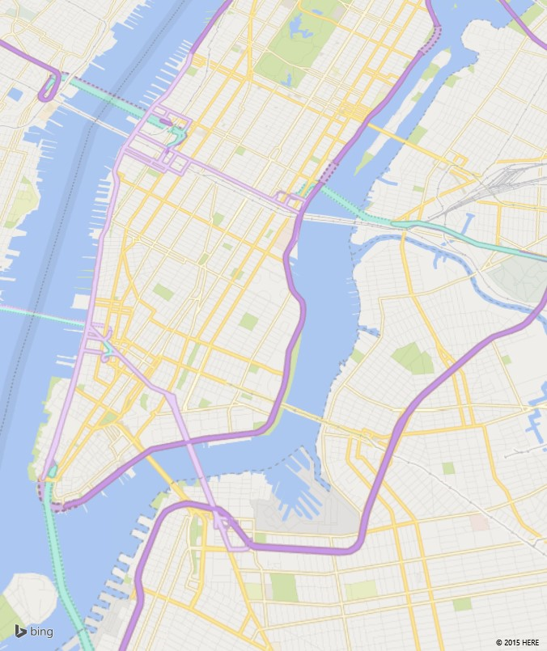
An Idea Solution
Predict bike usages at each station
Reallocate bikes by trucks
Bike usage is chaotic at an individual station !
10
S₁
5
10
S₁
S₂
5
S₂
1st 4th 7th 10th 13th 16th 19th 22th 25th 28th 31th
8am
9am
10am
11am

Slide 4
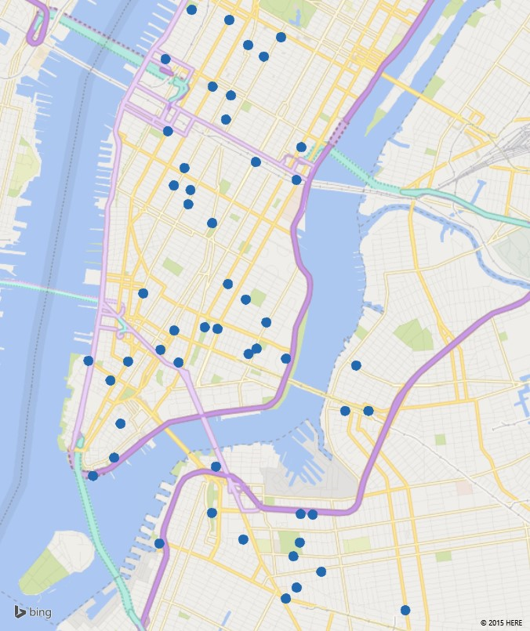



A Practical Solution
Our solution
  Cluster stations into groups
  Predict bike usage of each station cluster
  Reallocate bike between station clusters
Observations
  Bike usage of a cluster is more predictable.
  Inter-cluster transition is more stable.
7-8am C₁
Check-out
Transition Var.
day
hour
Prediction for each station is unnecessary
  Users check out/in bikes at a random station
  Events affect an area instead of a station
8am
9am
10am

Slide 5
Challenges
Cluster definition
    Features considered when clustering
Larger check-out at A
Larger check-in at B
Impacted by multiple factors
  Meteorology
B
A
  Correlation between clusters
  Events
  Correlation between clusters
Data imbalance
  # Sunny hours >> # Rainy hours
  (11.7, 4.6 mph) never happened in NYC, during 01/4-31/9, 2014
Weather distribution
Temperature & Wind
Speed sample

Slide 6
Framework of Our Solution
Predict check-out proportion
Predict bike usage of the entire city
Check-out
Bipartite station clustering
0.1
… …
0.2
Hierarchical Prediction
Check-in
Check-out
Probability & Expectation
Learning
Transition matrix
Check-in
Trip duration
Check-in Inference

Slide 7
Motivation of Bipartite Station Clustering
Stations in one cluster should be closed to each other
Stations in one cluster should perform similarly
  Stable inter-cluster transition
  Stable check-out proportion
C₁
C₁
C₅
C₅
C₂
C₄
C₂
C₄
C₃
C₃
Less stable
More stable

Slide 8
Bipartite Station Clustering
Geo-clustering
Geo-clustering
Procedure
  Geo-clustering: K₁ Clusters
  T-matrix generation
  T-clustering: K₂ Clusters
… …
T-matrix Generation
T-clustering
T-clustering
t₁
t₂
t₇
t₁
t₂
t₇

Slide 9
Motivation of Hierarchical Prediction
Bike usage in the entire city is more regular
  can be predicted more accurately.
Bound the total prediction error in the lower level
Predict check-out proportion
Predict bike usage of the entire city
0.1
day
… …
Entire Traffic
0.2
Hierarchical Prediction
day
Check-out of a cluster

Slide 10
Bike Usage of the Entire City
Solution → Gradient Boosting Regression Tree, i.e., GBRT
Features Extraction
Day
Hour
Weather
Temperature
Wind speed
13th , Aug. Rainy
Temperature keeps increasing
25th , Sep. Windy

Slide 11
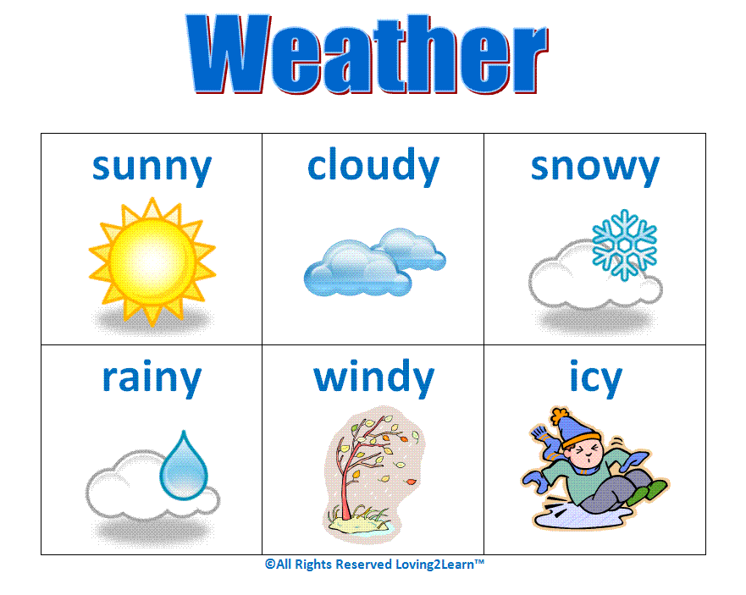

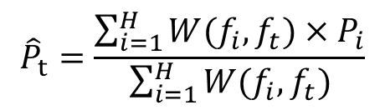


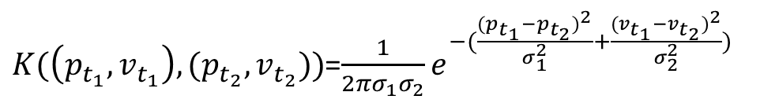



Check-out Proportion Prediction
$${\hat{P}}_{t}=\frac{\sum_{i=1}^{H}{W(f_{i},f_{t})×P_{i}}}{\sum_{i=1}^{H}{W(f_{i},f_{t})}}$$
… …
$$P_{t−H}$$
$$P_{t−H+1}$$
$$P_{t−H+2}$$
$$P_{t−1}$$
$$P_{t}$$
W(𝑓_{𝑖} , 𝑓_{𝑡} ) = 𝜆₁(𝑖, 𝑡) × 𝜆₂(𝑤_{𝑖} , 𝑤_{𝑡}) × 𝐾((𝑝_{𝑖} , 𝑣_{𝑖} ), (𝑝_{𝑡}, 𝑣_{𝑡} ))
Weather
foggy
Time
1
$$λ_{1}\left(t_{1},t_{2}\right)=1_{t_{1},t_{2}}×ρ_{1}^{∆h(t_{1},t_{2})}×ρ_{2}^{∆d(t_{1},t_{2})}$$
foggy
Temperature & Wind speed
$K(\left(p_{t_{1}},v_{t_{1}}\right),(p_{t_{2}},v_{t_{2}}))$=$\frac{1}{2πσ_{1}σ_{2}}e^{−(\frac{{(p_{t_{1}}−p_{t_{2}})}^{2}}{σ_{1}^{2}}+\frac{{(v_{t_{1}}−v_{t_{2}})}^{2}}{σ_{2}^{2}})}$

Slide 12


Transition Matrix & Trip Duration
Inter-cluster transition $T_{t,ij}$
0.01
0.65
0.1
0.05
Transition Probability. The probability that a bike will be checked in to cluster 𝐶_{𝑗} given it is checked out from 𝐶_{𝑖} in time 𝑡.
C₁
C₂
0.5
0.39
0.6
0.15
0.15
0.88
0.1
C₃
0.05
C₄
Trip duration $D_{ij}$
0.29
0.01
0.05
0.02
Using a log-normal distribution to fit

Slide 13



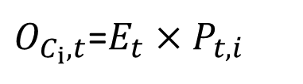

Check-in Inference
Check-out
Expectation of on-road bikes to each cluster
$O_{C_{i},t}$=$E_{t}×P_{t,i}$
Check-in
C₁
C₂
C₃
C₄
< t+$δ$
t+$δ$
0.4
0.2
0.3
0.1
2
2
2
C₁
0.1
C₂
Bikes will be borrowed
0.5
C₃
0.1
0.3
C₄
Bikes on road

Slide 14
Experiments
Datasets
  Citi-Bike Data in New York City
  Meteorology Data in New York City
  Capital Bikeshare in Washington D.C.
  Meteorology Data in Washington D.C.
Metric
  Error Rate
Data Released: http://research.microsoft.com/apps/pubs/?id=255961

Slide 15
Experiments
Check-out | All Hours |  | Anomalous Hours
Methods | GC | BC | GC | BC
HA | 0.353 | 0.355 | 1.964 | 1.968
ARMA | 0.346 | 0.346 | 2.276 | 2.273
GBRT | 0.311 | 0.314 | 0.696 | 0.683
HP-KNN | 0.298 | 0.299 | 0.692 | 0.685
HP-MSI | 0.288 | 0.282 | 0.637 | 0.503
Check-in | All Hours |  | Anomalous Hours
Methods | GC | BC | GC | BC
HA | 0.347 | 0.352 | 1.837 | 1.835
ARMA | 0.340 | 0.344 | 2.152 | 2.143
GBRT | 0.309 | 0.309 | 0.681 | 0.671
HP-KNN | 0.302 | 0.295 | 0.694 | 0.684
HP-MSI | 0.297 | 0.290 | 0.642 | 0.506
P-TD | 0.335 | 0.302 | 0.498 | 0.445
Clustering Results
Accuracy improvement >0.03 for all hours
>0.18 for anomalous hours

Slide 16
Conclusions
Bipartite station clustering
  Cluster stations based on locations and transitions
Hierarchical prediction improves the accuracy
  Bound the total error in the lower level
  >0.03 improvement for all hours
Multi-similarity-based model
    Deal with data imbalance
    >0.18 improvement for anomalous hours

Slide 17
Thanks !
Contact: Dr. Yu Zheng yuzheng@Microsoft.com
Released Data: http://research.microsoft.com/apps/pubs/?id=255961

