Slide 1
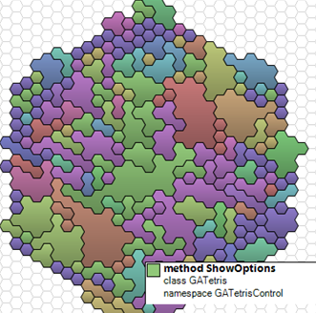
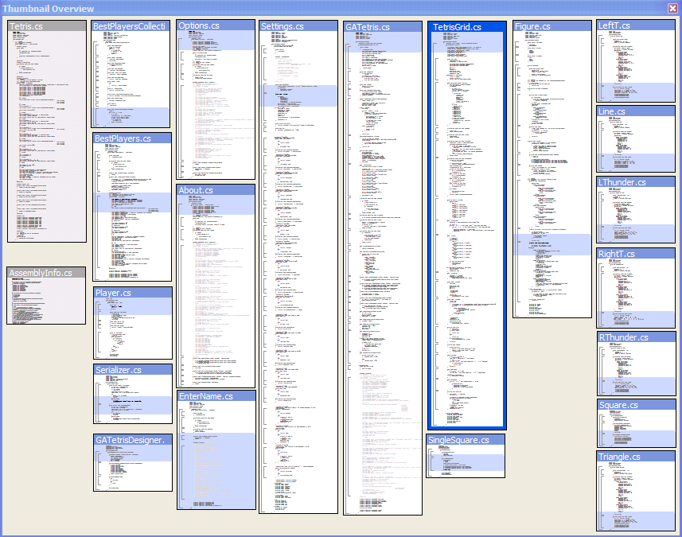
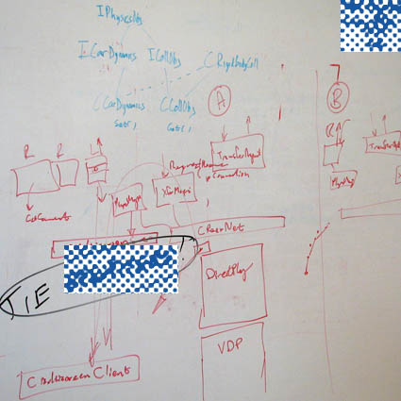
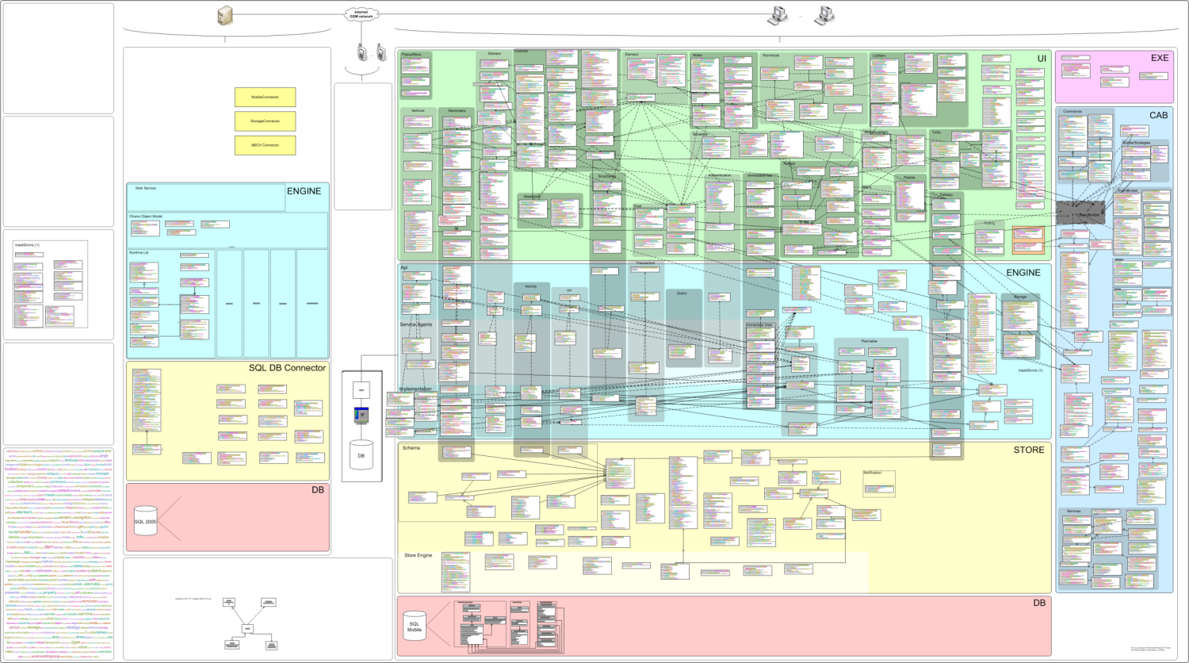
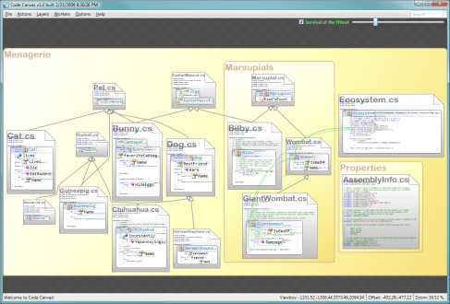
Five Attempts at Spatializing Code
Gina Venolia – Senior Researcher
With Rob DeLine, Mary Czerwinski, Brian Meyers, Steve Drucker, George Robertson, Mauro Cherubini*, Andy Ko* and Kael Rowan
Microsoft Research
http://research.microsoft.com/projects/spatialcode/
Software
Terrain Maps
Code
Thumbnails
How & Why
Code Map
Code Canvas

Slide 2
Intuition
Spatial cognitive resources are underutilized in software development
Tools exploiting these resources might have many benefits:
  Helping developers stay oriented in code
  Providing a substrate for understanding code-related information
  Serving as a boundary object between teammates
  Etc.

Slide 3
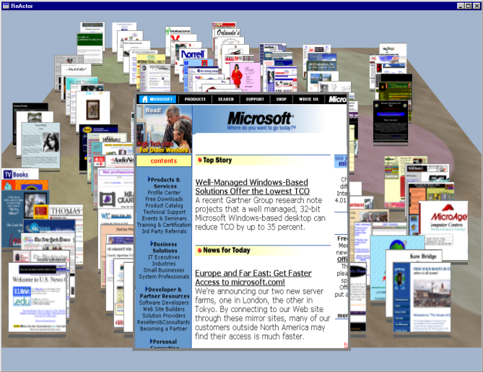
Inspiration
George Robertson, Mary Czerwinski, Kevin Larson, Dan Robbins, David Thiel and Martin van Dantzich.
Data Mountain: Using Spatial Memory for Document Management. UIST 1998.

Slide 4
Five Iterations
Staying Oriented with Software Terrain Maps
  Rob DeLine, VLC 2005
Code Thumbnails: Using Spatial Memory to Navigate Source Code
  Rob DeLine, Mary Czerwinski, Brian Meyers, Gina Venolia, Steve Drucker, and George Robertson, VL/HCC 2006
Let’s Go to the Whiteboard: How and Why Software Developers Use Drawings
  Mauro Cherubini, Gina Venolia, Rob DeLine, and Andrew J. Ko, CHI 2007
Building an Ecologically-valid, Large-scale Diagram to Help Developers Stay Oriented in Their Code
  Mauro Cherubini, Gina Venolia, and Rob DeLine, VL/HCC 2007
Code Canvas
  Kael Rowan (work-in-progress)

Slide 5
Software Terrain Maps
  Staying Oriented with Software Terrain Maps
  Rob DeLine
  VLC 2005

Slide 6
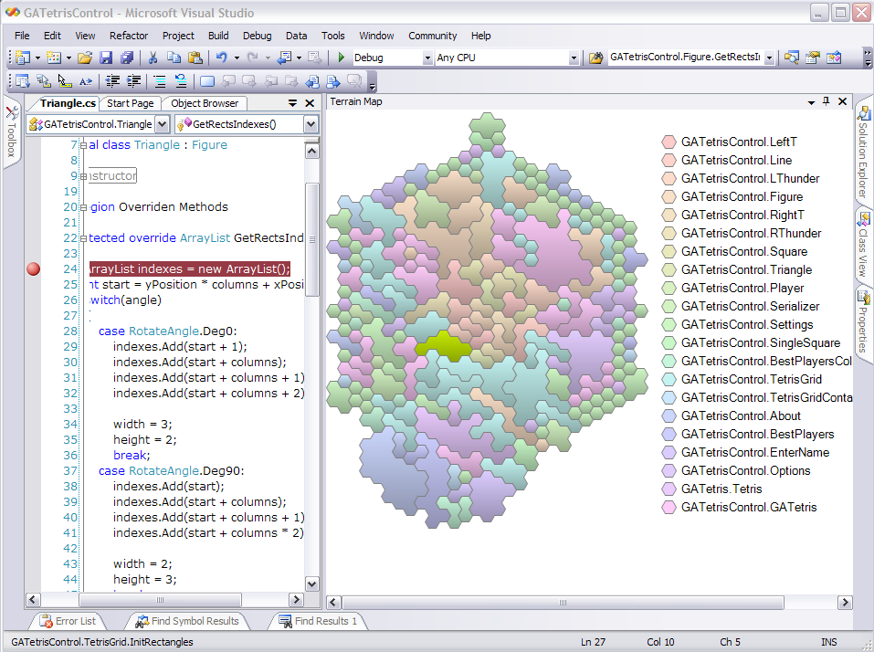

Slide 7
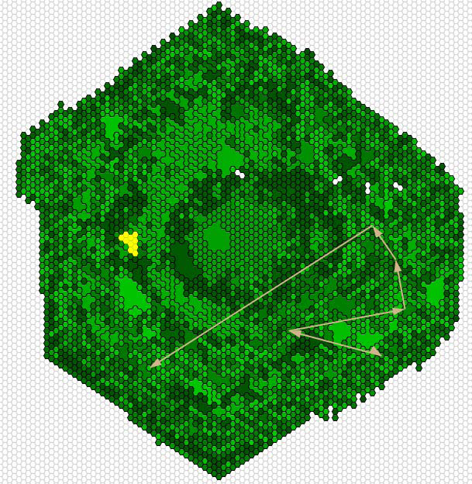
Overlays
Method in editor
Call stack

Slide 8
What we learned
Spatial is interesting
Overlays are compelling
Important things we’re missing
  Stability
  Locality
  Labels
Are methods the right level of analysis?

Slide 9
Code Thumbnails
  Code Thumbnails: Using Spatial Memory to Navigate Source Code
  Rob DeLine, Mary Czerwinski, Brian Meyers, Gina Venolia, Steve Drucker, and George Robertson
  VL/HCC 2006

Slide 10
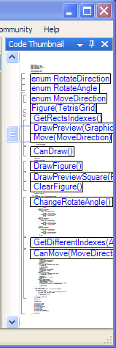
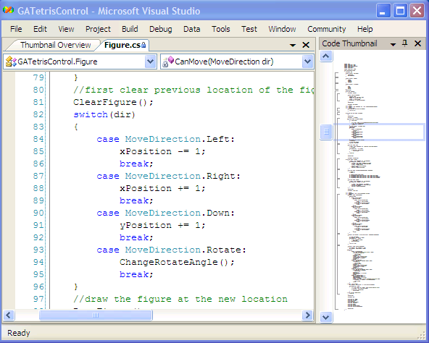
Code Thumbnails
SCREEN SHOT GOES HERE

Slide 12
What we learned
Microfont rendering is somewhat useful
  But only somewhat
  Must be augmented with labels, coloring and structure
Overlays (search results) are still compelling
Labels are good
Manual layout is tedious

Slide 13
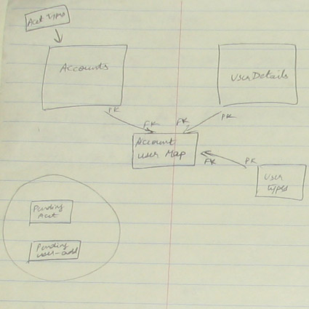
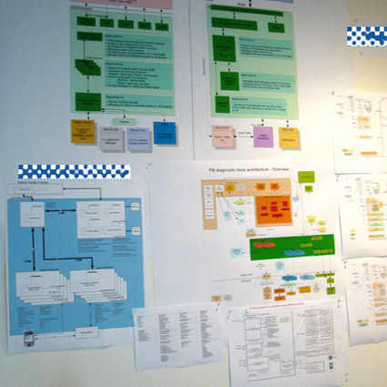
How and Why
Let’s Go to the Whiteboard: How and Why Software Developers Use Drawings
Mauro Cherubini, Gina Venolia, Rob DeLine, and Andrew J. Ko
CHI 2007

Slide 14
What we did
Eight semi-structured interviews at MS
Identified nine scenarios where drawings were important
Survey (427 responses) at MS
  24 questions x 9 scenarios

Slide 15
Nine scenarios
Scenario | Investment | Purpose | Media
Understand existing code | Transient | Understand | Sketch
Design and refactor | Transient | Understand Communicate | Sketch Drawing tools
Ad-hoc meetings | Reiterated | Understand Communicate | Sketch
Onboard new teammate | Reiterated | Communicate | Sketch
Explain to 2^{ndary} stakeholders | Reiterated | Communicate | Sketch Drawing tools
Design review | Rendered | Communicate | Sketch Drawing tools R-E tools
Explain to customers | Rendered | Communicate | Drawing tools
Hallway art | Archival | Communicate | Drawing tools
Documentation | Archival | Communicate | Drawing tools R-E tools

Slide 16
What we learned
Drawings are schematic and conceptual
  As opposed to detailed and accurate
  A few boxes, a few arrows
  Consistent use of space; some consistent symbols
Most drawings were used for communication
  Many were created during communication
  Drawings were a secondary but important channel
Certain sketches became archetypal through reiteration

Slide 17
Code Map
  Building an Ecologically-valid, Large-scale Diagram to Help Developers Stay Oriented in Their Code
  Mauro Cherubini, Gina Venolia, and Rob DeLine
  VL/HCC 2007

Slide 18
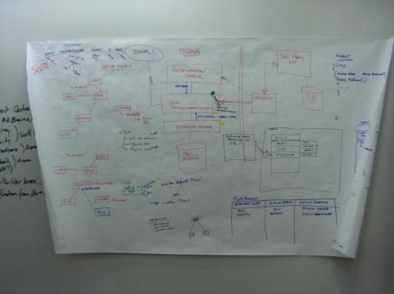
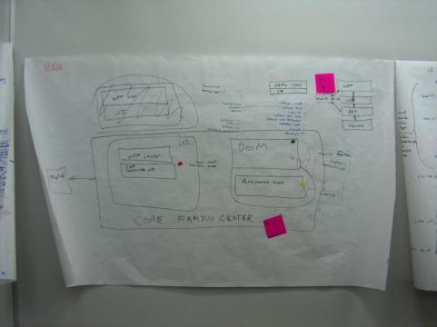
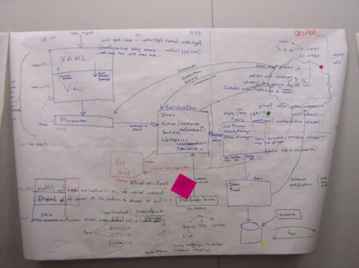
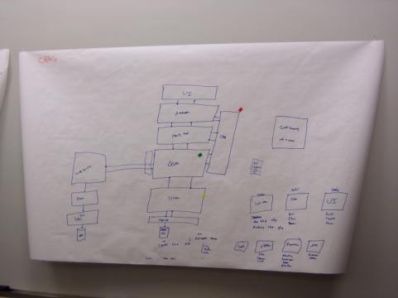
What we did
Iterative design to develop a paper prototype of a large-scale code map for a particular team
Independent drawings from eight teammates
Merged into master drawing
Every day for three weeks:
  Hang new map in the team’s hallway
  Gather verbal feedback
  Update drawing to integrate verbal feedback and latest source code changes
  Send to printer

Slide 19
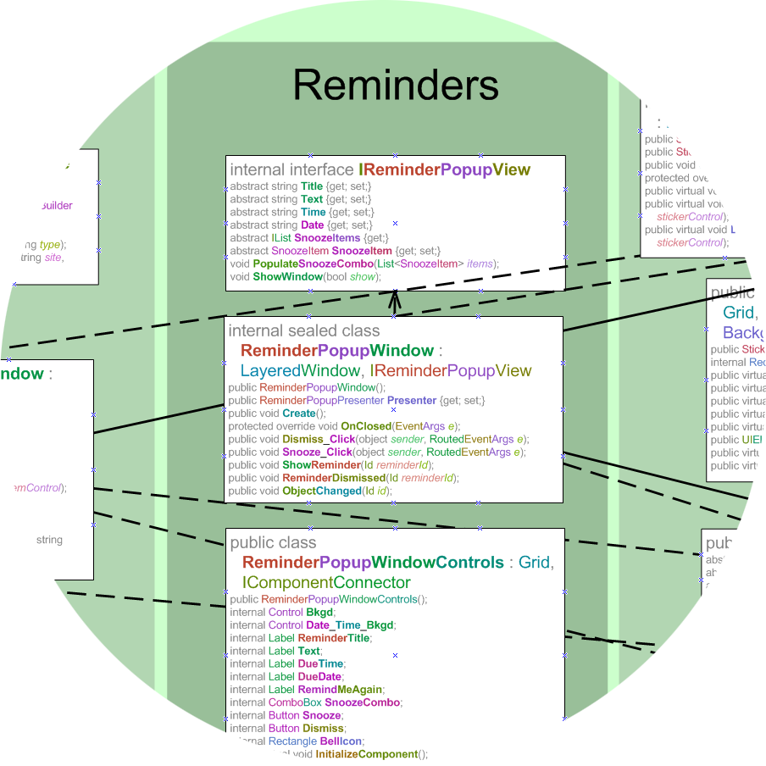
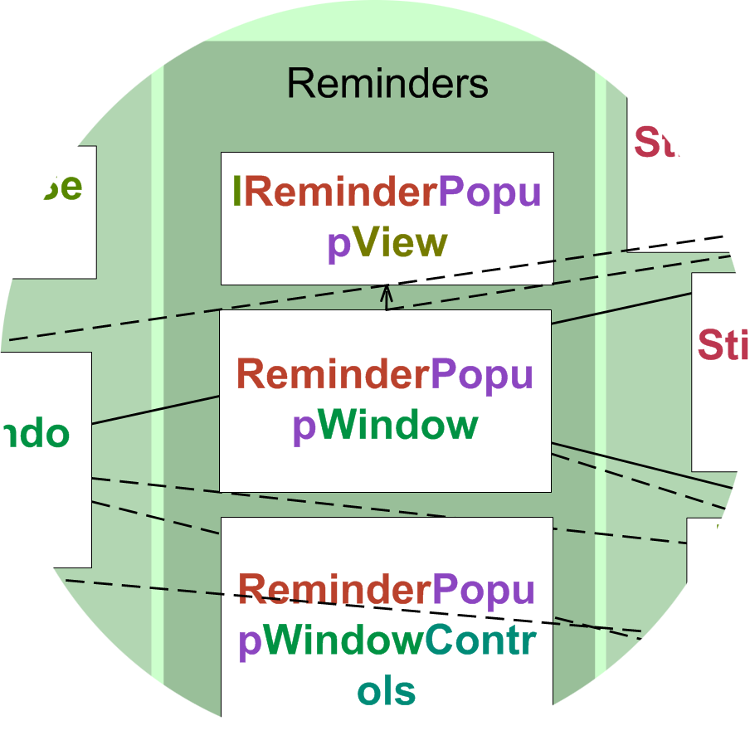
2 meters
1.5 meters
5 points

Slide 20
What we learned
Team can agree on a spatial layout and names
Current code is only part of the story
  Elision by category, access and black-boxing
  Folder hierarchy has errors
  Placeholders for planned work
Semantic zooming and labels are good
Vertical bands are a cool surprise
Manual layout is tedious
Location matters!

Slide 21
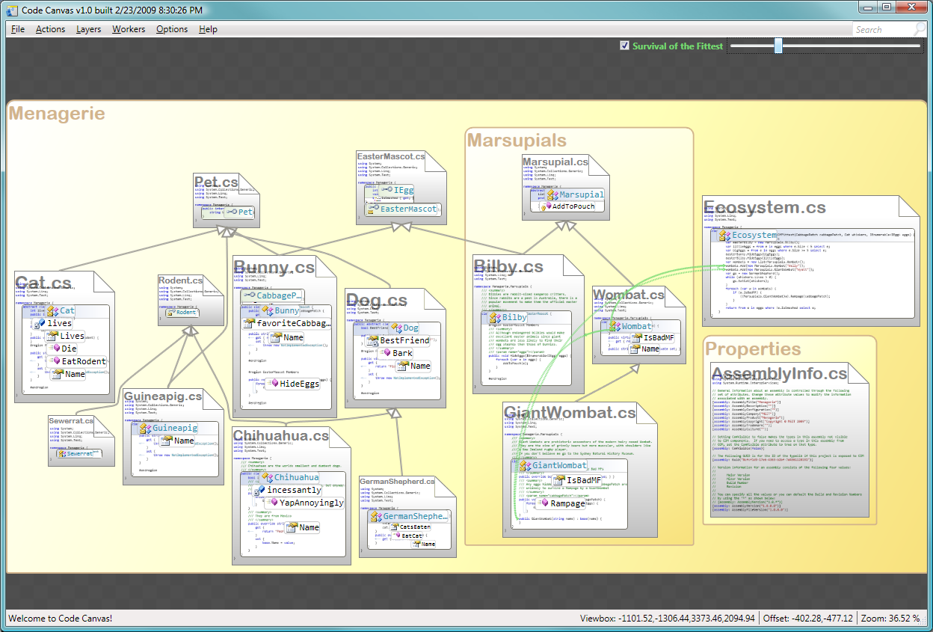
Code Canvas
Kael Rowan (work-in-progress)

Slide 22
What we have learned so far
Performance is good even for large projects
Semantic zooming and labels are good
Overlays are very compelling
Big open questions
  Is zooming to source code is the right thing?
  How to zoom into multiple parts of the map simultaneously?
  Need more better mixed-initiative layout

Slide 23
Wrap-up
Software
Terrain Maps
Code
Thumbnails
How & Why
Code Map
Code Canvas

Slide 24
What is working well
Spatial stability
Semantic zooming
Labels
Overlays

Slide 25
Big open questions
Low-effort, mixed-initiative layout
Spatial stability as software evolves
Microfonts vs. class diagrams
Transition from overview to text editor

Slide 26
Conclusion
Promising approach
Many hard problems to work out
Need to verify spatial memory and cognition
Need to verify team effects
Software
Terrain Maps
Code
Thumbnails
How & Why
Code Map
Code Canvas
http://research.microsoft.com/projects/spatialcode/

