Slide 1



focusing on shared experiences
moving beyond the camera
in video communication
Jed R. Brubaker
Gina Venolia
John C. Tang

Slide 2
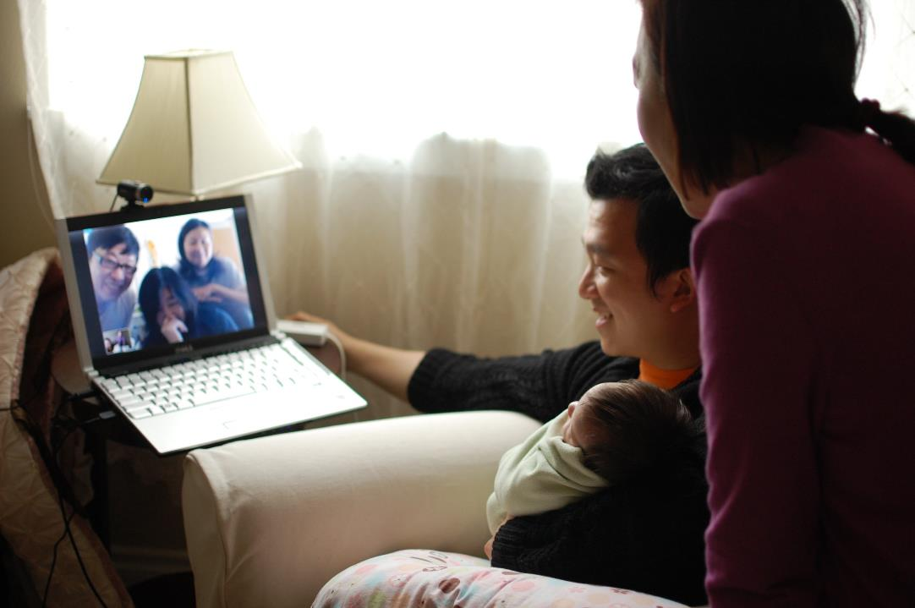
research objectives
“It was really profound to see them on Skype for the first time. We are so much closer to each other.”
Spanning the Pacific, his wife and mother-in-law often play the piano for each other... even lets Rick’s family check in on their cat that stayed back in Hong Kong
Notes:
Project Objective
Video is successful at home, less at work.
Trying to understand what this medium means to users
How are they distinct? How are they the same?
How are these domains impacting each other?
Not about technical barriers
Instead, what the future might hold.
Today I am going to talk about:
While our project looked at both personal and professional domains,
Our objective was to use the contrast between the two to highlight the nuances of how people understand video communication as a medium.
Today I want to focus on four insights from our study that I hope will help stimulate some thinking around some potentials for consumer video.
FOR DEEP DIVE – Next Wednesday over lunch.

Slide 3
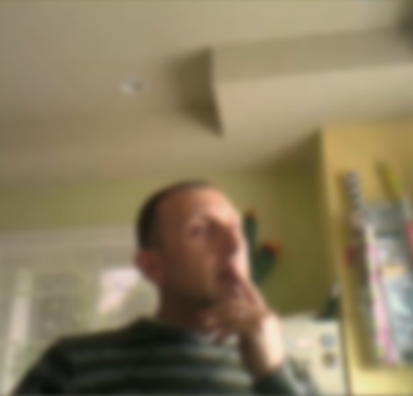
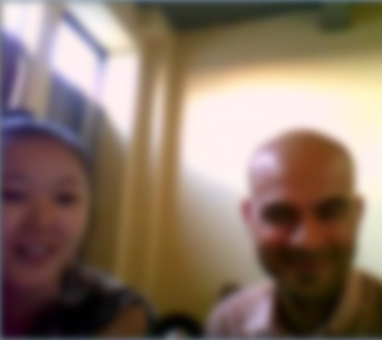
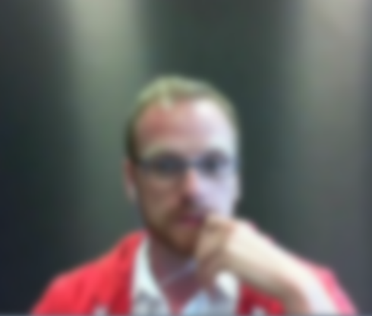
methods & focus
open-ended, and narrative driven interviews
(30-90 minutes)
collected experiences from
personal and professional domains
novel uses of video that extend beyond communication (e.g., shared activities)

Slide 4
interviews
Recruitment
email screener to random set of employees
actively used video at work and home within last 30 days
rated video communication as at least moderately important
Sample Profile
23 microsoft employees (+1 spouse): US (14), India (3), China (3), France, Germany, Russia, Singapore
16 men, 8 women
average age: 34.6
in relationship: 75%
have kids: 62%

Slide 5
surveys
Validation Survey
international distribution outside microsoft
147 responses analyzed
74% male
42% were 36-45/yrs. old (largest block)
74% married or partnered
67% had children (M=2.2; SD=.94)

Slide 6
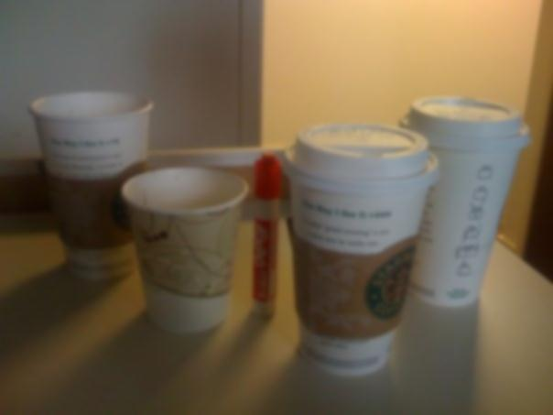
findings
managing impressions
relationships with
space & place
shared activities
co-presence
maintaining connections at a distance
group identity & shared values

Slide 7

managing impressions
“I don't want them to see me flipping through files and notebooks and trying to find whatever it was that we talked about a week ago, even if I have no idea, I don't want them to see that.”
Insight: Video communication constrains physical behavior while exaggerating displays of attention.
Notes:
ALEXA STORY

Slide 8

maintaining connections
“…and your family is abroad, you don’t get to share all the moments, and it’s almost starting from scratch every time you see that little one.
Without video, I would be the aunt that no-one knows.”
Insight: As a result of video communication, people are more willing to take on the challenge of distance.
Notes:
Maroof
- started using video comm years ago, but it didn’t stick
Until his brother moved across seas.
<SLIDE>
Professional ruptures too.
<SLIDE>
People trying it once, only to return and adopt it when faced with rupture.

Slide 9
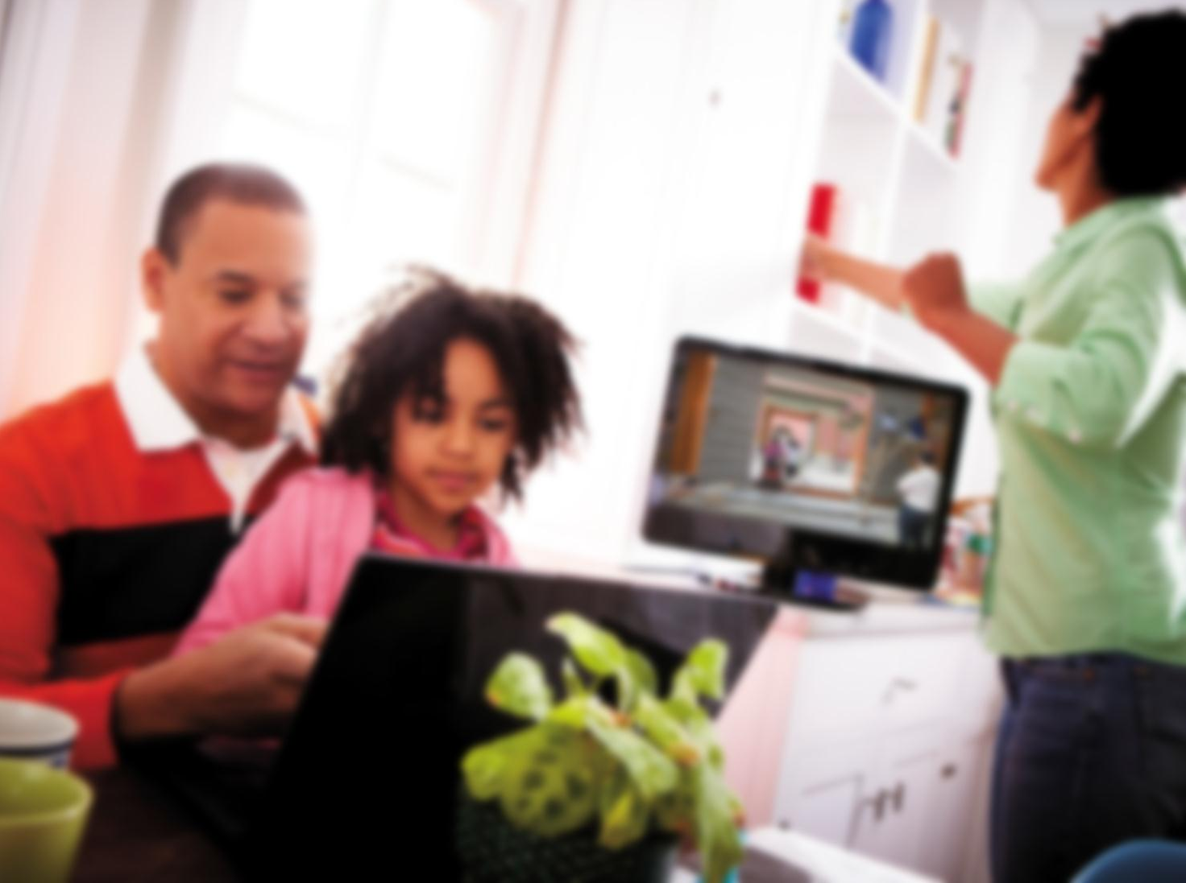
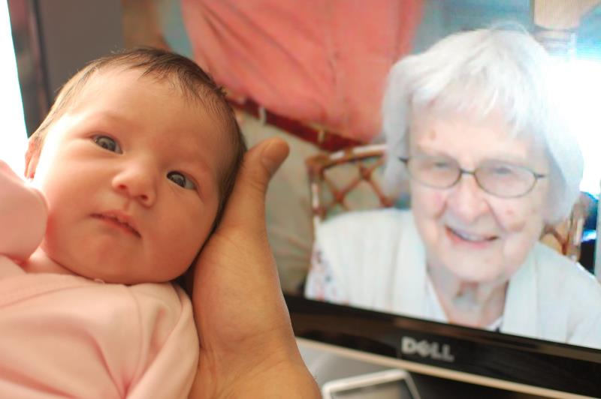
group identity & values
“We took a picture of my daughter, you know, next to the computer screen… I really cherish that photo…”
“She never got to physically meet my daughter… That picture ended up getting framed and shown at her funeral… That was such a powerful moment for our family”
Insight: Individuals use video communication to include remote people in group activities and events to demonstrate their membership in the group.
Notes:
"I really cherish that photo," Audrey explained. The photo in question was taken in a hospital recovery room, shortly after the birth of her child. In the photo, Audrey holds her new infant while a smiling family gathers around -- including her mother-in-law who was across the country at the time.

Slide 10
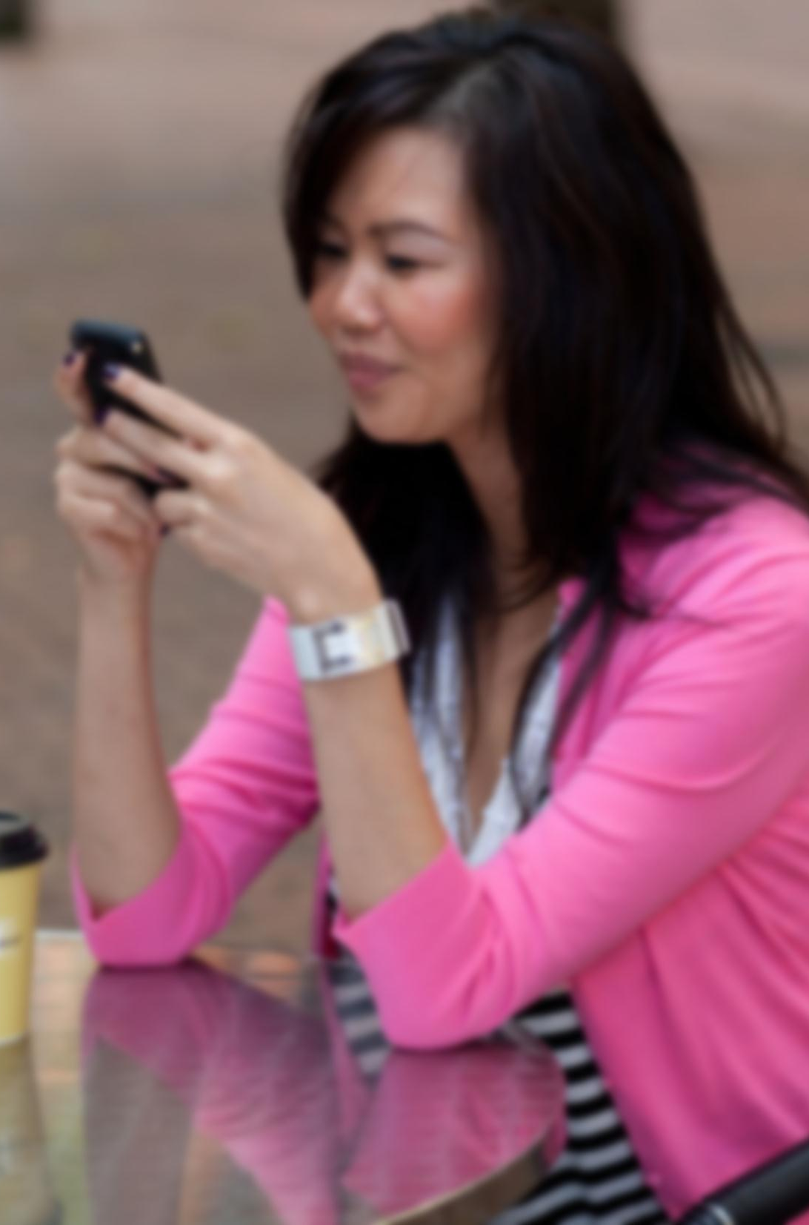
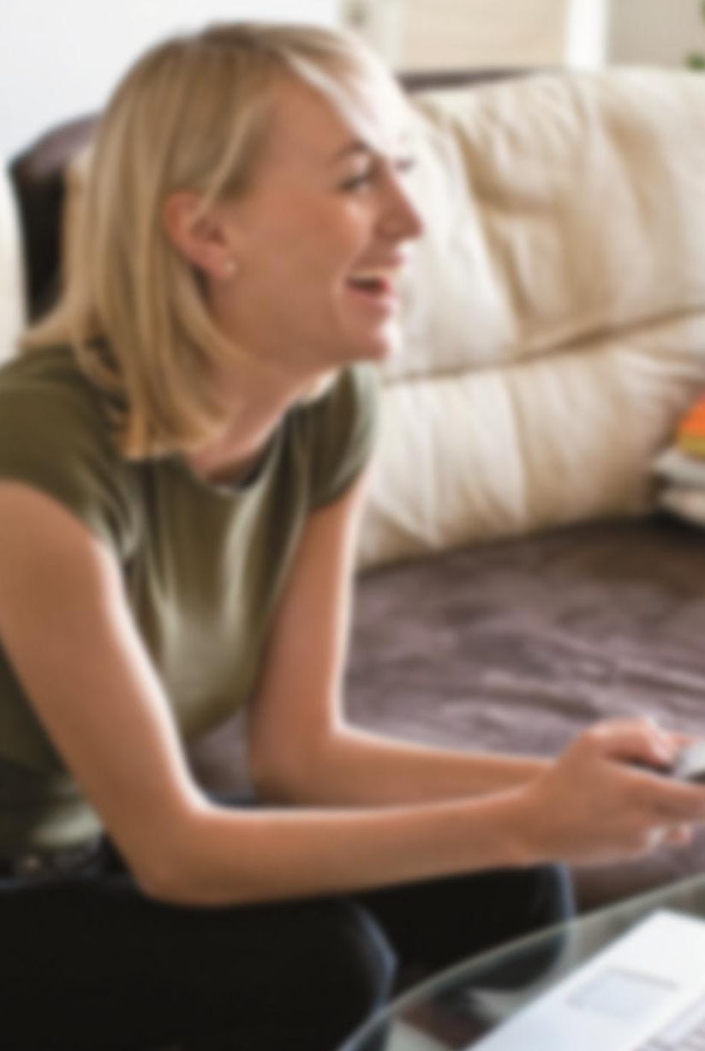
space & place
“So my daughter lived in Italy for a year… [and] could not make the trip [home]... But we try to make a point of getting together at Thanksgiving time…
And at one point, the phone rings, and we have a niece -- her cousin -- that lives in Hawaii. …we literally had the phone on speaker next to the computer that's Skyping, with people in the room, all sharing a Thanksgiving experience…”
Notes:
Large family gathering in a house, walking around with a laptop, set up in a corner to sit down and have a chat.

Slide 11
space & place
mobile and the living room
“I wish I didn’t really need the
PC. So the mobile phone will
really be the next level for me.”
“Chatting via the Kinect is much
easier for my daughter.”
Notes:
If the name of this theme is clever, that is only secondary.
Throughout this study, the importance of place has become very apparent.
Video communication is situated in places that already have norms and mores.
People hate being confined to the PC.
Quote #1: Most people turn to mobile when thinking about the solution.
Quote #2 & 3: However, people love the Kinect.

Slide 12
space & place
Insight: Video communication is reconfiguring personal “place” dramatically, but social expectations for work spaces are relatively stable.
Notes:
If the name of this theme is clever, that is only secondary.
Throughout this study, the importance of place has become very apparent.
Video communication is situated in places that already have norms and mores.
People hate being confined to the PC.
Quote #1: Most people turn to mobile when thinking about the solution.
Quote #2 & 3: However, people love the Kinect.

Slide 13
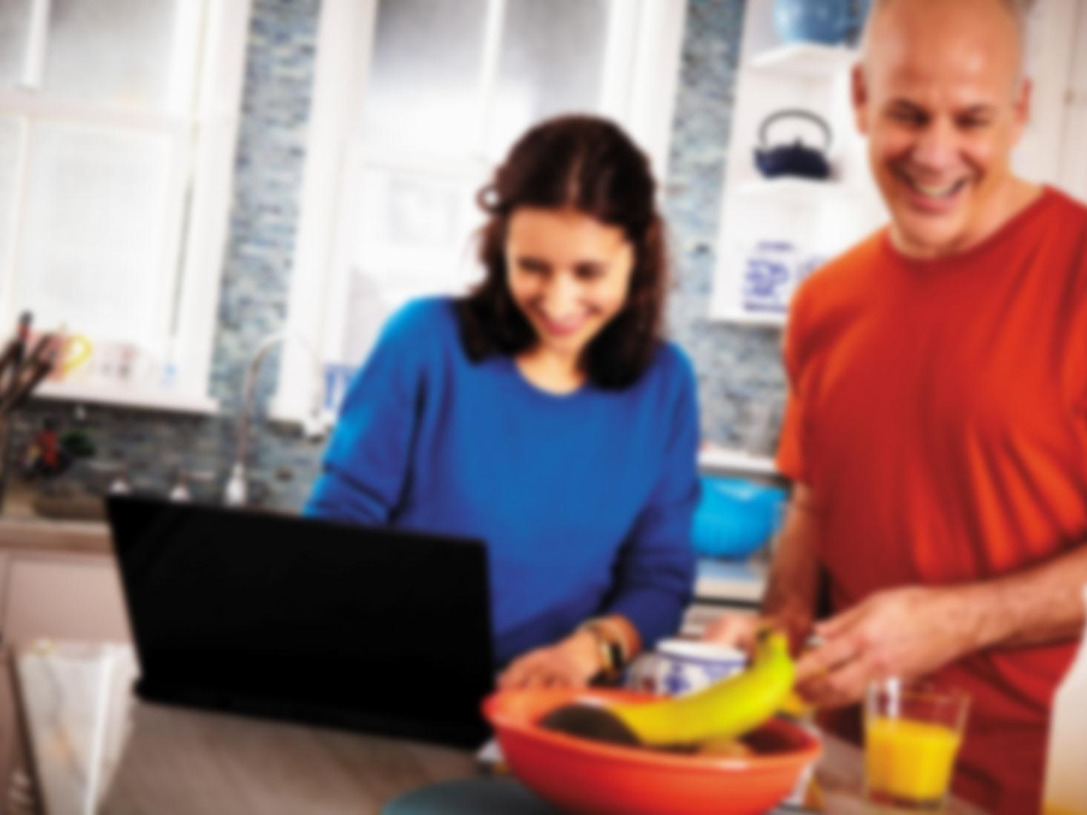
shared activities
“I took the camera and mounted it above the pot so my mother could help me…
I grab my mom, get her online, and say, okay, ‘Am I doing this right?’ … and she could see what I was working on, and you know, give me some advice directly on it.”
Notes:
Steven
Earlier in my interviews, I sat down with Steven.
Cooking with mom.
Swatti
- Who is very close to her grandparents, talked to me about “taking her grandparents out to the garden” and show them how the various chilies were growing.
Of course she is cooking too. She told me about calling her grandparents to be reminded just how many chillies she was supposed to include.
The key insight here is that people are moving beyond face-to-face conversations.
To engage in shared activities.
They do this with little direct assistance from technology, and in fact, they are often doing this despite the technology.

Slide 14
Cooking with mom
Gardening
“Grandma time”
Working on a plane with dad
House tour
Attending a party
Introducing a newborn
Meeting relatives
Saying goodbye to a dying brother
Family Vacation
Training for Search & Rescue
Portal/Open connection
Shared virtual environment
Sharing physical objects
Super Bowl party
Chat Roulette
Attending sports event
Sex
Playing with pets
Going on a date
Family Holiday
Tech-support
Watching Netflix
Auto-mechanic work
Screen sharing
Childbirth
Dancing
Remote baby-sitting
Sharing documents
Watching an international soap opera
Surfing the internet together
Purchasing a new home
Meeting people from different cultures
Homework
“Anything that sends my love”
Notes:
I could share more quotes with you, but I think this might be more powerful.

Slide 15
shared activities
Insight: Individuals are moving beyond conversations to engage in shared activities.
Insight: People are not using video communication with friends because there are limited activities that it supports.
Notes:
Definition: This theme relates to how individuals experience video in relationship to other mediums
Participants described it as a <list of attributes>
It is hard to overstate the powerfulness of video

Slide 16

co-presence
“‘Hey, let’s have a movie date on Skype.’… I think it mimics in-person dates…”
Insight: Shared points of view create a sense of co-presence.
Notes:
While you might think that looking straight into someone else’s face provides the most co-presence, actually focusing on something else together gives a strong sense of co-presence.

Slide 17
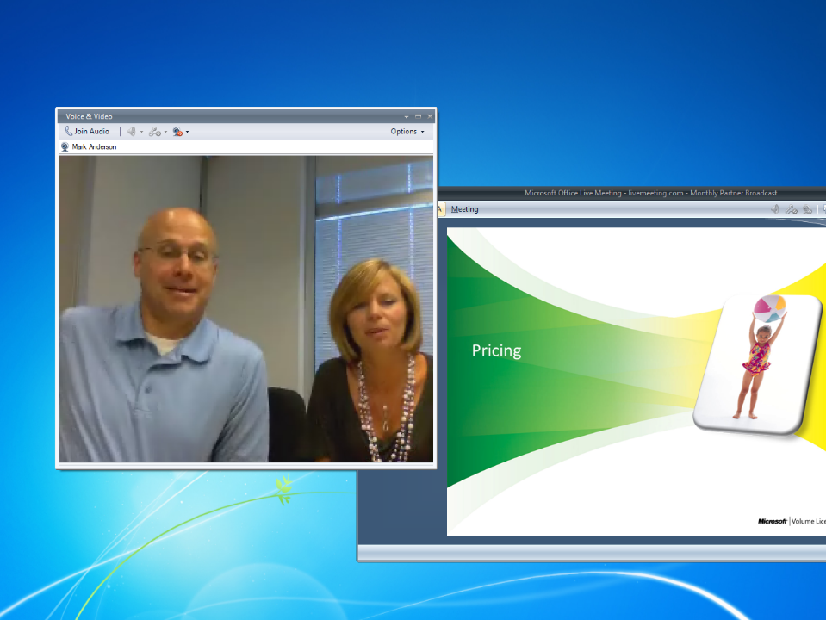
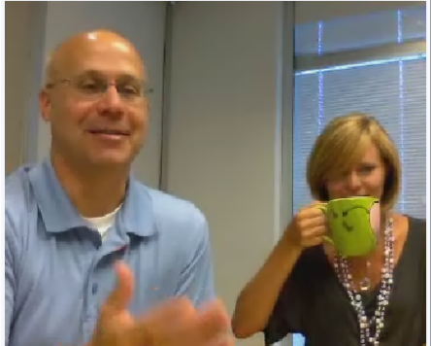
“Its kind of like a Kathy Lee and Regis thing…”

Slide 18
the context of video communication
managing impressions
relationships with
space & place
shared activities
co-presence
maintaining connections at a distance
group identity & shared values

Slide 19


Slide 20
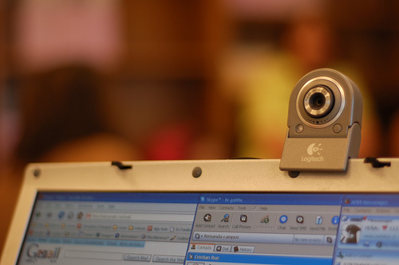
beyond the camera
home / personal settings
contrast with work
beyond talking heads
to sharing experiences
living spaces, mobile, on-the-go
doing activities together
with friends

Slide 21
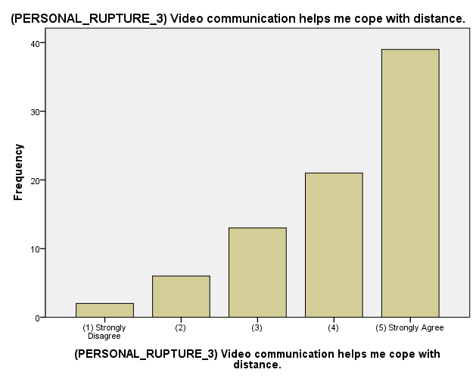
Notes:
So maybe you are more into numbers?
51% -- adopted as a result of someone moving
53% -- increased usage after someone relocated
73% of agree or strongly agree that VC helps them cope with distance.
88% say that it helps them stay in touch between visits.
As a result of VC:
68% say that they are more open to traveling to travel for work.
43% say that they are more open to relocating for a job.
37% more open to living apart from their spouse or partner.
Professionally –
78% work with remote teams
83% work with remote individuals
72% remote from their teams
72% remote from their manager

Slide 22
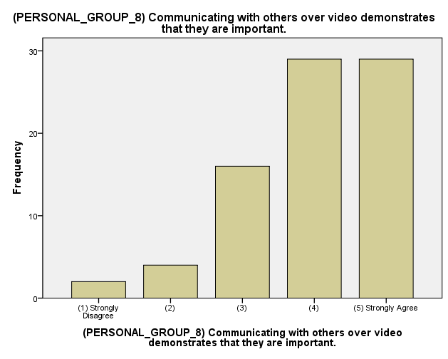
Notes:
73% agree or strongly agree that it demonstrates that the other person is important.
81% that “including remote family members is worth the hassle.”

Slide 23
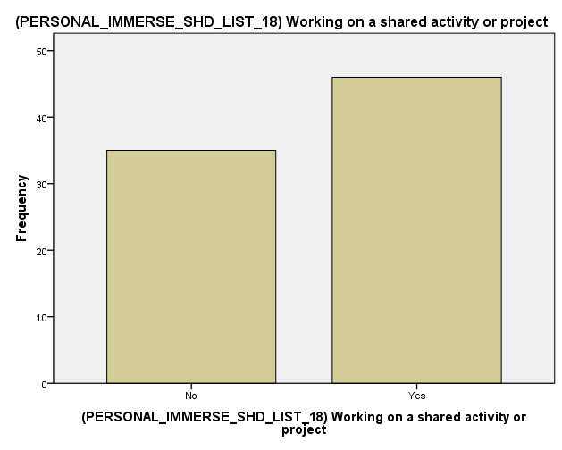
Notes:
Definition: This theme relates to how individuals experience video in relationship to other mediums
Participants described it as a <list of attributes>
It is hard to overstate the powerfulness of video

Slide 24
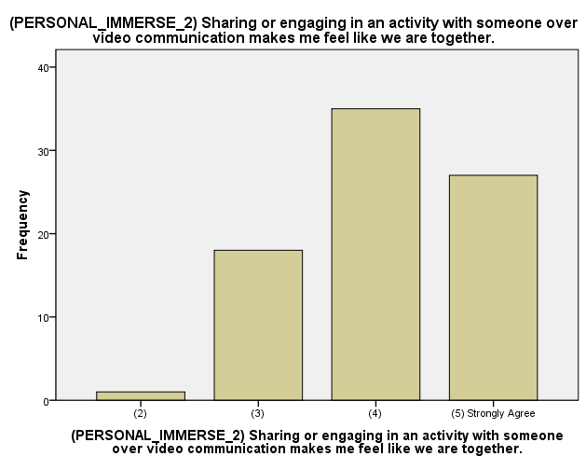
Notes:
IMPORTANT:
Previously I talked about how people are open to the challenge of distance.
Here we see people actively redefining what distance even is.

Slide 25



the context of video communication
Four Types of Encounters
The simple conversation
Proxies: Including someone in my place
Tours: Socializing space
Shared activities
Notes:
Even b

Slide 26
the context of
video communication
The benefit of video communication:
“I can be present because they are present.”
But where and when do you want to be present?
Notes:
Key Implications:
Support the creation of user-places.
Support shared activities.

