Slide 1

Balls into Bins
From Theory to Practice to Theory
Udi Wieder
Microsoft Research

Slide 2
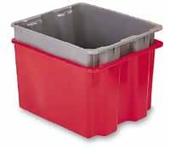
The Balls and Bin Model
Resource load balancing is often modeled by the task of throwing balls into bins
  Hashing, distributed storage, online load balancing etc.
Throw m balls into n bins:
  Pick a bin uniformly at random
  Insert a ball into the bin
  Repeat m times
1
2
3
4
5
6
7
h[ ] = 6

Slide 3


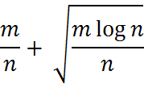

The Single Choice Paradigm
Resource load balancing is often modeled by the task of throwing balls into bins
  Hashing, distributed storage, online load balancing etc.
Throw m balls into n bins:
  Pick a bin uniformly at random
  Insert a ball into the bin
  Repeat m times
Number of Balls
Max Load

Slide 4




The Multiple Choice Paradigm
Throw m balls into n bins:
  Pick d bins uniformly at random
  Insert a ball into the less loaded bin
  Repeat m times
independent of m
Number of Balls
Max Load with prob. | [ABKU94] | [BCSV00]
Recurring phenomenon: The multiple choice paradigm is effective in practice

Slide 5
Application: Kinesis
Distributed storage system based on the multiple choice paradigm
Works well even though:
  Servers are heterogeneous
  Data items are heterogeneous
  Pseudorandom sampling procedure
  Replication across racks

Slide 6
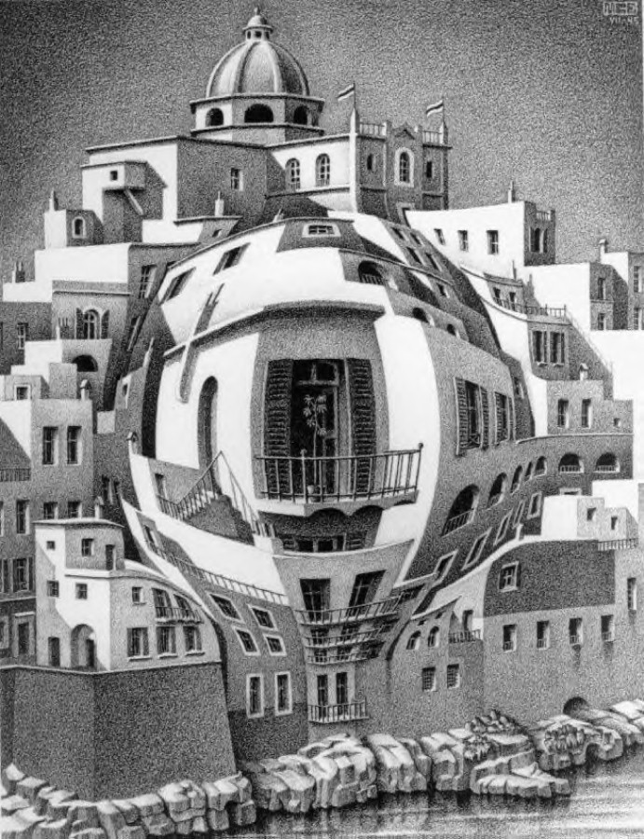
Heterogeneous Bins

Slide 7


Heterogeneous Bins: Motivation
Distribution such that
Distribution such that
Uneven allocation of hash key-space between servers
  Unavoidable if consistent-hashing scheme is used
    Standard approach when handling insertions and deletions
  Probability is proportional to the size of key space owned by the server

Slide 8
Heterogeneous Bins: Motivation
Distribution such that
Distribution such that
Heterogeneous capacity of servers
  A strong server simulates many virtual weak servers
  Each simulated server is sampled with a small probability
1
2
3
4
5
6
7
2.0
2.1
2.2

Slide 9
Heterogeneous Bins: Example
Throw m balls into n bins:
  Pick 2 bins according to D
  Insert a ball into the less loaded bin
  Repeat m times
Distribution such that
Distribution such that
If m=n then 2 choices are enough when α,β ≤ log n [BCM04].
Not true anymore when m>n
  n/4 bins with prob. 1/2n and 3n/4 bins with prob. 7/6n
  The probability an item falls in the big bins is ≥ (7/8)² = 49/64
  Average load of large bin is at least (49m/64)/(3n/4) = 49m/48n
Solution: Increase the number of choices

Slide 10
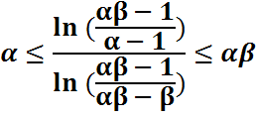



Heterogeneous Bins – Main Result
Throw m balls into n bins:
  Pick d bins according to D .
  Insert a ball into the less loaded bin.
  Repeat m times.
Distribution such that
Lower bound: If then gap is linear in m
Upper bound: If then gap is

Slide 11
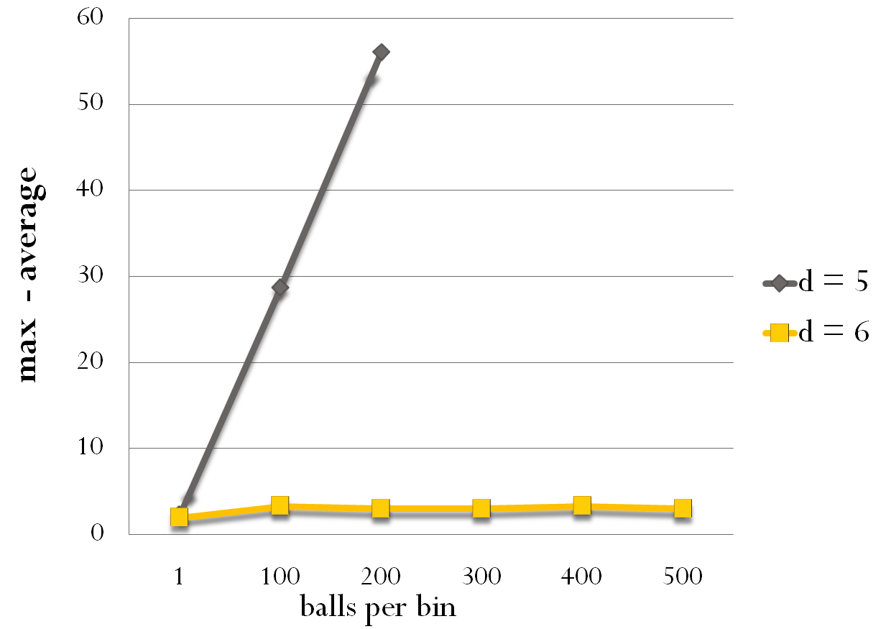



The Effect of Heterogneouty

Slide 12




Upper Bound: Proof Idea
If then the process is dominated by uniform k choices
Proof by coupling:
An exact copy of
uniform k-choice
An exact copy of
heterogeneous d-choice
Dependencies
Invariant:
uniform k-choice more loaded than heterogeneous d-choice

Slide 13
The Coupling
Het. d is majorized by Uniform k
The Het. process inserts a ball in Bin j
The Uniform process inserts a ball in Bin i
If j ≥ i then invariant is maintained
Goal: Find a coupling such that j ≥ i

Slide 14
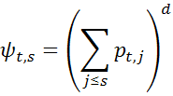



The Coupling
¹_{s} = Pr[ U puts a ball in the
s most loaded bins]
Ã_{t,s} = Pr[ H puts a ball in the s most
loaded bins in time t]
Sample c uniformly in (0,1]
i is such that ¹_{i-1} < c ≤ ¹_{i}
U puts a ball in Bin i
j is such that Ã_{j-1} < c ≤ Ã_{j}
H puts a ball in Bin j
If for every s,t ¹_{s} ≥ Ã_{t,s} then j ≥ i
If d ≥ k·f(®, ¯) then ¹_{s} ≥ Ã_{t,s}

Slide 15
A Tight Upper Bound
If d ≥ k·f(®, ¯) then Het with d choices is dominated by Uniform with k choices
  For k=2 we can use the two choice theorem
What if k is not an integer?
  Define Uniform k as the process that puts a ball in the s most loaded bins with probability (s/n)^{k}
  Process is not local – doesn’t make sense as an allocation rule
  Original proofs apply. The load is at most loglog n/log k

Slide 16

Weighted Balls
Joint work with Kunal Talwar

Slide 17
The Model
Items (balls) have weights coming from a distribution
  File sizes, computation tasks, popularity etc.
Throw m balls into n bins:
  Sample a weight w from the weight distribution W
  Pick 2 bins uniformly at random
  Insert a ball of weight w into the less loaded bin
  Repeat m times

Slide 18
Weighted Balls: Toy Examples I
m=n and W is uniform in {1,2}
  Process that ignoring weights has a load bounded by 2loglog n
m=n and W is the geometric distribution
  There is a ball of weight ½ log n w.h.p.
  The weight of log n balls is O(log n) w.h.p.
  The two choice paradigm is not better than one choice!
  When m=n load is dominated by heaviest ball

Slide 19

Weighted Balls: Toy Examples II
m arbitrary and W is uniform in {1,2}
  The weight of m/n balls is w.h.p.
  An allocation rule which ignores weights is no better than single choice!
The two choice paradigm will show independence from m
A gap of log log n is not true for all weight distributions
  If W is geometric, gap is at least log n
  If W is power law, gap is at least n²

Slide 20
Main Result
W has finite second moment and is decreasing from some point
Gap (t) = max – avg at time t
For every t,k, Pr[Gap(t)>k] ≤ Pr[Gap(n^{c})>k] + n⁻²
where c depends on W alone
For every t, E[Gap(t)] < n^{c}
assuming W has a finite fourth moment
Definition covers all interesting distributions
Distribution doesn’t have to be above integers

Slide 21
First Attempt
Show stochastical dominance over unweighted case
  Stochastical dominance effective in many settings, including heterogeneous bins
Problem: A heavy ball is favored by the less balanced configuration
  Dominance not preserved
Conclusion: Need to prove from scratch

Slide 22

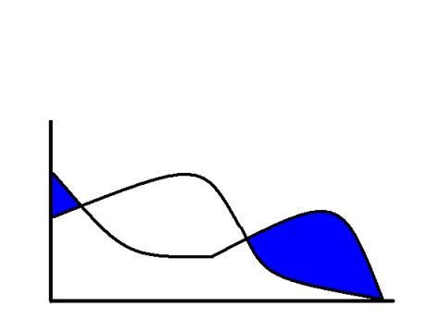


Proof Structure
Weak Gap Theorem:
Short Memory Theorem:
If x and y are two allocations with max |x_{i} – y_{j}| ≤ ∆ then
|x(∆ n³) - y(∆ n³)| ≤ t^{-1/5}
[BCSV]
Variation Distance
Pr[Gap(t)>k] ≤ Pr[Gap(n^{c})>k] + n⁻²
Idea: Iterative sharpening of the weak bound
Consider the gap at and compare with perfectly balanced allocation
Weak Gap Theorem implies gap is at most
Short Memory Theorem implies after additional steps, processes are similar

Slide 23

Weak Gap Theorem
Theorem holds for the Single Choice Process
  Expected load for bin is
  Use Chebyshev’s inequality
Don’t know how to show that 2-Choice is better than Single Choice!
Use a potential function argument

Slide 24



Short Memory Theorem
Coupling argument: x and y are two given allocations.
Goal: Show a coupling where x(t) and y(t) converge to the same allocation fast (in linear time)
An exact copy of
2-choice starting from X
An exact copy of
2-choice starting from Y
Dependencies
Coupling converges when
Coupling Lemma:
[coupling didn’t converge]

Slide 25



The Coupling Graph
Allocations are specified as sorted vectors
Define a graph over the set of vectors
Vectors form an edge if y is obtained from x by moving one unit of weight. for some i,j
All vectors of the same weight are connected
The path connecting x and y has at most n∙(max-min ) edges

Slide 26
The Coupling
Coupling defined on edges only and induced on every pair through short paths
i
j
Coupling: Put a ball of the same weight in the same bin
Coupling preserves the edge relation
  Assuming W is over the integers

Slide 27
Neighbor Coupling Approach
X₁(0)
X₂(0)
X₃(0)
X₄(0)
X₅(0)
X₆(0)
X₁(1)
X₂(1)
X₃(1)
X₄(1)
X₅(1)
X₆(1)
X₁(t)
X₂(t)
X₃(t)
X₄(t)
X₅(t)
X₆(t)
If (x,y) are neighbors in the graph, then after t steps they convergee with high probability
For arbitrary x,y union bound over all edges in the path
Valid since the coupling preserves the edge relation

Slide 28
The Distance Function
∆(x, y) = x_{i} - y_{j}
i
j
Δ = 0 iff x = y
If ball of weight w is put in bin i then Δ ← Δ + w
If ball of weight w is put in bin j then Δ ← | Δ – w|
In any other case Δ ← Δ
Distance is decreasing: Pr[Bin j] > Pr[Bin i]

Slide 29





Putting it Together
There is a such that if then the coupling reduces on expectation
Use Chernoff-like inequality to show that within steps of the coupling, the distance reaches with high probability
If then coupling converges with probability within O(1) steps
  Assuming some smoothness assumptions on the distribution
If the coupling didn’t converge then within steps it holds that and the coupling gets another chance to converge
  Process iterates until success

Slide 30
Distributions over the Reals
Proof assumes the distribution is over the integers
  Many natural distributions are over the reals
  Important as a mathematical statement
First attempt: Round with arbitrary precision
  Consistently round up, random rounding…
  The accumulated error depends on the number of balls thrown!
Solution: Dependant rounding:
  Round a weight given the bin it is put into, such that the accumulated error is at most 1 per bin
  Violates the assumption that weights are drawn independently at random
  Dependencies could be dealt with

Slide 31
Open Questions
Find exact bounds for interesting distributions
  A general bound based on distributions moments?
Remove assumption of smoothness
Derandomization

Slide 32
Papers
[MacCormick, Murphy, Ramasubramanian, W, Yang, Zhau] Kinesis: the Power of Controlled Freedom
[Talwar, W] Balanced Allocations: The Weighted Case
[W] Balanced Allocations with Heterogeneous Bins

