Slide 1
On Discovery of Traveling Companions from Streaming Trajectories
Lu-An Tang, Yu Zheng, Jing Yuan, Jiawei Han,
Alice Leung, Chih-Chieh Hung and Wen-Chih Peng

Slide 2
Outline
Introduction
Related Works
Companion Discovery Framework
The Buddy-based Approach
Experiments and Conclusion

Slide 3
Trajectory Data Streams
Technical advances in mobile & tracking devices have lead to huge volume of trajectory data
Trajectory stream: the devices report the object locations with timestamps in sequences
  Taxi traces by GPS
  Animal movements
  Military trajectories on battlefields
  Location based social network: check-in sequences

Slide 4
Motivation
It is interesting and useful to study the partnership in trajectory streams – discover the group of objects that move together, i.e., traveling companions
Applications:
  animal behavior analysis, migration path study
  traffic jam detection, smart driving direction recommendation
  anti-crime and anti-terrorist, battlefiled survilliance and control
  location based social network, online game play

Slide 5
A Motivation Example
size threshold = 4 & time threshold = 4 snapshots

Slide 6
A Motivation Example
size threshold = 4 & time threshold = 4 snapshots
{o₁, o₂, o₃, o₄} is the traveling companion

Slide 7
Problem Formulation
Let δ_{s} be the size threhsold and δ_{t} be the duration threshold, a group of objects q is called traveling companion if:
  The members of q are desity connected by themselves for a period t where t ≥ δ_{t}
  size(q) ≥ δ_{s}
Let trajectory stream S = {s₁, s₂, … s_{i}, …}, eash snapshot s_{i} = {(o₁,x_{1,i},y_{1,i}), (o₂,x_{2,i},y_{2,i}), …, (o_{n},x_{n,i},y_{n,i})}, the task is to discover the traveling companion set Q

Slide 8
The Challenges
Key issue: travel together – in the same cluster; the cluster may be in arbitrary shape – density-based clusters
Efficiency
  discover the companions along the data streams (cannot scan the whole dataset)
  scalable with large number of objects and long time lasting trajectories
Effectiveness
  report the large and long-lasting companions, rather than small and short-lasting ones

Slide 9
Our Contributions
Introduce the framwork to discover companions by clustering-and-intersection
Improve the technique with smart-intersection and closed companions
Propose the buddy-based approach to discover companions with higher efficiency
Evaluate the performences on both real and synthetic datasets

Slide 10
Outline
Introduction
Related Works
Companion Discovery Framework
The Buddy-based Approach
Experiments and Conclusion

Slide 11
Related Studies
Moving group discovery, Kalnis et.al., 2005: two consecutive clusters with the similar contents
Flock, Gudmundsson et.al., 2004: a group of objects that move together within a circle of user given ridus “r”, i.e., a disc
Spatial –tempo joins, Bakalov et.al., 2005: a pair of objects (only two) travel together
TraCluster, Lee et.al., 2007: the clusters that represent the main moving direction of sub-trajectories

Slide 12
Convoy Query and Swarm Query
Convoy, Jeung et.al., 2008: a group of objects that traveled together continuously for a period of time
Swarm, Li et.al., 2010: relaxed temporal moving object clusters
Why don’t they work on trajectory streams?
  Efficency: high time or I/O costs
  Effectiveness: the cluster must be in round shape, i.e, disc
  Generate results after scaning the entire dataset – for static dataset, but not data streams

Slide 13
Outline
Introduction
Related Works
Companion Discovery Framework
The Buddy-based Approach
Experiments and Conclusion

Slide 14
The Framework: Clustering-and-Intersection
A two-step process to retrieve the traveling companions
  clustering the objects in each snapshot
  intersecting the clusters to generate companion candidates, if the candidates meet the size and time standards, output them as companion

Slide 15
Example of CI: δ_{t}=40m, δ_{s}=4

Slide 16
Analysis of Clustering-and-Intersection
Pros: Guarantee not missing any companions
Cons: high costs on both clustering and intersection steps
In each snapshot, the intersection is carried out in every pair of candidate and cluster
Some redundant and unnecessary candidates are stored

Slide 17
The Smart Intersection and Closed Candidates
Can we stop the intersection earlier?
  Smart Intersection: if the objects of a candidate has already been found in a cluster, no need to intersect the candidate furthermore with other clusters
Can we only add the necessary ones?
  Closed candidate: for a new candidate r_{i}, if there exists already another candidate r_{j} that , and duration(r_{j}) ≥ duration (r_{i}), then r_{i} is not necessary to add into the memory

Slide 18
Example of Smart-Intersection and Closed Candidates
Once we found r₁’s objects in c₁, stop the interesection; do not add the un-closed candidates

Slide 19
Outline
Introduction
Related Works
Companion Discovery Framework
The Buddy-based Approach
Experiments and Conclusion

Slide 20
The Bottleneck of Companion Discovery
The clustering step: density-based clustering algorithm cost O(n²) time without spatial index
It is costly to maintain a spatial index in each snapshot , since the object locations change a lot [Lee et.al., 2003]
The clustering step is indeed the bottleneck

Slide 21

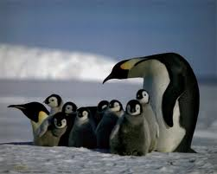
The Buddy-based Approach
Intuition: Speed up the clustering step by reusing the information of previous clusters
Observation: People, animal and other creatures like to travel within small groups – the buddies
  Couples/close friends like to travel together
  Animals migrate in families

Slide 22
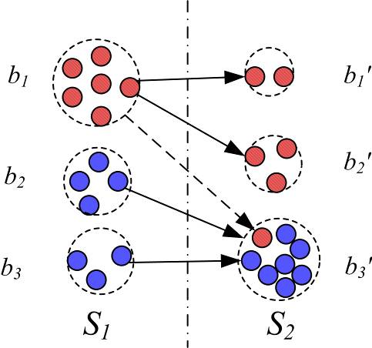
The Buddy Maintainence
Although the buddies may not be larger enough as the companion, they can still be used to improve clustering efficiency
The buddy only stores the relationships of objects
The maintain cost of buddies is low: with buddy radius, size and center,
easy to update the buddy’s
information when add/remove
member objects

Slide 23
The Buddy-based Clustering
How can the buddies help clustering process?
The principles (Lemma 2 to 4)
  If a buddy is tight (enough size with small radius), all the members of the buddy are density-connected
  If two buddies’ center distance is large, then the two of them cannot be directly density connected
  Lemma 4: If two tight buddies are close, then all their members are density-connected

Slide 24
The buddy-based companion discovery
The buddies can be used to help companion discovery
Construct a buddy index {BID, ObjectSet, CanIDs}
If a buddy stay unchanged, then the system only needs to check the buddy ID without looking object details in the intersection process – reduce the intersection times

Slide 25
Example: The Buddy-based Approach

Slide 26
Outline
Introduction
Related Works
Companion Discovery Framework
The Buddy-based Approach
Experiments and Conclusion

Slide 27
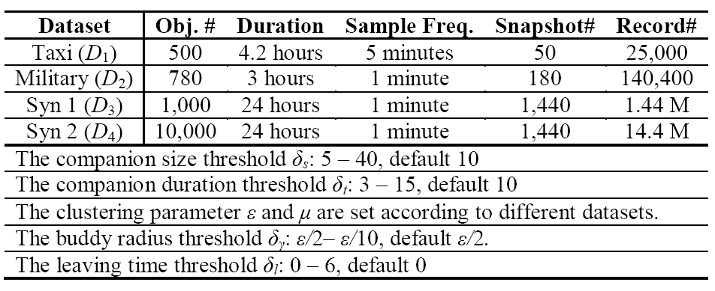
Experiment Setup
Four datasets: two real, two synthetic
comparing the methods of smart-and-closed (SC), buddy-based (BU) with clutering-and-intersection (CI), trajectory clustering (TC) and swarm pattern (SW)

Slide 28
Efficency Study I
BU costs only 10-20% time of CI
SC costs 20-30% time of CI
Larger δ_{t}, less time

Slide 29
Efficency Study II
Larger δ_{s}, fewer companion candidagtes, less time
If the average buddy size is larger than 2.5, BU outperforms density-based clustering

Slide 30
Effectiveness Study
CI’s precision is low, too many non-closed companions
TC(Trajectory clustering) may miss some companions

Slide 31
Conclusion
We have investigated the problem of companion discovery on streaming trajectories
Cluster-and-Intersection framework is introduced as the baseline, the improvement of smart-intersection and closed-candidates are proposed
The buddy-based companion algorithm is proposed for efficency companion discovery
Thank You Very Much!
Any Questions?

