Slide 1
Mining Interesting Locations and Travel Sequences From GPS Trajectories
Yu Zheng and Xing Xie
Microsoft Research Asia
March 16, 2009

Slide 2
Outline
Introduction
Our Solution
Experiments
Conclusion

Slide 3

Background
GPS-enabled devices have become prevalent
These devices enable us to record our location history with GPS trajectories
Human location history is a big cake given the large number of GPS phones

Slide 4
Motivation
When people come to an unfamiliar city
  What’s the top interesting locations in this city
  How should I travel among these places (travel sequences)
  A map does not make much sense to a freshman
?

Slide 5
Strategy
Mining interesting locations and travel sequences from multiple users’ location histories
http://geolife

Slide 6
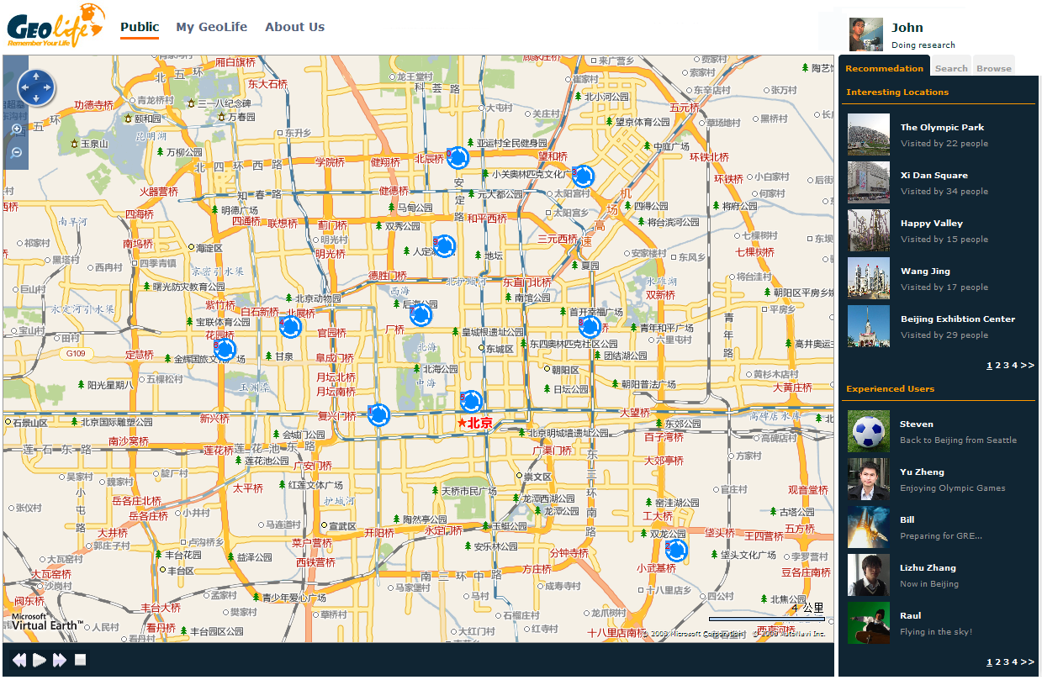

Slide 8
Difficulty
What is a location? (geographical scales)
The interest level of a location
  does not only depend on the number of users visiting this location
  but also lie in these users’ travel experiences
How to determine a user’s travel experience?
The location interest and user travel
  are region-related
  are relative value (Ranking problem)

Slide 9
Solution – Step 1: Modeling Human Location History
GPS logs P and GPS trajectory
Stay points S={s1, s2,…, sn}.
  Stands for a geo-region where a user has stayed for a while
  Carry a semantic meaning beyond a raw GPS point
Location history:
  represented by a sequence of stay points
  with transition intervals

Slide 10
1. Stay point detection
2. Hierarchical clustering
3.Graph Building

Slide 11

Solution – 2. The HITS-Based Inference
Mutual reinforcement relationship
  A user with rich travel knowledge are more likely to visit more interesting locations
  A interesting location would be accessed by many users with rich travel knowledge
A HITS-based inference model
  Users are hub nodes
  Locations are authority nodes
  Topic is the geo-region

Slide 12
Users:
Hub nodes
The HITS-based inference model
Locations:
Authority nodes

Slide 14

Solution – 3. Detecting Classical Travel Sequence
Three factors determining the classical score of a sequence:
  Travel experiences (hub scores) of the users taking the sequence
  The location interests (authority scores) weighted by
  The probability that people would take a specific sequence
The classical score of sequence A→C:
: Authority score of location A
: User k’s hub score
: Authority score of location C

Slide 15
Experiments
Settings
Evaluation Approach
Results

Slide 16
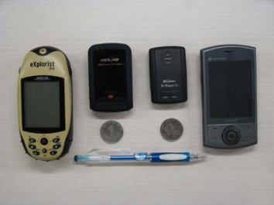
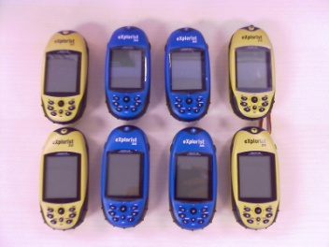
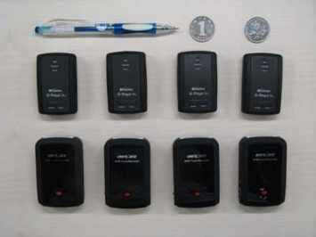
GPS Devices and Users
60 Devices and 138 users
From May 2007 ~ present

Slide 17
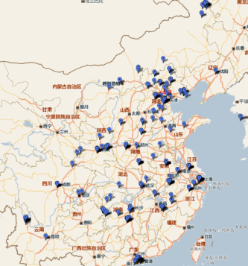
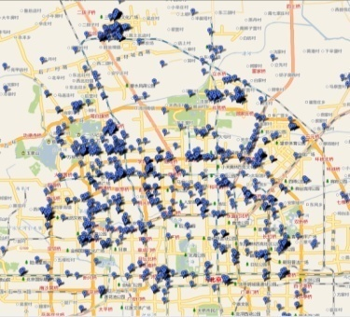
A large-scale GPS dataset (by Feb. 18, 2009)
  10+ million GPS points
  260+ million kilometers
  36 cities in China and a few city in the USA, Korea and Japan

Slide 18
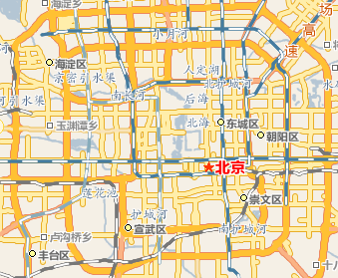
Evaluation Approach
29 subjects
  14 females and 15 males
  have been in Beijing for more than 6 years
The test region:
  specified by the fourth ring road of Beijing
Evaluated objects
  The top 10 interesting locations and
  the top 5 classical travel sequences

Slide 19
Evaluation Approach
Presentation
  The ability of the retrieved locations in presenting a given region.
  Investigate three aspects
    Representative (0-10)
    Comprehensive rating (1-5)
    Novelty rating (0-10)
Rank
  The ranking performance of the retrieved locations based on inferred interests.
Ratings | Explanations
2 | I’d like to plan a trip to that location.
1 | I’d like to visit that location if passing by.
0 | I have no feeling about this location, but don’t oppose others to visit it.
-1 | This location does not deserve to visit.
Ratings | Explanations
2 | I’d like to plan a trip with this travel sequence.
1 | I’d like to take that sequence if visiting the region.
0 | I have no feeling about this sequence, but don’t oppose others to choose it.
-1 | It is not a good choice to select this sequence.

Slide 20
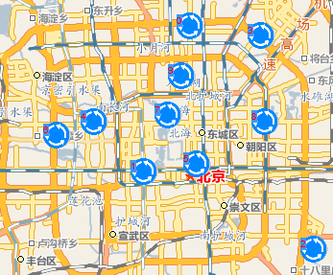
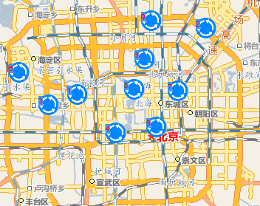
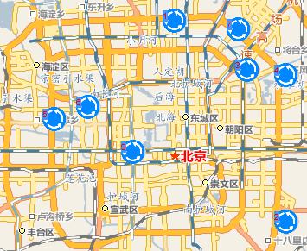
Results on Evaluating Interesting Locations
A) Our method
B) Rank-by-count
C) Rank-by-frequency

Slide 21
Results on Evaluating Interesting Locations
Comparison on the presentation ability of different methods
 | Ours | Rank-by-count | Rank-by-frequency
Representative | 5.4 | 4.5 | 3.1
Comprehensive | 4 | 3.4 | 2.3
Novelty | 3.4 | 2.4 | 2.2
Ranking ability of different methods
 | Ours | Rank-by-count | Rank-by-frequency
nDCG@5 | 0.823 | 0.714 | 0.598
nDCG@10 | 0.943 | 0.848 | 0.859
MAP | 0.759 | 0.532 | 0.365

Slide 22
Results on Evaluating Travel Sequences
 | Ours (Interest + Experience) | Rank-by-counts | Rank-by-interest | Rank-by-experience
Mean score | 1.6 | 1.2 | 1.4 | 1.5
Classical Rate | 0.6 | 0.3 | 0.4 | 0.4

Slide 23



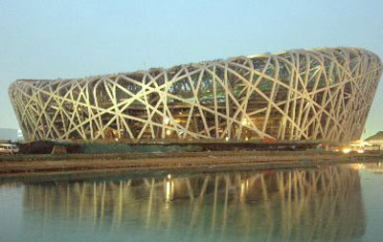

Rank-by-counts
Rank-by-interest
A railway station
A ordinary hotel nearby the station
Tiananmen Square
The Summer Palace
Rank-by-experience
Our methods
An ordinary café nearby an experienced user’s home
An normal store close to her home
The Bird’s nets
Houhai Bar street

Slide 24
Investigating in our method
Why Hierarchy
  Provide user with a comprehensive view of a large region (a city)
  help users understand the region step-by-step (level-by-level).
  The hierarchy can be used to specify users’ travel experiences in different regions.
A) Our method using hierarchy
B) Our method without using hierarchy

Slide 26
Conclusion
Enable generic travel recommendation
  Top interesting locations,
  travel experts and
  classical travel sequences
Regarding mining interesting locations
  Our method outperformed Ranking-by-count and Ranking-by-frequency
  User experience is very critical
  Hierarchy of the geo-spaces is important
Classical travel sequences
  Location interest + user travel experience is better

Slide 27
Thanks!
yuzheng@microsoft.com

