Slide 1
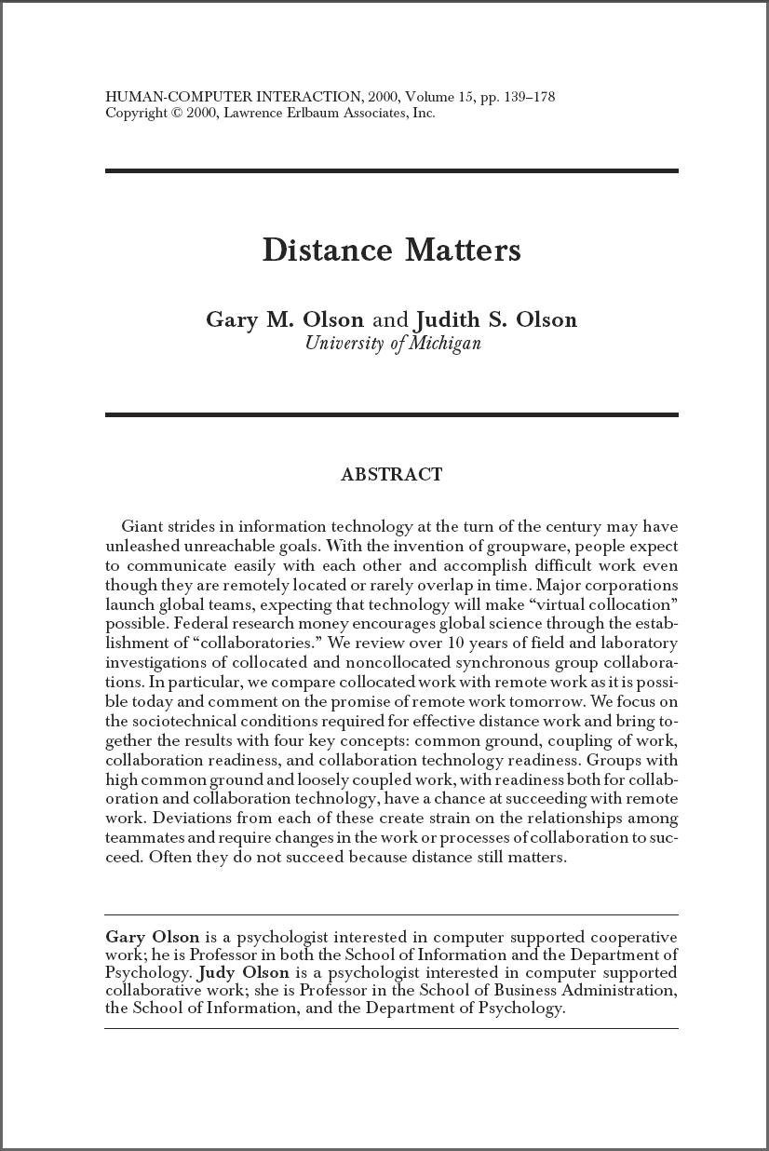
Can We Make “Distance Matter” Less?
Gina Venolia
Senior Researcher
Human Interactions in Programming
Microsoft Research
http://research.microsoft.com/~ginav/
October 10, 2008

Slide 2
I’m drawing from several studies that we’ve done of software development at Microsoft.
LaToza, Venolia and DeLine. Maintaining mental models. ICSE ’06.
  Pilot survey (28 MS-internal responses) → Recruitment survey (157) → 60-minute interviews (11) → Validation survey (187)
Ko, DeLine and Venolia. Information needs in collocated software development teams. ICSE ’07.
  Recruitment survey (55) → 90-minute observations (17) → Validation survey (42)
Cherubini, Venolia, DeLine and Ko. Let’s go to the whiteboard: How and why software developers use drawings. CHI ’07.
  Recruitment survey (60) → 45-minute interviews (9) → Validation survey (427)
Hemphill and Begel. Adopting distributed development: Case studies in onboarding a first remote team member. In submission.
  15-90-minute interviews (95; 26 unique people) → Observations (15 hours total)
Umarji, DeLine and Venolia. Communication and separation: An observational study of distributed work. In submission.
  Recruitment survey (1882) → 90-minute remote observations (24)
Brush, Meyers, Scott and Venolia. Exploring awareness needs and information display preferences between coworkers. In submission.
  Survey (549 MS and external)

Slide 3
What can we do to make geographically-distributed team work easier?
There are several economic and practical pressures leading to increased distributed work
However distributed teamwork is known to be harder in many ways than collocated
“Radical collocation” (aka “team rooms”) may be easier still [Olson and Olson 2002]

Slide 4
We’ve identified four key differences between collocated and distributed teamwork.
1. Communication in planned meetings
2. Ad-hoc conversations
3. Staying aware of teammates and their work
4. Building trust relationships between teammates
But first…

Slide 5
What is a Distributed Team?
That should be easy…

Slide 6
It depends on how you define team.
→ The organizational structure?
SR VP CORE OPERATING SYSTEM
GENERAL MANAGER
BUSINESS ADMINISTRATOR
BUSINESS MANAGER
GENERAL MANAGER
PRODUCT UNIT MANAGER
BUSINESS ADMINISTRATOR
DIRECTOR
DIRECTOR OF DEVELOPMENT
PRINCIPAL GROUP MANAGER
PRINCIPAL GROUP PROGRAM MGR
PRINCIPAL GROUP PROGRAM MGR
BUSINESS ADMINISTRATOR
SR. GROUP PROGRAM MANAGER
PARTNER ARCHITECT
TECHNICAL FELLOW
GENERAL MANAGER
PRINCIPAL TEST MANAGER
TECHNICAL ASSISTANT
DISTINGUISHED ENGINEER
DIRECTOR OF TEST
EXEC BUSINESS ADMINISTRATOR
BUSINESS MANAGER
DIRECTOR OF PROGRAM MANAGEMENT
DIRECTOR OF DEVELOPMENT
GENERAL MANAGER
DIRECTOR OF PROGRAM MANAGEMENT
CVP-DEVELOPMENT
DIRECTOR OF PROGRAM MANAGEMENT
PARTNER UX DIRECTOR
DIRECTOR
EXEC BUSINESS ADMINISTRATOR
GENERAL MANAGER
DIRECTOR OF PROGRAM MANAGEMENT
GENERAL MANAGER
DIRECTOR OF PROGRAM MANAGEMENT
DIRECTOR OF PROGRAM MANAGEMENT
DIRECTOR OF PROGRAM MANAGEMENT
BUSINESS ADMINISTRATOR
PRINCIPAL PROGRAM MGR LEAD
DIRECTOR OF PROGRAM MANAGEMENT
DIRECTOR OF PROGRAM MANAGEMENT
DIRECTOR OF PROGRAM MANAGEMENT
SENIOR PROGRAM MANAGER LEAD
CORP VICE PRESIDENT
DIRECTOR OF DEVELOPMENT
DIRECTOR OF DEVELOPMENT
DISTINGUISHED ENGINEER
EXEC BUSINESS ADMINISTRATOR
DISTINGUISHED ENGINEER
DIRECTOR OF DEVELOPMENT
DIRECTOR OF DEVELOPMENT
DIRECTOR OF DEVELOPMENT
PRINCIPAL DEVELOPMENT MANAGER
PARTNER ARCHITECT
EXEC BUSINESS ADMINISTRATOR
CORPORATE VP
TECHNICAL FELLOW
PRINCIPAL ARCHITECT
GENERAL MANAGER
SENIOR GROUP PROGRAM MANAGER
PRINCIPAL GROUP PROD. PLANNER
PRINCIPAL GROUP PROGRAM MGR
SENIOR PROGRAM MANAGER LEAD
BUSINESS ADMINISTRATOR
SENIOR PROGRAM MANAGER
PRINCIPAL ARCHITECT
PRINCIPAL GROUP PROGRAM MGR
GENERAL MANAGER, CORE OS TEST
PRINCIPAL TEST MANAGER
DIRECTOR OF TEST
BUSINESS ADMINISTRATOR
DIRECTOR OF TEST
DIRECTOR OF TEST
DIRECTOR OF TEST
DIRECTOR OF TEST
DIRECTOR OF TEST
DISTINGUISHED ENGINEER
PARTNER ARCHITECT
DISTINGUISHED ENGINEER
DISTINGUISHED ENGINEER
PARTNER ARCHITECT
PRINCIPAL ARCHITECT
PRINCIPAL PROGRAM MANAGER
DIRECTOR
DIRECTOR, WW CPE
EXEC BUSINESS ADMINISTRATOR
DISTINGUISHED ENGINEER

Slide 7
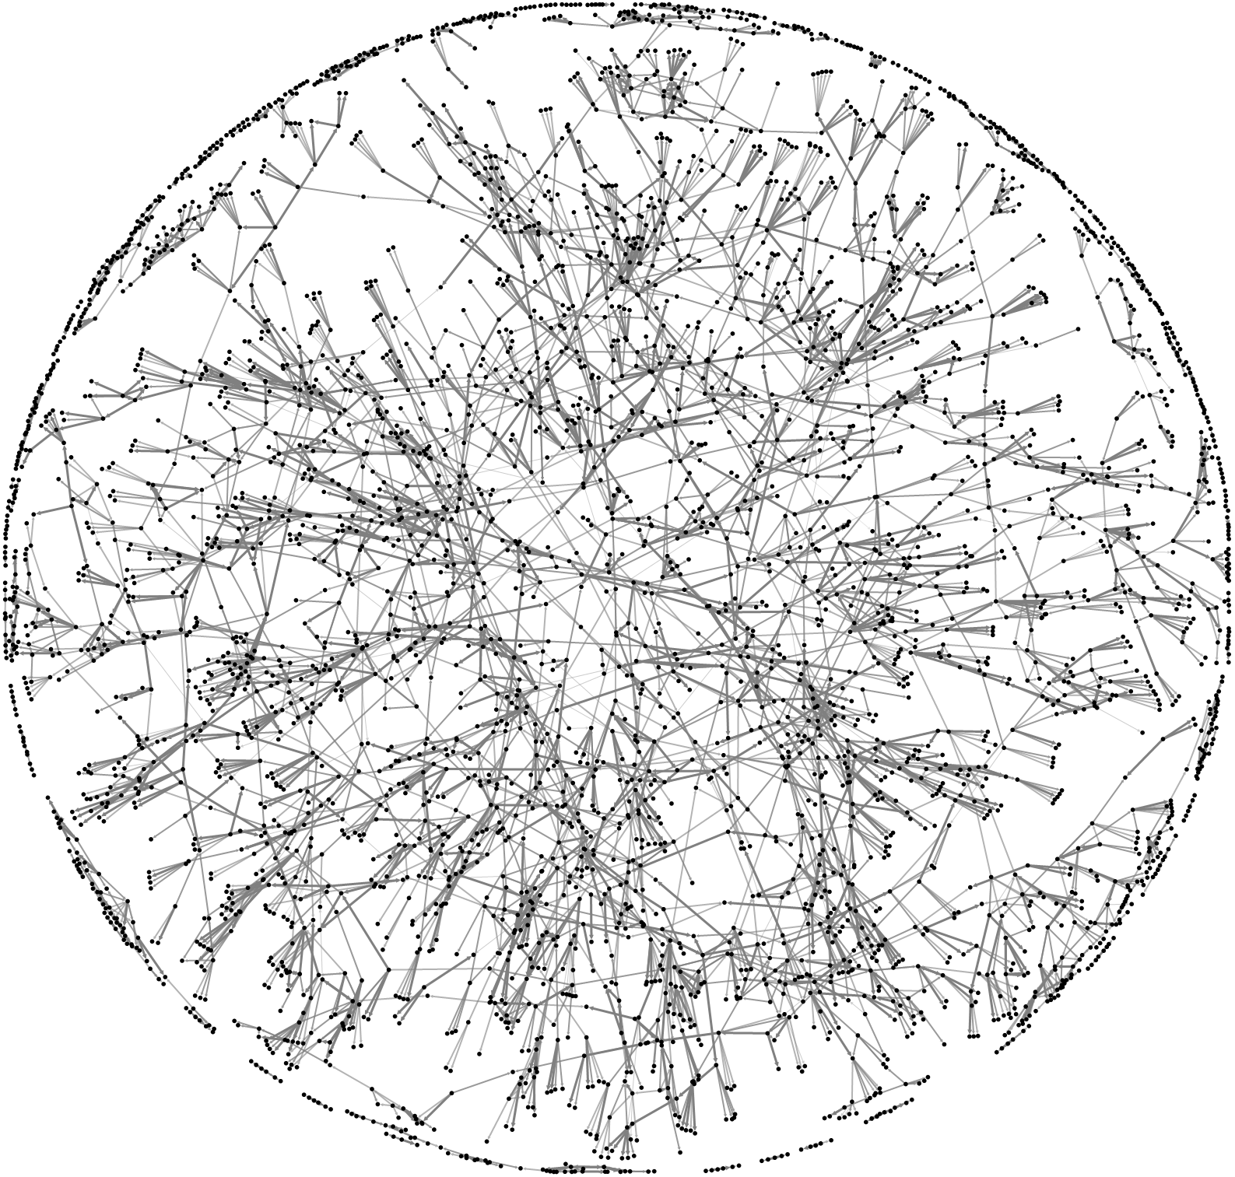
It depends on how you define team.
→ The communication structure?

Slide 8
It depends on how you define team.
→ The functional structure?
Feature crew
  2-3 developers
  1-2 testers
  About 1/3rd of a program manager

Slide 9
It depends on how you define distributed. [Umarji]

Slide 10
The effectiveness of collaboration degrades with physical distance.
People located closer in a building are more likely to collaborate [Kraut, Egido and Galegher 1990]
A distance of 100 feet may be no better than several miles [Allen 1977]
Even at short distances, 3 feet vs. 20 feet, there is an effect [Sensenig & Reed 1972]

Slide 11
Distributed teams come in many topologies.
Q: How far are the team members’ primary work location from your primary work location? (check all that apply) [Umarji]
Respondents
in configuration
Team Room
Hallway
Different floor
Hub
Satellite
Hub TZ
Satellite TZ

Slide 12
Distributed and team are both dynamic. [Umarji]
Distributed
  Work-at-home days, meetings in other buildings, site visits, business travel, …
Team
  39% of devs, 49% of testers and 72% of PMs have been a member of multiple teams in a month
  Feature teams last a median of 12 months

Slide 13
Aren’t you forgetting about inter-team work?
Yes.

Slide 14
OK, now let’s get back to the four key differences between collocated and distributed teamwork.
1. Communication in planned meetings
2. Ad-hoc conversations
3. Staying aware of teammates and their work
4. Building trust relationships between teammates

Slide 15
1. Communication in Planned Meetings

Slide 16
Meetings come in many sizes and shapes – each with unique characteristics.
Type of meeting | Frequency | Number of participants | Order vs. chaos | Use of whiteboard | Use of Projector | …
Weekly status
Daily standup
Bug triage
Ship-room
Brainstorming
Presentation
Spec/design/code review
Manager/lead 1:1
Pair programming
One size does not fit all!

Slide 17
Just like distributed teams, distributed meetings come in different topologies.
One size does not fit all!
Two-hub
Hub and satellite
Fully-distributed
…

Slide 18
Meetings are harder for remotes – though they have some mitigation strategies. [Umarji]
Problem | Mitigation
Time zones | Shift work hours
Teleconference setup problems [Hemphill] | Revert to most-reliable technology
A/V quality problems | Remind politely [Hemphill]
 | IM backchannel
Gaze direction and eye contact | –
Can’t use or see the whiteboard | (Why is shared OneNote underutilized?)
Last in the “circle” – or even forgotten | –
Difficult to interject or have fast-paced exchanges | –

Slide 19
2. Ad-hoc Conversations

Slide 20
Ad-hoc conversations are initiated primarily to fulfill an information need.
A specific question to a specific person
A specific question to a community of practice
“Another pair of eyes”

Slide 21
Ad-hoc conversations are the #1 resource for answering a variety of questions. [Ko]
What have my coworkers been doing? [20 times]
What are the implications of this change? [13]
Is this problem worth fixing? [12]
In what situations does this failure occur? [8]
What code could have caused this behavior? [5]

Slide 22
Face-to-face is generally the preferred medium for ad-hoc conversations. [LaToza]
Face-to-face [27% of communication time]
  Preferred unless the question is low priority, multi-party, or parties are distant
  Sometimes using secondary media:
    Shoulder-to-shoulder at the computer screen
    Whiteboard – just enough to support the conversation [Cherubini]
IM or phone [4% + 3%]
  For simple Q&A
Email [22%]
  The communication workhorse
→ Conversations often migrate between media

Slide 23
Opportunistic ad-hoc conversations, which piggyback on other interactions, are an important part of the information flow.
Various triggers
  Hallway, kitchen, lunch, ...
  Before or after planned meetings
  After another ad-hoc conversation
Also reporting status or progress [Ko]

Slide 24
Ad-hoc communication is harder for remotes – though they have some mitigation strategies. [Umarji]
Problem | Mitigation
Face-to-face: Not possible | Rely on other media
IM and phone: Time zones | Shift work hours
 | Rely on emails
IM and phone: Lack of secondary media | (Why are screen sharing and shared OneNote underutilized?)
Email: Time zones cause 24 (or more) hour response lag | Shift work hours
 | Monitor email in the evening
Email: Time zones make a back-and-forth conversation drag out for days | Over-specify the initial message
Opportunistic: Far fewer opportunities | –
General: Fewer opportunities and harder to do ad-hoc conversations | Save emails to self-answer questions
 | Multitask to keep working despite blockage
 | (More frequent or deep investigations to self-answer questions?)
General: Not getting asked because they’re out-of-sight, out-of-mind | –

Slide 25
3. Staying Aware of Teammates and Their Work

Slide 26
Workspace awareness is multifaceted and well-studied. [Gutwin and Greenberg 2002]
Who: Presence, presence history, identity, authorship
What: Action, action history, intention, artifact
Where: Location, location history, gaze, view, reach
How: Artifact history
When: Event history

Slide 27
Like any team-workers, developers stay aware of their shared resources and their teammates activities. [Ko]
What have my coworkers been doing?
  2nd most common of 21 info needs (43 instances)
  Max time: 11 minutes
  Observed in 88% of participants
  No answer found in 14% of observed instances
How have resources I depend on changed?
  6th most common (25 instances)
  Max time: 9 minutes
  Observed in 59% of participants
  No answer in 24%
→ Interestingly, engineers underestimate the importance and difficulty of getting this information

Slide 28
They actively monitor many online sources to maintain awareness. [Ko]
Team- and topic-oriented email lists
Check-in and bug-edit notification emails
Bug database
Bug count watcher
Teammates’ IM status
Teammates’ online calendars
Group schedule

Slide 29
Teammates actively emit and absorb awareness signals.
Meetings: Status, daily stand-up, ship-room, …
Status mails

Slide 30
Teammates passively emit and absorb awareness signals.
Side-effect of ad-hoc communication
Overheard conversations, whiteboards, printouts, …

Slide 31
Passive awareness is harder for remotes – though they have some mitigation strategies. [Umarji]
Problem | Mitigation
Far fewer opportunities for passive absorption of awareness signals | (Monitor online sources more?)
Far fewer opportunities for passive emission of awareness signals | Push status in email, blog or wiki

Slide 32
4. Building Trust Relationships Between Teammates

Slide 33
The formation of trust relationships is complex and has been studied extensively.
Face-to-face time
Multiple successful interactions
Visible personal life
Common ground
…
→ “Trust needs touch” [Handy 1995]

Slide 34
Trust relationships are harder to build between remote pairs – though they have some mitigation strategies. [Umarji]
Problem | Mitigation
Lack of face-to-face time | Videoconference [Hemphill]
 | Visit other site [Hemphill]
Culture and language differences | Isolate through liaisons
Lack of common ground [Hemphill] | –
Out of sight, out of mind | Intentionally build relationships

Slide 35
Remotes suffer many deficits, which can be seen as opportunities for new tools or practices.
Teleconference
  Setup problems
  A/V quality problems
  Gaze direction and eye contact
  Last in the “circle” – or even forgotten
  Difficult to interject
No whiteboard for meeting or ad-hoc conversations
Fewer opportunities and harder to do ad-hoc conversations
Less exchange of awareness signals
Time zones
Lack of face-to-face time
Culture and language differences
Out of sight, out of mind

Slide 36
A Tool Opportunity:
Embodied Social Proxies

Slide 37
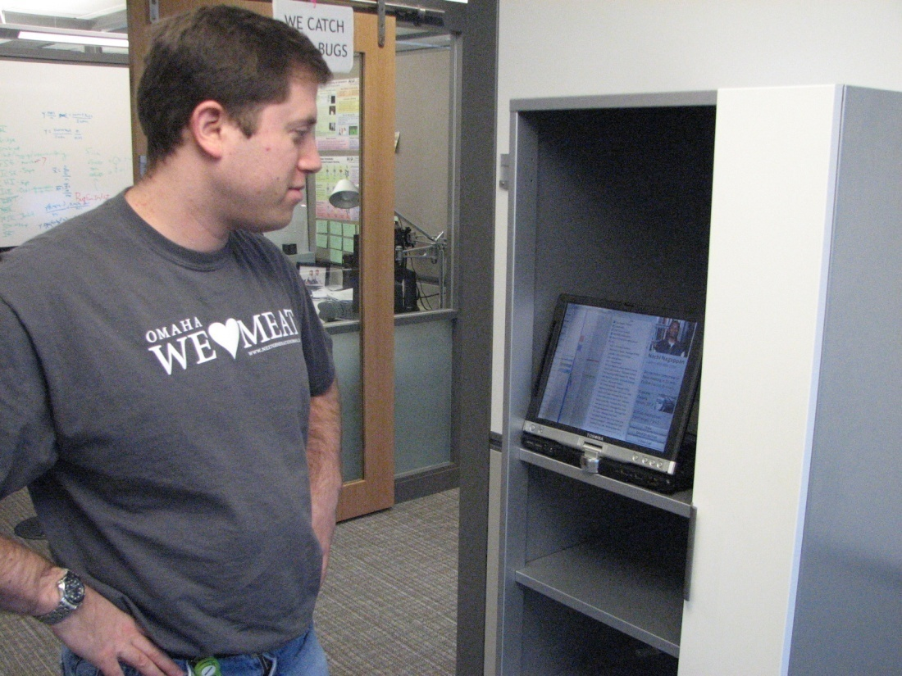
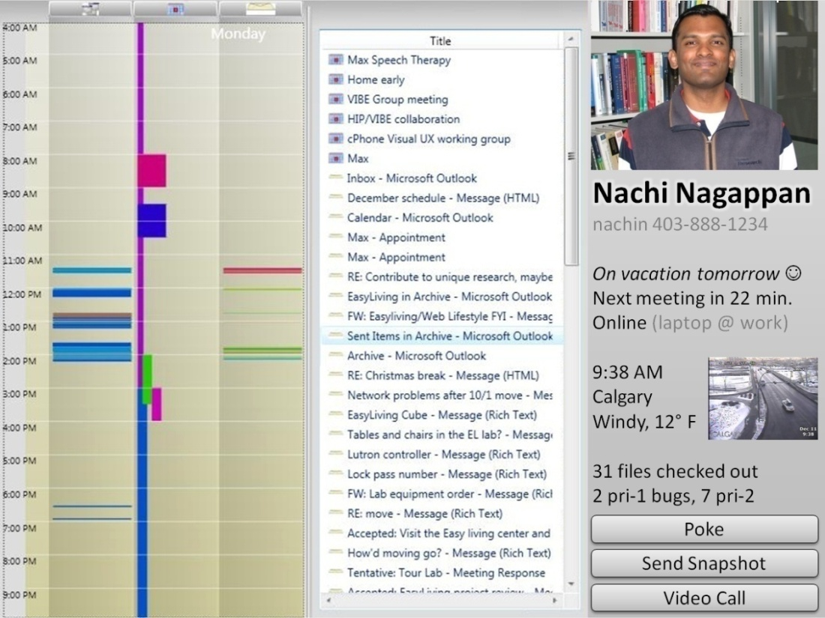
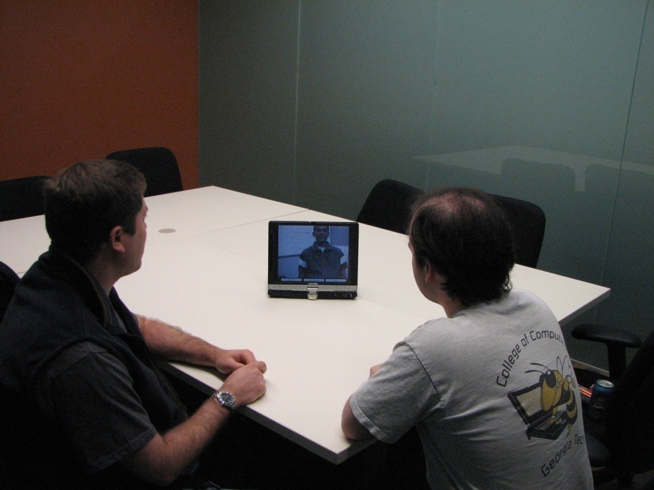
An Embodied Social Proxy is a device at a team’s hub location representing a satellite teammate.
It has two functions:
Ambient display of the remote worker’s state and activity
Videoconferencing head for 1:1 or group meetings
Timeline
Work activity
Identity
Availability
Local context
Work status
Communication
Notes:
Who: Gina Venolia, Kael Rowan, Brian Meyers, A. J. Brush, James Scott (MSR)
What: A device to represent a remote coworker, with two functions: Activity awareness and videoconferencing head. The goals are to provide awareness of the remote’s activities, help the user choose when and which medium to use for impromptu discussions, improve the remote’s “presence” in scheduled meetings, and to make the remote more “socially real.” Internal project.
Status: Working on demo for TechFest. Hoping to deploy Summer 2008.

Slide 38
The timeline of work activities is the aggregate of several RSS feeds.
Code check-ins
Bug edits
Document repository edits
Online calendar
Blog
Micro-blog
…

Slide 39
ESP addresses several of the deficits faced by hub-and-satellite teams.
Teleconference
  Setup problems
  A/V quality problems
  Gaze direction and eye contact
  Last in the “circle” – or even forgotten
  Difficult to interject
No whiteboard for meeting or ad-hoc conversations
Fewer opportunities and harder to do ad-hoc conversations
Less exchange of awareness signals
Time zones
Lack of face-to-face time
Culture and language differences
Out of sight, out of mind

Slide 40
There are many reasons this could fail.
Complexity of distributed and team
Technology must work first time and every time [Hemphill] [Umarji]
Increased visibility brings discomfort
  Though only 21% agree with “I would feel uncomfortable with [an ESP representing] me because I would not know who was looking at it” [Brush]
Scalability
  Though most would only give or receive “1-5” ESPs [Brush]
Hub’s physical environment
…

Slide 41
ESP might not be for just remote coworkers. [Brush]

Slide 42
The deficits I listed earlier provide many other plausible tool opportunities.
1. Communication in planned meetings
  Other topologies
  Whiteboard
2. Ad-hoc conversations
  Better search tools to self-answer information needs
  Whiteboard
3. Staying aware of teammates and their work
  Team ambient or peripheral display
4. Building trust relationships between teammates
  ???

Slide 43
Some deficits may be difficult or impossible to address with technology.
Classic problems of distributed work
  Relationship-building
  Time zones make rapid-fire exchanges impossible
  Language barriers impede communication
  Cultural differences can confuse communication
Power asymmetries lead to us-versus-them conflicts
  Mother-ship vs. outpost
  Old-timers vs. newcomers
  Hub vs. satellite
All parties must be motivated to appropriate solutions

Slide 44
Thanks! Questions?

Slide 45
Additional References
Olson, G.M. and Olson, J.S. (2000). Distance matters. In Human-Computer Interaction, 15, Erlbaum, 139-178.
Kraut, R.E., C. Egido, J. Galegher. (1990). Patterns of contact and communication in scientific research collaboration. J. Galegher, R.E. Kraut, C. Egido, eds. Intellectual Teamwork: Social and Technological Foundations of Cooperative Work. Erlbaum, 149-171.
Sensenig, J., & Reed, T. (1972). Cooperation in the prisoner's dilemma as a function of interpersonal distance. In Psychonomic Science, 26(2), 105-106.
Allen, T. J. (1977). Managing the Flow of Technology. Cambridge: MIT Press.
Gutwin, C. and Greenberg, S. (2002). A Framework of Awareness for Small Groups in Shared-Workspace Groupware. In Computer-Supported Cooperative Work, Issue 3-4, 411-446.
Handy, C. (1995). Trust and the virtual organization. In Harvard Business Review, 73(3), 40-50.

