Slide 1

An Introduction to Entity Recommendation and Understanding
Hao Ma and Yan Ke
Microsoft

Slide 2
The contents and opinions described in this tutorial do not necessarily reflect the opinions of Microsoft.
Technologies mentioned might or might not be in actual use.

Slide 3

Motivation
Database?
NLP?
Entity
????
????
Application?

Slide 4
Goals of this Tutorial
Help identify many interesting applications in the field of Entity Recommendation and Understanding
Present the current state of research on related topics
Pinpoint challenging research problems
Entity
????
????
WWW 2015 Tutorial: An Introduction to Entity Recommendation and Understanding, Florence, Italy, May 19th, 2015

Slide 5
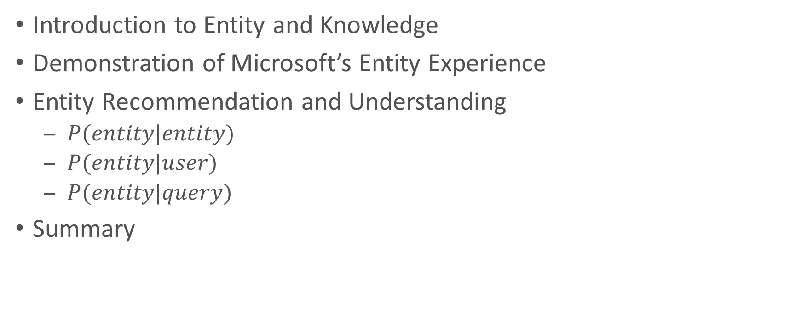
Outline
Introduction to Entity and Knowledge
Demonstration of Microsoft’s Entity Experience
Entity Recommendation and Understanding
  $P(entity|entity)$
  $P(entity|user)$
  $P(entity|query)$
Summary

Slide 6
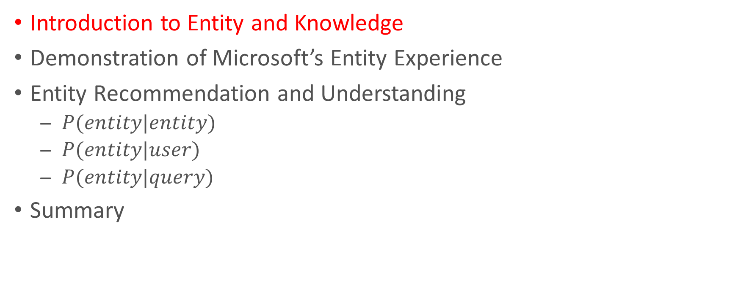
Outline
Introduction to Entity and Knowledge
Demonstration of Microsoft’s Entity Experience
Entity Recommendation and Understanding
  $P(entity|entity)$
  $P(entity|user)$
  $P(entity|query)$
Summary

Slide 7
Introduction to Entity and Knowledge

Slide 8
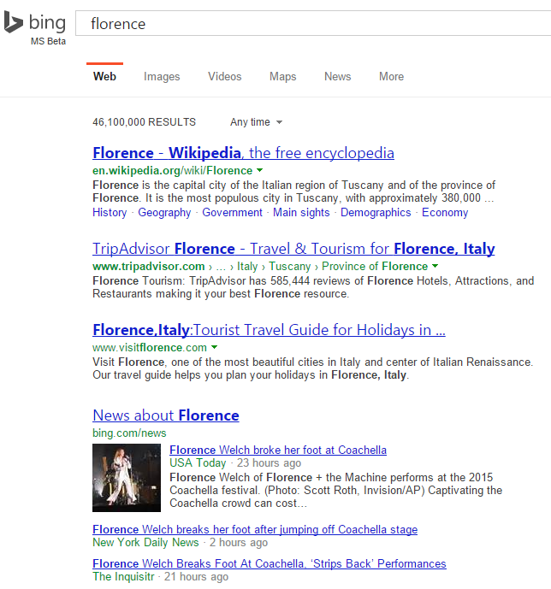

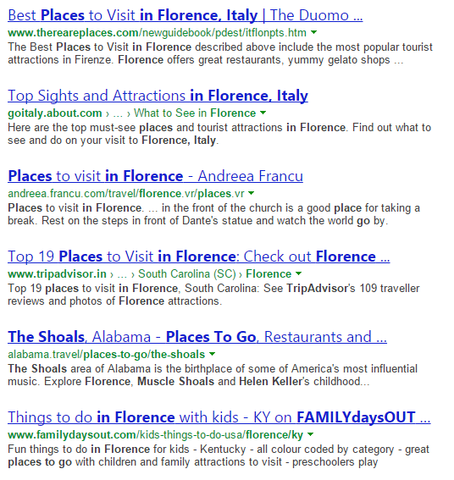
Why “Entities”

Slide 9
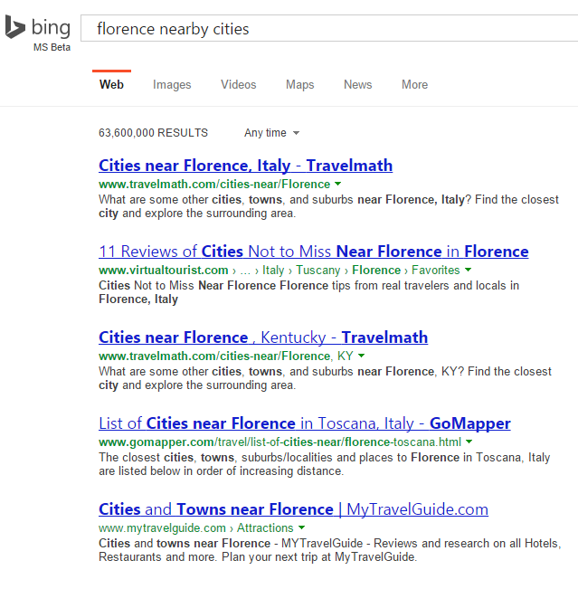
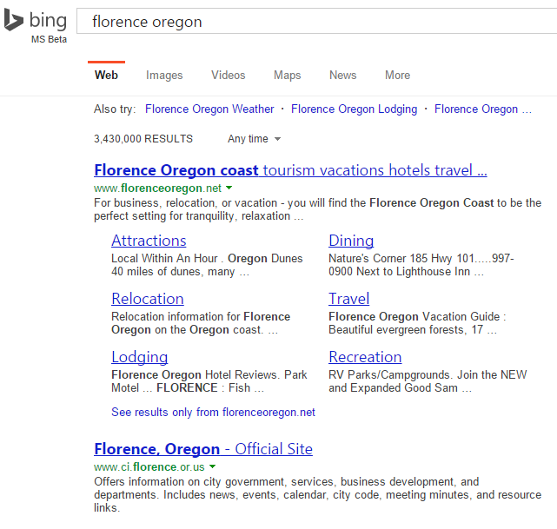
Why “Entities”

Slide 10
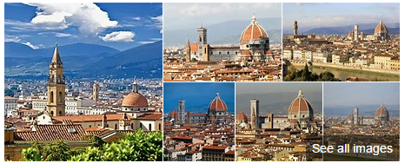
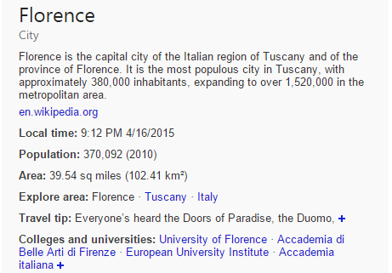

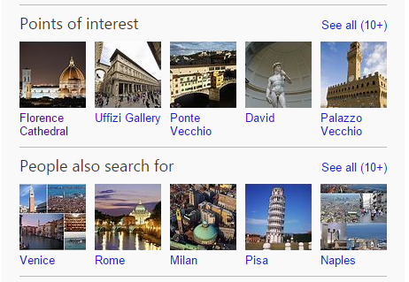
Why “Entities”

Slide 11
Why “Entities”
Florence photos
Time in florence
How big is florence
Florence population
Florence travel tips
Popular schools in florence
What’s the weather in florence
Florence places to go
One single Entity Pane can answer many user queries and satisfy users’ diverse information needs
Cities similar to florence

Slide 12
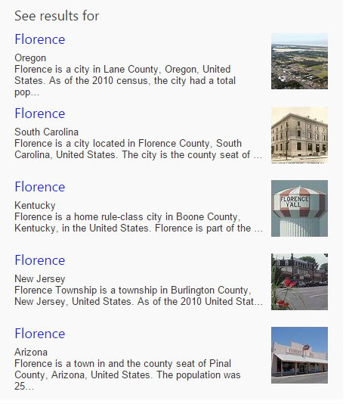
Why “Entities”

Slide 13
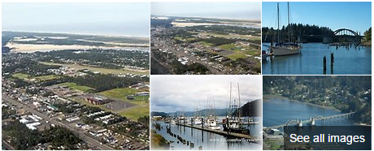
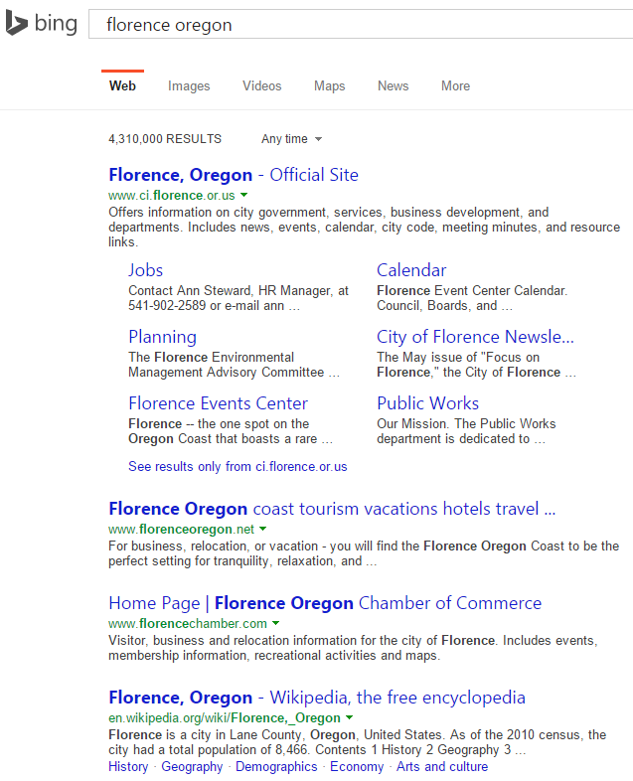
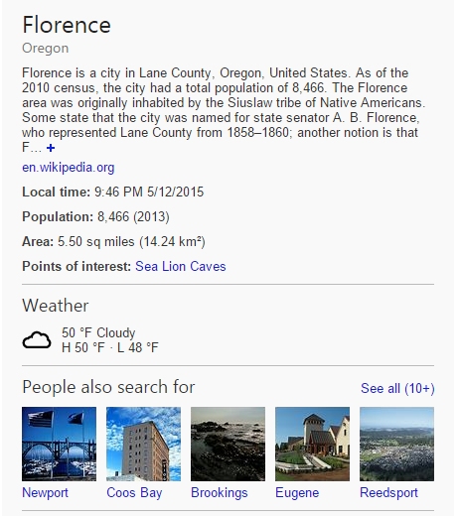
Why “Entities”

Slide 14


Because Entities are Surrounded by Knowledge

Slide 15

Why People Search?

Slide 16
Our Job

Slide 17





Entity Graphs
Knowledge Graph
Satori Knowledge Base
Freebase

Slide 18

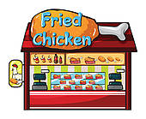



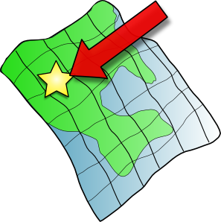



Entity Definition

Slide 19
Knowledge Definition
Address: 400 Broad St, Seattle, 98109
Phone: (800) 937-9582
Opened: Apr 21, 1962
Height: 605 feet (184.41 m)
Floors: 6
NFL championships: 2013
Head coach: Pete Carroll
Founded: 1976
Division: NFC West
Location
Home Field
Seattle
Population: 652,405 (2013)
Area: 142.55 sq miles (369.20 km²)
Mayor: Ed Murray
Founded: Mar 30, 1971 · Pike Place Market
Customer service: +1 800-782-7282
CEO: Howard Schultz
Founders: Jerry Baldwin · Zev Siegl · Gordon Bowker
Headquarters

Slide 20
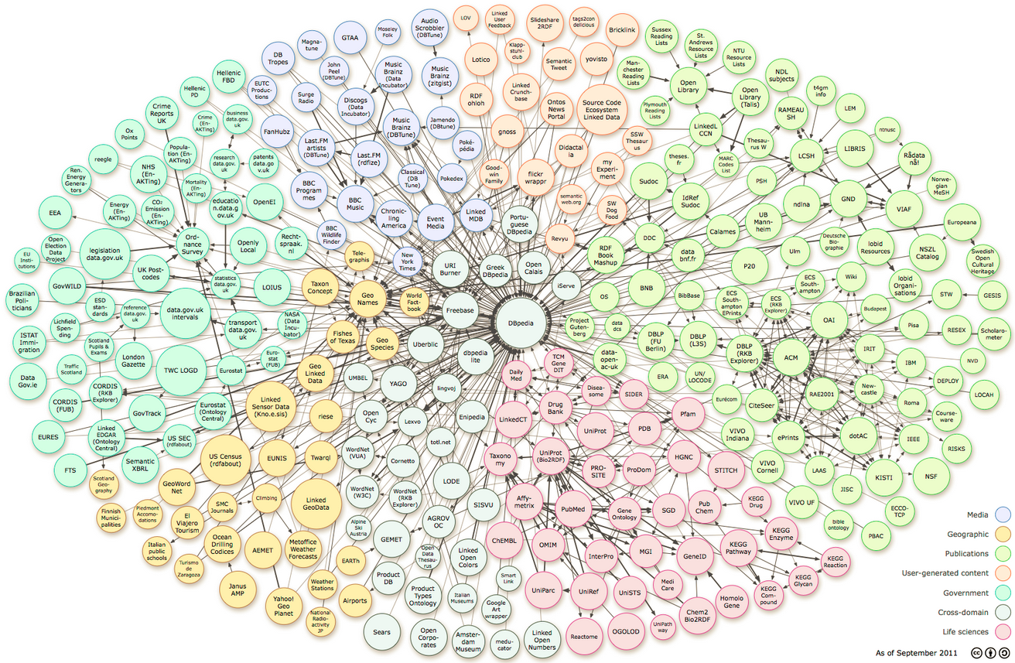
Entity Graphs

Slide 21

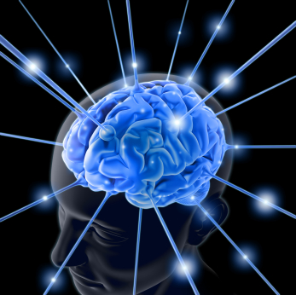
Why “Entity Recommendation”
Information Explosion

Slide 22


Why “Entity Recommendation”
Freebase
English
4,580,000
580,000,000

Slide 23


Why “Entity Recommendation”
Information Overload
Help Explore the Knowledge Base

Slide 24


Why “Entity Recommendation”

Slide 25
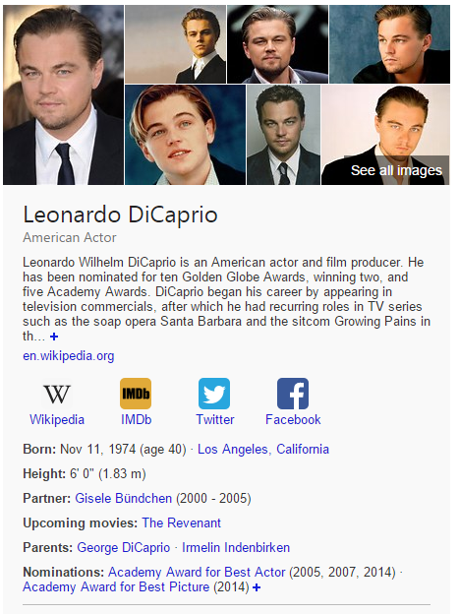
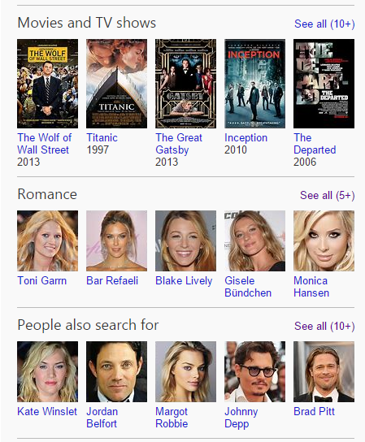
Why “Entity Recommendation”

Slide 26

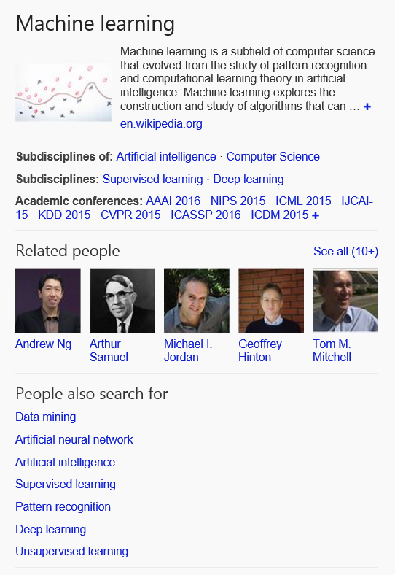
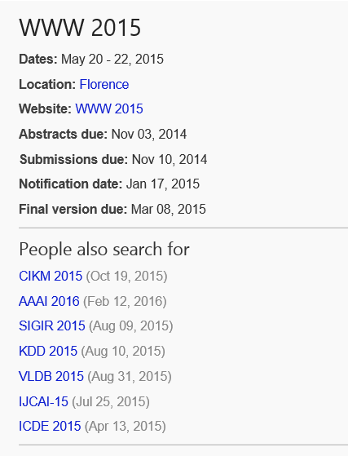
Why “Entity Recommendation”

Slide 27
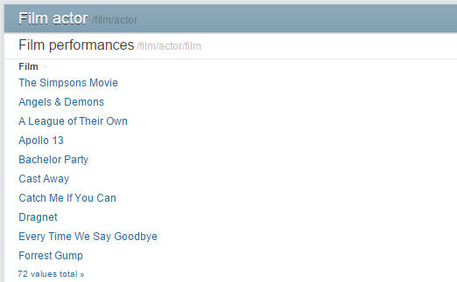
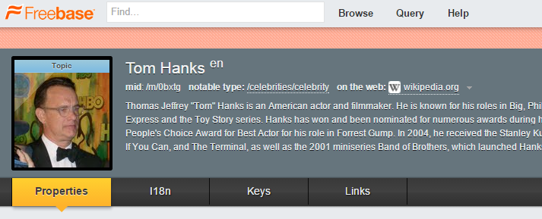
Why “Entity Understanding”
Knowledge Bases are just an unordered list of facts

Slide 28
Why “Entity Understanding”
Knowledge Bases are just an unordered list of facts
Understanding is
  Ranking facts
  Creating connections between entities
  Connecting entities and facts to queries and documents

Slide 29

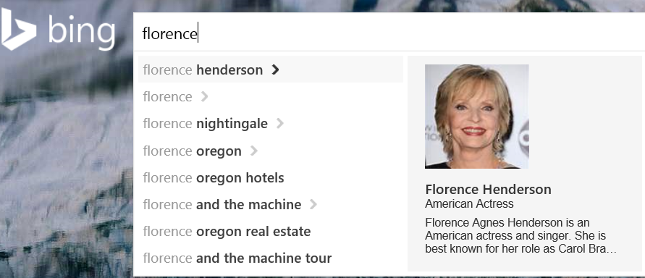
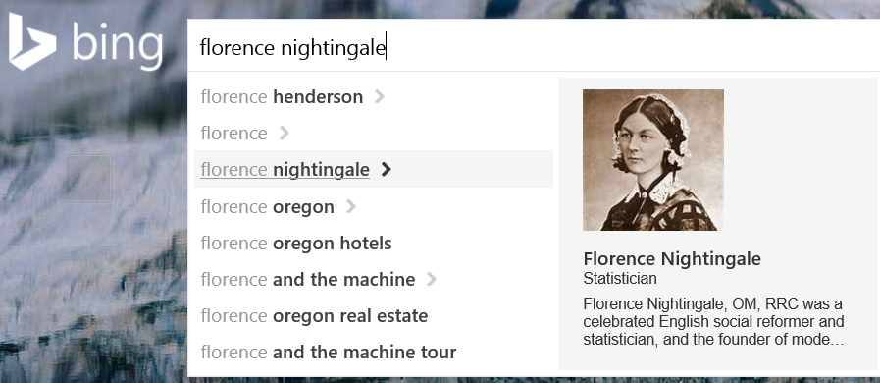
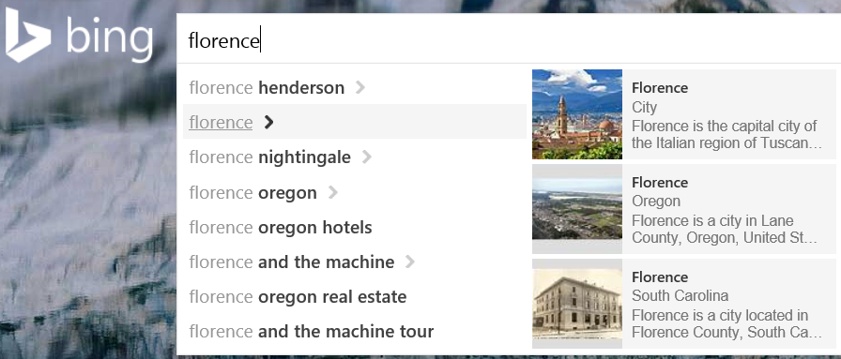
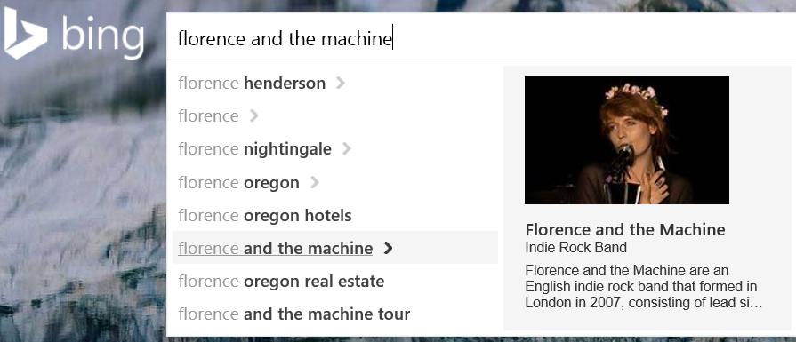
Why “Entity Understanding”
When a user typed “Florence”, how do you know which “Florence”?

Slide 30
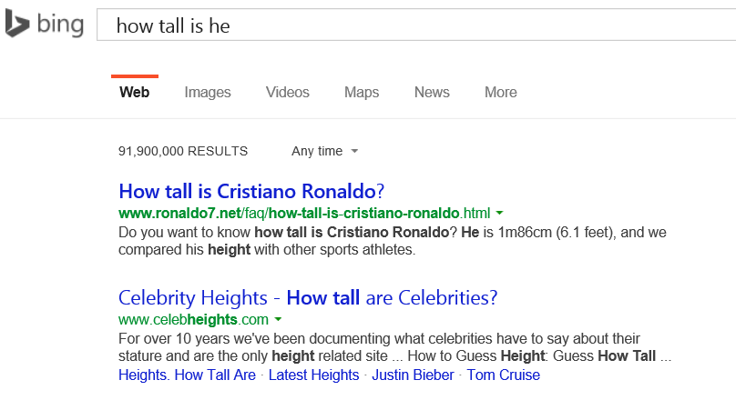
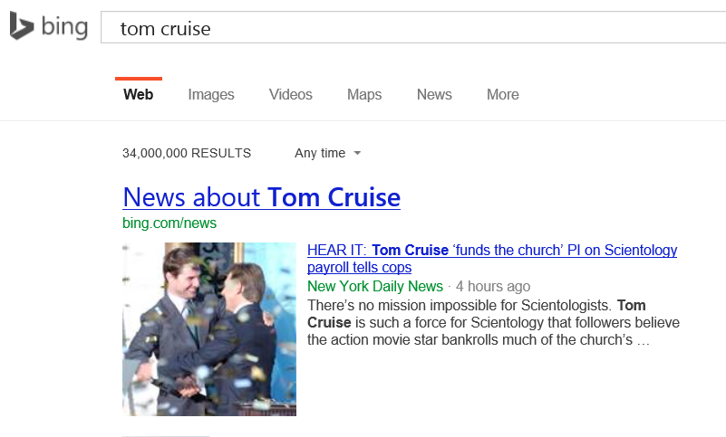
Why “Entity Understanding”
When a user typed “how tall is he”, how do you know who is “he”?

Slide 31
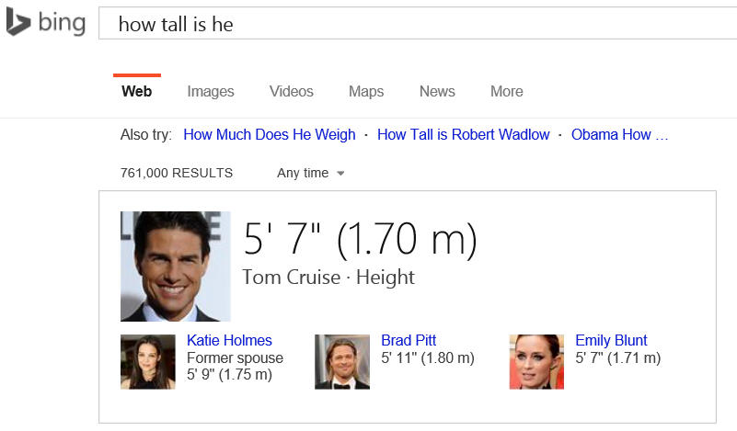
Why “Entity Understanding”
When a user typed “how tall is he”, how do you know who is “he”?

Slide 32

Why “Entity Understanding”
When a user clicked a few Web pages, how do you know what kind of entities this user is interested in?

Slide 33
Technologies
Natural Language Processing
Machine Learning
Information Retrieval
Recommender Systems
Text and Log Mining
……

Slide 34
Data Sources
Wikipedia
  Semi-structured free Internet encyclopedia, contributed by community members
Freebase
  Structured data composed mainly by its community members
  Acquired by Google on July 2010, and will be retired on June 2015
  Data will be ported to WikiData
WikiData
  a collaboratively edited knowledge base
DBPedia
  Extracted structured information from Wikipedia
Yago
  a knowledge base automatically extracted from Wikipedia and other sources
  Accuracy 95.02% based on manual evaulation
Web Documents
Queries and Search Click Log

Slide 35
Applications
Entity Pane Experiences
Entity Recommendation
  Recommendation and Ranking
  Interpretation
  Exploration
  Personalization
Factoid Answers
Graph Search
Conversational Question and Answering
Natural Language Question and Answering
... …

Slide 36
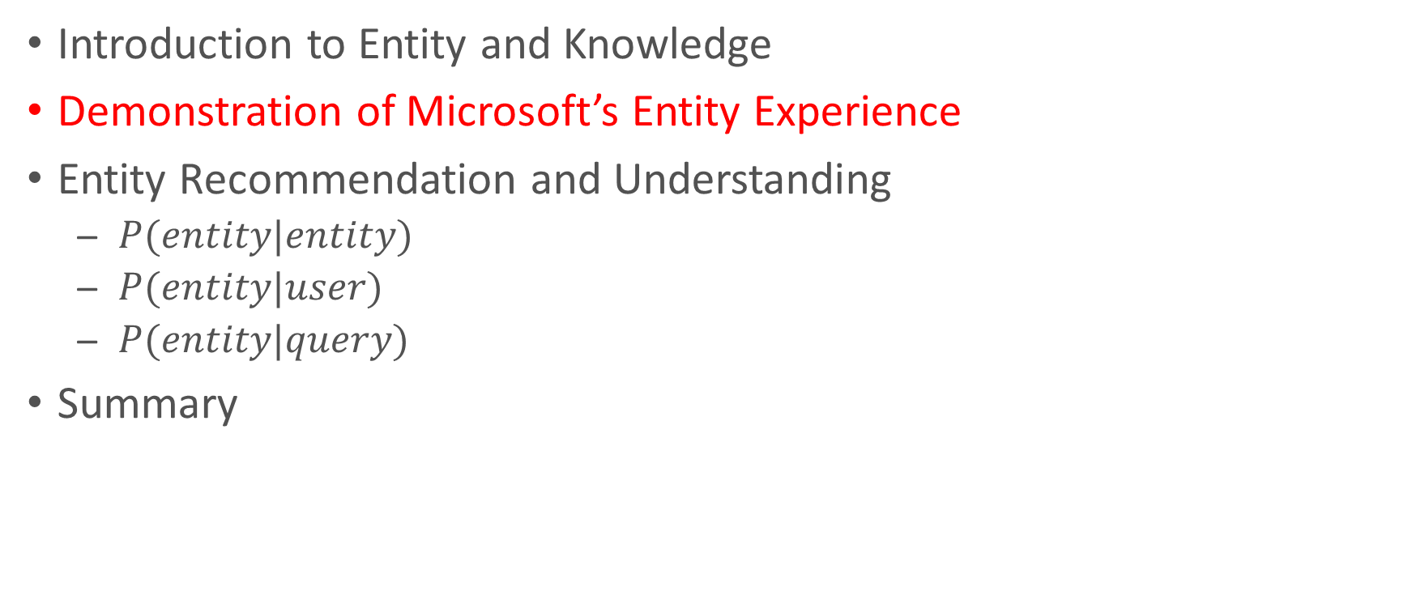
Outline
Introduction to Entity and Knowledge
Demonstration of Microsoft’s Entity Experience
Entity Recommendation and Understanding
  $P(entity|entity)$
  $P(entity|user)$
  $P(entity|query)$
Summary

Slide 37
Demonstration of Microsoft’s Entity Experience

Slide 38
Entities are deeply integrated
Bing
  SERP, Images, Videos, Maps, …
Office
Windows
Edge Browser
Phone
Xbox

Slide 39
Integrated Entity Experiences
Combine data from many sources for an entity to build a rich user experience.
Web page
Web page
UGC
Licensed data
Entity
Open data
Inferred knowledge

Slide 40
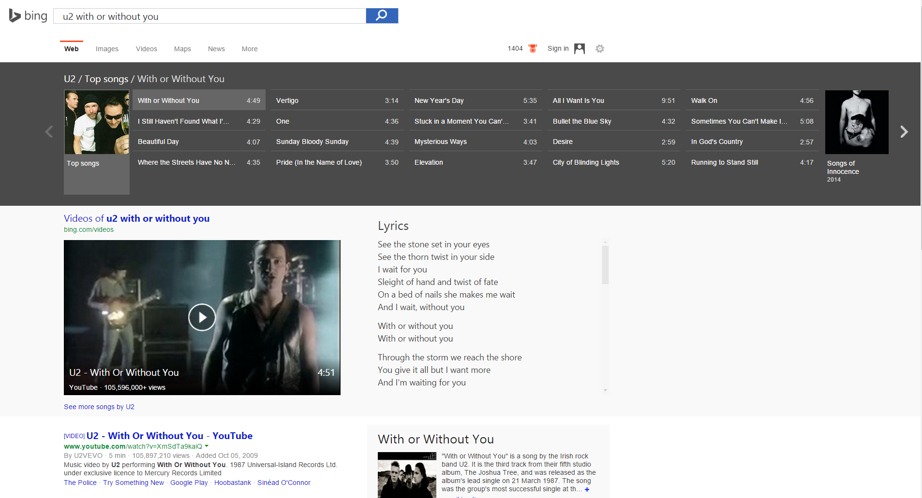

Slide 41
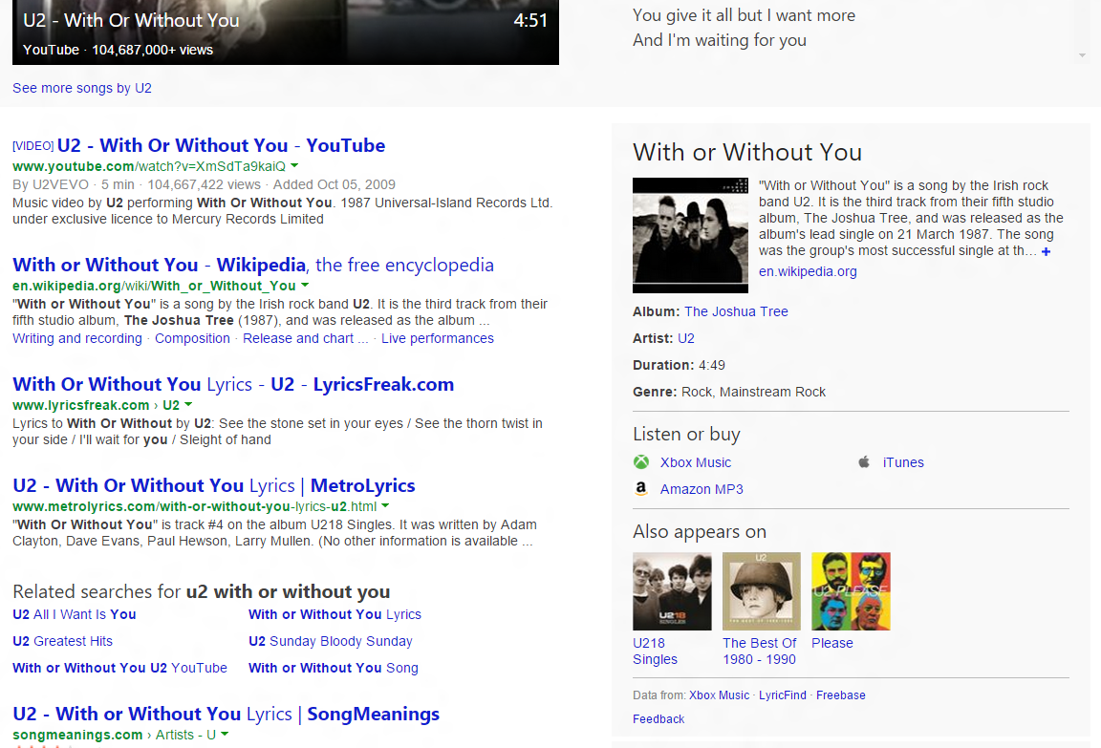

Slide 42
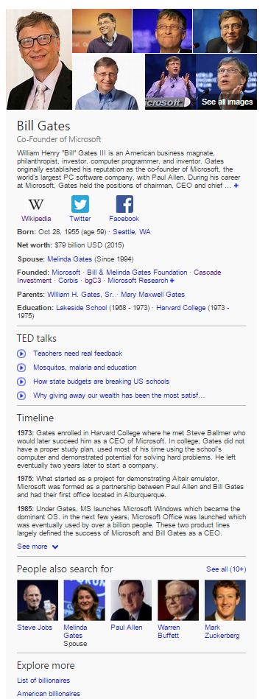

http://blogs.bing.com/search/2013/12/12/expand-your-understanding-with-bing/

Slide 43
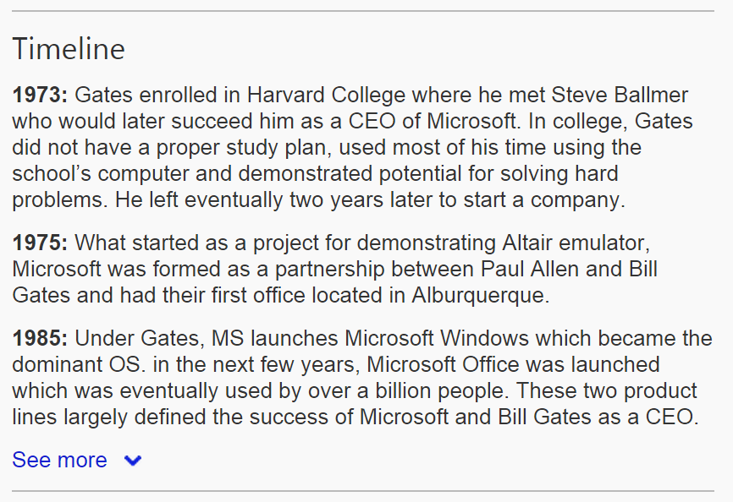
http://blogs.bing.com/search/2014/02/21/timeline-understanding-important-events-in-peoples-lives/

Slide 44
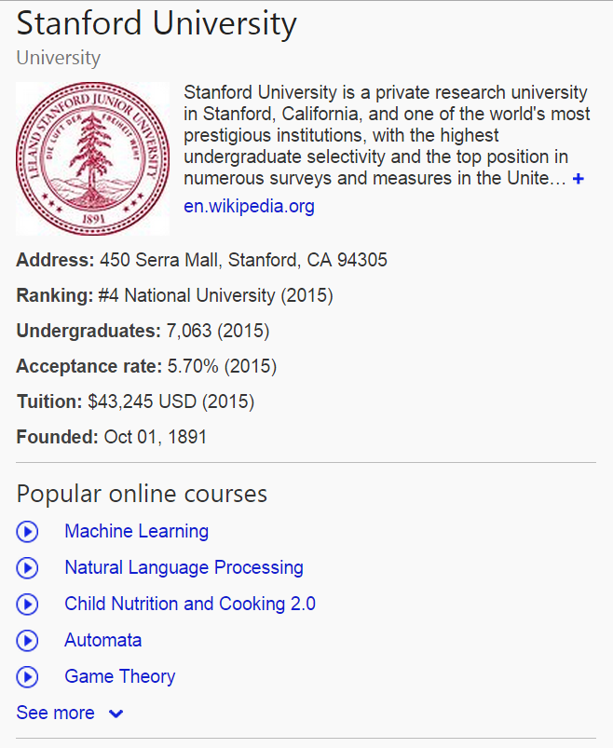
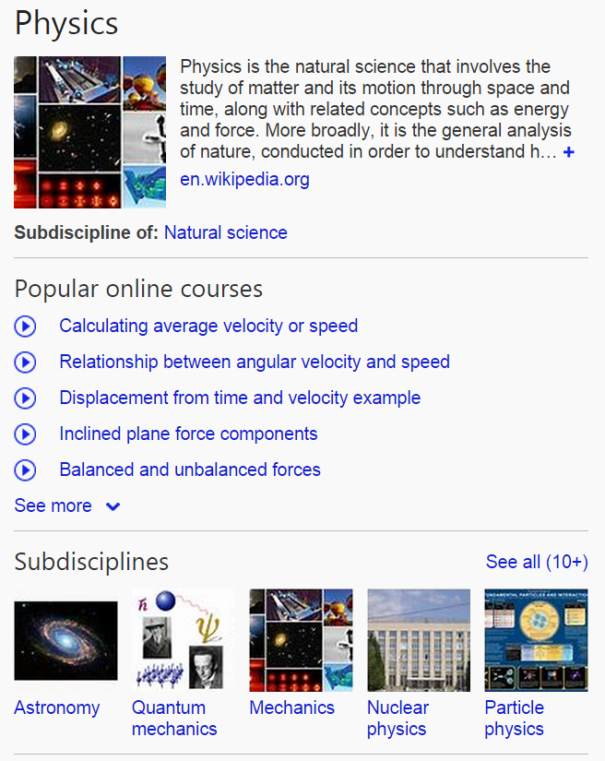
Online Courses

Slide 45
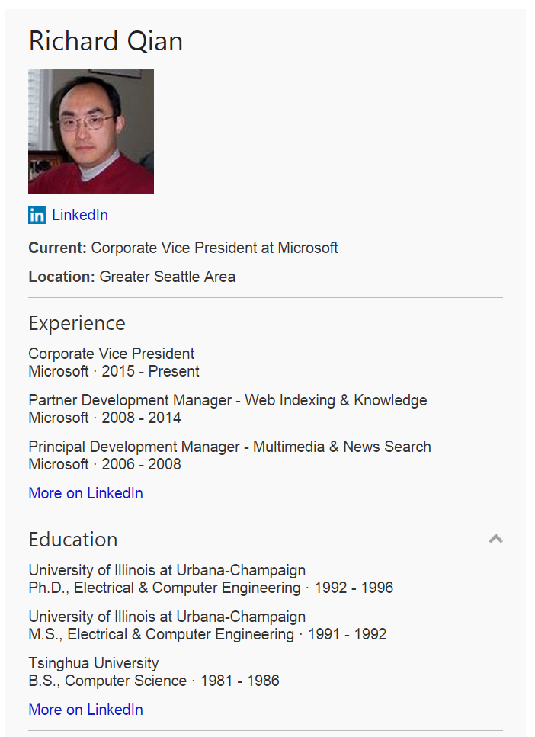
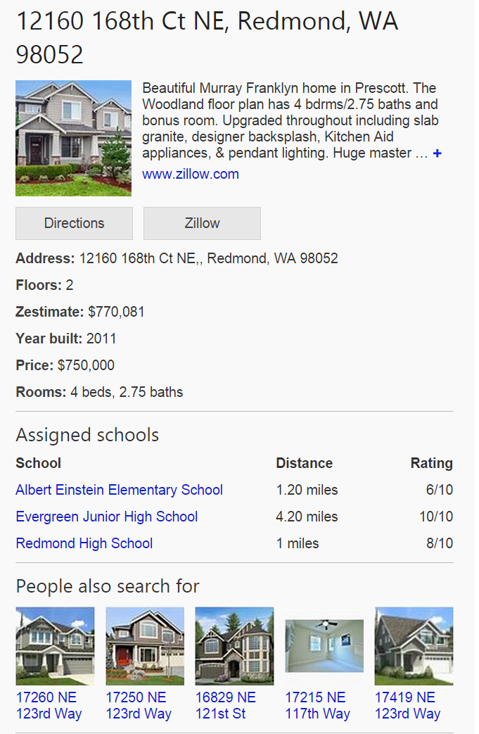
Long tail of interconnected entities
http://blogs.bing.com/search/2014/03/31/150-million-more-reasons-to-love-bing-everyday/

Slide 46
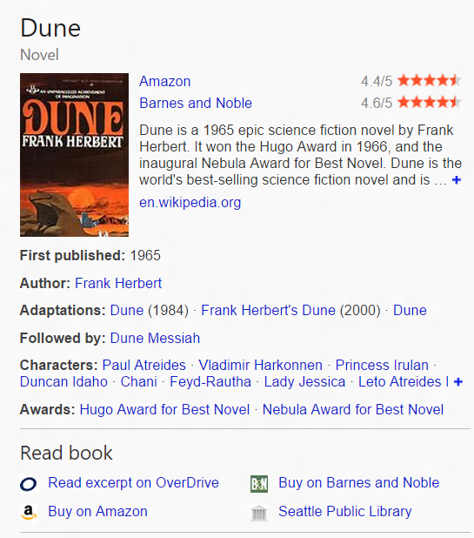
Actions – facilitate task completion

Slide 47
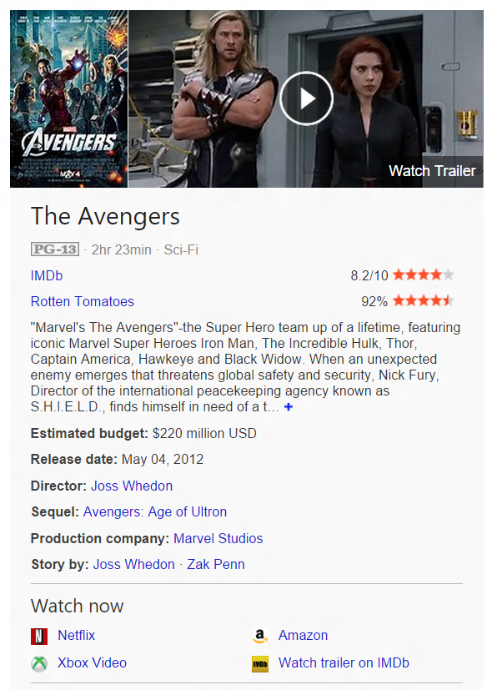
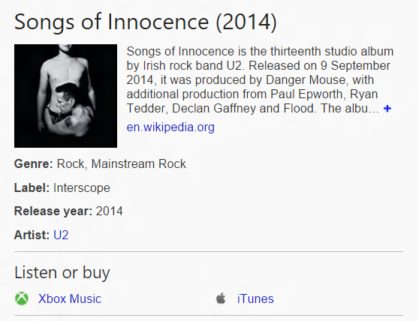

Slide 48
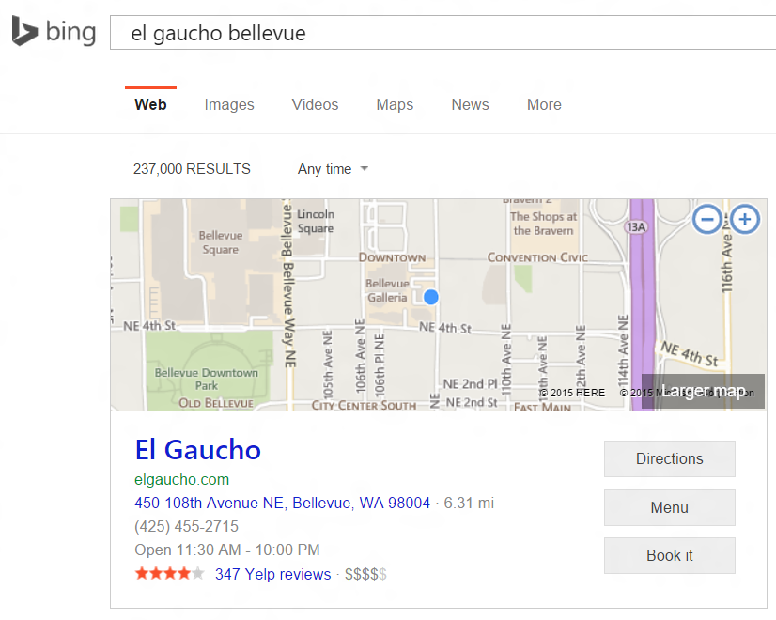

Slide 49
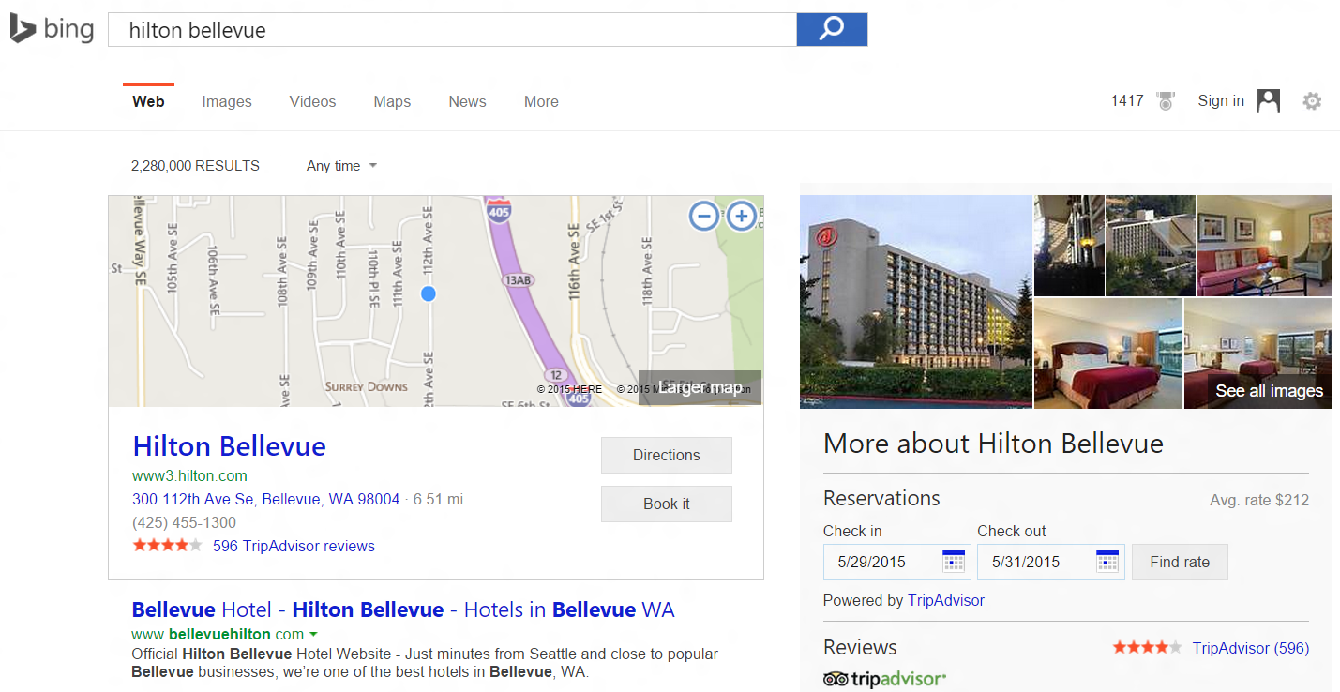

Slide 50
Demonstration of Microsoft’s Entity Experience
Question Answering

Slide 51
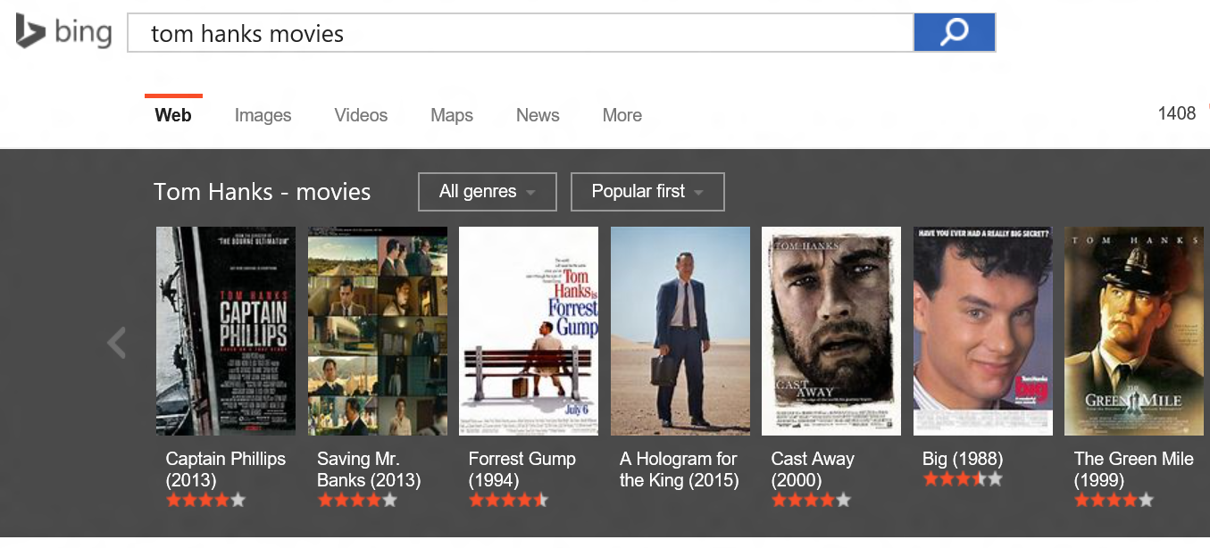

Slide 52
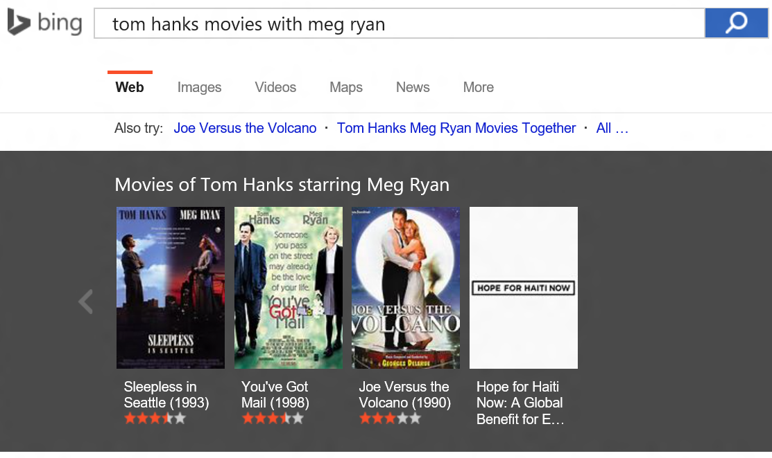

Slide 53
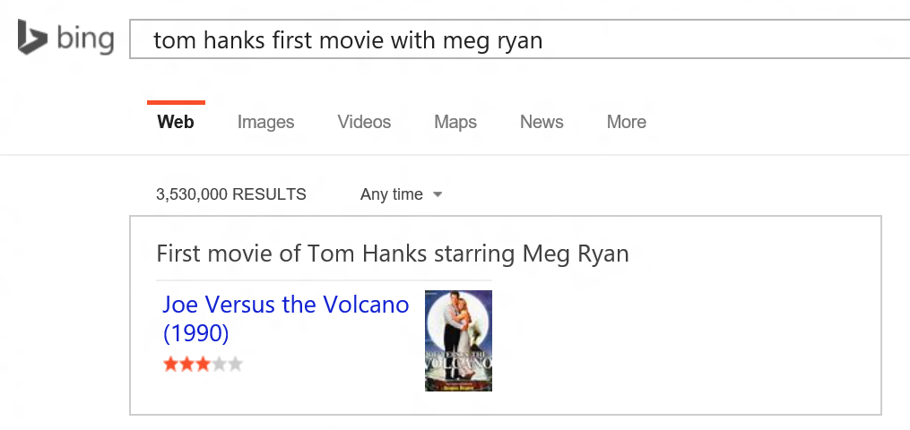

Slide 54
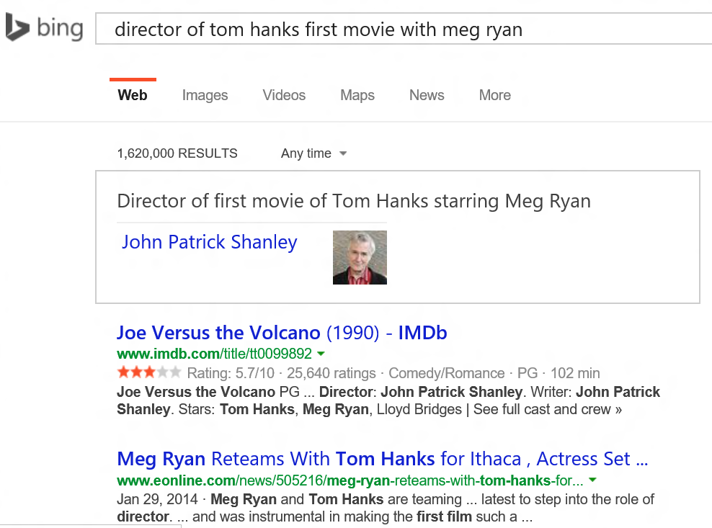

Slide 55
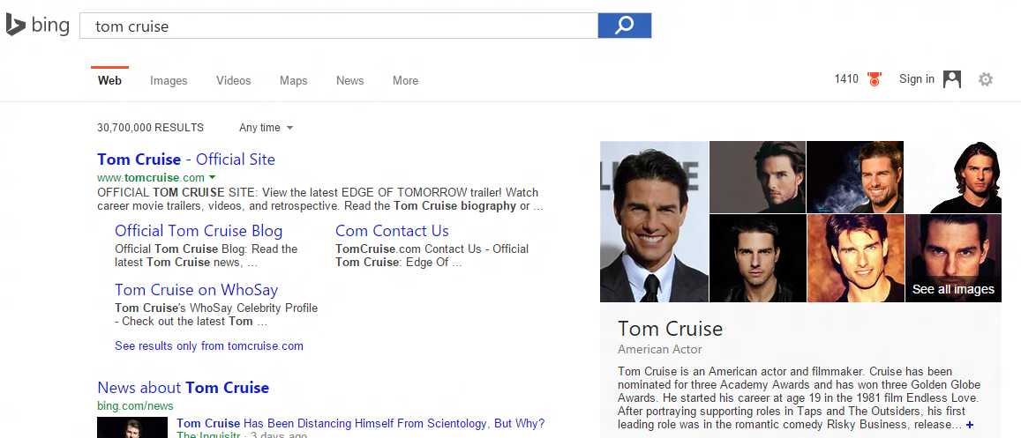
Conversational Question Answering
http://blogs.bing.com/search/2014/08/13/lets-have-a-conversation/

Slide 56
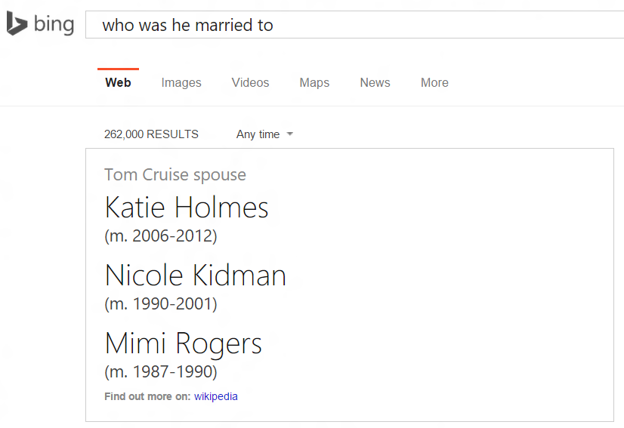

Slide 57


Slide 58


Slide 59


Slide 60


Slide 61
Demonstration of Microsoft’s Entity Experience
Diversity of entity collections

Slide 62


Slide 63


Slide 64


Slide 65


Slide 66


Slide 67


Slide 68

Segment-specific entity rankings

Slide 69
Demonstration of Microsoft’s Entity Experience
Entities in the platform

Slide 70

Bing Predicts
https://www.bing.com/explore/predicts

Slide 71

Bing Predicts

Slide 72

Bing Widget API
http://blogs.bing.com/webmaster/2014/01/03/bringing-the-power-of-bing-knowledge-to-webmasters/
http://blogs.bing.com/webmaster/2014/06/19/bing-knowledge-comes-to-webmaster-tools/
http://blogs.bing.com/webmaster/2014/05/15/mark-it-up/

Slide 73

App Linking
http://blogs.bing.com/webmaster/2014/04/02/announcing-bing-knowledge-widget-app-linking/
http://www.bing.com/webmaster/help/app-linking-09399b4b

Slide 74

App Linking

Slide 75

Office Insights
http://blogs.bing.com/search/2014/12/10/bing-brings-the-worlds-knowledge-straight-to-you-with-insights-for-office/
http://blogs.office.com/2014/12/11/first-look-insights-office-word-online-bringing-knowledge-web-document/
http://blogs.office.com/2014/12/10/whats-new-office-online/

Slide 76

Office Insights

Slide 77

Office Insights

Slide 78

Edge Browser
http://windows.microsoft.com/en-us/windows/preview-microsoft-edge-pc

Slide 79

http://blog.nwf.org/2014/01/is-the-seahawk-a-real-bird/

Slide 80

http://blog.nwf.org/2014/01/is-the-seahawk-a-real-bird/

Slide 81




Phone / Cortana
http://www.windowsphone.com/en-us/how-to/wp8/cortana/what-can-i-say-to-cortana
http://blogs.bing.com/search/2014/10/17/bing-adds-smarts-to-cortana/

Slide 82

Windows
http://blogs.bing.com/search/2013/10/18/unwrapping-windows-8-1-bing-smart-search/

Slide 83

Windows

Slide 84

Xbox
http://blogs.bing.com/search/2013/11/19/xbox-bing-deliver-me-a-whole-new-way-to-search/

Slide 85
Challenges
Speed – entity search can’t slow down web search.
Size – serve hundreds of millions of entities online.
Generalize to tail – how to retrieval and recommend tail entities when there are no popularity signals.
Ambiguity – how to ask users to clarify intent.

Slide 86

Outline
Introduction to Entity and Knowledge
Demonstration of Microsoft’s Entity Experience
Entity Recommendation and Understanding
  $P(entity|entity)$
  $P(entity|user)$
  $P(entity|query)$
Summary

Slide 87
Entity Recommendation and Understanding

Slide 88






Traditional Recommender Systems

Slide 89











Traditional Recommender Systems
Recommender Systems have been well studied from many aspects
  Collaborative filtering
  Content-based
  Context-aware
  Rating-based
  Learning to Rank
  Diversity
  Serendipity
  Social-Aware
  Temporal
  Explore/Exploit
  … …

Slide 90



Traditional Recommender Systems
Majority of the algorithms is focusing on Personalization
  $P(item|user)$
  User-Item Matrix

Slide 91

Entity Recommender Systems
Entity Graph
  Heterogeneous Graph
  Freebase
  2K+ commonly used types
  30K+ commonly used properties

Slide 92
Entity Recommender Systems
Entity Graph
  Hugh Size
  Freebase
  47M+ topics
  2.9B+ facts

Slide 93



Entity Recommender Systems
Non-Personalized
  $P\left(item | item\right)$
  $P(item|query)$

Slide 94

Entity Recommender Systems
Personalization
  $P(item|user)$

Slide 95
Entity Recommender Systems in Search
Recommendation & Ranking
Interpretation
Entity Collection Recommendation
Exploration
Personalization

Slide 96





Recommendation & Ranking

Slide 97




Interpretation

Slide 98


Entity Collection Recommendation

Slide 99


Entity Collection Recommendation

Slide 100




Exploration

Slide 101

Entity Recommendation & Understanding Taxonomy
$P\left(item | item\right)$
  Recommendations given an item
  $P\left(item | user\right)$
  Recommendations given a user
$P(item|query)$
  Recommendations given a query

Slide 102

Entity Recommendation & Understanding Taxonomy
$P\left(entity | entity\right)$
  Recommendations given an entity
  $P\left(entity | user\right)$
  Recommendations given a user
$P(entity|query)$
  Recommendations given a query
Item
Entity

Slide 103


$$P(entity|entity)$$
$P\left(Florence | Italy\right)= \frac{Freq(Florence, Italy)}{Freq(Italy)}$
$P\left(Florence | Italy\right)= \frac{Sim(Florence, Italy)}{\sum{Sim( ∗ , Italy)}}$
Co-occurrence
Cosine Similarity
Item-Based Top-N Recommendation Algorithms [Mukund Deshpande, et al., ACM TOIS 2004]

Slide 104


$P(entity|entity)$ – Co-occurrence
Sources
  Within Queries
  Across Queries
  User Url Clicks
  Wikipedia Pages
  Wikipedia Categories/Templates
  Wikipedia Revision Histories
  Web documents
  … …
The Wisdom of Crowds

Slide 105





$P\left(entity | entity\right)$ – Co-occurrence
Within Queries
How to extract those entities?
Entity Recommendations in Web Search [Roi Blanco, et al., ISWC 2013]

Slide 106




$P(entity|entity)$ – Co-occurrence
Across Queries
Entity Recommendations in Web Search [Roi Blanco, et al., ISWC 2013]

Slide 107




$P(entity|entity)$ – Co-occurrence
  User Url Clicks

Slide 108

$P(entity|entity)$ – Co-occurrence
  Wikipedia Pages

Slide 109

$P(entity|entity)$ – Co-occurrence
  Wikipedia Pages
An Effective, Low-Cost Measure of Semantic Relatedness Obtained from Wikipedia Links [David Milne, et al., AAAI 2008]

Slide 110










$P(entity|entity)$ – Co-occurrence
  Wikipedia Pages
Direct Link
Shared Link
Shared Backlink
Directed Path
Exploratory Recommendations Using Wikipedia's Linking Structure [Adrian M. Kentsch, et al., Benelearn 2011]

Slide 111

$P(entity|entity)$ – Co-occurrence
  Wikipedia
  Categories &
  Templates
WikiRelate! Computing Semantic Relatedness Using Wikipedia [Michael Strube, et al., AAAI 2006]

Slide 112



$P(entity|entity)$ – Co-occurrence
Wikipedia
Revision
History

Slide 113

$P(entity|entity)$ – Co-occurrence
Web documents
  Moon
  John F. Kennedy
  United States
  NASA
  Apollo 11
  Neil Armstrong
  Edwin “Buzz” Aldrin
  Michael Collins
  Astronauts
TimeMachine:Timeline Generation for Knowledge-Base Entities [Tim Althoff, et al., arXiv:1502.04662, 2015]

Slide 114


$P(entity|entity)$ – Co-occurrence
Entity Recommendations based on Wikipedia Co-occurrence

Slide 115

Entity Linking
How to extract entities from Queries and Documents?
  Through Entity Linking!

Slide 116











Entity Linking

Slide 117
Entity Linking - Main Problem
Linking free text to entities
  Any piece of text
    News document
    Blog posts
    Tweets
    Queries
    …
Entities taken from a knowledge base
  Freebase
  Wikipedia
  …
Entity Linking and Retrieval for Semantic Search [Edgar Meij, et al., WSDM 2014]

Slide 118
Entity Linking - Common Steps
Determine “linkable” phrases
  Mention detection
Select candidate entity links
  Link generation
  May include NILs (null values, i.e., no target in KB)
Use “context” to disambiguate/filter/improve
  Disambiguation
Entity Linking and Retrieval for Semantic Search [Edgar Meij, et al., WSDM 2014]

Slide 119

Entity Linking
An Example
Learning to Link with Wikipedia [David Milne, et al., CIKM 2008]

Slide 120
Public Toolkits for Entity Linking
Wikipedia Miner
TagMe
DBpedia Spotlight
IIIinios Wikifier
AIDA
RPI Entity Linking System
Entity Linking and Retrieval for Semantic Search [Edgar Meij, et al., WSDM 2014]

Slide 121

$P\left(entity | entity\right)$ - Recap
Co-occurrence
  Within Queries
  Across Queries
  User Url Clicks
  Wikipedia Pages
  Wikipedia Categories/Templates
  Wikipedia Revision Histories
  Web documents
Entity Linking
Similarity

Slide 122



$P(entity|entity)$ – Similarity
TF*IDF scores based on Wikipedia Corpus

Slide 123

$P(entity|entity)$ – Similarity
Entity Recommendations based on Wikipedia textual similarity

Slide 124
$P(entity|entity)$ – Similarity
Challenges
  Textual Similarity suffers the vocabulary mismatch problem
    “USA” and “United States of America” are semantically equivalent, yet share no terms in common
Solution
  Project entities into latent space that can semantically represent the entities

Slide 125





$P(entity|entity)$ – Word Embedding
Word Embedding
Linguistic Regularities in Continuous Space Word Representations [Tomas Mikolov, et al., ACL 2013]

Slide 126

$P(entity|entity)$ – Word Embedding
Word Embedding
Linguistic Regularities in Continuous Space Word Representations [Tomas Mikolov, et al., ACL 2013]

Slide 127

$P(entity|entity)$ – Word Embedding
Word Embedding
Efficient Estimation of Word Representations in Vector Space [Tomas Mikolov, et al., ICLR 2013]

Slide 128

$P(entity|entity)$ – Word Embedding
Distributed Representations of Words and Phrases and their Compositionality [Tomas Mikolov, et al., NIPS 2013]

Slide 129



$P(entity|entity)$ – Word Embedding
Efficient Estimation of Word Representations in Vector Space [Tomas Mikolov, et al., ICLR 2013]

Slide 130
$P(entity|entity)$ – Word Embedding
How to apply Word Embedding in Entities?
  Perform entity linking on documents
  Treat each entity as a single word
  Learning the representation
Word2Vec [Tomas Mikolov, et al., ICLR 2013]

Slide 131

$P(entity|entity)$ – Word Embedding
Entity Recommendations based on Word Embedding (Skip-gram)
Trained on 100M Google News Articles
Word2Vec [Tomas Mikolov, et al., ICLR 2013]

Slide 132

$$P(entity|entity)$$
Co-occurrence
Co-occurrence and Textual Similarity methods work well
Textual Similarity method is very topic- or genre-related
Word Embedding might not always work (depend on training data)
Textual Similarity
Word Embedding

Slide 133
$P\left(entity | entity\right)$ - Recap
Co-occurrence
  Within Queries
  Across Queries
  User Url Clicks
  Wikipedia Pages
  Wikipedia Categories/Templates
  Wikipedia Revision Histories
  Web documents
Entity Linking
Similarity
  Textual Similarity
  Word Embedding
Interpretation

Slide 134


$$P\left(entity | entity\right)$$
Why are they related to “Florence Cathedral”?

Slide 135



$P\left(entity | entity\right)$ - Interpretation

Slide 136


$P(entity|entity)$ - Interpretation
Problem definition
Input
Output
Explaining Relationships Between Entities [Nikos Voskarides]

Slide 137


$P(entity|entity)$ - Interpretation
Entity text representation
Wikipedia Anchor:
President obama
Wikipedia Anchor:
Clinton
Wikipedia Title:
Barack Obama
Wikipedia Redirect:
Obama
Wikipedia Title:
Bill Clinton
Wikipedia Redirect:
President clinton
Explaining Relationships Between Entities [Nikos Voskarides]

Slide 138
$P(entity|entity)$ - Interpretation
Candidate Sentences
  On the wiki pages of “Barack Obama” and “Bill Clinton”
  Keep those sentences that contains at least one entity’s text representations
Wikipedia Anchor:
President obama
Wikipedia Anchor:
Clinton
Wikipedia Title:
Barack Obama
Wikipedia Redirect:
Obama
Wikipedia Title:
Bill Clinton
Wikipedia Redirect:
President clinton
Explaining Relationships Between Entities [Nikos Voskarides]

Slide 139
$P(entity|entity)$ - Interpretation
Sentences enrichment
  Perform Co-reference resolution
  Replace detected strings with the entity text representations
  Examples:
    “He” → Barack Obama
    “The company” → Toyota
    “The film” → Titanic
Explaining Relationships Between Entities [Nikos Voskarides]

Slide 140
$P(entity|entity)$ - Interpretation
Sentences enrichment
  Perform Entity Linking on Wikipedia articles
In response to the 2010 Haiti earthquake, U.S. President Barack Obama announced that Clinton and George W. Bush would coordinate efforts to raise funds for Haiti's recovery.
Explaining Relationships Between Entities [Nikos Voskarides]

Slide 141

$P(entity|entity)$ - Interpretation
Ranking sentences
  Generate features and using Learning to Rank algorithms to rank sentences
Features
  Text features: Average IDF of terms of $s$in Wikipedia; Number of terms in s; Part of Speech distribution of $s$; etc.
  Entity features: Number of entities in $s$; Whether $s$ contains links to both $e_{a}$ and $e_{b}$; Distance between $e_{a}$ and $e_{b}$ in $s$; Number of entities between $e_{a}$ and $e_{b}$; etc.
  Relation features: Whether $s$ contains any term of $r$ (binary); Average score of phrases in word2vec($r$) that are matched in $s$; etc.
  Source features: Position of $s$ in document $d$; etc.
Explaining Relationships Between Entities [Nikos Voskarides]

Slide 142

$P(entity|entity)$ - Interpretation
Explaining Relationships Between Entities [Nikos Voskarides]

Slide 143

$P(entity|entity)$ - Interpretation
Challenges
  Relationships are missing or unknown in the real world scenarios

Slide 144

$P(entity|entity)$ - Interpretation
Challenges
  The selected sentences should be more “interesting” instead of just replicating the relationships

Slide 145

Entity Recommendation & Understanding Taxonomy
$P\left(entity | entity\right)$
  Recommendations given an entity
    Co-occurrence
    Similarity
    Entity Linking
    Interpretation
  $P\left(entity | user\right)$
  Recommendations given a user
$P(entity|query)$
  Recommendations given a query

Slide 146

Entity Recommendation & Understanding Taxonomy
$P\left(entity | entity\right)$
  Recommendations given an entity
    Co-occurrence
    Similarity
    Entity Linking
    Interpretation
  $P\left(entity | user\right)$
  Recommendations given a user
$P(entity|query)$
  Recommendations given a query

Slide 147
Personalized Recommender Systems
Problem definition
  User-Item Matrix
Rating/Frequency
Implicit/One-class

Slide 148
Personalized Recommender Systems
Memory-based methods
  Pearson Correlation Coefficient
  Vector Space Similarity/Cosine Similarity
Model-based methods
  Matrix Factorization
  Probabilistic models
  Clustering
  Classification
  …

Slide 149
Personalized Recommender Systems
Memory-based methods
  Pearson Correlation Coefficient
  Vector Space Similarity/Cosine Similarity
Model-based methods
  Matrix Factorization
  Probabilistic models
  Clustering
  Classification
  …

Slide 150

Personalized Recommender Systems
Memory-based methods

Slide 151

Personalized Recommender Systems
Memory-based methods

Slide 152

Personalized Recommender Systems
Memory-based methods

Slide 153

Personalized Recommender Systems
Memory-based methods

Slide 154

Personalized Recommender Systems
Memory-based methods

Slide 155

Personalized Recommender Systems
Memory-based methods

Slide 156

Personalized Recommender Systems
Pearson Correlation Coefficient
GroupLens: an open architecture for collaborative filtering of netnews [Paul Resnick, et al., CSCW 1994]

Slide 157
Personalized Recommender Systems
Challenges on using Memory-based methods
  Sparsity issue
    User-item matrix is normally very sparse, and the density is normally under 1%
    The sparsity issue will make estimating user similarity difficult and inaccurate
  Scalability
    Finding nearest neighbors require computation that grows with both the number of users and the number of items

Slide 158


Personalized Recommender Systems
Matrix Factorization
$$M_{\left[m×n\right]}=U_{\left[m×r\right]}V_{\left[n×r\right]}^{T}$$

Slide 159

Personalized Recommender Systems
Matrix Factorization
  Adding bias
  $b_{ij}=μ+b_{i}+b_{j}$
  Predicting rating as
  $r_{ij}=b_{ij}+{u_{i}v}_{j}^{T}$
Matrix factorization method is the single most effective method in the Netflix 1M prize challenge
The Recommender Problem Revisited [Xavier Amatriain, et al., KDD 2014]

Slide 160

Personalized Recommender Systems
Matrix Factorization
  What about implicit user-item matrix?
  Negative Sampling
Implicit/One-class
Negative Sampling
One-Class Collaborative Filtering [Rong Pan, et al., ICDM 2008]

Slide 161
An Incomplete List of Academic Papers on RS
Breese et al. “Empirical analysis of predictive algorithms for collaborative filtering. ” UAI-1998.
Deshpande et al. “Item-based top-n recommendation.” ACM TOIS-2004.
Herlocker et al. “An algorithmic framework for performing collaborative filtering.” SIGIR-2009.
Hofmann et al. “Collaborative filtering via gaussian probabilistic latent semantic analysis.” SIGIR-2003.
Koren et al. “Factorization meets the neighborhood: a multifaceted collaborative filtering model.” KDD-2008.
Koren et al. “Collaborative filtering with temporal dynamics.” KDD-2009.
Koren et al. “Matrix factorization techniques for recommender systems.” IEEE Computer-2009.
Linden et al. “Amazon.com recommendations: Item-to-item collaborative filtering.” Internet Computing-2003.
Rennie et al. “Fast maximum margin matrix factorization for collaborative prediction.” ICML-2005.
Salakhutdinov et al. “Probabilistic matrix factorization.” NIPS-2007.
Salakhutdinov et al. “Bayesian probabilistic matrix factorization using markov chain monte carlo.” ICML-2008.
Sarwar et al. “Item-based collaborative filtering recommendation algorithms.” WWW-2001.
Si et al. “Flexible mixture model for collaborative filtering.” ICML-2003.
Srebro et al. “Weighted low-rank approximations.” ICML-2003.

Slide 162
Why is Entity Recommender System different?
The problem definition for traditional recommender systems is clearer than entity recommender systems since most of the time user-item matrix is given
Rating/Frequency
Implicit/One-class

Slide 163



Why is Entity Recommender System different?
Entity recommender systems are embedded within searching process, users’ preferences on entities are more difficult to observe
Users
Queries
Clicks

Slide 164
Why is Entity Recommender System different?
The huge Entity Graph with knowledge makes entity recommender systems more challenging and also appealing
Entities

Slide 165

$$P\left(entity | user\right)$$
Queries
Clicks
Users
Entities
Universal
Recommender Systems

Slide 166




Current Entity Experience

Slide 167


Current Entity Experience

Slide 168




















$$P\left(entity | user\right)$$
Movie recommendation for you
Restaurant recommendation for you
Book recommendation for you
Music album recommendation for you

Slide 169













$$P\left(entity | user\right)$$
movie recommendation for you
restaurant recommendation for you
point of interest recommendation for you
event recommendation for you
dec 5th
dec 13th
dec 6th
dec 5th

Slide 170
User Logs and Entity Graph
On Building Entity Recommender Systems Using User Click Log and Freebase Knowledge [Xiao Yu, et al., WSDM 2014]

Slide 171








Problem Definition
search engine user logs
Consider entity related web pages
User log sequence, sorted by timestamp
Use $L_{T}^{u}$ to predict $e_{T}^{u}$
Freebase
entity graph
user
$$<e_{1}^{u}, e_{2}^{u},…, e_{t}^{u}, …, e_{T−1}^{u}, e_{T}^{u}>$$
target entity page
user log sequence before T, denotes as $L_{T}^{u}$
recommender system
recommendation
On Building Entity Recommender Systems Using User Click Log and Freebase Knowledge [Xiao Yu, et al., WSDM 2014]

Slide 172
Benefits in Using User Logs and Entity Graph
Besides implicit feedback, user log also has
  e.g., timestamp, dwell time, user country or region, time of day …
Cross domain user log events
  Which movies will foxnews.com readers like?
Besides entity relationship, entity graph also has
  e.g., movie release date, tagline, running time, gross revenue, budget, MPAA rating, text description, number of ratings, …
On Building Entity Recommender Systems Using User Click Log and Freebase Knowledge [Xiao Yu, et al., WSDM 2014]

Slide 173

Exploring data - User interests drift
User interests are consistent within a short time period but drift over time
The longer the time interval is, the less similar users’ interests are
Left: accumulated user interest similarity for two weeks
Right: averaged user interest similarity with relative time difference (number of day)
On Building Entity Recommender Systems Using User Click Log and Freebase Knowledge [Xiao Yu, et al., WSDM 2014]

Slide 174
Exploring data - Cross Domain Correlation
comicbookresources.com
(comic books)
The Avengers
Spider-Man
The Dark Knight Rises
Prometheus
Men In Black 3
Iron Man 2
Superman: The Man Of Steel
Thor
Snow White & Huntsman
Battleship
ruelala.com
(women shopping)
Magic Mike
The Avengers
Prometheus
Moonrise Kingdom
Ted
Snow White & Huntsman
Savages
Hunger Games
Rock of Ages
The Best Exotic Marigold Hotel
Top 10 most viewed movies estimated using cross domain correlation
On Building Entity Recommender Systems Using User Click Log and Freebase Knowledge [Xiao Yu, et al., WSDM 2014]

Slide 175

Entity Pairwise Features
Meta-path based entity similarity from Freebase
Other pairwise or non-pairwise feature (e.g., popularity)
$$S(e_{i}, e_{j})$$
Entity attribute similarity (e.g., movie description)
Entity relations derived from user log (e.g., conditional probability)
Cross domain user log events correlation
On Building Entity Recommender Systems Using User Click Log and Freebase Knowledge [Xiao Yu, et al., WSDM 2014]

Slide 176

Entity Pairwise Features
Representative Features
On Building Entity Recommender Systems Using User Click Log and Freebase Knowledge [Xiao Yu, et al., WSDM 2014]

Slide 177



Recommendation Models
Global recommendation model
entity at timestamp T
time decay function
$$w_{t}\left(e_{T}, e_{t}\right)=βe^{−α\left(T−t\right)}$$
pairwise features
events happened before T
${L_{T}^{u}=<e}_{1}^{u}, e_{2}^{u},…, e_{t}^{u}, …, e_{T−1}^{u}>$
On Building Entity Recommender Systems Using User Click Log and Freebase Knowledge [Xiao Yu, et al., WSDM 2014]

Slide 178

Recommendation Models
Personalized recommendation model (PRM)
for each user at target timestamp T
On Building Entity Recommender Systems Using User Click Log and Freebase Knowledge [Xiao Yu, et al., WSDM 2014]

Slide 179

Recommendation Models
Personalized Recommendation with K-NN (PRM+KNN)
neighbor subsequences
neighbor similarity
Collaborative filtering
On Building Entity Recommender Systems Using User Click Log and Freebase Knowledge [Xiao Yu, et al., WSDM 2014]

Slide 180

Experiment Setup
Movie recommendation with search engine user log and movie related freebase knowledge graph
  Sampled 1+ million users with at least one movie entity
  2+ million movie related entities with attributes and relationships, including movies, actors/actresses, directors, producers, etc.
On Building Entity Recommender Systems Using User Click Log and Freebase Knowledge [Xiao Yu, et al., WSDM 2014]

Slide 181

Evaluation
Top 10 Mean Reciprocal Rank (MRR) as evaluation metric
$$MRR=\frac{1}{|Test|}\sum_{i=1}^{|Test|}{\frac{1}{rank_{i}}}$$
On Building Entity Recommender Systems Using User Click Log and Freebase Knowledge [Xiao Yu, et al., WSDM 2014]

Slide 182
Comparison
Comparison Method | Description
Global Popularity | Frequently visited movies in 3 months
Local Popularity | Frequently visited movies in short time period
Domain Co-Click | Recommend based on non-movie related events
Matrix Factorization | Implicit feedback factorization
Co-Click with Time Decay | Conditional probability of events
On Building Entity Recommender Systems Using User Click Log and Freebase Knowledge [Xiao Yu, et al., WSDM 2014]

Slide 183
Performance
Method | MRR
Global Popularity | 0.024
Local Popularity | 0.043
Domain Co-click | 0.039
Matrix Factorization | 0.160
Co-Click Time Decay | 0.340
Global Model | 0.354
PRM | 0.361
PRM+KNN | 0.451
comparison
methods
proposed methods
PRM+KNN utilizes neighbor information when recommending (CF)
On Building Entity Recommender Systems Using User Click Log and Freebase Knowledge [Xiao Yu, et al., WSDM 2014]

Slide 184

Analysis – Entity Popularity
Popular movies are easier to predict than other movies
  Features in recommendation models favor popular movies, e.g., global and local popularity
  With sufficient training data for popular movies, high quality recommendation models can be learned in such scenarios
On Building Entity Recommender Systems Using User Click Log and Freebase Knowledge [Xiao Yu, et al., WSDM 2014]

Slide 185

Analysis – Number of Neighbors
The more neighbors each user log sequence has, the better the results
  More neighbors indicate more data during parameter estimation
  User log sequences with more neighbors, are usually associated with popular movie entities
On Building Entity Recommender Systems Using User Click Log and Freebase Knowledge [Xiao Yu, et al., WSDM 2014]

Slide 186
Analysis – Length of User Log Sequence
Performance varies with sequence length
1. User interests drift over time
2. Movie-holics have more diverse interests
MRR
Not enough data
Length of Sequence
On Building Entity Recommender Systems Using User Click Log and Freebase Knowledge [Xiao Yu, et al., WSDM 2014]

Slide 187

$P(entity|user)$ – Conclusion
It is possible to build a universal recommender system on top of any search engines
The heterogeneous information in the entity graph can be very helpful in improving the recommendation results

Slide 188

Entity Personalization
Entity recommender systems - $P(entity|user)$
What are other possible entity personalization experiences that are fundamentally different
Music album recommendation for you
Learning to Recommend Related Entities to Search Users [Bin Bi, et al., WSDM 2015]

Slide 189


Definitions
Main
Entity
A User
Related Entities
Learning to Recommend Related Entities to Search Users [Bin Bi, et al., WSDM 2015]

Slide 190



Related Entities
Current recommender:
  $P\left(entity | entity\right)$
  $P\left(Other Movies | Lincoln\right)$
User-specific information is completely ignored
Learning to Recommend Related Entities to Search Users [Bin Bi, et al., WSDM 2015]

Slide 191
User’s information needs are diverse
Given “Lincoln” movie, a user may be interested in
  Movies directed by “Steven Spielberg”, or
  Movies starred by “Daniel Day-Lewis”, or
  Movies related to “Abraham Lincoln ”, or
  Biographical movies, or
  Civil War movies, or
  ……
Personalizing
Related Entities
Learning to Recommend Related Entities to Search Users [Bin Bi, et al., WSDM 2015]

Slide 192



Related entity personalization
Goal: Given a main entity, we aim to recommend a list of related entities based on the search user’s interest.
Three important dimensions are involved:
New Paradigm of
Recommender Systems
$$P\left(entity | user, entity\right)$$
User
Learning to Recommend Related Entities to Search Users [Bin Bi, et al., WSDM 2015]

Slide 193
User dimension
User interest patterns can be mined through users’ interactions with the search engine
Two sources:
  Search click log
  Entity pane log
Learning to Recommend Related Entities to Search Users [Bin Bi, et al., WSDM 2015]

Slide 194

User dimension
User interest patterns can be mined through users’ interactions with the search engine
Two sources:
  Search click log
  Entity pane log
Learning to Recommend Related Entities to Search Users [Bin Bi, et al., WSDM 2015]

Slide 195
User dimension
User interest patterns can be mined through users’ interactions with the search engine
Two sources:
  Search click log
  Entity pane log
Entity pane log
User ID | Time | Main entity | Related entity | Rank | Click
32 | 7/9/2013 10:32:26 | Pacific Rim | Man of Steel | 1 | 0
32 | 7/9/2013 10:32:26 | Pacific Rim | The Wolverine | 2 | 0
32 | 7/9/2013 10:32:26 | Pacific Rim | The Lone Ranger | 3 | 1
498 | 6/16/2013 15:16:41 | Leonardo DiCaprio | Kate Winslet | 1 | 0
498 | 6/16/2013 15:16:41 | Leonardo DiCaprio | Johnny Depp | 2 | 1
Learning to Recommend Related Entities to Search Users [Bin Bi, et al., WSDM 2015]

Slide 196
User dimension
User interest patterns can be mined through users’ interactions with the search engine
Two sources:
  Search click log
  Entity pane log
Each user is represented as a vector of features:
Learning to Recommend Related Entities to Search Users [Bin Bi, et al., WSDM 2015]

Slide 197

Main entity
Reflects the user’s current search interest
Ignoring main entities leads to inferior performance
  If related entities are obtained based purely on the user’s past interest, they will be completely independent of her information need
Each main entity is represented as a feature vector:
Learning to Recommend Related Entities to Search Users [Bin Bi, et al., WSDM 2015]

Slide 198

Related entity
A user may click a related entity, when it is aligned with both her interest pattern and current need
Clicks on related entities specify user interests in certain facets of the main entities
Each related entity is represented as a feature vector:
Learning to Recommend Related Entities to Search Users [Bin Bi, et al., WSDM 2015]

Slide 199









Goal
Knowledge base
Search click log
Entity pane log
Three-way Entity Model
Learning to Recommend Related Entities to Search Users [Bin Bi, et al., WSDM 2015]

Slide 200


Three-way Entity Model (TEM)
Trilinear function:
Weights capture the associations among users, main entities and related entities
Feature vectors:
i-th feature of user u
j-th feature of main entity m
k-th feature of related entity r
Learning to Recommend Related Entities to Search Users [Bin Bi, et al., WSDM 2015]

Slide 201

CTR incorporation
Trilinear function contributes an important indicator to entity recommendation, especially for rare/new entities
To further enhance recommendation on popular entities:
  CTR(r): CTRs on related entities
  CTR(m,r): CTRs on related entities specific to main entity m
  CTR(u,m,r): CTRs on related entities specific to user u & main entity m
Integration:
weight vector
CTR feature vector
Learning to Recommend Related Entities to Search Users [Bin Bi, et al., WSDM 2015]

Slide 202
Learning from entity pane log
Clicks on entity pane
  Positive feedback from users
Negative feedback is missing
  Users didn’t click recommended entities for different reasons
Solution: we use entity pairs as training data instead of individual entities
Learning to Recommend Related Entities to Search Users [Bin Bi, et al., WSDM 2015]

Slide 203
Constructing training data
Assumption
  Users prefer the related entities they clicked over all the other suggestions
User ID | Time | Main entity | Related entity | Rank | Click
32 | 7/9/2013 10:32:26 | Pacific Rim | Man of Steel | 1 | 0
32 | 7/9/2013 10:32:26 | Pacific Rim | The Wolverine | 2 | 0
32 | 7/9/2013 10:32:26 | Pacific Rim | The Lone Ranger | 3 | 1
32 | 7/9/2013 10:32:26 | Pacific Rim | World War Z | 4 | 0
498 | 6/16/2013 15:16:41 | Leonardo DiCaprio | Kate Winslet | 1 | 0
498 | 6/16/2013 15:16:41 | Leonardo DiCaprio | Baz Luhrmann | 2 | 0
498 | 6/16/2013 15:16:41 | Leonardo DiCaprio | Johnny Depp | 3 | 1
Learning to Recommend Related Entities to Search Users [Bin Bi, et al., WSDM 2015]

Slide 204


Likelihood function
Likelihood function relating values to pairwise preferences:
Likelihood of all preference observations:
Learning to Recommend Related Entities to Search Users [Bin Bi, et al., WSDM 2015]

Slide 205


Experiments
Two tasks:
Data (3/2013 ~ 7/2013)
Movie recommendation
Celebrity recommendation
Dataset | #users | #entities | #instances
Movie | 36,641 | 15,409 | 224,567
Celebrity | 26,371 | 2,016 | 1,450,609
Learning to Recommend Related Entities to Search Users [Bin Bi, et al., WSDM 2015]

Slide 206
Features used for movie & celebrity recommendation
Movie recommendation
User dimension | Main & related movie
Viewed entities Types of viewed entities Viewed movie's actors Viewed movie's directors Viewed movie's genres Viewed movie's country Viewed movie's language Viewed movie's producers Viewed movie's series Viewed movie's story Viewed movie's subject Viewed movie's music ...... | Actors Directors Genres Country of origin Language Producers Series Story Subject Music ......
Celebrity recommendation
User dimension | Main & related movie
Viewed entities Types of viewed entities Attributes of viewed entities Viewed pop singers Viewed business leaders Viewed writers Viewed musicians Viewed actors Viewed film directors ...... | Profession Movie acted Movie directed Book written Music genre Organization Spouse Nationality Language Types ......
Learning to Recommend Related Entities to Search Users [Bin Bi, et al., WSDM 2015]

Slide 207





Recommendation accuracy
Metric: MRR
  calculates the reciprocal of the rank of the first hit in the list
Movie recommendation
Celebrity recommendation

Slide 208

Efficacy of personalization
Case study
A fan of Leonardo DiCaprio
Main movie entity
Related movie entities
Co-click | CTR-model | TEM
Iron Man 3 Man of Steel Star Trek (2013) Django Unchained | Iron Man 3 Star Trek (2013) Django Unchained Man of Steel | Django Unchained Iron Man 3 Star Trek (2013) Man of Steel
Learning to Recommend Related Entities to Search Users [Bin Bi, et al., WSDM 2015]

Slide 209

Other Entity Personalization Experience

Slide 210


Other Entity Personalization Experience

Slide 211





Other Entity Personalization Experience
$$P(entity|user, query)$$

Slide 212

Entity Recommendation & Understanding Taxonomy
$P\left(entity | entity\right)$
  Recommendations given an entity
    Co-occurrence
    Similarity
    Entity Linking
    Interpretation
  $P\left(entity | user\right)$
  Recommendations given a user
    Universal recommender system
    $P(entity|user, item)$
    $P(entity|user, query)$
$P(entity|query)$
  Recommendations given a query

Slide 213

Entity Recommendation & Understanding Taxonomy
$P\left(entity | entity\right)$
  Recommendations given an entity
    Co-occurrence
    Similarity
    Entity Linking
    Interpretation
  $P\left(entity | user\right)$
  Recommendations given a user
    Universal recommender system
    $P(entity|user, item)$
    $P(entity|user, query)$
$P(entity|query)$
  Recommendations given a query

Slide 214


$$P(entity|query)$$
Ad-hoc Object Retrieval in the Web of Data [Jeffrey Pound, et al., WWW 2010]
Entity Linking and Retrieval for Semantic Search [Edgar Meij, et al., WSDM 2014]

Slide 215
$$P(entity|query)$$
Entity Retrieval/Finding
Knowledge Base Question and Answering (KB QnA)
Web-based Question and Answering (Web QnA)

Slide 216



$P(entity|query)$ – Entity Retrieval/Finding

Slide 217
$P(entity|query)$ – Entity Retrieval/Finding
TREC Entity Track (2009 – 2011)
  Related Entity Finding Task
  Given
    Input entity
    Type of the target entity (PER/ORG/LOC)
    Narrative (describing the nature of the relation in free text)
  Return related entities

Slide 218
$P(entity|query)$ – Entity Retrieval/Finding
Input Entity: Boeing 747
Target Entity Type: Organization
Narrative: Airlines that currently use Boeing 747 planes
Input Entity: The food network
Target Entity Type: Person
Narrative: Chefs with a show on the food network
Input Entity: Eurail
Target Entity Type: Location
Narrative: What countries does Eurail operate in
Input Entity: Dow Jones
Target Entity Type: Organization
Narrative: Find companies that are included in the Dow Jones industrial average

Slide 219

$P(entity|query)$ – Entity Retrieval/Finding
A typical pipeline
Entity Linking and Retrieval for Semantic Search [Edgar Meij, et al., WSDM 2014]

Slide 220

$P(entity|query)$ – Entity Retrieval/Finding
Three component model
Related Entity Finding Based on Co-Occurrence [Marc Bron, et al., TREC 2009]

Slide 221



$P(entity|query)$ – Entity Retrieval/Finding
Related Entity Finding Based on Co-Occurrence [Marc Bron, et al., TREC 2009]

Slide 222




$P(entity|query)$ – Entity Retrieval/Finding
Model A
Model B
Related Entity Finding by Unified Probabilistic Models [Yi Fang, et al., World Wide Web 2013]

Slide 223

$P(entity|query)$ – Entity Retrieval/Finding
Input Entity: Dow Jones
Target Entity Type: Organization
Narrative: Find companies that are included in the Dow Jones industrial average
Related Entity Finding by Unified Probabilistic Models [Yi Fang, et al., World Wide Web 2013]

Slide 224



$P(entity|query)$ – Entity Retrieval/Finding
Knowledge base are largely incomplete
Entity Retrieval/Finding techniques can be used in Knowledge Base Completion
Knowledge Base Completion via Search-Based Question Answering [Robert West, et al., WWW 2014]

Slide 225


$P(entity|query)$ – Entity Retrieval/Finding
Knowledge Base Completion via Search-Based Question Answering [Robert West, et al., WWW 2014]

Slide 226
$P(entity|query)$ – Entity Retrieval/Finding
Challenges
  The TREC’s related entity finding track is relatively easy since the “query intent” is known
  In real world search engines, we need to understand the intent of queries
Input Entity: Dow Jones
Target Entity Type: Organization
Narrative: Find companies that are included in the Dow Jones industrial average
Companies in Dow Jones industrial

Slide 227



$P(entity|query)$ – KB QnA

Slide 228
$P(entity|query)$ – KB QnA
Question
Who founded apple?
Typical Architect of KB QnA
Parsing and
Transformation
Understanding
Founder
Ronald Wayne
Steve Jobs
Founder
Knowledge Base
Inventor
Apple Inc.
Founder
Inventor
Steve Wozniak
Product
Product
iPhone
iPad
Open Domain Question and Answering via Semantic Enrichment [Huan Sun, et al., WWW 2015]

Slide 229
An Incomplete List of Academic Papers on KB QnA
Unger et al. “Template-based question answering over RDF data.” WWW-2012.
Yahya et al. “Natural language questions for the web of data.” EMNLP-2012.
Cai & Yates. “Large-scale semantic parsing via schema matching and lexicon extension.” ACL-2013.
Kwiatkowski et al. “Scaling semantic parsers with on-the-fly ontology matching.” EMNLP-2013.
Berant et al. “Semantic parsing on Freebase from question-answer pairs.” EMNLP-2013.
Zou et al. “Natural language question answering over RDF: a graph data driven approach.” SIGMOD-2014.
Yih et al. “Semantic parsing for single-relation question answering.” ACL-2014.
Bao et al. “Knowledge-Based Question Answering as Machine Translation.” ACL-2014.
Berant & Liang. “Semantic Parsing via Paraphrasing.” ACL-2014.
Yao & Van Durme. “Information extraction over structured data: Question answering with freebase.” ACL-2014.
Fader et al. “Open question answering over curated and extracted knowledge bases.” KDD-2014.
Bordes et al. “Open question answering with weakly supervised embedding models.” ECML-PKDD-2014.
Bordes et al. “Question answering with subgraph embeddings.” EMNLP-2014.
Yang et al. “Joint relational embeddings for knowledge-based question answering.” EMNLP-2014.
Reddy et al. “Large-scale Semantic Parsing without Question-Answer Pairs.” TACL, 2014.
Yih et al. “Semantic Parsing via Staged Query Graph Generation: Question Answering with Knowledge Base.” ACL-2015

Slide 230
$P(entity|query)$ – KB QnA
Semantic Parsing
Who did Tom Cruise marry in 1987?
semantic parsing
Type.Person ⊓ Marriage.(Spouse.TomCruise ⊓ StartDate.1987)
execute logical form
Mimi Rogers
Semantic Parsing via Paraphrasing [Jonathan Berant, et al., ACL 2014]

Slide 231
$P(entity|query)$ – KB QnA
Traditional statistical semantic parsing
  Manually annotated logical forms
Limitations
  Requires experts | slow, expensive, does not scale!
  Restricted to limited domains
What's California's capital? Capital.California
How long is the Mississippi river? RiverLength.Mississippi
... ...
Semantic Parsing via Paraphrasing [Jonathan Berant, et al., ACL 2014]

Slide 232
$P(entity|query)$ – KB QnA
What languages do people in Brazil use?
Advantage: Use a lot of text and paraphrase methods
Paraphrase Model
What language is the language of Brazil?
What city is the capital of Brazil?
Type.HumanLanguage ⊓ LanguagesSpoken.Brazil
...
CapitalOf.Brazil
Portuguese, ...
Simple model suggests candidate logical forms
Simple model generates canonical utterances
Ranking of canonical utterances
Semantic Parsing via Paraphrasing [Jonathan Berant, et al., ACL 2014]

Slide 233

$P(entity|query)$ – KB QnA
Input
  Knowledge-base $K$
  Training set of question-answer pairs ${\left\{(xi, yi)\right\}}_{1}^{n}$
Output
  Semantic parser that maps questions $x$ to answers $y$ through logical forms $z$
What are the main cities in California? SF, LA, ...
Countries in Asia Type.Country ⊓ ContainedBy.Asia
China, Japan, India, ...
Semantic Parsing via Paraphrasing [Jonathan Berant, et al., ACL 2014]

Slide 234

$P(entity|query)$ – KB QnA
Logical forms are graph templates
Type.Person ⊓ PlacesLived.Location.Chicago
Semantic Parsing via Paraphrasing [Jonathan Berant, et al., ACL 2014]

Slide 235

$P(entity|query)$ – KB QnA
Candidate logical forms
Semantic Parsing via Paraphrasing [Jonathan Berant, et al., ACL 2014]

Slide 236


$P(entity|query)$ – KB QnA
Candidate logical forms
$p, p_{1}p_{2}$– Freebase properties $t$ – Freebase type
$e, e_{1}, e_{2}$– Freebase entities $z$ – logical form
Semantic Parsing via Paraphrasing [Jonathan Berant, et al., ACL 2014]

Slide 237

$P(entity|query)$ – KB QnA
Canonical utterance generation
Semantic Parsing via Paraphrasing [Jonathan Berant, et al., ACL 2014]

Slide 238

$P(entity|query)$ – KB QnA
Canonical utterance generation
Semantic Parsing via Paraphrasing [Jonathan Berant, et al., ACL 2014]

Slide 239

$P(entity|query)$ – KB QnA
Paraphrase model
Simple paraphrase model utilizing a lot of text
  Association model - Paralex
  Vector space model - Wikipedia
What countries in the world speak Arabic?
What country is Arabic language spoken in?
Semantic Parsing via Paraphrasing [Jonathan Berant, et al., ACL 2014]

Slide 240

$P(entity|query)$ – KB QnA
PARALEX corpus with 18 millions pairs of question paraphrases
Semantic Parsing via Paraphrasing [Jonathan Berant, et al., ACL 2014]

Slide 241

$P(entity|query)$ – KB QnA
Vector Space Model
Semantic Parsing via Paraphrasing [Jonathan Berant, et al., ACL 2014]

Slide 242


$P(entity|query)$ – KB QnA
Semantic Parsing via Paraphrasing [Jonathan Berant, et al., ACL 2014]

Slide 243
$P(entity|query)$ – KB QnA
WebQuestions dataset
  What character did Natalie Portman play in Star Wars? ➔ Padme Amidala
  What kind of money to take to Bahamas? ➔ Bahamian dollar
  What currency do you use in Costa Rica? ➔ Costa Rican colon
  What did Obama study in school? ➔ political science
  What do Michelle Obama do for a living? ➔ writer, lawyer
  What killed Sammy Davis Jr? ➔ throat cancer
5,810 questions crawled from Google Suggest and answered using AMT
Semantic Parsing via Paraphrasing [Jonathan Berant, et al., ACL 2014]

Slide 244

$P(entity|query)$ – KB QnA
Semantic Parsing via Paraphrasing [Jonathan Berant, et al., ACL 2014]

Slide 245

$P(entity|query)$ – KB QnA
“Who first voiced Meg on Family Guy?”
$λx. ∃y. cast\left(FamilyGuy, y\right)∧actor\left(y,x\right)∧character(y, MegGriffin)$
Semantic Parsing via Staged Query Graph Generation: Question Answering with Knowledge Base [Scott Yih, et al., ACL 2015]

Slide 246
$P(entity|query)$ – KB QnA
“Who first voiced Meg on Family Guy?”
Topic Entity Linking (E2E tool)
Leveraging KB more tightly when forming the parse (search pruning)
The expressiveness of the query graphs controlled by search actions
Augmenting Constraints
Core Inferential Chain (DSSM)
Semantic Parsing via Staged Query Graph Generation: Question Answering with Knowledge Base [Scott Yih, et al., ACL 2015]

Slide 247

$P(entity|query)$ – KB QnA
Semantic Parsing via Staged Query Graph Generation: Question Answering with Knowledge Base [Scott Yih, et al., ACL 2015]

Slide 248
$P(entity|query)$ – KB QnA
Semantic Parsing via Staged Query Graph Generation: Question Answering with Knowledge Base [Scott Yih, et al., ACL 2015]

Slide 249


$P(entity|query)$ – Web QnA
Knowledge Base is largely incomplete

Slide 250
$P(entity|query)$ – Web QnA
Knowledge Base is largely incomplete
Knowledge Base Completion via Search-Based Question Answering [Robert West, et al., WWW 2014]

Slide 251


$P(entity|query)$ – Web QnA

Slide 252
An Incomplete List of Academic Papers on Web QnA
Dumais et al. “Web Question Answering: Is More Always Better? ” SIGIR-2002.
Brill et al. “An analysis of the AskMSR question-answering system.” EMNLP-2002.
Chu-Carroll et al. “A multi-strategy and multi-source approach to question answering.” Technical report-2006.
Ko et al. “A probabilistic graphical model for joint answer ranking in question answering.” SIGIR-2007.
Schlaefer et al. “A pattern learning approach to question answering within the ephyra framework.” TSD-2006.
Azari et al. “Web-Based Question Answering: A Decision-Making Perspective.” UAI-2003.
Ravichandran et al. “Learning surface text patterns for a Question Answering system.” ACL-2002.
Kwok et al. “Scaling question answering to the web.” TOIS-2001.
Brill et al. “Data-intensive question answering.” TREC-2001.
Bian et al. “Finding the Right Facts in the Crowd: Factoid Question Answering over Social Media.” WWW-2008.
Cheng et al. “EntityRank: Searching Entities Directly and Holistically.” VLDB-2007.
Lin et al. “Question answering from the web using knowledge annotation and knowledge mining techniques.” CIKM-2003.
Chaturvedi et al. “Joint question clustering and relevance prediction for open domain non-factoid question answering.” WWW-2014

Slide 253
$P(entity|query)$ – Web QnA
Question
Who first landed on the Moon?
Typical Architect of Web QnA
Type Detection, NER Parsing and Candidate Ranking
Understanding
Apollo 11 was the spaceflight that landed the first humans on the Moon, Americans Neil Armstrong and Buzz Aldrin, on July 20, 1969, at 20:18 UTC.
Web Corpus
Open Domain Question and Answering via Semantic Enrichment [Huan Sun, et al., WWW 2015]

Slide 254
$P(entity|query)$ – Web QnA
Detailed Architect
Question Answering [Dan Jurafsky, Stanford]

Slide 255
$P(entity|query)$ – Web QnA
QUESTION PROCESSING
  Detect question type, answer type
  Formulate queries to send to a search engine
PASSAGE RETRIEVAL
  Retrieve ranked documents
  Break into suitable passages and rerank
ANSWER PROCESSING
  Extract candidate answers
  Rank candidates
Question Answering [Dan Jurafsky, Stanford]

Slide 256

$P(entity|query)$ – Web QnA
Answer Type Detection: Name Entities
  Who first landed on the moon?
    Person
  Where is the headquarters of Microsoft?
    Location
  What is the largest country in terms of population?
    Country
  Highest flying bird
    Animal/Bird
Question Answering [Dan Jurafsky, Stanford]

Slide 257
$P(entity|query)$ – Web QnA
6 coarse classes
  ABBEVIATION, ENTITY, DESCRIPTION, HUMAN, LOCATION, NUMERIC
50 finer classes
  LOCATION: city, country, mountain…
  HUMAN: group, individual, title, description
  ENTITY: animal, body, color, currency…
Learning Question Classifiers [Xin Li, et al., COLING 2002]
Question Answering [Dan Jurafsky, Stanford]

Slide 258
$P(entity|query)$ – Web QnA
Part of the Answer Type Taxonomy
Learning Question Classifiers [Xin Li, et al., COLING 2012]
Question Answering [Dan Jurafsky, Stanford]

Slide 259
$P(entity|query)$ – Web QnA
Answer Type Detection
  Rules
    Regular expression based rules
      Who {is|was|are|were} PERSON
    Question headword
      Which city in China has the largest number of foreign financial companies?
      What is the state flower of California?
  Machine Learning
    Define a taxonomy of question types
    Annotate training data for each question type
    Train classifiers for each question class using a rich set of features: Question words and phrases; Part-of-speech tags; Parse features (headwords); Named Entities; Related words
Question Answering [Dan Jurafsky, Stanford]

Slide 260


$P(entity|query)$ – Web QnA
Passage Retrieval
  Retrieve documents using query terms through search engines
  Segment the documents into shorter unites, like paragraphs.
  Passage ranking, features
    Number of Named Entities of the right type in passage
    Number of query words in passage
    Number of question N-grams also in passage
    Proximity of query keywords to passage
    Longest sequence of question words
    Rank of the document containing passage
    …
Question Answering [Dan Jurafsky, Stanford]

Slide 261

$P(entity|query)$ – Web QnA
Run an answer-type named-entity tagger on the passages
  Each answer type requires a named-entity tagger that detects it
  If answer type is CITY, tagger has to tag CITY
Return the string with the right type:
  How many bones in a human body? (Number)
    The human skeleton is the internal framework of the body. It is composed of 270 bones at birth – this total decreases to 206 bones by adulthood after some bones have fused together.
Question Answering [Dan Jurafsky, Stanford]

Slide 262


$$P(entity|query)$$
KB QnA
Web QnA

Slide 263


$P(entity|query)$ – Web-KB QnA
Open Domain Question and Answering via Semantic Enrichment [Huan Sun, et al., WWW 2015]

Slide 264
$P(entity|query)$ – Web-KB QnA
Advantages
  Entity Linking: Reduce redundancy among answer candidates
  Answer candidates Freebase types
  Freebase information semantic features for ranking
Open Domain Question and Answering via Semantic Enrichment [Huan Sun, et al., WWW 2015]

Slide 265




$P(entity|query)$ – Web-KB QnA
Type detection is modeled latently
    The likelihood of observing a question $q$and its answer types $ta$ as:
Variational EM to optimize
Open Domain Question and Answering via Semantic Enrichment [Huan Sun, et al., WWW 2015]

Slide 266
$P(entity|query)$ – Web-KB QnA
Experiments
  Search Queries
Measure
Systems
 | MRR | Precision | Recall | F1
QuASE | 0.6402 | 0.5962 | 0.5691 | 0.5823
AskMSR+ | 0.5337 | 0.3782 | 0.3760 | 0.3771
SEMPRE | 0.2372 | 0.2646 | 0.1940 | 0.2239
Web QnA
KB QnA
Open Domain Question and Answering via Semantic Enrichment [Huan Sun, et al., WWW 2015]

Slide 267

Outline
Introduction to Entity and Knowledge
Demonstration of Microsoft’s Entity Experience
Entity Recommendation and Understanding
  $P(entity|entity)$
  $P(entity|user)$
  $P(entity|query)$
Summary

Slide 268
Summary

Slide 269

Entity Recommendation & Understanding Taxonomy
$P\left(entity | entity\right)$ - Recommendations given an entity
  Co-occurrence
  Similarity
  Entity Linking
  Interpretation
  $P\left(entity | user\right)$ - Recommendations given a user
  Universal Recommender System
  $P(entity|user, item)$
  $P\left(entity | user, query\right)$
  $P(entity|query)$ - Recommendations given a query
  Entity Retrieval/Finding
  Knowledge Base Question and Answering
  Web Question and Answering

Slide 270

Challenges
Entity Understanding
  Ranking, KB completion, Entity Triggering ($P(query|entity)$), …
User Understanding
  Users’ Entity Preference, Interest Drift, Multiple Sources (query, url click, entity pane click), …
Query Understanding
  Query Intent (definition, list, factoid, question, etc.), Question Type, …
Document Understanding
  Entity Linking, NER, Event Detection, …

Slide 271

Challenges
Query Entity Linking
  Short and noisy
  When a user types “Florence”, which one to link?
  Utilize user location
  Utilize previous queries in the same session
Personalized Entity Linking System

Slide 272



Challenges
Question Understanding
  Rules are not always correct
  “where is my refund”
    location?
    When and how to get refund
  “when a cat loves a dog”
    Date Time?
    TV series

Slide 273

Challenges
Question and Answering
  TREC data - Web QnA
  WebQuestions data – KB QnA
  All the question in these research datasets are real and valid questions
    Who first landed on the moon
    Who killed Abraham Lincoln
  Real world scenario
    When is the end of the world
    Who won the world cup 2017
  A data set contains both valid and invalid questions
    Make sure the algorithms won’t return answers for invalid questions

Slide 274
Related Tutorials
Entity Linking and Retrieval (Meij, Balog and Odijk)
  http://ejmeij.github.io/entity-linking-and-retrieval-tutorial/
Entity Resolution (Getoor and Machanavajjhala)
  http://www.umiacs.umd.edu/~getoor/Tutorials/ER_VLDB2012.pdf
Constructing and Mining Web-scale Knowledge Graphs tutorial (Bordes, Gabrilovich)
  http://www.cs.technion.ac.il/~gabr/publications/papers/KDD14-T2-Bordes-Gabrilovich.pdf
The Recommender Problem Revisited (Amatriain, Mobasher)
  http://www.slideshare.net/xamat/kdd-2014-tutorial-the-recommender-problem-revisited
Question Answering Lecture (Jurafsky)
  https://web.stanford.edu/class/cs124/lec/qa.pdf

Slide 275
Thanks!
Hao Ma: haoma at Microsoft.com
Yan Ke: yanke at Microsoft.com

