Slide 1

Heterogeneous Memory &
Its Impact on Rack-Scale Computing
Babak Falsafi
Director, EcoCloud ecocloud.ch
Contributors: Ed Bugnion, Alex Daglis, Boris Grot, Djordje Jevdjic, Cansu Kaynak, Gabe Loh, Stanko Novakovic, Stavros Volos, and many others

Slide 2
Three Trends in Data-Centric IT
Data
  Data grows faster than 10x/year
  Memory is taking center stage in design
Energy
  Logic density continues to increase
  But, Silicon efficiency has slowed down/will stop
Memory is becoming heterogeneous
  DRAM capacity scaling slower than logic
  DDR bandwidth is a showstopper
What does this all mean for servers?

Slide 3
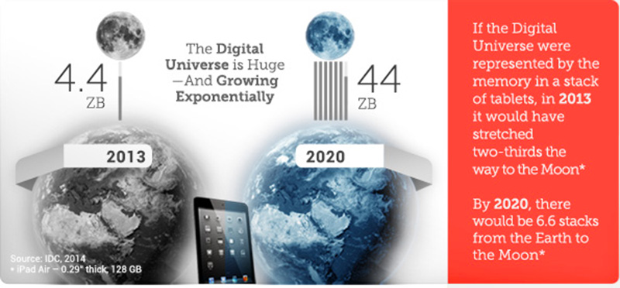
Inflection Point #1: Data Growth
Data growth (by 2015) = 100x in ten years [IDC 2012]
  Population growth = 10% in ten years
Monetizing data for commerce, health, science, services, ….
Big Data is shaping IT & pretty much whatever we do!

Slide 4
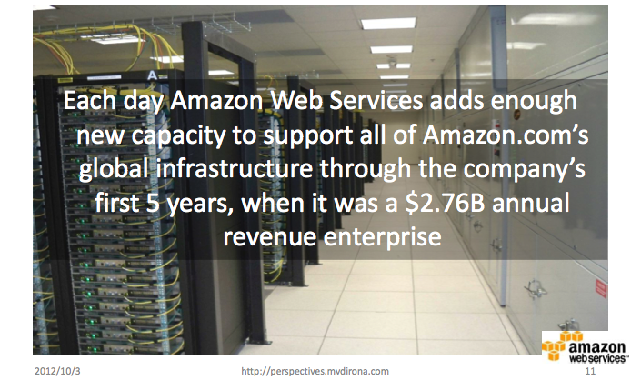
Data-Centric IT Growing Fast
Source: James Hamilton, 2012
BC 332.
Daily IT growth in 2012 = IT first five years of business!
Notes:
Founded in 1994. 1994-99
Amazon revenue today: 55B $

Slide 5
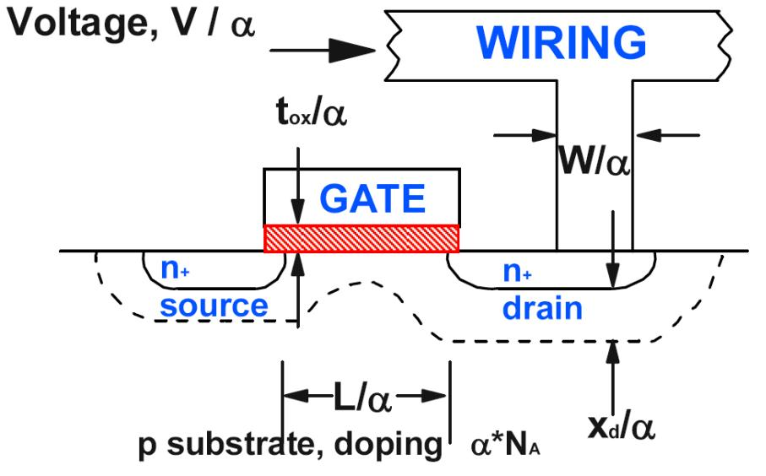
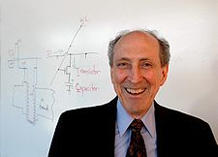
Inflection Point #2: So Long “Free” Energy
Robert H. Dennard, picture from Wikipedia
Dennard et. al.,
1974
Four decades of Dennard Scaling (1970~2005):
P = C V² f
More transistors
Lower voltages
Constant power/chip

Slide 6
End of Dennard Scaling
Today
Projections
[source: ITRS]
  The fundamental energy silver bullet is gone!

Slide 7


The Rise of Parallelism to Save the Day
With voltages leveling:
Parallelism has emerged as the only silver bullet
Use simpler cores
  Prius instead of race car
Restructure software
Each core ➔
less joules/op
Conventional Server
CPU (e.g., Intel)
Multicore Scaling
Modern Multicore
CPU (e.g., Tilera)

Slide 8
The Rise of Dark Silicon:
End of Multicore Scaling
But parallelism can not offset leveling voltages
Even in servers with abundant parallelism
Core complexity has leveled too!
Soon, cannot power all chip
Dark Silicon
Hardavellas et. al., “Toward Dark Silicon in Servers”, IEEE Micro, 2011
Notes:
The common solution is to pursue parallel computing

Slide 9
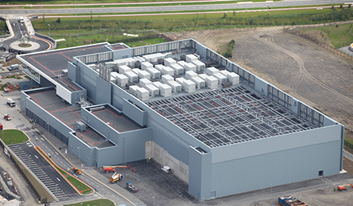
Higher Demand + Lower Efficiency:
Datacenter Energy Not Sustainable!
A Modern Datacenter
17x football stadium, $3 billion
Billion Kilowatt hour/year
50 million homes
2001 2005 2009 2013 2017
Modern datacenters ➔ 20 MW!
In modern world, 6% of all electricity, growing at >20%!
Notes:
How many homes?

Slide 10
Inflection Point #3: Memory
[source: Lim, ISCA’09]
DRAM/core capacity lagging!

Slide 11
Inflection Point #3: Memory
[source: Hardavellas, IEEE Micro’11]
DDR bandwidth can not keep up!

Slide 12
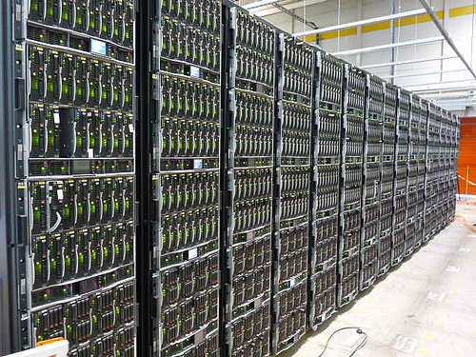


Online Services are All About Memory
Vast data sharded across servers
Memory-resident workloads
  Necessary for performance
  Major TCO burden
Put memory at the center
  Design system around memory
  Optimize for data services
Core
Core
Core
Network
Core
Core
Core
$
Data
Memory
Server design entirely driven by DRAM!
Notes:
Therefore, the key to efficiency are processor designs that maximize the throughput per chip and deliver the biggest benefit from the costly memory investment.

Slide 13

Our Vision: Memory-Centric Systems
software stack
networks
memory-centric
systems
memory
system
memory
system
processors
processors
Design Servers with Memory Ground Up!

Slide 14
Memory System Requirements
Want
High capacity: Workloads operate on massive datasets
High bandwidth: Well-designed CPUs are bw-constrained
But, must also keep
Low latency: on critical path of data structure traversals
Low power: memory’s energy a big fraction of TCO

Slide 15
Many Dataset Accesses are highly Skewed
10 ⁰
10 ⁻¹
10 ⁻²
90% of dataset accounts
for only 30% of traffic
Access Probability
10 ⁻³
10 ⁻⁴
10 ⁻⁵
10 ⁰
10 ¹
10 ²
10 ³
10 ⁴
What are the implications on memory traffic?

Slide 16
Implications on Memory System
H
O
T
C
O
L
D
Page Fault Rate
25 GB
256 GB
Capacity
Capacity/bandwidth trade off highly skewed!

Slide 17
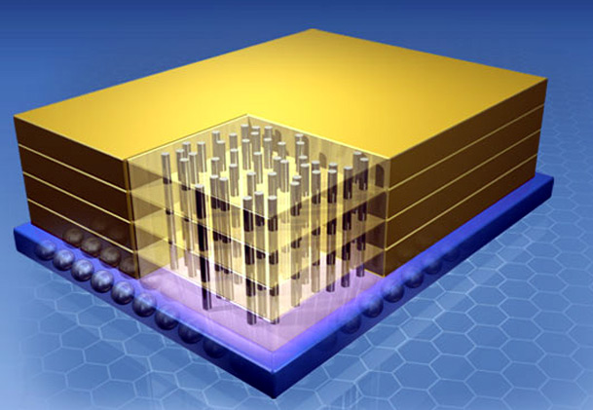
Emerging DRAM: Die-Stacked Caches
Die-stacked or 3D DRAM
Through-Silicon Vias
High on-chip BW
Lower access latency
Energy-efficient interfaces
Two ways to stack:
100’s MB with full-blown logic (e.g., CPU, GPU, SoC)
A few GB with a lean logic layer (e.g., accelerators)
DRAM
Individual stacks are limited in capacity!
Notes:
Emerging 3D die stacking technology allows us to stack heterogeneous dies, richly interconnected using dense through-silicon vias.
What’s interesting to us is die-stacked DRAM on top of a CPU die, as shown in the picture, because provides low-latency, high-bandwidth and energy-efficient interface to the stacked DRAM -> which is all we need.
Today’s technology allows us to integrate hundreds of MB to a couple gigabytes of DRAM per chip, which might not enough to accommodate the whole memory of servers,
but it is enough for a decent DRAM cache, that can greatly reduce off-chip traffic.

Slide 18
Example Design: Unison Cache [ISCA’13, Micro’14]
  256MB stacked on server processor
  Page-based cache + embedded tags
  Footprint predictor [Somogyi, ISCA’06]
  → Optimal in latency, hit rate & b/w
DRAM Cache
Core
Core
Core
Core
Core
Core
Core
Core
CPU
LOGIC
Core
Core
Core
Core
Core
Core
Core
Core
Core
Core
Core
Core
Core
Core
Core
Core
Off-chip memory
Notes:
Technology has offered several effective solutions, one of them being die-stacked DRAM caches. Die-stacking provides rich connectivity between the CPU and the stacked DRAM, and can accommodate BW needs of todays and future chips. Because they are made of DRAM, these caches have high capacity and thus are able to reduce off-chip traffic to sustainable levels. Whenever we find the data in the cache, we avoid accessing off-chip memory. The subject of this talk is how to build such a large DRAM cache.

Slide 19

Example Design: In-Memory DB
  Much deeper DRAM stacks (~4GB)
  Thin layer of logic
  E.g., DBMS ops: scan, index, join
  Minimizes data movement,
  maximizes parallelism
DRAM
DRAM
DB Request/
Response
DRAM
DRAM
CPU
DB Operators
Notes:
Technology has offered several effective solutions, one of them being die-stacked DRAM caches. Die-stacking provides rich connectivity between the CPU and the stacked DRAM, and can accommodate BW needs of todays and future chips. Because they are made of DRAM, these caches have high capacity and thus are able to reduce off-chip traffic to sustainable levels. Whenever we find the data in the cache, we avoid accessing off-chip memory. The subject of this talk is how to build such a large DRAM cache.

Slide 20
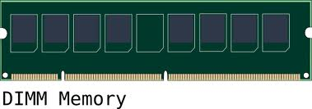
Conventional DRAM: DDR
CPU-DRAM interface: Parallel DDR bus
Require large number of pins
Poor signal integrity
More memory modules for higher capacity
  Interface sharing hurts bandwidth, latency and power efficiency
So-called “Bandwidth Wall”
CPU
DDR bus
~ 10’s GB/s per channel
High capacity but low bandwidth

Slide 21

Emerging DRAM: SerDes
Serial link across DRAM stacks
Much higher bandwidth than conventional DDR
Point-to-point network for higher capacity
But, high static power due to serial links
Longer chains ➔ higher latency
Cache
CPU
4x bandwidth/channel
SerDes links
Must trade off bandwidth and capacity for power!

Slide 22
Scaling Bandwidth with Emerging DRAM
Emerging DRAM
Conventional DRAM
matches BW
high static power
low bandwidth
low static power
2015
2018
2021

Slide 23
Servers with Heterogeneous Memory
Emerging DRAM
Conventional DRAM
DDR bus
Cache
Serial links
CPU
C
O
L
D
HOT
C
O
L
D

Slide 24
Power, Bandwidth & Capacity Scaling
Emerging DRAM
Conventional DRAM
Heterogeneous
4x more energy-efficient
1.4x higher server throughput
2.5x higher
server throughput
HMC’s much better suited as caches than main memory!

Slide 25














Server benchmarking with
CloudSuite 2.0 (parsa.epfl.ch/cloudsuite)
Data Analytics
Machine learning
Data Caching
Memcached
Data Serving
Cassandra NoSQL
Graph Analytics
TunkRank
Media Streaming
Apple Quicktime Server
SW Testing as a Service
Symbolic constraint solver
Web Search
Apache Nutch
Web Serving
Nginx, PHP server
In Use by AMD, Cavium, Huawei, HP, Intel, Google….
Notes:
Talk less

Slide 26
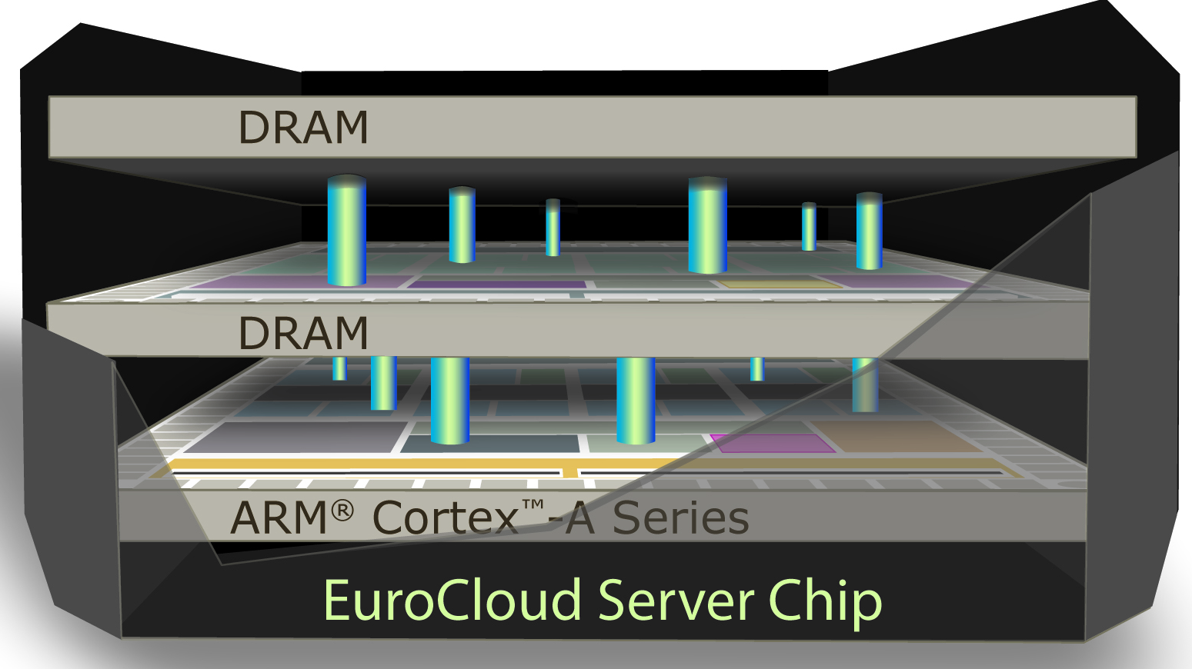

Specialized CPU for in-memory workloads: Scale-Out Processors [ISCA’13,ISCA’12,Micro’12]
64-bit ARM out-of-order cores:
Right level of MLP
Specialized cores = not wimpy!
System-on-Chip:
On-chip SRAM sized for code
Network optimized to fetch code
Cache-coherent hierarchy
Die-stacked DRAM
Results
10x performance/TCO
Runs Linux LAMP stack

Slide 27

1st Scale-Out Processor:
Cavium ThunderX
48-core 64-bit ARM SoC [based on “Clearing the Clouds”, ASPLOS’12]
Instruction-path optimized with:
On-chip caches & network
Minimal LLC (to keep code)
3x core/cache area

Slide 28

Scale-Out NUMA:
Rack-scale In-memory Computing [ASPLOS’14]
core
core
core
Coherence
domain 2
. . .
Coherence
domain 1
LLC
NUMA
fabric
Memory Controller
Remote
MC
N I
300 ns round-trip latency
to remote memory
Rack-scale networking suffers from
  Network interface on PCI + TCP/IP
  Microseconds of roundtrip latency at best
soNUMA:
  SoC Integrated NI (no PCI)
  Protected global memory read/write + lean network
  100s of nanosecond roundtrip latency
Notes:
Simulation results:
- 300ns latency (4x local DRAM)
- Stream at memory bandwidth (read or send)
- 10M IOPS per core
Comparison with Mellanox Connect-X2 (20Gpbs)
- 10x better latency
- 5x better bandwidth

Slide 29
Summary
Three trends impacting servers:
  Data growing at ~10x/year
  Nearing end of Dennard & Multicore Scaling
  DDR memory capacity & bandwidth lagging
Future server design dominated by DRAM
  Online services are in-memory
  Memory is a big fraction of TCO
  Design servers & services around memory
  Die stacking is an excellent opportunity
Notes:
Scale-out datacenters have vast memory resident datasets that are sharded across many servers. The massive memory footprint contributes to a significant fraction of the total cost and power consumption. To maximize performance per cost, we need high throughput processors to fully leverage memory.
For this goal, we propose multi-pod scale-out processors that deliver the maximum performance for scale-out workloads. Each pod in a scale-out processor is a stand-alone server with the maximum performance density. Not only the pod based design make it possible to achieve the maximum performance but also gives technology scalability for free: as more transistors become available more pods will be integrated which linearly increases the throughput.

Slide 30

Thank You!
For more information please visit us at
ecocloud.ch

