Slide 1

Logic-based
Modeling and Analysis Tools from Microsoft Research
Nikolaj Bjørner
Microsoft Research
HIPERFIT Workshop May 25 - 2011
FSE &

Slide 2
Agenda
Research in Software Engineering
- an overview and three (HIPERFIT fit?) projects
Z3: An efficient SMT solver
FORMULA: Formal Modeling using
Logic and Analysis
F*: Refinement types for security

Slide 3
Other FITs from Microsoft (Research)
F#: async, quotations, and metrics.
Accelerator (data-parallel library).
Unit testing with Pex/Moles
Parallels library, concurrent revisions.
HPC/Technical Computing.

Slide 4
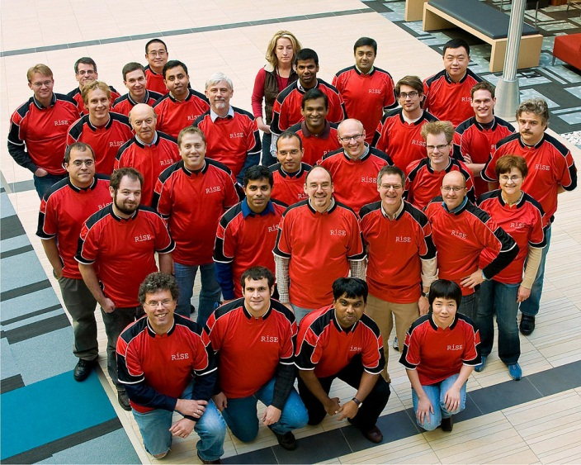
Research In Software Engineering

Slide 5
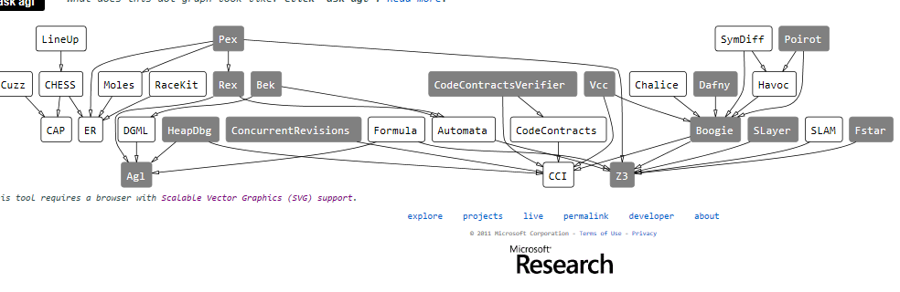
Tools
Try some tools online: http://rise4fun.com

Slide 6
RiSE EcoSystem
Maintainability
Reliability
Programmability/Extensability
Energy
Benefits
Performance
Predictability
Security/Privacy
Analyzability
R
e
s
e
a
r
c
h
P
r
o
j
e
c
t
s
Code Analysis
- Unit testing (.NET pex)
- Env construction (.NET moles)
- Security testing (bin: Sage)
- Code contracts (.Net)
- Security audits (C: havoc)
- Perf analysis (bin: speed)
- Conc. testing(bin: Chess, ..)
- Sec analysis (JS: gatekeeper)
- Race detectors ()
- Semantic diff
Modeling, synth., Verif.
- Distributed authorization (DKAL)
- E2E security verification (Fine)
- Model-driven eng. (Formula)
- Verifying System Pgms (VCC)
- Verifying OO Pgms (Spec#, Daphne)
- Synthesis of end user pgms
(ITI Sans-script)
Runtimes, Optimization
- Tracing JITs (.NET: Spur)
- Bowser Extensions (C3)
- Benchmarks (JS, HTML)
- Download optim (JS: Dolotto)
- Mem Manager (bin: DieHard)
- Malware detector (bin: Noozle)
- Adaptive QoS comp (bin:Green)
- Pgm. Mod (.NET: TPL, Version)
- Mem.Mod (Travers,..)
SE Dev.-Analysis
- Prediction (CRANE)
- Assessment (TDD, Distr. Dev, ..)
- Process optim. (HR network ana.)
Root
Technologies
Verification
Platform
(Boogie)
SMT
Solver
(Z3)
Software Develop-
ment Datamart
(CodeMine)
Web-Client
Platform
(C3)
Compiler/Runtime
Infrastructure
(.NET:CCI, Spur, ER)
Core
Competencies
Logic
Statistics
Semantics
Type
Systems
Automata

Slide 7



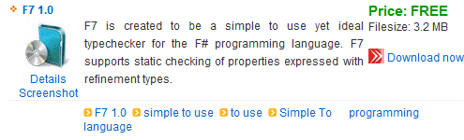




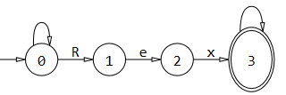



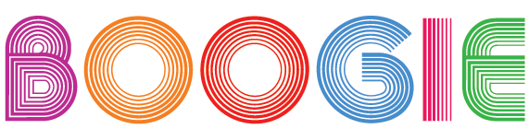
Tools using Z3
Property Execution Model
Driven Guided Based
Program
Verification
Auditing
Type Safety
Over-Approximation
Under-Approximation
Testing
Analysis
Synthesis
BEK
HAVOC
SLAyer
SAGE

Slide 8
SAGE by numbers
Slide shamelessly stolen and adapted from [Patrice Godefroid, ISSTA 2010]
100+ CPU-years - largest dedicated fuzz lab in the world
100s apps - fuzzed using SAGE
100s previously unknown bugs found
1,000,000,000+ computers updated with bug fixes
Millions of $ saved for Users and Microsoft
10s of related tools (incl. Pex), 100s DART citations
100,000,000+ constraints - largest usage for any SMT solver

Slide 9
Formal Modeling using Logic and Analysis
Ethan Jackson, Nikolaj Bjørner and Wolfram Schulte
Research in Software Engineering (RiSE), Microsoft Research
Dirk Seifert, Markus Dahlweid and Thomas Santen,
European Microsoft Innovation Center (EMIC), Aachen, Germany

Slide 10
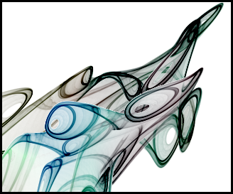

Overview
Introduction to the FORMULA formal specification language
An example using FORMULA for platform mappings

Slide 11
What is FORMULA?
Provides general language capturing model-based abstractions
Supports automated model synthesis

Slide 12
What is FORMULA?
Provides general language capturing model-based abstractions
  Core based on CLP with negation.
  Uniform Regular type system (ICLP 2011)
  Specs composed as modules.
  Abstraction boundaries managed by module system.
Supports automated model synthesis

Slide 13
What is FORMULA?
Provides general language capturing model-based abstractions
  Core based on CLP with negation.
  Uniform Regular type system (ICLP 2011)
  Specs composed as modules.
  Abstraction boundaries managed by module system.
Supports automated model synthesis
  Formal descriptions of design spaces and model checking problems
  Solves open CLP systems
    Find me the facts such that my query holds.

Slide 14
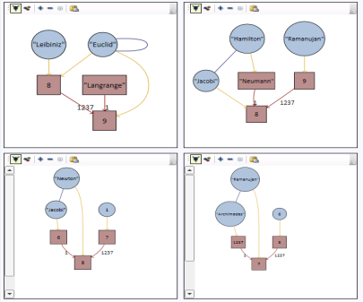
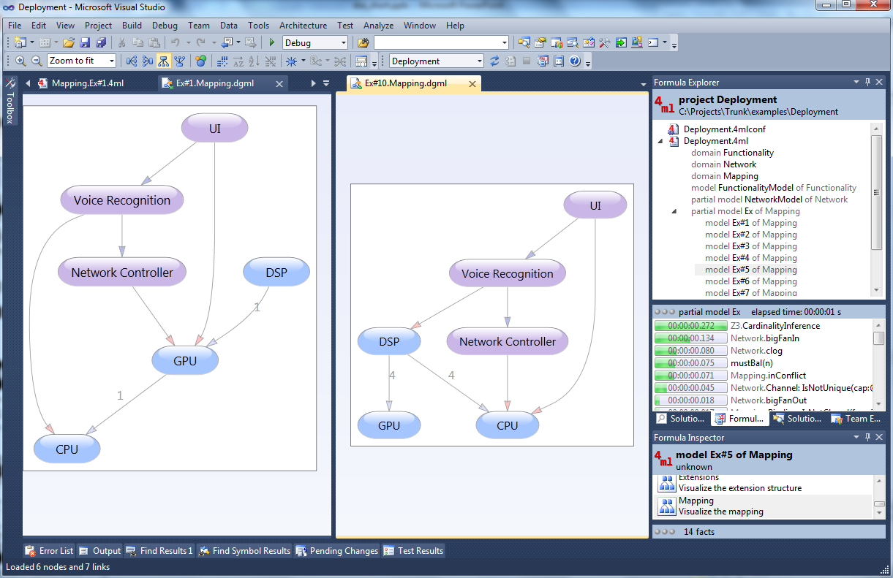
The FORMULA Tool

Slide 15

An example

Slide 16
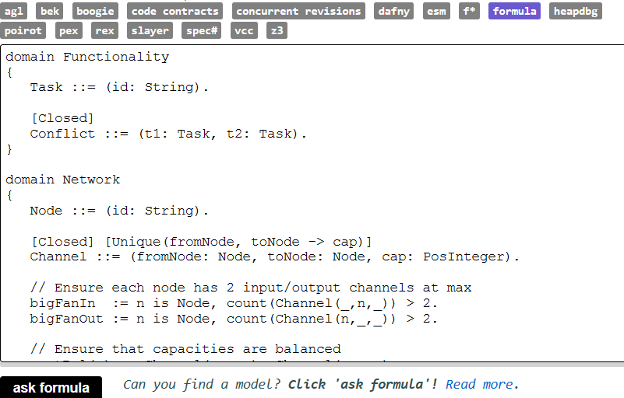
FORMULA

Slide 17
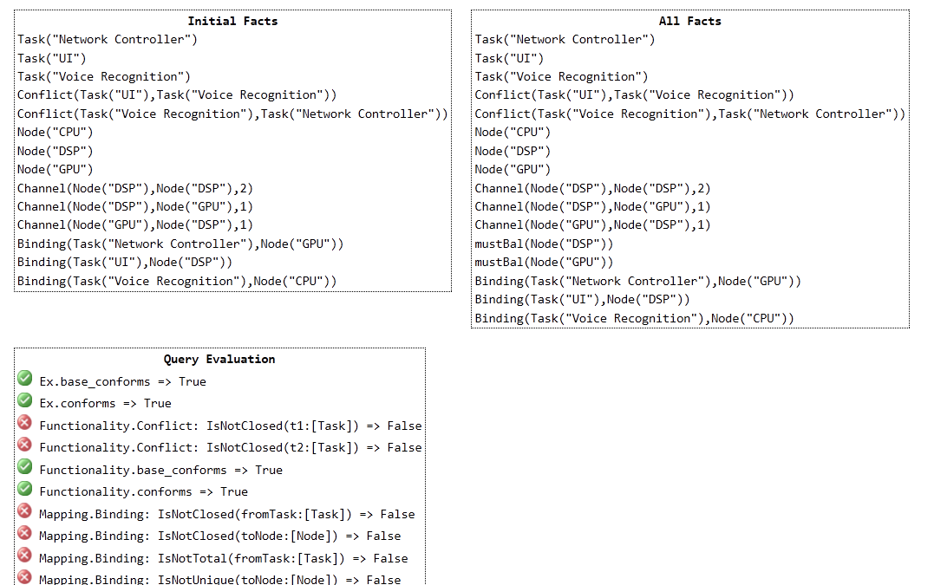
FORMULA - results

Slide 18


The Software Components (I)
For simplicity, assume a software component is just a task.
Two tasks can be in conflict, meaning they should not execute on the same device.
SCM
Map
T1
PM
T3
T2

Slide 19
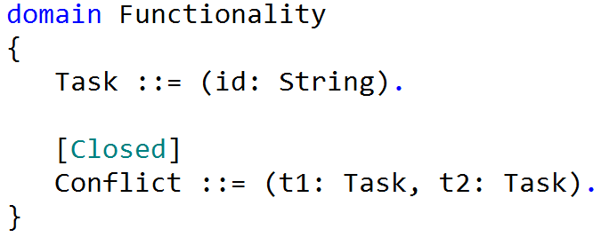
The Software Components (II)
SCM
Map
PM

Slide 20
The Platform (I)
Nodes are connected by channels with communication capacities.
No node can support more than two incoming and outgoing channels.
Capacities must be balanced on node with incoming and outgoing channels.
SCM
Map
PM
In-degree = 0
Out-degree = 1
In capacity = 0
Out capacity = 8
D4
In-degree = 1
Out-degree = 0
In capacity = 4
Out capacity = 0
4
D1
D2
D3
8
4
In-degree = 1
Out-degree = 2
In capacity = 8
Out capacity = 4+4

Slide 21
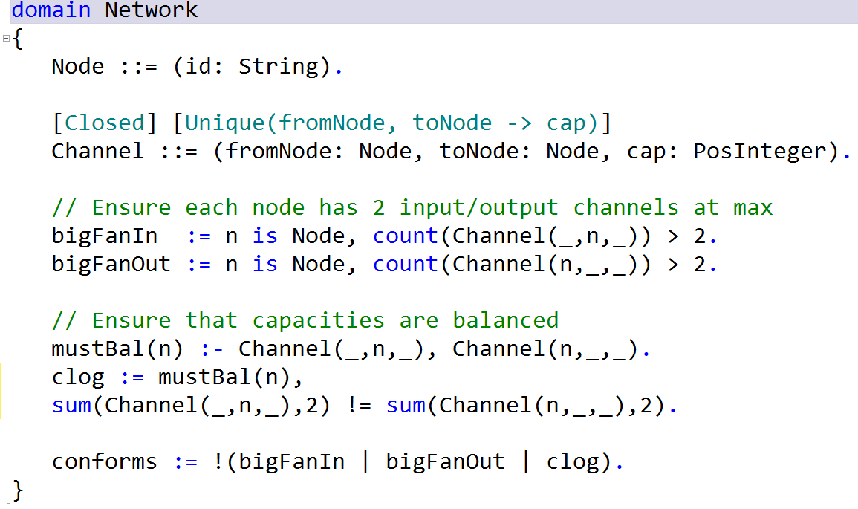
The Platform (II)
SCM
Map
PM

Slide 22
The Mapping (I)
Tasks should be place on nodes so all conflict
constraints are respected.
SCM
Map
T2
PM
D4
4
D1
D2
D3
T1
8
4
T3

Slide 23
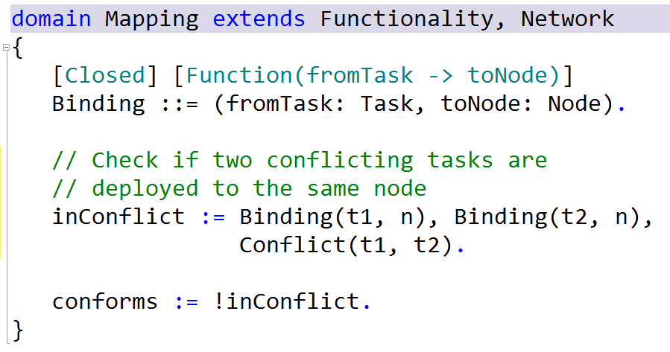
The Mapping (II)
SCM
Map
PM
A number of constraint problems are in this specification, including:
A coloring problem,
A forbidden-subgraph problem
Linear arithmetic problem
Similar process to add new architectural facets onto this structure

Slide 24
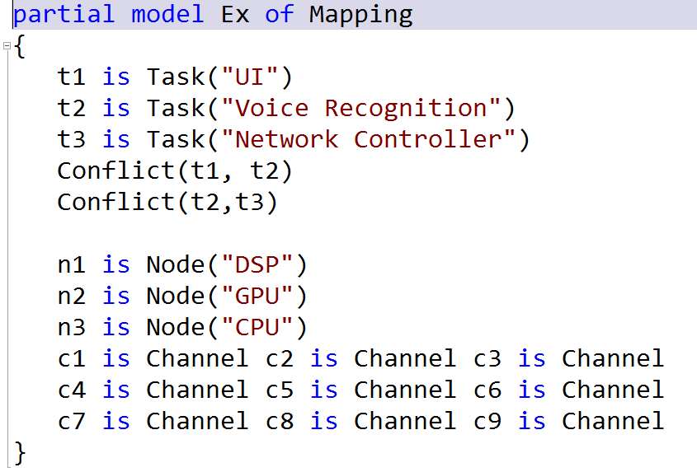
Solve in Any Direction
The user constructs a partial model to represent the degrees of freedom in the problem. Degrees of freedom can be anywhere.

Slide 25
Design Space Exploration
Given a spec and a partial model, then symbolic execution constructs a formula representing the design space.
Formula Specification
Symbolic Execution
Add symmetry breaking
SMT Formula
Z3 Solver
Cardinality bounds on record instances
Reconstruct FORMULA model
Encode solution region
Try something new
Pick next region

Slide 26

A Verifying ML Compiler
Karthik Bhargavan Juan Chen Cedric Fournet
Pierre-Yves Strub Nikhil Swamy Jean Yang

Slide 27
F* type system:
Dependently typed Core ML,
with higher kinding,
and affine types

Slide 28
F* combines several projects at MSR
Fine: Security-oriented
F# subset (ESOP ’10)
DCIL: Dependently typed .NET bytecode (PLDI ‘10)
F7: Refinement types for crypto protocols
(CSF’08, POPL ‘10)
Ibex/RePriv: Dependently typed web browser extensions
(2 x Oakland ‘11)
FX: Modular
verification of
stateful code (PLPV ‘11)

Slide 29




F* Source: core-ML with dependent refinement types
  x:int -> {y:int | x > y}
F* source
Preserve types in .NET
class C<‘a::int => *>
Z3
Type-checker
+ Compiler
Interop with
C#, VB.NET, F#,…
Run on Azure,
Windows Phone 7
rDCIL
Java
Script
Z3
DCIL
Type-Checker
C#, F#,…
DCIL
.NET Virtual Machine
Notes:
\
Before we look at the details a bit more, let me tell you about how our compiler works and what we’ve used the compiler for, so far.
Here’s how our compiler roughly works.
As we’ve seen, F* allows programmers to state security properties using refinement types
Now, programming with these refinement types is not always easy.
Several prior languages that F* is related to required programmers to manually construct explicit security proofs with their programs. But, that gets to be really tedious, quickly.
Our compiler verifies that programs respect these type-based security constraints by using a type checker augmented with an external theorem prover, called Z3.
Doing this has a number of benefits:
-- Several other languages that use this form of security typing require programmers to write down security proofs. Using Z3 makes programming significantly easier
-- But, rather than simply trust that Z3 does the right thing, (which many other languages do), we extract type-checkable proof terms from Z3
-- And we represent proofs using a flexible LCF-style proof representation, which allows us to encode a variety of different logics in our system
Having extracted proofs from Z3, we compile the program and its proofs to DCIL
-- Verifying DCIL programs is purely syntactic --- we don’t need a solver
-- So that makes verification fast (although we’ll see that carrying proofs inflates code size)
-- And by compiling to DCIL, we can execute on stock .NET VMs, interface with other languages, libraries and so on.

Slide 30
Web demo: rise4fun.com/fstar

Slide 31
Web Browser Extension Security

Slide 32
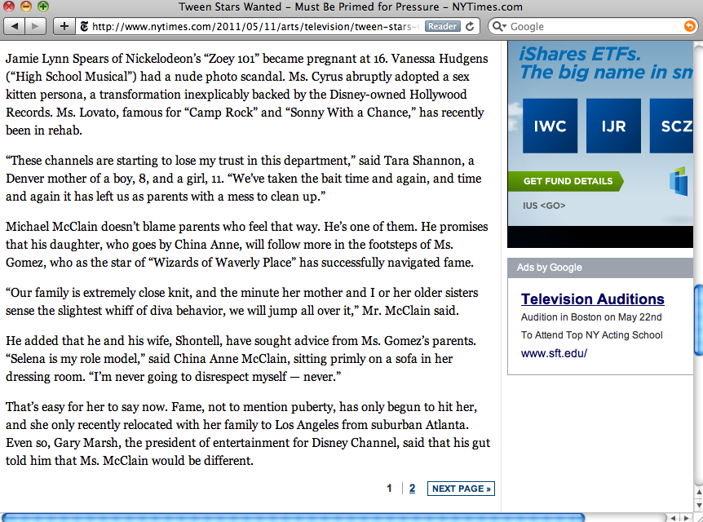
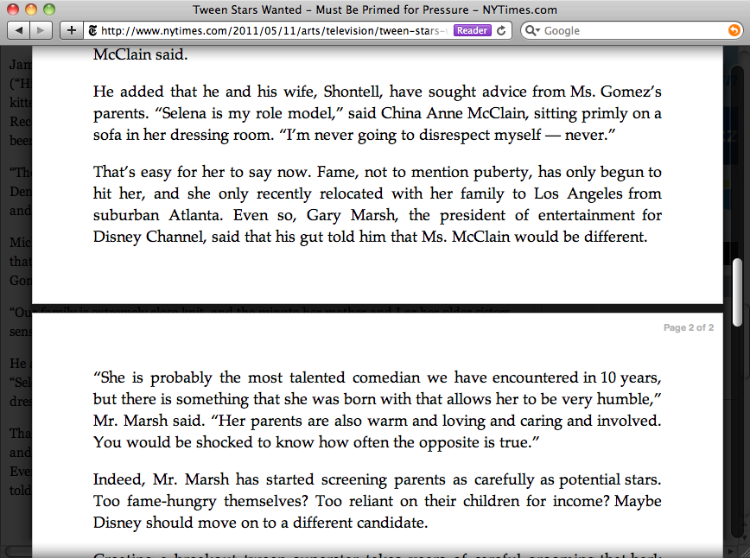
Notes:
The readability extension stiches together multi-page articles.
Apple built this into the latest version of Safari, in fact reusing the open-source code of Readability.

Slide 33
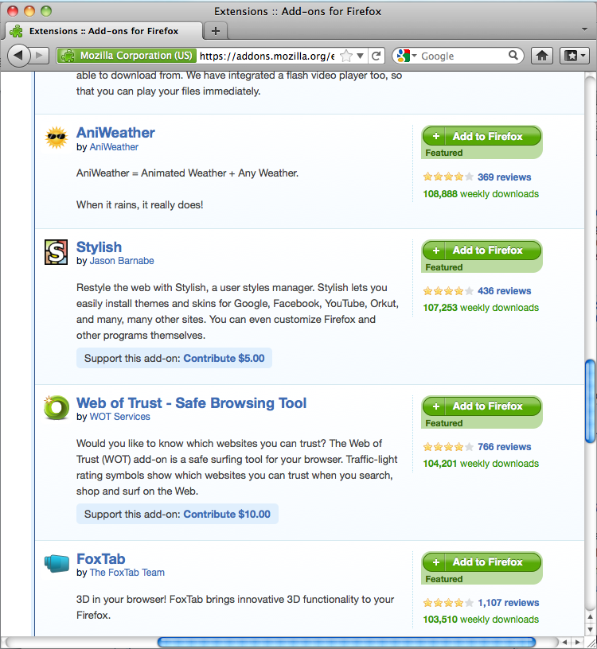
1/3rd of Firefox users run extensions (~34 million users)
Popular Chrome extensions have thousands of users

Slide 34
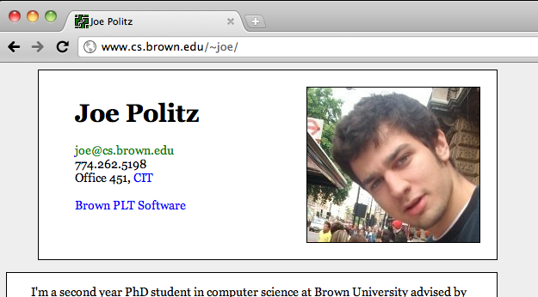
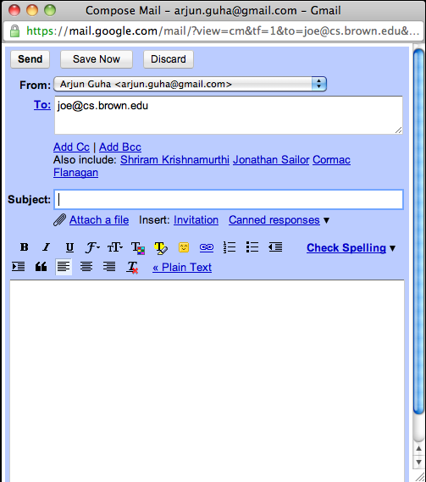
Change mailto: links
mailto:joe@cs.brown.edu
Change links to evil.com?
https://mail.google.com/mail/?view=cm&tf=1&to=joe@cs.brown.edu&cc=&su=&body=&fs=1
Notes:
Let’s think about extension security. Extensions do awesome useful things—can they do bad things?
Another cool extension that rewrites mailto: links to open Gmail instead of a local email client.
But, if an extension can do this, can an extension simply rewrite all links to redirect me to some malicious website?

Slide 35
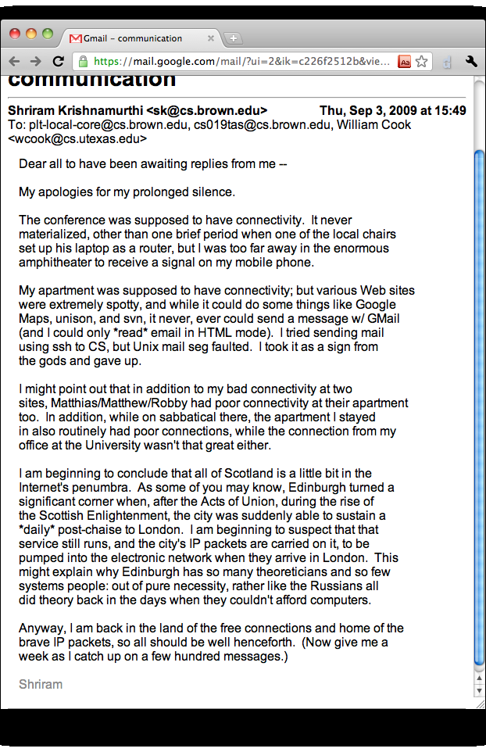
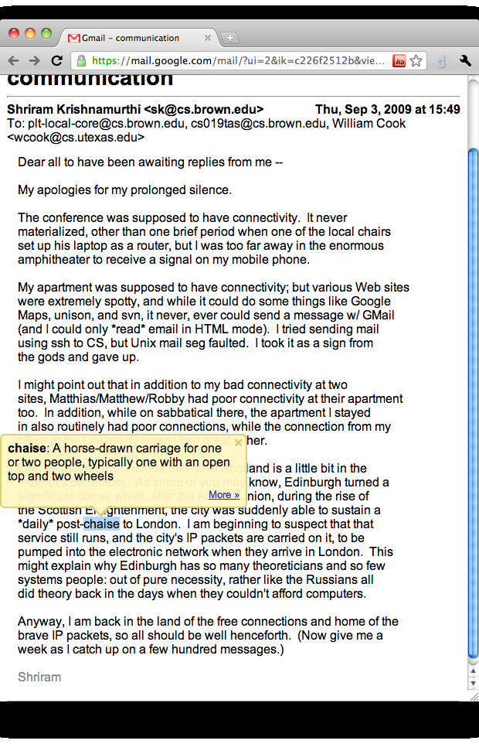
evil.com
Google Dictionary Service
Send my email to evil.com?
Sends selected word to Google
Notes:
Another cool dictionary extension. Shriram likes using obscure words, so this is helpful. I double-click, it sends the word to Google.
But, could a malicious extension just send my email to evil.com/
NS: Great! Love this intro. Only concern is that it may be a tad too long. Remember, you only have like 22mins … tops. Do a practice run and see how long this takes. Should not be more that 4mins-ish.

Slide 36
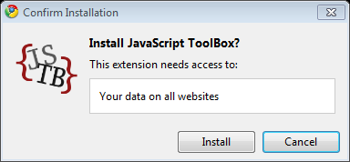
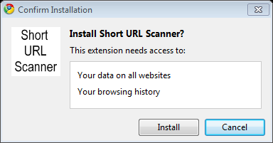
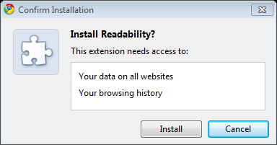
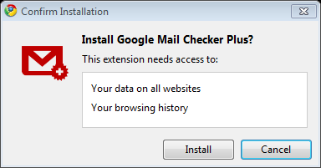
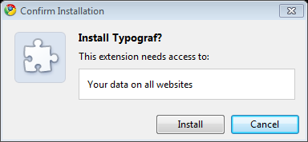
60% (of 1,137) have access to history, storage, and the Web
30% (of 1,137) have access to your data on all websites
Notes:
Looks like this to the user. Not very helpful. User is trained to ignore warning and just click Install.

Slide 37

IBEX: Formal Basis for Browser Extension Security
Secure-by-construction extensions
Expressive, fine grained policies
Tools to understand policies
Cross-platform deployment

Slide 38
Extension policy
Extension in F*
Developers
Write extensions and
policies in F*
Use tools to ensure
extension conforms
to policy
ML/F# dialect with a type system for program verification
1. Datalog-style authorization logic for writing policies
F*
Compiler & Verifier
Policy Visualizer
Secure
DOM API
Curator
Uses tools to ensure code matches policy
Uses visualizer to help understand policy
2. Secure DOM API
3. Semantics and type soundness—policy not violated
Violation
5. Visualize fine-grained access-control policies on examples
Users
Trust curated extension gallery
Install approved extensions
type-preserving compiler to .NET
C3
new compiler to JavaScript
4. Cross-platform deployment; retrofitted security
Notes:
1. Policies that talk about resources on Web pages and the Web browser

Slide 39
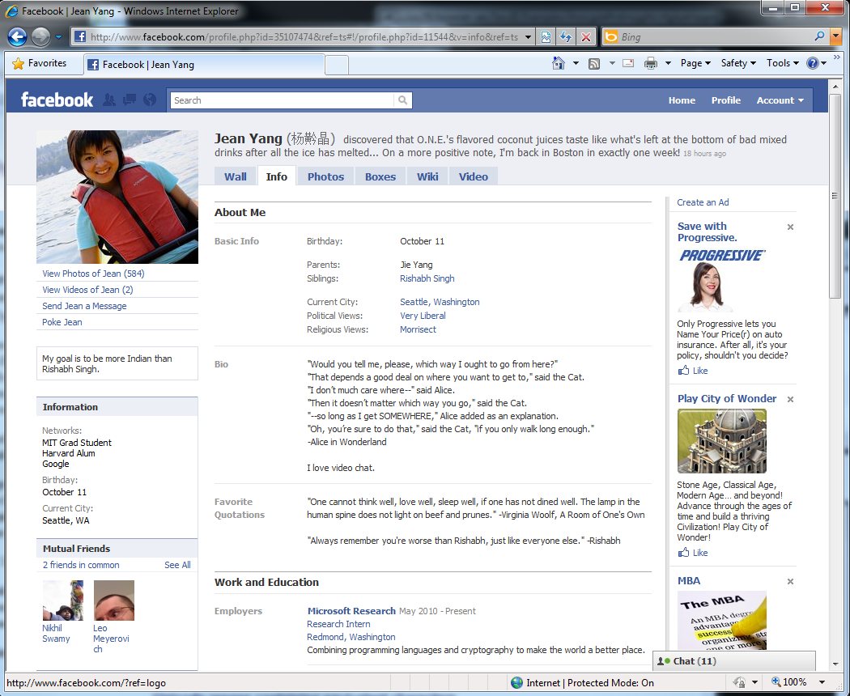
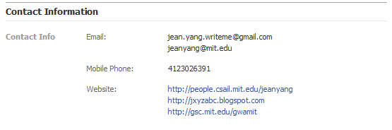
Question: What is the security policy?
Bookmarks my friends’ Websites
Notes:
Simple extension we wrote—a more detailed example in the paper
Bookmarks friends’ websites
Security policy—in Chrome—requires access to Facebook account

Slide 40
Can Read Names
<name>Jean Yang</name>
Can Read Websites
(and ability to bookmark—elided)
<web>http://people.csail.mit.edu/jeanyang</web>
Principle of
Least Authority
Notes:
Let’s do better… lots of data here, no need to write or even read all of it
the least privileges required are … (and ability to create bookmarks)
Very simple policy—problem is there is no metadata on the page saying “this is the name”, “this is the website”
This affects policy writing and extension writing.

Slide 41
Basic Extension: read text in <head>
Secure DOM API
DOM predicates and permissions
Policy language
Extension code

Slide 42
type elt
val getInnerText :
elt
-> string
val getTagName :
elt
-> string
Native DOM elements, abstract to F*
Defined in .NET/JavaScript with this type

Slide 43
A Refined API for the DOM
type elt
val getInnerText :
{ e:elt | CanRead e}
-> string
val getTagName :
elt
-> string
Precondition;
DOM permission

Slide 44
assumption in the model
A Refined API for the DOM
type elt
val getInnerText :
{ e:elt | CanRead e}
-> string
val getTagName :
e:elt
-> { s:string | EltTagName e s}
can read tag names and attribute names
Precondition;
DOM permission
Postcondition; DOM predicate

Slide 45
Refined DOM API
type elt
val getInnerText :
{ e:elt | CanRead e}
-> string
val getTagName :
e:elt
-> { s:string | EltTagName e s}
let read elt =
if getTagName elt = "head" then
getInnerText elt
else
"not <head>“
Extension source code
assume ∀ (e:elt) . EltTagName e "head"
⇒ CanRead e
Requires
F* + Z3 check pre- and post-conditions statically
Ensures

Slide 46
Extension in F*
Extension in F*
Extension policy
Extension policy
Extension in F*
F*
Compiler & Verifier
Extension policy
Secure
DOM API
Extension in F*
Extension policy
Single DOM API
No code audit
No security exceptions (robust) and no runtime overhead (fast)
C3
Notes:
1. Policies that talk about resources on Web pages and the Web browser

Slide 47
research.microsoft.com/fstar

