Slide 1
Privacy-Preserving Smart Metering
George Danezis (MSR)
Alfredo Rial (KU Leuven)
Markulf Kohlweiss (MSR),
Klaus Kursawe (Nijmegen),
Cedric Fournet (MSR),
Andy Gordon (MSR),
Misha Aizatulin (OU),
Francois Dupressoir (OU)
and MS XCG

Slide 2
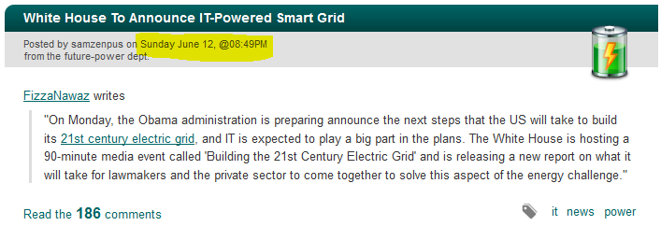

Slide 3
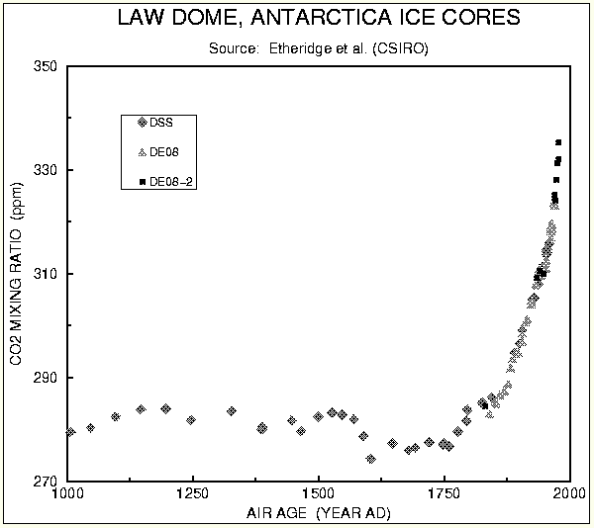
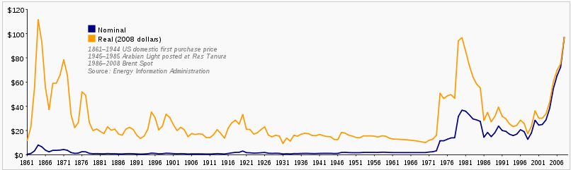
The new energy landscape (I)
Energy pressures:
  Energy cost, carbon & climate change
  Reduce peak consumption (+ efficient transport)

Slide 4
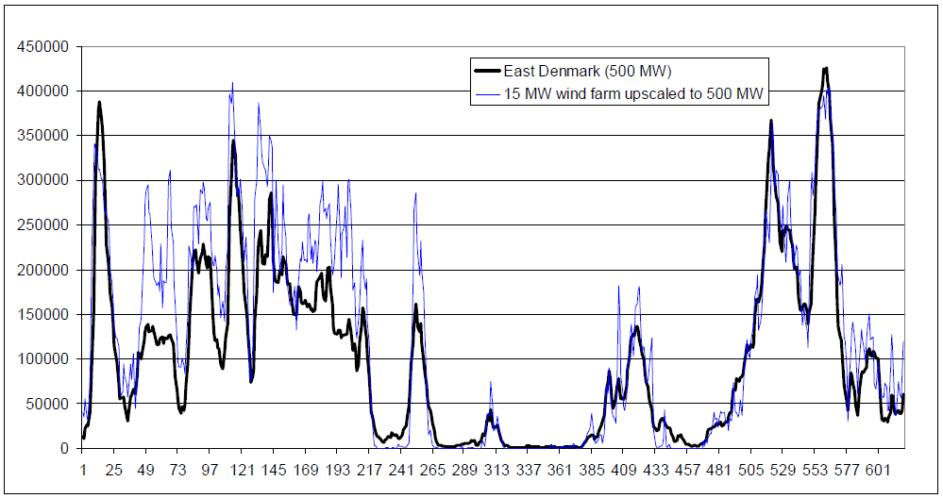
The new energy landscape (II)
Renewables:
  Unpredictable yield over time
  Electric cars = heavy load to shift

Slide 5
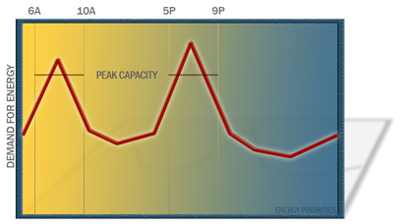
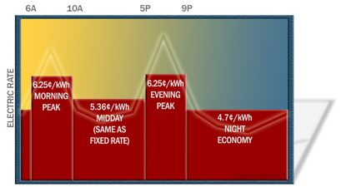
The new energy landscape (III)
Smart metering: increase efficiency
  Better feedback to users through fine grained 15-30 min readings
  Time of use billing (you pay for when you consume)
  Remote readings, monitoring, change of tariff, disconnection (competition)
  Integrate renewable micro-generation
http://energypriorities.com/entries/2006/02/pse_tou_amr_case.php

Slide 6
Key changes for electricity
Current metering
Smart metering
Manual reads
One read every
¼ year to 1 month
Remote reads
Reads every
15-30 minutes
(+ easy to switch supplier, different tariffs, pre-paid, in-house display, remote disconnection)

Slide 7
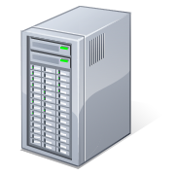
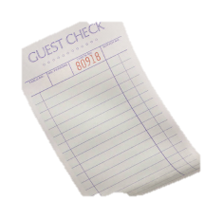
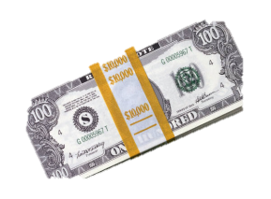
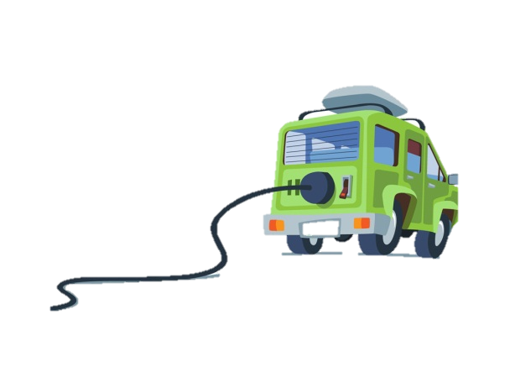
What is smart metering?
Electricity readings per ½ hour
Bill
Display
Meter
(Electricity, time)
(Gas, time)
Utility
Provider
Payment
Policy
Dynamic rates per ½ hour
Fixed plan of rates
(Non-linear rates -- taxation)
User

Slide 8
Smart-grid for electricity
USA: Energy Independence and Security Act of 2007
  American Recovery and Reinvestment Act (2009, $4.5bn)
EU: Directive 2009/72/EC
UK: deployment of 47 million smart meters by 2020
BUT:
“The Dutch First Chamber considers the mandatory nature of smart metering as an unacceptable infringement of citizens’ privacy and security”

Slide 9
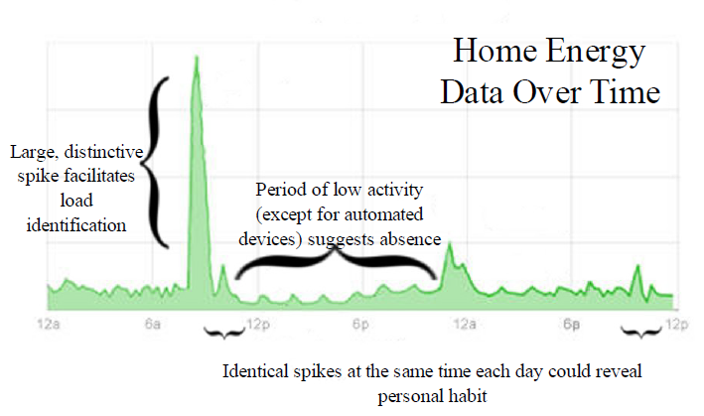
Privacy issues
Meter readings are sensitive:
    Were you in last night? You do like watching TV don’t you? Another ready meal in the microwave? Has your boyfriend moved in?
More issues …
  Proposed centralised routing / database (?) of readings (UK)
  Mandatory to receive service
  Ability to switch off / switch to prepaid meters
Toward Technological Defenses Against Load Monitoring Techniques
Thomas Nicol, Student Member, IEEE, Thomas J. Overbye, Fellow, IEEE

Slide 10
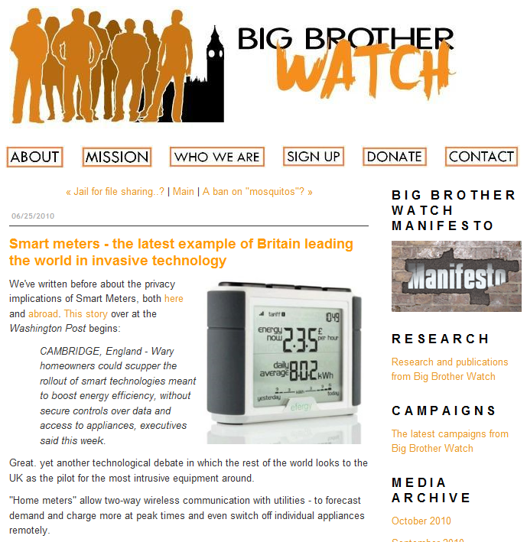
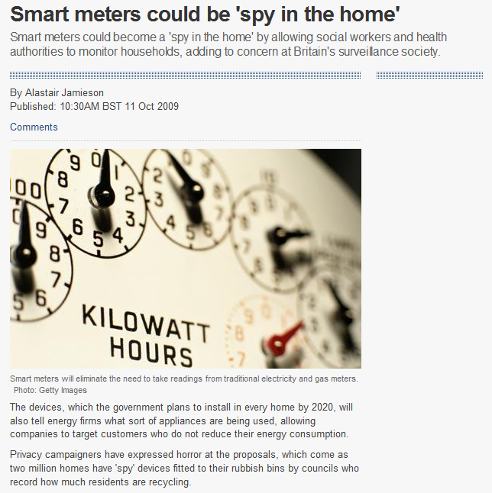
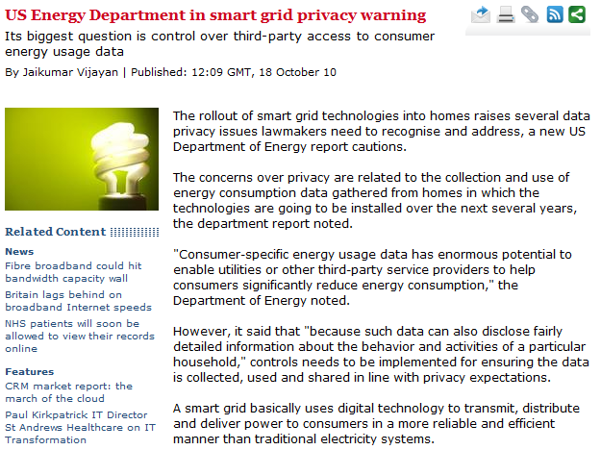
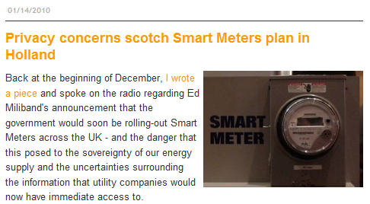

Slide 11

Privacy preserving metering: design principles
Obviously: integrity & privacy (unconditional)
Keep meters very simple = cheap
  No mobile code
  No knowledge of tariff policy or structure
  No need for smartness
  Low-communication overhead
  Ease of certification
Agility
  Use any device to compute bills = user control
  Compute arbitrary functions of readings aside bills
  Keep up with changing infrastructure for WAN communications
  Same meter for different utilities or relying parties
End-to-end verifiability
  Bills can be verified, and show to be correct (or incorrect) to third parties.

Slide 12
Our approach
(A) Certified readings & policy (B) Proof of bill & verification
Signed & encrypted electricity
readings per ½ hour
Signed & encrypted readings
Certified Policy
Dynamic rates per ½ hour
(Non-linear rates -- taxation)
Meter
(Electricity, time)
Utility
Provider
Shared
key K
Can verify correctness of computation without access to secret readings!
Decrypted readings
Do not leave the user device
Certified Bill
& Zero-knowledge
Proof of correctness
User

Slide 13
Two flavours of crypto
Fast Billing protocol:
  Special case: policy is public, and selection of rate independent of reading.
  Very fast: process 3 weeks of all UK data in 12 days on 1 CPU.
Generic protocol:
  Supports any tariff policy that can be expressed as table look-ups and polynomial splines.
  In theory supports any computation (some faster than others)
Technical report & other resources:
  http://research.microsoft.com/en-us/projects/privacy_in_metering/

Slide 14
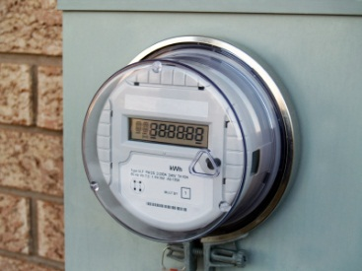
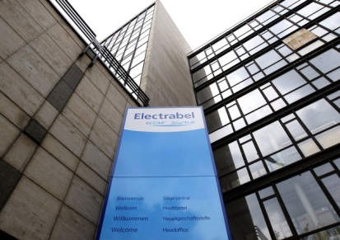
The fast protocol
cons
rate
Reveal!
Hide!
Bill = Σ_{i} rate_{i} ⋅ cons_{i}
Meter
Provider
Prove
Bill = Σ_{i} rate_{i} ⋅ cons_{i}
Open’ = Σ_{i} rate_{i} ⋅ open_{i}
Policy
{ …, i→rate_{i}, …}_{sign}
Open Readings
E_{k}[{ …, (i, cons_{i}, open_{i}) … }]
Blind Readings
{… i, C_{i} = g^{consi}h^{openi}, …}_{sign}
Blind readings C_{i} &
{Bill, Open’}_{sign}
Verify
(Verify all signatures)
Π_{i} C_{i}^{ratei} = g^{Bill}h^{Open’}
User
Commitments ?:
(1) Hiding (2) Binding
ACCEPT or REJECT

Slide 15
Why the verification works?
Verify
1. Verify all signatures
2. Check Π_{i} C_{i}^{ratei} = g^{Bill}h^{Open’}
C_{i} = g^{consi}h^{openi}
Π_{i} C_{i}^{ratei} =
= Π_{i} (g ^{consi}h ^{openi}) ^{ratei}
= Π_{i} (g ^{consi* ratei} h ^{openi * ratei})
= g ^{Σ consi * ratei} h ^{Σ openi * ratei}
= g^{Bill}h^{Open’}
(gª )^{b} = g^{ab}
gª g^{b} = g^{a+b}
Prove
Bill = Σ_{i} rate_{i} ⋅ cons_{i}
Open’ = Σ_{i} rate_{i} ⋅ open_{i}
Security: binding property of commitments!
= cannot find a “fake” bill, open’ that opens to the same commitment

Slide 16
General computations?
Fast protocol:
  Linear algebra:
General zero-knowledge proofs:
  Multiplication
  Lookup:
  Range:
  Polynomial:
  Any circuit (decompose into gates)
Result = Σ_{i} x_{i} ⋅ cons_{i}
Result = x_{i} ⋅ cons_{i}
Result = Table[ cons_{i} ]
Result = Table[ min< cons_{i} < max]
Result = Table[ min< cons_{i} < max]
Result = a cons_{i} ³+ b cons_{i}

Slide 17
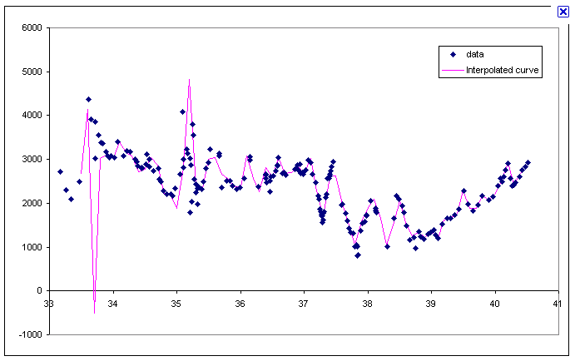
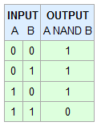

Really any function!
Ranges + polynomials
= splines
= any function
“*” or Table[]
= NAND gate
= any circuit

Slide 18
Deployment options
Certified Policy
Dynamic rates per ½ hour
My grandmother
has no server!
Cloud
Service
(Azure)
Utility
Provider
Certified Bill
& Zero-knowledge
Proof of correctness
Home server
Smart Device (WP7)
Certified Electricity
readings per ½ hour
Personal
Computer
(IE8)
Meter
(Electricity, time)

Slide 19
Demo!
My grandmother does not understand crypto!

Slide 20
How do we know its secure?
Proofs & definitions in the UC model
  Abstract functionality defining metering & billing.
  Proof that our protocols are indistinguishable from the abstract functionality.
  Use of lemmas from standard primitives:
    Commitments, signatures, ZK proofs
Aspects verified in F# and C (for real meter)

Slide 21
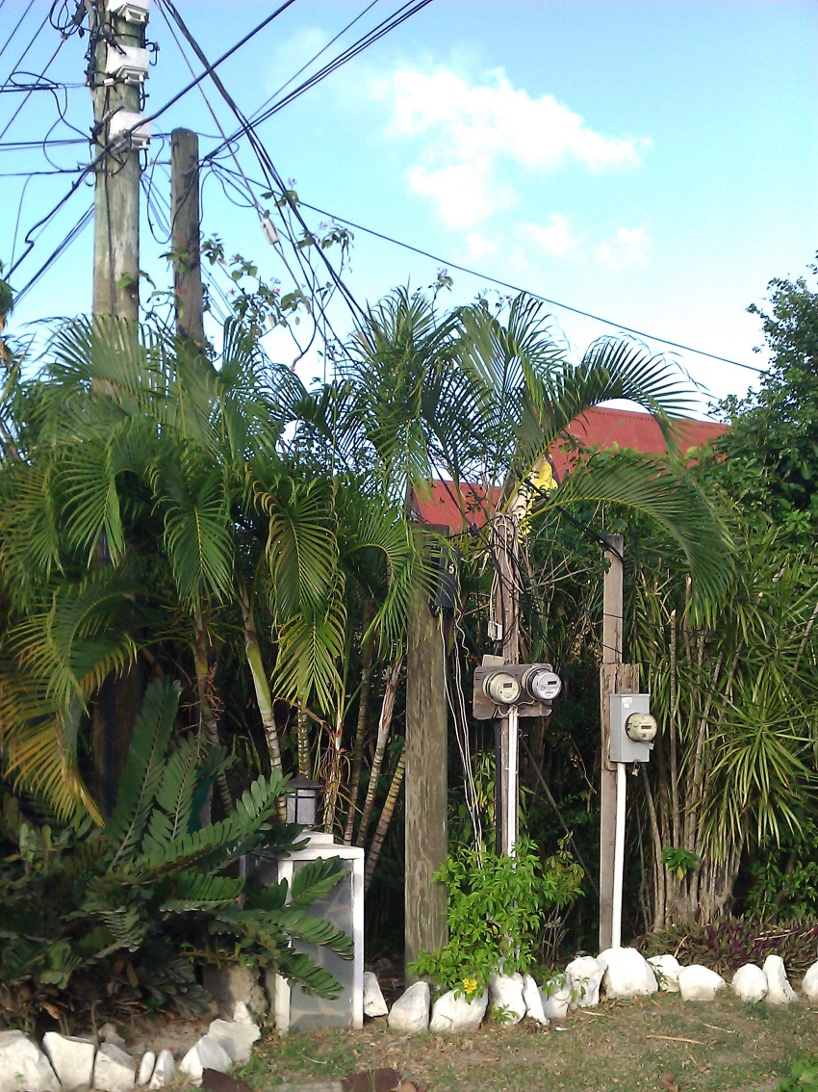
Fraud detection
Problem:
US – about 10%
Brazil Favelas – 60%
Solution:
Physical
Aggregation
Supply
Any other wires?
Meter

Slide 22
Aggregation for fraud detection
Use a feeder meter for a group of houses
Sum all house readings
Compare with feeder meter
Readings should be about the same
Rtotal
RA
RB
RC
How to detect fraud?
Rtotal
>>
RA
+
RB
+
RC

Slide 23
Privacy friendly aggregation
Aim:
compute sum without revealing readings.
2 Phases:
  Distribute keys
  Compute readings
RA
RB
RC

Slide 24
Privacy friendly aggregation
PKB = g^{xb}
KAB = H(g^{xa xb} | time)
Aim:
compute sum without revealing readings.
2 Phases:
  Distribute keys
  Compute readings
KAB
KAC
KAB
KBC
KAC
KBC
PKA, PKB, PKC
PKA, PKB, PKC
PKA, PKB, PKC
RA
RB
RC
PKA
PKB
PKC
Group
management
server
PKA, PKB, PKC

Slide 25
Privacy friendly aggregation
Aim:
compute sum without revealing readings.
2 Phases:
  Distribute keys
  Compute readings
KAB
KAC
KAB
KBC
KAC
KBC
RA
RB
RC
CA = RA
+ KAB
+ KAC
Group
management
server
CB = RB
- KAB
+ KBC
CC = RC
- KAC
- KBC
Sum = CA + CB + CC = RA + RB + RC

Slide 26
Really?
Sum = CA + CB + CC =
RA
+ KAB
+ KAC
+ RB
- KAB
+ KBC
RC
- KAC
- KBC
= RA + RB + RC

Slide 27
Security & performance
Privacy friendly aggregation is possible without revealing any readings!
  (Proofs of security reduce scheme to DH + Hash)
Very efficient
  Public keys are 32 bytes
  No public key operations to generate readings
  No communication overhead

Slide 28

Where next?
Language & compiler for complex verifiable computations.
Automotive applications & metering
  PAYD, LBS, CC, Tax

Slide 29
Conclusion
Smart metering can be done without violating privacy
Private billing, and other uses of data are possible.
  Side information can be revealed (and is certified) for other uses
  Tariff structure can change as fast as software can be updated on untrusted machines.
  Fast protocols as fast as uncertified calculations.
  General protocols well within realm of real-time.
Aggregation does not require anyone to know detailed readings
  Can do real time monitoring and fraud detection with privacy
Paradigm shift: Trustworthy computations in the client domain for privacy.

Slide 30
Resources
Technical report & other resources:
  http://research.microsoft.com/en-us/projects/privacy_in_metering/
Alfredo Rial & George Danezis. Privacy-friendly smart metering. Microsoft Research Technical Report MSR-TR-2010-150. November 19, 2010.
George Danezis, Markulf Kohlweiss, and Alfredo Rial. Differentially Private Billing with Rebates. Microsoft Research Technical Report MSR-TR-2011-10. February 2011.
Klaus Kursawe, Markulf Kohlweiss, George Danezis. Privacy-friendly Aggregation for the Smart-grid. Microsoft Research Tech Report, March 2011.
Nikhil Swamy, Juan Chen, Cedric Fournet, Karthikeyan Bharagavan, and Jean Yang. Security Programming with Refinement Types and Mobile Proofs. Microsoft Research Technical Report MSR-TR-2010-149. November 2010.

