Slide 1



Predicting Post-Operative Visual Acuity for LASIK Surgeries
Manish Gupta, Prashant Gupta, Pravin K. Vaddavalli, Asra Fatima
April 19, 2016
Pacific Asia Knowledge Discovery and Data Mining Conference (PAKDD) 2016

Slide 2
Motivation
LASIK (Laser-Assisted in SItu Keratomileusis) surgeries may not be recommended for everyone
  high cost with potentially no significant improvement for certain types of patients
  possible eye complications after the surgery
LASIK surgeries cost approximately $2000 USD per surgery. An ability to predict post-operative UCVA can help patients make an informed decision about investing their money in undergoing a LASIK surgery or not.
  It can also help surgeons recommend the most promising type of laser surgery to the patients.
  How can we perform this prediction?
Further, while performing such surgeries, surgeons need to set multiple parameters like suction time, flap and hinge details, etc. These are often set using manually designed rules.
  Can we design a data driven automated method to suggest the best settings for a patient undergoing a laser surgery of a certain type?

Slide 3
Problem
Given pre-surgery data (Pre-operative examination results and demography information) about 404 patients (791 LASIK surgeries) from 2013 and 2014
Train a machine learning model to predict what would be the new “eye number” (Uncorrected Visual Acuity or UCVA) 1 day/1 week/1 month after the surgery

Slide 4
Challenges
The problem is challenging because
  large amount of data about such surgeries is not easily available
  there are a lot of pre-operative measurements that can be used as signals
  data is sparse, i.e., there are a lot of missing values.

Slide 5
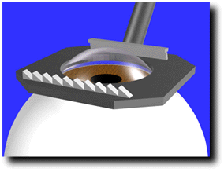
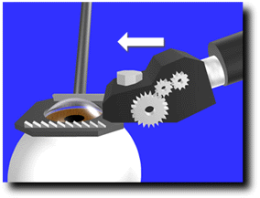
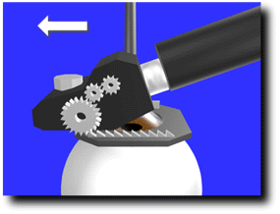
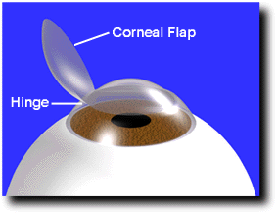
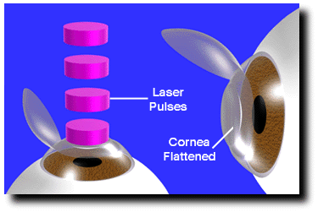
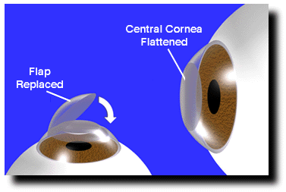
Laser Surgery Process
A suction ring is centered over the cornea of the eye
The microkeratome creates a partial flap in the cornea of uniform thickness
The corneal flap is folded back on the hinge exposing the middle portion of the cornea.
The excimer laser is then used to remove tissue and reshape the center of the cornea.
In the final step, the hinged flap is folded back into its original position.

Slide 6
Types of LASIK Surgeries
Plano-scan-LASIK: The corneal tissue is evenly ablated by the laser beam.
Aspheric-LASIK: Ablate the corneal tissue in an “egg-shaped” way using a “flying spot” laser beam.
Tissue-saving-LASIK: The aim is to save as much corneal tissue as possible during the laser ablation time.
Wavefront-guided-LASIK (“individualized” or “personalized”): the eyes are measured pre-operatively using a wavefront pattern scanner.

Slide 7
Features
Demography details
  Gender, age
Pre-operation examination details
  UCVA (uncorrected), Near vision, BCVA (best) with glasses, Sphere, Cylinder, Axis, Spherical equivalent, Slit lamp, IOP, Retina, Topography machine, AR sphere, AR cylinder, AR Axis, Preop Corneal Thickness-Thinnest, steep-K, Flat -K, Axis@Flat K

Slide 8
Features
Uncorrected Visual Acuity (UCVA): VA without glasses.
Uncorrected Near vision: VA measured using a small chart held near the patient.
Corrected Near vision: VA measured using a small chart held near the patient with glasses.
BCVA with glasses: The best VA one can achieve with glasses.

Slide 9
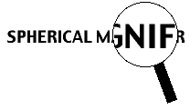
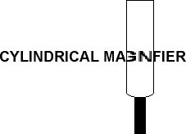

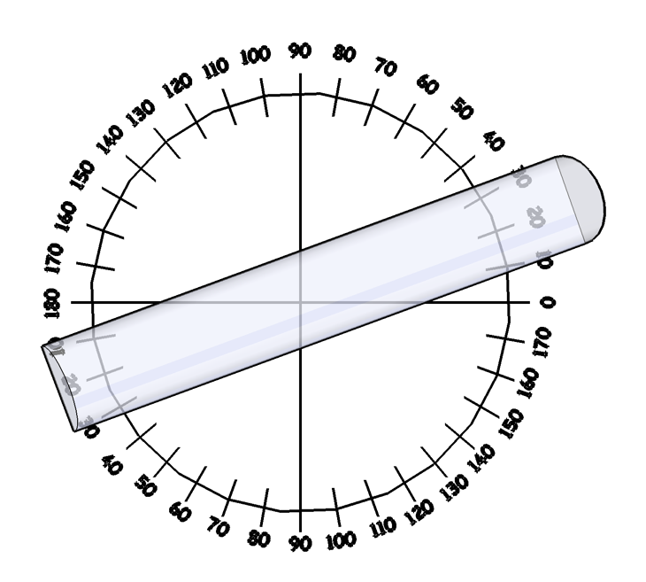
Features
Current sphere, cylinder and axis
Sphere: Correction in all meridians of the eye
Cylinder: Correction perpendicular to the axis direction
Axis: Lens meridian that contains no cylindrical power

Slide 10
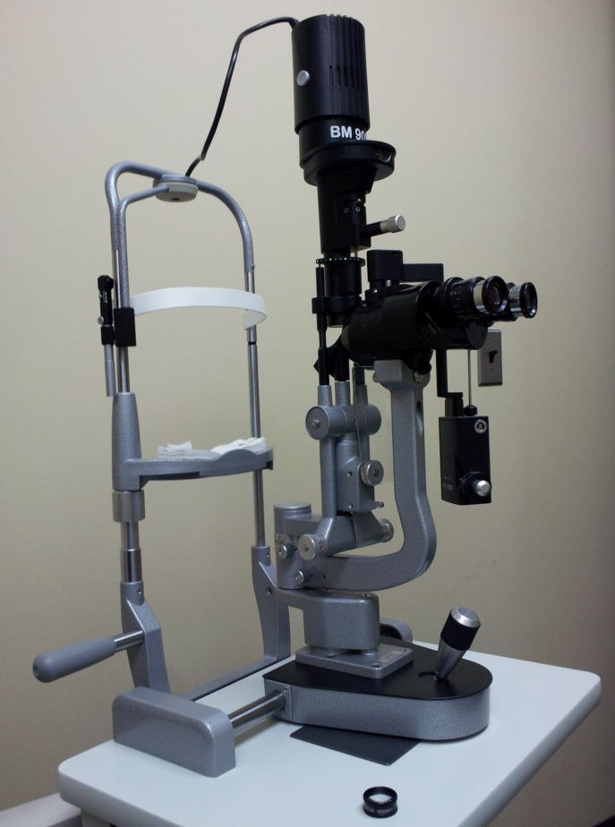
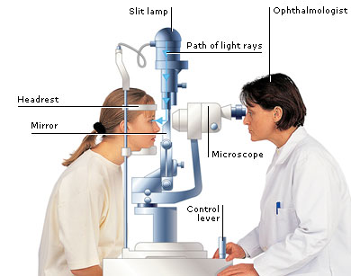
Features
Spherical equivalent: sphere+0.5*clinder
Slit lamp exam: microscopic study of various structures of the eye like eyelid(s), lashes, conjunctiva, cornea, anterior chamber, pupil, iris, vitreous, and retina

Slide 11
Features
IOP (intraocular pressure)
Retina examination: binary feature (“normal”/“abnormal”)
Steep-K, Flat-K and Axis@Flat-K: Lower diopter number represents the less steep meridian of the cornea, or the “flat-K”. The higher diopter number represents the steepest meridian of the cornea, or the “steep-K”. Usually these are numbers between 40 and 50. Axis@Flat-K is a number from 1 to 180.
Thinnest Preop Corneal Thickness: The minimum thickness of the cornea. (450 to 650 microns)
Topography machine: Orbscan, Galilei and Oculyzer.

Slide 12
Surgery Settings as Features
Surgery type: Plano-scan, Aspheric, tissue-saving, or wavefront-guided.
Flap thickness: between 100 microns and 120 microns.
Suction time: from half a minute to a minute.
Optic zone: size of the treatment area. diameter between 6-7 mm.
Flap diameter
Flap side cut angle
Hinge details: This includes hinge position (usually 90), hinge angle (40 to 60 degrees), and the hinge width (3 to 4.5 mm).

Slide 13
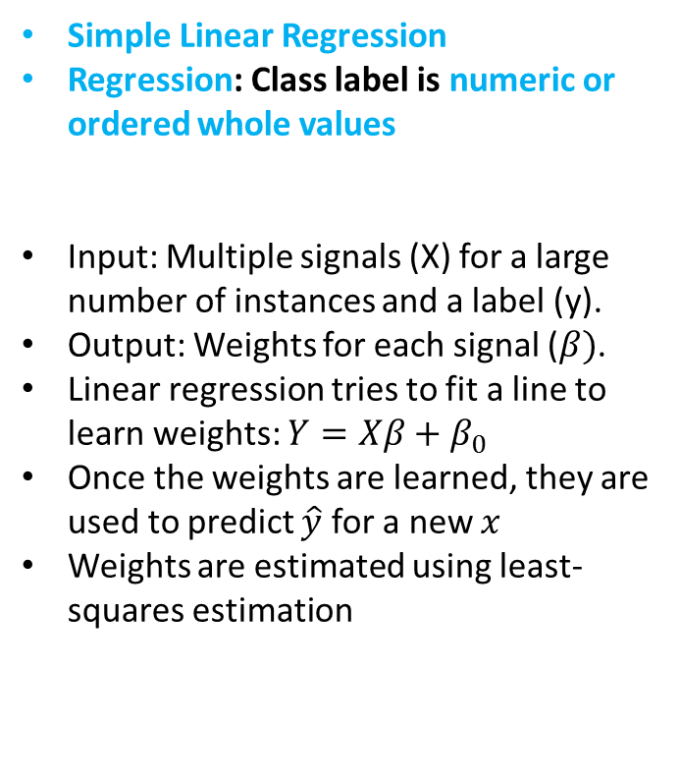

Method: Regression
Simple Linear Regression
Regression: Class label is numeric or ordered whole values
Input: Multiple signals (X) for a large number of instances and a label (y).
Output: Weights for each signal ($β)$.
Linear regression tries to fit a line to learn weights: $Y=Xβ+β_{0}$
Once the weights are learned, they are used to predict $\hat{y}$ for a new $x$
Weights are estimated using least-squares estimation
$\hat{y}$ is the predicted value of y for a given value of x
Quantify this relationship y=381.68x+3276.2

Slide 14
Multiple Forms of Regression
GDBT Regression
Online Gradient Descent based Regression
Neural network based regression
Poisson Regression

Slide 15
GDBT Regression
The MART gradient boosting algorithm learns an ensemble of regression trees, which is a decision tree with scalar values in its leaves.
The functions that can be produced by a regression tree are all the piece-wise constant functions.
The ensemble of trees is produced by computing, in each step, a regression tree that approximates the gradient of the loss function, and adding it to the previous tree with coefficients that minimize the loss of the new tree.
The output of the ensemble produced by MART on a given instance is the sum of the tree outputs. In case of a regression problem, the output is the predicted value of the function.

Slide 16
Dataset Statistics
404 patients (215 females, 189 males).
791 surgeries (397 left eyes, 394 right eyes).
Pre-operative UCVA: between 0.15 and 2
Post-operative UCVA: between 0.2 and 1 for day 1, -0.3 and 1 for week 1, -0.2 and 0.95 for month 1.
Missing values were replaced by the average value for the column for numeric features, and by the most frequent value for the column for categorical features.

Slide 17
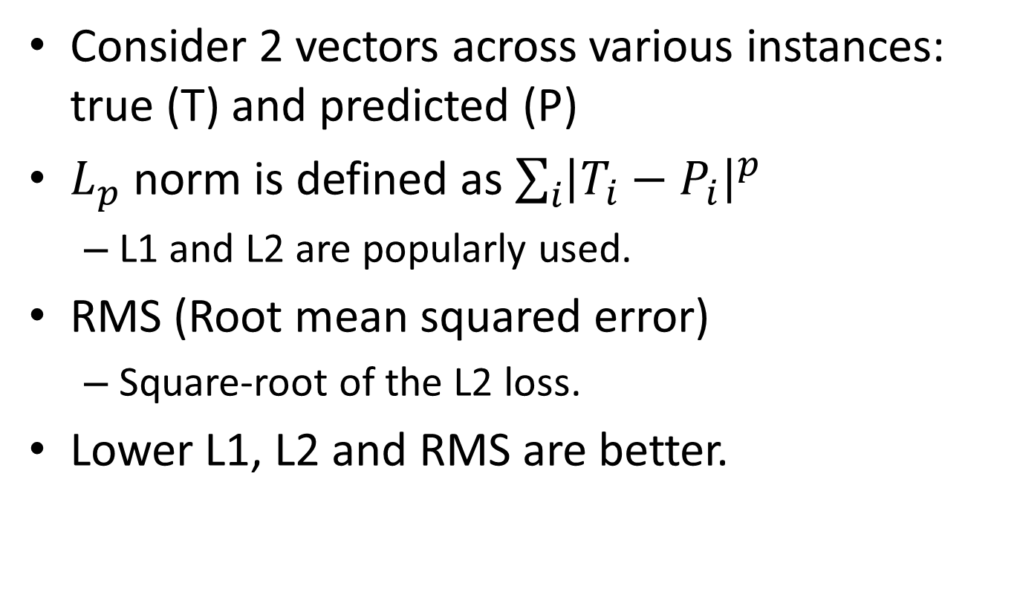
Metrics to Evaluate the Model
Consider 2 vectors across various instances: true (T) and predicted (P)
$L_{p}$ norm is defined as $\sum_{i}{{\left|T_{i}−P_{i}\right|}^{p}}$
  L1 and L2 are popularly used.
RMS (Root mean squared error)
  Square-root of the L2 loss.
Lower L1, L2 and RMS are better.

Slide 18
Results Summary (10-fold Cross Validation)
Model | L1(avg) | L2(avg) | RMS(avg)
OnlineGradientDescent | 0.0771 (0.0084) | 0.0136 (0.0065) | 0.1155 (0.026)
PoissonRegression | 0.0744 (0.008) | 0.0128 (0.0049) | 0.1108 (0.0217)
GDBTRegression | 0.0695 (0.0123) | 0.0108 (0.0051) | 0.1024 (0.0234)
RegressionNeuralNetwork | 0.082 (0.0077) | 0.0142 (0.0068) | 0.1179 (0.027)
Day 1
Learner Name | L1(avg) | L2(avg) | RMS(avg)
OnlineGradientDescent | 0.0638 (0.0068) | 0.0132 (0.0057) | 0.112 (0.0244)
RegressionNeuralNetwork | 0.0643 (0.011) | 0.0149 (0.0073) | 0.1184 (0.03)
GDBTRegression | 0.0577 (0.007) | 0.0094 (0.0032) | 0.094 (0.0161)
PoissonRegression | 0.061 (0.0118) | 0.0118 (0.0067) | 0.1064 (0.0298)
Week 1

Slide 19
Results Summary (Day 1 UCVA)

Slide 20

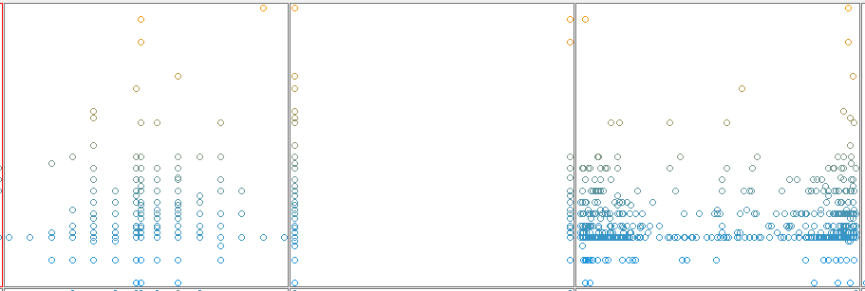
Post-operative UCVA
BCVA with glasses
Spherical Equivalent
Slit Lamp Examination
Post-operative UCVA
IOP
Retina Examination
Axis @ Flat-K

Slide 21
Most Important Features
Day 1 | Week 1 | Month 1
BCVA with glasses | BCVA with glasses | Age
Spherical equivalent | Spherical equivalent | Uncorrected near vision
Slit lamp examination | Corrected near vision | BCVA with glasses
IOP | Thinnest Preop Corneal Thickness | Axis
Axis@Flat K | Axis@Flat K | Spherical Equivalent

Slide 22
Related Work
Data Mining in Healthcare
  Personalized medicine [9]
  Phenotyping [7, 15, 14]
  Analysis of electronic medical records [5, 18]
  Mortality prediction [11, 16]
  Patient re-admission risks [6, 4]
Visual Acuity Prediction
  Baron et al. [3] use pupil size, ablation size, refractive error, and photoreceptor directional sensitivity as features and a point-spread function
    For PRK (photorefractive keratectomy) surgeries
  Olsen et al. [17] use coloboma size, optic nerve color, foveal development, and subfoveal retinal pigment epithelial changes as features and linear regression
    For children

Slide 23
Take-aways
Problem: Given pre-surgery data about 404 patients. Train a machine learning model to predict what would be the new “eye number” (Uncorrected Visual Acuity or UCVA) 1 day/1 week/1 month after the surgery
We modeled the problem as a regression problem.
Overall we can predict the right “eye number” UCVA with an RMSE of 0.102, 0.094 and 0.074 respectively for day 1, week 1 and month 1 after the surgery.

Slide 24
Thanks! gmanish@microsoft.com

Slide 25
References
1. Raymond A Applegate, Charles Ballentine, Hillery Gross, Edwin J Sarver, and Charlene A Sarver. Visual Acuity as a Function of Zernike Mode and Level of Root Mean Square Error. Optometry & Vision Science, 80(2):97–105, 2003.
2. Dimitri T Azar and Douglas Koch. LASIK (Laser in Situ Keratomileusis): Fundamentals, Surgical Techniques, and Complications. CRC Press, 2002.
3. WS Baron and C Munnerlyn. Predicting Visual Performance following Excimer Photorefractive Keratectomy. Refractive & Corneal Surgery, 8(5):355–362, 1991.
4. Senjuti Basu Roy, Ankur Teredesai, Kiyana Zolfaghar, Rui Liu, David Hazel, Stacey Newman, and Albert Marinez. Dynamic Hierarchical Classification for Patient Risk-of- Readmission. In Proceedings of the 21th ACM SIGKDD International Conference on Knowledge Discovery and Data Mining, 1691–1700. ACM, 2015.
5. Karla L Caballero Barajas and Ram Akella. Dynamically Modeling Patient’s Health State from Electronic Medical Records: A Time Series Approach. In Proceedings of the 21th ACM SIGKDD International Conference on Knowledge Discovery and Data Mining, 69–78. ACM, 2015.
6. Rich Caruana, Yin Lou, Johannes Gehrke, Paul Koch, Marc Sturm, and No´emie Elhadad. Intelligible Models for HealthCare: Predicting Pneumonia Risk and Hospital 30-day Readmission. In Proceedings of the 21th ACM SIGKDD International Conference on Knowledge Discovery and Data Mining, 1721–1730. ACM, 2015.
7. Zhengping Che, David Kale, Wenzhe Li, Mohammad Taha Bahadori, and Yan Liu. Deep Computational Phenotyping. In Proceedings of the 21th ACM SIGKDD International Conference on Knowledge Discovery and Data Mining, 507–516. ACM, 2015.
8. Xu Cheng, Arthur Bradley, and Larry N Thibos. Predicting Subjective Judgment of Best Focus with Objective Image Quality Metrics. Journal of Vision, 4(4):7, 2004.
9. Kai Fan, Marisa Eisenberg, AlisonWalsh, Allison Aiello, and Katherine Heller. Hierarchical Graph-Coupled HMMs for Heterogeneous Personalized Health Data. In Proceedings of the 21th ACM SIGKDD International Conference on Knowledge Discovery and Data Mining, 239–248. ACM, 2015.
10. Wade Faulkner. Laser Interferometric Prediction of Postoperative Visual Acuity in Patients with Cataracts. American Journal of Ophthalmology, 95(5):626–636, 1983.

Slide 26
References
11. Marzyeh Ghassemi, Tristan Naumann, Finale Doshi-Velez, Nicole Brimmer, Rohit Joshi, Anna Rumshisky, and Peter Szolovits. Unfolding physiological state: Mortality modelling in intensive care units. In Proceedings of the 20th ACM SIGKDD international conference on Knowledge discovery and data mining, 75–84. ACM, 2014.
12. Antonio Guirao, David R Williams, et al. A Method to Predict Refractive Errors from Wave Aberration Data. Optometry & Vision Science, 80(1):36–42, 2003.
13. M. A. Hall. Correlation-based Feature Subset Selection for Machine Learning. PhD thesis, University of Waikato, Hamilton, New Zealand, 1998.
14. Joyce C Ho, Joydeep Ghosh, and Jimeng Sun. Marble: High-throughput phenotyping from electronic health records via sparse nonnegative tensor factorization. In Proceedings of the 20th ACM SIGKDD international conference on Knowledge discovery and data mining, 115–124. ACM, 2014.
15. Chuanren Liu, Fei Wang, Jianying Hu, and Hui Xiong. Temporal Phenotyping from Longitudinal Electronic Health Records: A Graph Based Framework. In Proceedings of the 21th ACM SIGKDD International Conference on Knowledge Discovery and Data Mining, 705–714. ACM, 2015.
16. Nozomi Nori, Hisashi Kashima, Kazuto Yamashita, Hiroshi Ikai, and Yuichi Imanaka. Simultaneous Modeling of Multiple Diseases for Mortality Prediction in Acute Hospital Care. In Proceedings of the 21th ACM SIGKDD International Conference on Knowledge Discovery and Data Mining, 855–864. ACM, 2015.
17. TW Olsen, CG Summers, and WH Knobloch. Predicting Visual Acuity in Children with Colobomas involving the Optic Nerve. Journal of Pediatric Ophthalmology and Strabismus, 33(1):47–51, 1995.
18. Sriram Somanchi, Samrachana Adhikari, Allen Lin, Elena Eneva, and Rayid Ghani. Early Prediction of Cardiac Arrest (Code Blue) using Electronic Medical Records. 1691– 1700, 2015.
19. Robert C Spurny, Roberto Zaldivar, C Davis Belcher, and Richard J Simmons. Instruments for Predicting Visual Acuity: A Clinical Comparison. Archives of Ophthalmology, 104(2):196–200, 1986.
20. Larry N Thibos, Xin Hong, Arthur Bradley, and Raymond A Applegate. Accuracy and Precision of Objective Refraction from Wavefront Aberrations. Journal of Vision, 4(4):9, 2004.
21. Andrew B Watson and Albert J Ahumada. Predicting Visual Acuity from Wavefront Aberrations. Journal of Vision, 8(4):17, 2008.

