Slide 1

Author2Vec: Learning Author Representations by Combining Content and Link Information
Ganesh J, Soumyajit Ganguly, Manish Gupta, Vasudeva Varma, Vikram Pudi

Slide 2
Problem
Learn representations (or feature vectors) for each author in bibliographic co-authorship network.
The representation must capture the network properties of each author (i.e. authors who work in the same research area must be closer in the vector space), in a compact form.

Slide 3
Applications
The representations learned will help solve the following network mining tasks using off-the-shelf machine learning algorithms.
  Author classification
  Author recommendation
  Co-authorship prediction
  Author visualization

Slide 4
Existing Work
State-of-the-art: DeepWalk (Perozzi et al.)
DeepWalk converts a graph into a collection of sequences containing vertices using uniform sampling (truncated random walk).
Assuming each sequence as a sentence, they run the Skip-gram model (Mikolov et al.) to learn representation for each vertex.

Slide 5
Challenges
Link sparsity problem in real world information network.
For instance, two authors who write scientific articles related to the field ‘Machine Learning’ are not considered to be similar by DeepWalk if they are not connected.

Slide 6
Overcoming link sparsity problem
Can we use the content information (research article content) to bring authors who write similar content, closer?
Can it complement the model focusing on link information only?
In this work, we experiment with two models: one capturing the network information and the other capturing the textual information.

Slide 7
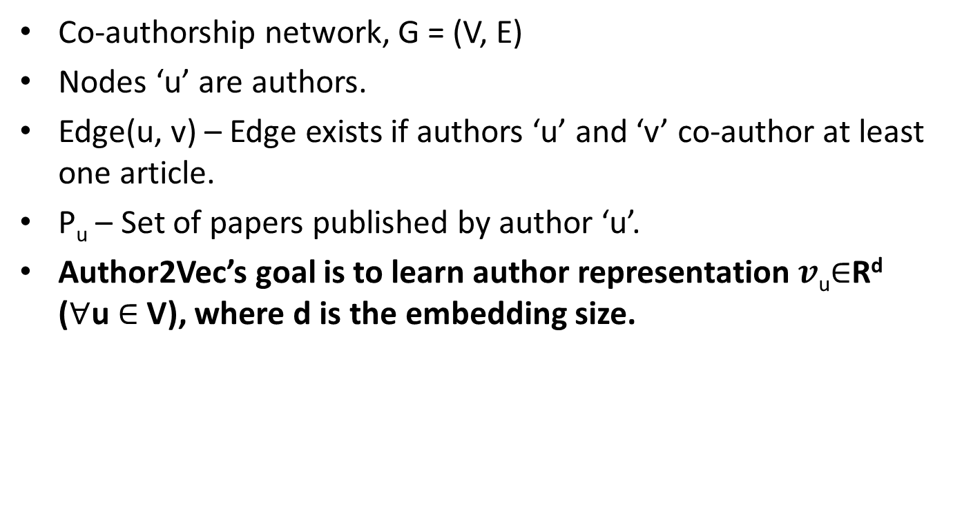
Problem formulation
Co-authorship network, G = (V, E)
Nodes ‘u’ are authors.
Edge(u, v) – Edge exists if authors ‘u’ and ‘v’ co-author at least one article.
P_{u} – Set of papers published by author ‘u’.
Author2Vec’s goal is to learn author representation $v$_{u}$∈$R^{d} ($∀$u $∈$ V), where d is the embedding size.

Slide 8
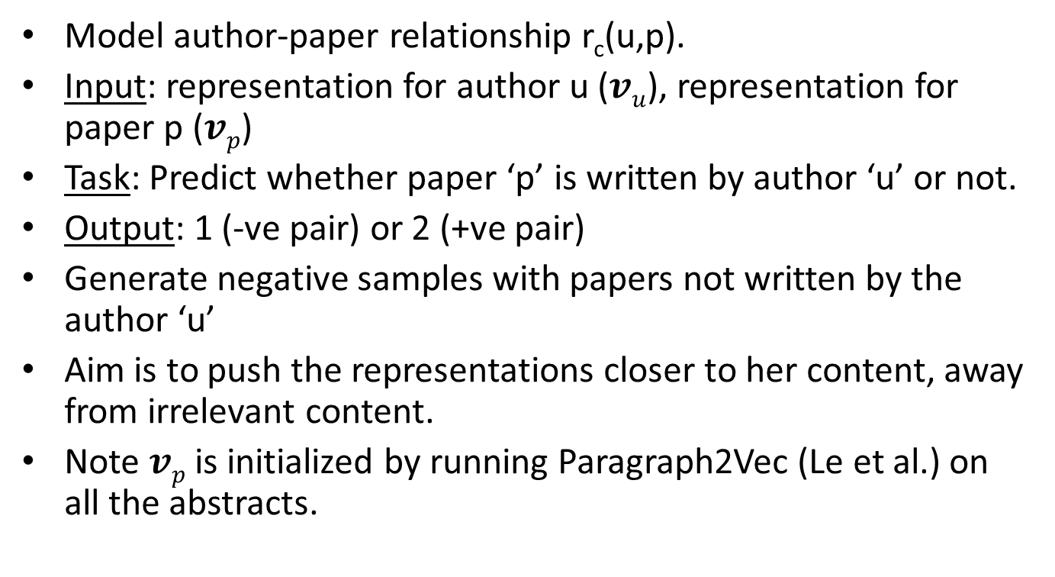
Content-Info model (1)
Model author-paper relationship r_{c}(u,p).
Input: representation for author u ($vu$), representation for paper p ($vp$)
Task: Predict whether paper ‘p’ is written by author ‘u’ or not.
Output: 1 (-ve pair) or 2 (+ve pair)
Generate negative samples with papers not written by the author ‘u’
Aim is to push the representations closer to her content, away from irrelevant content.
Note $vp$ is initialized by running Paragraph2Vec (Le et al.) on all the abstracts.

Slide 9
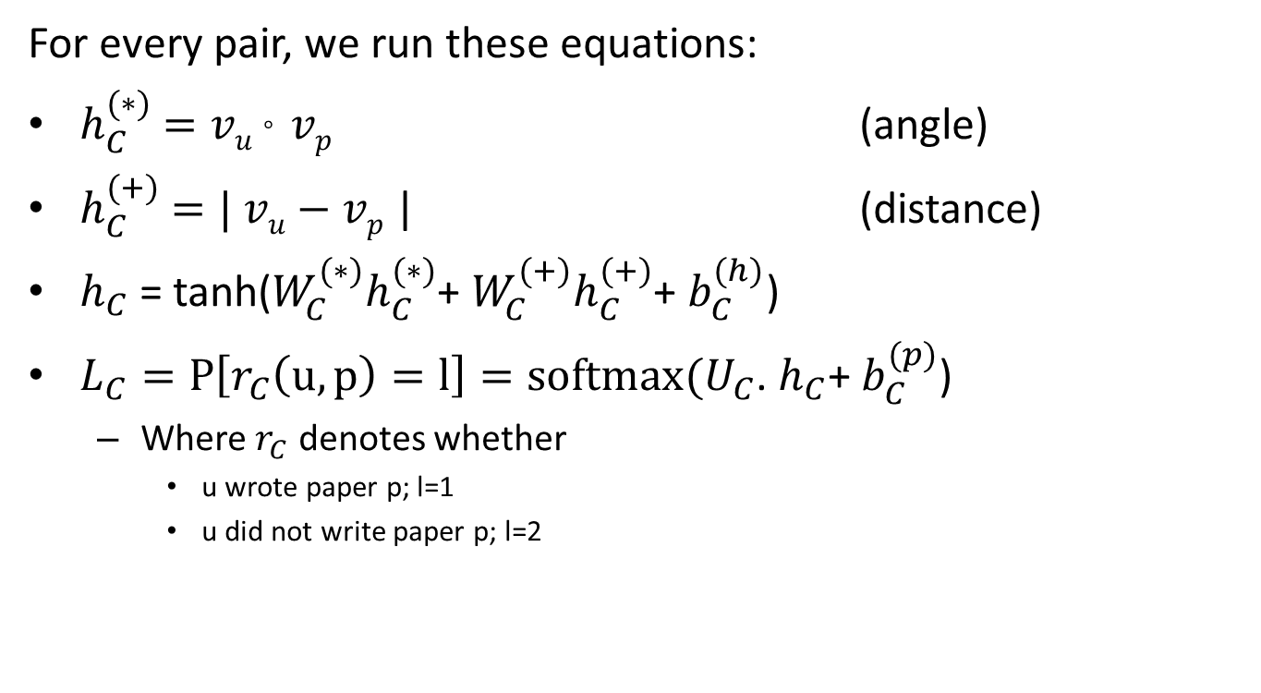
Content-Info model (2)
For every pair, we run these equations:
$h_{C}^{(∗)}$ $=vu$ $°$ $vp$ (angle)
$h_{C}^{(+)}$ $=| vu$ $−$ $vp$ | (distance)
$h_{C}$ = tanh(${W_{C}^{(∗)}h}_{C}^{(∗)}$+ ${W_{C}^{(+)}h}_{C}^{(+)}$+ $b_{C}^{(h)}$)
$L_{C}=P\left[r_{C}\left(u,p\right)=l\right]=softmax(U_{C}$. $h_{C}\text{+ }b_{C}^{(p)}\text{)}$
  Where $r_{C}$ denotes whether
    u wrote paper p; l=1
    u did not write paper p; l=2

Slide 10
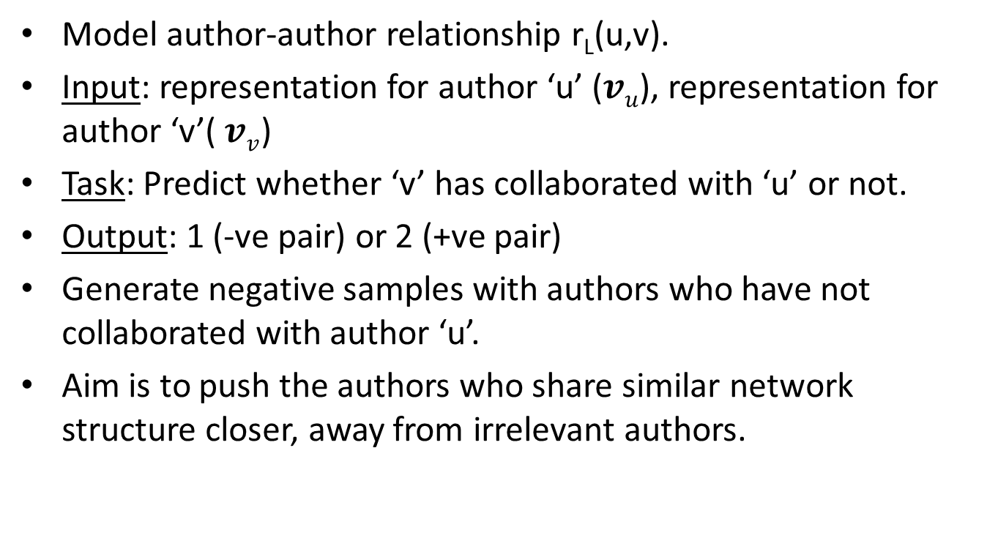
Link-Info model (1)
Model author-author relationship r_{L}(u,v).
Input: representation for author ‘u’ ($vu$), representation for author ‘v’($vv$)
Task: Predict whether ‘v’ has collaborated with ‘u’ or not.
Output: 1 (-ve pair) or 2 (+ve pair)
Generate negative samples with authors who have not collaborated with author ‘u’.
Aim is to push the authors who share similar network structure closer, away from irrelevant authors.

Slide 11
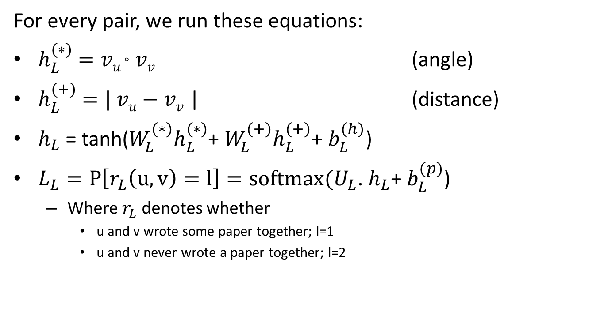
Link-Info model (2)
For every pair, we run these equations:
$h_{L}^{(∗)}$ $=vu$ $°$ $vv$ (angle)
$h_{L}^{(+)}$ $=| vu$ $−$ $vv$ | (distance)
$h_{L}$ = tanh(${W_{L}^{(∗)}h}_{L}^{(∗)}$+ ${W_{L}^{(+)}h}_{L}^{(+)}$+ $b_{L}^{(h)}$)
$L_{L}=P\left[r_{L}\left(u,v\right)=l\right]=softmax(U_{L}$. $h_{L}\text{+ }b_{L}^{(p)}\text{)}$
  Where $r_{L}$ denotes whether
    u and v wrote some paper together; l=1
    u and v never wrote a paper together; l=2

Slide 12

Author2Vec
Overall objective function: $L$= $L_{C}$ +${ L}_{L}$
Uses Stochastic Gradient Descent (SGD) and Backpropagation to learn unknown parameters
Learning rate is fixed at 0.1.

Slide 13
Evaluation (1)
Dataset: DBLP (Chakraborty et al.)
  711810 papers (along with abstracts)
  500361 authors
  24 computer science fields (paper tags)
Baseline: DeepWalk

Slide 14
Evaluation (2)
Tasks-
  Link Prediction
    Training years: 1990-2009
    Testing year: 2010
    Logistic Regression
  Clustering
    K-Means (with k=24)
    Pick the field in which the author publishes the most as his/her tag.

Slide 15
Evaluation (3)
Performance comparison
Task | Link Prediction | Clustering
Model\Metric | Accuracy (%) | NMI (%)
DeepWalk | 81.965 | 19.956
Content-info | 80.707 | 19.823
Link-info | 72.808 | 19.163
Author2Vec | 83.894 | 20.122

Slide 16
Conclusion
Author2Vec fuses content and link information to learn author embeddings given a co-authorship network.
Future Directions:
  Considering weighted graphs (‘weight’ indicates the number of papers co-authored).
  Incorporating the global network information.

Slide 17
References
[1] Ahmed, A., Shervashidze, N., Narayanamurthy, S., Josifovski, V., Smola, A.J.: Distributed Large-scale Natural Graph Factorization. In: WWW. (2013) 37-48
[2] Perozzi, B., Al-Rfou, R., Skiena, S.: DeepWalk: online learning of social representations. In: KDD. (2014) 701-710
[3] Le, Q., Mikolov, T.: Distributed Representations of Sentences and Documents. In: ICML. (2014) 1188-1196
[4] Chakraborty, T., Sikdar, S., Tammana, V., Ganguly, N., Mukherjee, A.: Computer Science Fields as Ground-truth Communities: Their Impact, Rise and Fall. In: ASONAM. (2013) 426-433
[5] Mikolov, T., Sutskever, I., Chen, K., Corrado, G., Dean, J.: Distributed Representations of Words and Phrases and their Compositionality. In: NIPS. (2013) 3111-3119
[6] Nowell, D.L., Kleinberg, J.: The link-prediction problem for social networks. In: Journal of the American Society for Information Science and Technology. (2007) 1019-1031
[7] Tai, K.S., Socher, R., Manning, C.D.: Improved semantic representations from tree-structured long short-term memory. In: ACL. (2015) 1556-1566

