Slide 1

Approximating Complex Ad-hoc BigData Queries
Srikanth Kandula, Anil Shanbhag, Aleksandar Vitorovic, Matthaios Olma,
Robert Grandl, Surajit Chaudhuri, Bolin Ding
Notes:
Hi, My name is Srikanth from Microsoft. I am here to tell you about how to approximate the complex ad-hoc queries that we see in big-data clusters. This is joint work with several collaborators.

Slide 2
Motivation: Approximating Big-Data Queries
Data-Analysis Clusters
  >10⁵ servers
  Exabytes of data
  >10⁶ queries/ day
  >70% avg. usage
Data, Queries
$
$
Results
1) Approximations can reduce query cost; even 2x is a big win
2) Queries are approximable
Dashboards (aggregations over groups with predicates)
ML jobs tolerate imprecision in early iterations
Notes:
Imagine a large shared cluster with tens of thousands of servers and exabytes of data. The cluster serves over a million queries each day, a mix of batch and interactive workload and the all-up average server usage is over 70%.
Such clusters are a sizable investment. Moreover the groups using the cluster pay for a share of the cluster; when their query load is larger than the paid-for-share, their queries wait in a queue.
So, we ask whether we can use approximations to lower cost of running queries.
Indeed, queries are approximable.
Several feed dashboards and are aggregations with predicates.
Some ML jobs tolerate imprecision in early iterations…

Slide 3
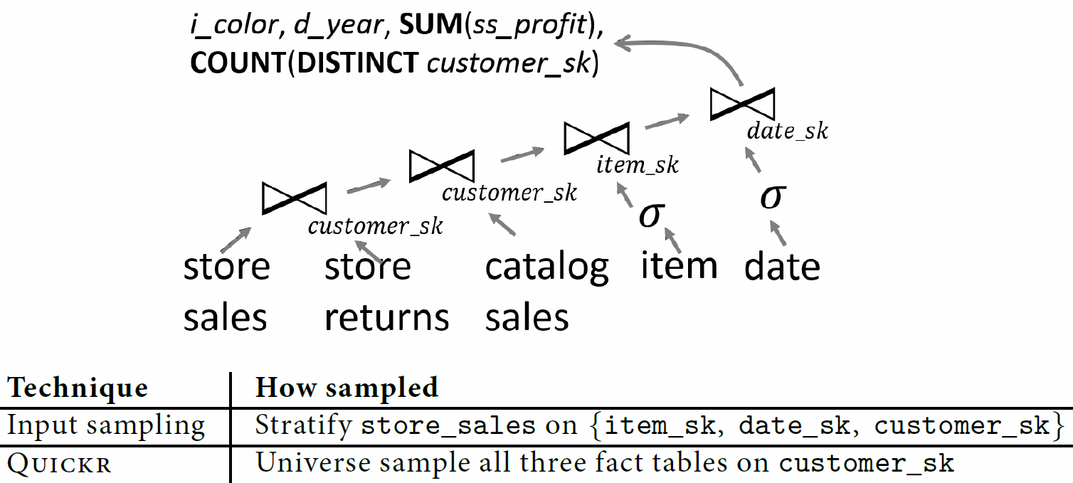
An example…
Can run 3X faster, reasonable accuracy **without** apriori {samples, indices} or pre-knowledge of query
Notes:
Here is an example query to frame the context.
There are couple of non foreign key joins, some predicates, groups and complex aggregates.
Will show you how we can speed this query up by 3X; return a decent answer; without any pre-existing samples or indices or views and without knowing query before hand.

Slide 4
Challenges in approximating big-data
Prior approach 1
Precompute samples per input table
Examine entire input at leisure
Predict.
Queries
Build optimal Samples
Data
offline
online
Plan
Query
Match
“Complex” “ad-hoc” queries are hard to match to pre-existing sample
Even otherwise, we see small gains and high storage costs
queries are diverse and use different inputs
non foreign-key joins
Notes:
There has been a lot of work in AQP; so lets quickly review some approaches.

Slide 5
Challenges in approximating big-data
Prior approach 2
Online aggregation: run the query until user is satisfied with answer
Zero apriori overhead
But, prior work
Only bernoulli sampling (“Zipcode, AVG(Salary)” needs stratification)
Costly to implement esp if out-of-memory and parallel plans (e.g., ripple join)

Slide 6
With minimal apriori overhead, can we approximate a large fraction of complex ad-hoc queries?
(high accuracy and performance gains)

Slide 7
Our approach
Compute synopses per {column, table}
Data
offline
online
Plans with samplers
Borrow the best of prior approaches
[precompute] sophisticated stats on input
[on-the-fly] add samplers to plan
2) Bridge significant technical gaps …
Query
QO ++
but not fully online
Minimal preparation: no samples, indices…
Robust to #datasets and ad-hoc queries.
For complex queries, can sample after predicates and joins…
When many passes over data, gains are large

Slide 8
We bridge significant technical gaps in on-the-fly sampling…
Streaming Samplers
Cost- and error-based selection of sampled plans

Slide 9
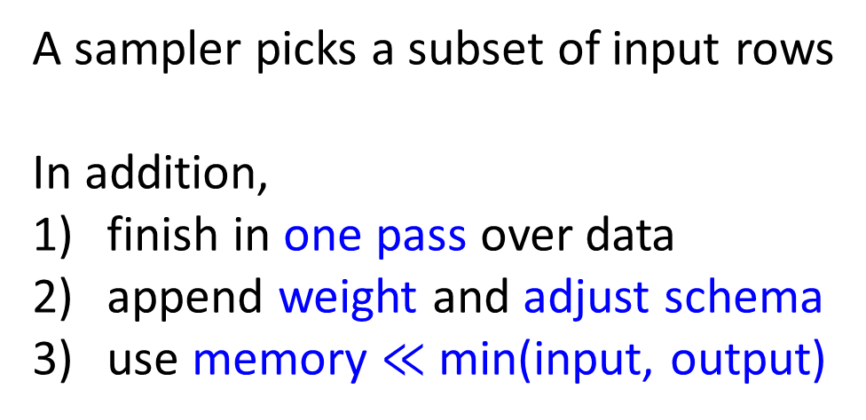
Samplers can be injected anywhere in parallel plan
A sampler picks a subset of input rows
In addition,
finish in one pass over data
append weight and adjust schema
use memory $≪$ min(input, output)
Sampler
+ Negligible overhead
+ Should not break vertex boundaries

Slide 10





Streaming Samplers
SUM(ss_profit)
SUM(ss_profit * w)
Uniform
$$Γ_{p}^{U}$$
store sales
item_sk, SUM(ss_profit)
item_sk, SUM(ss_profit*w)
Naively, memory required → O(input)
Idea: use heavy-hitter sketch (lossy counting)
Trade-off: mem vs. data reduction
Distinct
$$Γ^{D}$$
$$σ$$
$$p, f, \left\{item_sk\right\}$$
$$date_sk$$
store sales

Slide 11









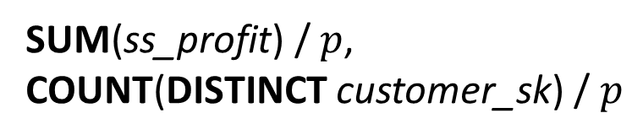


Streaming Samplers
SUM(ss_profit),
COUNT(DISTINCT customer_sk)
SUM(ss_profit) / $p$,
COUNT(DISTINCT customer_sk) / $p$
Universe
Sample after join has limited gains; esp. when parallel
Imagine…
$$$$
$$$$
$$customer_sk$$
$$Γ^{V}$$
$$Γ^{V}$$
$$p, \left\{customer_sk\right\}$$
$$p, \left\{customer_sk\right\}$$
store sales
store returns
Details
Applicability
$$Γ^{V}$$
$$:F\left(H\left(t_{C}\right)\right)=0$$
Not a uniform sample (higher variance, …)
Works for (multiple) equijoins
Careful reconciliation with stratification
Requires no co-ordination at runtime
$$p, C$$
Pick p random fraction (e.g., key xor mod-$\left\lceil \frac{1}{p}\right\rceil$)
Cryptographically strong hash function

Slide 12
New QO to reason about { } of sampled plans
accuracy
performance
How close is sampled aggregate to true val.?
Confidence intervals?
Miss groups?
Treat samplers first-class in QO vs. Add samplers post-facto
Method
  1) Inject samplers before every select with aggregates
  2) Cascade-style transformation rules (invariant: no worse error)
    Sampler has logical requirements (“what is needed to get good accuracy?’’)
    Rules move samplers and optionally edit requirements
  3) Costing decides which sampler if any to use
  [accuracy] support for average group after corrections
  [perf] data reduction (and saved work) due to sampler
  4) Compensate for imperfect stats: large grace; {y, n} for p=0.1

Slide 13










i_color, d_year, SUM(ss_profit), COUNT(DISTINCT customer_sk)
$$$$
$$$$
$$$$
$$date_sk$$
$$$$
EXAMPLE
$$$$
$$$$
$$item_sk$$
$$σ$$
$$customer_sk$$
$$σ$$
$$$$
$$$$
item
date
$$customer_sk$$
store
sales
store
returns
catalog
sales
Push to one input esp. if it is more work
Replace stratcols with join key; use sfm
Universe iff pushing to multiple join inputs
Ignore strat iff support is high
Need not strat on pred. cols; use ds
Add exchanges to reduce DOP

Slide 14
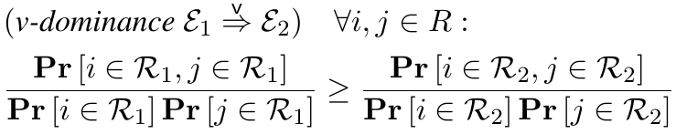
Analyzing accuracy of plans with samplers
Prior analysis works only for uniform sampler, does not consider group-miss, is expensive
We offer:
Dominance between sampled plans: sufficient conditions that ensure no worse error
Given expressions $ε_{1}$, $ε_{2}$ with same core; their outputs $R_{1}$, $R_{2}$; and $R$ is the answer w/o sampling,

Slide 15
















A family of dominance rules that relate a sampled query expression to one that has one sampler at the root
A family of dominance rules that relate a sampled query expression to one that has one sampler at the root
A family of dominance rules that relate a sampled query expression to one that has one sampler at the root
i_color, d_year, SUM(ss_profit), COUNT(DISTINCT customer_sk)
i_color, d_year, SUM(ss_profit), COUNT(DISTINCT customer_sk)
$$$$
$$Γ_{c}^{V}$$
$$$$
$$$$
dominates
$$$$
$$$$
$$$$
$$$$
$$$$
$$$$
$$date_sk$$
$$$$
$$$$
$$$$
$$item_sk$$
$$$$
$$$$
$$customer_sk$$
$$date_sk$$
$$$$
$$σ$$
$$σ$$
$$$$
$$item_sk$$
$$Γ_{c}^{V}$$
$$customer_sk$$
$$customer_sk$$
$$Γ_{c}^{V}$$
$$Γ_{c}^{V}$$
$$customer_sk$$
$$σ$$
$$σ$$
ss
sr
cs
item
date
ss
sr
cs
item
date
We compute unbiased estimators & confidence-intervals in one* pass on data

Slide 16
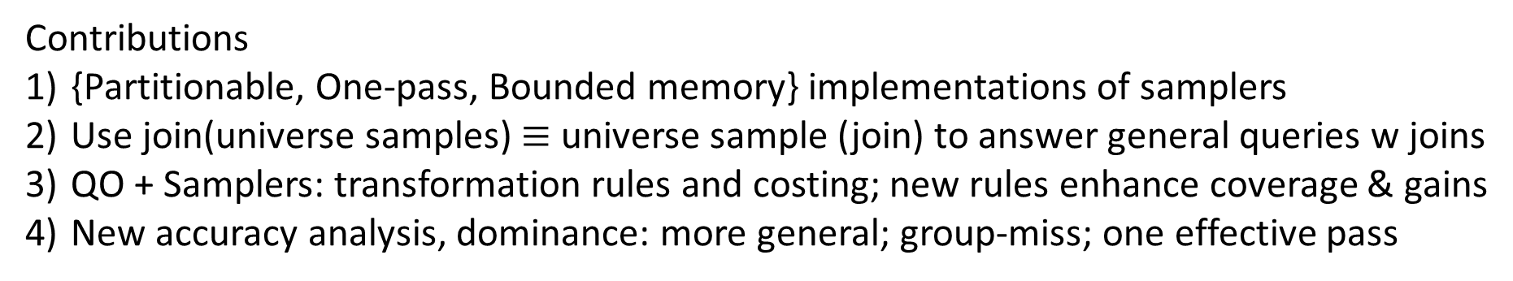
We bridge significant technical gaps in on-the-fly sampling…
Streaming Samplers
Cost- and error-based selection of sampled plans
Contributions
{Partitionable, One-pass, Bounded memory} implementations of samplers
Use join(universe samples) $≡$ universe sample (join) to answer general queries w joins
QO + Samplers: transformation rules and costing; new rules enhance coverage & gains
New accuracy analysis, dominance: more general; group-miss; one effective pass
Notes:
Use this as a conclusion slide

Slide 17
System and Evaluation
Functioning prototype deployed on Cosmos/ SCOPE clusters
Workloads
TPC-DS at scale factor 500 (also TPC-H and user scripts)
Compare with
Baseline without samplers
Blink-DB (assuming perfect matching)

Slide 18
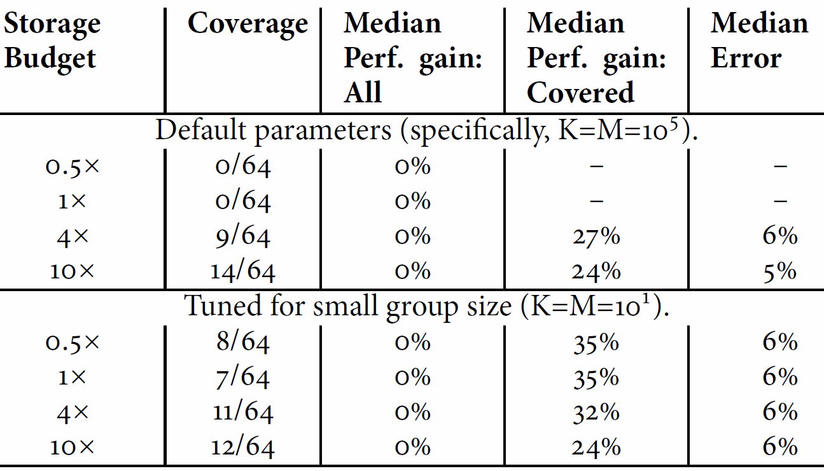
Apriori sampling has
Poor coverage
Small gains
High storage costs
Apriori sampling
On TPC-DS, results for BlinkDB
Query Dataset
Optimal Sample Construction
Data
Samples
offline
online
Plan
Query
Sample Selection

Slide 19
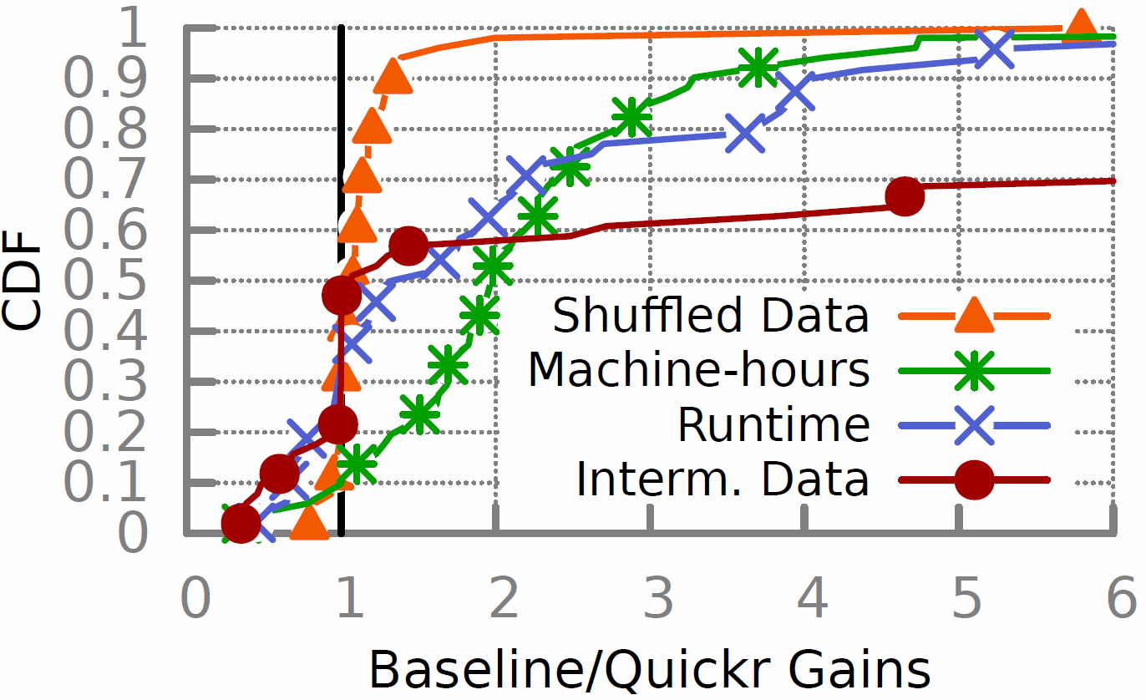
On-the-fly sampling
Collect Input stats.
Data
offline
Stats
online
Plans with samplers
Query
ASALQA
Query with samplers on all data
TPC-DS 500GB dataset
Experiments on cosmos09
Baseline is production Scope

Slide 20
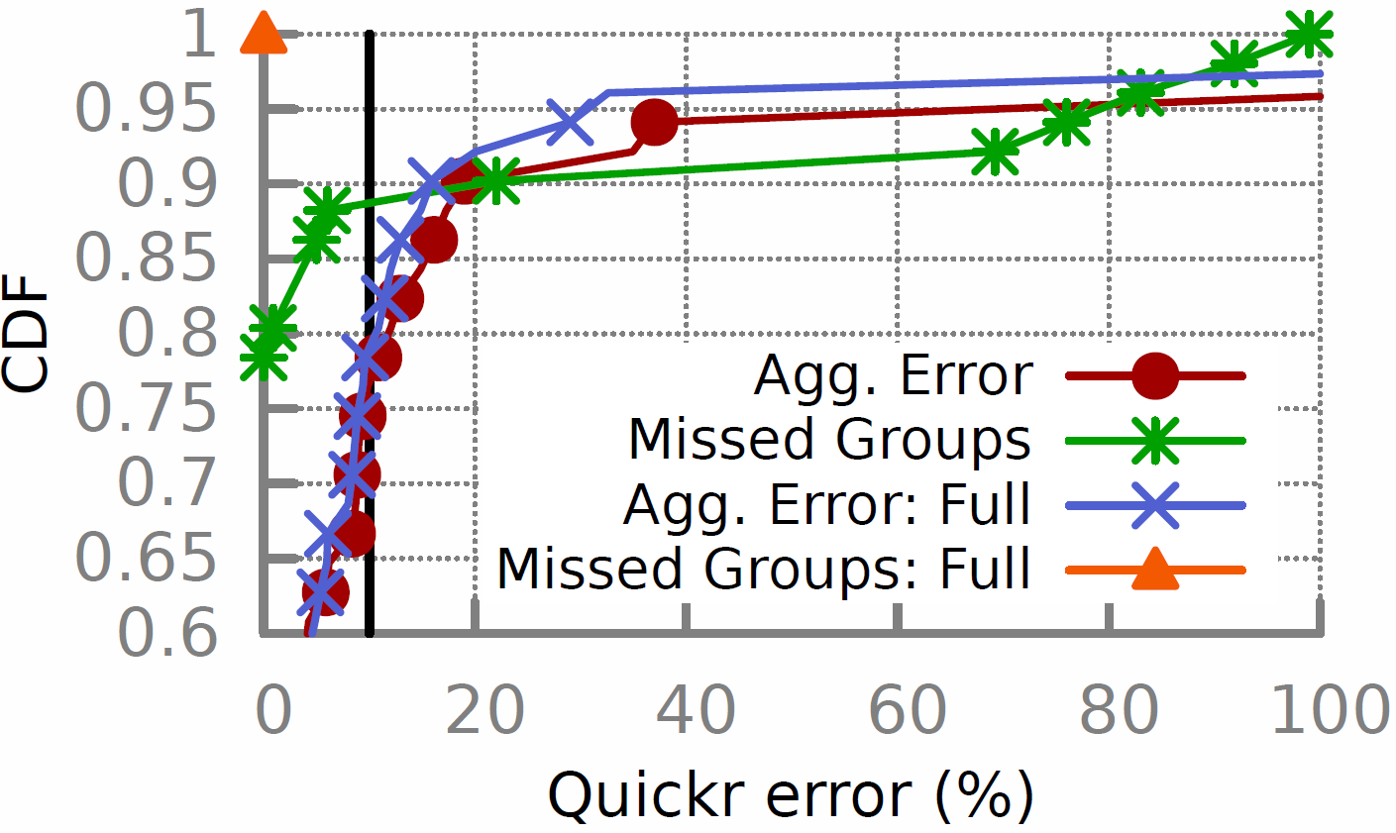
Accuracy guarantees

Slide 21

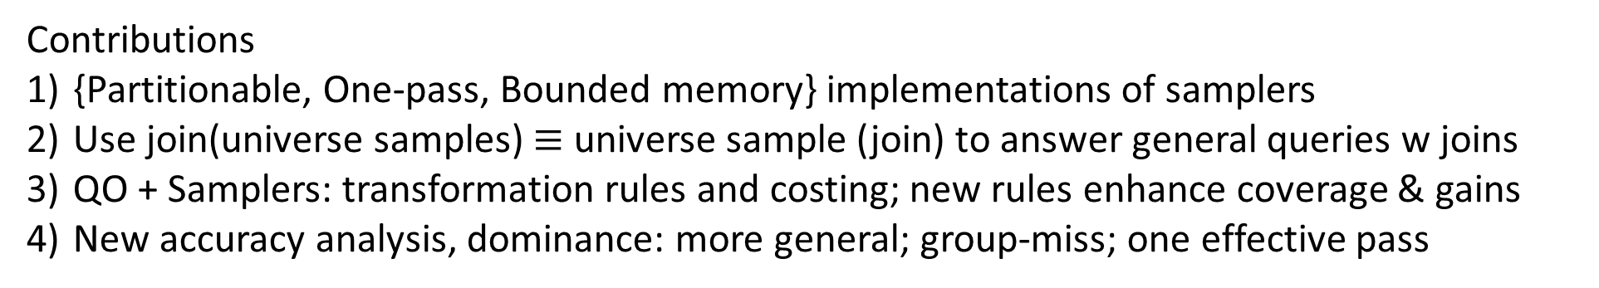
Summary
Approximating complex ad-hoc queries in bigdata clusters
Streaming Samplers
Cost- and error-based selection of sampled plans
Contributions
{Partitionable, One-pass, Bounded memory} implementations of samplers
Use join(universe samples) $≡$ universe sample (join) to answer general queries w joins
QO + Samplers: transformation rules and costing; new rules enhance coverage & gains
New accuracy analysis, dominance: more general; group-miss; one effective pass
Results
TPC-DS 500GB dataset
Experiments on cosmos; vs. prod.
[Perf] 50% of the jobs have 2X lower cost (10% are 4X lower)
[Error] 80% of aggregates in ±10% error (90% in ± 20% error)
Quickr
project
Working towards a release.
Msr-Quickr@Microsoft.Com

