Slide 1
Practical power management for enterprise storage
Dushyanth Narayanan
Austin Donnelly
Ant Rowstron
Microsoft Research, Cambridge

Slide 2
Energy in data centres
Substantial portion of TCO
  Power bill, peak power ratings
  Cooling
  Carbon footprint
It’s (becoming) a big deal for Microsoft
  Our own data centres
  Enterprise customers

Slide 3
Saving energy in storage
Storage is significant energy consumer
Especially in an idle system
  Idle Seagate Cheetah 15K.4: 12 W
    Mostly to keep spindles spinning
  Idle Intel Xeon dual-core: 24 W
    Can be improved

Slide 4
Challenge
Most of disk’s energy just to keep spinning
  17 W peak, 12 W idle, 2.6 W standby
Other technologies not quite there yet
  Flash too expensive
  Low-power disks have lower performance
    And still have spinning spindles
Need to spin down disks when idle

Slide 5
Small/medium enterprise DC
FS1
10s to100s of disks
  Not MSN search
Heterogenous servers
  File system, DBMS, etc
RAID volumes
High-end disks
Vol 0
Vol 1
FS2
Vol 0
Vol 1
Vol 2
DBMS
Vol 0
Vol 1
5

Slide 6
Intuition
Small/medium enterprise workloads have
  Diurnal, weekly patterns
  Idle periods
  Write-only periods
    Reads absorbed by main memory caches
We should exploit these
  Convert write-only to idle
  Spin down when idle

Slide 7
Design principles
Incremental deployment
  Don’t rearchitect the storage
    Keep existing servers, volumes, etc.
  Work with current, disk-based storage
    Flash more expensive/GB for at least 5-10 years
    If system has some flash, then use it
Assume fast network
  1 Gbps+

Slide 8
Write off-loading
Spin down idle volumes
Offload writes when spun down
  To idle / lightly loaded volumes
  Reclaim data lazily on spin up
  Maintain consistency, failure resilience
Spin up on read miss
  Large penalty, but should be rare

Slide 9
Roadmap
Motivation
Traces
Write off-loading
Evaluation

Slide 10
How much idle time is there?
Is there enough to justify spinning down?
  Previous work claims not
    Based on TPC benchmarks, cello traces
  What about real enterprise workloads?
    Traced servers in our DC for one week

Slide 11
MSRC data center traces
Traced 13 core servers for 1 week
    File servers, DBMS, web server, web cache, …
    36 volumes, 179 disks
    Per-volume, per-request tracing
    Block-level, below buffer cache
Typical of small/medium enterprise DC
  Serves one building, ~100 users
  Captures daily/weekly usage patterns

Slide 12
Idle and write-only periods

Slide 13
Roadmap
Motivation
Traces
Write off-loading
Preliminary results

Slide 14
Write off-loading: managers
One manager per volume
  Intercepts all block-level requests
  Spins volume up/down
Off-loads writes when spun down
  Probes logger view to find least-loaded logger
Spins up on read miss
  Reclaims off-loaded data lazily

Slide 15
Write off-loading: loggers
Reliable, write-optimized, short-term store
  Circular log structure
Uses a small amount of storage
  Unused space at end of volume, flash device
Stores data off-loaded by managers
  Includes version, manager ID, LBN range
  Until reclaimed by manager
    Not meant for long-term storage

Slide 16
Off-load life cycle
Invalidate
Reclaim
Probe
Write
Read
Write
Spin down
v1
Spin up
v2

Slide 17
Consistency and durability
Read/write consistency
  manager keeps in-memory map of off-loads
  always knows where latest version is
Durability
  Writes only acked after data hits the disk
Same guarantees as existing volumes
  Transparent to higher/lower layers

Slide 18
Recovery: transient failures
Loggers can recover locally
  Scan the log
Managers recover from logger view
  Logger view is persisted locally
  Recovery: fetch metadata from all loggers
  On clean shutdown, persist metadata locally
    Manager recovers without network communication

Slide 19
Recovery: disk failures
Data on original volume: same as before
  Typically RAID-1 / RAID-5
  Can recover from one failure
What about off-loaded data?
  Ensure logger redundancy >= manager
  k-way logging for additional redundancy

Slide 20
Roadmap
Motivation
Traces
Write off-loading
Experimental results

Slide 21
Energy savings

Slide 22
Energy by volume (worst day)

Slide 23
Response time: 95th percentile

Slide 24
Response time: mean

Slide 25
Conclusion
Need to save energy in DC storage
Enterprise workloads have idle periods
  Analysis of 1-week, 36-volume trace
Spinning disks down is worthwhile
  Large but rare delay on spin up
Write off-loading: write-only → idle
  Increases energy savings of spin-down

Slide 26
Questions?

Slide 27
Testbed
4 rack-mounted servers
  1 Gbps network
  Seagate Cheetah 15k RPM disks
Single process per testbed server
  Trace replay app + managers + loggers
  In-process communication on each server
  UDP+TCP between servers

Slide 28
Workload
Open loop trace replay
Traced volumes larger than testbed
  Divided traced servers into 3 “racks”
    Combined in post-processing
1 week too long for real-time replay
  Chose best and worst days for off-load
    Days with the most and least write-only time

Slide 29
Configurations
Baseline
Vanilla spin down (no off-load)
Machine-level off-load
  Off-load to any logger within same machine
Rack-level off-load
  Off-load to any logger in the rack

Slide 30
Storage configuration
1 manager + 1 logger per volume
  For off-load configurations
    Logger uses 4 GB partition at end of volume
Spin up/down emulated in s/w
  Our RAID h/w does not support spin-down
  Parameters from Seagate docs
    12 W spun up, 2.6 W spun down
    Spin up delay is 10—15s, energy penalty is 20 J
      Compared to keeping the spindle spinning always

Slide 31
Related Work
PDC
  Periodic reconfiguration/data movement
  Big change to current architectures
Hibernator
  Save energy without spinning down
  Requires multi-speed disks
MAID
  Need massive scale

Slide 32
Just buy fewer disks?
Fewer spindles → less energy, but
  Need spindles for peak performance
    A mostly-idle workload can still have high peaks
  Need disks for capacity
    High-performance disks have lower capacities
    Managers add disks incrementally to grow capacity
  Performance isolation
    Cannot simply consolidate all workloads

Slide 33
Circular on-disk log
HEAD
TAIL
X
X
X
X
1
X
H
........
8
7
1
2
7-9
7
8
9
4
2
........
Write
Reclaim
Spin up

Slide 34

Circular on-disk log
Header block
Tail
Nuller
Stale versions
Null blocks
Active log
Reclaim
Head
Invalidate

Slide 35
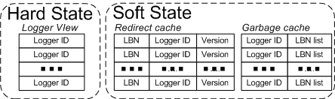
Client state
35

Slide 36
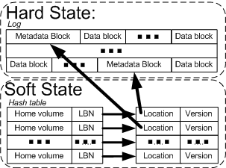
Server state
36
36

Slide 37
Mean I/O rate

Slide 38
Peak I/O rate

Slide 39
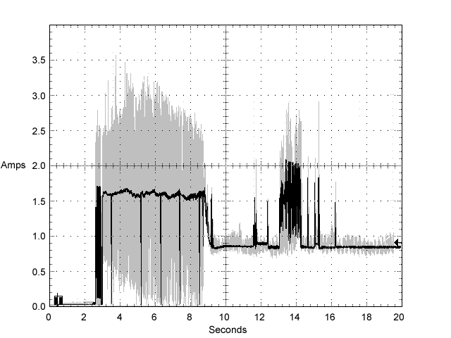
Drive characteristics
Typical ST3146854 drive +12V LVD current profile
39
Notes:
39

Slide 40
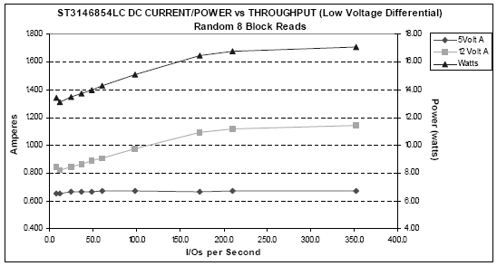
Drive characteristics
40
Notes:
40

