Slide 1
New Hardware Enabling New User Experiences
James Scott
Sensors and Devices Group
Microsoft Research Cambridge

Slide 2
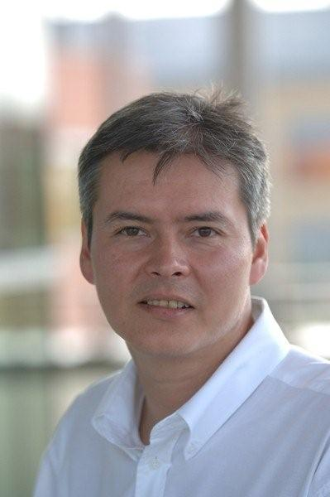
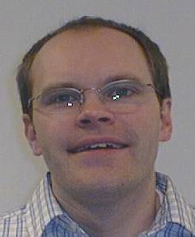
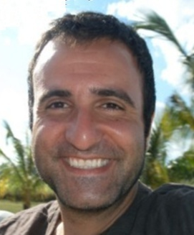
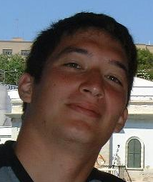
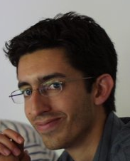
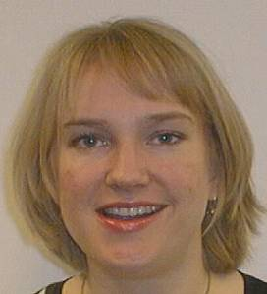
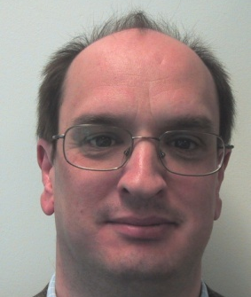


Sensors and Devices group
Alex
Butler
Steve
Hodges
Shahram
Izadi
James
Scott
Nicolas Villar
Emma
Berry
Darren
West
David
Molyneaux
Mike
Hazas

Slide 3
Sensors and Devices group
user
experience
Compelling new user experiences are driven by innovation throughout the stack
software
hardware

Slide 4
Sensors and Devices group
graphic design
user interface
Interaction techniques
user
experience
application
development
rendering
graphics
computer vision
signal processing
software
sensor
fusion
drivers
P2P
networking
haptics
low-power
sensing
displays
PCB layout
devices
wireless
hardware
optics
materials
industrial
design
circuit design
mechanics
manufacturing

Slide 5
Four Projects
SenseCam
Somniloquy
Force Sensing
SecondLight
  Live Demo

Slide 6
SenseCam
Emma Berry, Steve Hodges, Georgina Browne, et al.

Slide 7
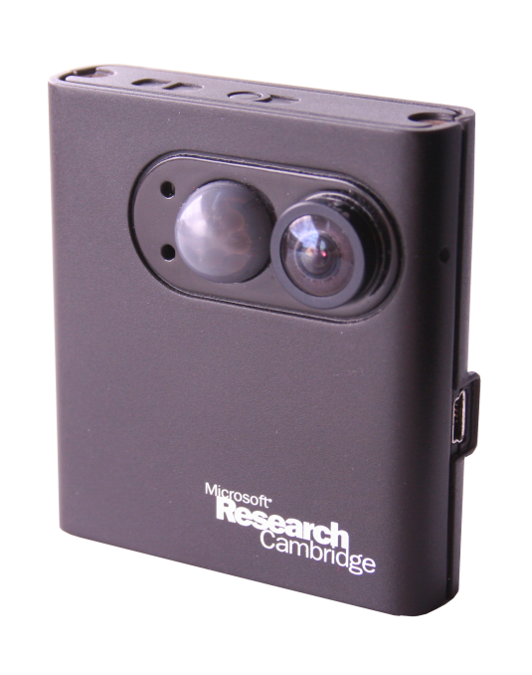
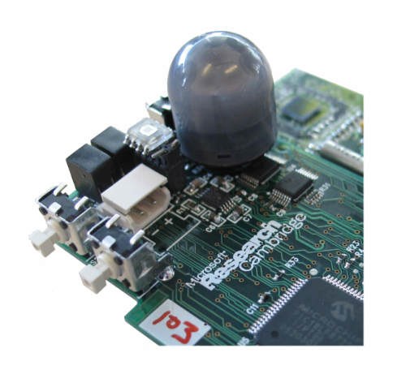
SenseCam
A new concept for digital cameras
  wearable, wide-angle lens
  automatic capture
  range of sensors
New media type
  between digital stills & video
  ‘digital experience’ capture
Applications
  sharing experiences with others
  cueing recall for the wearer

Slide 8
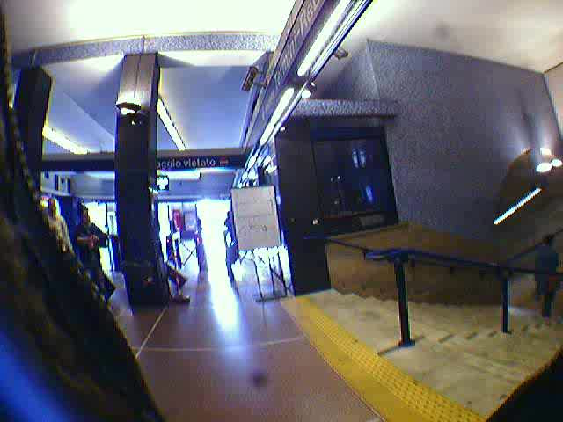
SenseCam Video

Slide 9
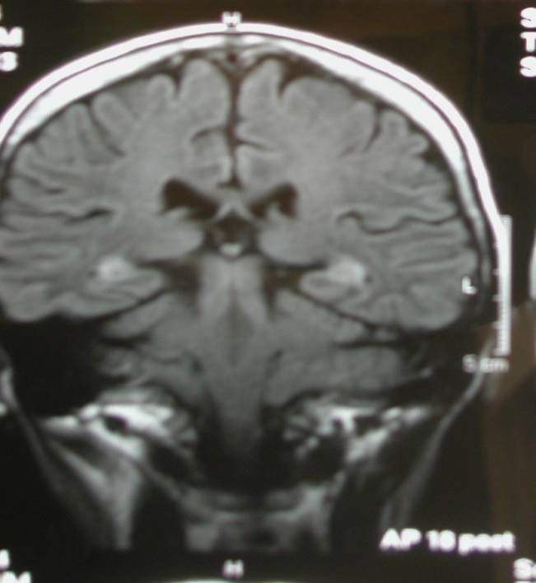
Clinical studies: case study 1
Mrs B
(Berry et al., 2007)
Cambridge Memory Clinic
63 year old, well educated woman
Limbic encephalitis 2002
Severe episodic memory impairment
  No recall of an event within 3 to 5 days

Slide 10
Results
Memory of an event over time
% Recall
Baseline
Written diary
(days)
Time elapsed since event
SenseCam

Slide 11
Results
Memory of an event over time
% Recall
Baseline
Written diary
(days)
Time elapsed since event
SenseCam

Slide 12
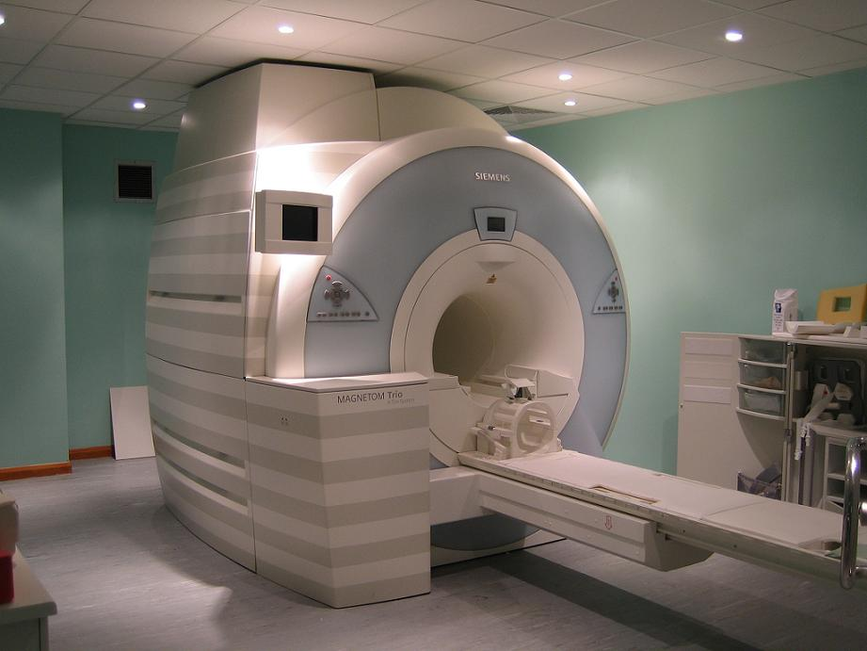
fMRI Study with Mrs B
Studying physiological effects of SenseCam using fMRI machine

Slide 13
Design
  Experimental condition (‘SenseCam’)
    Trip away 4.5 weeks before scan
    SenseCam used to rehearse memorable weekend
    Rehearsal continued until 1 week before scan
    50 images presented
  Control condition (‘Written’)
    Trip away 3.5 weeks before scan
    Written diary used to rehearse memorable weekend
    Rehearsal continued until day of scan
    50 images presented

Slide 14
Design
  Control condition (‘Not Reviewed’)
    Trip away 6.5 weeks before scan
    No rehearsal of memorable weekend
    25 images presented
  Control condition (‘Novel’)
    Another person’s images viewed while being scanned
    25 images presented

Slide 15
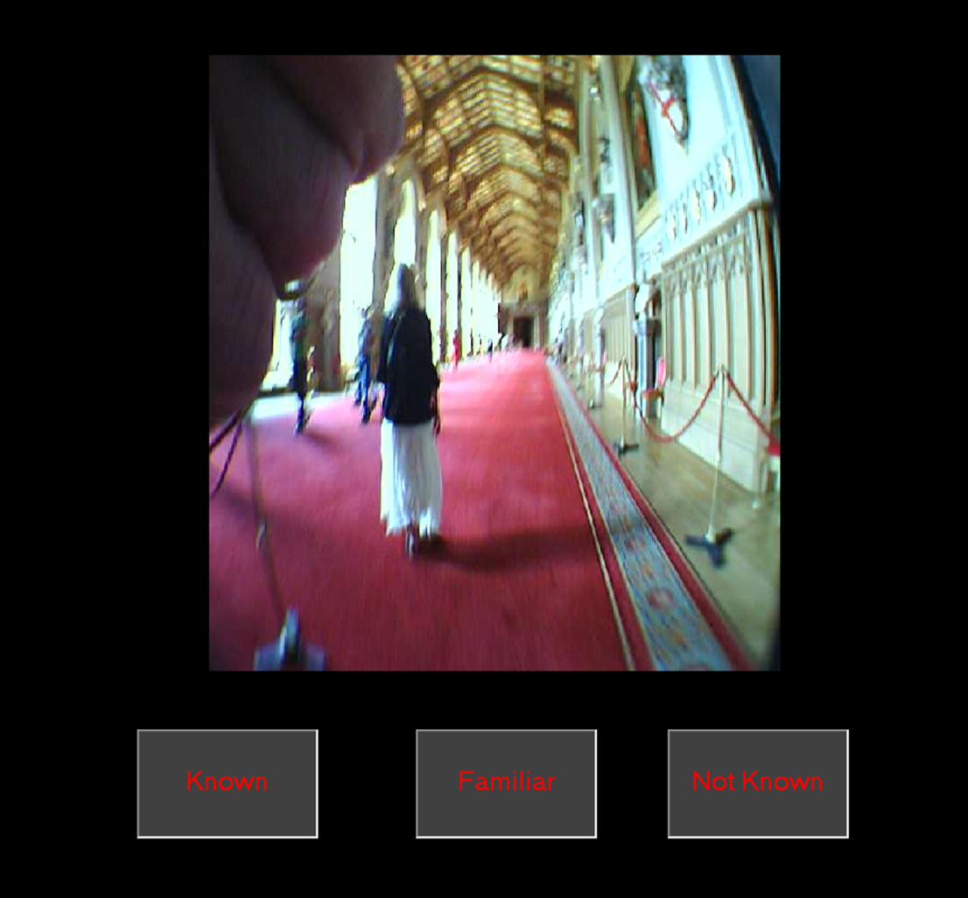
User interface inside fMRI

Slide 16
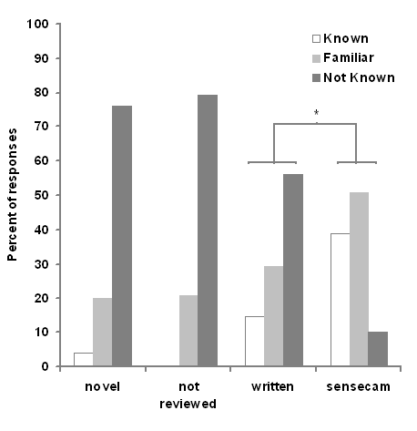
Behavioural results
Not reviewed v novel: not significant
SC v written:
p<0.001

Slide 17
fMRI Study: Novel v. Not Reviewed
No significant differences in brain activity

Slide 18
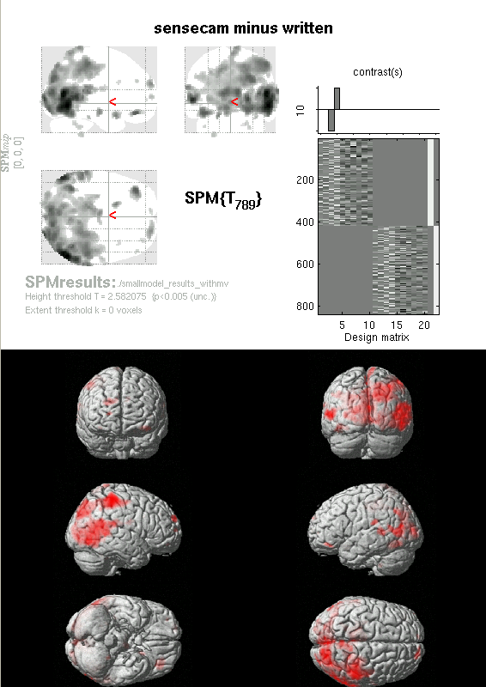
SenseCam v. Written

Slide 19
Summary
Mrs B is no more likely to recognise pictures from an experienced, not reviewed event, than novel pictures, with no brain differences
SenseCam helps Mrs B to recall events more effectively than a diary or no method at all
When viewing SenseCam images, activity is observed across a network of regions involved in autobiographical memory

Slide 20
Somniloquy*
Augmenting Network Interfaces to Reduce PC Energy Usage
Yuvraj Agarwal, Steve Hodges, Ranveer Chandra, James Scott, Victor Bahl, Rajesh Gupta
*som-nilo-quy (noun): The act or habit of talking while asleep.

Slide 21
Motivation
Users leave PCs on instead of putting them in sleep mode, causing:
  Monetary cost
  Environmental cost
  Laptops: shorter battery life
  Heat/noise
We propose a simple hardware modification allowing absent users’ needs from their PCs to be achievable while the PC is asleep

Slide 22
Why do people leave PCs on?
What apps do you leave running on your computer?
Motivating survey of 107 computer users
Respondents regularly left 75% of office PCs and 30% of home PCs on unattended

Slide 23
Somniloquy overview
Augment NIC with a low-power domain which stays on when the PC is asleep
Same MAC and IP address → transparent to network and to remote servers
Wake the PC up on specified events at any layer e.g. incoming connection
Handles some application functionality while PC remains asleep using “application stubs”
Host PC
Apps
Somniloquy
daemon
Operating system, including networking stack
Host processor,
RAM, peripherals, etc.
Port filters
Appln stubs
Embedded OS, incl. networking stack
Secondary processor
Embedded CPU, RAM, flash
Network interface hardware

Slide 24
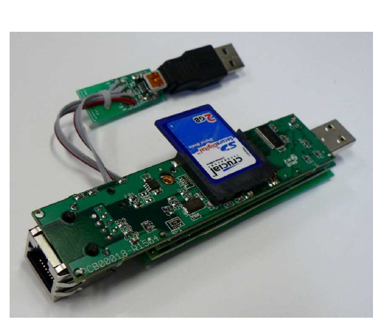
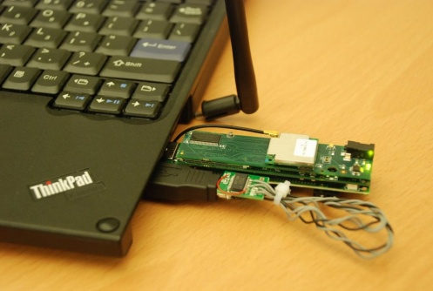
Prototype
Prototype uses “gumstix” platform
  PXA270 processor with full TCP/IP stack
  USB connection to PC for sleep detection/wakeup trigger, power whilst asleep, and IP networking for data
Wired (802.3) and wireless (802.11) versions implemented
Wired prototype
Wireless prototype

Slide 25
Applications
Home PCs
  Continue to perform file downloads during sleep (gumstix downloads file onto SD card, wakes PC when finished)
  Ready for remote access (e.g. Xbox media center) while asleep
Office PCs
  Ready for remote desktop login even while asleep
  Management functions – e.g. Patches to OS or software
Mobile PCs
  Extend battery life by performing functions while asleep
  Stay logged in to “presence” servers, e.g. For incoming instant messages or voice calls, even while mobile

Slide 26
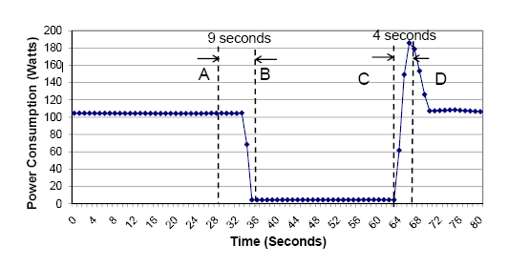
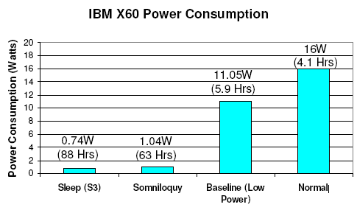
Power Savings
Gumstix prototype draws 250mW (idle) to 1.6W (fully active)
For test desktop, power drops from >100W to <5W, i.e. 620kWh saved per year (~£35, ~378 kg CO₂)
For test laptop, power drops from >10W to ~1W, battery life increases from <6 hours to >60 hours
Dell Optiplex 745 Power Consumption

Slide 27

Somniloquy Video

Slide 28
Offloading File Sharing
To address P2P file sharing, we run a simple bittorrent client on the gumstix
  Downloads (and uploads) files while the PC is asleep using 2Gb SD card
  Wakes the PC up e.g. when download completes, when SD card is full, or when a peer requests a file on the hard disk
  Uses 16% of CPU when downloading, and fits easily into the 64Mb RAM

Slide 29
Conclusions
Somniloquy is an architecture augmenting NICs to be network-connected while the PC is asleep
Allows the millions of office PCs left on e.g. for RDP/SMB, and home PCs left on e.g. for file sharing, to accomplish these tasks by “talking in their sleep”
Savings of ~100W per desktop

Slide 30
Mobile Device Interaction with Force Sensing
James Scott, Lorna Brown and Mike Molloy

Slide 31
Force Sensing
Sense forces that a user applies to the device casing
Makes casing an active input region
Device does NOT need to deform (key difference to related work e.g. Gummi)
Four force “gestures”
Stretching/Compressing
Squeezing, Steering
Bending, Folding
Twisting, Screwing

Slide 32
Qualities of Force Sensing
Adds sensing capability to unused casing areas of devices
Avoids “clutter” of controls on device
Usable without obscuring the screen
Two-handed or potentially one-handed
May be useful for context sensing outside interaction, e.g. “Am I under something”
Useful in combination with other inputs

Slide 33
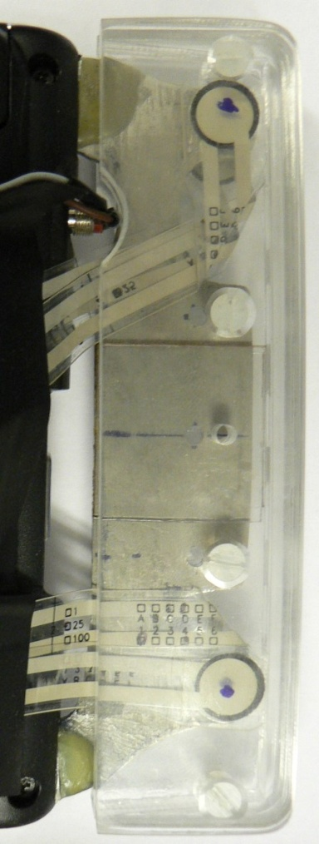
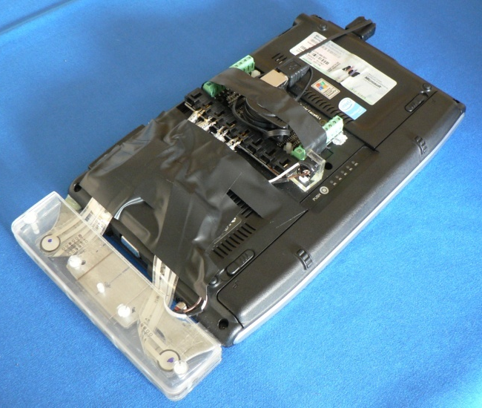
Prototype based on Augmented UMPC
Screw through
casing and
metal layer
Phidgets analog interface kit
USB data
port
Acrylic
layers
Metal layer
Samsung
Q1 UMPC
Force sensors
on top of metal
tongues (2 more
underneath)
Sensors could be built inside casing in future

Slide 34
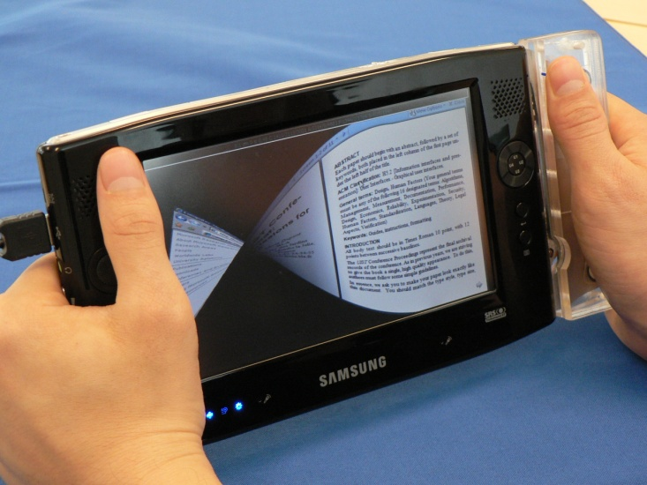
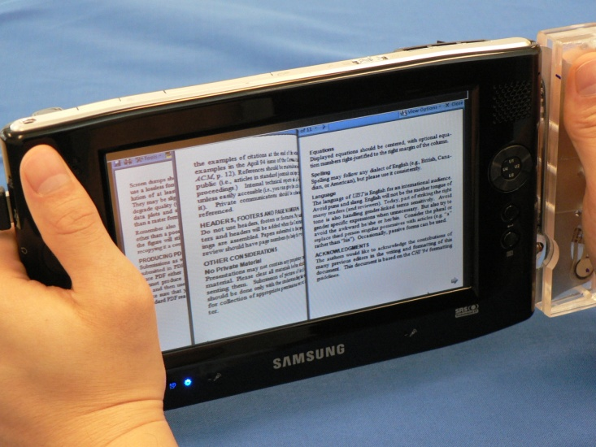
Force-Based Interaction Example
Provide “shortcut keys” on mobile devices w/out keyboards
  Twist for alt-tab
  Bend for page-down/up
Visual feedback matches force
  Makes it really easy to learn, like many touch-based gestures
  Compare to “alt-tab”
Avoids:
  Putting lots of buttons on bezel
  Using screen real-estate on virtual buttons
Other uses also possible
  E.g. Scrolling/zooming, 3D CAD, ...

Slide 35
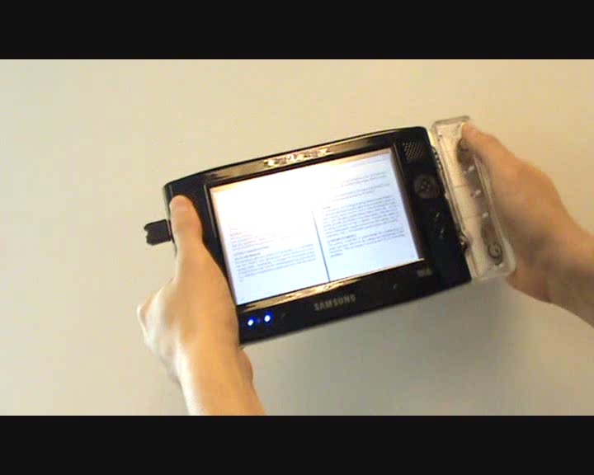
Force Sensing Video

Slide 36
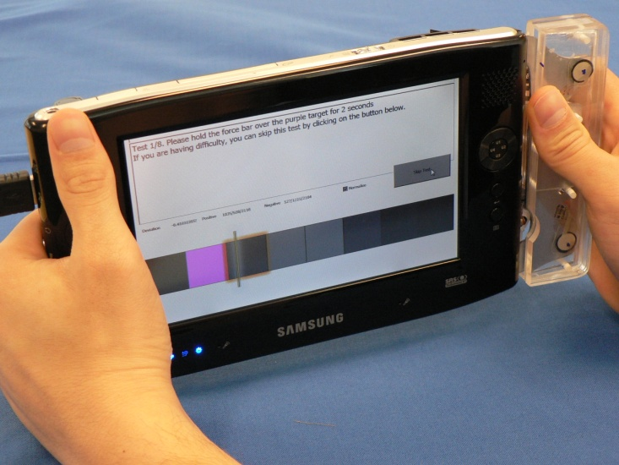
Currently selected target
Force cursor
User
Study
Inactive targets
Active target
Participant either twists (9 users) or bends (9 other users)
Twisting/bending moves a “force cursor” left or right
Once an “active target” is highlighted, participant moves force cursor over it and holds it there for 2 seconds to make it inactive
Participant then returns back to zero force before next target

Slide 37
Currently selected target
Force cursor
User
Study
Inactive targets
Active target
Initial training “cycle” to familiarise users with target hitting
3 test cycles in which number of targets varied from 2 each side (large) to 8 each side (small)
Each target of each size was shown once per cycle, randomly ordered
Total of 3780 test-cycle target trials across 18 users

Slide 38
Results: Cycles; Twist vs. Bend
Bend significantly faster than twist
Cycle has significant effect for twist but not bend
NB times on all graphs do not include final 2 seconds hold time

Slide 39
Results: Target Number and Position

Slide 40
Results: Target Number and Position
For both twist & bend
More (i.e. smaller) targets were harder
Low forces surprisingly harder (i.e. Does not follow Fitt’s Law)
For bend
Higher forces easiest

Slide 41
Results: Target Number and Position
... For twist
Highest forces start being harder too

Slide 42
Results: Target Number and Position
... For twist
Highest forces start being harder too
Closest target on “left” has very high times due to repeated overshooting and resetting of the 2s hold time (true for both forces)

Slide 43
Implications of Study
Small forces not necessarily easier
  Can be explained by some flex in the device (inevitable for any device though may be higher in prototype)
  Normalise “size” of targets to reflect human perception of difficulty rather than sensor level
Up to 4 discrete bend force levels in each direction (8 total) in <1s selection time
Up to 3 discrete twist force levels in each direction (6 total) in <2s selection time

Slide 44
Conclusions
Force sensing is a new input type for mobile devices
  Complementary to existing inputs e.g. touch, tilt
Providing interactions with feedback mimicking the force applied makes them easy to learn and use
  To explore: haptic and sound feedback
Users were able to apply forces reliably for up to 8 levels each way, and fast for 2-4 levels each way
  Interestingly, small forces are not easiest to apply

Slide 45
SecondLight
Shahram Izadi, Steve Hodges, Stuart Taylor, Dan Rosenfeld, Nicolas Villar, Alex Butler, Jon Westhues

Slide 46
Implicit in surface computing is that interactions are bound to the surface
Can we support interaction ‘beyond the surface’?

Slide 47
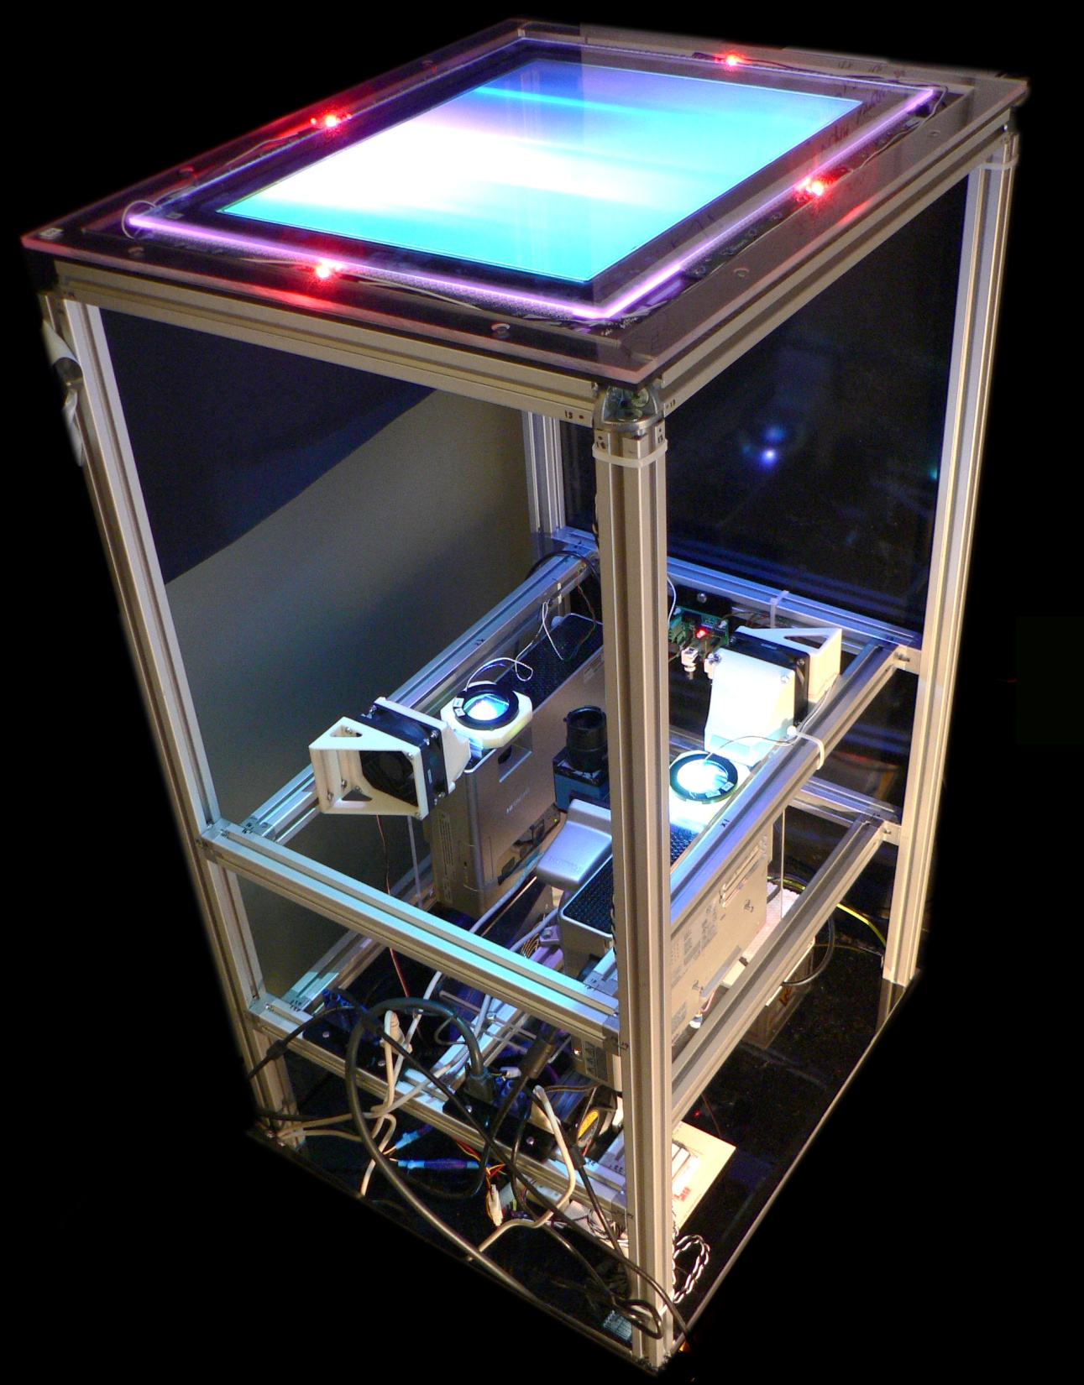

Slide 48
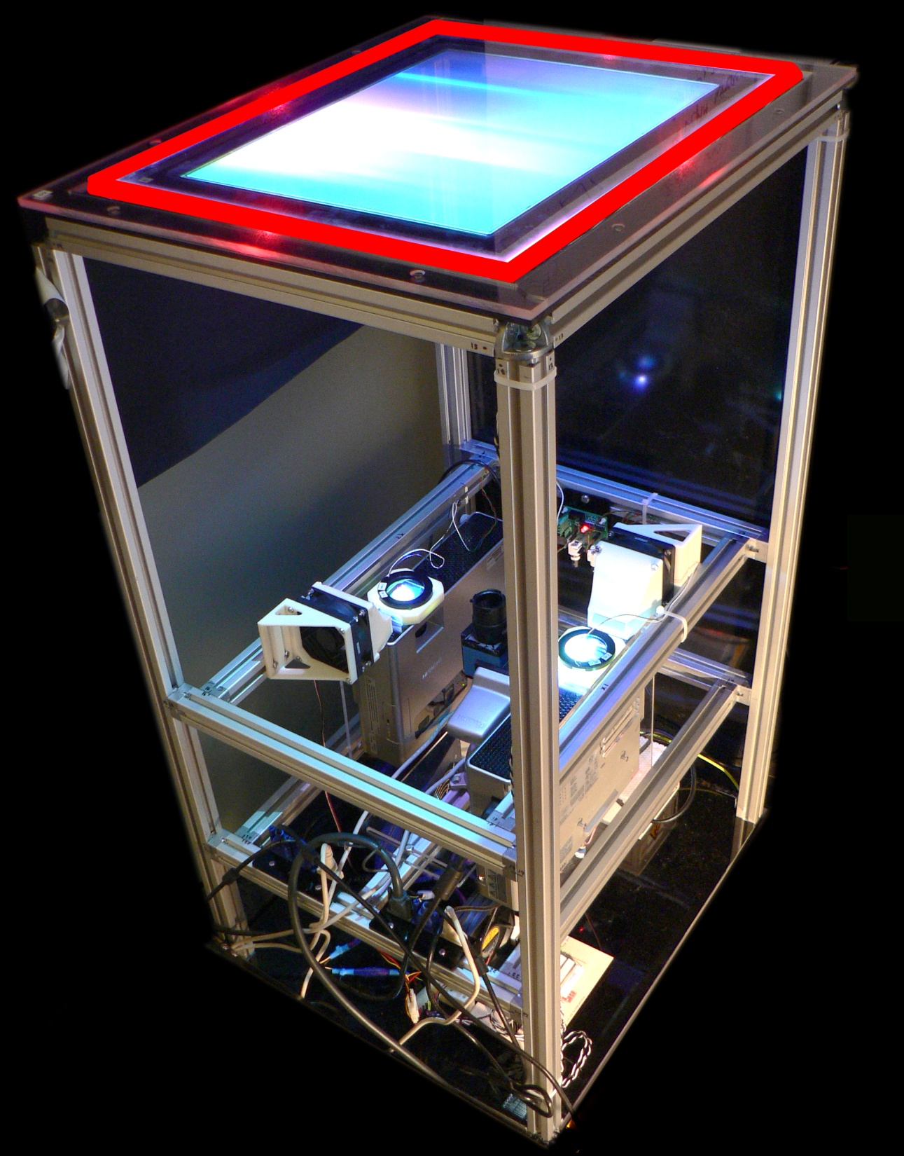

Slide 49


Slide 50
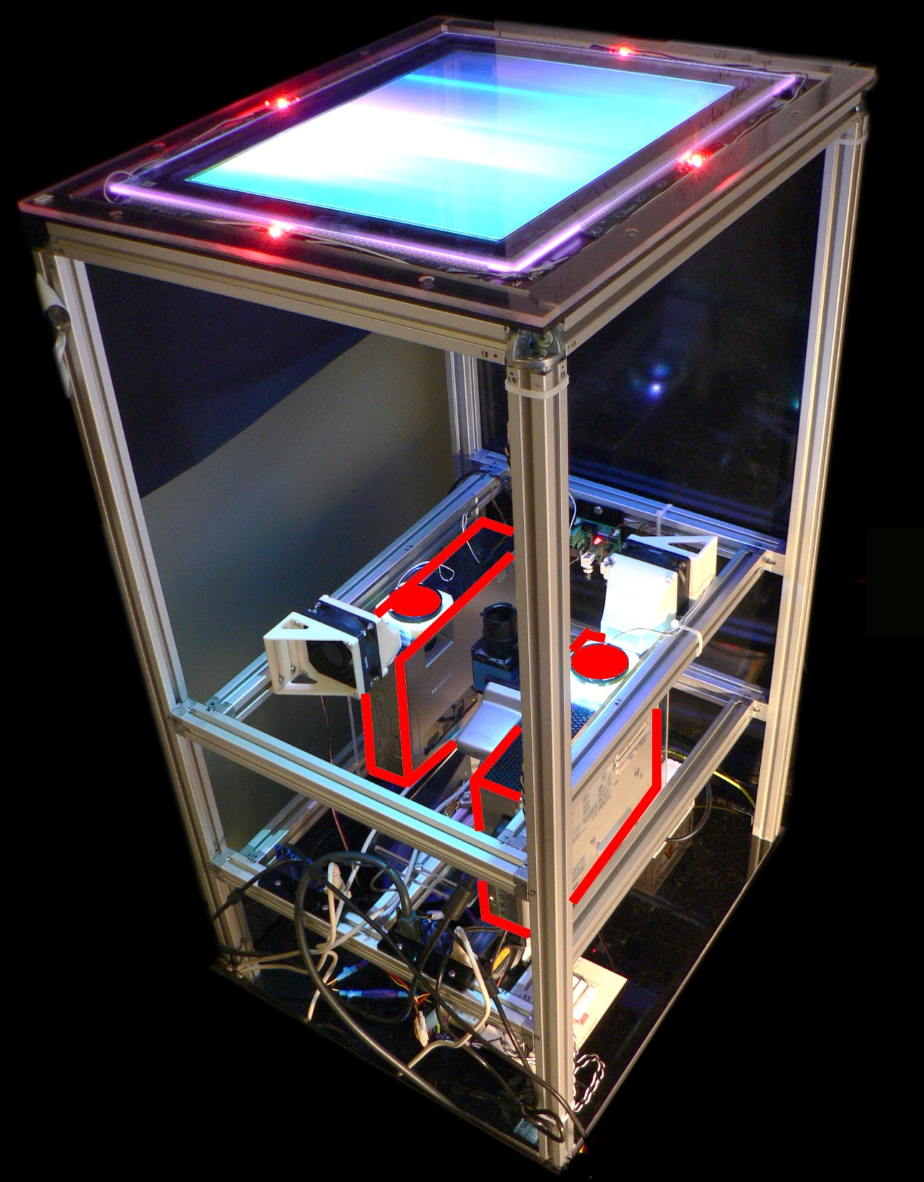

Slide 51
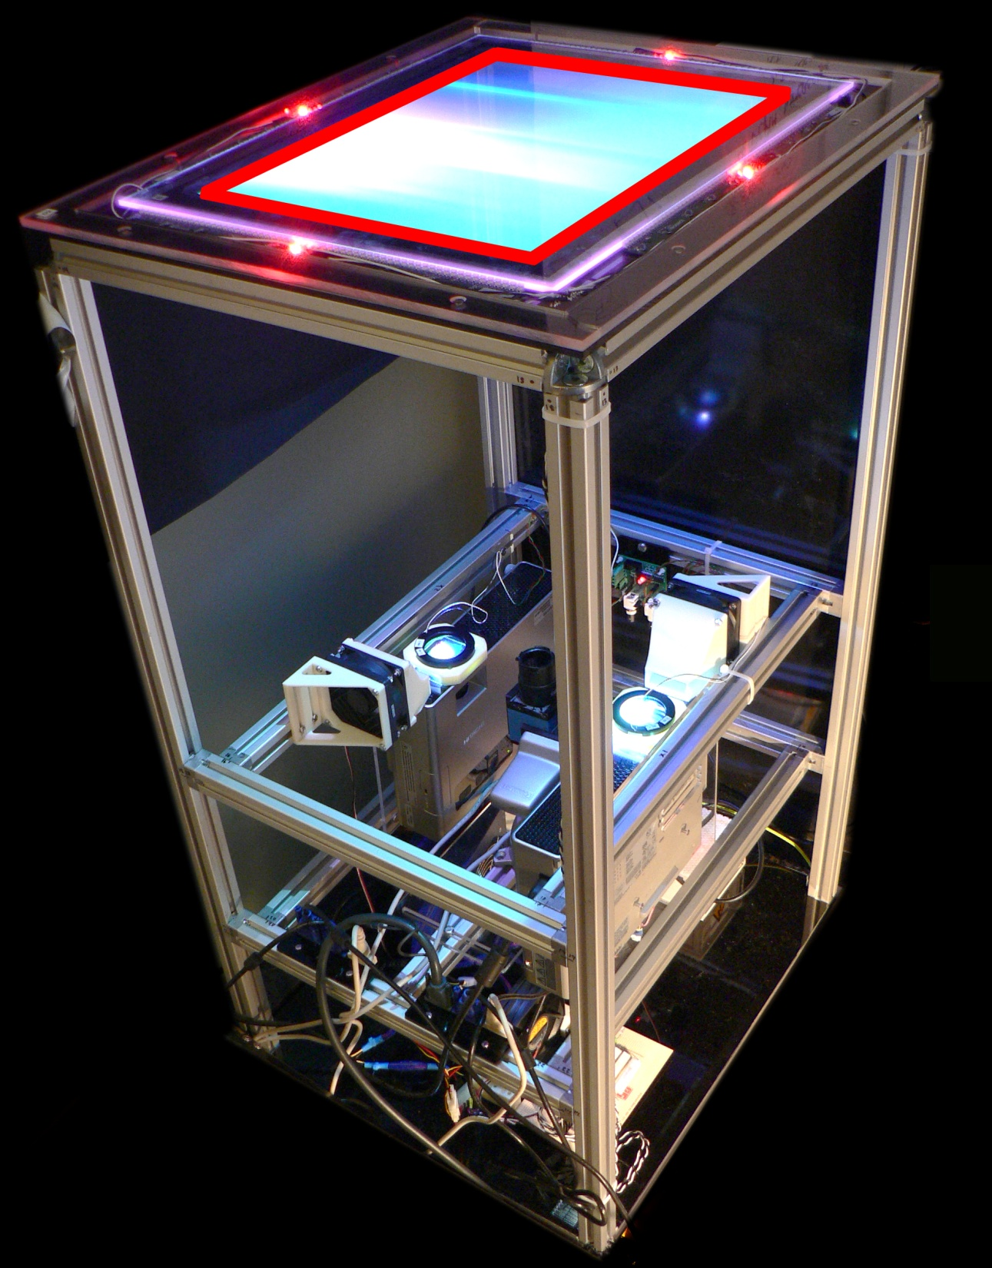

Slide 52
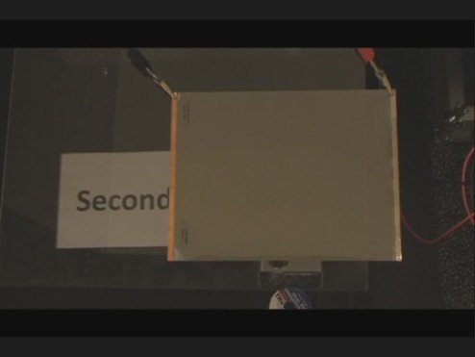

Slide 53
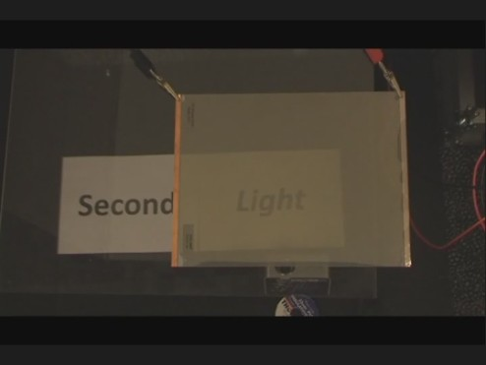

Slide 54
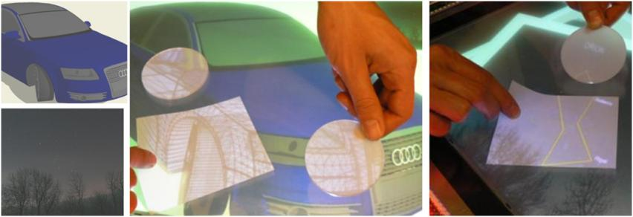

Slide 55
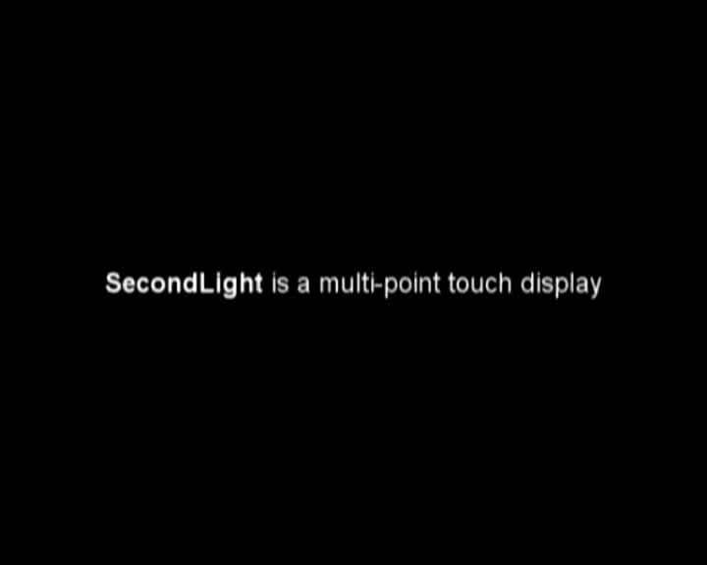
SecondLight Video

Slide 56
Live Demo of SecondLight
Demo runs over lunch – 5-10 at a time in Digital Living Suite (opposite LLT)
Those presenting posters please go first
I’ll be around for questions until 12 and then over lunch

Slide 57
New hardware enables new user experiences
SenseCam
Somniloquy
Force Sensing
SecondLight

