Slide 1
How does the Internet work?
Richard Black
PhD Summer School 2008
Microsoft Research Cambridge

Slide 2
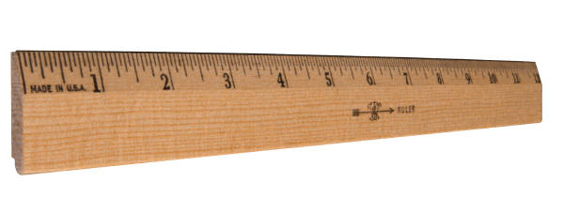
What’s your Internet score?

Slide 3
Questions for today
How can information move from A to B
Why do we have packets and what are they
How does Ethernet work
How do packets cross networks
How does the Internet know where to send my packets
How does it find news.bbc.co.uk
How does data move reliably
I’ve heard of NAT, what’s that

Slide 4
Questions for today
How can information move from A to B
Why do we have packets and what are they
How does Ethernet work
How do packets cross networks
How does the Internet know where to send my packets
How does it find news.bbc.co.uk
How does data move reliably
I’ve heard of NAT, what’s that

Slide 5
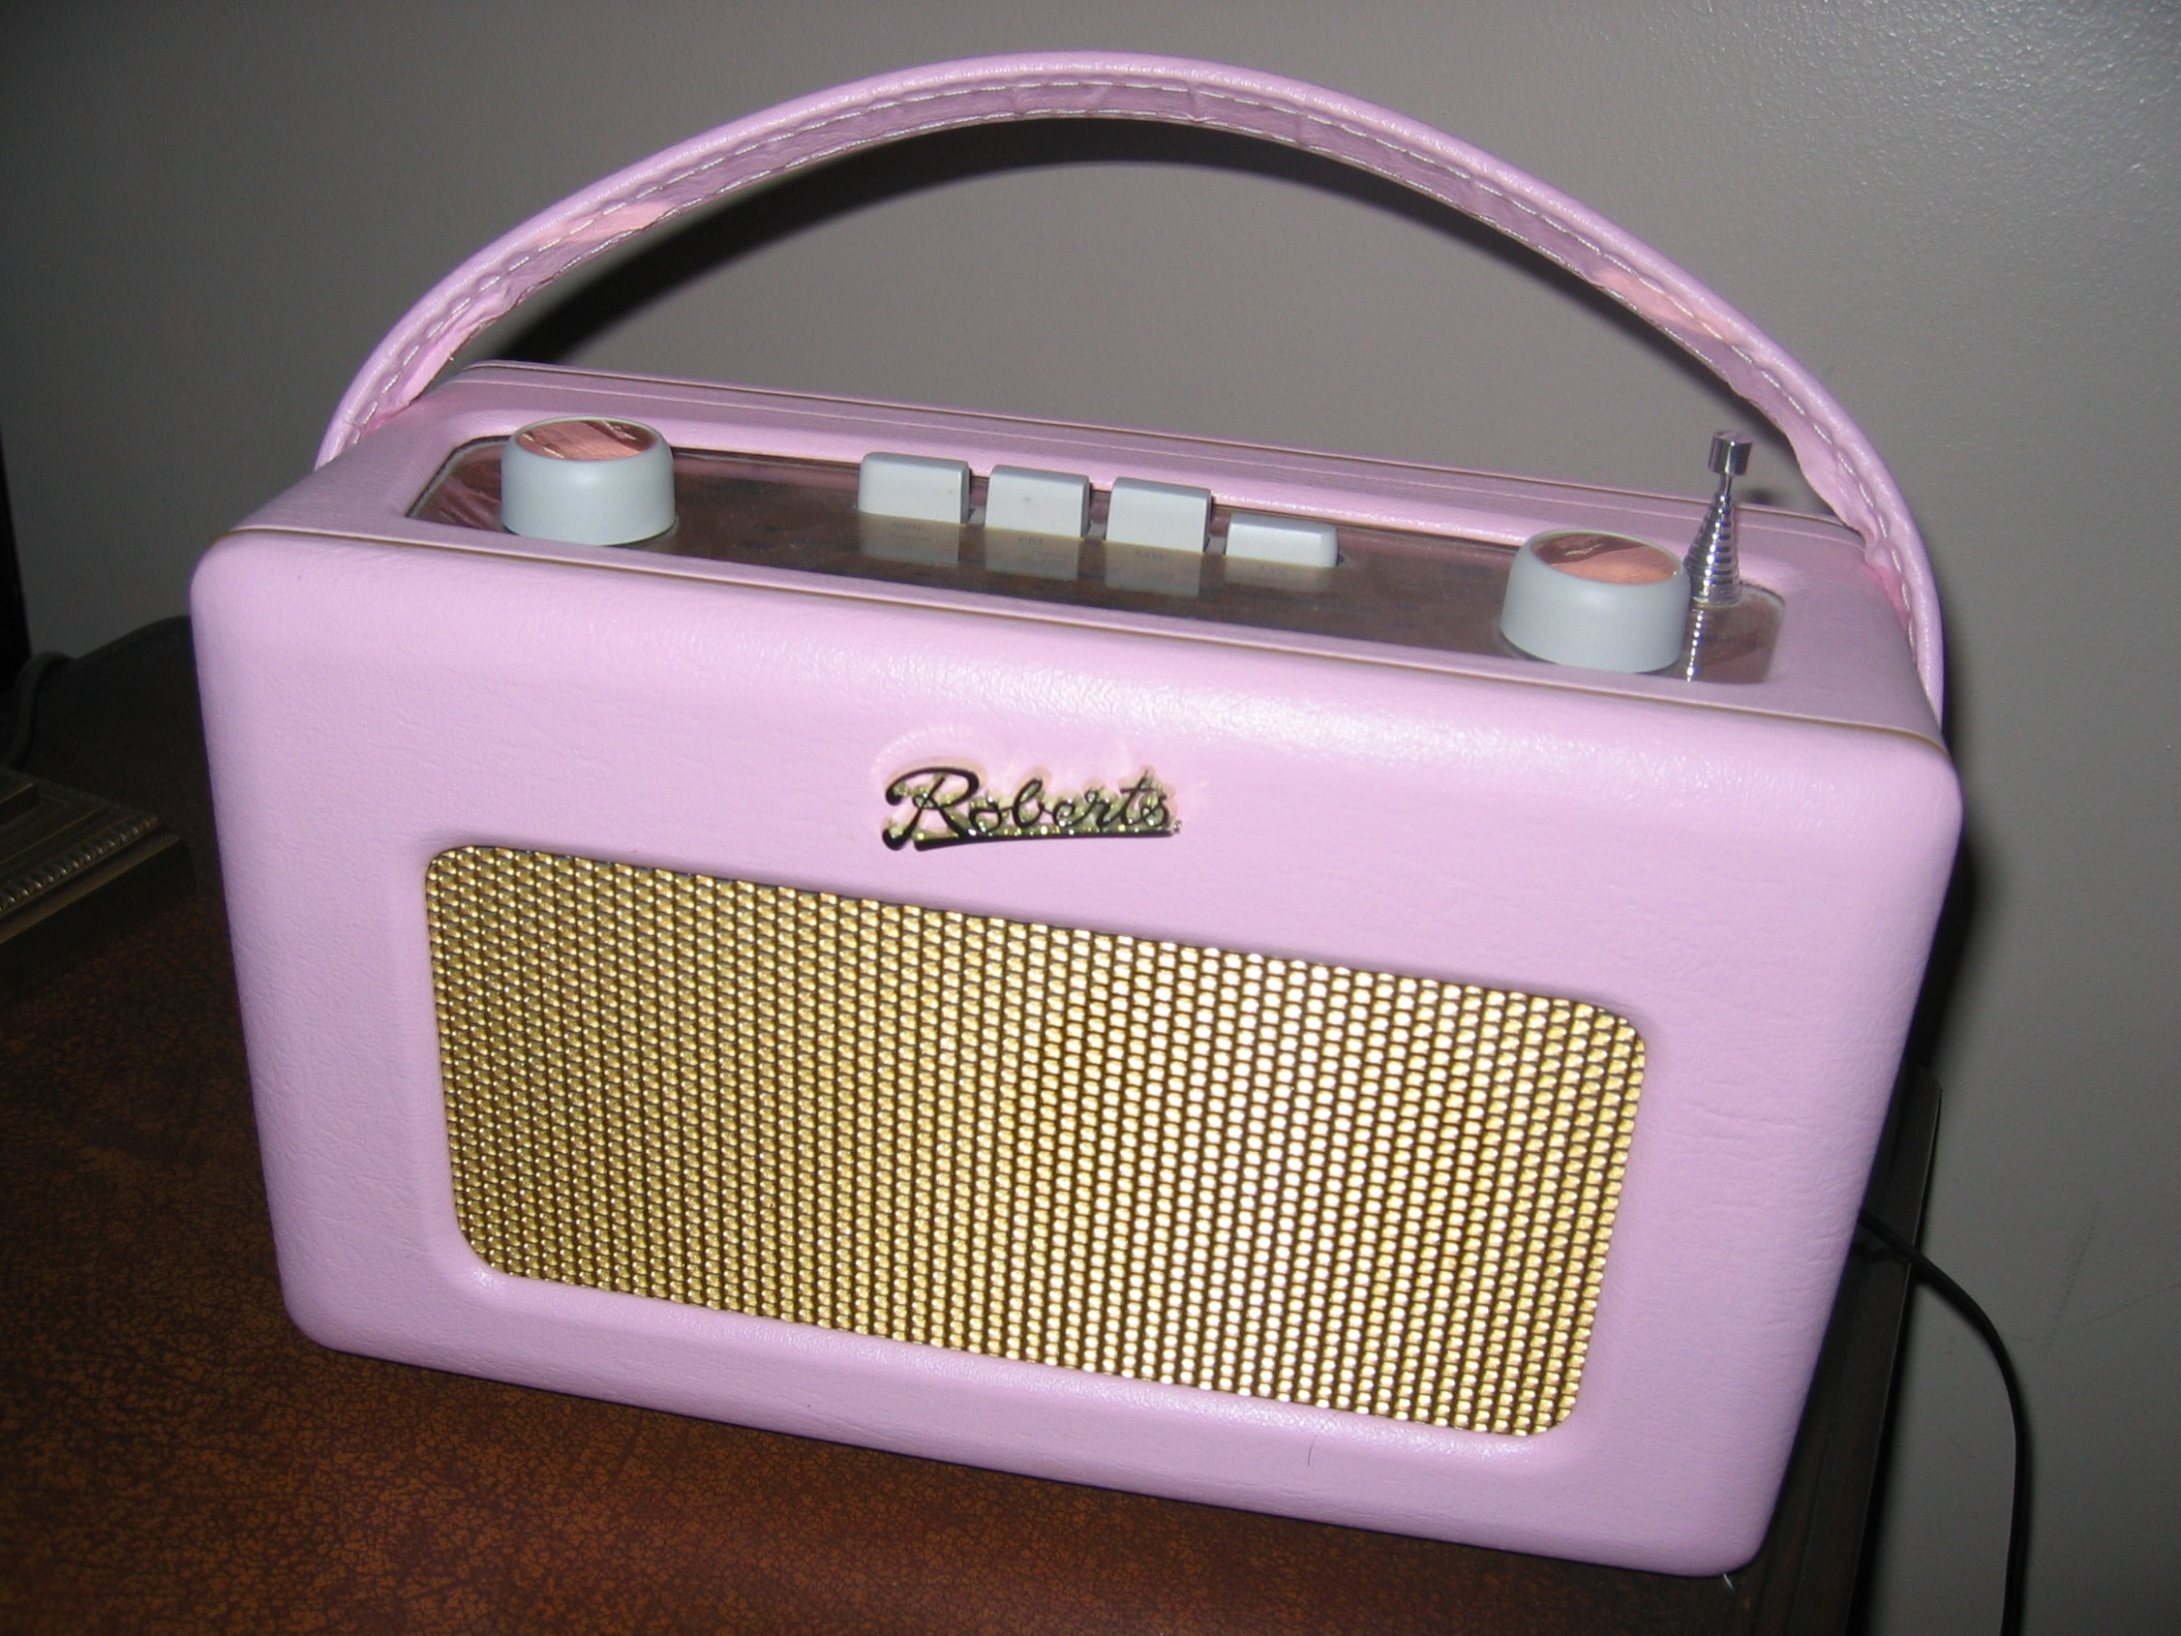

Slide 6
Waves
Waves have a height (“Amplitude”), speed, frequency and length
Speed = frequency x length
Length
Amplitude

Slide 7
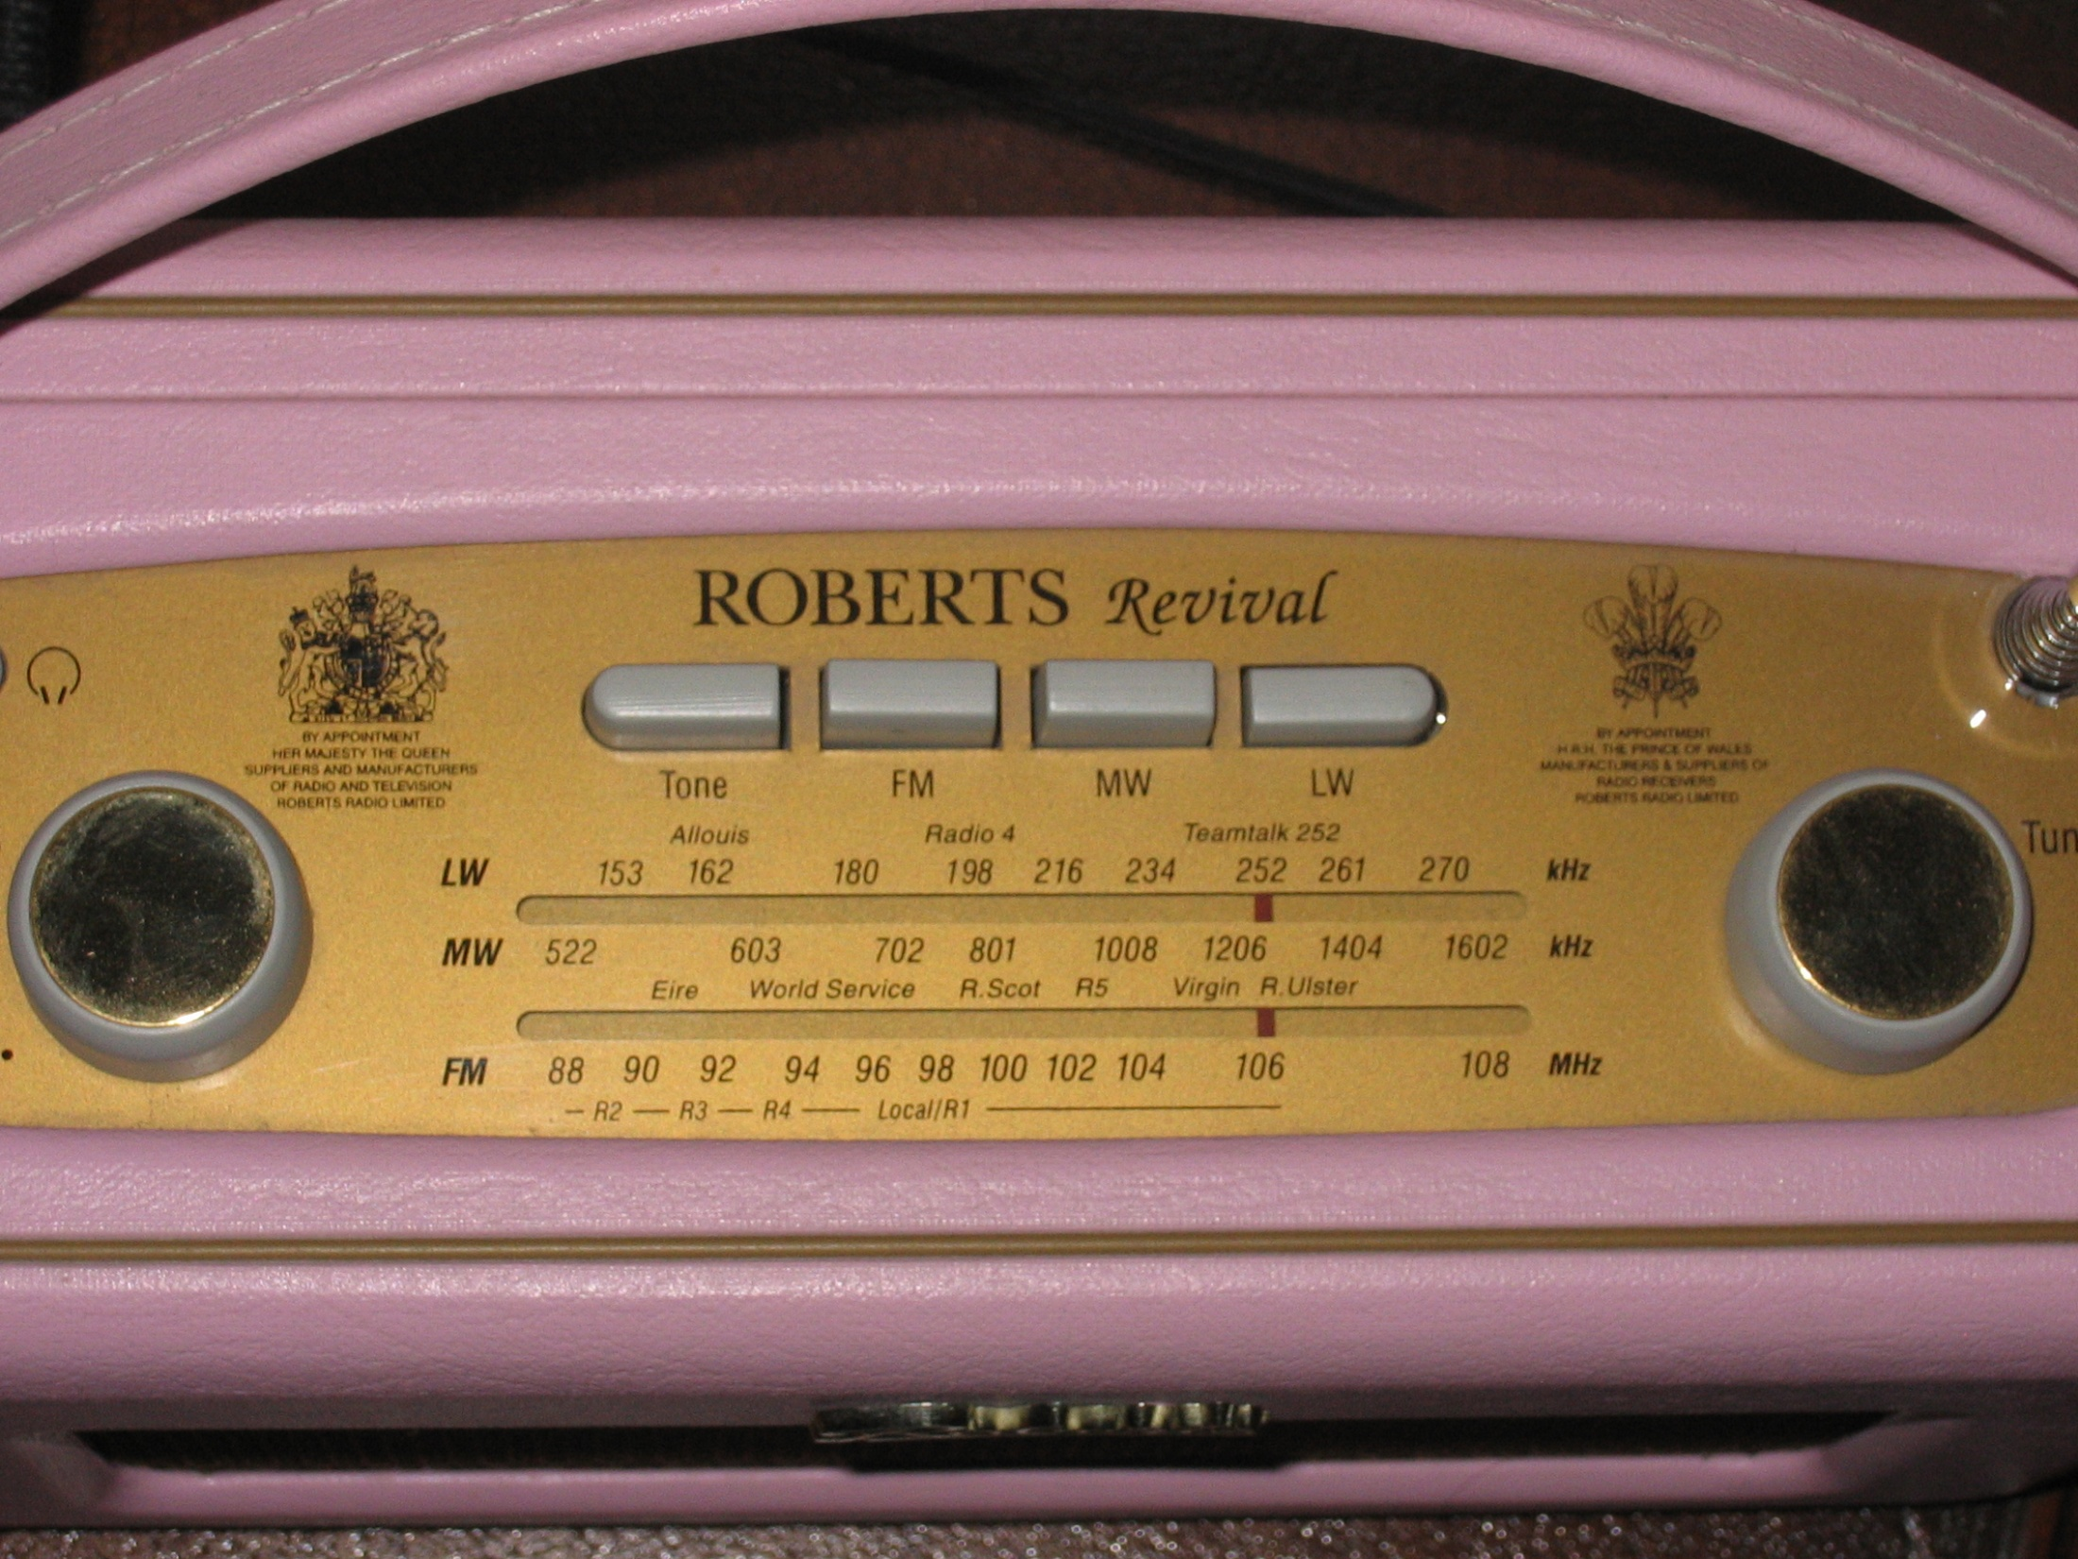

Slide 8

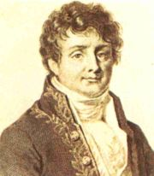
Shape of the wave
Pure “sine” wave has
a single frequency
Joseph Fourier (1769-1830)
Showed any other shape wave
is made up of many sine waves
of different frequencies

Slide 9
Example shape

Slide 10


Frequency response for wire

Slide 11
Example of Attenuation
Distance

Slide 12
Noise
Interference noise from outside
Thermal noise from inside
Sender
Receiver

Slide 13
Enter Digital Communication
Don’t try to send complex shapes
  Two shapes of wave, one for 1 and one for 0
  Chose them carefully so we can still tell them apart after attenuation and noise
  Agreed clock to know how many 1s or 0s – i.e. length of a bit

Slide 14
Example: Morse Code
Short silence = clock tick (separating the bits)
Short tone = zero
Longer tone = one
Longer silence = grouping bits into letters

Slide 15
Example: Serial Line (RS232)
Start bit tells receiver to start clock
Receiver samples each bit in middle of bit time (when likely to be most accurate)
Advanced ideas:
  Needs ½ bit sync over 9 bits i.e. ~5%
  2 stop bits ensures receiver will lock on
0
1
2
3
4
5
6
7
Idle
Stop bits
Start bit

Slide 16
Example: Manchester Encoding
Bit time
Zero
One
0
1
0
1
0
0
1
0

Slide 17
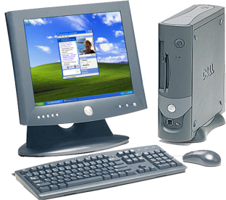
Big picture
bits
modulation
modulation
waves

Slide 18
Questions for today
How can information move from A to B
Why do we have packets and what are they
How does Ethernet work
How do packets cross networks
How does the Internet know where to send my packets
How does it find news.bbc.co.uk
How does data move reliably
I’ve heard of NAT, what’s that

Slide 19
What is a packet
Computers exchange data in “packets”
Packet is a group of bits sent together
Comprised of:
  Header: indicates how to deliver it
  Payload: the data
Payload
Header

Slide 20
Data is split into Packets
A packet has a maximum size
  About a paragraph; thousands for photograph
  Headers include information to reassemble
Web Page or email
Header
Data
Header
Data
Header
Data

Slide 21
Things a header contains
The destination address
  i.e. where the data is going
The sender’s address
  usually called the source address
The type of the data (e.g. email or web)
The length of the packet
Has a check-sum (to protect from errors)

Slide 22
Packets needed due to Multiplexing
Multiplexing is sharing a channel
  Coding to distinguish higher level channels
  Policy needed to determine sharing
next
layer entity
next
layer entity
next
layer entity
next
layer entity
lower
layer entity
lower
layer entity

Slide 23
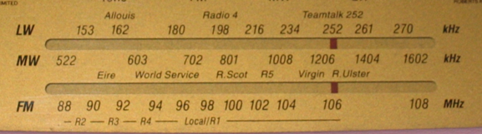
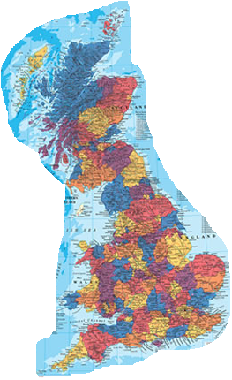
Example: Radio & Television
Three ways to multiplex
  Different frequencies
  Different locations
  Different times

Slide 24
Telephones
Times of higher layer channels periodic
One 8-bit sample every 8kHz
Great for constant rate information
Frame time 125μs

Slide 25
What if you don’t always need to send?
Imagine machines send with 25% chance
Called “Statistical Multiplexing”
1 sender at 25%
10 senders at 25%
100 senders at 25%
1
10
100
0
0
0
Time
Time
Time

Slide 26
Send when something to send
Sending at any time means must label what was sent
That’s what a packet is: label plus data
4
3
12
7
9
1
6

Slide 27
Questions for today
How can information move from A to B
Why do we have packets and what are they
How does Ethernet work
How do packets cross networks
How does the Internet know where to send my packets
How does it find news.bbc.co.uk
How does data move reliably
I’ve heard of NAT, what’s that

Slide 28
Ethernet
A Local Area Network (LAN)
Based on packets
  Header of 14 bytes
  Payload of up to 1500 bytes
Has 6 byte addresses
  Written as hex numbers: 00-15-c5-59-cf-bb
  Permanent part of your computer
  Header has source and destination addresses

Slide 29
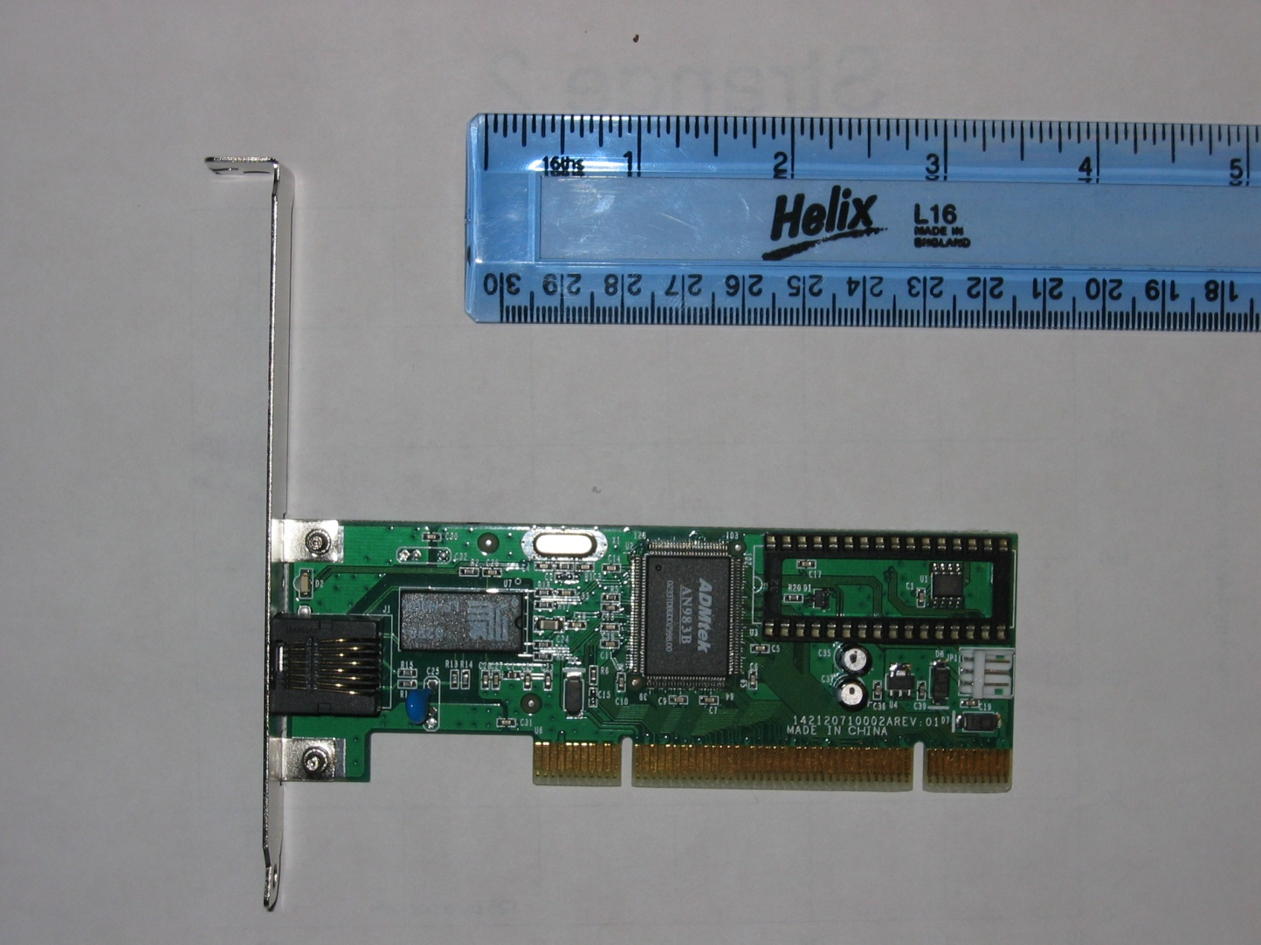
An Ethernet Card
Clock
Ethernet chip
cable connector
Socket for boot ROM
isolator
PCI connector

Slide 30
How packets are sent
Imagine the network as a pipe …
… and the packet being poured in

Slide 31
How packets are sent (continued)
So what happens if two computers try to send at the same time?

Slide 32
Dealing with contention (1)
Solved with “media access control” (MAC)
  Control when computers send packets so that they do not collide.
A bit like conversation when two people start talking at once.
  Wait for a while and try sending again
  If collision happens again, wait for longer, ...

Slide 33


Dealing with contention (2)
Replace this
With “switches”

Slide 34
Dealing with contention (2)
Switches provide a similar interface by learning where machines are
Consider this network
A sends a packet to C
  S learns where A is
  Floods for C
Switch “S”
A
C
C
C
A
B
C

Slide 35
Dealing with contention (2)
Switches provide a similar interface by learning where machines are
Consider this network
A sends a packet to C
C sends packet to A
  S learns where C is
  Sends directly to A
Switch “S”
A
C
A
A
A
B
C

Slide 36
Dealing with contention (2)
Switches provide a similar interface by learning where machines are
Consider this network
A sends a packet to C
C sends packet to A
A sends packet to C
  S sends to C only.
Switch “S”
A
C
C
C
A
B
C

Slide 37
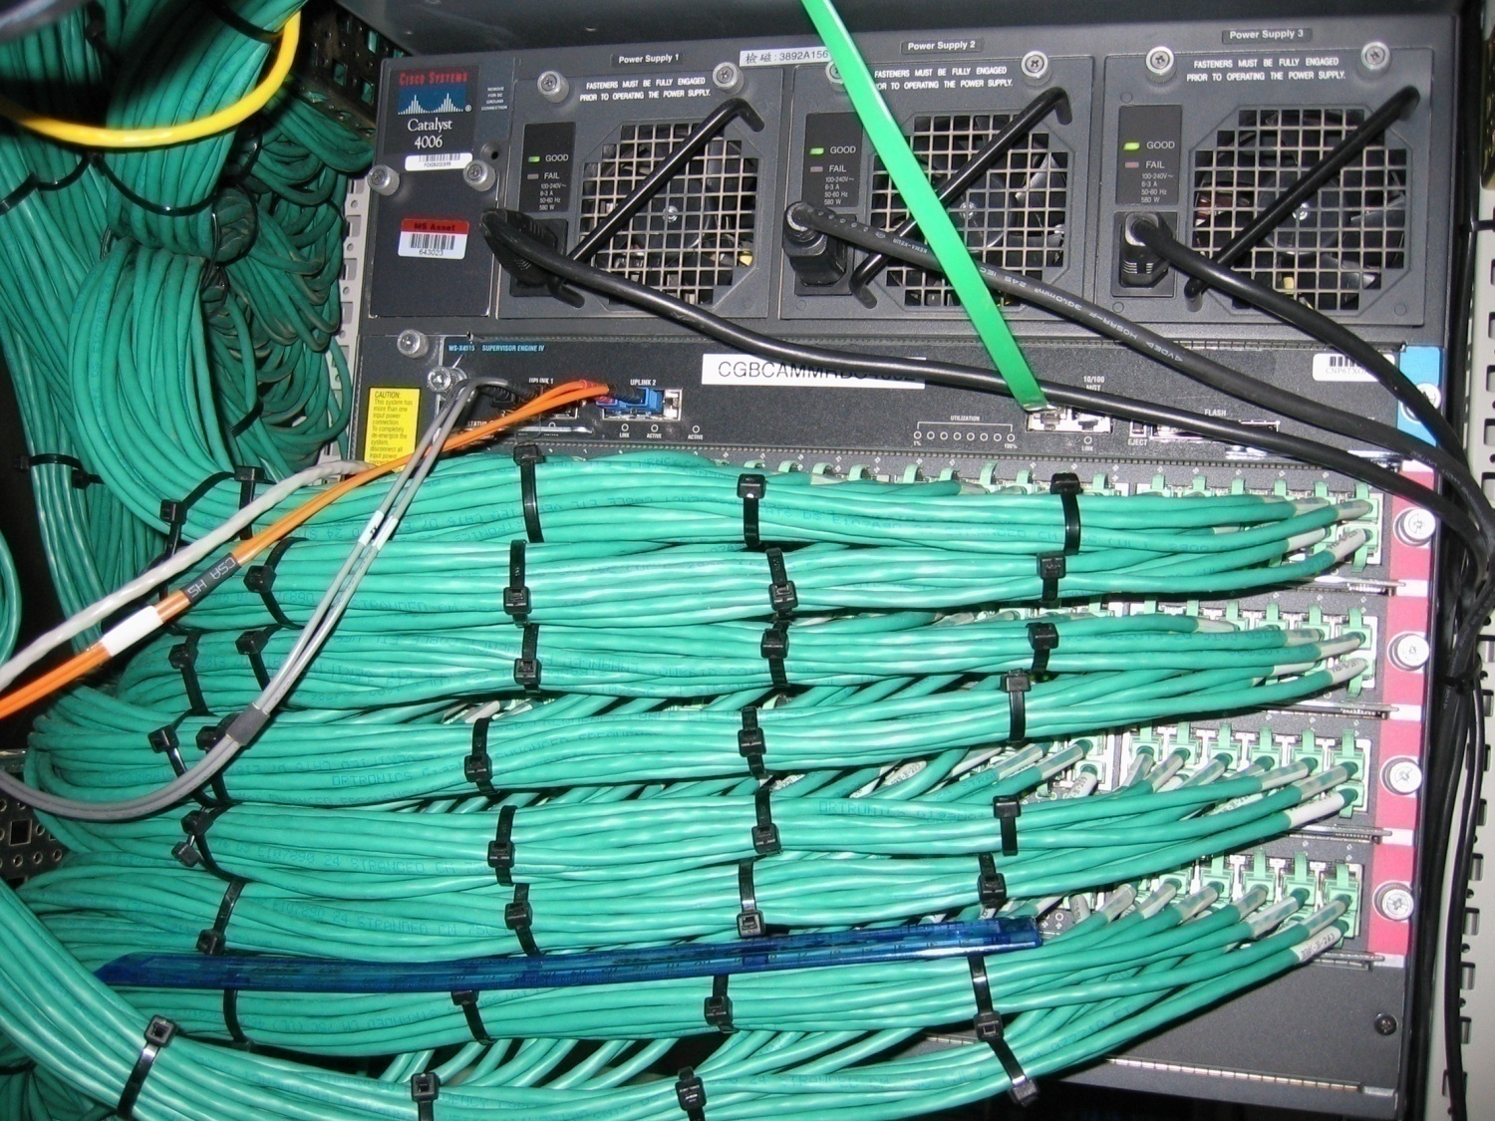
A large Ethernet switch
Three
power
supplies!
console access
fibre ports
2x 1000 Mbit
flash card
(no disk)
Line card
with 48 x 100 Mbit
30cm ruler
spare slot

Slide 38
Big picture
Ethernet packets
Ethernet
Ethernet
bits
modulation
modulation
waves

Slide 39
Questions for today
How can information move from A to B
Why do we have packets and what are they
How does Ethernet work
How do packets cross networks
How does the Internet know where to send my packets
How does it find news.bbc.co.uk
How does data move reliably
I’ve heard of NAT, what’s that

Slide 40

History of the Internet
Started as DoD ARPA Network “Arpanet”
J.C.R. Licklider and Bob Taylor, ~1968
  Idea to connect computers together
  Make it easier to share, and move information
Myth about design for nuclear attack

Slide 41
Inter-networking
End of 1970s
Lots of manufacturer-specific protocols
  Networks linked by application gateways
Define a new lowest common denominator every network can do and build on top
  Called Internet Protocol (IP)

Slide 42
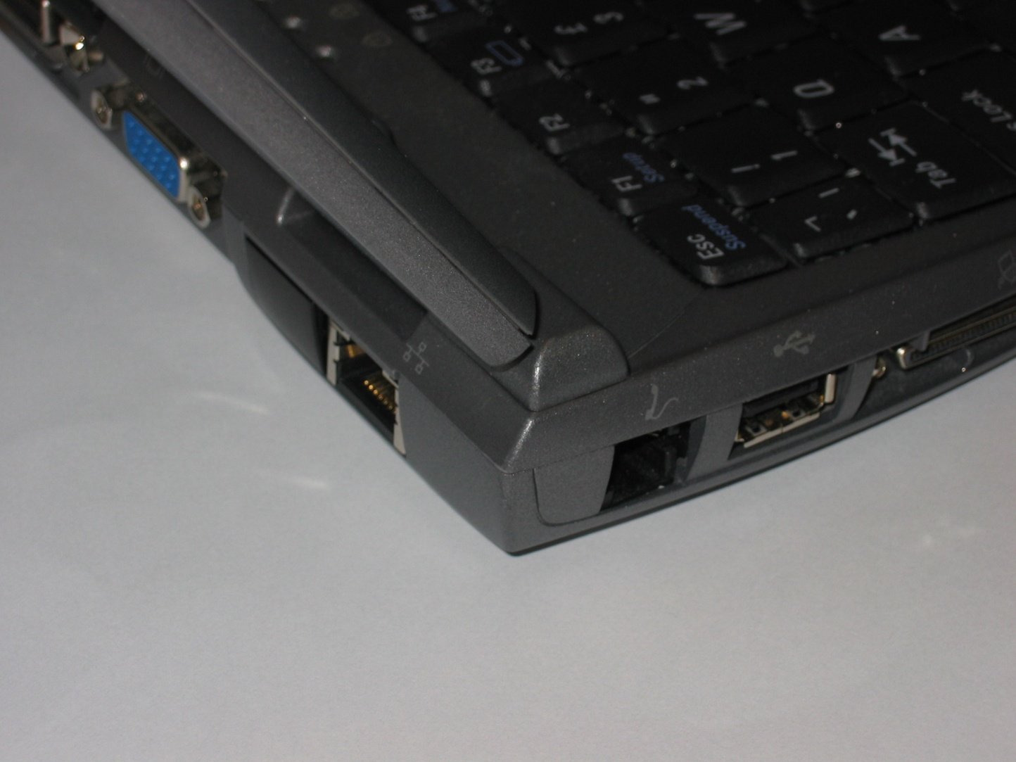
Different types of network
Ethernet
network interface
Telephone network interface

Slide 43
Packets go through the network
The Internet (Inter-Network)
Network
B
Network
A
Network
C

Slide 44
Connecting networks together
A device takes packets off one network
And sends them onto another network
Called a “router” or a “gateway”

Slide 45

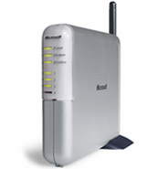
Headers for each network
Header
Data
Some headers go right across the Internet from one computer to another
Some headers are just for one network
Ethernet
Header
Header
Data
Local Area Network
(such as Ethernet)
Ethernet
Header
Header
Data
PPP
Header
Header
Data
Wide Area Network
(phone or broadband)
PPP
Header
Header
Data

Slide 46
Internet Protocol Address
157
58
63
8
IP address is 4 bytes
  Written as four numbers with dots 157.58.63.8
Two parts, network and host
Structure designed for easy routeing
  Like phone numbers
Networks written /nn number of network bits
  Microsoft has 157.56/14
  MSRC has 157.58.63.0/25, 157.58.60/24, ...
network
host

Slide 47
Getting an IP address
DHCP: Dynamic Host Configuration Protocol
Computer connects to network
  Please can I have an address
  Server(s) offer an address
  Client chooses one (e.g. first) and requests it
  Server grants for lease
Grant contains other information
  Division between network and host
  Address of a router

Slide 48
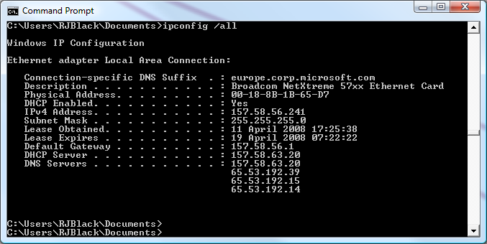
DHCP in action

Slide 49

IP Routeing
Send packet
for Net A use R1
for Net B use R2
Yes
Local
Network?
No
Routing table maps from network to next hop router on local net
Consult table
Send to host
on local net
Net A
Local
Net
Net B
Router R1
Router R2

Slide 50
Send to host on local network
Need to map IP to Ethernet address
Use ARP: Address Resolution Protocol
  Broadcast “who has 157.58.56.241”
  Owner responds
  “157.58.56.241 is 00-18-8B-1B-65-D7”
Remember this information in a cache

Slide 51


Big picture
IP packets
IP
IP Router
IP
packets
packets
some-net
some-net
some-net
some-net
bits
bits
modulation
modulation
modulation
modulation
waves
waves

Slide 52
Questions for today
How can information move from A to B
Why do we have packets and what are they
How does Ethernet work
How do packets cross networks
How does the Internet know where to send my packets
How does it find news.bbc.co.uk
How does data move reliably
I’ve heard of NAT, what’s that

Slide 53
Maintaining Routeing Tables
Internet divided into Autonomous Systems
  Large organisational groups of many networks
Within AS
  Topology private to the AS itself
  Distance-vector or link-state (see next 2 slides)
Between AS
  Topology public
  Path vector with policy (called BGP)

Slide 54
Distance vector
Router sends vector to neighbours of
  Network, number of hops “157.58.56/24 in 2”
Router hears vectors from neighbours
  Updates if new network, fewer hops, or more hops but from current next router.
Advantages
  Easy to build
  Good news travels quickly

Slide 55

Distance Vector in action
1
3
5
2
4
5
3
4
T
B
C
S
A
D
E
F
G
1
2
3
2
4
3
5
It can take a while to stabilize in the general case!

Slide 56
Link-state routeing
Distribute the correct topology to all nodes
When something breaks send that
  e.g. “link B-T is down”
Advantages: stabilizes faster
Disadvantages:
  More complex to build
  Have to share sensitive topology information
  Have to share topology correctly!

Slide 57
Path Vector routeing
Like distance vector, but send entire AS path not just length of the path
Filter or rank options based on business relationship with all path members
  E.g. “that’s a great path to Iraq, but I’m ignoring it because it goes through Iran”
Extremely complex to implement

Slide 58
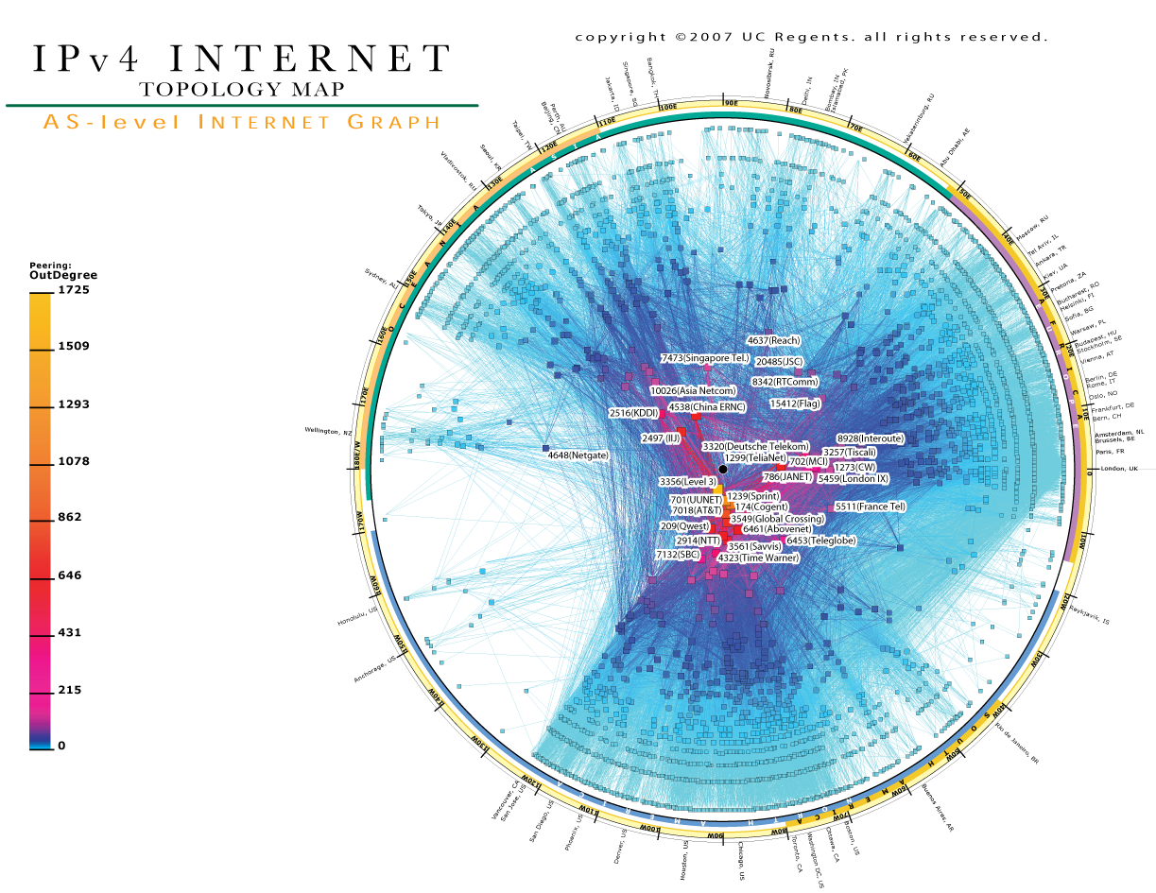

Slide 59
Questions for today
How can information move from A to B
Why do we have packets and what are they
How does Ethernet work
How do packets cross networks
How does the Internet know where to send my packets
How does it find news.bbc.co.uk
How does data move reliably
I’ve heard of NAT, what’s that

Slide 60

DNS: Domain Name System
news.bbc.co.uk
For .uk see 199.7.66.44, remember for 2 weeks
Root server
193.0.14.129
news.bbc.co.uk
For bbc.co.uk see 132.185.132.21, remember for 4 days
news.bbc.co.uk
news.bbc.co.uk =212.58.226.33, remember for 24 hours
Server for “.uk”
199.7.66.44
Server for “bbc.co.uk”
132.185.132.21

Slide 61
Questions for today
How can information move from A to B
Why do we have packets and what are they
How does Ethernet work
How do packets cross networks
How does the Internet know where to send my packets
How does it find news.bbc.co.uk
How does data move reliably
I’ve heard of NAT, what’s that

Slide 62
Transport Layer Operation
Data to send divided into frames
Send packet of 1 frame, seq.no, checksum
Receiver checks sum and seq.no, sends an ACK with the next sequence expected
  Errors turn into lost packet
Sender gets ACK,
  Sends again, or sends next one
If no ACK after awhile, sender sends again

Slide 63
Transport Flow Control
Acknowledgement contains “window”
Represents maximum number of frames receiver currently has space for
Sender will not over-run this

Slide 64
Transport Congestion Control
If ACK doesn’t arrive assume loss
Send packet again, but
  Reduce window of packets in flight at once
  Wait longer for ACK than last time

Slide 65
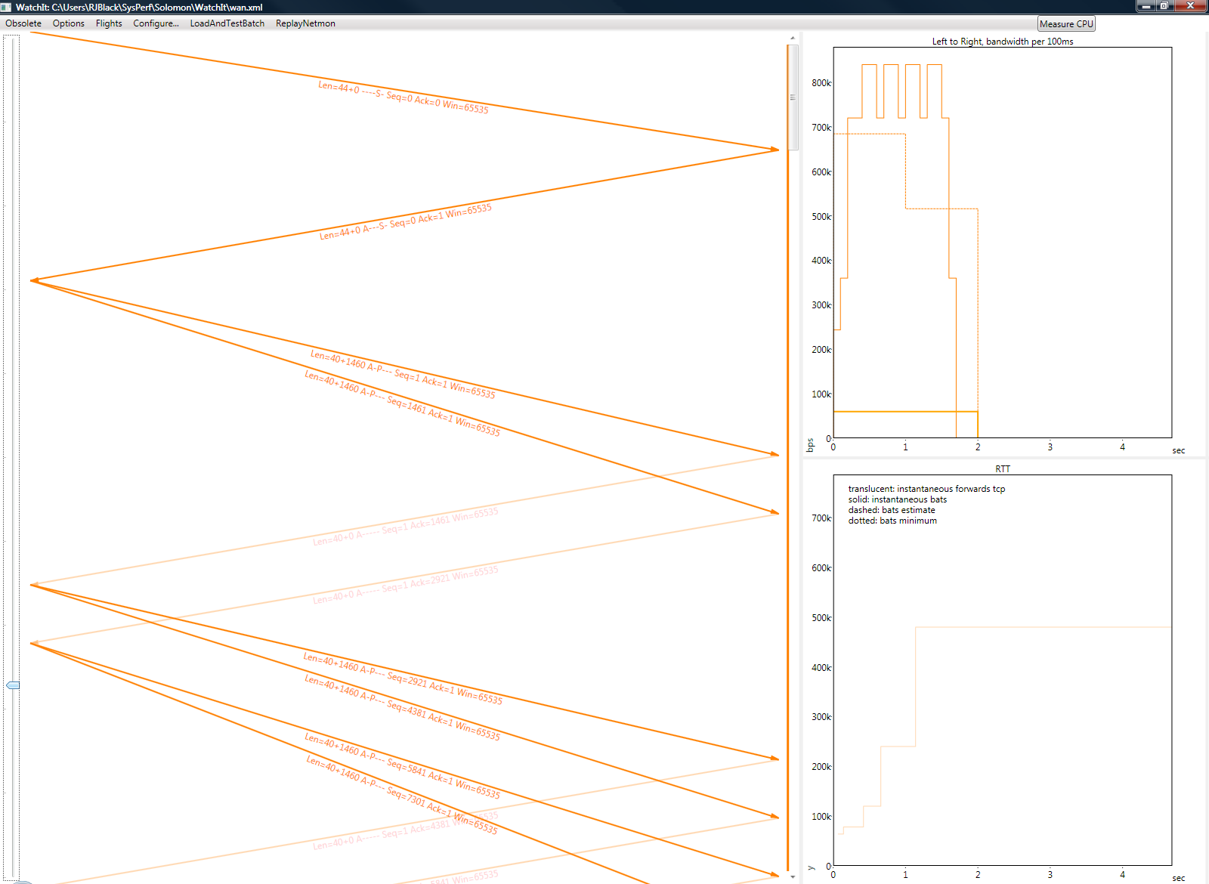
TCP Demo

Slide 66
Big picture
Reliable data
TCP
TCP
IP packets
IP
IP Router
IP
packets
packets
some-net
some-net
some-net
some-net
bits
bits
modulation
modulation
modulation
modulation
waves
waves

Slide 67
Questions for today
How can information move from A to B
Why do we have packets and what are they
How does Ethernet work
How do packets cross networks
How does the Internet know where to send my packets
How does it find news.bbc.co.uk
How does data move reliably
I’ve heard of NAT, what’s that

Slide 68


NAT: Network Address Translation
A workaround for greedy ISPs
A whole network uses a single address
  NAT box rewrites addresses in both directions
192.168.0.1
65.53.196.90
192.168.0.101
From 192.168.0.101 to 212.58.226.33
From 65.53.196.90 to 212.58.226.33
From 212.58.226.33 to 192.168.0.101
From 212.58.226.33
to 65.53.196.90

Slide 69
Questions and Discussion
© 2008 Microsoft Corporation. All rights reserved.
This presentation is for informational purposes only. Microsoft makes no warranties, express or implied, in this summary.

Slide 70
Acknowledgements
Images taken from
  CAIDA: the visualisation of the Internet
  Wikipedia: the portrait of Fourier
  Olografix: the photograph of Bob Taylor
For commenting on drafts
  Simon PJ, Joy

Slide 71
Topics I’ve skipped today
HTTP
Firewall
VPN
Intranet
IPSEC
SMB
IP version 6
Mobile IP
ICMP
Fragmentation
Proxies
NAP
Wi-Fi
TCP details
Multi-homing
Load balancing
Virtual IP
Mesh networking
Traffic Engineering
QoS

