Slide 1
Learning the Crowd KErnel
Adaptively
Adam Tauman Kalai - MSR
Joint work with Serge Belongie (UCSD), Ce Liu (MSR),
Ohad Shamir (MSR), and Omer Tamuz (Weizmann/MSR)

Slide 2
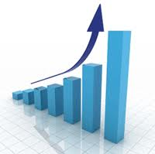

Large datasets

Slide 3
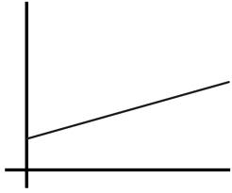

# problem domains
Each domain requires expertise in the form of specific features/kernel.

Slide 4

1. Input
Database of $n$ objects, say images.

Slide 5

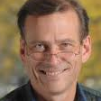
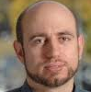
1. INPUT
+

Slide 6

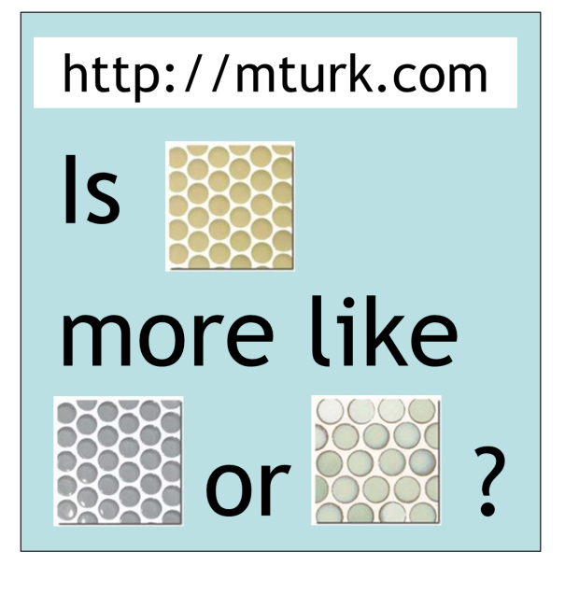
2. Crowd Queries
Adaptively chosen
Randomly chosen
Notes:
http://65.215.1.20/faces/simp_sim4.py?instructions=112462&tid=shortCut112465&assignmentId=ASSIGNMENT_ID_NOT_AVAILABLE&hitId=218W618N46UXOGYOUO3EYNDS5YBOQA

Slide 7
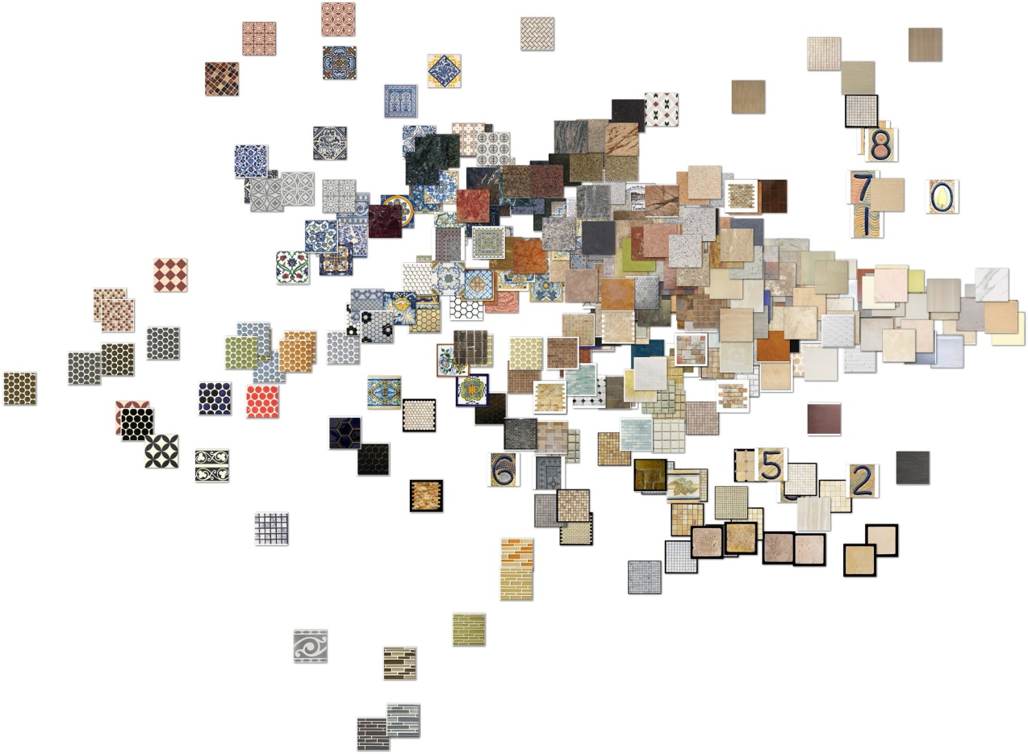
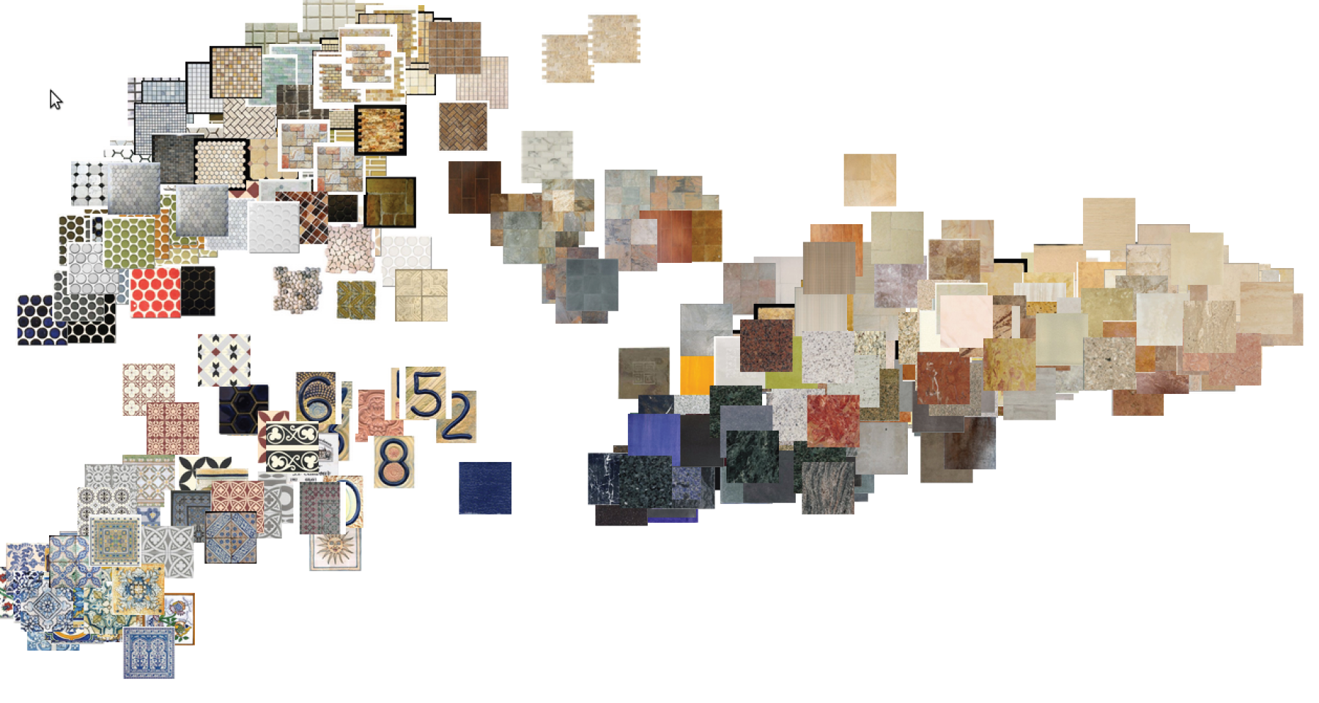

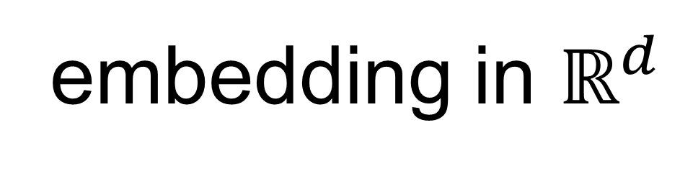
3. Output
embedding in $ℝ^{d}$

Slide 8
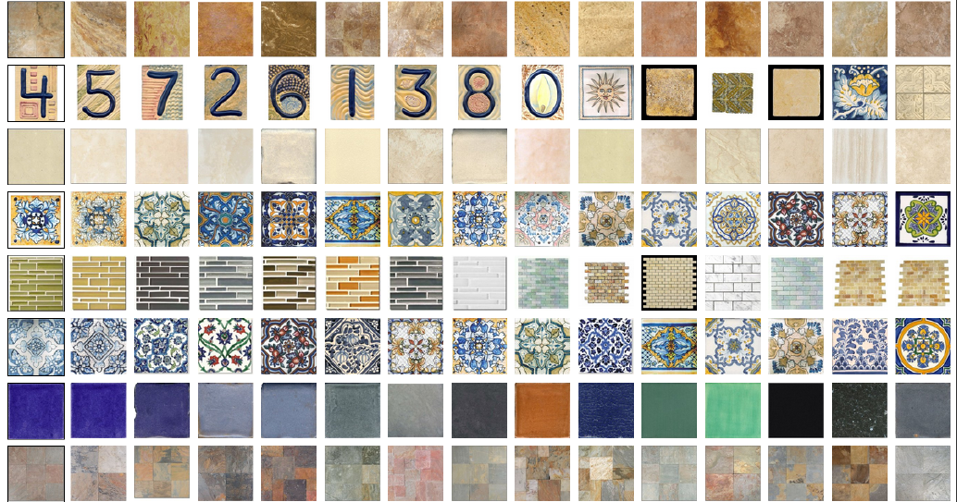
Nearest Neighbors

Slide 9
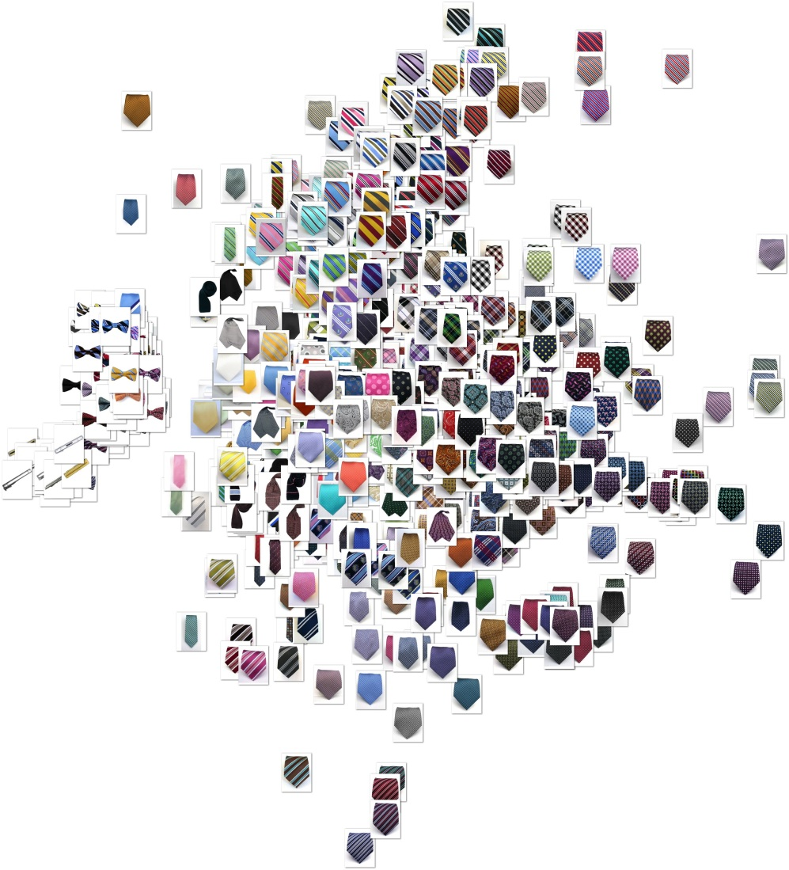
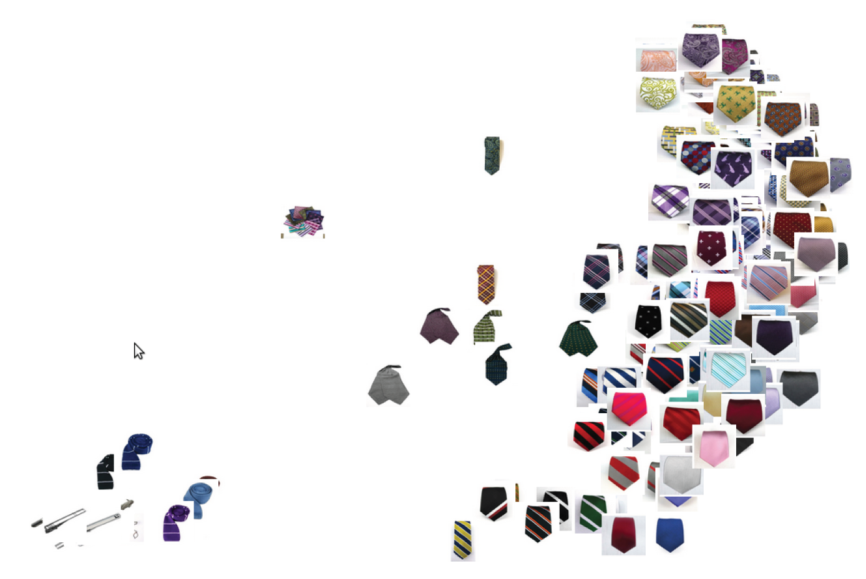
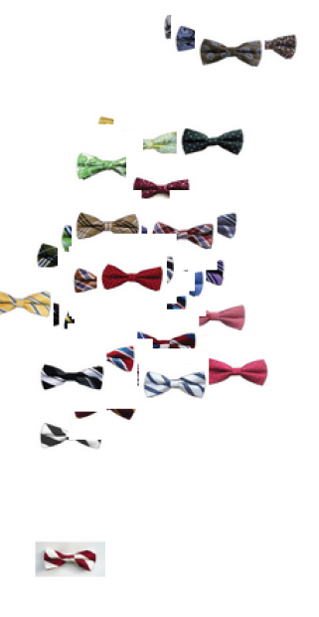
Works on any image set

Slide 10
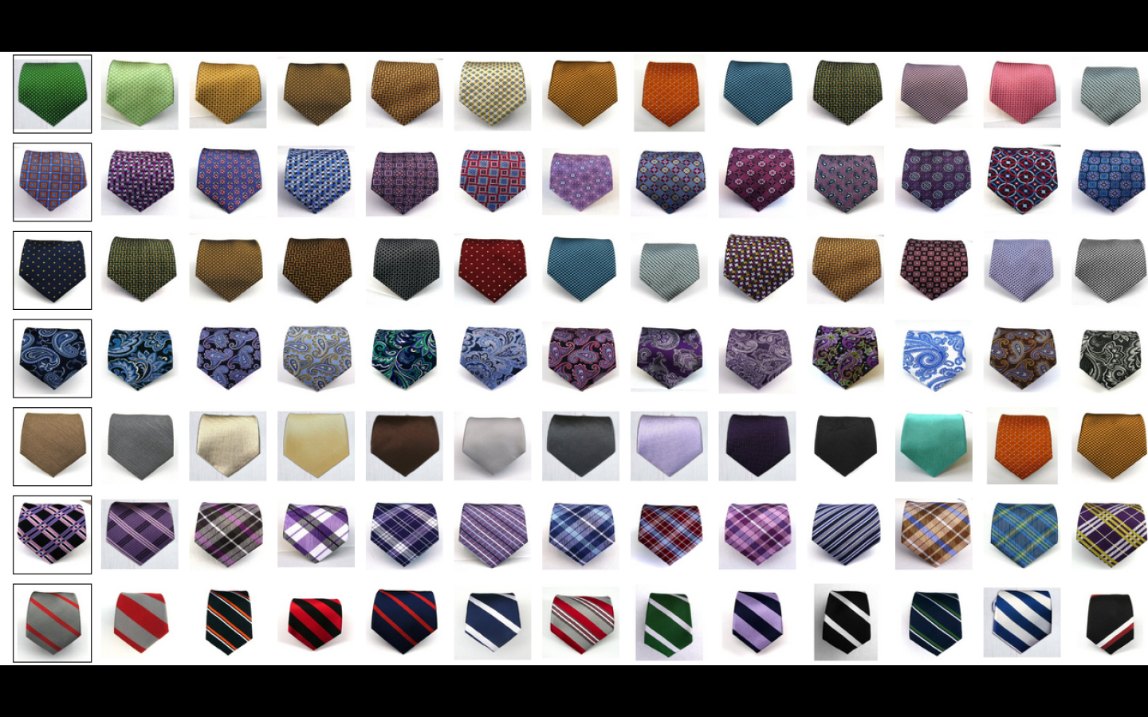

Ideal system: all nearest neighbors in $O(n\log{n)}$ comparisons?
That’s $n$ noisy sorting problems with $O(\log{n)}$ comarisons/item.

Slide 11
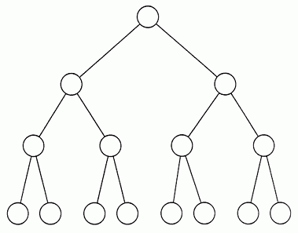

Lure of Adaptivity
Toy example: complete binary trees with $n$leaves, depth $O(log n)$
Avg. cost is $Θ\left(n\right) \text{from} \text{random} \text{queries}$.
Avg. cost is $Θ\left(log n\right)$ from adaptive queries.
Tie store
Scarves
Tie clips
Bow ties
Neck ties

Slide 12



























Embeddings and kernels
Embedding of the $n$objects into $ℝ^{d}$ for some $d≤n.$ Kernel ${K∈ℝ^{n×n}, K}_{ij}=x_{i}⋅x_{j}$.
$$x_{1}$$
$$x_{2}$$
$$x_{3}$$
$$x_{4}$$
$$x_{1}$$
$$x_{1}⋅x_{1}$$
$$x_{1}⋅x_{2}$$
$$x_{1}⋅x_{3}$$
$$x_{1}⋅x_{4}$$
$$x_{2}$$
$$x_{2}⋅x_{1}$$
$$x_{2}⋅x_{2}$$
$$x_{2}⋅x_{3}$$
$$x_{2}⋅x_{4}$$
$$x_{3}$$
$$x_{3}⋅x_{1}$$
$$x_{3}⋅x_{2}$$
$$x_{3}⋅x_{3}$$
$$x_{3}⋅x_{4}$$
$$x_{4}$$
$$x_{4}⋅x_{1}$$
$$x_{4}⋅x_{2}$$
$$x_{4}⋅x_{3}$$
$$x_{4}⋅x_{4}$$
$$K≽0$$
Assume $x_{i}^{2}=1$.

Slide 13




Embeddings and kernels
Embedding of the $n$objects into $ℝ^{d}$ for some $d≤n.$ Kernel ${K∈ℝ^{n×n}, K}_{ij}=x_{i}⋅x_{j}$.
$$x_{1}$$
$$x_{2}$$
$$x_{3}$$
$$x_{4}$$
$$x_{1}$$
$$1$$
$$x_{1}⋅x_{2}$$
$$x_{1}⋅x_{3}$$
$$x_{1}⋅x_{4}$$
$$x_{2}$$
$$x_{2}⋅x_{1}$$
$$1$$
$$x_{2}⋅x_{3}$$
$$x_{2}⋅x_{4}$$
$$x_{3}$$
$$x_{3}⋅x_{1}$$
$$x_{3}⋅x_{2}$$
$$1$$
$$x_{3}⋅x_{4}$$
$$x_{4}$$
$$x_{4}⋅x_{1}$$
$$x_{4}⋅x_{2}$$
$$x_{4}⋅x_{3}$$
$$1$$
$$K≽0$$
Assume $x_{i}^{2}=1$.

Slide 14



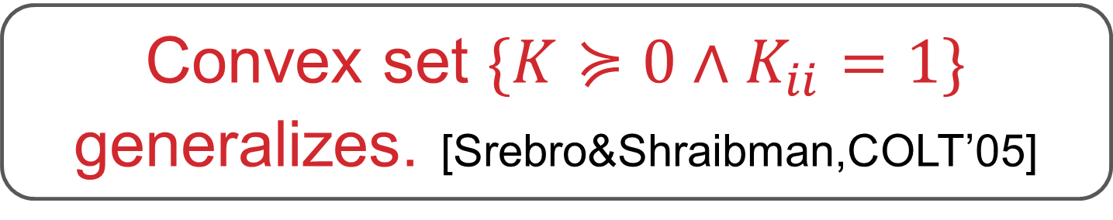

Embeddings and kernels
Embedding of the $n$objects into $ℝ^{d}$ for some $d≤n.$ Kernel ${K∈ℝ^{n×n}, K}_{ij}=x_{i}⋅x_{j}$.
$$x_{1}$$
$$x_{2}$$
$$x_{3}$$
$$x_{4}$$
$$x_{1}$$
$$1$$
$$x_{1}⋅x_{2}$$
$$0.9$$
$$x_{1}⋅x_{3}$$
$$x_{1}⋅x_{4}$$
$$0.9$$
$$1$$
$$x_{2}⋅x_{3}$$
$$x_{2}⋅x_{4}$$
$$x_{2}$$
$$≥\text{.62}$$
$$x_{3}$$
$$1$$
$$x_{3}⋅x_{4}$$
$$x_{4}$$
$$1$$
$$K≽0$$
Convex set $\{K≽0∧K_{ii}=1\}$ generalizes. [Srebro&Shraibman,COLT’05]

Slide 15
Adaptive ALGORITHM
Turk random triples
Fit $K$ to all data so far
Fit 𝑲 to all data so far
Turk “most informative triples”
Maximum likelihood fit
to logistic or relative model
using gradient descent
Which triples are most informative?
Those which current model says 50/50?
Like labeling examples “closest to the margin” in active learning.

Slide 16
Adaptive ALGORITHM
Turk random triples
Fit $K$ to all data so far
Fit 𝑲 to all data so far
Turk “most informative triples”
Maximum likelihood fit
to logistic or relative model
using gradient descent
We use probabilistic model +
information gain to decide how informative a triple is.

Slide 17
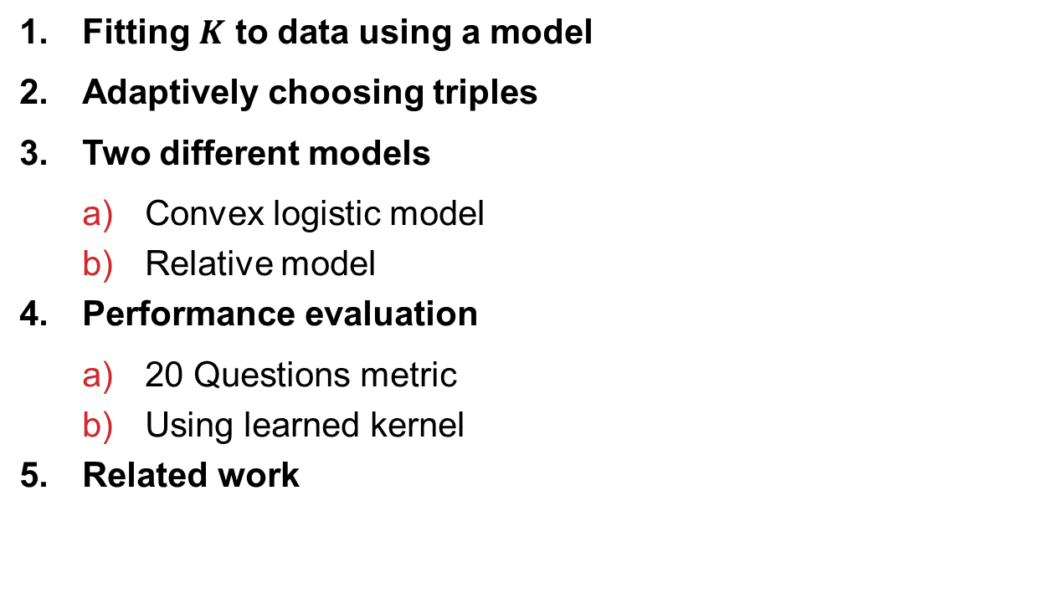
Roadmap
Fitting $K$ to data using a model
Adaptively choosing triples
Two different models
  Convex logistic model
  Relative model
Performance evaluation
  20 Questions metric
  Using learned kernel
Related work

Slide 18
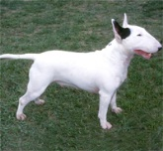
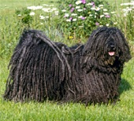
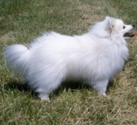
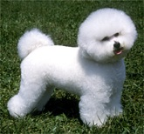




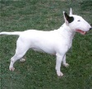




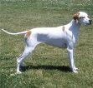





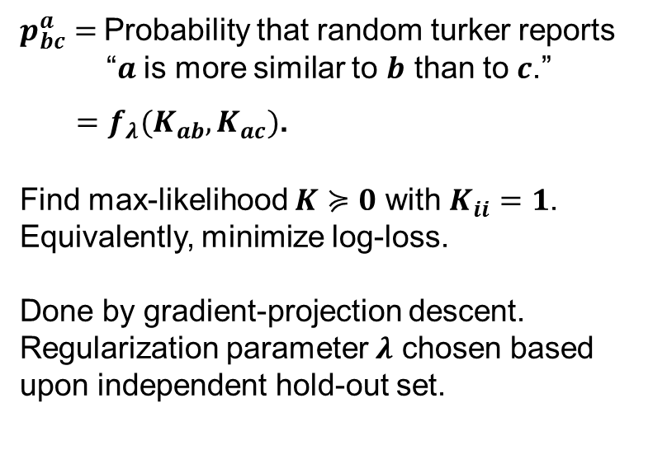


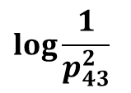
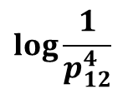


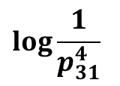

Fit $K$ to data
$$K_{12}$$
$$K_{13}$$
$$K_{14}$$
$$K_{23}$$
$$K_{24}$$
$$\log{\frac{1}{p_{31}^{4}}}$$
$$K_{34}$$
$$+$$
$p_{bc}^{a}=$Probability that random turker reports
“$a$ is more similar to $b$ than to $c$.”
$=f_{λ}(K_{ab},K_{ac})$.
Find max-likelihood $K≽0$ with $K_{ii}=1$.
Equivalently, minimize log-loss.
Done by gradient-projection descent.
Regularization parameter $λ$ chosen based
upon independent hold-out set.
$$\log{\frac{1}{p_{43}^{2}}}$$
$$+$$
$$\log{\frac{1}{p_{12}^{4}}}$$

Slide 19
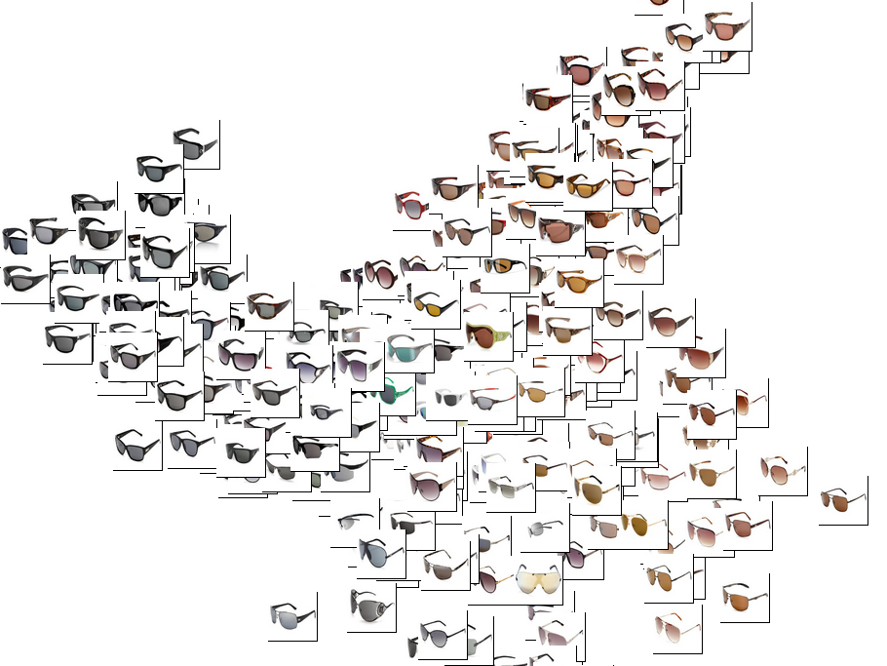

Slide 20

Adaptively choosing triples
First, $k=10$ random triples are chosen per object.
Then, at each round $t=11,12,…,40$, for each object $i$:
Pick a triple comparing $i$ to two other objects
Get posterior distribution over where $i$ is embedded.
explain how
Choose triple that results in largest expected decrease in entropy (greatest mutual information).

Slide 21
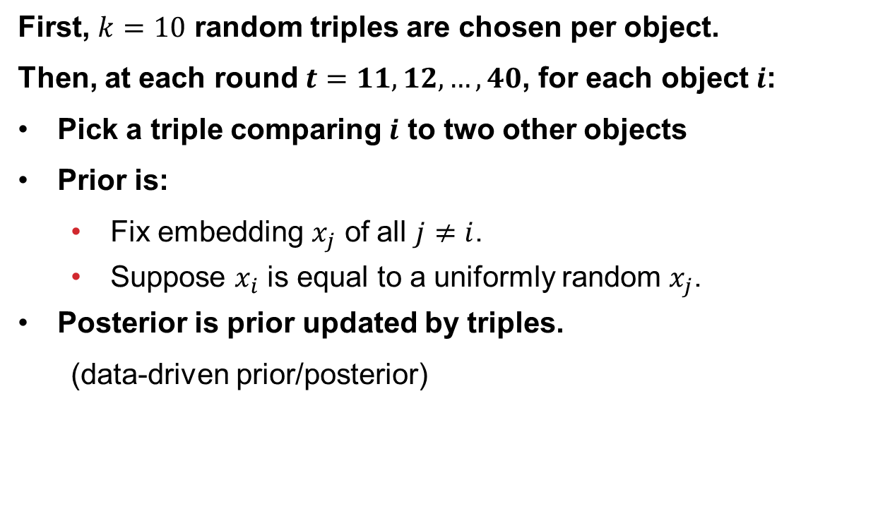
Adaptively choosing triples
First, $k=10$ random triples are chosen per object.
Then, at each round $t=11,12,…,40$, for each object $i$:
Pick a triple comparing $i$ to two other objects
Prior is:
  Fix embedding $x_{j}$ of all $j≠i$.
  Suppose $x_{i}$ is equal to a uniformly random $x_{j}$.
Posterior is prior updated by triples.
  (data-driven prior/posterior)
Choose triple that results in largest expected decrease in entropy (greatest mutual information).

Slide 22
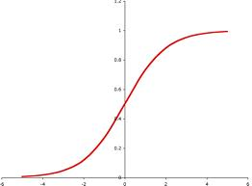
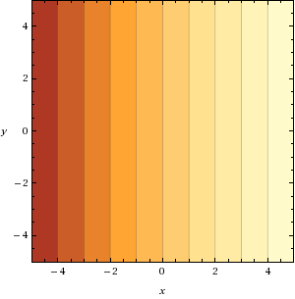
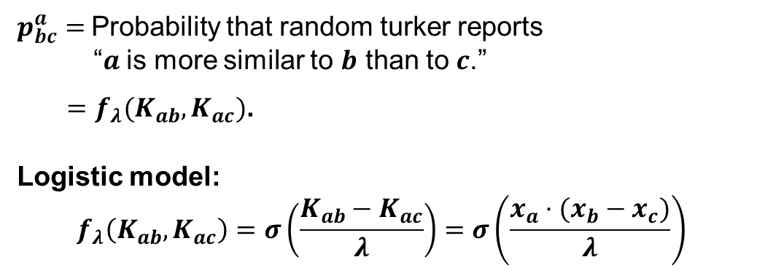


Fit $K$ to data
$p_{bc}^{a}=$Probability that random turker reports
“$a$ is more similar to $b$ than to $c$.”
$=f_{λ}(K_{ab},K_{ac})$.
Logistic model:
$$f_{λ}\left(K_{ab},K_{ac}\right)=σ\left(\frac{{K_{ab}−K}_{ac}}{λ}\right)=σ\left(\frac{x_{a}⋅(x_{b}−x_{c})}{λ}\right)$$
$$b$$
$$c$$

Slide 23
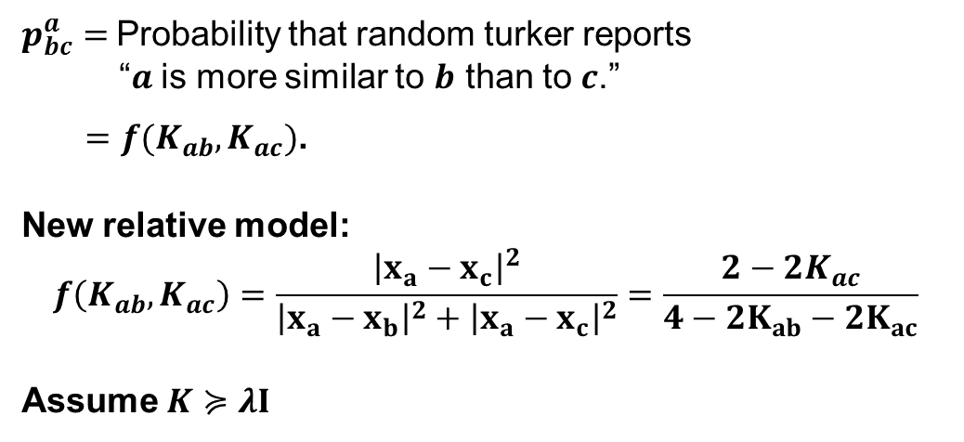
Fit $K$ to data
$p_{bc}^{a}=$Probability that random turker reports
“$a$ is more similar to $b$ than to $c$.”
$=f(K_{ab},K_{ac})$.
New relative model:
$$f\left(K_{ab},K_{ac}\right)=\frac{{\left|x_{a}−x_{c}\right|}^{2}}{{\left|x_{a}−x_{b}\right|}^{2}+{\left|x_{a}−x_{c}\right|}^{2}}=\frac{2−2K_{ac}}{4−2K_{ab}−2K_{ac}}$$
Assume $K≽λI$

Slide 24
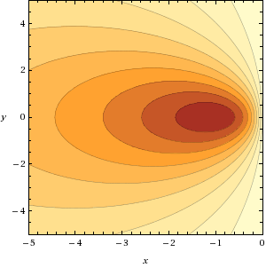
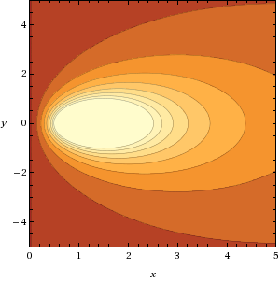


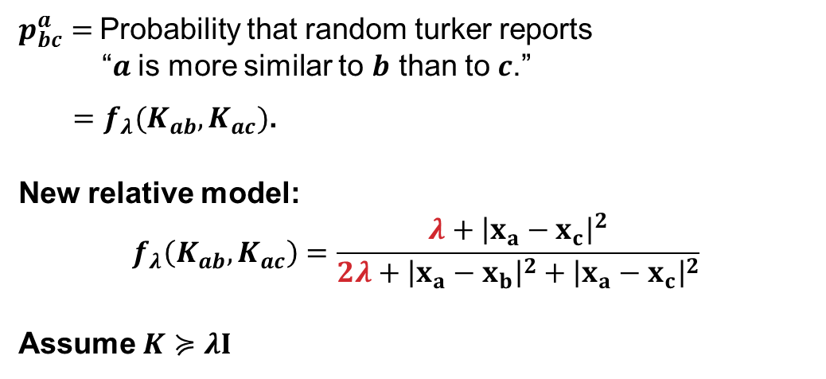






Fit $K$ to data
$p_{bc}^{a}=$Probability that random turker reports
“$a$ is more similar to $b$ than to $c$.”
$=f_{λ}(K_{ab},K_{ac})$.
New relative model:
$$f_{λ}\left(K_{ab},K_{ac}\right)=\frac{λ+{\left|x_{a}−x_{c}\right|}^{2}}{{2λ+\left|x_{a}−x_{b}\right|}^{2}+{\left|x_{a}−x_{c}\right|}^{2}}$$
Assume $K≽λI$
$K≽$ 0
$$b′$$
$$c′$$
$$a$$
$$b$$
$$c$$
$$b$$
$$c$$

Slide 25
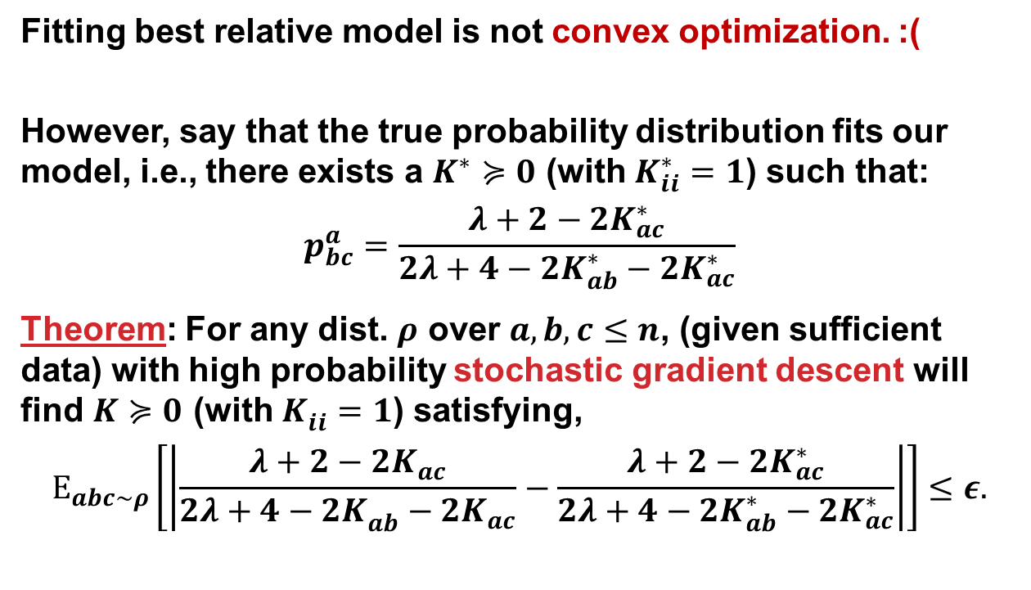
Relative
Model FITTING
Fitting best relative model is not convex optimization. :(
However, say that the true probability distribution fits our model, i.e., there exists a $K^{∗}≽0$ (with $K_{ii}^{∗}=1$) such that:
$$p_{bc}^{a}=\frac{λ+2−2K_{ac}^{∗}}{2λ+4−2K_{ab}^{∗}−2K_{ac}^{∗}}$$
Theorem: For any dist. $ρ$ over $a,b,c≤n$, (given sufficient data) with high probability stochastic gradient descent will find $K≽0$ (with $K_{ii}^{}=1$) satisfying,
$$E_{abc∼ρ}\left[\left|\frac{λ+2−2K_{ac}^{}}{2λ+4−2K_{ab}^{}−2K_{ac}^{}}−\frac{λ+2−2K_{ac}^{∗}}{2λ+4−2K_{ab}^{∗}−2K_{ac}^{∗}}\right|\right]≤ε.$$

Slide 26



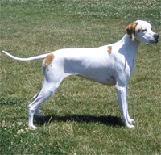

Good question?
Say we have “figured out” it’s a small white dog and
we want to know how furry it is.

Slide 27
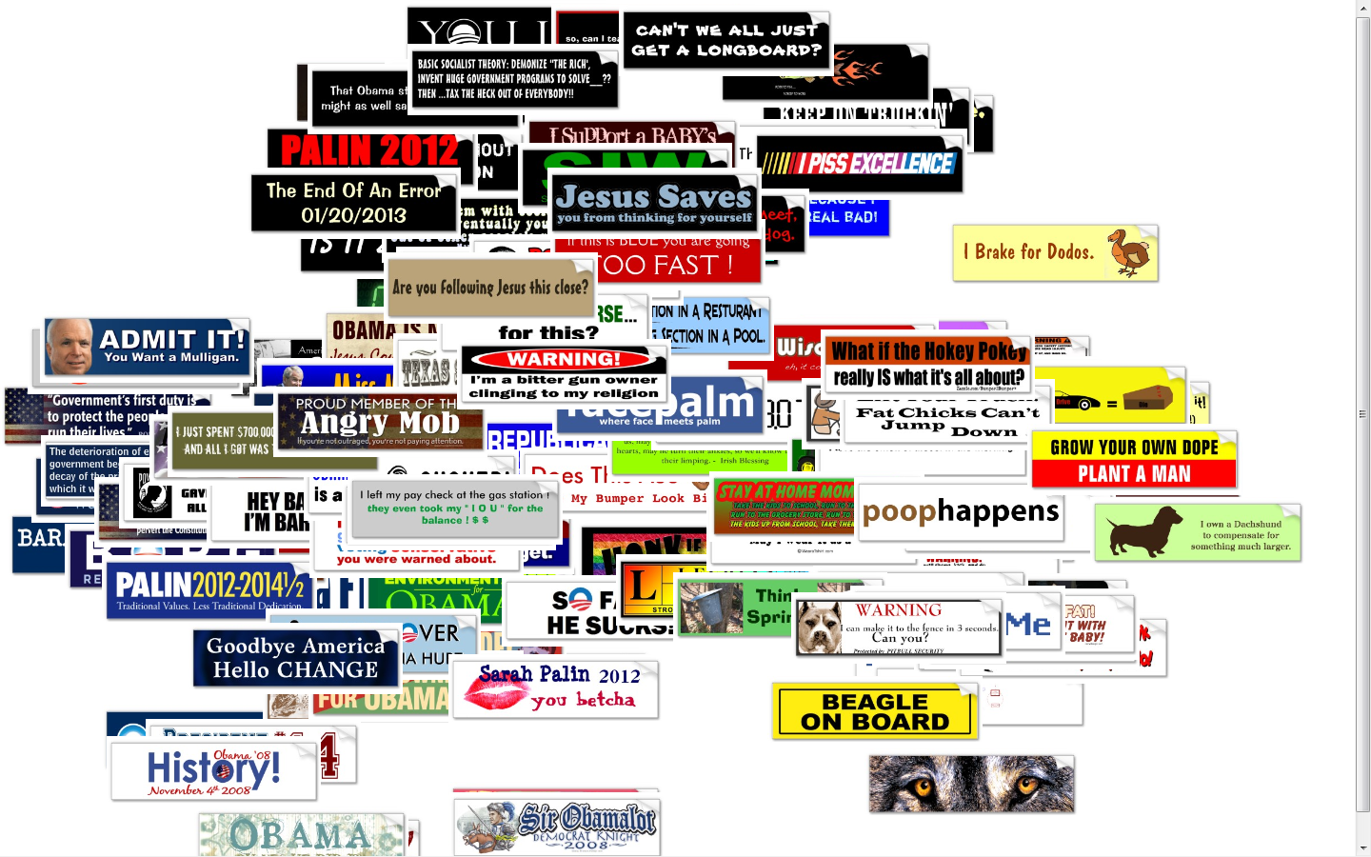

Slide 28
Related work
Multidimensional scaling and matrix completion […]
How similar are A and B? How does person A rate item B?
Triple-based multidimensional scaling (nonadaptive) [AgarwalWillsCaytonLanckrietKriegmanBelongie ‘07]
Crowd-based visual search
Visipedia [WelinderBransonBelongiePerona ’10]
(requires domain-specific features)
Content-based image retrieval […]
Collaborative filtering […]

Slide 29

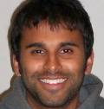

Slide 30
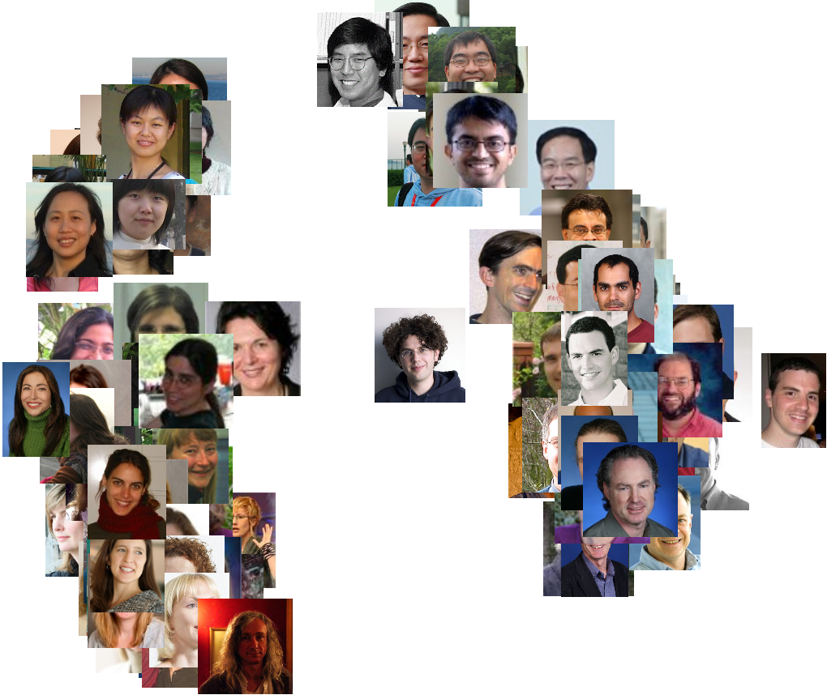

Slide 31
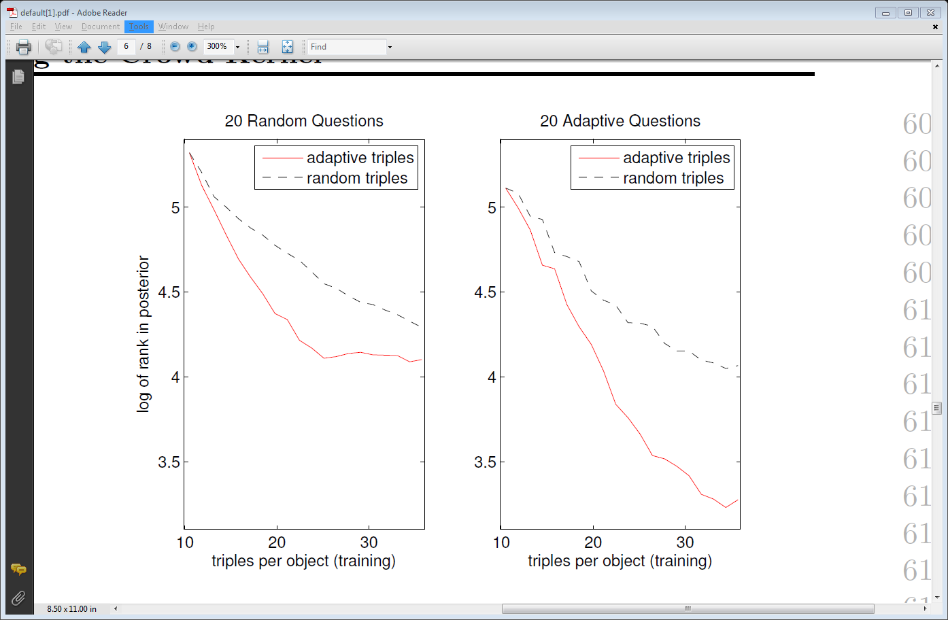
Performance Evaluation
20 Questions metric
Random object is chosen secretly
System asks 20 questions and then ranks objects in terms of likelihood
Dataset: 75 ties+75 tiles+75 flags

Slide 32
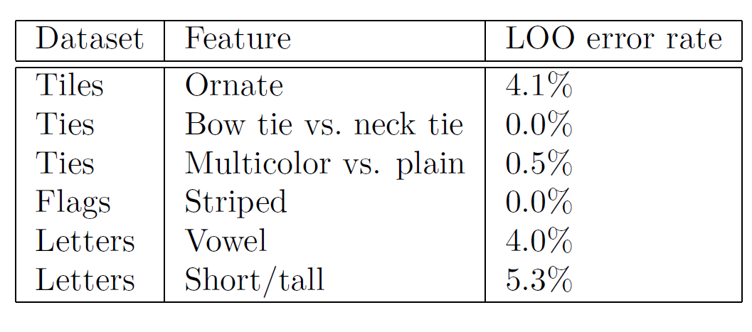
Performance evaluation:
Using Kernel

Slide 33
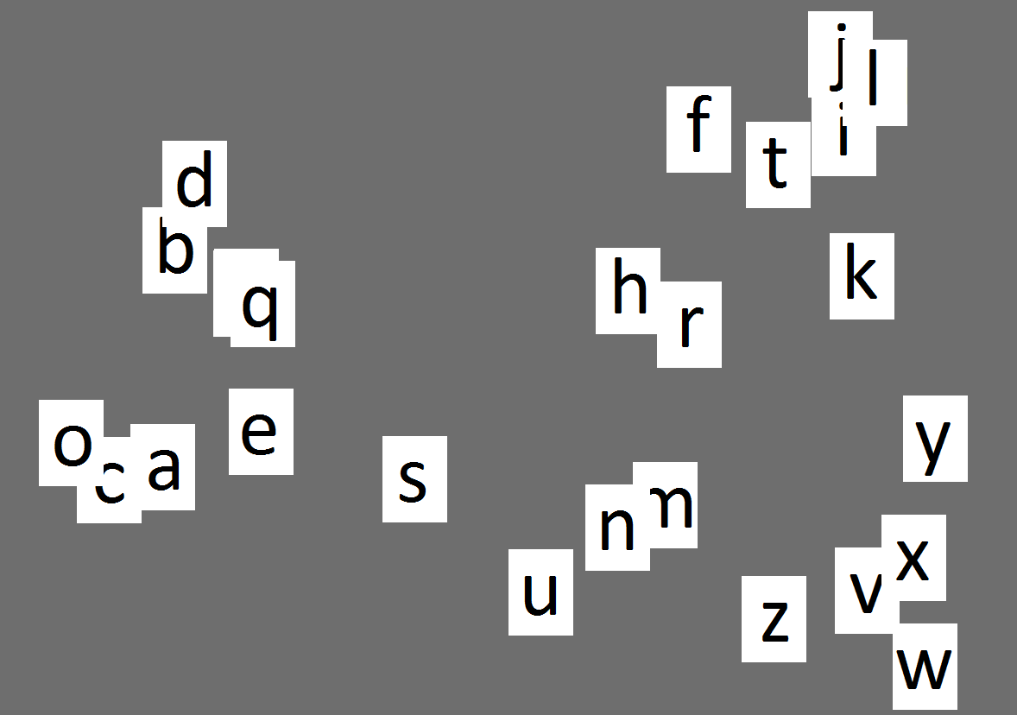

Slide 34
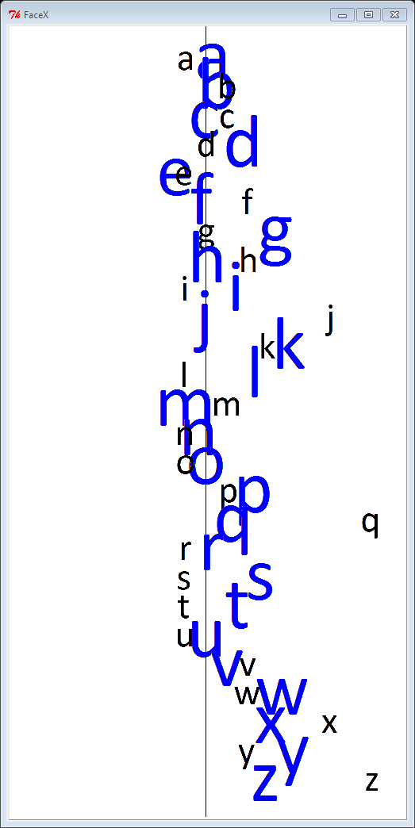
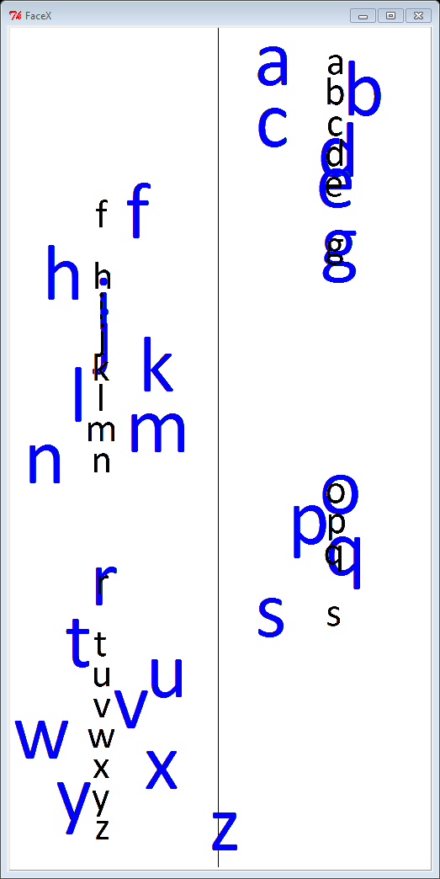
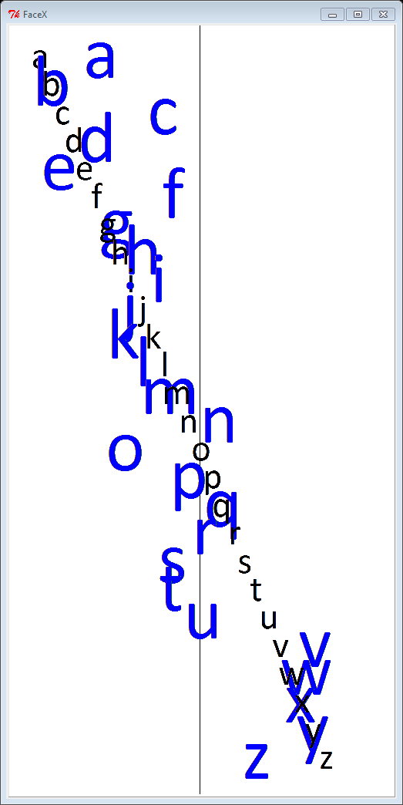
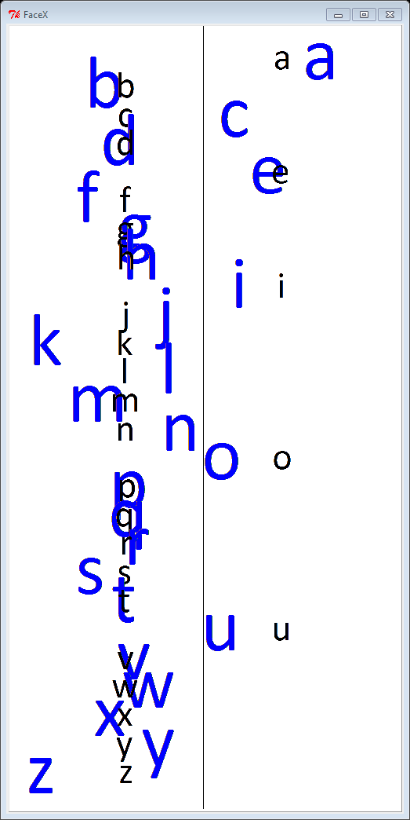



Slide 35

THE system
Takes any set of images as input.
Farms out adaptive queries to turkers, in rounds.
Fits data to an embedding in $d$ dimensions.
Creates a visual search browser.
All for about 15₵ per object. For $n=500$, costs about $75.
Naive approach on $n=500$ objects would cost $\frac{n^{3}}{2}×0.005≈\$30,000$.
What we pay per
similarity assessment.

Slide 36


Cool game...really enjoyed it...I was getting good towards the end...lol
fun, getting better as i do more
Thanks for the bonuses, I feel Good Now!
This was interesting, but difficult. I was always happy when it was a girl!

Slide 37

Conclusions AND
FUTURE WORK
Approximating the crowd kernel works across domains.
Adaptivity helps save $$ and improve performance.
Future work
Approximate by “machine features” + humans
$$K_{ab}=φ\left(a\right)⋅φ\left(b\right)+h\left(a\right)⋅h(b)$$
Interactive ML for solving AI-hard classification problems
Thank you!

Slide 38


