Slide 1
Processing Sequential
Sensor Data
John Krumm
Microsoft Research
Redmond, Washington USA
jckrumm@microsoft.com

Slide 2
Interpret a Sequential Signal
Signal is
Often a function of time (as above)
Often from a sensor

Slide 3


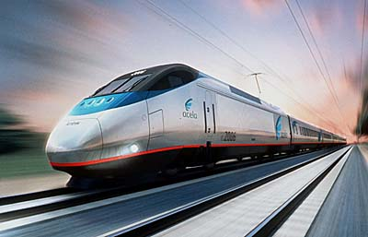

Pervasive/Ubicomp Examples
Signal sources
Accelerometer
Light sensor
Gyro sensor
Indoor location
GPS
Microphone
…
Interpretations
Speed
Mode of transportation
Location
Moving vs. not moving
Proximity to other people
Emotion
…

Slide 4
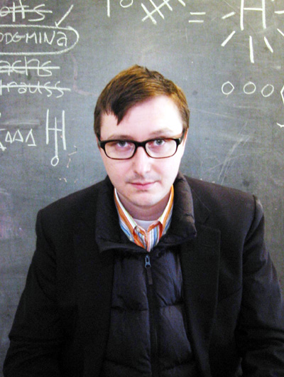
Goals of this Tutorial
Confidence to add sequential signal processing to your research
Ability to assess research with simple sequential signal processing
Know the terminology
Know the basic techniques
  How to implement
  Where they’re appropriate
Assess numerical results in an accepted way
At least give the appearance that you know what you’re talking about

Slide 5
Not Covering
Regression – fit function to data
Classification – classify things based on measured features
Statistical Tests – determine if data support a hypothesis

Slide 6
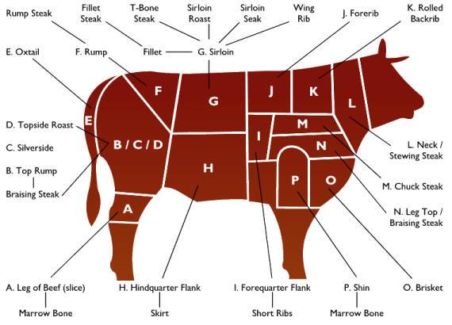
Outline
Introduction (already done!)
Signal terminology and assumptions
Running example
Filtering
  Mean and median filters
  Kalman filter
  Particle filter
  Hidden Markov model
Presenting performance results

Slide 7
Signal Dimensionality
1D: z(t)
(
)
2D: z(t) =
z₁(t)
z₂(t)
bold means vector

Slide 8
Sampled Signal
Cannot measure nor store continuous signal, so take samples instead
[ z(0), z(Δ), z(2Δ), … , z((n-1)Δ) ] = [ z₁, z₂, z₃, … , z_{n} ]
Δ = sampling interval, e.g. 1 second, 5 minutes, …
Δ = 0.1 seconds

Slide 9
Signal + Noise
Noise
Often assumed to be Gaussian
Often assumed to be zero mean
Often assumed to be i.i.d. (independent, identically distributed)
v_{i} ~ N(0,σ) for zero mean, Gaussian, i.i.d., σ is standard deviation
z_{i} = x_{i} + v_{i}
random number representing sensor noise
measurement from noisy sensor
actual value, but unknown

Slide 10
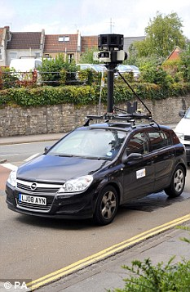
Running Example
Track a moving person in (x,y)
1000 (x,y) measurements
Δ = 1 second
measurement vector
actual location
noise
zero mean
standard deviation = 3 meters
start
outlier
Also 10 randomly inserted outliers with N(0,15)

Slide 11
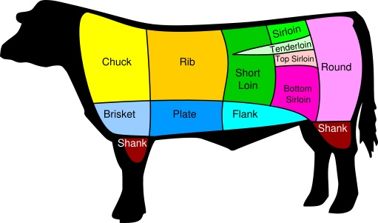
Outline
Introduction
Signal terminology and assumptions
Running example
Filtering
  Mean and median filters
  Kalman filter
  Particle filter
  Hidden Markov model
Presenting performance results

Slide 12
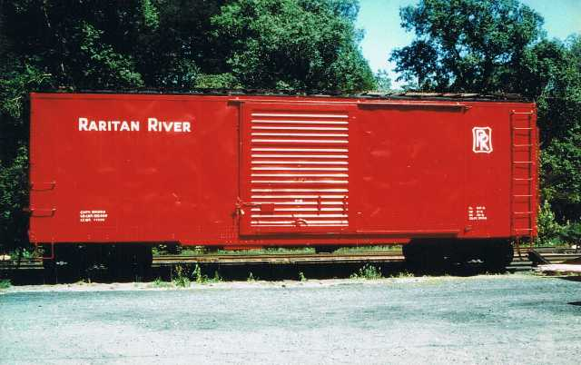
Mean Filter
Also called “moving average” and “box car filter”
Apply to x and y measurements separately
Filtered version of this point is mean of points in solid box
z_{x}
t
“Causal” filter because it doesn’t look into future
Causes lag when values change sharply
Help fix with decaying weights, e.g.
Sensitive to outliers, i.e. one really bad point can cause mean to take on any value
Simple and effective (I will not vote to reject your paper if you use this technique)

Slide 13
Mean Filter
outlier
10 points in each mean
Outlier has noticeable impact
If only there were some convenient way to fix this …

Slide 14
Median Filter
Filtered version of this point is mean median of points in solid box
Insensitive to value of, e.g., this point
z_{x}
t
Median is way less sensitive to outliners than mean
median (1, 3, 4, 7, 1 x 10¹⁰) = 4
mean (1, 3, 4, 7, 1 x 10¹⁰) ≈ 2 x 10⁹

Slide 15
Median Filter
outlier
10 points in each median
Outlier has noticeable less impact

Slide 16

Mean and Median Filter
The median is almost always better to use than the mean.
Editorial: mean vs. median

Slide 17
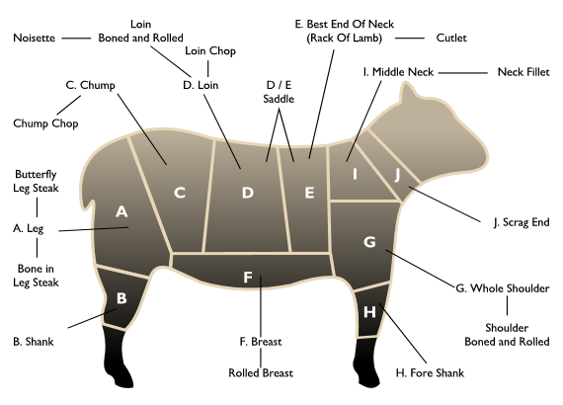
Outline
Introduction
Signal terminology and assumptions
Running example
Filtering
  Mean and median filters
  Kalman filter
  Particle filter
  Hidden Markov model
Presenting performance results

Slide 18
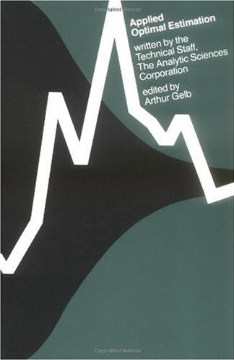
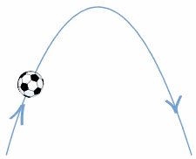
Kalman Filter
Assumed trajectory is parabolic
Mean and median filters assume smoothness
Kalman filter adds assumption about trajectory
My favorite book on Kalman filtering
Weight data against assumptions about system’s dynamics
Big difference #1: Kalman filter includes (helpful) assumptions about behavior of measured process
dynamics
data

Slide 19
Kalman Filter
Kalman filter separates measured variables from state variables
Running example: measure (x,y) coordinates (noisy)
Measure:
Running example: estimate location and velocity (☺!)
Infer state:
Big difference #2: Kalman filter can include state variables that are not measured directly

Slide 20
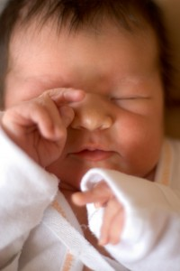
Kalman Filter Measurements
Measurement vector is related to state vector by a matrix multiplication plus noise.
Running example:
Sleepy eyes threat level: orange
In this case, measurements are just noisy copies of actual location
Makes sensor noise explicit, e.g. GPS has σ of around 5 meters

Slide 21
Kalman Filter Dynamics
Insert a bias for how we think system will change through time
location is standard straight-line motion
velocity changes randomly (because we don’t have any idea what it actually does)

Slide 22
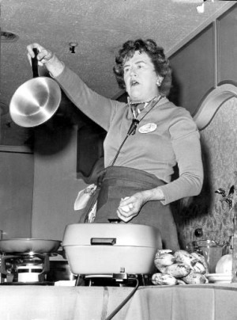
Kalman Filter Ingredients
H matrix: gives measurements for given state
Measurement noise: sensor noise
φ matrix: gives time dynamics of state
Process noise: uncertainty in dynamics model

Slide 23
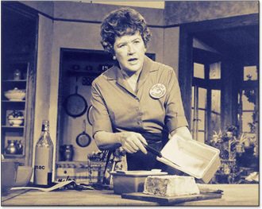
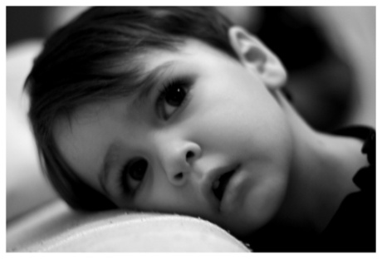
Kalman Filter Recipe
Sleepy eyes threat level: red
Just plug in measurements and go
Recursive filter – current time step uses state and error estimates from previous time step
Big difference #3: Kalman filter gives uncertainty estimate in the form of a Gaussian covariance matrix

Slide 24

Kalman Filter State
Evaluation of the Kalman filter on each location measurement gives velocity!
In general, Kalman gives a principled way to compute related state variables from raw measurements.
Mean and median filters don’t do this.

Slide 25
Kalman Filter
Velocity model:
Smooth
Tends to overshoot corners
Too much dependence on straight line velocity assumption
Too little dependence on data
dynamics
data

Slide 26
Kalman Filter
Velocity model:
Hard to pick process noise σ_{s}
Process noise models our uncertainty in system dynamics
Here it accounts for fact that motion is not a straight line
“Tuning” σ_{s} (by trying a bunch of values) gives better result

Slide 27
Kalman Filter
The Kalman filter was fine back in the old days. But I really prefer more modern methods that are not saddled with Kalman’s restrictions on continuous state variables and linearity assumptions.
Editorial: Kalman filter

Slide 28
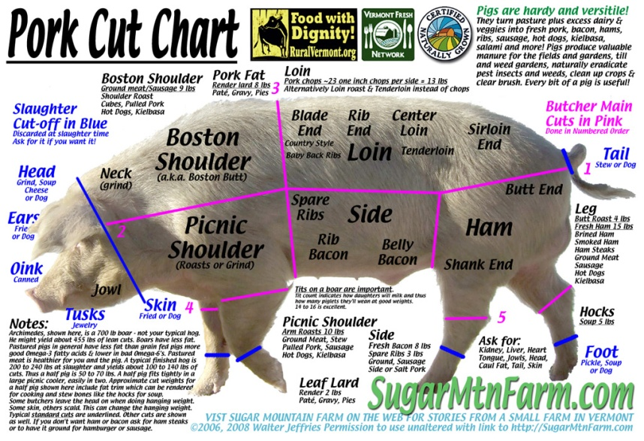
Outline
Introduction (already done!)
Signal terminology and assumptions
Running example
Filtering
  Mean and median filters
  Kalman filter
  Particle filter
  Hidden Markov model
Presenting performance results

Slide 29
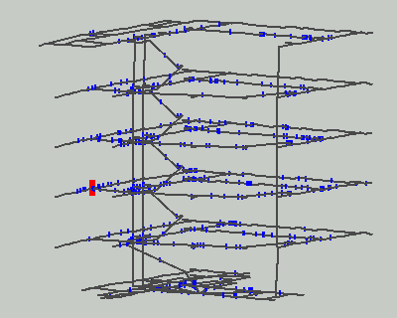
Particle Filter
Dieter Fox et al.
WiFi tracking in a multi-floor building
Multiple “particles” as hypotheses
Particles move based on probabilistic motion model
Particles live or die based on how well they match sensor data

Slide 30
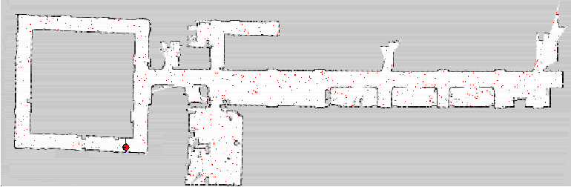
Particle Filter
Dieter Fox et al.
Allows multi-modal uncertainty (Kalman is unimodal Gaussian)
Allows continuous and discrete state variables (e.g. 3rd floor)
Allows rich dynamic model (e.g. must follow floor plan)
Can be slow, especially if state vector dimension is too large
(e.g. (x, y, identity, activity, next activity, emotional state, …) )

Slide 31
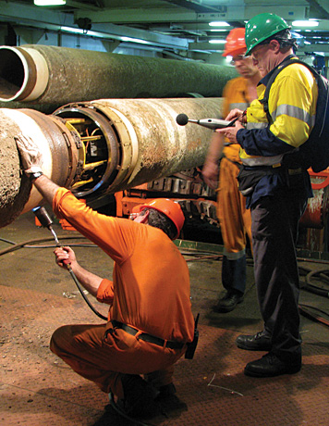
Particle Filter Ingredients
z = measurement, x = state, not necessarily same
Probability distribution of a measurement given actual value
Can be anything, not just Gaussian like Kalman
But we use Gaussian for running example, just like Kalman
E.g. measured speed (in z) will be slower if emotional state (in x) is “tired”
For running example, measurement is noisy version of actual value

Slide 32
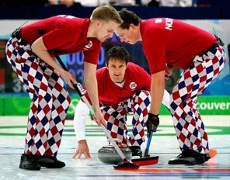
Particle Filter Ingredients
Probabilistic dynamics, how state changes through time
Can be anything, e.g.
  Tend to go slower up hills
  Avoid left turns
  Attracted to Scandinavian people
Closed form not necessary
Just need a dynamic simulation with a noise component
But we use Gaussian for running example, just like Kalman
x_{i}
random vector
x_{i-1}

Slide 33
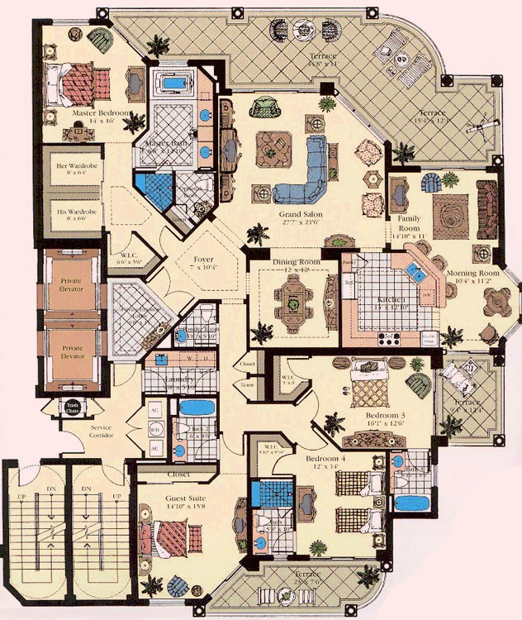
Home Example
Rich measurement and state dynamics models
Measurements
z = ( (x,y) location in house from WiFi)^{T}
State (what we want to estimate)
x = (room, activity)
p((x,y) in kitchen | in bathroom) = 0
p( sleeping now | sleeping previously) = 0.9
p( cooking now | working previously) = 0.02
p( watching TV & sleeping| *) = 0
p( bedroom 4 | master bedroom) = 0

Slide 34
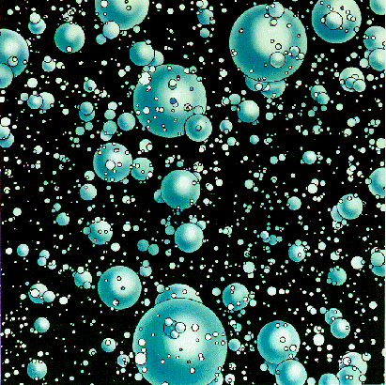

Particle Filter Algorithm
Start with N instances of state vector x_{i}^{(j)} , i = 0, j = 1 … N
i = i+1
Take new measurement z_{i}
Propagate particles forward in time with p(x_{i}|x_{i-1}), i.e. generate new, random hypotheses
Compute importance weights w_{i}^{(j)} = p(z_{i}|x_{i}^{(j)}), i.e. how well does measurement support hypothesis?
Normalize importance weights so they sum to 1.0
Randomly pick new particles based on importance weights
Goto 1
Compute state estimate
Weighted mean (assumes unimodal)
Median
Sleepy eyes threat level: orange

Slide 35
Particle Filter
Dieter Fox et al.
WiFi tracking in a multi-floor building
Multiple “particles” as hypotheses
Particles move based on probabilistic motion model
Particles live or die based on how well they match sensor data

Slide 36
Particle Filter Running Example
Measurement model reflects true, simulated measurement noise. Same as Kalman in this case.
Straight line motion with random velocity change. Same as Kalman in this case.
location is standard straight-line motion
velocity changes randomly (because we don’t have any idea what it actually does)
Sometimes increasing the number of particles helps

Slide 37

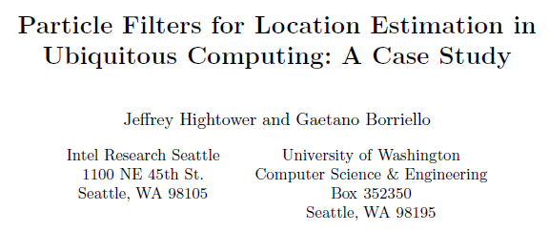
Particle Filter Resources
UbiComp 2004
Especially Chapter 1

Slide 38
Particle Filter
The particle filter is wonderfully rich and expressive if you can afford the computations. Be careful not to let your state vector get too large.
Editorial: Particle filter

Slide 39

Outline
Introduction
Signal terminology and assumptions
Running example
Filtering
  Mean and median filters
  Kalman filter
  Particle filter
  Hidden Markov model
Presenting performance results

Slide 40
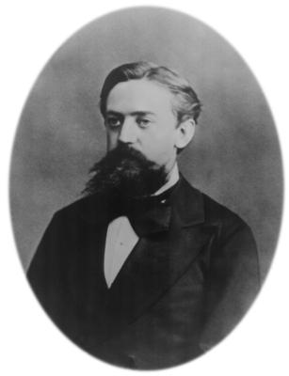
Hidden Markov Model (HMM)
Big difference from previous: states are discrete, e.g.
Spoken phoneme
{walking, driving, biking, riding bus}
{moving, still}
{cooking, sleeping, watching TV, playing game, … }
Markov 1856 - 1922
Hidden Markov

Slide 41
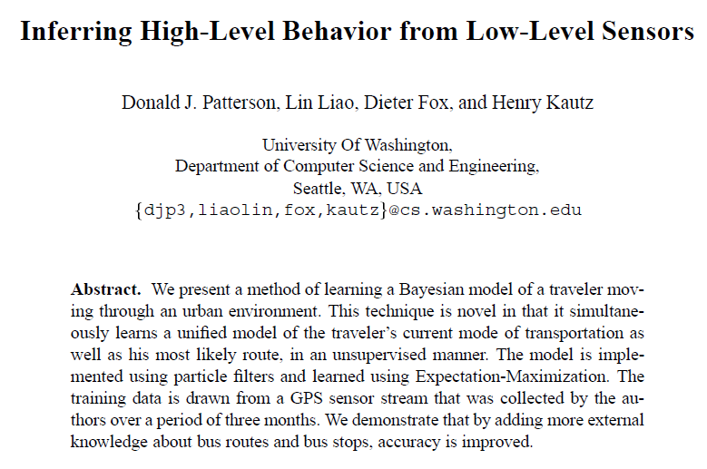
(Unhidden) Markov Model
0.9
0.7
0.1
Move to new state (or not)
  at every time click
  when finished with current state
Transition probabilities control state transitions
bus
walk
0.1
0.0
0.2
0.0
0.1
drive
Example inspired by:
0.9
UbiComp 2003

Slide 42
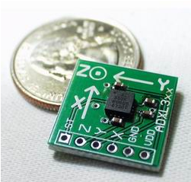
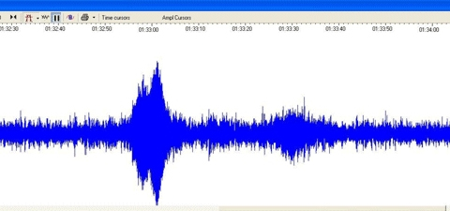
Hidden Markov Model
0.9
0.7
Can “see” states only via noisy sensor
0.1
bus
walk
0.1
0.0
0.2
0.0
0.1
drive
accelerometer
0.9

Slide 43
HMM: Two Parts
Two parts to every HMM:
Observation probabilities P(X_{i}^{(j)}|z_{i}) – probability of state j given measurement at time i
Transition probabilities a_{jk} – probability of transition from state j to state k
Find path that maximizes product of probabilities (observation & transition)
Use Viterbi algorithm to find path efficiently

Slide 44
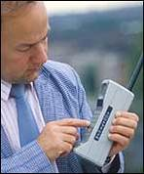
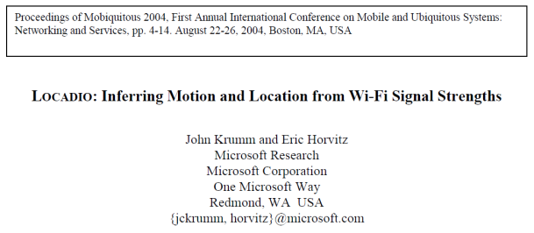
Smooth Results with HMM
still
moving
still
moving vs. still
0.99989
0.00011
0.99989
still
moving
0.00011
Signal strength has higher variance when moving → observation probabilities
Transitions between states relatively rare (made-up numbers) → transition probabilities

Slide 45
Smooth Results with HMM
still
0.99989
still
still
still
0.4
0.00011
0.2
0.9
0.3
Viterbi algorithm finds path with maximum product of observation and transition probabilities
0.00011
moving
0.99989
moving
moving
moving
0.6
0.8
0.1
0.7
Results in fewer false transitions between states, i.e. smoother and slightly more accurate

Slide 46
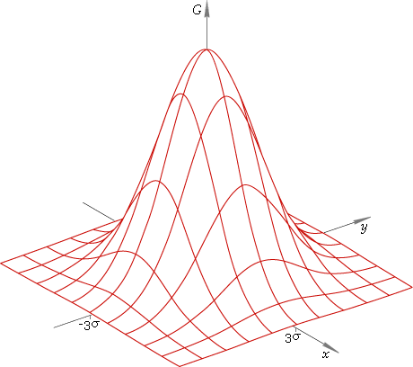
Running Example
Discrete states are 10,000 1m x 1m squares
Observation probabilities spread in Gaussian over nearby squares as per measurement noise model
Transition probabilities go to 8-connected neighbors

Slide 47
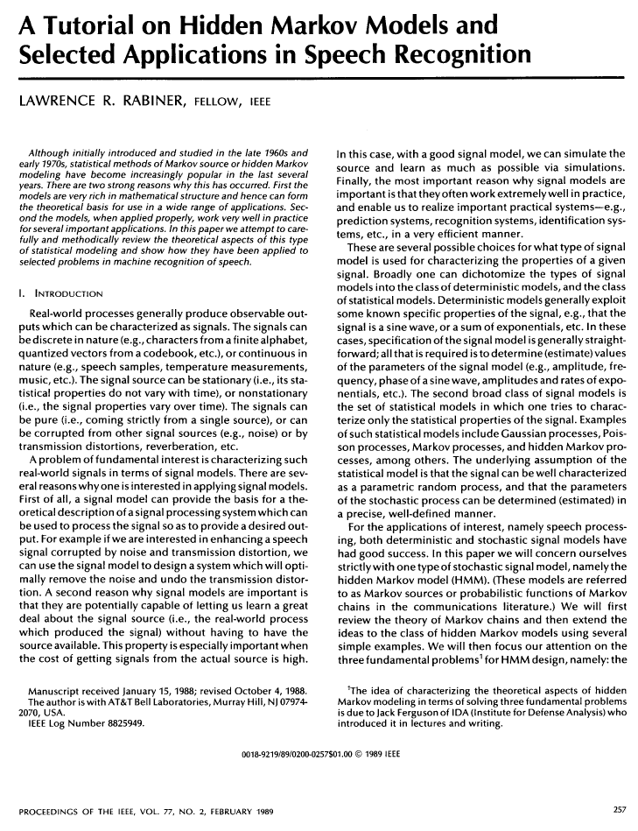
HMM Reference
Good description of Viterbi algorithm
Also how to learn model from data

Slide 48

Hidden Markov Model
The HMM is great for certain applications when your states are discrete.
Editorial: Hidden Markov Model
Tracking in (x,y,z) with HMM?
Huge state space (→ slow)
Long dwells
Interactions with other airplanes

Slide 49
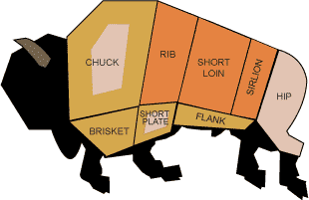
Outline
Introduction
Signal terminology and assumptions
Running example
Filtering
  Mean and median filters
  Kalman filter
  Particle filter
  Hidden Markov model
Presenting performance results

Slide 50
Presenting Continuous
Performance Results
Euclidian
distance
estimated
value
actual
value
Plot mean or median of Euclidian distance error
Median is less sensitive to error outliers
Note: Don’t judge these filtering methods based on these plots. I didn’t spend much time tuning the methods to improve their performance.

Slide 51
Presenting Continuous
Performance Results
Cumulative error distribution
Shows how errors are distributed
More detailed than just a mean or median error
95th percentile
95% of the time, the particle filter gives an error of 6 meters or less (95th percentile error)
50% of the time, the particle filter gives an error of 2 meters or less (median error)

Slide 52
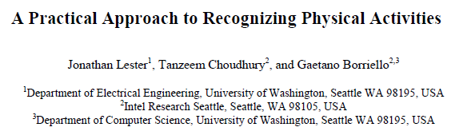
Presenting Discrete
Performance Results
Techniques like particle filter and HMM can classify sequential data into discrete classes
Confusion matrix
Pervasive 2006

Slide 53
End
Introduction
Signal terminology and assumptions
Running example
Filtering
  Mean and median filters
  Kalman filter
  Particle filter
  Hidden Markov model
Presenting performance results

Slide 55
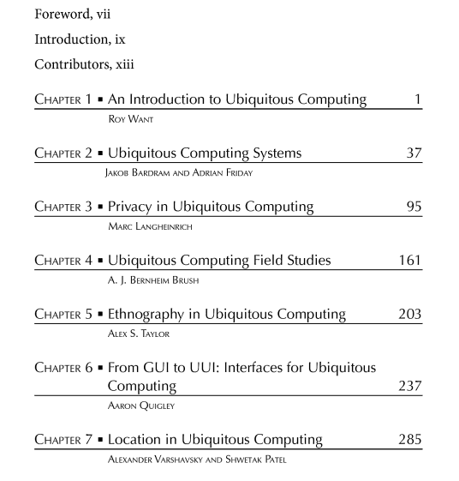
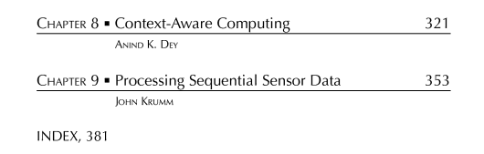
Ubiquitous Computing Fundamentals,
CRC Press, © 2010

