Slide 1
Inference Attacks on Location Tracks
John Krumm
Microsoft Research
Redmond, WA USA

Slide 2
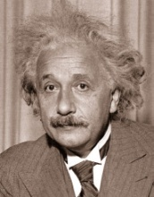
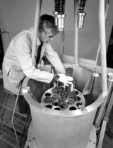
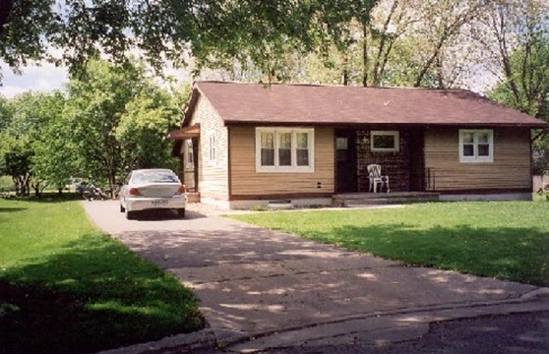
Questions to Answer
Do anonymized location tracks reveal your identity?
If so, how much data corruption will protect you?
theory
experiment

Slide 3
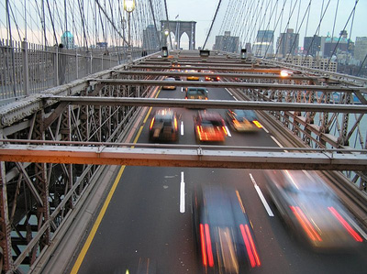
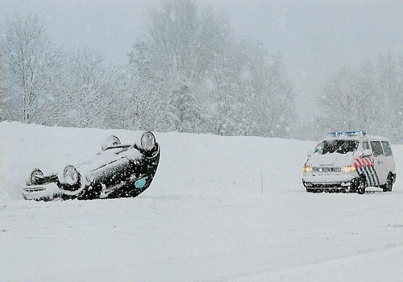
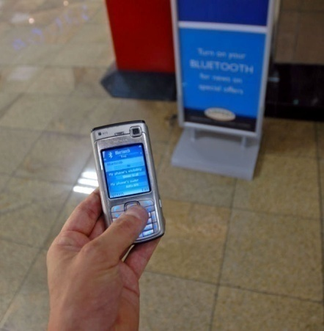
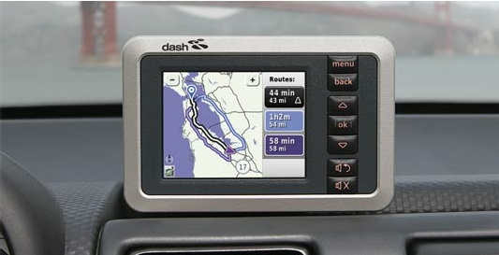
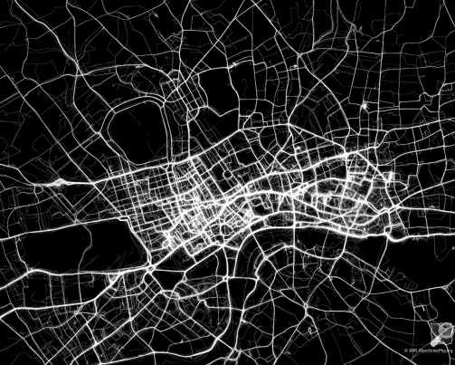

Motivation – Why Send Your Location?
Congestion Pricing
Pay As You Drive (PAYD) Insurance
Location Based Services
Collaborative Traffic Probes (DASH)
Research (London OpenStreetMap)
Nancy Krumm (Mom)
Moving out of basement soon?
Your father and I are wondering if you plan to

Slide 4
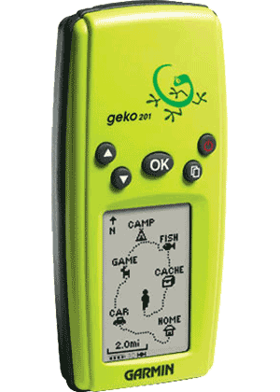
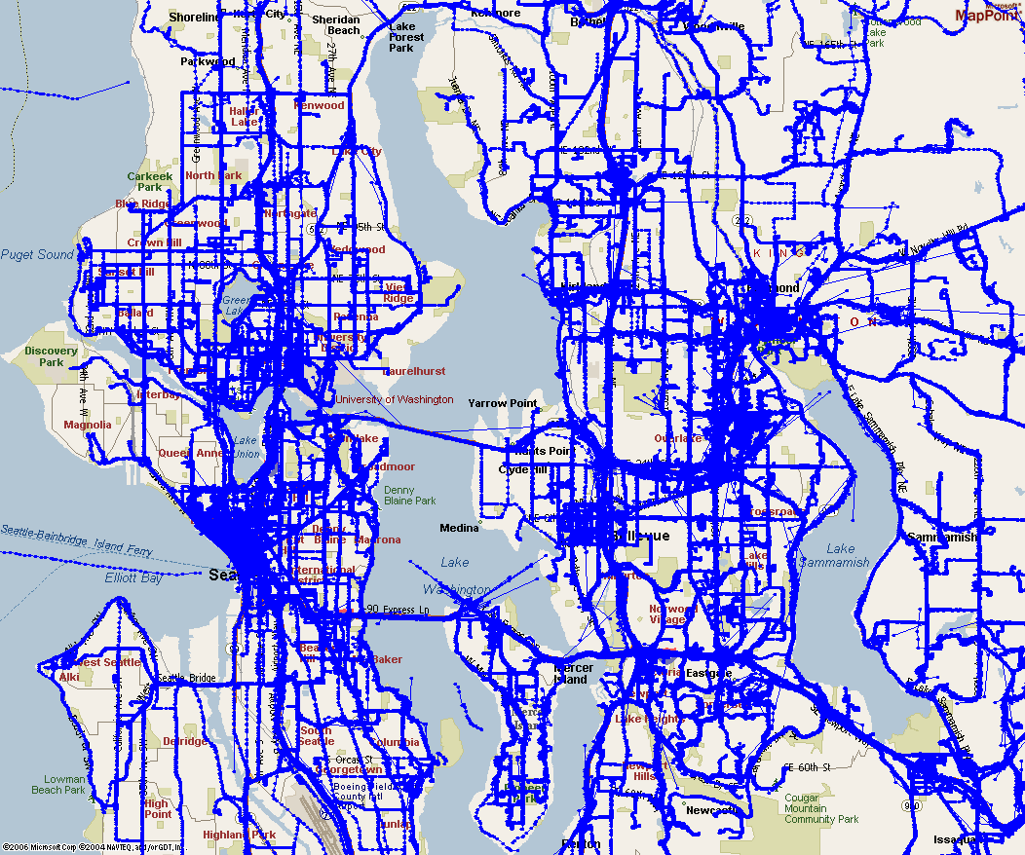
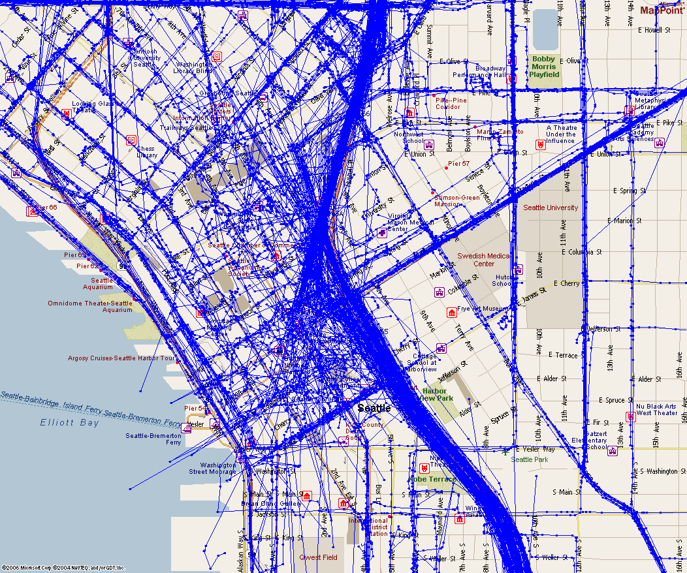
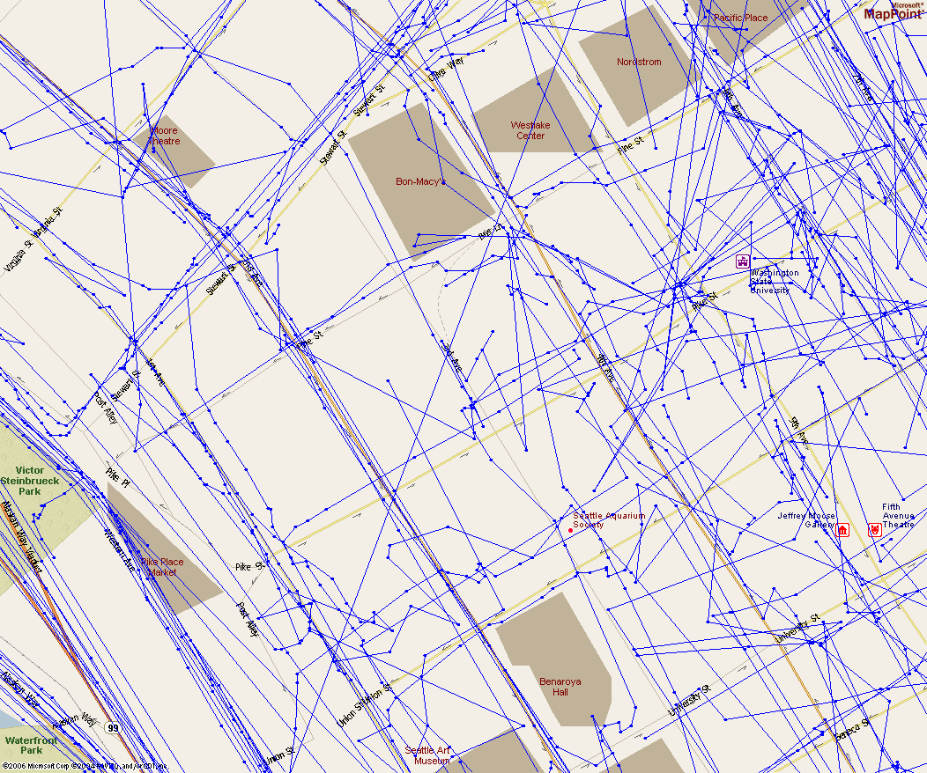
GPS Data
Microsoft Multiperson Location Survey (MSMLS)
Garmin Geko 201
$115
10,000 point memory
median recording interval
  6 seconds
  63 meters
55 GPS receivers
226 subjects
95,000 miles
153,000 kilometers
12,418 trips
Home addresses & demographic data
Greater Seattle
Seattle Downtown
Close-up

Slide 5
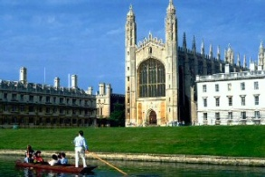
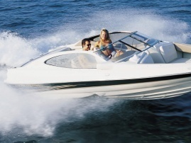
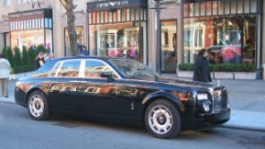
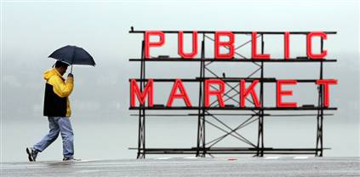
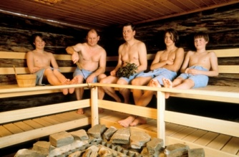
People Don’t Care About Location Privacy
74 U. Cambridge CS students
Would accept £10 to reveal 28 days of measured locations (£20 for commercial use) ⁽¹⁾
226 Microsoft employees
14 days of GPS tracks in return for 1 in 100 chance for $200 MP3 player
62 Microsoft employees
Only 21% insisted on not sharing GPS data outside
11 with location-sensitive message service in Seattle
Privacy concerns fairly light ⁽²⁾
55 Finland interviews on location-aware services
“It did not occur to most of the interviewees that they could be located while using the service.” ⁽³⁾
⁽¹⁾ Danezis, G., S. Lewis, and R. Anderson. How Much is Location Privacy
Worth? in Fourth Workshop on the Economics of Information Security.
2005. Harvard University.
⁽²⁾ Iachello, G., et al. Control, Deception, and Communication: Evaluating the Deployment of a Location-Enhanced Messaging Service. in UbiComp 2005: Ubiquitous Computing. 2005. Tokyo, Japan.
⁽³⁾ Kaasinen, E., User Needs for Location-Aware Mobile Services. Personal and Ubiquitous Computing, 2003. 7(1): p. 70-79.
Seattle Area Probation Authority
Probation check-in on May 15
Mr. Krumm – sure hope to find you at home

Slide 6
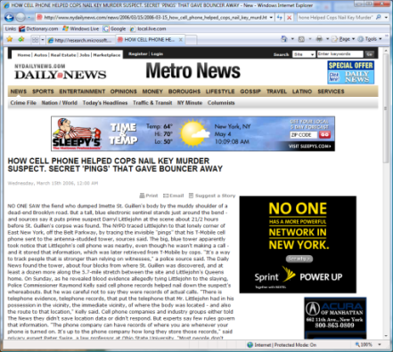
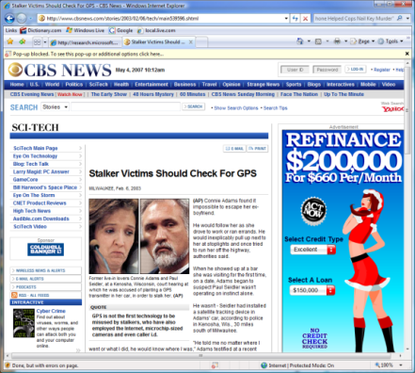
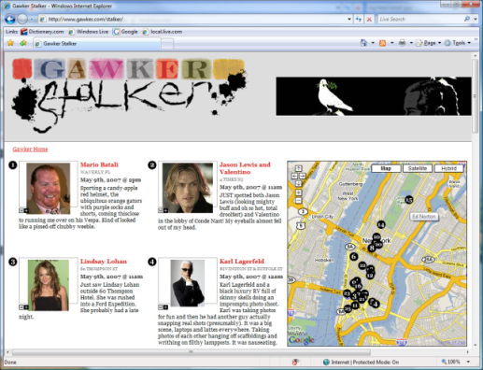
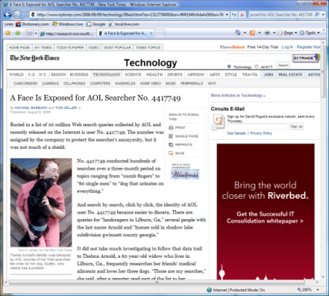
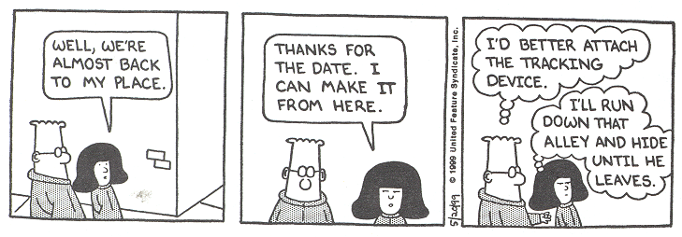
Documented Privacy Leaks
How Cell Phone Helped Cops Nail Key Murder Suspect – Secret “Pings” that Gave Bouncer Away
New York, NY, March 15, 2006
Stalker Victims Should Check For GPS
Milwaukee, WI, February 6, 2003
Real time celebrity sightings
http://www.gawker.com/stalker/
A Face Is Exposed for AOL Searcher No. 4417749
New York, NY, August 9, 2006

Slide 7
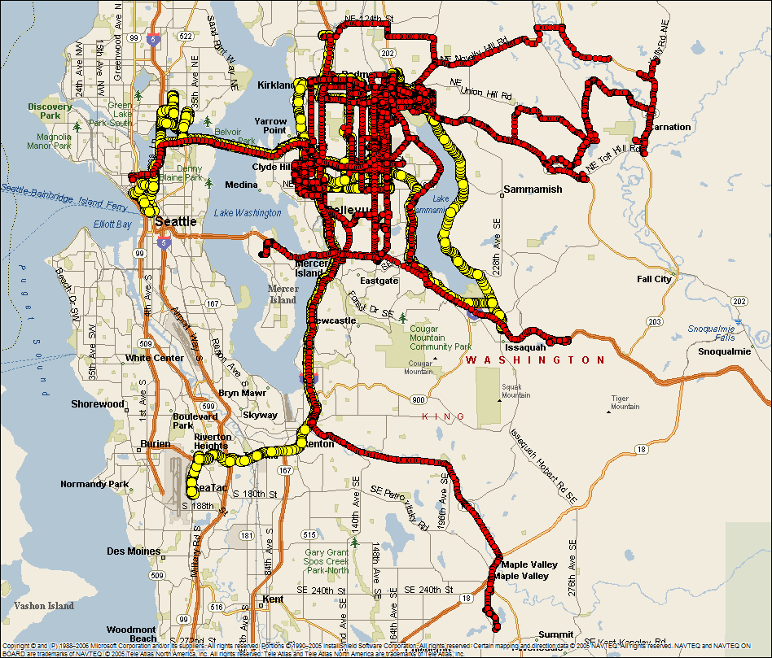
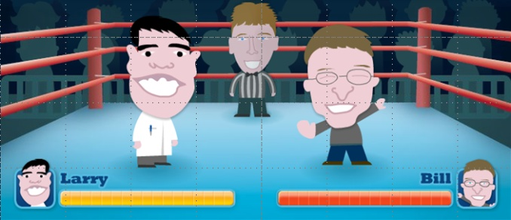
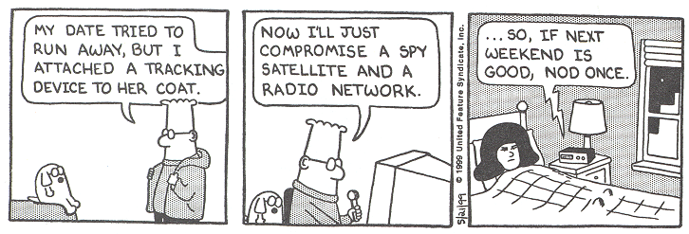
Pseudonimity for Location Tracks
Pseudonimity
Replace owner name of each point with untraceable ID
One unique ID for each owner
Example
“Larry Page” → “yellow”
“Bill Gates” → “red”
eBay
You’ve won item #245632!
Darth Vader costume and light saber will be

Slide 8

Attack Outline
Pseudonomized GPS tracks
Infer home location
Reverse white pages for identity

Slide 9
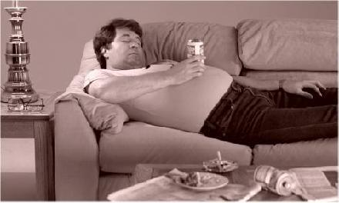
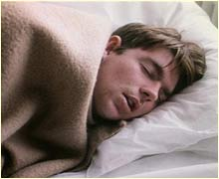
GPS Tracks → Home Location Algorithm 1
Last Destination – median of last destination before 3 a.m.
Median error = 60.7 meters
Netflix.com
Netflix movie shipment
“Velvety Vixens from Venus II” has shipped as

Slide 10
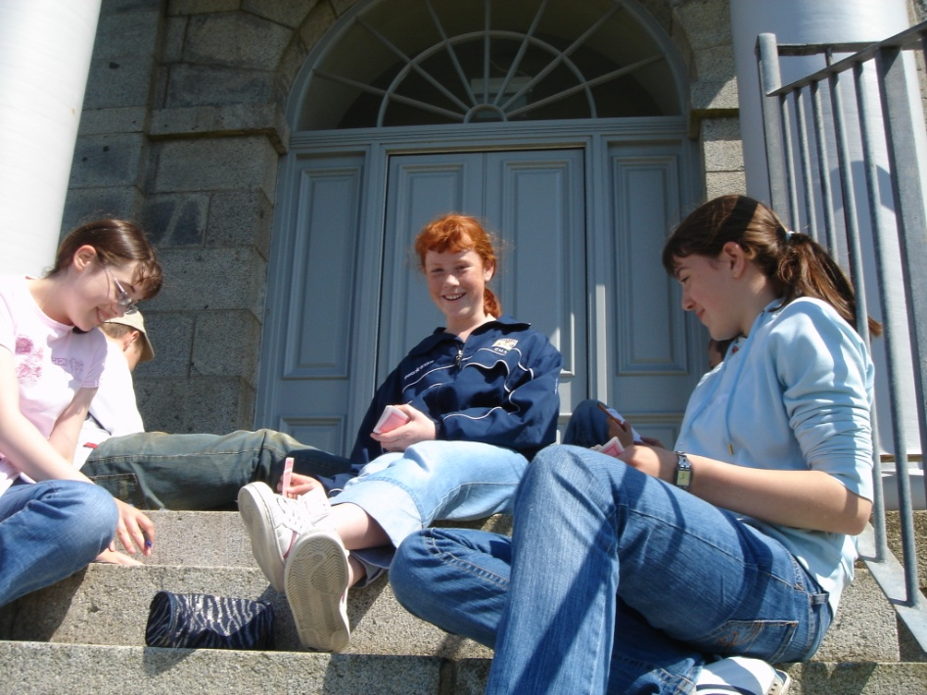
GPS Tracks → Home Location Algorithm 2
Weighted Median – median of all points, weighted by time spent at point (no trip segmentation required)
Median error = 66.6 meters

Slide 11
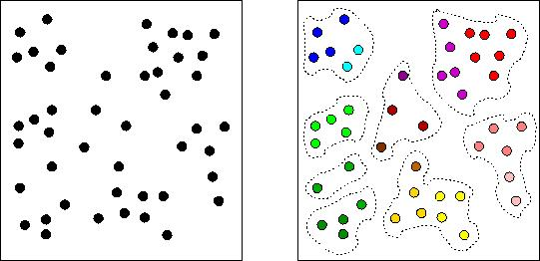
GPS Tracks → Home Location Algorithm 3
Largest Cluster – cluster points, take median of cluster with most points
Median error = 66.6 meters

Slide 12
GPS Tracks → Home Location Algorithm 4
Best Time – location at time with maximum probability of being home
Median error = 2390.2 meters (!)
Microsoft Human Resources
Termination package
In light of your most recent performance review

Slide 13
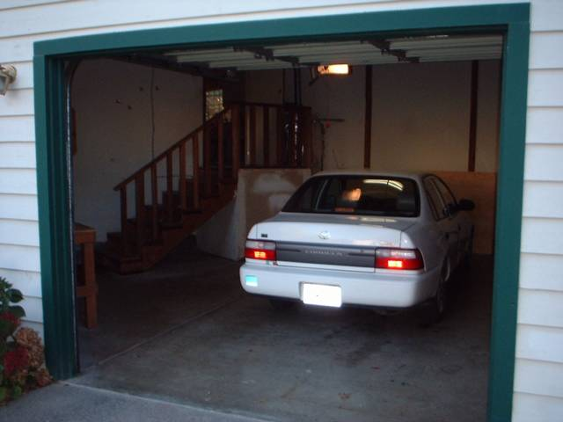
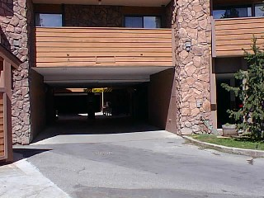
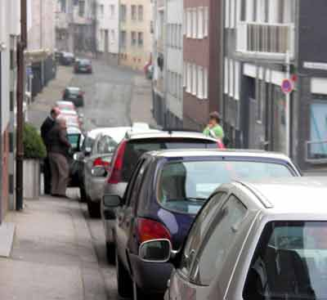
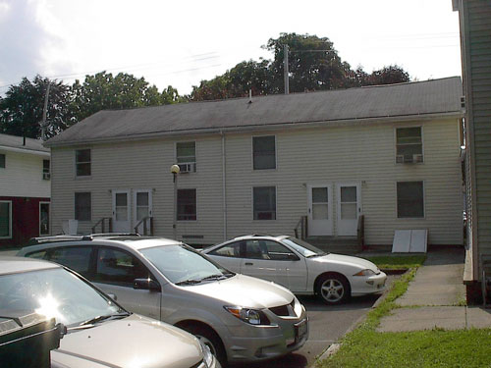
Why Not More Accurate?
GPS interval – 6 seconds and 63 meters
GPS satellite acquisition -- ≈45 seconds on cold start, time to drive 300 meters at 15 mph
Covered parking – no GPS signal
Distant parking – far from home
covered parking
distant parking

Slide 14
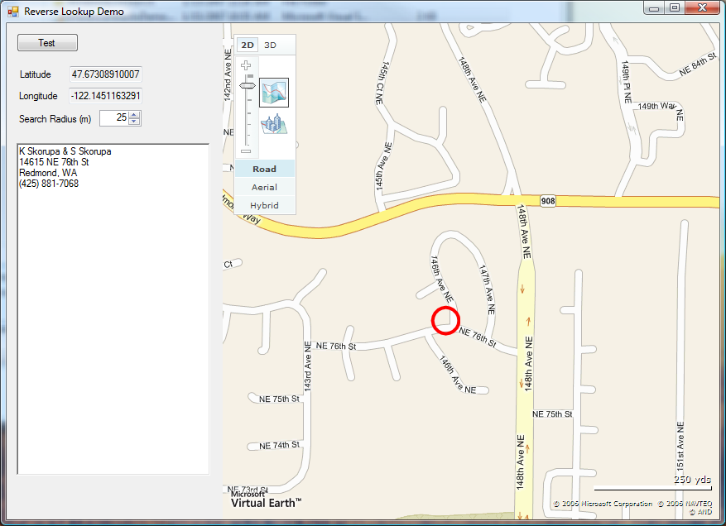
GPS Tracks → Identity?
Windows Live Search reverse white pages lookup
Hunter Randall, M.D.
(free API at http://dev.live.com/livesearch/)
Diagnosis of red sore
John – have you been involved recently with

Slide 15
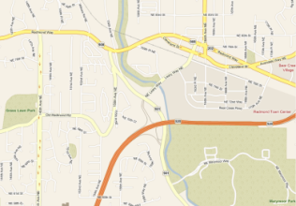
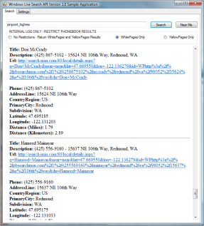
Identification
GPS Tracks (172 people)
Home Location (61 meters)
Home Address (12%)
Identity (5%)
Algorithm | Correct out of 172 | Percent Correct
Last Destination | 8 | 4.7%
Weighted Median | 9 | 5.2%
Largest Cluster | 9 | 5.2%
Best Time | 2 | 1.2%
MapPoint Web Service reverse geocoding
Windows Live Search reverse white pages
Ellen Krumm
Home’s a mess!
Would it kill you to take out the garbage?

Slide 16
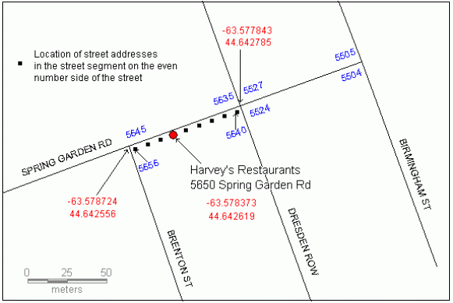
Why Not Better?
Multiunit buildings
Outdated white pages
Poor geocoding
Ela Dramowicz, “Three Standard Geocoding Methods”, Directions Magazine, October 24, 2004.
Toupees for Men
Awaiting payment
We may be forced to repossess your hairpiece

Slide 17
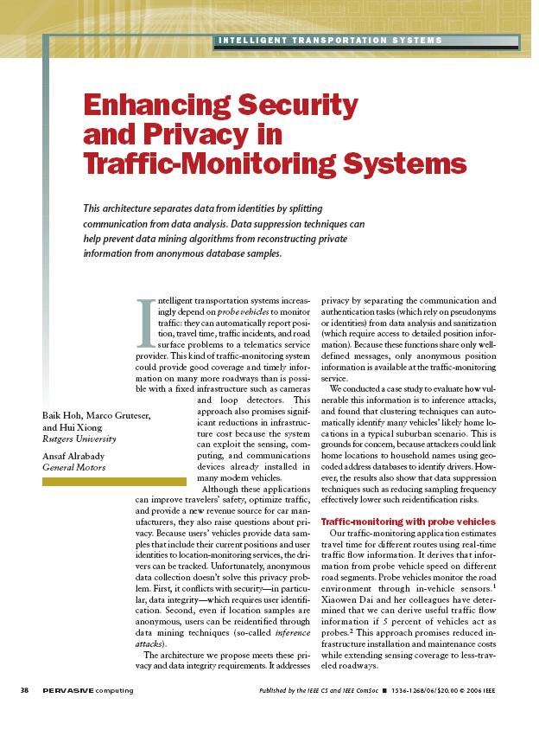
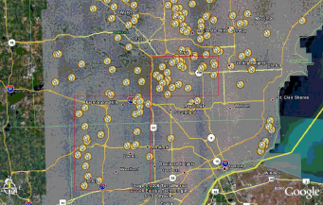
Similar Study
Hoh, Gruteser, Xiong, Alrabady, Enhancing Security and Privacy in Traffic-Monitoring Systems, in IEEE Pervasive Computing. 2006. p. 38-46.
219 volunteer drivers in Detroit, MI area
Cluster destinations to find home location
  arrive 4 p.m. to midnight
  must be in residential area
Manual inspection on home location (no knowledge of drivers’ actual home address)
85% of homes found

Slide 18
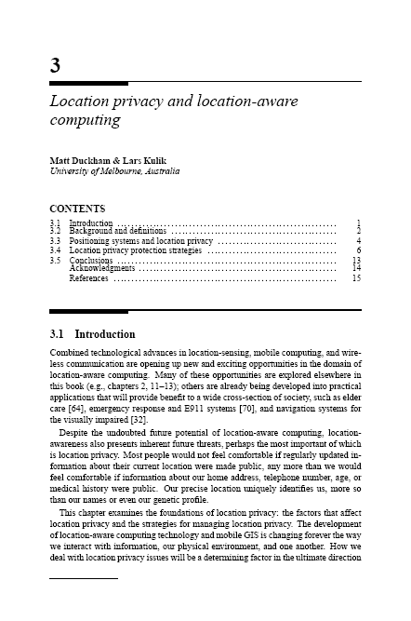
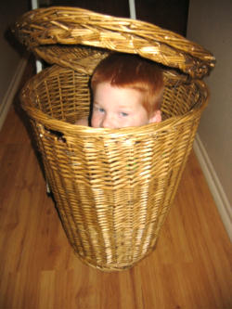
Easy Way to Fix Privacy Leak?
Duckham, M. and L. Kulik, Location Privacy and Location-Aware Computing, in Dynamic & Mobile GIS: Investigating Change in Space and Time, J. Drummond, et al., Editors. 2006, CRC Press: Boca Raton, FL.
Location Privacy Protection Methods
Regulatory strategies – based on rules
Privacy policies – based on trust
Anonymity – e.g. pseudonymity
Obfuscation – obscure the data
Burger King – Redmond, WA
Your job application
After evaluating your application, we regret

Slide 19







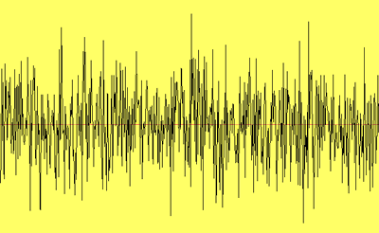
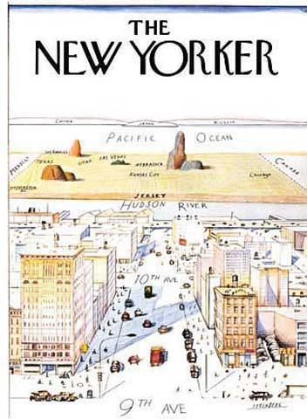
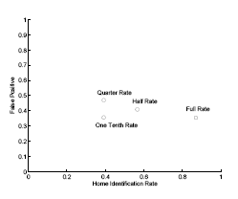
Obfuscation Techniques
(Duckham and Kulik, 2006)
Spatial Cloaking^{1,2} – confuse with other people
Noise³ – add noise to measurements
Rounding³ – discretize measurements
Vagueness⁴ – “home”, “work”, “school”, “mall”
Dropped Samples⁵ – skip measurements
¹Gruteser, M. and D. Grunwald 2003.
²Beresford, A.R. and F. Stajano 2003.
³Agrawal, R. and R. Srikant 2000.
⁴Consolvo, S., et al. 2005.
⁵Hoh, B., et al. 2006.

Slide 20
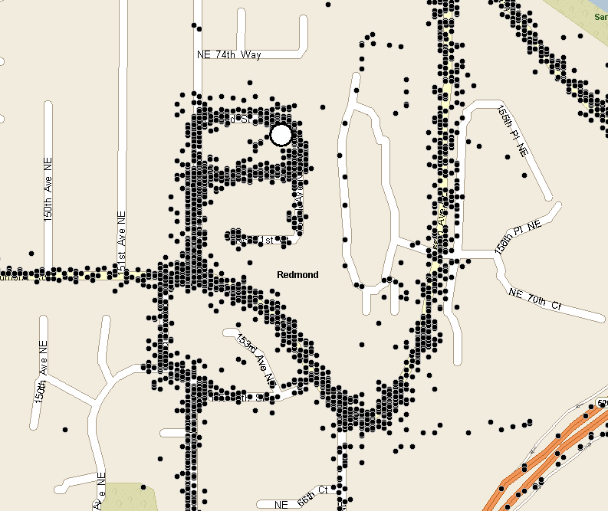
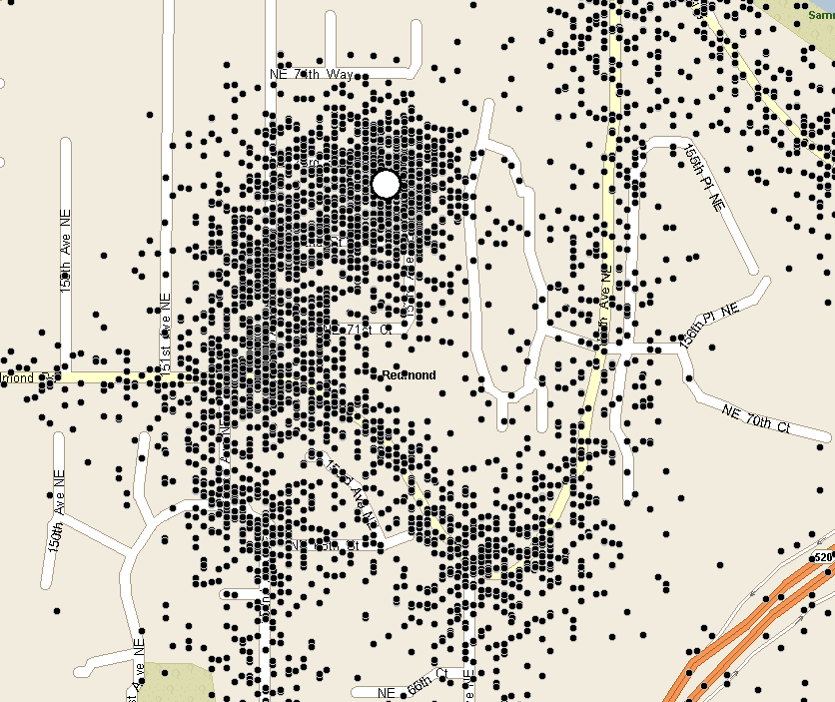
Countermeasure: Add Noise
original
σ= 50 meters noise added
Effect of added noise on address-finding rate
Christine Krumm
Minivan insurance card
Hey Dad, I thought the insurance card was in

Slide 21
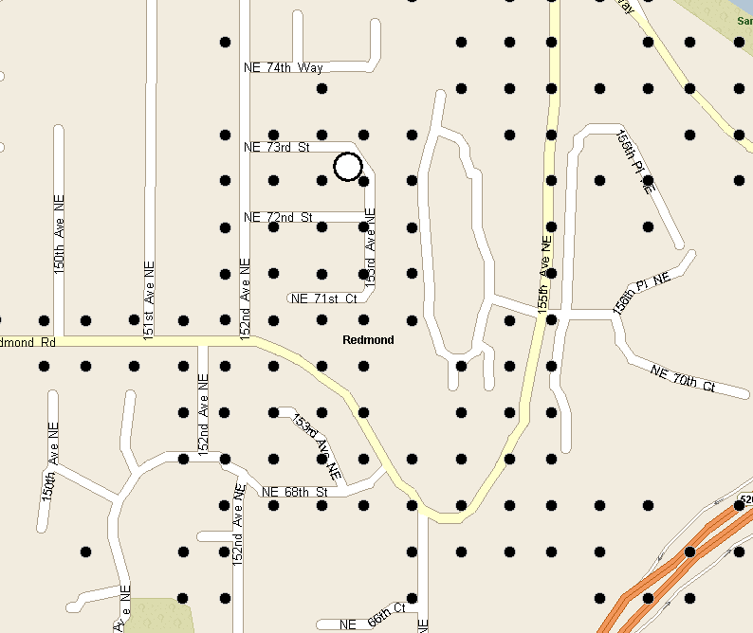
Countermeasure: Discretize
original
snap to 50 meter grid
Effect of discretization on address-finding rate

Slide 22
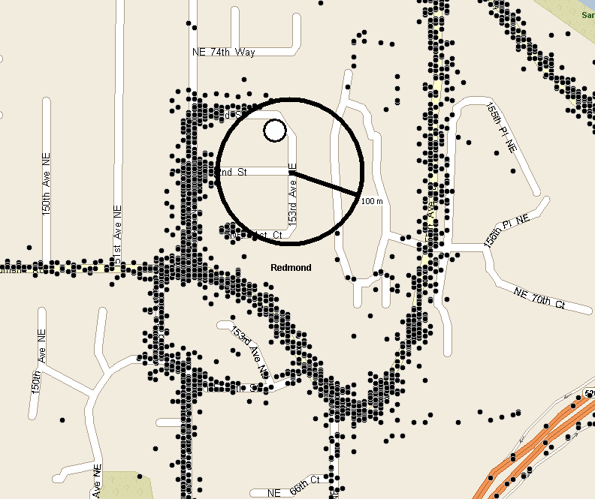
Countermeasure: Cloak Home
Pick a random circle center within “r” meters of home
Delete all points in circle with radius “R”
Toronto Marriott at Eaton Centre
Attention please, attention please
Trained personnel hope you have a restful stay

Slide 23

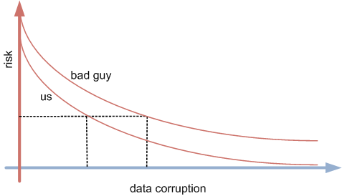
Conclusions
Privacy Leak from Location Data
  Can infer identity: GPS → Home → Identity
  Best was 5%
  5% is lower bound, evil geniuses will do better
Obfuscation Countermeasures
  Need lots of corruption to approach zero risk

Slide 24
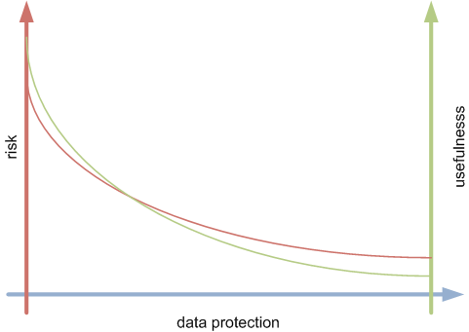

Next Steps
How does data corruption affect applications?

Slide 25

End
original
noise
reverse white pages
discretize
cloak
Professor Gerald Stark
Your talk at Pervasive
First of all, the email popups weren’t funny .

