Slide 1

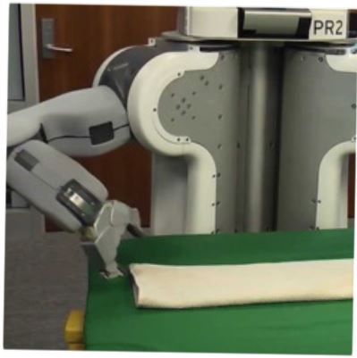

Programming by Examples
Applications, Algorithms & Ambiguity Resolution
Lecture 4: Miscellaneous Related Topics
Sumit Gulwani
Winter School in Software Engineering
TRDDC, Pune
Dec 2017

Slide 2
Q&A
Financial issues in pursuing graduate education?
Should I go for Phd or not?
Do I need to have a problem definition before joining Phd?
How to measure impact?
How can I have impact with this technology?
Aren’t research jobs very limited?
Any other advice you would give?

Slide 3
Outline
Lecture 1:
Applications
DSLs
Lecture 2:
Search Algorithm
Ambiguity Resolution
  Ranking
  User interaction models
Leveraging ML for improving synthesis
Lecture 3: Hands-on session
Lecture 4: Miscellaneous related topics
Programming using Natural Language
Applications in computer-aided Education
The Four Big Bets

Slide 4
Dimensions in Program Synthesis
Domain-specific language
  SyGuS: parameterized DSL framework [Alur et.al., FMCAD ‘13]
  User-provided sketch [Solar-Lezama, Phd Thesis ‘08]
Search methodology
  Enumerative search [Udupa et al; PLDI 2013]
  Deductive
  Constraint solving
  Stochastic search [Schkufza, Sharma, Aiken; CACM RH ’15]
  Web/Repository based search [Yahav et al, Swarat et al]
Specification
  Examples, Demonstrations
PPDP 2010; “Dimensions in Program Synthesis”; Gulwani

Slide 5
Programming by Examples
Earlier literature:
Version space algebra and its application to programming by demonstration; [Lau, Domingos, Weld: ICML 2000]
Why PBD Systems Fail: Lessons Learned for Usable AI.
[Lau, CHI 2008]
Recent PL literature:
Type-and-example-directed program synthesis;
[Osera, Zdancewic; PLDI 2015]
Synthesizing data structure transformations from input-output examples; [Feser, Chaudhuri, Dillig; PLDI 2015]
Interactive Parser synthesis from example;
[Leung, Sarracino, Lerner; PLDI 2015]

Slide 6
Dimensions in Program Synthesis
Domain-specific language
  User-provided sketch [Solar-Lezama, Phd Thesis ‘08]
  SyGuS: parameterized DSL framework [Alur et.al., FMCAD ‘13]
Search methodology
  Deductive
  Constraint solving
  Enumerative search [Udupa et al; PLDI 2013]
  Stochastic search [Schkufza, Sharma, Aiken; CACM RH ’15]
  Web/Repository based search [Yahav et al, Swarat et al]
Specification
  Examples, Demonstrations
  Logical specifications
  Natural language
PPDP 2010; “Dimensions in Program Synthesis”; Gulwani

Slide 7
SmartPhone Programming using Natural Language
  “When I receive a new SMS, if the phone is connected to my car’s bluetooth, read the message content and reply to the sender ‘I am driving’.“
Synthesis Methodology
Similar to PBE, there is an underlying DSL & ranking fn.
Candidate set of programs is produced using:
  Rule based NLP engine identifies operators and likely relationships between them.
  Type-based synthesis is used to complete partial programs.
“SmartSynth: Synthesizing Smartphone Automation Scripts from Natural Language”, MobiSys 2013, Le, Gulwani, Su

Slide 8
SmartSynth (TouchDevelop) Video
https://www.microsoft.com/en-us/research/video/programming-natural-language-smartphone-scripts/

Slide 9
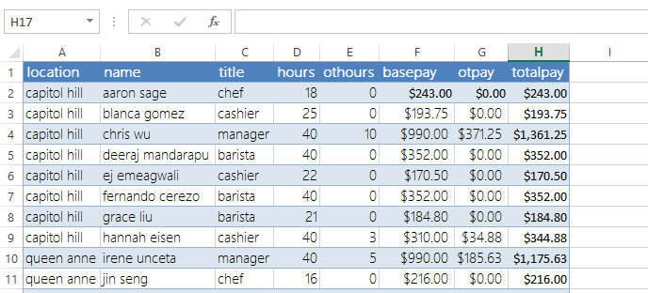
Spreadsheet Programming using Natural Language
    Challenge: Handle variability in English description
    “sum the hours for the capitol hill location chefs”
    “total hours capitol hill chefs”
    “get the hours where title = chef that work at capitol hill & sum them up”
    “sum column D where column C is chef and A is capitol hill”
“NLyze: Interactive Programming by Natural Language for SpreadSheet Data Analysis and Manipulation”; SIGMOD 2014; Gulwani, Marron

Slide 10
Future Directions
Programming using multi-modal intent involving examples and natural language
Application to Robotics
Adaptive synthesis
Predictive synthesis

Slide 11

Predictive Program Synthesis
Intended programs can sometimes be synthesized from just the input.
  Tabular data extraction, Sort, Join
Can save large amount of user effort.
  User need not provide examples for each of tens of columns.
“Automated Data Extraction using Predictive Program Synthesis”,
[AAAI 2017], Raza, Gulwani

Slide 12
Outline
Lecture 1:
Applications
DSLs
Lecture 2:
Search Algorithm
Ambiguity Resolution
  Ranking
  User interaction models
Leveraging ML for improving synthesis
Lecture 3: Hands-on session
Lecture 4: Miscellaneous related topics
Programming using Natural Language
Applications in computer-aided education
The Four Big Bets

Slide 13
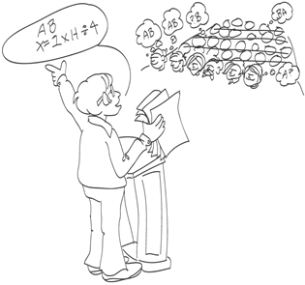
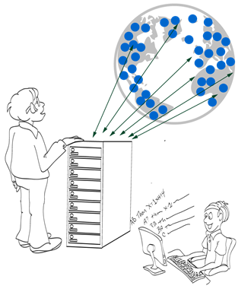
Intelligent Tutoring Systems
Repetitive tasks
Problem Generation
Feedback Generation
Various subject domains
Math, Logic
Automata, Programming
Language Learning
[CACM 2014] “Example-based Learning in Computer-aided STEM Education”;

Slide 14

Problem Generation
Motivation
Problems similar to a given problem.
  Avoid copyright issues
  Prevent cheating in MOOCs (Unsynchronized instruction)
Problems of a given difficulty level and concept usage.
  Generate progressions
  Generate personalized workflows
Key Ideas
Test input generation techniques

Slide 15
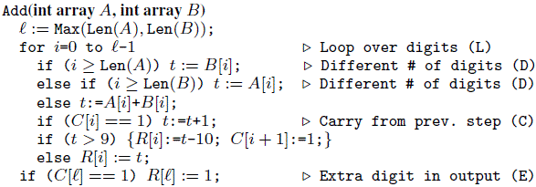
Problem Generation: Addition Procedure
Concept | Trace Characteristic | Sample Input
Single digit addition | L | 3+2
Multiple digit w/o carry | LL+ | 1234 +8765
Single carry | L* (LC) L* | 1234 + 8757
Two single carries | L* (LC) L+ (LC) L* | 1234 + 8857
Double carry | L* (LCLC) L* | 1234 + 8667
Triple carry | L* (LCLCLCLC) L* | 1234 + 8767
Extra digit in i/p & new digit in o/p | L* CLDCE | 9234 + 900
“A Trace-based Framework for Analyzing and Synthesizing Educational Progressions”
[CHI 2013] Andersen, Gulwani, Popovic.

Slide 16
Problem Generation
Motivation
Problems similar to a given problem.
  Avoid copyright issues
  Prevent cheating in MOOCs (Unsynchronized instruction)
Problems of a given difficulty level and concept usage.
  Generate progressions
  Generate personalized workflows
Key Ideas
Test input generation techniques
Template-based generalization

Slide 17
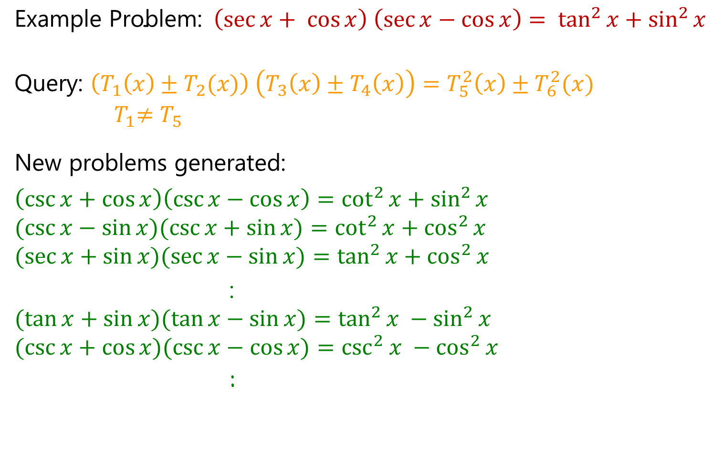
Problem Generation: Algebra (Trigonometry)
$$\text{Example} \text{Problem}\text{:}{ \left(\sec{x+ \cos{x}}\right) \left(\sec{x−\cos{x}}\right)}= \tan^{2}{x+\sin^{2}{x}}$$
$$\text{Query}\text{: }\left(T_{1}\left(x\right)±T_{2}(x)\right) \left(T_{3}\left(x\right)±T_{4}\left(x\right)\right)=T_{5}^{2}\left(x\right)±T_{6}^{2}(x)$$
$${ T}_{1}≠T_{5}$$
New problems generated:
$$\left(\csc{x}+\cos{x}\right)\left(\csc{x}−\cos{x}\right)=\cot^{2}{x}+\sin^{2}{x}$$
$$(\csc{x−\sin{x)(\csc{x+\sin{x)=\cot^{2}{x+\cos^{2}{x}}}}} }$$
$$(\sec{x+\sin{x)(\sec{x−\sin{x)=\tan^{2}{x+\cos^{2}{x}}}}}}$$
:
$$(\tan{x+\sin{x)(\tan{x−\sin{x)=\tan^{2}{x −\sin^{2}{x} }}}}}$$
$$(\csc{x+\cos{x)(\csc{x−\cos{x)=\csc^{2}{x −\cos^{2}{x}}}}}}$$
:
AAAI 2012: “Automatically generating algebra problems”;
Singh, Gulwani, Rajamani.

Slide 18
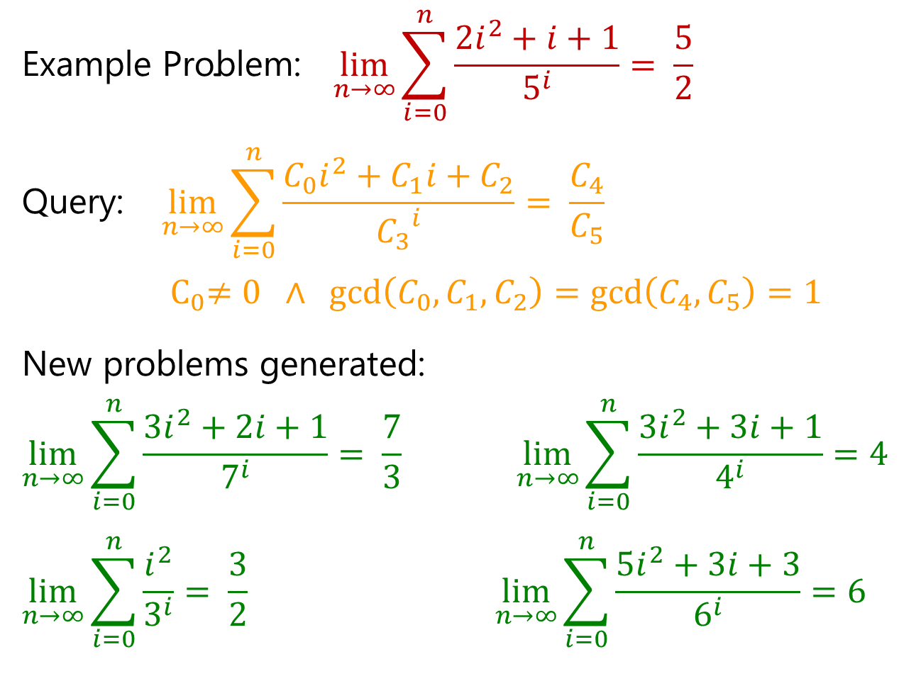
Problem Generation: Algebra (Limits)
$$\text{Example} \text{Problem}\text{:} \lim_{n→∞}{\sum_{i=0}^{n}{\frac{2i^{2}+i+1}{5^{i}}= \frac{5}{2}} }$$
$$\text{Query}\text{:} \lim_{n→∞}{\sum_{i=0}^{n}{\frac{C_{0}i^{2}+C_{1}i+C_{2}}{{C_{3}}^{i}}= \frac{C_{4}}{C_{5}}} }$$
$${ C}_{0}≠0 ∧ \gcd\left(C_{0},C_{1},C_{2}\right)=\gcd\left(C_{4},C_{5}\right)=1$$
New problems generated:
$$\lim_{n→∞}{\sum_{i=0}^{n}{\frac{3i^{2}+2i+1}{7^{i}}= \frac{7}{3} }\lim_{n→∞}{\sum_{i=0}^{n}{\frac{3i^{2}+3i+1}{4^{i}}=4 } }}$$
$$\lim_{n→∞}{\sum_{i=0}^{n}{\frac{i^{2}}{3^{i}}= \frac{3}{2}} \lim_{n→∞}{\sum_{i=0}^{n}{\frac{5i^{2}+3i+3}{6^{i}}=6 } }}$$

Slide 19
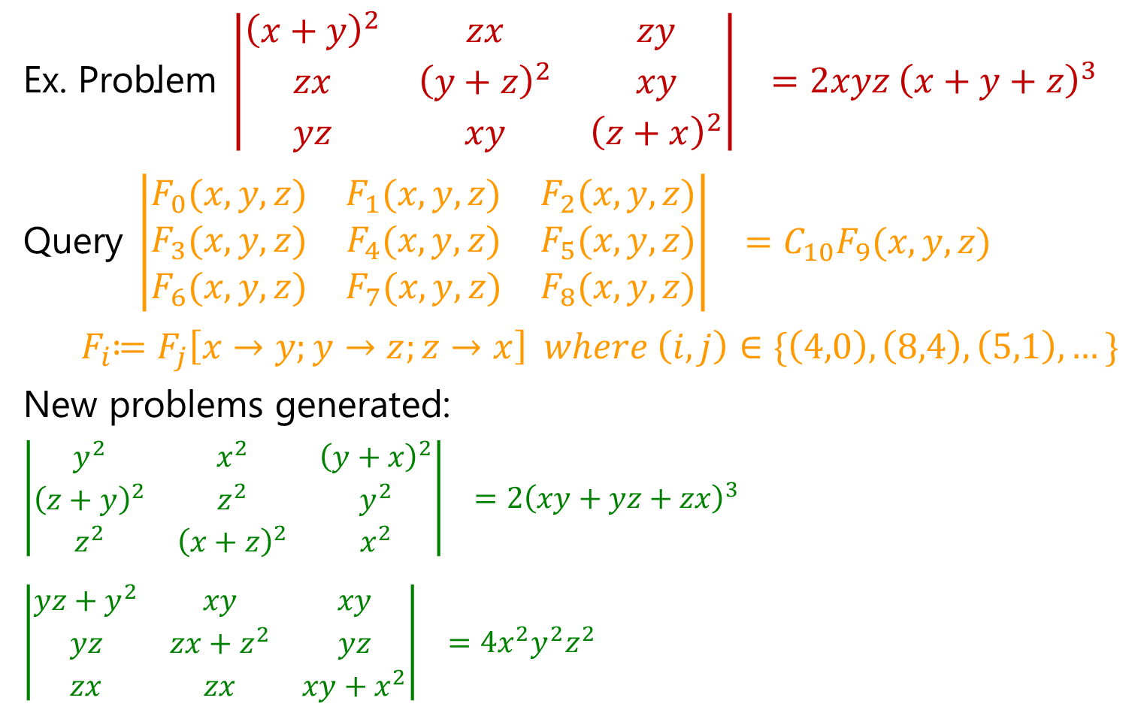
Problem Generation: Algebra (Determinant)
$$\text{Ex}\text{. }\text{Problem} \left|\begin{matrix}{\left(x+y\right)}^{2} & zx & zy \\ zx & {\left(y+z\right)}^{2} & xy \\ yz & xy & {\left(z+x\right)}^{2}\end{matrix}\right|{ }=2xyz {\left(x+y+z\right)}^{3}$$
$$\text{Query} \left|\begin{matrix}F_{0}(x,y,z) & F_{1}(x,y,z) & F_{2}(x,y,z) \\ F_{3}(x,y,z) & F_{4}(x,y,z) & F_{5}(x,y,z) \\ F_{6}(x,y,z) & F_{7}(x,y,z) & F_{8}(x,y,z)\end{matrix}\right|{ }=C_{10}F_{9}(x,y,z)$$
$${ F}_{i}≔F_{j}\left[x→y;y→z;z→x\right] where \left(i,j\right)∈\{\left(4,0\right), \left(8,4\right), \left(5,1\right),…\}$$
New problems generated:
$$\left|\begin{matrix}y^{2} & x^{2} & {\left(y+x\right)}^{2} \\ {\left(z+y\right)}^{2} & z^{2} & y^{2} \\ z^{2} & {\left(x+z\right)}^{2} & x^{2}\end{matrix}\right|{ }=2{\left(xy+yz+zx\right)}^{3}$$
$$\left|\begin{matrix}yz+y^{2} & xy & xy \\ yz & zx+z^{2} & yz \\ zx & zx & xy+x^{2}\end{matrix}\right|{ }=4x^{2}y^{2}z^{2}$$

Slide 20
Problem Generation: Sentence Completion
The principal characterized his pupils as _________ because they were pampered and spoiled by their indulgent parents.
The commentator characterized the electorate as _________ because it was unpredictable and given to constantly shifting moods.
(a) cosseted (b) disingenuous (c) corrosive (d) laconic (e) mercurial
One of the problems is a real problem from SAT (standardized US exam),
while the other one was automatically generated!
From problem 1, we generate:
template T₁ = *₁ characterized *₂ as *₃ because *₄
We specialize T₁ to
template T₂ = *₁ characterized *₂ as mercurial because *₄
Problem 2 is an instance of T₂
found using web search!
“LaSEWeb: Automating Search Strategies Over Semi-structured Web Data”; KDD 2014; Alex Polozov, Sumit Gulwani

Slide 21

Feedback Generation
Motivation
Make teachers more effective.
  Save them time.
  Provide immediate insights on where students
  are struggling.
Can enable rich interactive experience for students.
  Generation of hints.
  Pointer to simpler problems depending on kind of mistakes.
Different kinds of feedback:
Counterexamples

Slide 22
Feedback Generation
Motivation
Make teachers more effective.
  Save them time.
  Provide immediate insights on where students
  are struggling.
Can enable rich interactive experience for students.
  Generation of hints.
  Pointer to simpler problems depending on kind of mistakes.
Different kinds of feedback:
Counterexamples
Nearest correct solution

Slide 23
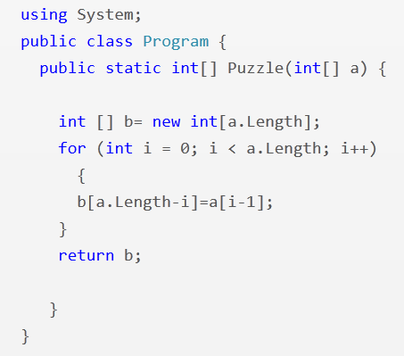
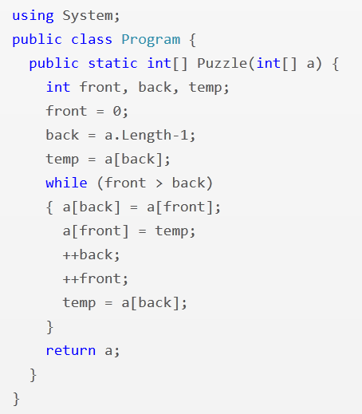
Feedback Synthesis: Programming (Array Reverse)
i = 1
i <= a.Length
front <= back
--back
“Automated Feedback Generation for Introductory Programming Assignments”; PLDI 2013; Singh, Gulwani, Solar-Lezama

Slide 24
Some Results
13,365 incorrect attempts for 13 Python problems.
(obtained from Introductory Programming course at MIT and its MOOC version on the EdX platform)
Average time for feedback = 10 seconds
Feedback generated for 64% of those attempts.
Reasons for failure to generate feedback
  Large number of errors
  Timeout (4 min)
Tool accessible at: http://sketch1.csail.mit.edu/python-autofeedback/

Slide 25
Feedback Generation
Motivation
Make teachers more effective.
  Save them time.
  Provide immediate insights on where students
  are struggling.
Can enable rich interactive experience for students.
  Generation of hints.
  Pointer to simpler problems depending on kind of mistakes.
Different kinds of feedback:
Counterexamples
Nearest correct solution
Strategy-level feedback

Slide 26
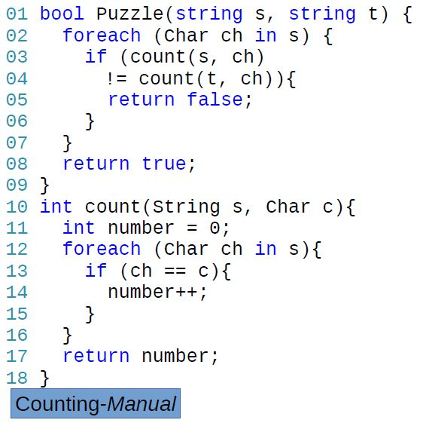
Anagram Problem: Counting Strategy
Problem: Are two input strings permutations of each other?
Strategy: For every character in one string, count and compare the number of occurrences in another. O(n²)
Feedback: “Count the number of characters in each string in a pre-processing phase to amortize the cost.”

Slide 27
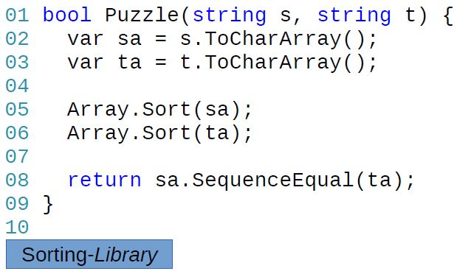
Anagram Problem: Sorting Strategy
Problem: Are two input strings permutations of each other?
Strategy: Sort and compare the two input strings. O(n²)
Feedback: “Instead of sorting, compare occurrences of each character.”

Slide 28
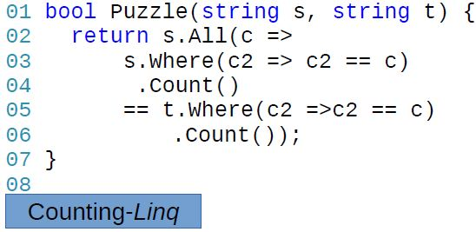
Different implementations: Counting strategy

Slide 29
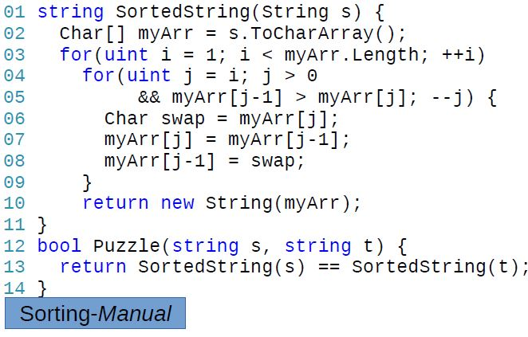
Different implementations: Sorting strategy

Slide 30
Strategy-level Feedback Generation
Teacher documents various strategies and associated feedback.
  Strategies can potentially be automatically inferred from student data.
Computer identifies the strategy used by a student implementation and passes on the associated feedback.
  Different implementations that employ the same strategy produce the same sequence of “key values”.
FSE 2014: “Feedback Generation for Performance Problems in Introductory Programming Assignments” Gulwani, Radicek, Zuleger

Slide 31
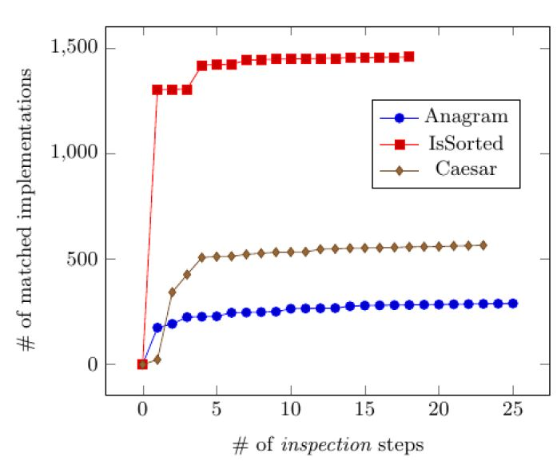
Some Results: Documentation of teacher effort
# of matched implementations
# of inspection steps
When a student implementation doesn’t match any strategy:
the teacher inspects it to refine or add a (new) strategy.

Slide 32
Feedback Generation
Motivation
Make teachers more effective.
  Save them time.
  Provide immediate insights on where students
  are struggling.
Can enable rich interactive experience for students.
  Generation of hints.
  Pointer to simpler problems depending on kind of mistakes.
Different kinds of feedback:
Counterexamples
Nearest correct solution
Strategy-level feedback
Nearest problem description (corresponding to student solution)

Slide 33
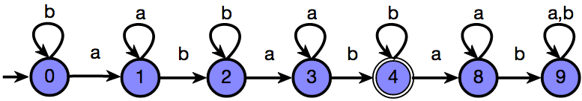
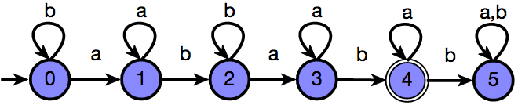
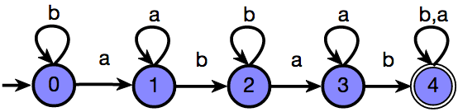
Feedback Synthesis: Finite State Automata
Draw a DFA that accepts: { s | ‘ab’ appears in s exactly 2 times }
Grade: 9/10
Feedback: One more state should be made final
Attempt 1
Based on nearest correct solution
Grade: 6/10
Feedback: The DFA is incorrect on the string ‘ababb’
Attempt 2
Based on counterexamples
Grade: 5/10
Feedback: The DFA accepts {s | ‘ab’ appears in s at least 2 times}
Attempt 3
Based on nearest problem description
IJCAI 2013: “Automated Grading of DFA Constructions”;
Alur, d’Antoni, Gulwani, Kini, Viswanathan

Slide 34
Some Results
Tool has been used at 10+ Universities.
An initial case study: 800+ attempts to 6 automata problems graded by tool and 2 instructors.
95% problems graded in <6 seconds each
Out of 131 attempts for one of those problems:
  6 attempts: instructors were incorrect (gave full marks to an incorrect attempt)
  20 attempts: instructors were inconsistent (gave different marks to syntactically equivalent attempts)
  34 attempts: >= 3 point discrepancy between instructor & tool; in 20 of those, instructor agreed that tool was more fair.
Instructors concluded that tool should be preferred over humans for consistency & scalability.
Tool accessible at: http://www.automatatutor.com/

Slide 35
Future Directions in Intelligent Tutoring Systems
Domain-specific natural language understanding to deal with word problems.
Leverage large amounts of student data.
  Repair incorrect solution using a nearest correct solution [DeduceIt/Aiken et.al./UIST 2013]
  Clustering for power-grading [CodeWebs/Nguyen et.al./WWW 2014]
Leverage large populations of students and teachers.
  Peer-grading
Notes:
DeduceIt
CodeWebs

Slide 36
Outline
Lecture 1:
Applications
DSLs
Lecture 2:
Search Algorithm
Ambiguity Resolution
  Ranking
  User interaction models
Leveraging ML for improving synthesis
Lecture 3: Hands-on session
Lecture 4: Miscellaneous related topics
Programming using Natural Language
Applications in computer-aided Education
The Four Big Bets

Slide 37
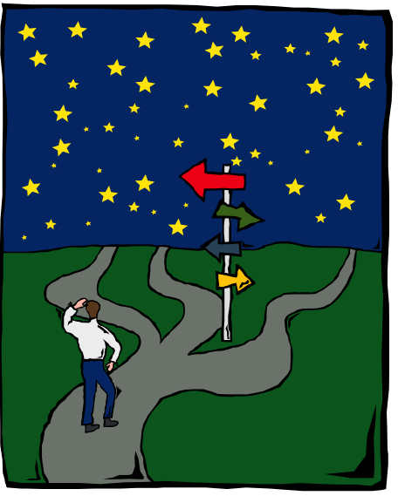
The Four Big Bets

Slide 38

Bet #1
Customer Connection

Slide 39


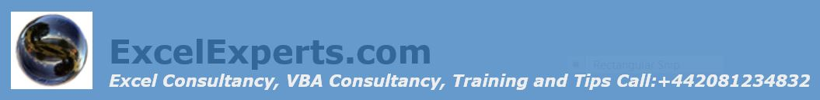

Excel Help Forums

Slide 40
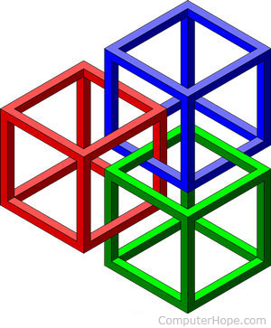
Bet #2
Framework-based design and development

Slide 41

Bet #3
Research & Engineering: Better Together

Slide 42
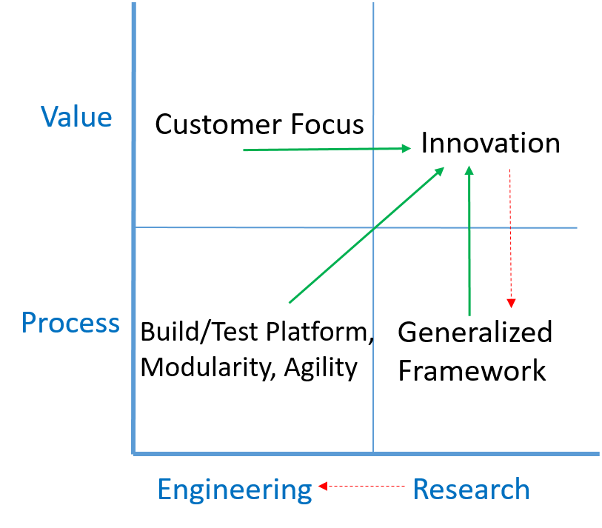
Accelerating innovation and its delivery
Engineering: Researchers follow best engineering practices with help from engineers on the team.
Team work: Researchers working synergistically towards a common mission.

Slide 43
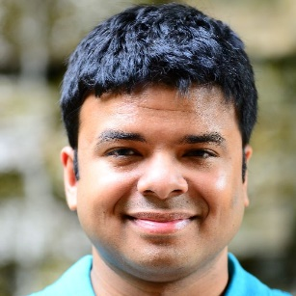
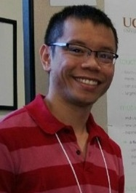
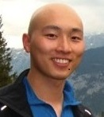

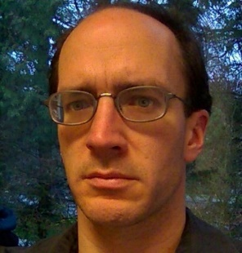

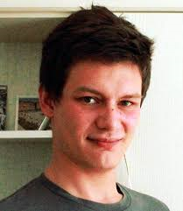
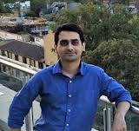

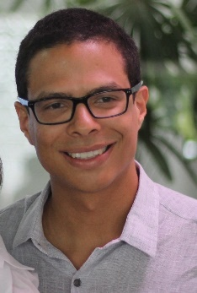

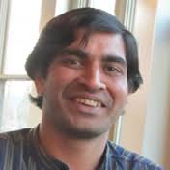
The PROSE Team
Titus Barik
Sumit Gulwani
Alan Leung
Kunal Pathak
Daniel Perelman
Mark Plesko
Vu Le
Arjun Radhakrishna
Ivan Radicek
Mohammad Raza
Danny Simmons
Gustavo Soares
Ashish Tiwari
Abhishek
Udupa

Slide 44

Bet #4
Cross-disciplinary research

Slide 45





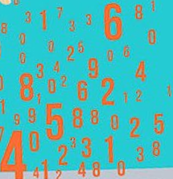

AI=PL+ML
Intelligent software
(e.g., PBE component)
Logical strategies
Creative heuristics
Features
Model
Can be learned and maintained by ML-backed runtime
Written by developers
Advantages
Better models
Less time to author
Online adaptation, personalization
“Programming by Examples: PL meets ML”; Gulwani, Jain, Invited talk paper at APLAS 2017

Slide 46


Conclusion
Bet #1: Customer connection (Data Wrangling, Code Migration)
Identifies killer applications
Challenge: Data collection
Bet #2: Framework-based design and development (PROSE)
Facilitates reuse, guides algorithmic thinking
Challenge: Balance between specialization & generalization
Bet #3: Research & Engineering---better together
Accelerates innovation & its delivery
Challenge: Maintenance, end-to-end delivery
Bet #4: Cross-disciplinary research (PL meets ML)
Leads to novel ideas
Challenge: Fitting into molds of framework and engineering rigor

Slide 47
Q&A
Financial issues in pursuing graduate education?
  Take a loan
Should I go for Phd or not?
  Do you cherish freedom, travel, impact, intellectual company.
Do I need to have a problem definition before joining Phd?
  need maturity about what you want to get out of Phd
How to measure impact?
  Academic (top-tier conference publication, citations)
  Practical (# of users, depth of engagement per user)
How can I have impact with this technology?
  An alternative style: Pick an impactful problem definition first
Aren’t research jobs very limited?
  Don’t depend on standard models.
Any other advice you would give?

Slide 48
Any other advice you would give?
Build connections
Develop communication skills
Think entrepreneurially
Take breadth courses
Cross-disciplinary collaboration
Learn engineering
Pass on the goodness

