Slide 1
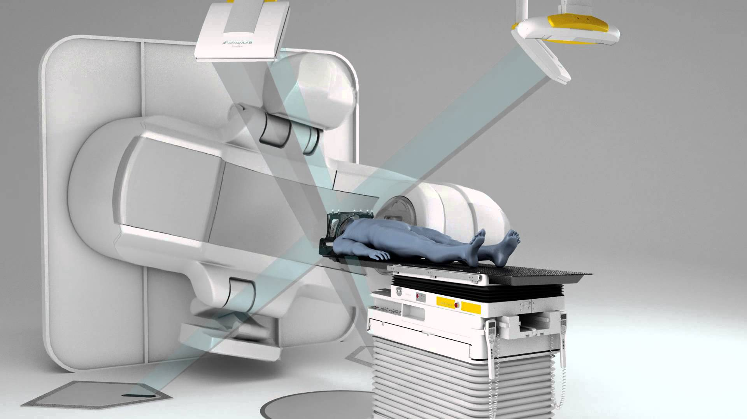
An oncologist’s guide to using AI for cancer therapy
Raj Jena
Innereye team | Microsoft Research | Radiation Oncologist | University of Cambridge

Slide 2
Overview
What is radiation therapy, and where are we right now?
  AI in image reconstruction
  AI in image segmentation
  AI in response assessment
How will AI impact radiation therapy soon?
  Real-time tracking
  Adaptive radiotherapy
  Predictive radiomics
Horizon scanning in radiation therapy

Slide 3
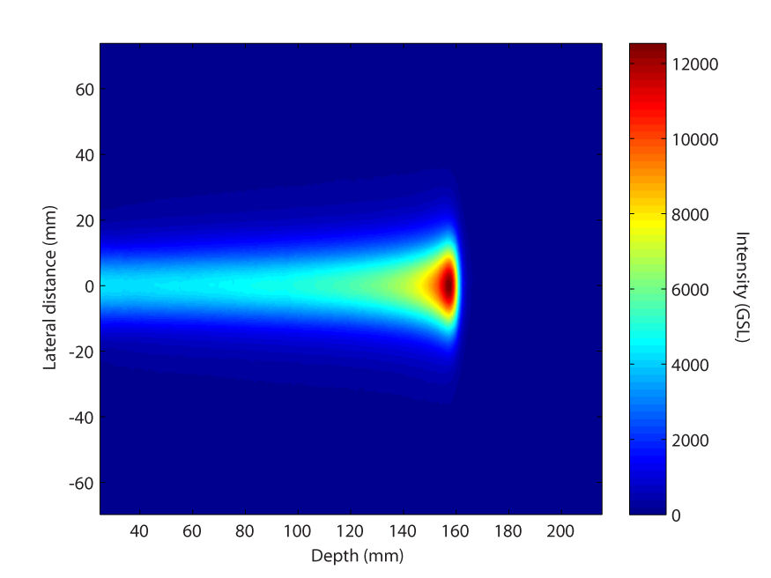
What is Radiotherapy
And where are we at right now?

Slide 4
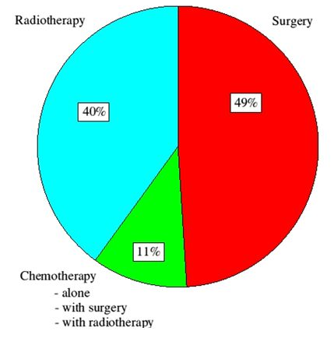
Radiation therapy (RT)
Use of ionising radiation to kill tumours
  X-rays (>100 years)
  Electrons (>80 years)
  Protons (>50 years)
  Neutrons (>40 years)
  Other hadrons (>20 years)
Main treatment in 40% of patients cured of cancer
  Effect and cost effective treatment
Cancer services collaborative, 2002

Slide 5
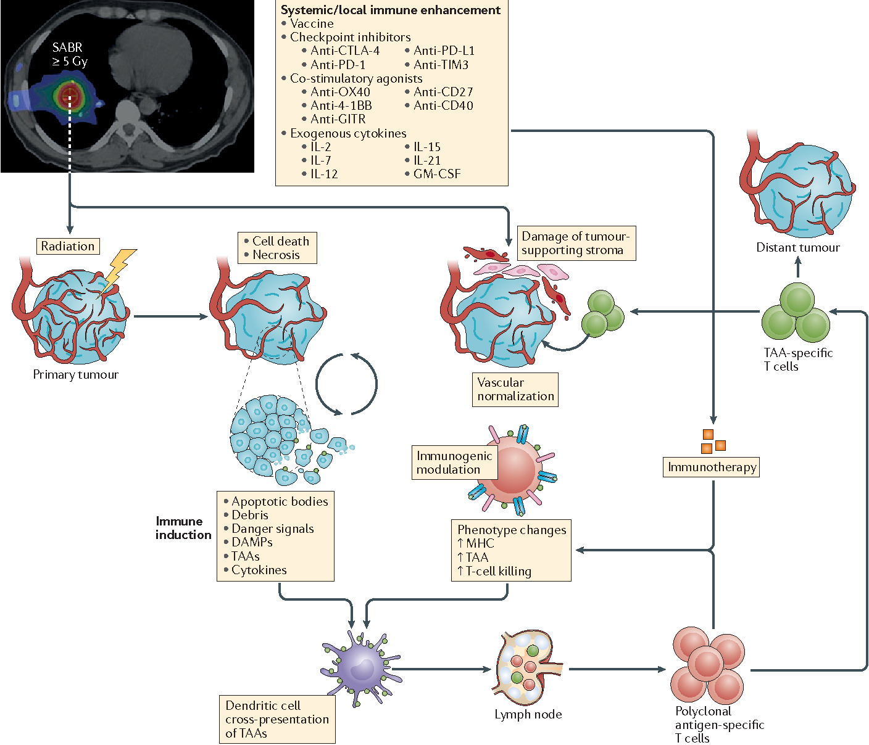
How does RT work?
Damage to DNA backbone
  Single strand breaks
  Double strand breaks
Damage to tumour’s blood supply
  Endothelial injury
Activation of immune system
  Tumour neo-antigens
  Activate dendritic cells
Bernstein, Krishnan, Hodge & Chang Nature Reviews Clinical Oncology 2016

Slide 6
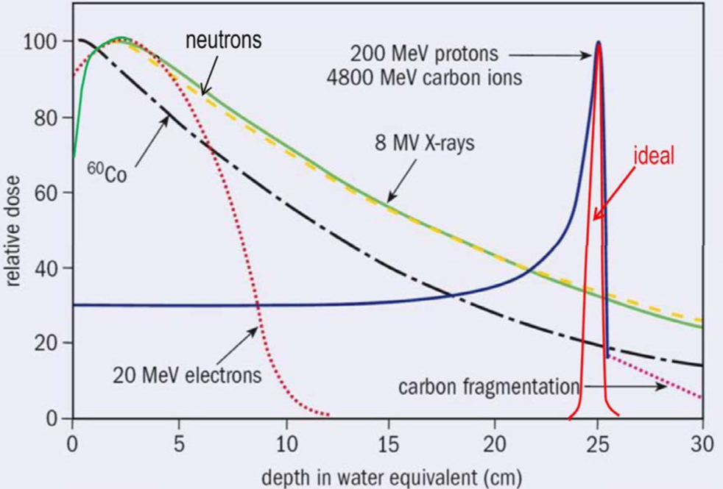
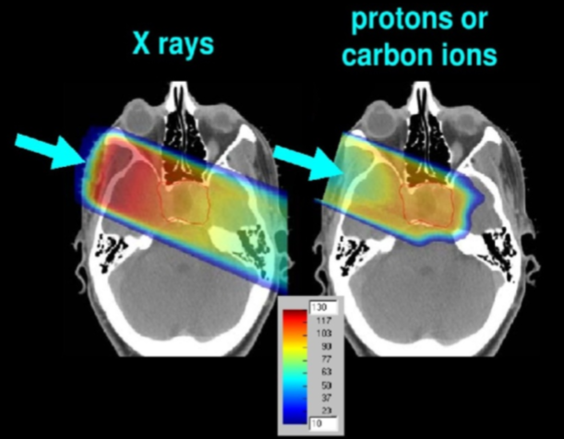
RT species compared

Slide 7
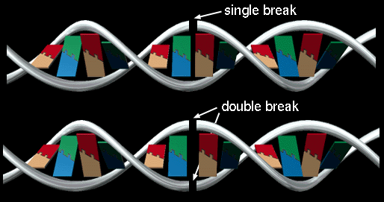
DNA Damage and Oxygen
X-rays
  Mainly single stranded DNA breaks (16:1)
  Oxygen needed to stop backbone re-annealing
  Tumours often have low oxygen levels at their core
Particles
  Mainly double stranded DNA breaks (80:1)
  Big holes in DNA cannot re-anneal
  Less dependent of availability of oxygen

Slide 8
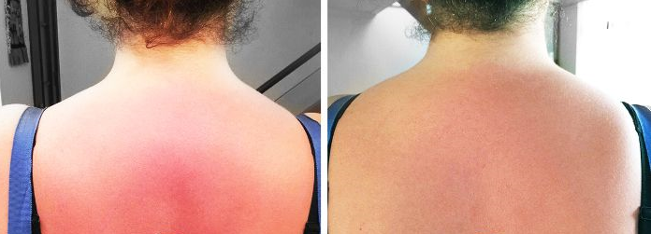
Time, Dose, and Fractionation
Healthy tissues (mutation=bad)
  Competent DNA repair mechanisms
  Takes 8 hours to repair ~50% of DNA damage
  Cells that cannot be repaired ‘commit suicide’ - apoptosis
Tumours (mutation=good)
  Defective DNA repair
  DNA damage sustained
  Eventually cell has so much DNA damage it falls apart – necrosis / mitotic catastrophe

Slide 9
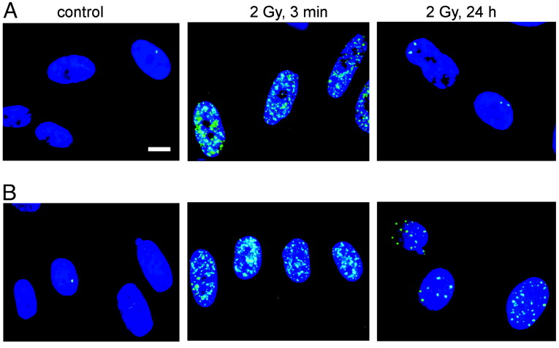
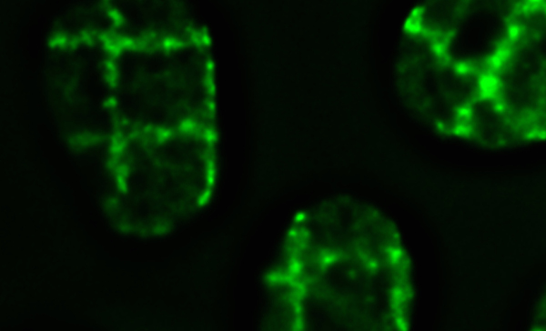
Little guns, Big guns
Rothkamm & Lobrich PNAS 2003
Courtesy Katia Parodi, SNAKE microbeam, LMU

Slide 10
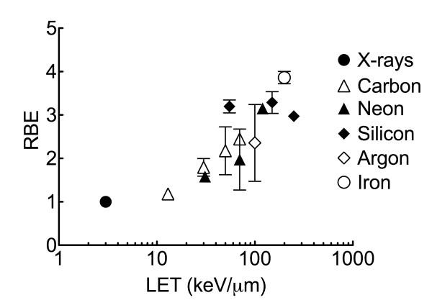
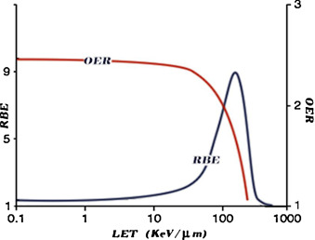
Relative biological effectiveness : 1Gy ≠ 1Gy
Desouky & Zhou, JTUSCI 2016

Slide 11
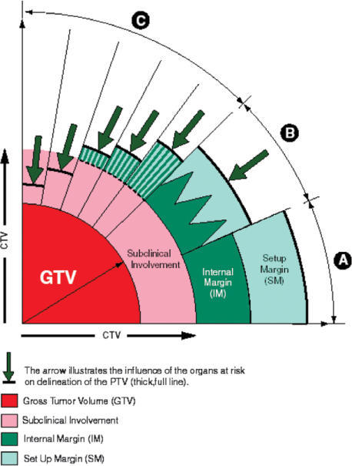
RT targeting concepts
GTV – gross tumour volume
  Visible with the eye, or on a scan
  Segmented as first part of RT workflow
CTV – clinical target volume
  Microscopic tumour spread
  Inferred from scans
  Probability of finding tumour cell falls to zero at edge of CTV
PTV – planning target volume
  Motion effects
  Setup uncertainty of the machine
ICRU Reports 50, 62, 83

Slide 12
RT targeting goals
GTV – tumour only
  Maximise cell damage
  Remove dependence on oxygen
CTV – tumour & health tissue
  Kill the tumour cells
  Shield the healthy cells
  Activate the immune system
PTV – healthy tissue
  Target accurately
  Track target motion
ICRU Reports 50, 62, 83

Slide 13
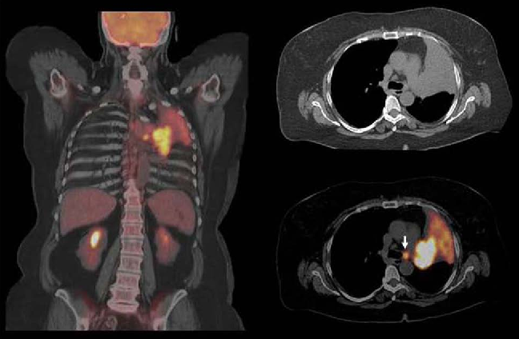
Imaging for RT – seeing the target
CT and PET scans for lung cancer
Diagnostic imaging

Slide 14
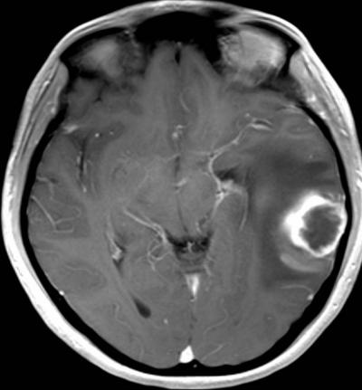
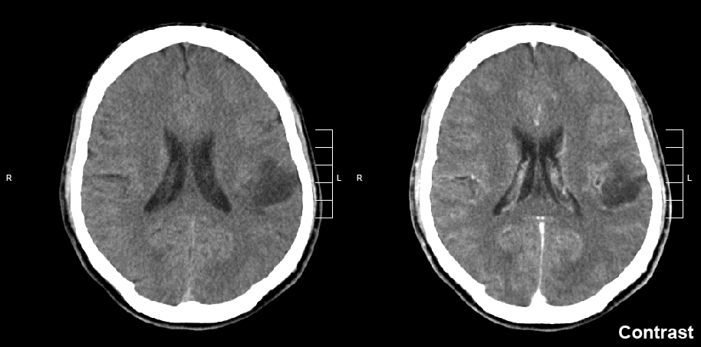
Imaging for RT – seeing the target
CT and MRI scans for glioblastoma
Diagnostic imaging

Slide 15
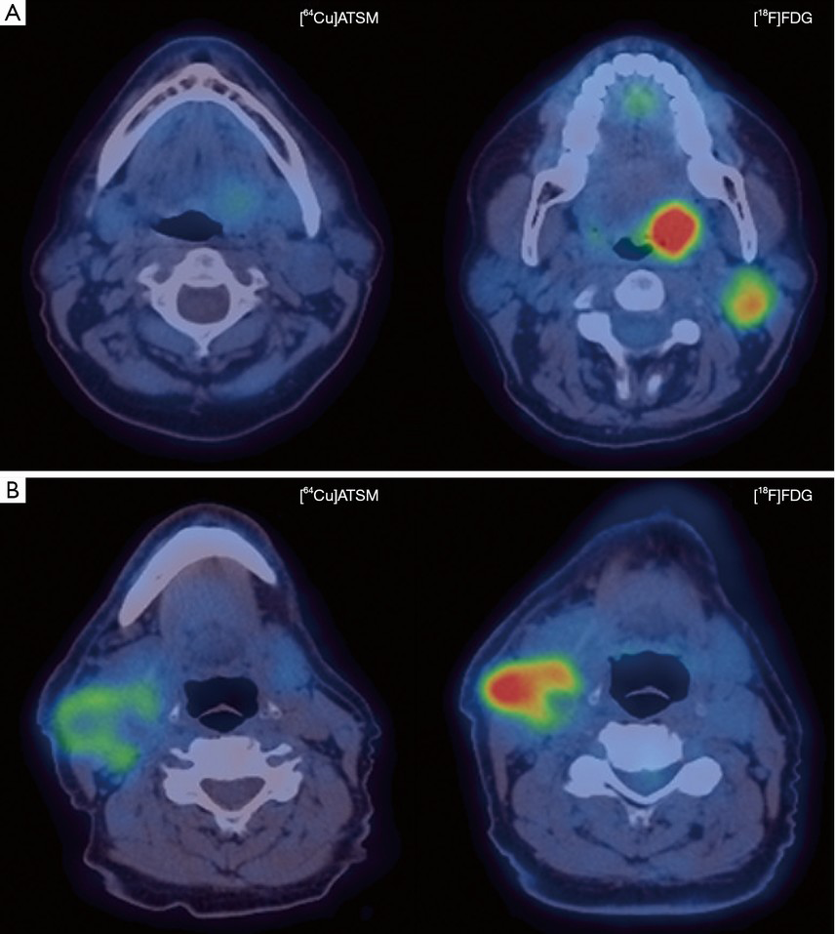
Imaging for RT – measuring the target
Cu ATSM PET quantification of hypoxia levels in head & neck cancer
Theranostic imaging (more later)

Slide 16
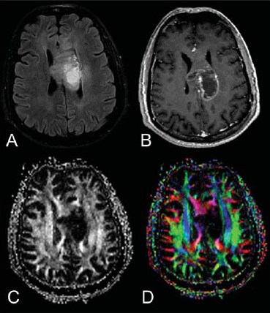
Imaging for RT – measuring the target
Quantifying infiltration of glioblastoma into surrounding brain white matter
Theranostic imaging (more later)

Slide 17
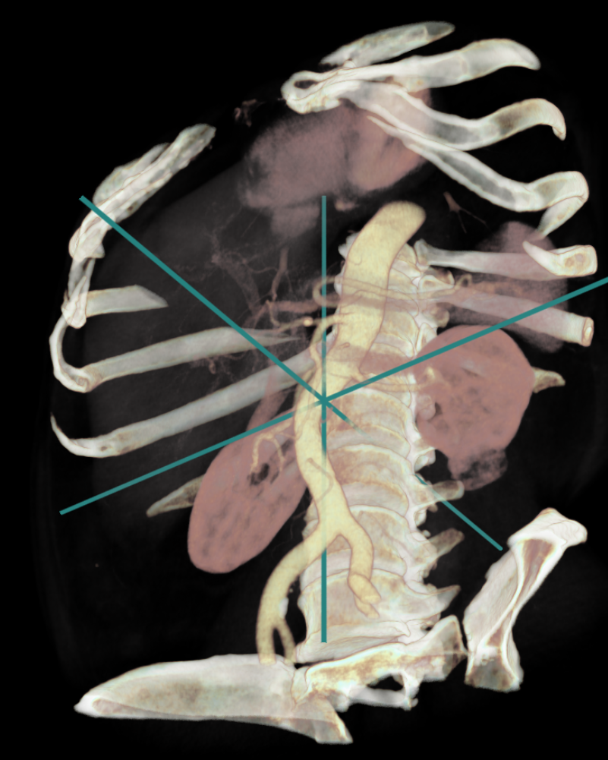
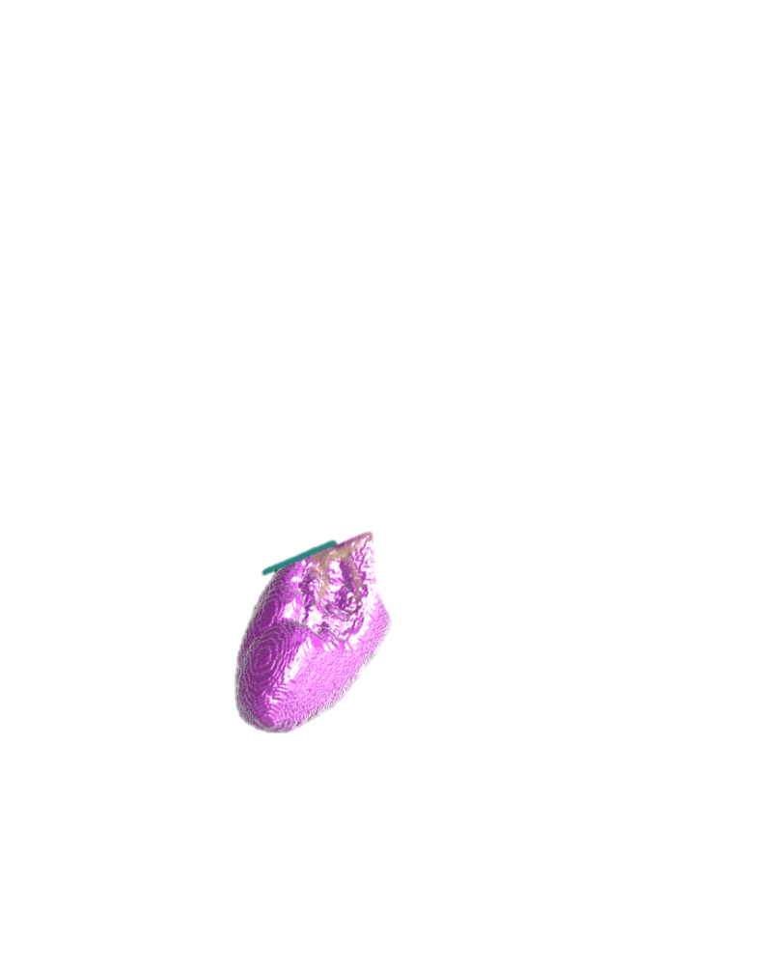
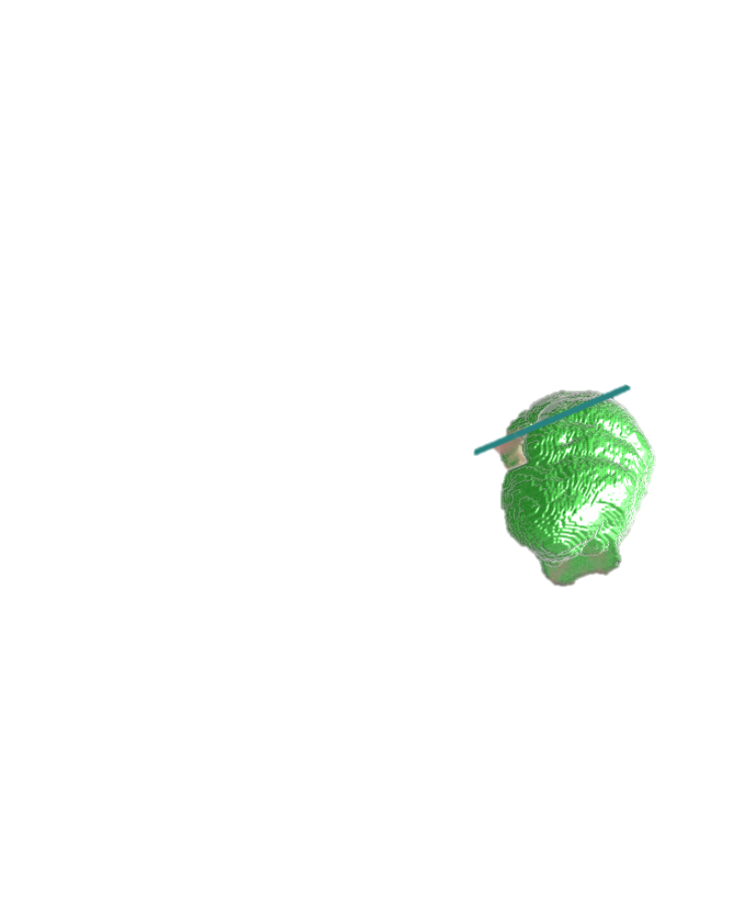
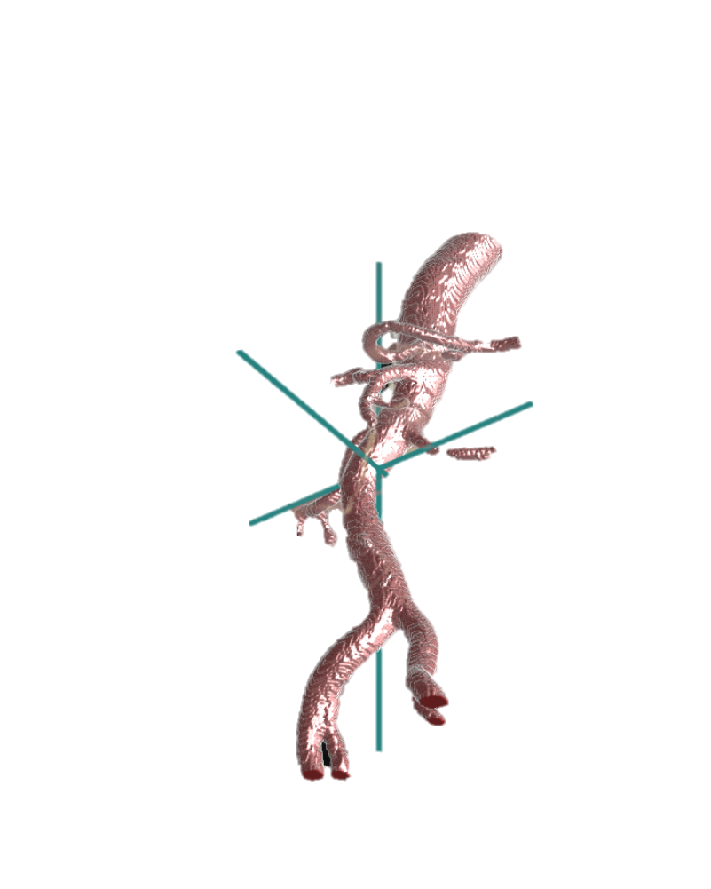


AI applications in RT
Image reconstruction | Segmentation
Adaptive & real-time RT | RT Radiomics

Slide 18

Imaging reconstruction
Filtered back projection (CT, PET, PET-CT)
MRI – more complex
Usually optimised for specific features
  Signal / Noise
  Artefact reduction
  Spatial distortion
  Quantification

Slide 19
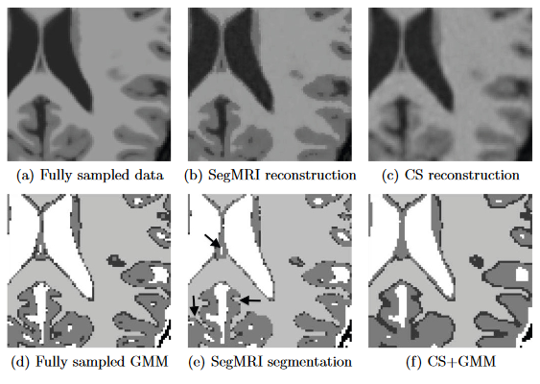
ML for joint reconstruction and processing
‘Reconstruction’ ML
‘Processing’ ML
One cost function
Joint training / parameter optimisation
Daniel Rueckert, UCL

Slide 20
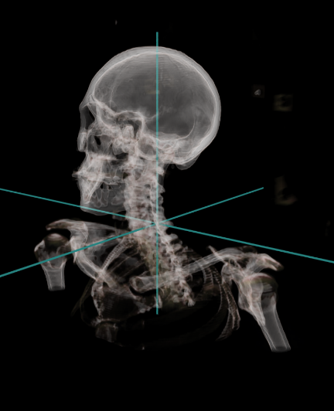
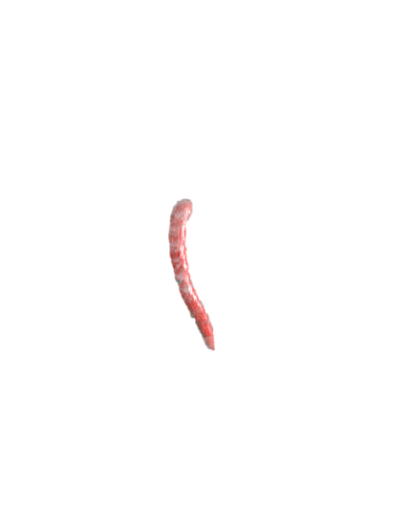
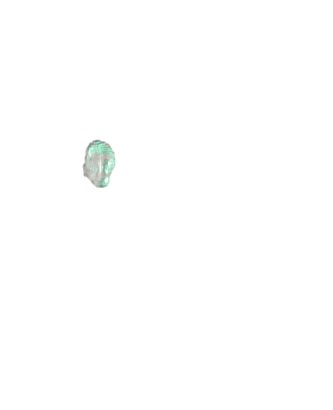
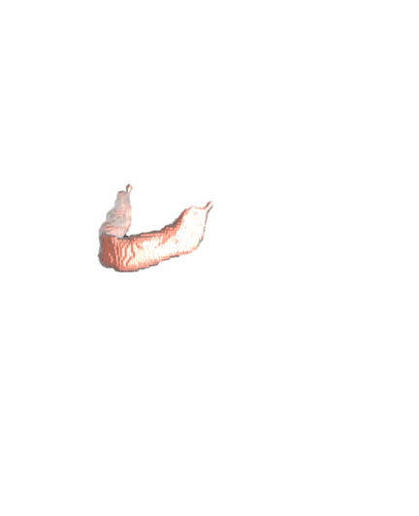
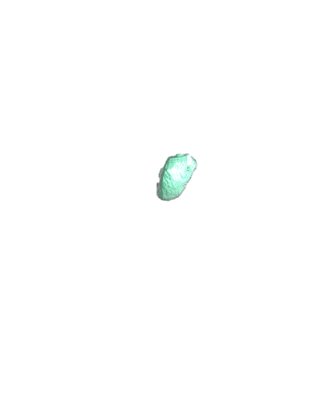
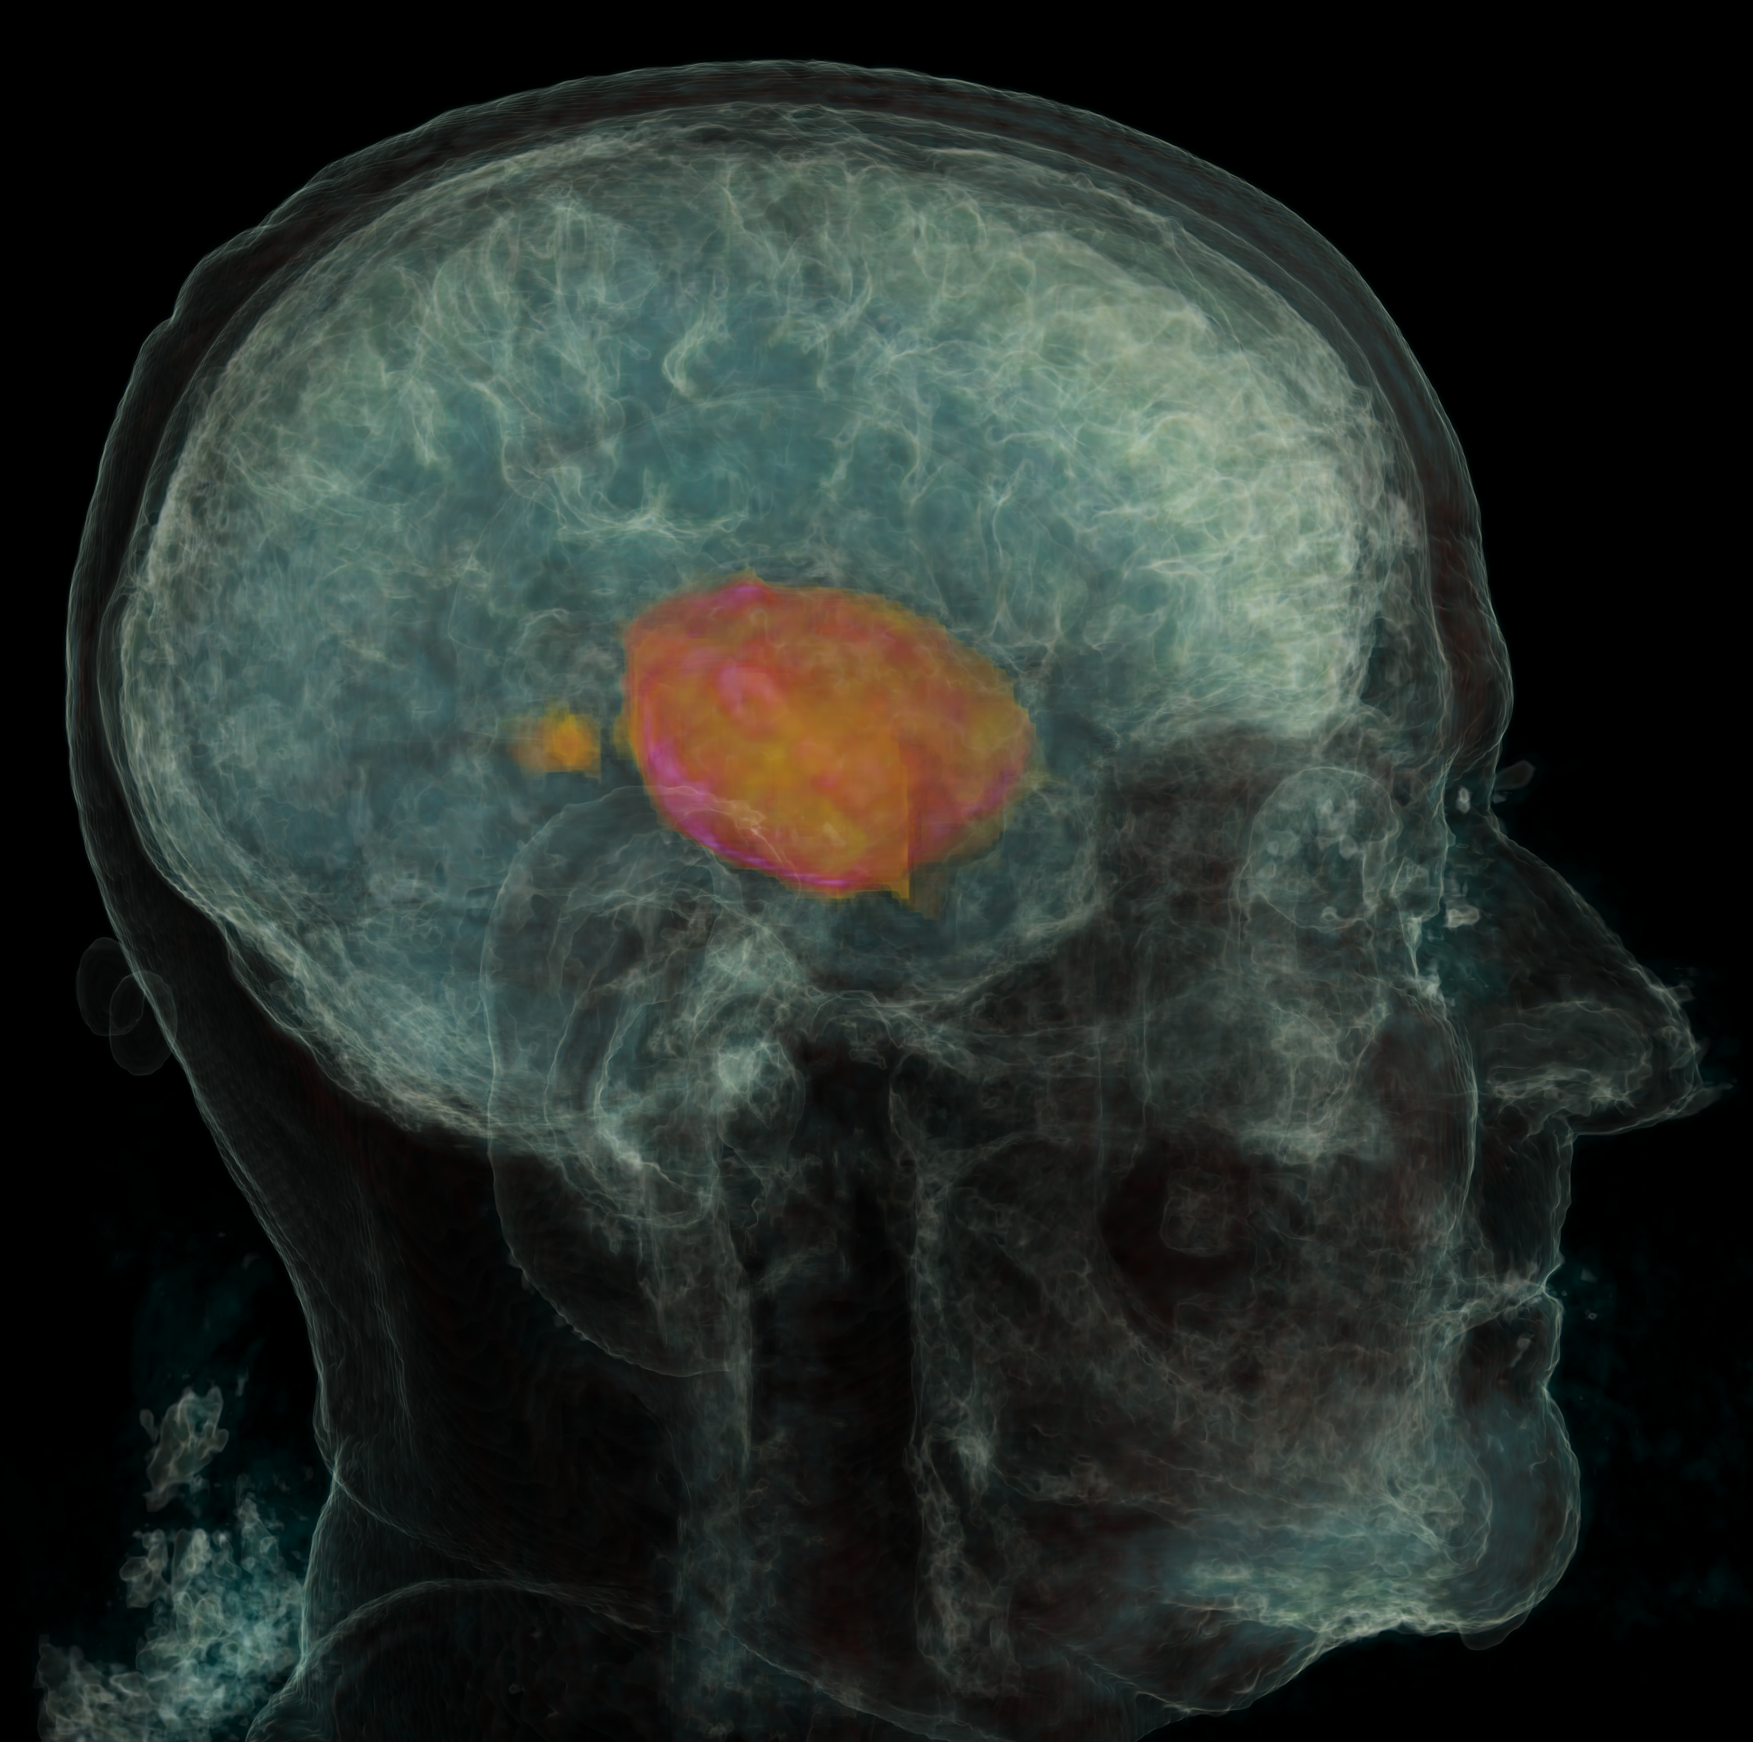


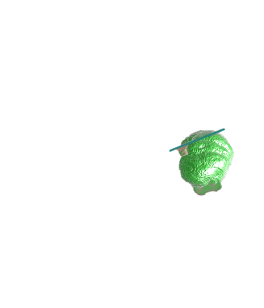



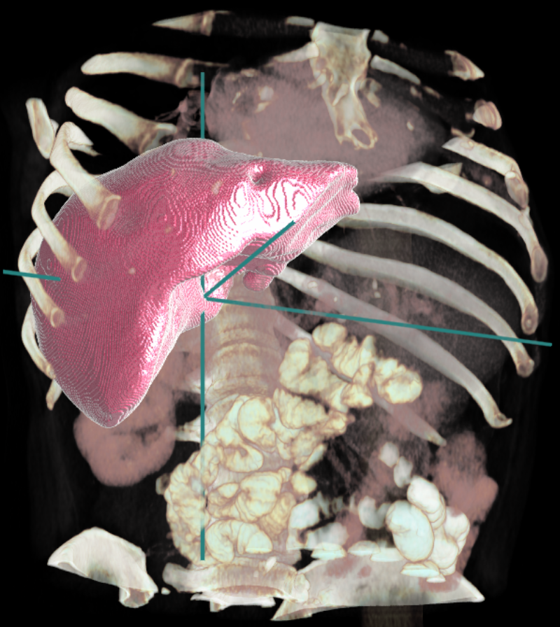
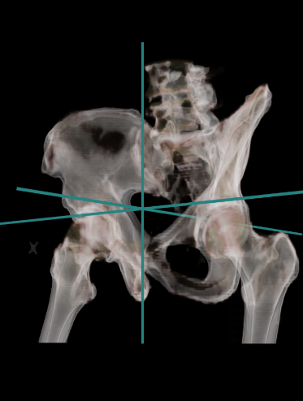
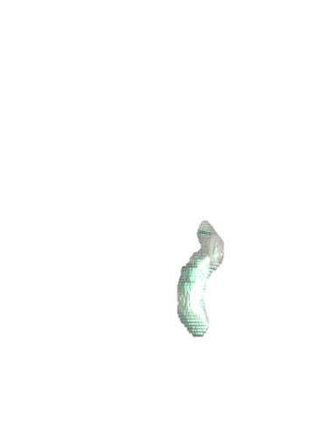
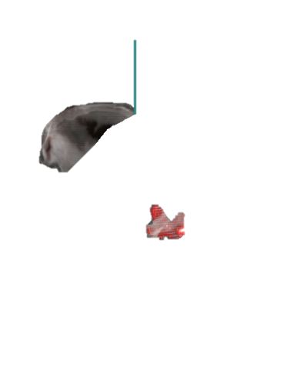
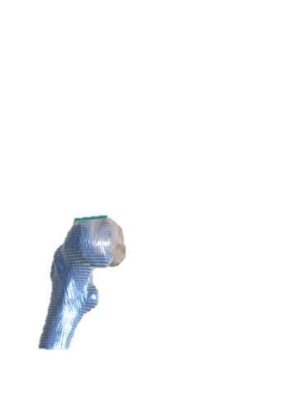
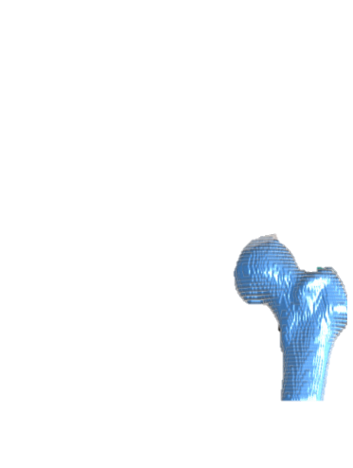
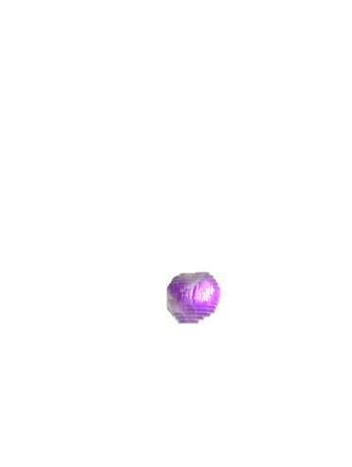
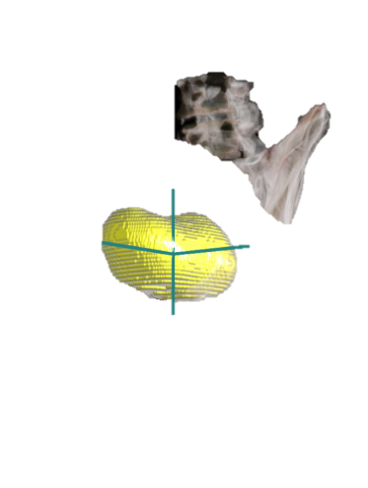
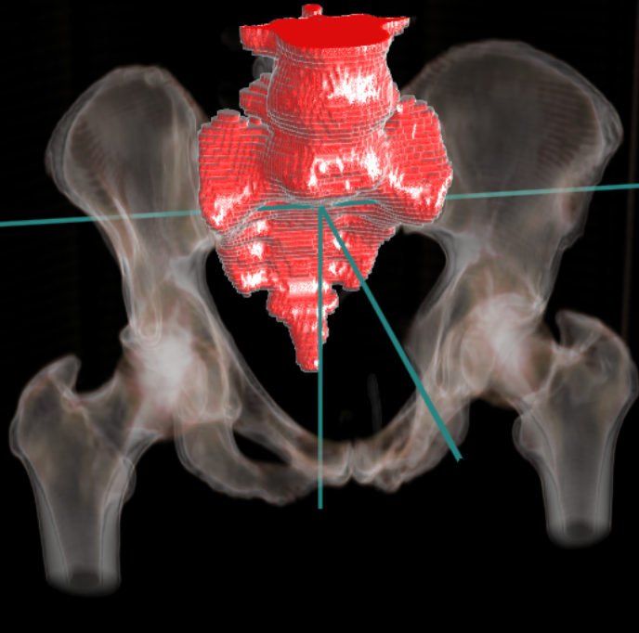
ML for Medical Image segmentation
Microsoft Azure
Innereye team
Computer vision researchers
ML experts
Software development Engineers
Business development experts
UX Design experts
Medical Doctor
InnerEye segmentation services
BrainML.Glioblastoma
BrainML.LowGradeGlioma
HeadNeckML
ThoraxML.Lungs
AbdomenML.Liver
AbdomenML.Kidneys
PelvisML.Spine
PelvisML.Prostate
…
Medical components, paid services

Slide 21
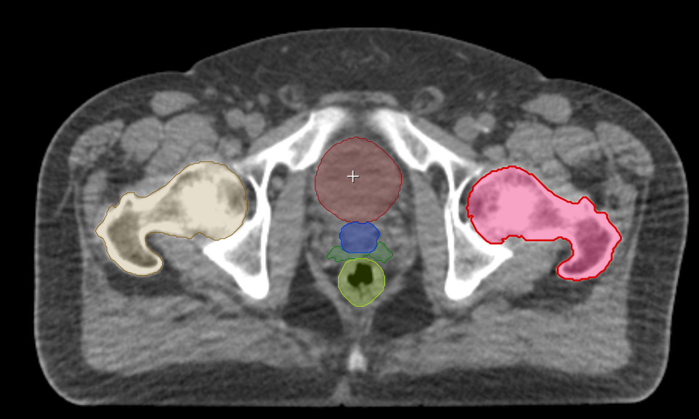
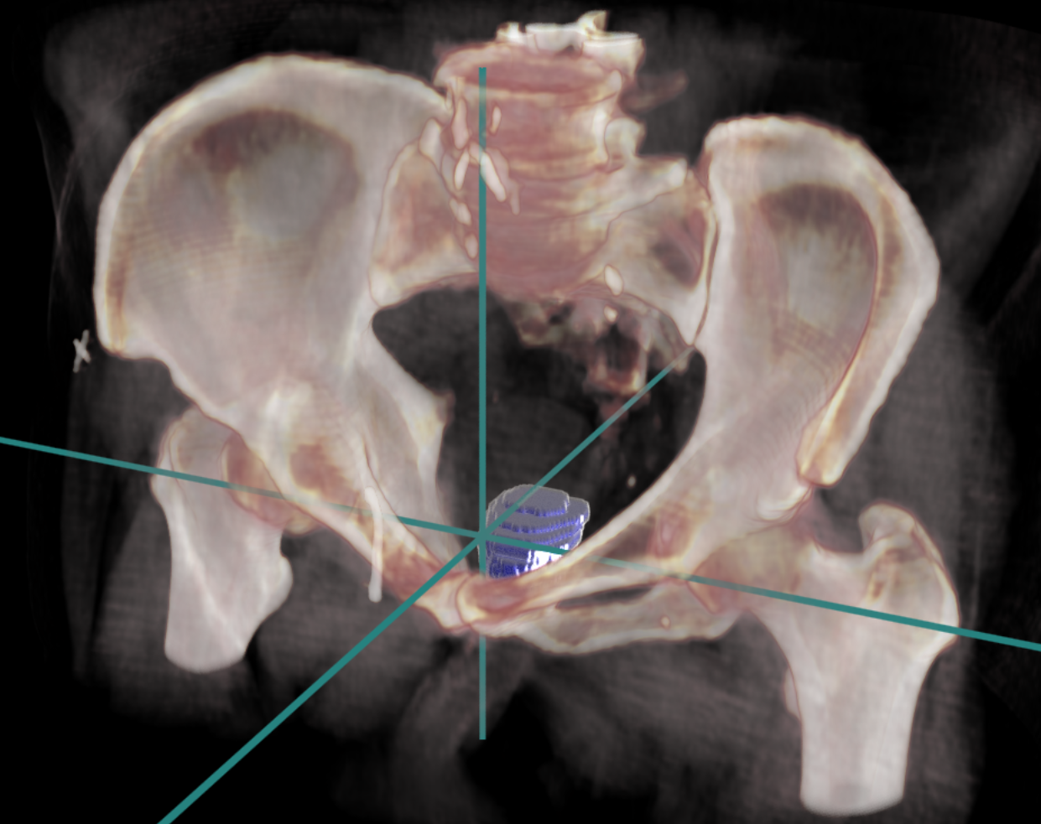
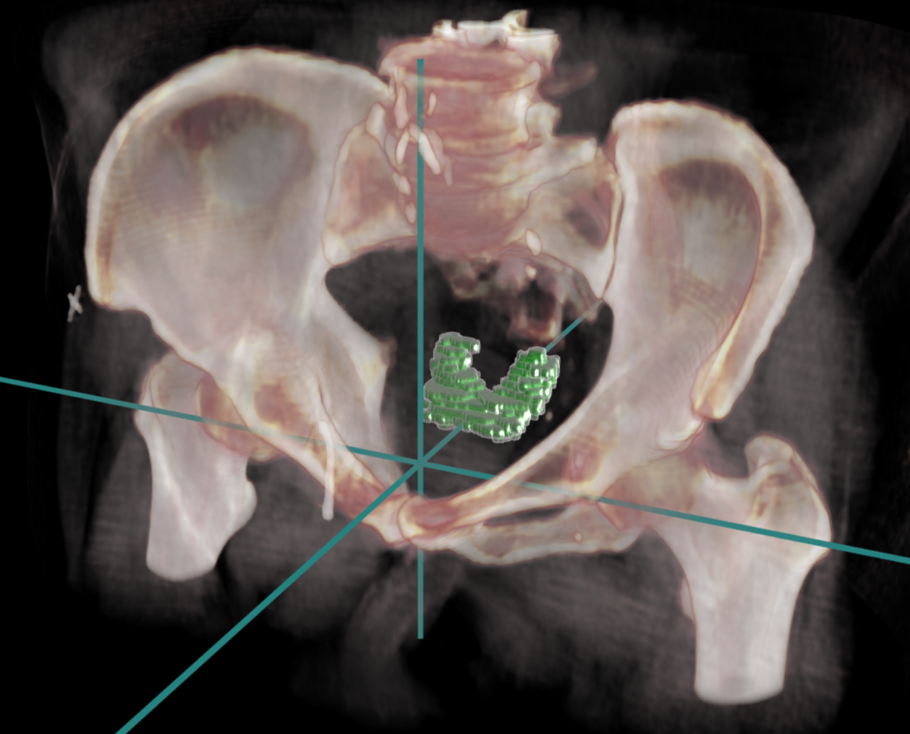
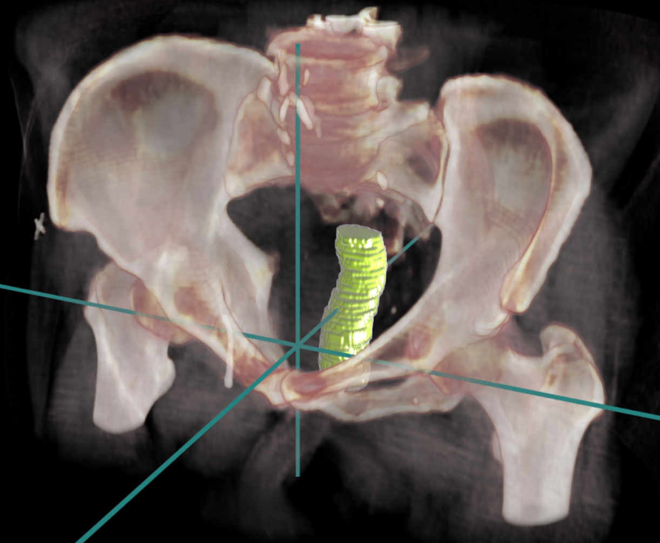
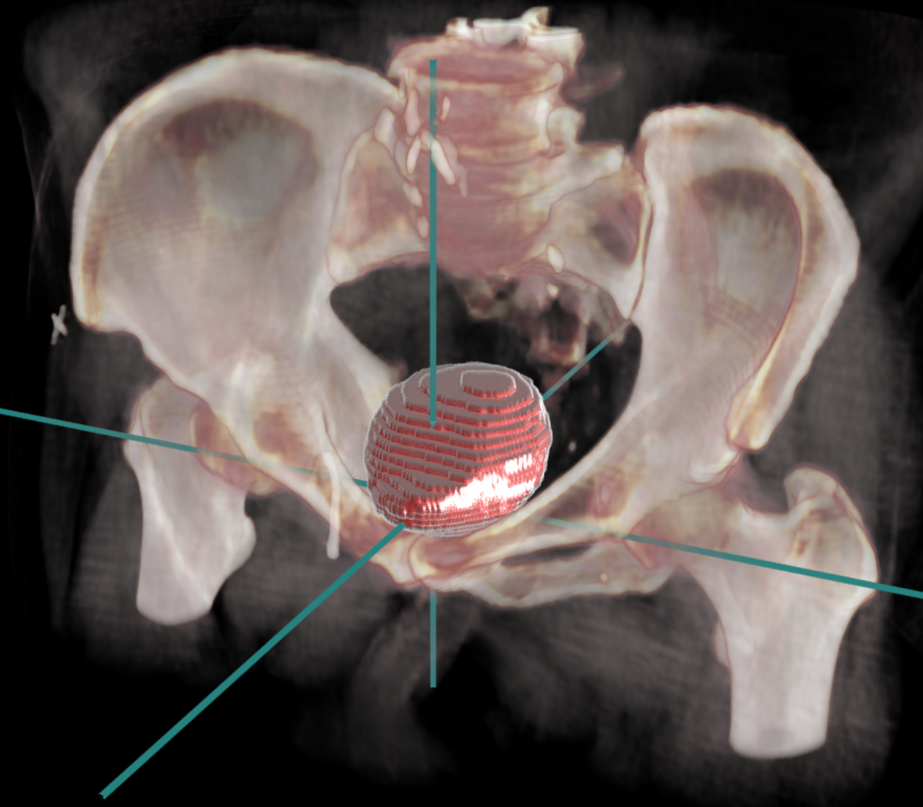
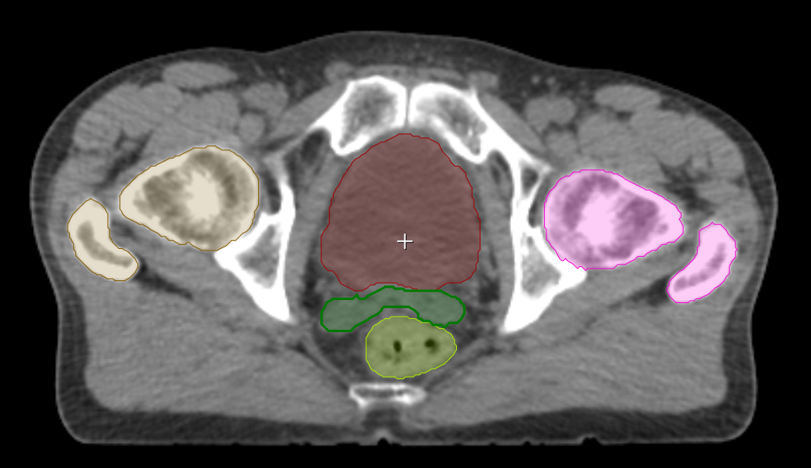
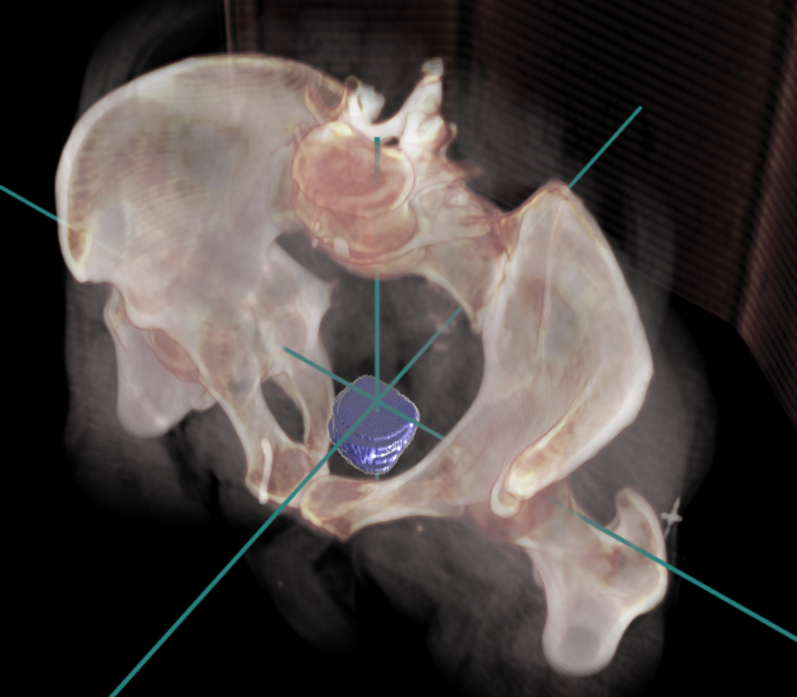
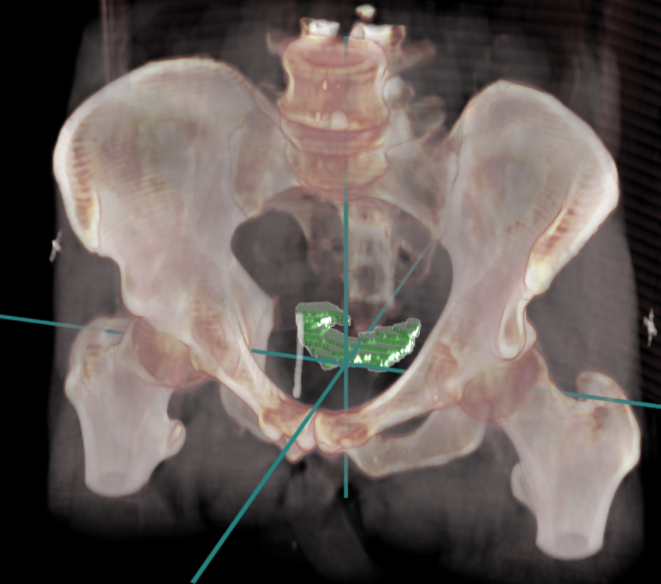
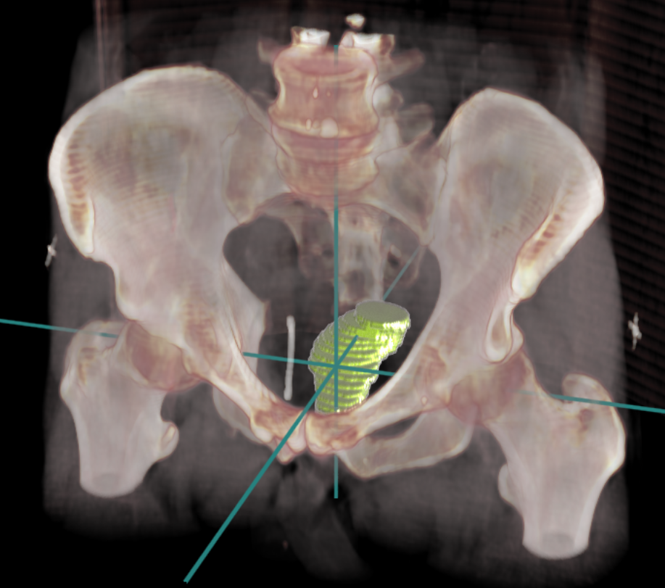
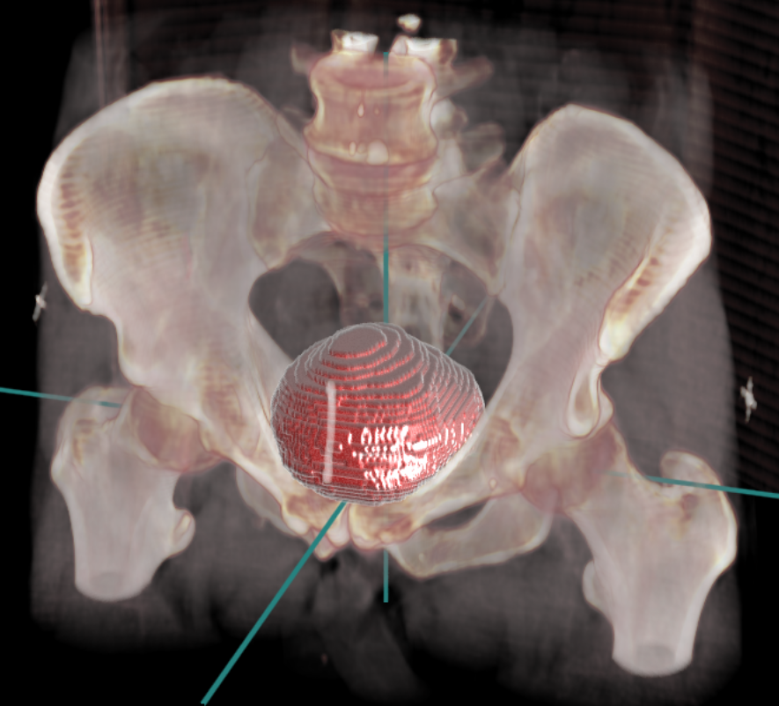
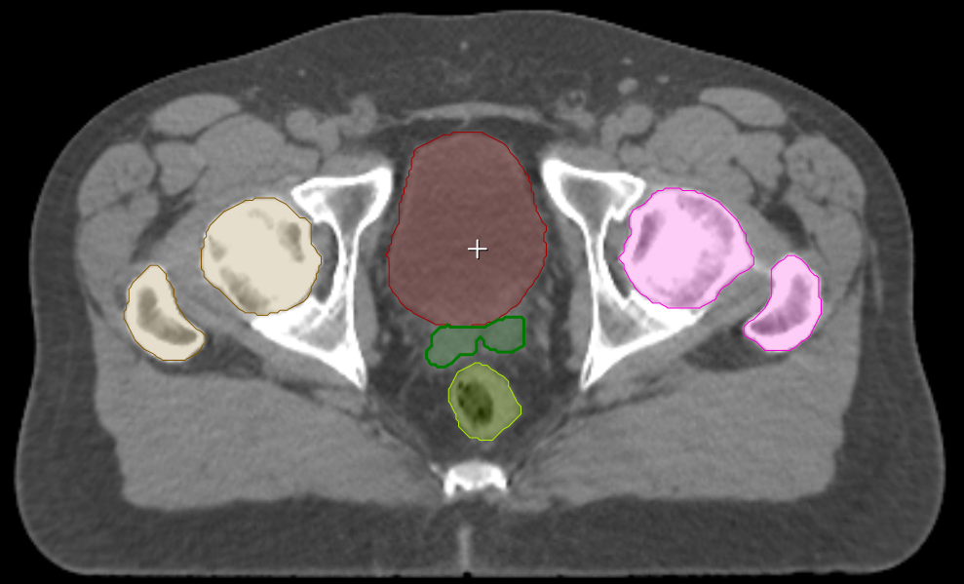




Our “ground-truth” labelled image dataset – hundreds of patients
axial + labels
prostate
seminal vesicles
rectum
bladder
patient 1
patient 2
patient 3
…
…
…
…
…
Notes:
Our algorithms do not need millions of labelled training images. We have can get away with hundreds.

Slide 22




Deep Decision Forests for semantic segmentation - training
Input CT image
Output - probabilities @ layer 1
Appearance context
Input - probabilities @ layer 0
Semantic context

Slide 23

Deep Decision Forests for semantic segmentation - training
Input CT image
Output - probabilities @ layer 2
Appearance context
Input - probabilities @ layer 1
Semantic context

Slide 24



Trained Deep Decision Forest model
Forest layer 0
Probabilities @ layer 0
Forest layer 1
Probabilities @ layer 1
Input CT images
Forest layer 2
Probabilities @ layer 2
Forest layer 3
Segmentation

Slide 25



Deep Decision Forests for semantic segmentation - runtime
Patient 1
Patient 2
@ runtime
Input CT image
Patient 3
Patient 4

Slide 26



Deep Decision Forests for semantic segmentation - runtime
Patient 1
Patient 2
@ runtime
Probabilities @ layer 0
Input CT image
Patient 3
Patient 4

Slide 27



Deep Decision Forests for semantic segmentation - runtime
Patient 1
Patient 2
@ runtime
Probabilities @ layer 1
Probabilities @ layer 0
Input CT image
Patient 3
Patient 4

Slide 28



Deep Decision Forests for semantic segmentation - runtime
Patient 1
Patient 2
@ runtime
Probabilities @ layer 2
Probabilities @ layer 1
Probabilities @ layer 0
Input CT image
Patient 3
Patient 4

Slide 29




Deep Decision Forests for semantic segmentation - runtime
Patient 1
Patient 2
@ runtime
Segmentation
Probabilities @ layer 2
Probabilities @ layer 1
Probabilities @ layer 0
Input CT image
Patient 3
Patient 4

Slide 30

Deep Decision Forests – comparison with inter-observer variability

Slide 31

Benchmarking tests with third party data

Slide 32



2018 – Continuous ML at Addenbrookes
SimCT 1
Prosoma
TPS 1
TPS 2
SimCT 2
TPS 3
Gateway

Slide 33


ML for Adaptive radiation therapy
ART – rescan and reoptimize treatment during each day of radiotherapy
  Stay on target
  Shield healthy tissues from radiation as much as possible
Multiple timepoint segmentation
  Same problem as response assessment

Slide 34

ML for real-time radiation therapy
Tracking and re-segmenting targets and normal tissues in real time
  Liver tumours
  Lung tumours

Slide 35


ML for Predictive Radiomics
Predict effect to tumour
  Use multiple image channels to build predictive classifier of tumour response during treatment
Predict effect to healthy tissues
  Hamlet.rt
  Predicting toxicity of treatment from image and non-image data (normal tissue radiomics)
Courtesy of Kevin Brindle Lab

Slide 36

Horizon Scanning
AI| Hadron therapy| Real-time tumour painting

Slide 37
RT targeting goals
GTV – tumour only
  Maximise cell damage
  Remove dependence on oxygen
CTV – tumour & health tissue
  Kill the tumour cells
  Shield the healthy cells
  Activate the immune system
PTV – healthy tissue
  Target accurately
  Track target motion
ICRU Reports 50, 62, 83

Slide 38

CHAMP – Compact Hybrid Accelerator MR PET
C-13 Hyp-MRI
Pyruvate
pH
Photon RT
Tumour CTV
Immune activation
ATSM PET
Oxygen
Perfusion
Hadron dose paint
Protons
Carbon ions
Lithium?
CINE MRI
Targeting
Motion tracking
MR Perfusion
Vascular imaging
NK cell ligand PET
Immunome imaging

Slide 39

CHAMP – Science fact or science fiction?
Component technologies exist, but huge & very expensive
Needs AI to work in real-time
  Predictive radiomics
  Image processing
  Segmentation
  Plan optimisation
BELLA at LBNL accelerates an electron from 0 to 4.3 GeV in 9cm!!!
LHC – 0 to 6TeV in 17 miles

Slide 40
Acknowledgements
Innereye Team
Antonio Criminisi
Javier Alvarez Valle
Aditya Nori
Kenji Takeda
Richard Lowe
Ivan Tarapov
Stefan Wijnen
Anton Schwaighofer
Jay Nanavati
Laurence Bourn
Addenbrooke’s
Andrew Hoole
Simon Thomas
Yvonne Rimmer
Simon Russell
Luke Hughes-Davies
Alex Martin
UCAM
Carola Schonlieb
Mihaela van der Schaar
Kevin Brindle

