Slide 1
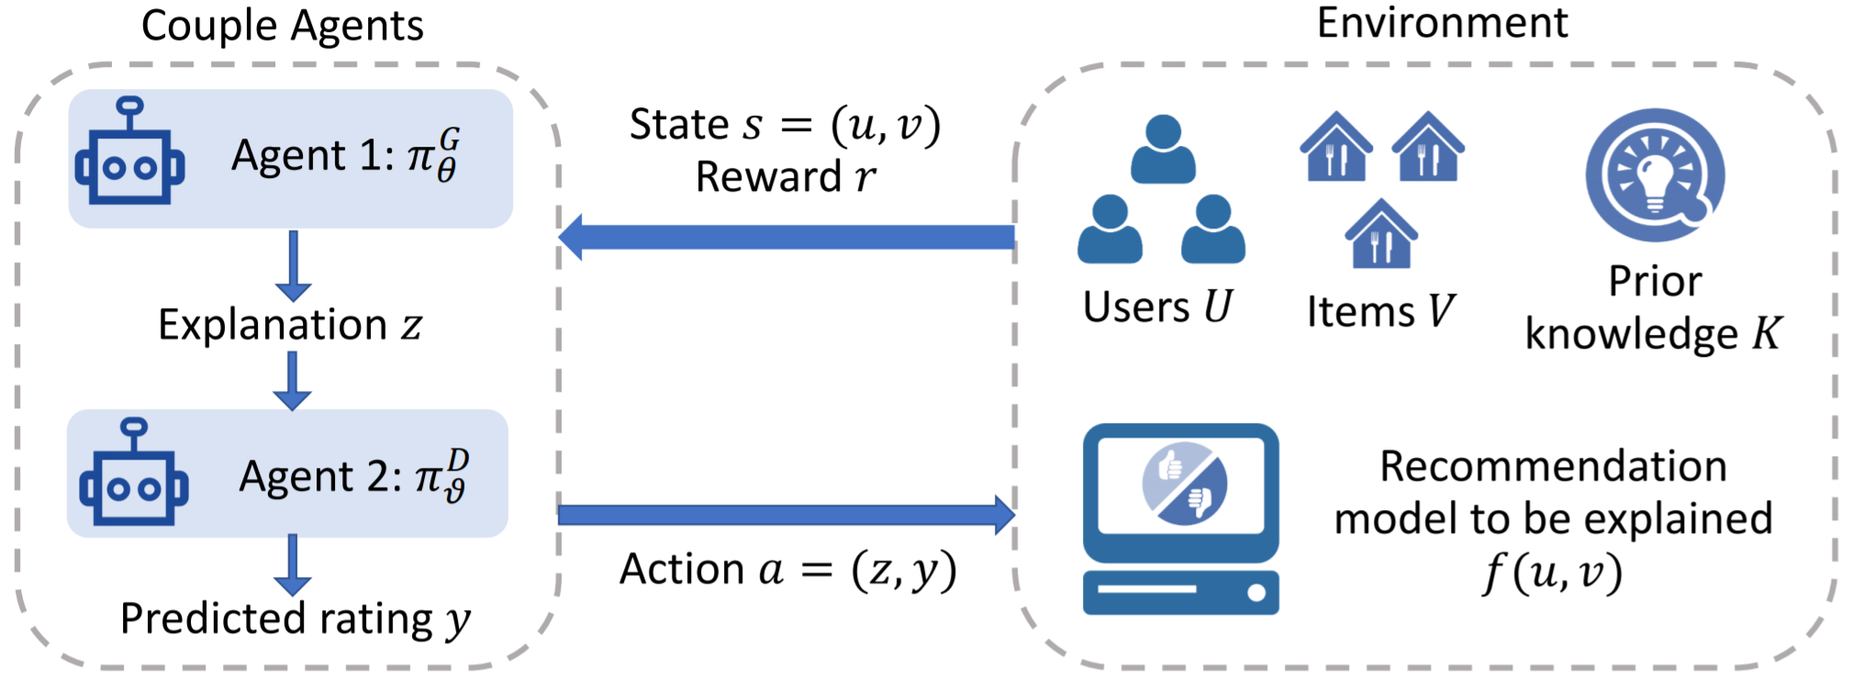
A Reinforcement Learning Framework for Explainable Recommendation
Xiting Wang, Yiru Chen, Jie Yang, Le Wu, Zhengtao Wu, Xing Xie
Microsoft Research Asia, Peking University, Tsinghua University, Hefei University of Technology, USTC
Notes:
Good afternoon. My name is Xiting Wang. I am a researcher from Microsoft Research Asia.
It is my honor to introduce our work on developing a …

Slide 2


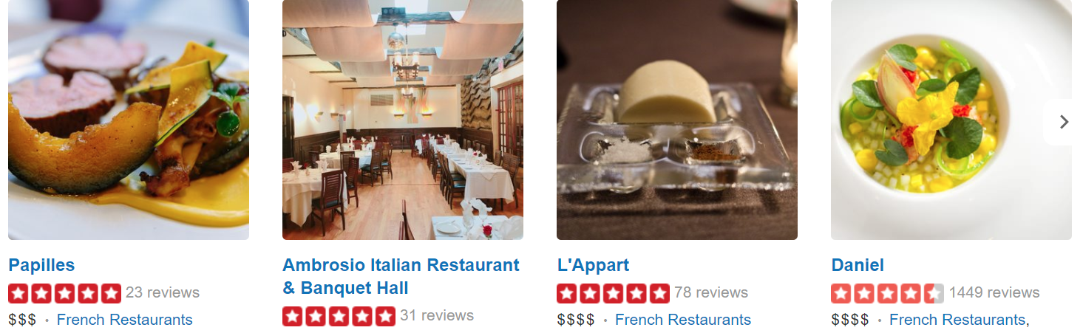
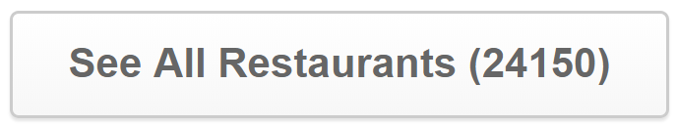
Recommender Systems
Help billions of users to make decisions related to their personal lives
Choose a restaurant
Buy products
A growing need to ensure that the users understand and trust the system
Notes:
Billions of online users leverage recommender systems to sift through massive contents and make decisions related to their personal lives.
As recommender systems impact people’s lives in increasingly profound ways, there is a growing need to ensure that the users understand and trust the system [1].

Slide 3
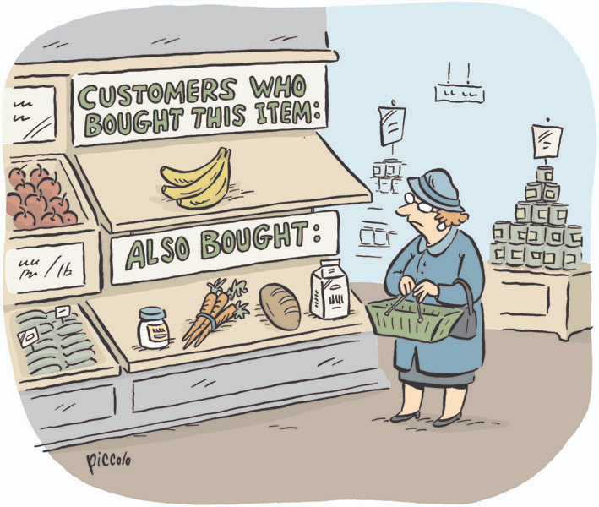
Explainable Recommendation
A growing need to ensure that the users understand and trust the system
Explanations: why the items are recommended
Explanations serve as a bridge between recommender systems and users
  Increase user trust
  Help users make better decisions
  Persuade users to try or buy an item
Notes:
Explanations about why the items are recommended serve as a bridge between recommender systems and users
Good explanations may increase users’ trust in the system [2], help users make better decisions [3], and persuade users to try or buy an item [4].

Slide 4

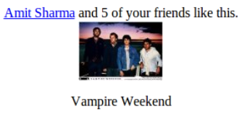
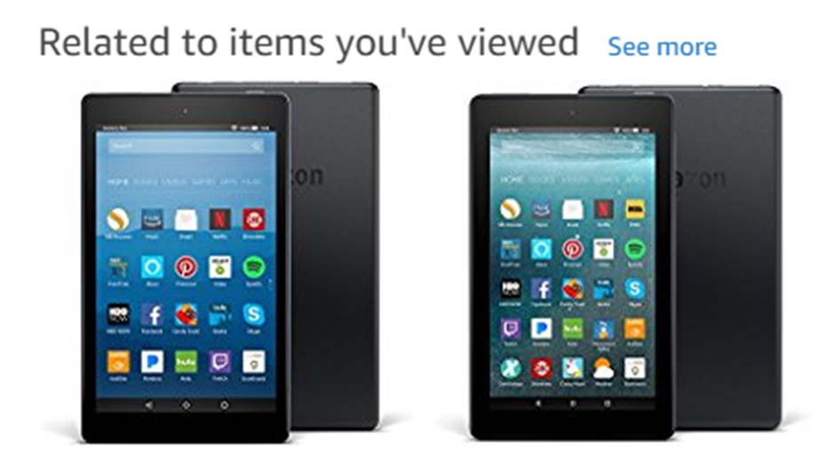









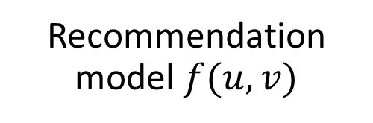
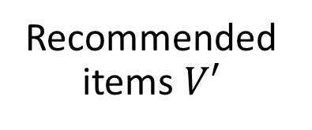

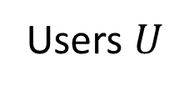
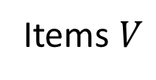
Existing Methods – Post Hoc
Users $U$
Recommendation model $f(u,v)$
Recommended items $V′$
Explanation Method
Explanation $z$
Items $V$
Diversity limited by the number of predefined templates
Ignore the working mechanism of the recommendation model
Notes:
Current explainable recommendation methods can be divided into two groups.
The first group is post-hoc methods.
These methods generate explanations after the items have been recommended.
They usually generate explanations by using some kind of templates, such as “Amit Sharma and 5 of your friends like this”
While the explanations are usually persuasive and highly readable, the diversity of the explanations is often limited by the number of predefined templates.
Also, they often ignore the working mechanism of the recommendation model

Slide 5
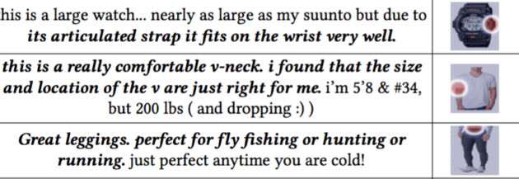
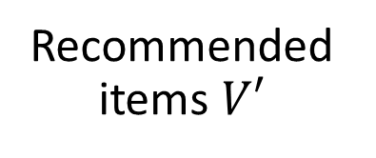

Existing Methods - Embedded
Users $U$
…
…
Explanation Method
Explanation $z$
Recommended items $V′$
Items $V$
Difficult to ensure readability and consistency
Different explanation methods for different recommendation models
Notes:
Embedded methods incorporate the explanation process into the construction of a recommendation model.
The explanations are often pieces of text or images selected from the side information of the items.
For example, …
Usually, the pieces that contribute most to the recommendation accuracy are selected.
While the produced explanations are diversified and closely tied to the recommendation model, it is difficult to ensure the readability and consistency of these explanations.
Also, we need to design different explanation methods for different recommendation models.

Slide 6
Desirable Properties for
Explainable Recommendation
Model-agnostic: can be used to explain any recommendation model
Model explainability: reveal the working mechanism of the model
Explanation quality control: ensure the quality of the explanations (e.g., their readability, consistency, and diversity)
Notes:
Model-agnostic. The method can be used to explain any recommendation model. This allows us to explain complex deep-learning-based model and provides flexibility to explain future recommendation models.
Model explainability. The explanations should be tied closely to the recommendation model and reveal its working mechanism.
Explanation quality control. Ensuring the quality of the explanations (e.g., their readability, consistency, and diversity) is very important in real-world applications.
It is desirable that the method can flexibly control the explanation quality based on the application scenario.

Slide 7
Desirable Properties for
Explainable Recommendation
 | Model agnostic | Model explainability | Presentation quality
Post-hoc
Embedded
Notes:
Although post-hoc methods are model-agnostic, they do not consider model explainability and have problems in generating diversified results (quality control).
While the embedded methods have good model explainability, they are not model-agnostic and are not good at explanation quality control.

Slide 8
Desirable Properties for Explainable Recommendation
 | Model agnostic | Model explainability | Presentation quality
Post-hoc
Embedded
Wrapper (RL)
Notes:
We solve the aforementioned problems by designing a reinforcement learning framework for explainable recommendation. We call it wrapper methods.
Our framework is model-agnostic, have good model explainability, and can flexibly control the explanation.

Slide 9
Contribution
Design a reinforcement learning framework for explainable recommendation
  Model-agnostic
  Has good model explainability
  Can flexibly control the presentation quality
Instantiate the agents with personalized-attention-based neural networks
Evaluate the effectiveness of our method by using both offline experiments and evaluation with human subjects
Notes:
The major contributions of this paper are as follows.
First, we design a reinforcement learning framework for explainable recommendation.
The framework is model-agnostic, has model good explainability, and can flexibly control the presentation quality of the explanations.
Second, we instantiate the agents in the framework with personalized-attention-based neural networks.
These agents can be used to generate personalized sentence-level explanations.
Finally, we evaluate the effectiveness of our method by using both offline experiments and evaluation with human subjects.

Slide 10

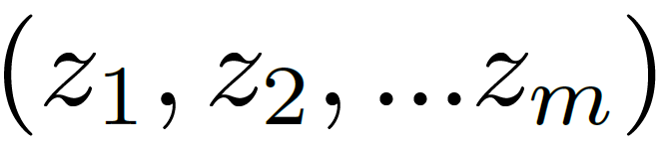
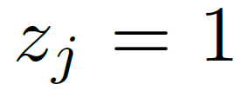
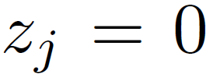
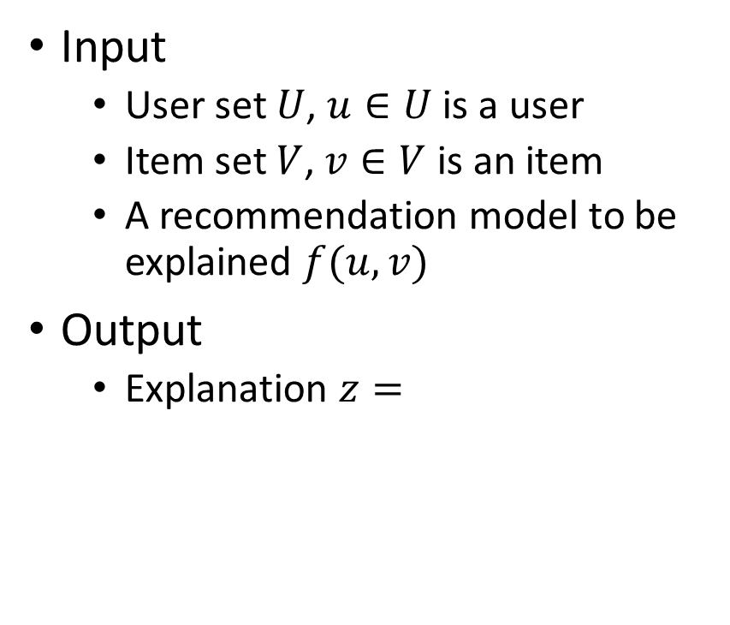




Problem Definition
Input
  User set $U$, $u∈U$ is a user
  Item set $V$, $v∈V$ is an item
  A recommendation model to be explained $f(u, v)$
Output
  Explanation $z=$
$u:$ user ID and/or some side information
$i:$ item ID $l_{j}$: interpretable component
Attributes like “price - low”; user review; product image;
The $j$th interpretable component is selected
The $j$th interpretable component is not selected

Slide 11
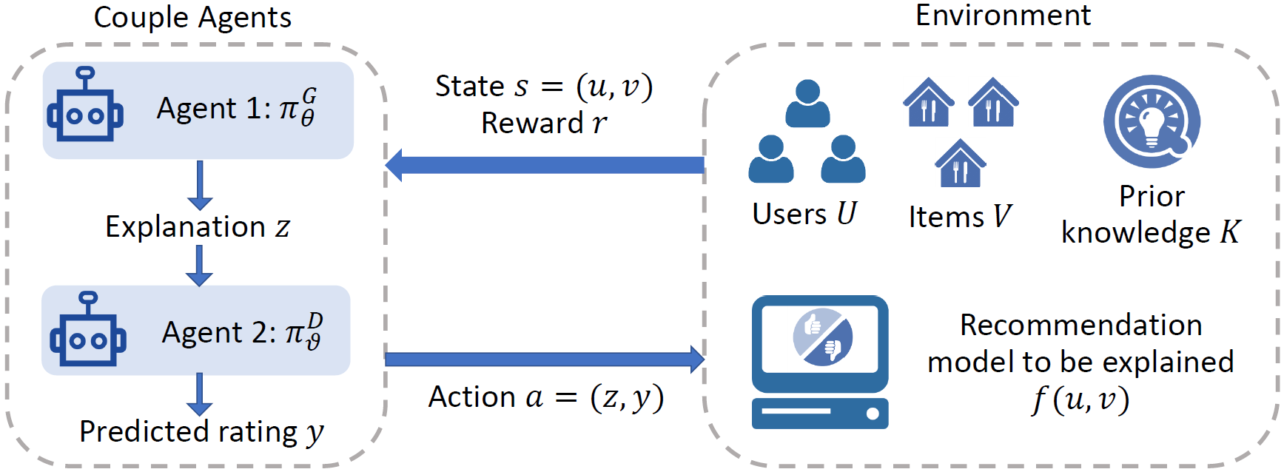
Reinforcement Learning Framework
Advantages: model-agnostic, model-explainability, presentation quality
Notes:
Here is an overview of our reinforcement learning framework. In our design, the recommendation model to be explained is a part of the environment. It is separated from the agents, which are responsible for 1) generating explanations and 2) predicting the output ratings of the recommendation model based on the explanations.

Slide 12
Reinforcement Learning Framework
Advantages: model-agnostic, model-explainability, presentation quality
Independent
Notes:
The framework is model-agnostic because the agents treat the recommendation model as a black box and interact with the environment to get information (reward) about how good the explanations are.

Slide 13
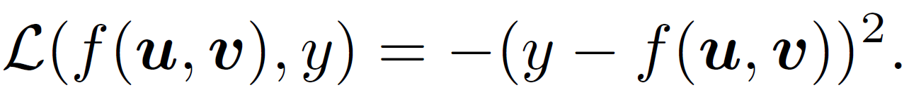
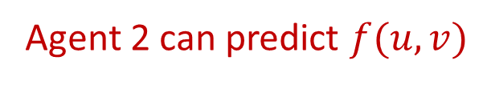
Reinforcement Learning Framework
Advantages: model-agnostic, model-explainability, presentation quality
Agent 2 can predict $f(u,v)$
Model-explainability reward:
Notes:
Our framework has good model explainability because the environment rewards the agents if the predicted rating y is similar to the output of recommendation model f(u,v).
If the agent can accurately predict the behavior of the recommendation model based on the explanations, we say that the explanation reveals the working mechanism of the recommendation model, in other words, the explanations have good model-explainability.

Slide 14

Reinforcement Learning Framework
Advantages: model-agnostic, model-explainability, presentation quality
$r$ will increase if $z$ is good given $K$
Notes:
Our framework can also flexibly control explanation quality.
Based on some prior knowledge about desirable explanations (e.g., desirable length of an explanation), the environment rewards the agents if the explanations have good presentation quality.

Slide 15
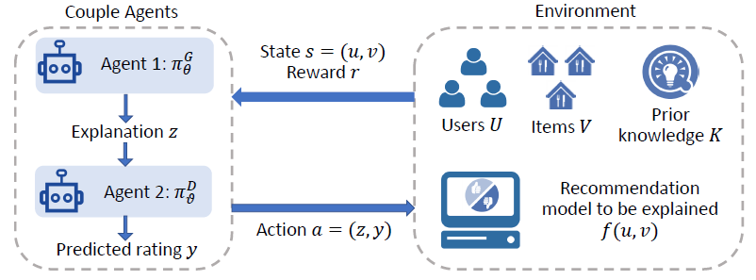
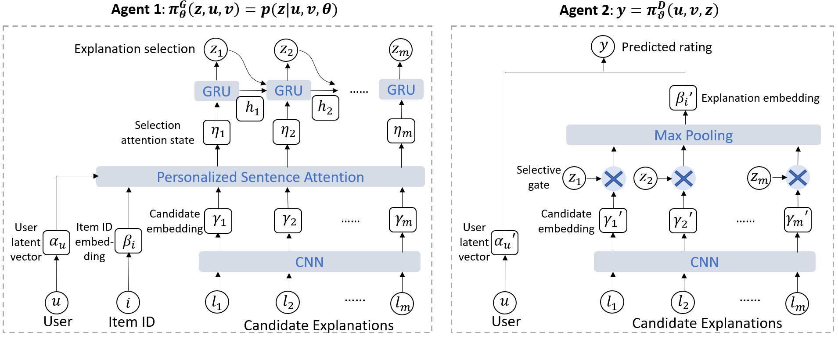
Couple Agents
Sentence-level Explanation
Notes:
In this model, we design two agents.
This is the first agent.
Given a user id, an items id, and interpretable components of the items, the first agent generates the explanation by selecting the interpretable components.
The selection is based on user’s personalized attention.
The second agent predicates the output rating of the recommendation model based on the user id and the explanation.
The environment rewards the agents if they can correctly predict the output ratings of the recommendation model and if the explanations have good presentation quality.
The agents learn to generate good explanations by optimizing the expected reward of their actions.

Slide 16
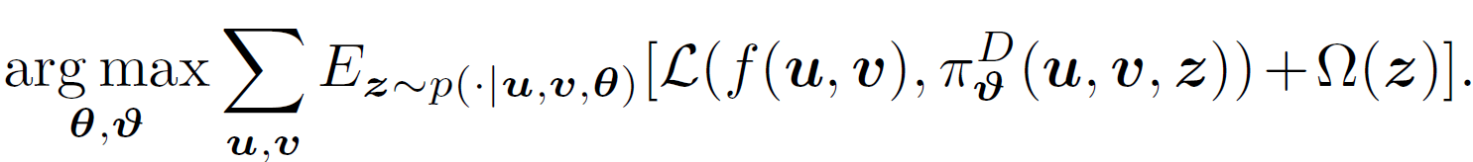
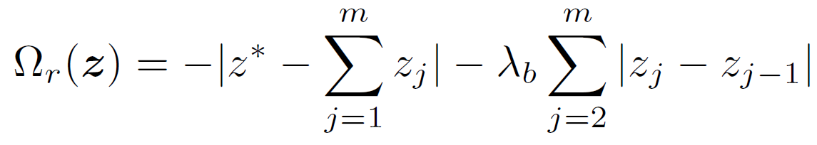
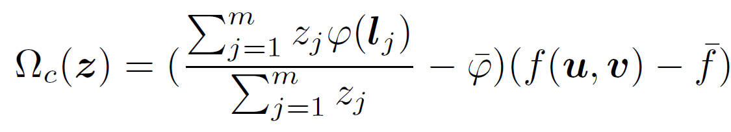




Optimization Goal
Reward $r$
Maximizing expected reward
Model-explainability
Presentation quality
Readability
(Sentiment) Consistency
Conciseness
Coherence
returns the sentiment score of
:desirable sentence length
Notes:
Sometimes we may hope that the selected sentences are adjacent to each other so that the explanation is more coherent and the users can better understand
the overall context.
If the interpretable components are sentences from the review comments, the generated explanations usually express positive or negative sentiment. In such a case, it is desirable that the sentiment of the explanation is consistent with the rating.
Thus, we design a consistency metric to make sure that higher (lower) ratings correspond to more positive (negative) sentiments

Slide 17
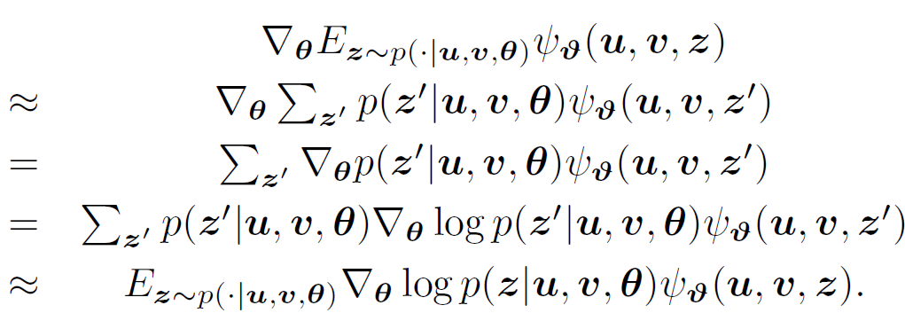
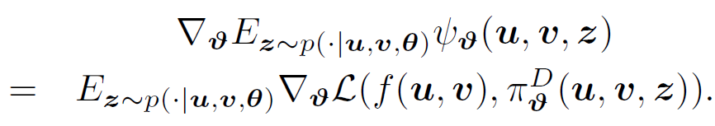
Optimization Method
Doubly Stochastic Policy Gradient
Agent 1
Agent 2
Notes:
We derive a doubly stochastic policy gradient method to optimize the expected reward.
More details can be found in the paper.

Slide 18
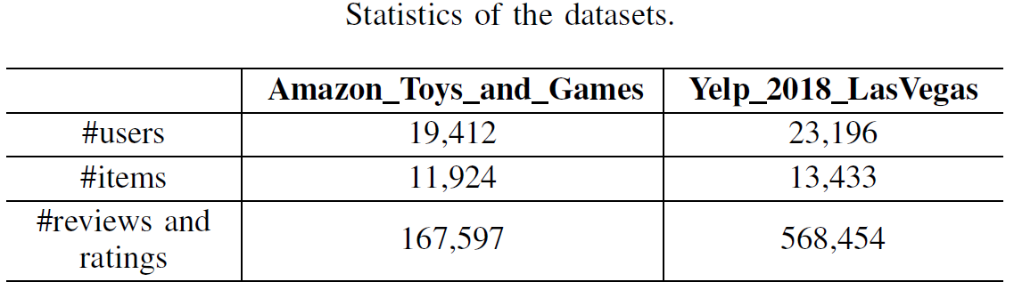
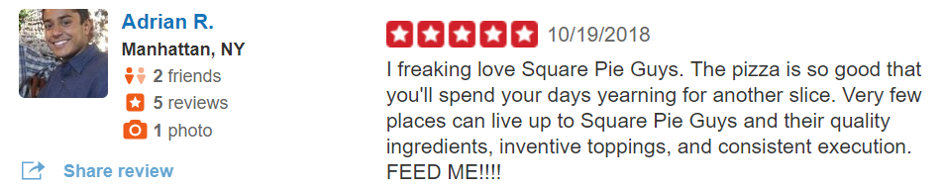
Offline Evaluation
Each training sample: user, item, rating, review text
Notes:
To evaluate our method, we conducted experiments on two datasets: Yelp and Amazon.

Slide 19
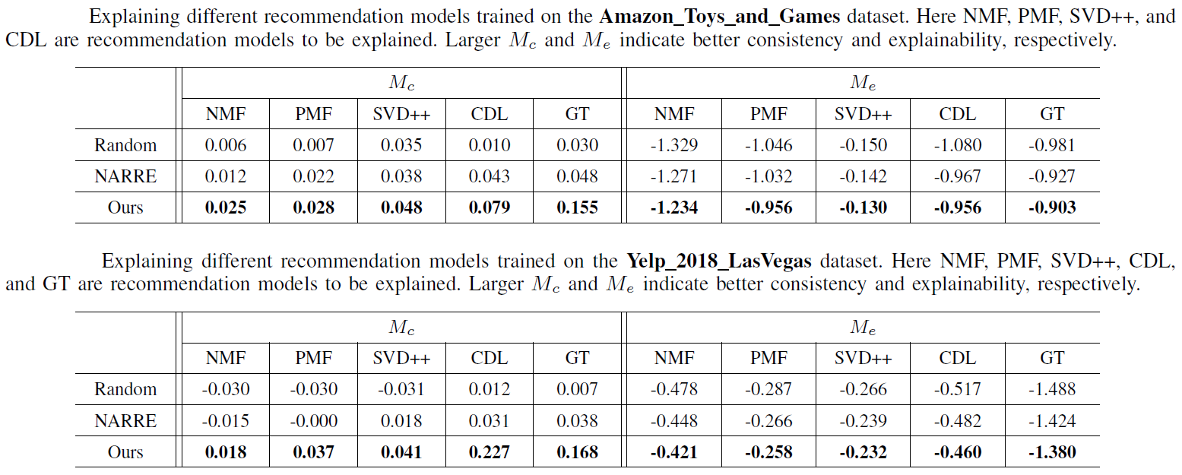
Offline Evaluation
Different recommendation models to be explained
Presentation quality
Model explainability
Presentation quality
Model explainability
Notes:
In offline experiments, we use our method to explain different recommendation models, including matrix-factorization-based models and deep-learning-based models.
Results show that our model outperforms existing methods in terms of presentation quality and model explainability.

Slide 20
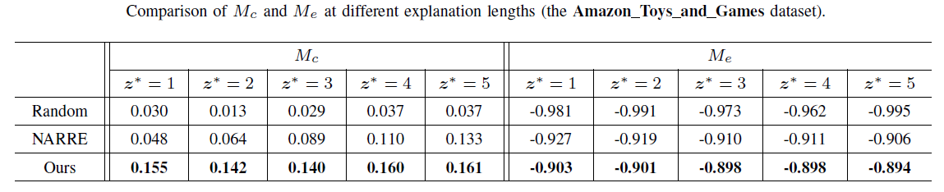
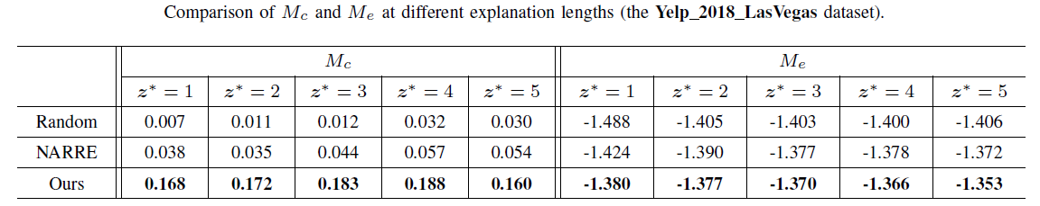
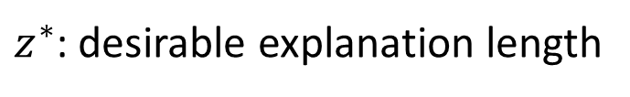
Offline Evaluation
Different parameter settings
$z^{∗}$: desirable explanation length
Presentation quality
Model explainability
Presentation quality
Model explainability
Notes:
The experiments also show that our model outperforms existing methods at different parameter settings.

Slide 21
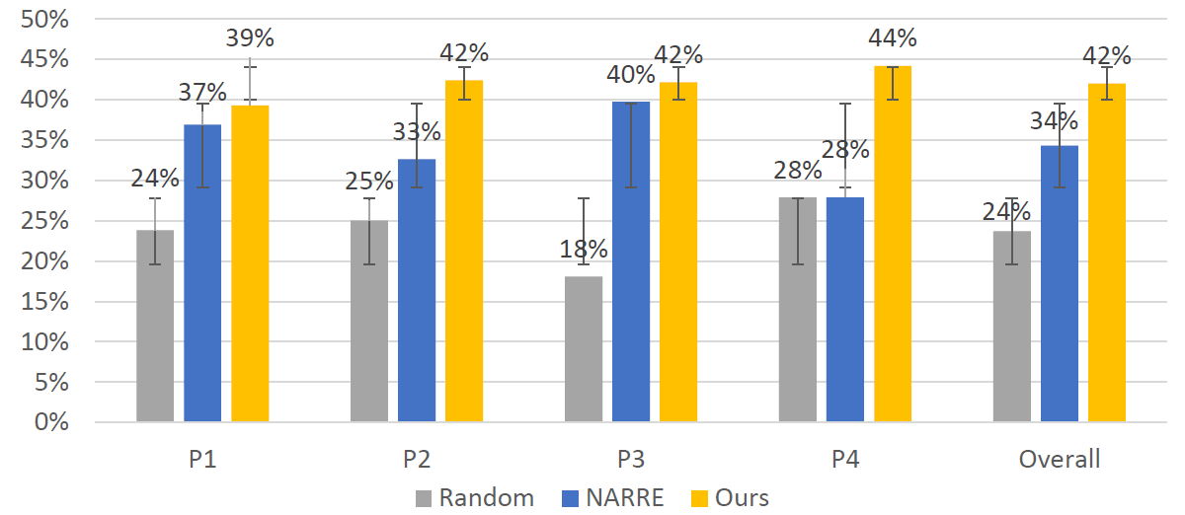



Evaluation with Human Subjects
Ask the participants to choose the explanations that are most useful in helping them decide whether they will go to the restaurants
Notes:
Evaluation with human subjects show that the explanations generated by our model is considered as the most useful,

Slide 22
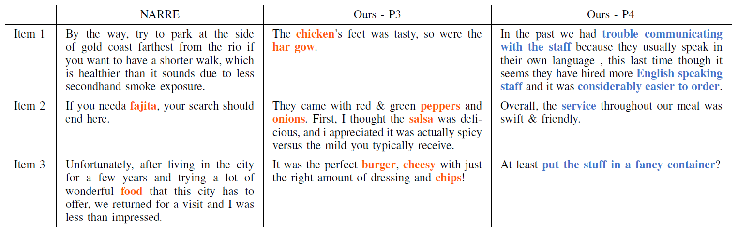
Evaluation with Human Subjects
P3
Frequent words in reviews:
P4
Words related to food
Words related to services
Notes:
The table here shows examples of our explanations.
Here, user P3 is interested in food, especially meat.
User P4 is interested in services of the restaurants.
Our model correctly captures the user interests.
When explaining to P3, it says the chicken’s tasty.
When explaining to P4, it says the service was swift and friendly.
However, the baseline can only emphasize one aspect because it is not personalized.

Slide 23
Conclusion
Design a reinforcement learning framework for explainable recommendation
  Model-agnostic
  Has good model explainability
  Can flexibly control the presentation quality
Instantiate the agents with personalized-attention-based neural networks
Evaluate the effectiveness of our method by using both offline experiments and evaluation with human subjects
Notes:
Here I conclude our work.
First, we design a reinforcement learning framework for explainable recommendation.
The framework is model-agnostic, has good explainability, and can flexibly control the presentation quality of the explanations.
Second, we instantiate the agents with personalized-attention-based neural networks.
These agents can be used to generate personalized sentence-level explanations.
Finally, we evaluate the effectiveness of our method by using both offline experiments and evaluation with human subjects.

Slide 24


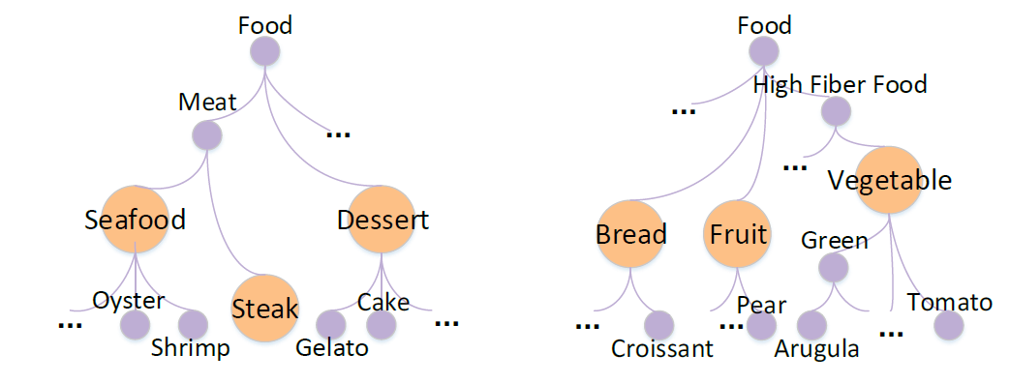
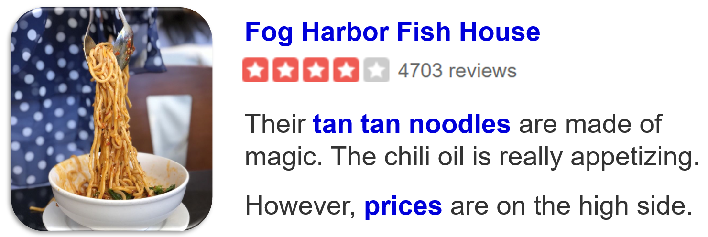


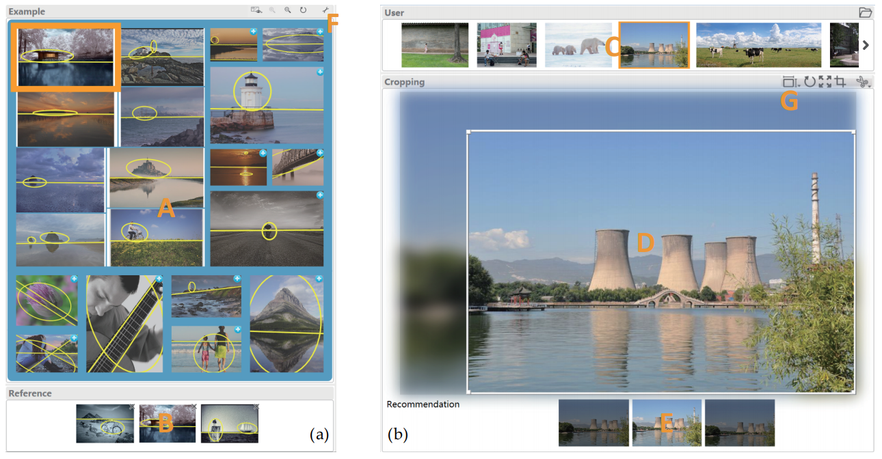
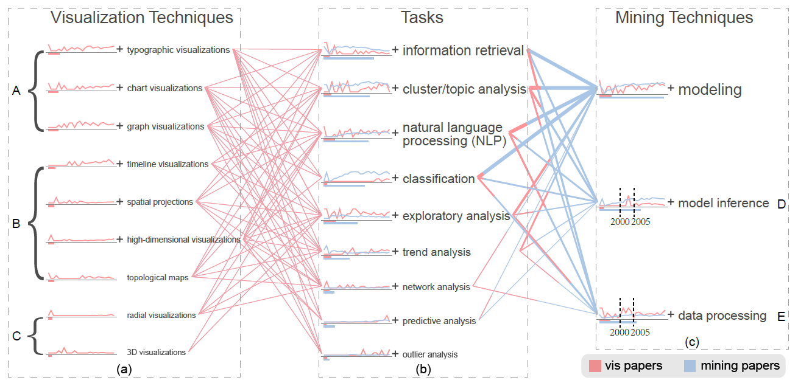
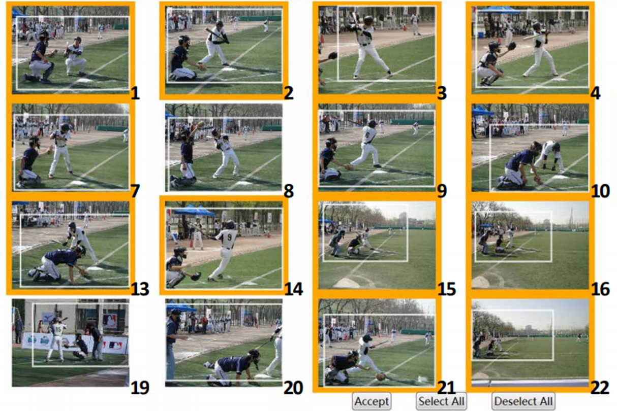
Our Works on Explainable Recommendation
http://xitingwang.net
Choose a restaurant
Textual
[AAAI2019]
[ICDM2018]
Daily life
Homepage
Buy products
Visualization
Determine research direction
[TVCG2018], Spotlight
[TVCG2018]
Professional activities
Recomposite photos

Slide 25
Thanks!

