Slide 1
Regression Detection for Index Tuning Scenarios using Machine Learning
a.k.a.
AI meets AI: Leveraging Query Executions to Improve Index
Recommendations
Bailu Ding¹, Sudipto Das¹, Ryan Marcus², Wentao Wu¹,
Surajit Chaudhuri¹, Vivek R. Narasayya¹
¹Microsoft Research ²Brandeis University
Notes:
Title and authors

Slide 2
Indexes are Crucial for Database Performance
Example: select … from R, S where R.a = S.a
Selecting an appropriate set of indexes for a given query can significantly reduce query execution cost
Hash Join
350
Nested Loop Join
200
150
200
200
10
Table Scan
Table Scan
Table Scan
Index Seek
R
S
S
Index on R
Notes:
Indexes are crucial

Slide 3



Index Changes Can Cause Query Regression
CREATE INDEX I₁ …
Execution Cost: 5
Query Q
Query Q
Optimizer estimated cost: 100
Execution cost: 10
Optimizer estimated cost: 50
Plan P_{current}
Plan P_{new}
Execution Cost: 20
Why query regression?
  Error in cost estimation by query optimizer
Query regressions can be disruptive
Notes:
Index changes result in plan changes, which can result in query regression

Slide 4
Implication of Query Regression in Practice
Disruptive for production workloads
Major road block for automating index recommendation and implementation
  E.g. Azure SQL DB has auto-indexing feature
  Needs to run with minimal manual intervention due to scale of number of DBs
Notes:
Query regression is bad

Slide 5
Existing Solutions for Query Regression
Automatic plan correction [1]
  Revert to the best plan available from past
Plan stitch [2]
  Stitch a new plan from execution data of past plans
Reactive techniques
  Cannot prevent regression from happening
[1] Automatic plan correction in SQL Server 2017
[2] Ding, Bailu, et al. "Plan stitch: harnessing the best of many plans." VLDB 2018
Notes:
Current solution for query regression

Slide 6
Feedback from Query Execution
In cloud databases (e.g. Azure SQL DB) we can observe impact of index creation on queries
Both regressions and non-regressions…
…on many databases
Execution Cost: 5
Query Q
Auto-indexing service
Query Q
Optimizer estimated cost: 100
Execution cost: 10
Optimizer estimated cost: 50
CREATE INDEX I₁ …
Plan P_{current}
Plan P_{new}
Execution Cost: 20

Slide 7
Can We Predict Query Regression Using ML?
Setting: Index Tuning Scenario
  Same query, different index configurations, different plans
All other system parameters assumed to be identical
Query Q
Query Q
Optimizer estimated cost: 100
Execution cost: 10
Optimizer estimated cost: 50
Execution cost: ?
P_{current}
P_{new}
Is P_{new} a regression compared with P_{current}?

Slide 8
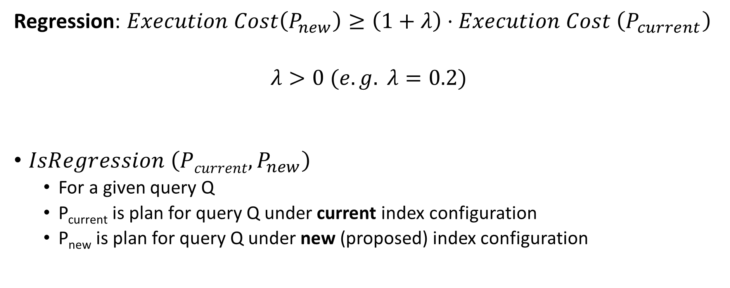
Regression Detection
Regression: $Execution Cost\left(P_{new}\right)≥\left(1+λ\right)⋅Execution Cost \left(P_{current}\right)$
$$λ>0 (e.g. λ=0.2)$$
$IsRegression \left(Pcurrent, P_{new}\right)$
  For a given query Q
  P_{current} is plan for query Q under current index configuration
  P_{new} is plan for query Q under new (proposed) index configuration

Slide 9
Overview
Existing solutions
Our approach
Architecture
Featurization
Evaluation
Notes:
AI meets AI overview

Slide 10
Existing Solutions for IsRegression
Use Query optimizer estimated cost only
  This is what commercial index tuning tools do
Machine learning based query execution cost prediction [1]
  Learns ML model for cost of each physical operator
  Regression ML task
Li, Jiexing, et al. "Robust estimation of resource consumption for SQL queries using statistical techniques." VLDB 2012

Slide 11
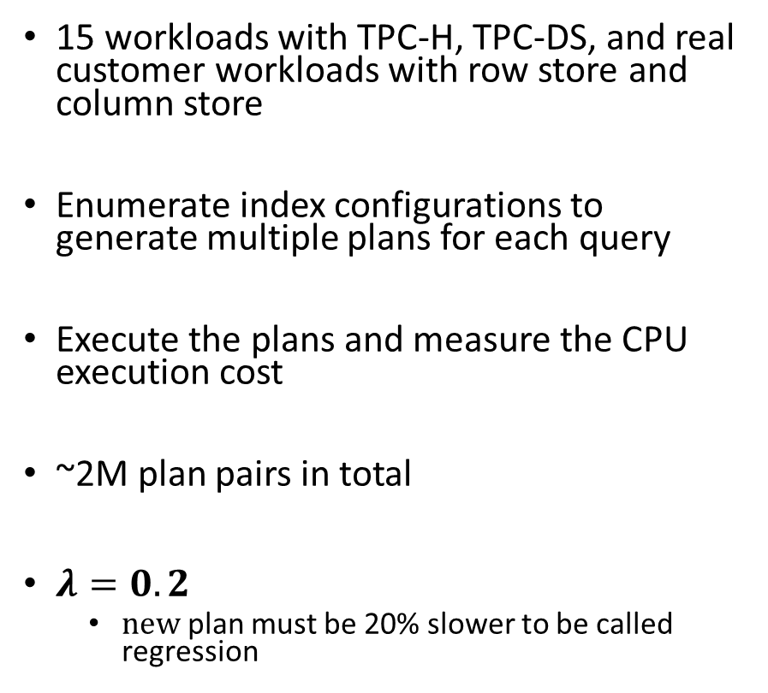
Workloads
Workload | DB Size | #Tables | Query # | Avg Joins #
TPC-DS 10G | 11 | 24 | 92 | 8
TPC-DS 100G | 88 | 24 | 92 | 8
TPC-H 10G Zipf | 12 | 8 | 22 | 3
TPC-H 100G Zipf | 132 | 8 | 22 | 3
Customer 1 | 88 | 20 | 111 | 6
Customer 2 | 1723 | 23 | 34 | 7
Customer 3 | 45 | 614 | 32 | 8
Customer 4 | 1 | 8 | 125 | 2
Customer 5 | 283 | 3394 | 35 | 7
Customer 6 | 10 | 474 | 311 | 21
Customer 7 | 93 | 22 | 23 | 5
Customer 8 | 0.3 | 129 | 474 | 1
Customer 9 | 49 | 7 | 15 | 2
Customer 10 | 17 | 32 | 10 | 8
Customer 11 | 7 | 81 | 399 | 1
15 workloads with TPC-H, TPC-DS, and real customer workloads with row store and column store
Enumerate index configurations to generate multiple plans for each query
Execute the plans and measure the CPU execution cost
~2M plan pairs in total
$λ=0.2$
  $new$ plan must be 20% slower to be called regression

Slide 12
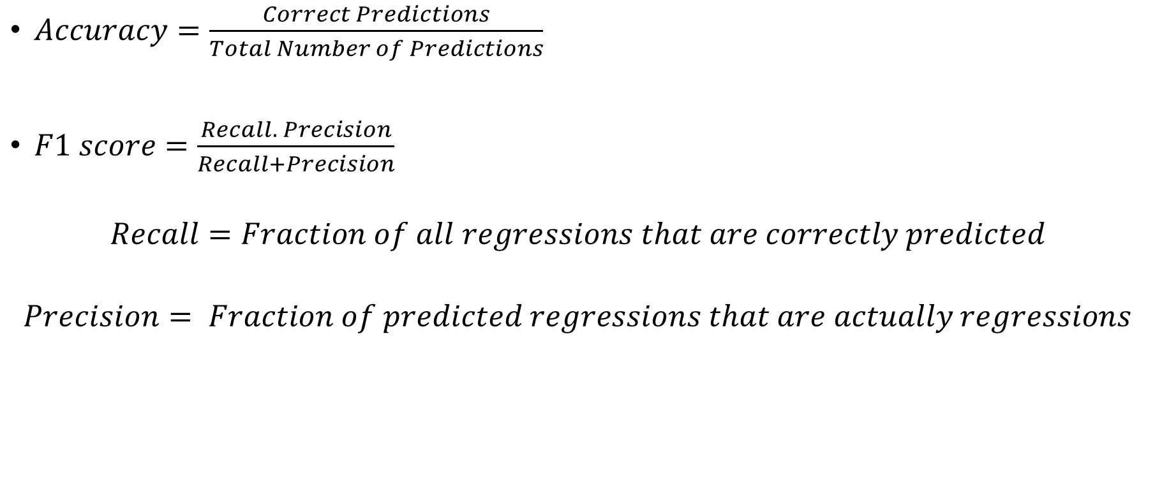
Metrics
$Accuracy=\frac{Correct Predictions}{Total Number of Predictions}$
$F1 score=\frac{Recall. Precision}{Recall+Precision}$
$$Recall=Fraction of all regressions that are correctly predicted$$
$$Precision= Fraction of predicted regressions that are actually regressions$$

Slide 13
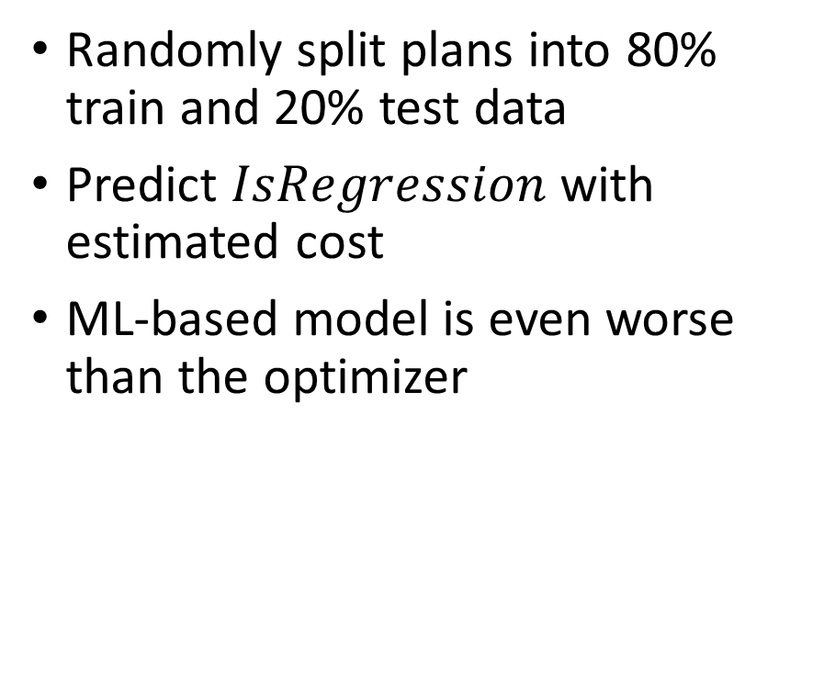
Existing Solutions: Accuracy
Randomly split plans into 80% train and 20% test data
Predict $IsRegression$ with estimated cost
ML-based model is even worse than the optimizer

Slide 14
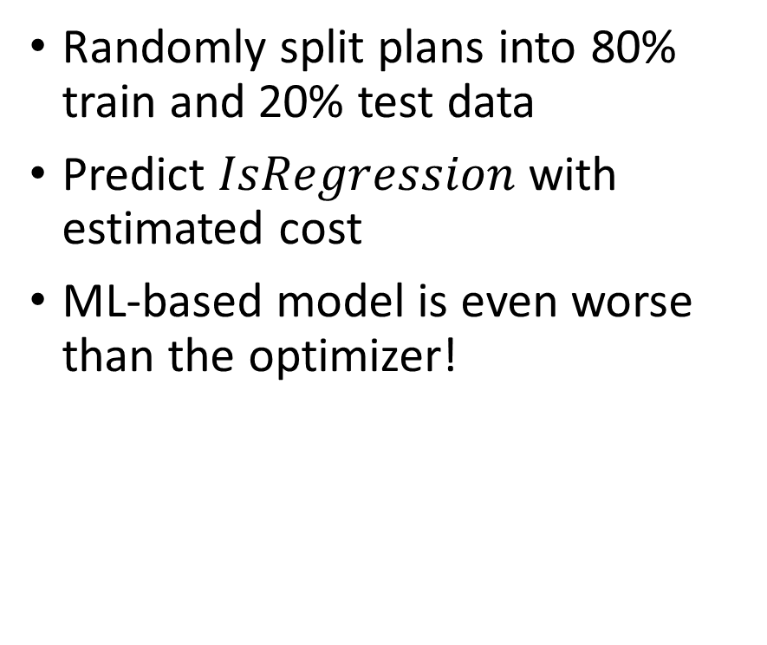
Existing Solutions: F1 score
Randomly split plans into 80% train and 20% test data
Predict $IsRegression$ with estimated cost
ML-based model is even worse than the optimizer!

Slide 15
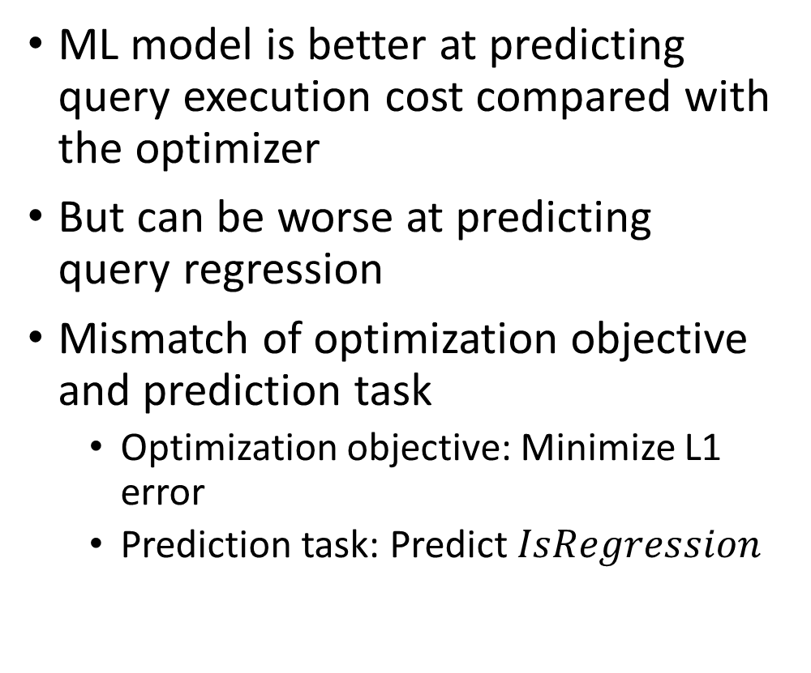
Why is ML-based Prediction Bad?
ML model is better at predicting query execution cost compared with the optimizer
But can be worse at predicting query regression
Mismatch of optimization objective and prediction task
  Optimization objective: Minimize L1 error
  Prediction task: Predict $IsRegression$

Slide 16
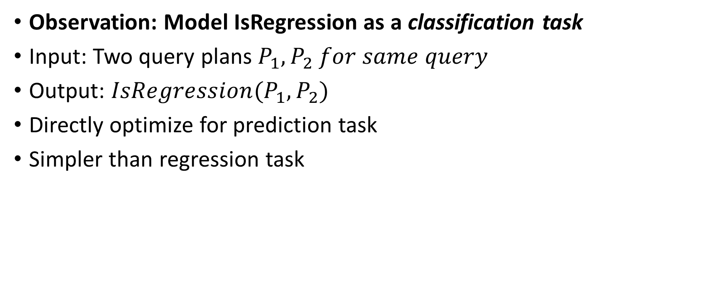
IsRegression: A Classification Task
Observation: Model IsRegression as a classification task
Input: Two query plans $P_{1},P_{2} for same query$
Output: $IsRegression(P_{1},P_{2})$
Directly optimize for prediction task
Simpler than regression task

Slide 17
Overview of Approach
Architecture
  “Global” model trained on execution feedback from multiple databases
Featurization
  Lightweight, simple
  Focus on difference between attributes of two plans
ML Models
  Traditional ML models: Linear regression, Random forest, Boosted trees
  Deep neural network: Fully connected neural networks, Customized neural networks
  Hybrid DNN: Combine random forest with DNNs

Slide 18





Architecture
Leverage execution statistics from multiple databases
  (P_{current}, P_{new})
  E.g. auto-indexing service in Azure SQL DB
Cross-database offline model
Periodically re-train with new data
Application requests
Aggregated execution stats
Deploy model
Cross-database offline model
Cloud Database Service

Slide 19
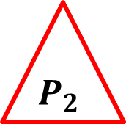

Featurize a Plan Pair
Combine feature vectors of two plans into a single feature vector
Intuition: Capture the change between two plans
  Difference of two feature vectors
  Difference normalized by 1-norm of the vector
  Difference normalized by 1-norm of each feature channel
$$P_{1}$$
Featurization
Combine Feature Vectors
$$P_{2}$$
Featurization

Slide 20
Example: Featurize Estimated Node Cost
Plan P₁
Index_Seek | 0
Index_Scan | 90
Hash_Join | 20
NLJ | 0
Merge_Join | 0
… | …
Index_Seek | 15
Index_Scan | 30
Hash_Join | 0
NLJ | 50
Merge_Join | 0
… | …
Est Node Cost(P₁)
Est Node Cost(P₂)
Index_Seek | 15
Index_Scan | -60
Hash_Join | -20
NLJ | 50
Merge_Join | 0
… | …
Plan P₂
Est Node Cost (P₂ – P₁)

Slide 21
Example: Featurize Subtree Rows
Plan P₁
Index_Seek | 0
Index_Scan | 3000
Hash_Join | 3200
NLJ | 0
Merge_Join | 0
… | …
Index_Seek | 500
Index_Scan | 1000
Hash_Join | 0
NLJ | 1700
Merge_Join | 0
… | …
Subtree Rows (P₁)
Index_Seek | 500
Index_Scan | -2000
Hash_Join | -3200
NLJ | -1700
Merge_Join | 0
… | …
Subtree Rows (P₂)
Plan P₂
Subtree Rows
(P₂ - P₁)
Notes:
Sum up all the rows in its subtree (including the node itself). This tries to capture the structural information of the node, e.g., how deep its subtree is.

Slide 22
Evaluation

Slide 23
Model Evaluation
Training data: Three split modes with increasing data distribution difference
  Split by pair, plan, query
Baselines
  Query Optimizer cost
  Operator model: Predict query plan cost based on operator cost

Slide 24
Regression vs. Classification (Accuracy)
Randomly split plans into 80% train and 20% test data
Classifier reduces 6x error compared with the optimizer!
Notes:
Classifier details: random forest with 250 trees, gini for impurity score, impurity threshold for split is set to 1e-6, minimal sample on leaf is 1. No other hyperparameters.

Slide 25
Regression vs. Classification (F1 Score)
Randomly split plans into 80% train and 20% test data
Classifier reduces 5x error compared with the optimizer!
Notes:
Classifier details: random forest with 250 trees, gini for impurity score, impurity threshold for split is set to 1e-6, minimal sample on leaf is 1. No other hyperparameters.

Slide 26
Accuracy on Unseen Data Distribution
Randomly split data by plans vs. queries
Prediction performance degrades with new queries
Notes:
I suggest NOT to present the full bar because it is a bit confusing why the optimizer’s score drops when splitting the data by database.
The reason is that when we split data by pair / plan / query, we merge all the data points and the number of the data points is different from each database.
When we split the data by databases, we average the results over each database. So the result is normalized per database.
It will be a bit complicated to explain all these. I suggest put this as a back up slide.

Slide 27
F1 Score on Unseen Data Distribution
Randomly split data by plans vs. queries
Prediction performance degrades with new queries
Notes:
I suggest NOT to present the full bar because it is a bit confusing why the optimizer’s score drops when splitting the data by database.
The reason is that when we split data by pair / plan / query, we merge all the data points and the number of the data points is different from each database.
When we split the data by databases, we average the results over each database. So the result is normalized per database.
It will be a bit complicated to explain all these. I suggest put this as a back up slide.

Slide 28
Extensions (described in paper)
Adaptation to current database
  Learn local model on each database
  Combine with global offline model
Integration with index tuning tools
  Simple approach: reject any configuration that is flagged as regression
  Can be too conservative when workload contains many queries/updates
Experiments on adaption, end-to-end results with index tuning

Slide 29
Overhead of ML Models
Training Cost
  Offline Model
    Traditional models: 10s of minutes on CPU
    DNNs and Hybrid DNNs: Hours on GPU
  Local model training
    A few minutes on CPU
Memory consumption: 10s of MB
Inference Time
  Traditional models: sub-millisecond on CPU
  DNNs and Hybrid DNNs: milliseconds on CPU

Slide 30
Takeaways / Future Work
Ability to predict query regression with high accuracy can be valuable
Feedback from query execution on different configurations appears to contain enough signal…
  …even with simplistic featurization, simple ML models
Future work
  Effective integration into index tuning tools (workload-level)
  Can IsRegression be used in query optimizer? (integration into Volcano/Cascades)

Slide 31
Backup Slides

Slide 32
Impact of Query Regression Can Be Significant
Estimated to be 10x faster
turns out to be 10x slower!
Execute TPC-DS queries under different index configurations
Compare query plan pairs of the same query
TPC-DS: ~20% query regresses with index changes
Notes:
Query regressions are common

Slide 33
Partially Connected Deep Neural Network
200
189
98
103
…
4
Channels
10
85
0
-10
…
23
30
30
0
10
…
5
Input
Partially-connected layers
Fully-connected layers
Output

Slide 34
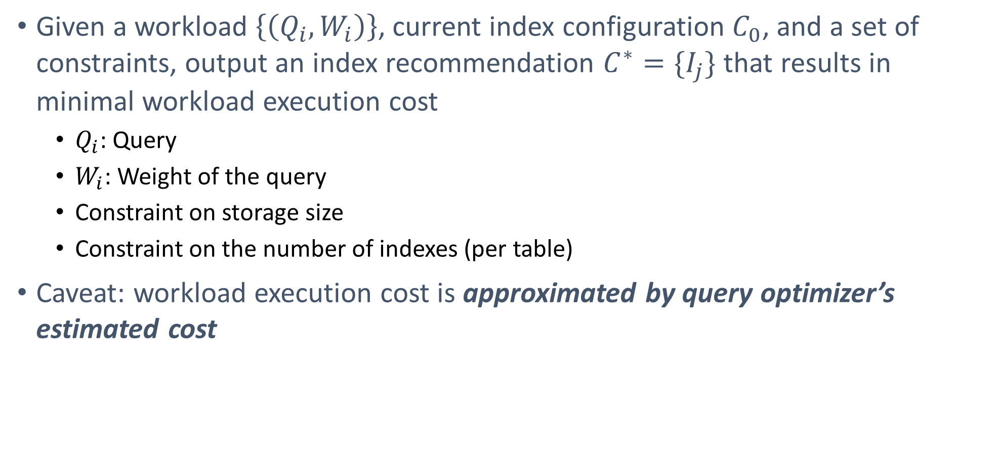
Index Tuning Problem Formulation
Given a workload $\left\{\left(Q_{i}, W_{i}\right)\right\}$, current index configuration $C_{0}$, and a set of constraints, output an index recommendation $C^{∗}=\{I_{j}\}$ that results in minimal workload execution cost
  $Q_{i}$: Query
  $W_{i}$: Weight of the query
  Constraint on storage size
  Constraint on the number of indexes (per table)
Caveat: workload execution cost is approximated by query optimizer’s estimated cost

Slide 35
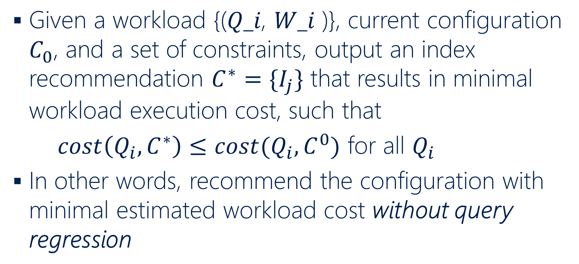
Index Tuning without Query Regression
Given a workload {(𝑄_𝑖, 𝑊_𝑖 )}, current configuration $C_{0}$, and a set of constraints, output an index recommendation $C^{∗}=\{I_{j}\}$ that results in minimal workload execution cost, such that
$cost\left(Q_{i}, C^{∗}\right)≤cost(Q_{i}, C^{0})$ for all $Q_{i}$
In other words, recommend the configuration with minimal estimated workload cost without query regression

Slide 36
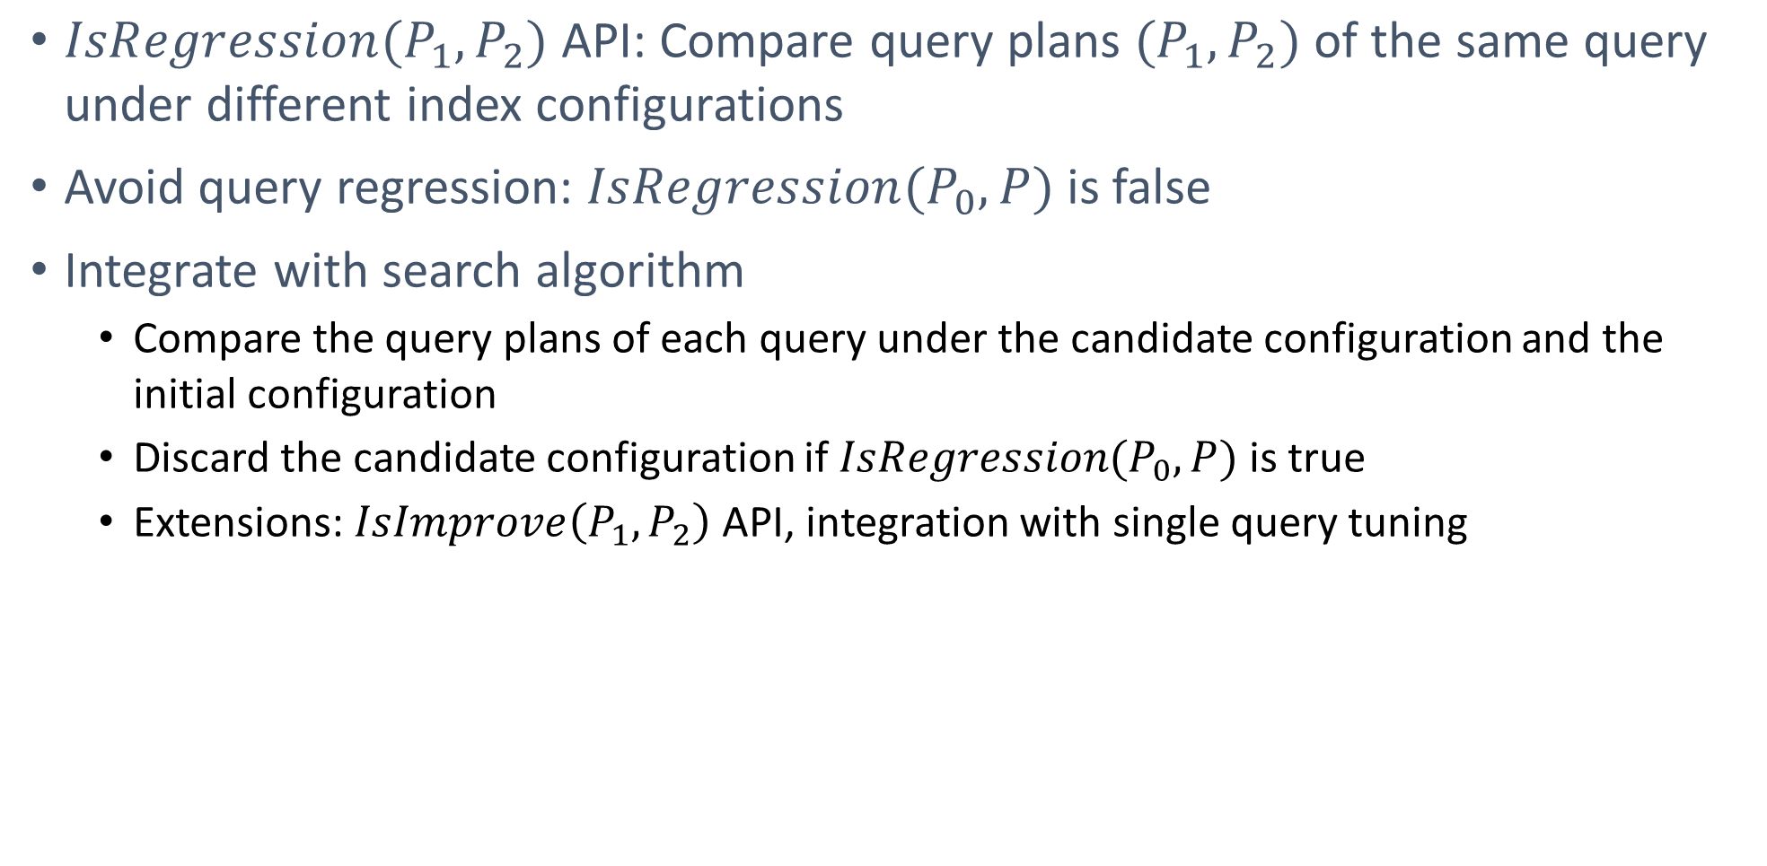
Problem Formulation
$IsRegression(P_{1},P_{2})$ API: Compare query plans $(P_{1},P_{2})$ of the same query under different index configurations
Avoid query regression: $IsRegression(P_{0},P)$ is false
Integrate with search algorithm
  Compare the query plans of each query under the candidate configuration and the initial configuration
  Discard the candidate configuration if $IsRegression(P_{0},P)$ is true
  Extensions: $IsImprove\left(P_{1},P_{2}\right)$ API, integration with single query tuning

Slide 37
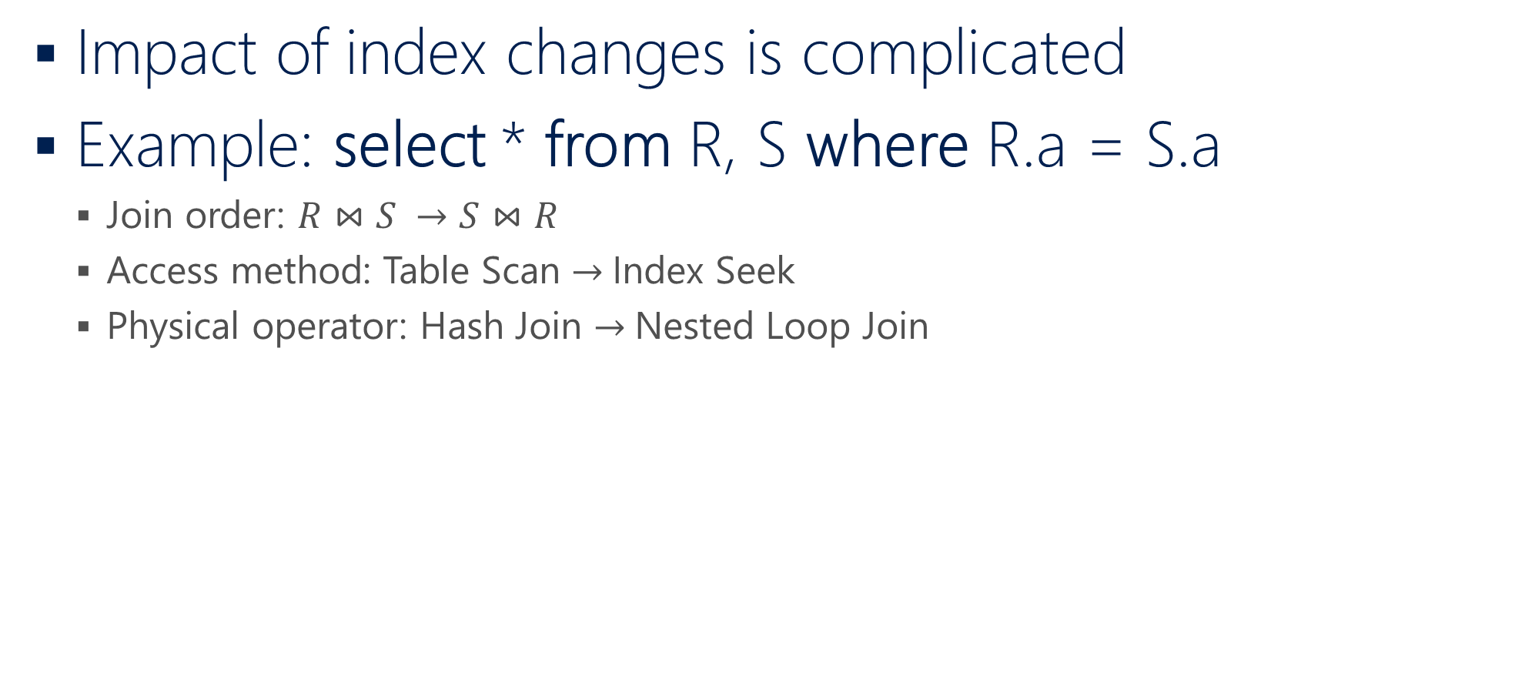
Search-based Index Tuning w/ What-If API
Impact of index changes is complicated
Example: select * from R, S where R.a = S.a
  Join order: $R⋈S →S⋈R$
  Access method: Table Scan $→$Index Seek
  Physical operator: Hash Join $→$Nested Loop Join
Hash Join
350
Nested Loop Join
200
150
200
200
10
Table Scan
Table Scan
Table Scan
Index Seek
R
S
S
Index on R

Slide 38
Search-based Index Tuning w/ What-If API
What-If API: Optimize a query given a set of hypothetical indexes
Greedy-based search algorithm
  Enumerate different combinations of indexes
  Use What-If API to get query plans with hypothetical index configurations
  Compare query plans under different index configurations and recommend the one with minimal estimated workload cost
Critical operation: Compare query plans of the same query under different configurations

Slide 39
Experiment Setup
Workload
  15 benchmarks include TPC-DS, TPC-H, and real customer workloads
  Database size ranges from 200MB to 1.7TB
  Average number of joins range from 0.8 to 8.1
Scenario
  Standalone model performance
  End-to-end index recommendation quality
Metric
  Model prediction: F1 Score
  End-to-end tuning: execution cost reduction and query regressions

Slide 40
Query Regression Hinders Auto Indexing
Auto indexing: Automatically recommend and implement indexes given a workload
Query regression is a major road block for automated indexing in production
  TPC-DS: ~20% query regresses with new index recommendations
Current solution: Indexes get reverted after query regression
  Resources are wasted for implementing the indexes
  Auto indexing gets stuck after query regression

Slide 41
Example: Featurize a Plan
Feature key
  Physical operator details
  Aggregate values of the same
  physical operator
Feature channel
  Measure of work done
  Structural information
Estimated Node Cost
Weighted Leaf Row
Seek_Row_Serial | 10
Scan_Row_Serial | 80
HJ_Row_Serial | 55
NLJ_Row_Serial | 0
MJ_Row_Serial | 0
… | …
Seek_Row_Serial | 200
Scan_Row_Serial | 6000
HJ_Row_Serial | 8600
NLJ_Row_Serial | 0
MJ_Row_Serial | 0
… | …

Slide 42
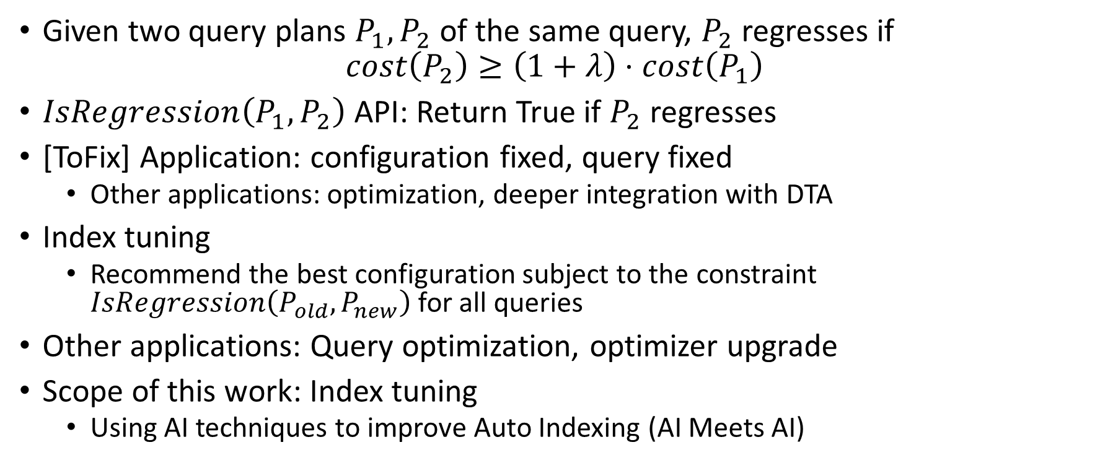
Can We Predict Query Regression?
Given two query plans $P_{1},P_{2}$ of the same query, $P_{2}$ regresses if
$$cost\left(P_{2}\right)≥\left(1+λ\right)⋅cost\left(P_{1}\right)$$
$IsRegression\left(P_{1},P_{2}\right)$ API: Return True if $P_{2}$ regresses
[ToFix] Application: configuration fixed, query fixed
  Other applications: optimization, deeper integration with DTA
Index tuning
  Recommend the best configuration subject to the constraint $IsRegression\left(P_{old}, P_{new}\right)$ for all queries
Other applications: Query optimization, optimizer upgrade
Scope of this work: Index tuning
  Using AI techniques to improve Auto Indexing (AI Meets AI)
Notes:
New API for query regression

Slide 43
When Offline Model Meets New Data (F1 Score, full bar, suggest as backup slide)
Randomly split data by plan pairs, plans, queries, and databases
Prediction performance degrades with new queries
Notes:
I suggest use this as a backup slide because it is a bit confusing why the optimizer’s score drops when splitting the data by database.
The reason is that when we split data by pair / plan / query, we merge all the data points and the number of the data points is different from each database.
When we split the data by databases, we average the results over each database. So the result is normalized per database.
It will be a bit complicated to explain all these. I suggest put this as a back up slide.

Slide 44
When Offline Model Meets New Data (Accuracy, full bar, suggest as backup slide)
Randomly split data by plan pairs, plans, queries, and databases
Prediction performance degrades with new queries
Notes:
I suggest use this as a backup slide because it is a bit confusing why the optimizer’s score drops when splitting the data by database.
The reason is that when we split data by pair / plan / query, we merge all the data points and the number of the data points is different from each database.
When we split the data by databases, we average the results over each database. So the result is normalized per database.
It will be a bit complicated to explain all these. I suggest put this as a back up slide.

Slide 45
Need for Adaptation
Why do we care about new data distribution in a cloud platform?
  New applications and databases deployed
  Diversity in the types of queries executed
  Alternative query plans searched during index tuning but not executed
ML models perform well when the train and test data follow the similar distribution
Need to adapt the ML models to new data
  Adaptive model: traditional ML models
  Transfer learning: DNN-based models

Slide 46
Adaptive Model
Offline model: Trained offline with data from multiple databases
  Suffer from distribution mismatch
Local model: Trained with data from the target database
  Suffer from data scarcity
Adaptive model: Combine the offline and local models

Slide 47
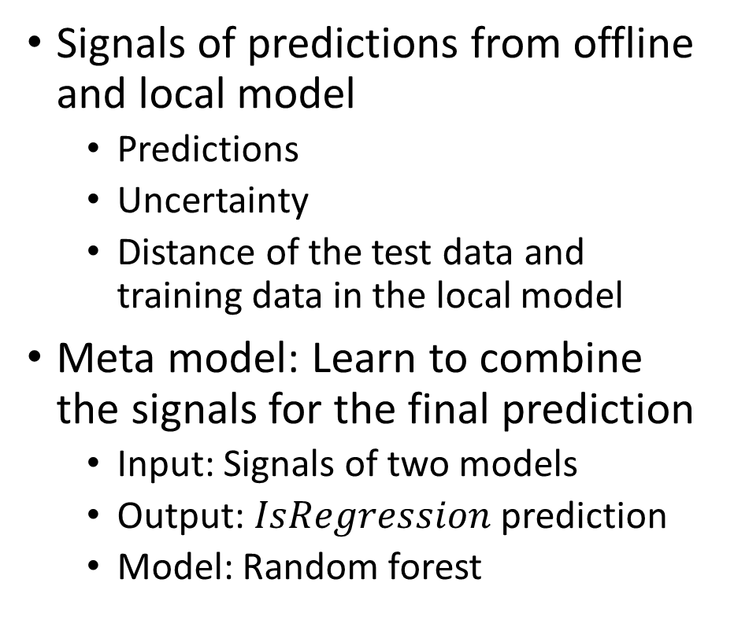
Meta Model for Adaptive Model
Signals of predictions from offline and local model
  Predictions
  Uncertainty
  Distance of the test data and training data in the local model
Meta model: Learn to combine the signals for the final prediction
  Input: Signals of two models
  Output: $IsRegression$ prediction
  Model: Random forest
Offline Model
Signals
Meta Model
Local Model
Signals

Slide 48

Architecture with Offline and Local Models
Meta Model
Local Model
Application requests
Aggregated execution stats
Deploy model
Offline Model
Execution History
Cross-database offline model
DBMS Engine
Cloud Database Service

Slide 49
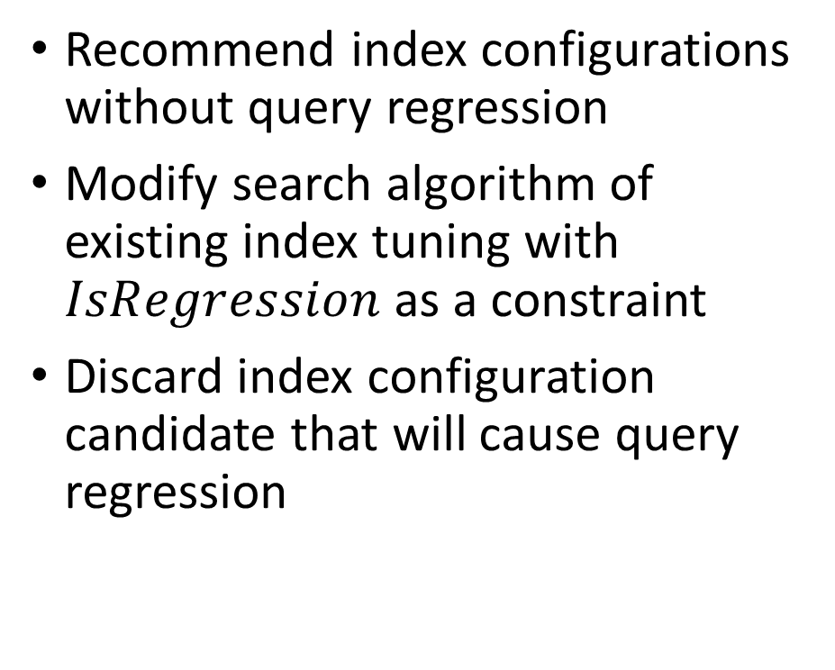
Integration into Index Tuning
Index Tuner
Recommend index configurations without query regression
Modify search algorithm of existing index tuning with $IsRegression$as a constraint
Discard index configuration candidate that will cause query regression
Classifier
<P₁, P₂>
Search Algorithm
Query-level
Regress, Improve
Workload-level
P^{H}
Q, C^{H}
“what-if” API
Metadata
Query Optimizer
Execution History
Query Execution
DBMS Engine
Notes:
Need to talk about the full pipeline, including how the training data is collected

Slide 50
Machine Learning Models
Traditional ML models
  Linear regression
  Random forest
  Boosted trees
Deep neural network
  Fully connected neural networks
  Customized neural networks
Hybrid DNN: combine random forest with DNNs

Slide 51
Workloads
Workload | DB Size | Table # | Query # | Avg Joins #
TPC-DS 10G | 11 | 24 | 92 | 8
TPC-DS 100G | 88 | 24 | 92 | 8
TPC-H 10G Zipf | 12 | 8 | 22 | 3
TPC-H 100G Zipf | 132 | 8 | 22 | 3
Customer 1 | 88 | 20 | 111 | 6
Customer 2 | 1723 | 23 | 34 | 7
Customer 3 | 45 | 614 | 32 | 8
Customer 4 | 1 | 8 | 125 | 2
Customer 5 | 283 | 3394 | 35 | 7
Customer 6 | 10 | 474 | 311 | 21
Customer 7 | 93 | 22 | 23 | 5
Customer 8 | 0.3 | 129 | 474 | 1
Customer 9 | 49 | 7 | 15 | 2
Customer 10 | 17 | 32 | 10 | 8
Customer 11 | 7 | 81 | 399 | 1
15 workloads with TPC-H, TPC-DS, and real customer workloads with row store and column store
Enumerate index configurations to generate multiple plans for each query
Execute the plans and measure the CPU execution cost
~2M plan pairs in total

Slide 52
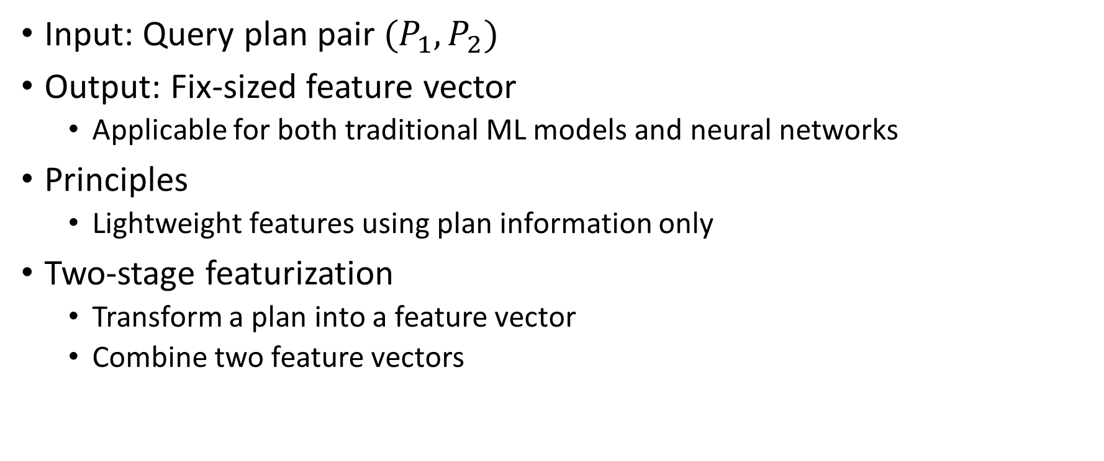
Featurization
Input: Query plan pair $(P_{1},P_{2})$
Output: Fix-sized feature vector
  Applicable for both traditional ML models and neural networks
Principles
  Lightweight features using plan information only
Two-stage featurization
  Transform a plan into a feature vector
  Combine two feature vectors

Slide 53
Transform a Plan into a Feature Vector
Feature key
  Physical operator details
  Aggregate values of the same type of physical operator, i.e., fixed dimension
Feature channel
  Ways to measure of work done and structural information
  Multiple channels to encode different types of information

Slide 54
Adaptive Models (F1 Score)
Notes:
Note that the test F1 / accuracy numbers are slightly different from previous experiments because their test data are slightly different in the way how the experiment runs and evaluates.
In this case, the data is gradually leaked in to the system and the evaluation is done on the rest of the plans (that are not leaked).

Slide 55
Adaptive Models (Accuracy)

Slide 56
Regression vs. Classification (with other regression models, suggest as back up slide)
Up to 5x error reduction
Notes:
Operator model: Jiexing’s model
Plan model: use our featurization to train a regressor to predict cost, then compute IsRegression with the predicted cost.
Pair model: use our featurization to train a regressor to predict the cost ratio (new / old), then compute IsRegression with the predicted ratio
Classifier: random forest

Slide 57
Offline Classification Model (F1 Score)

Slide 58
Offline Classification Model (Accuracy)

Slide 59
Offline Classification Model (F1 Score w/o DNN)

Slide 60
Offline Classification Model (Accuracy w/o DNN)

Slide 61
Offline Classification Model (F1 Score, minimal)

Slide 62
Offline Classification Model (Accuracy minimal)

Slide 63
End-to-End Recommendation
Baseline
  Opt: Optimizer’s estimated cost
  OptTr: Optimizer’s estimated cost with a threshold
Continuous tuning with up to 10 iterations
  Tuning stops if a fixed point is reached
Model
  Offline model is trained with all data collected offline
  Adapt the offline model to new plans executed from prior iterations
Revert indexes upon query regression
  Compare the execution cost after such indexes reverted

Slide 64
End-to-End Recommendation
Similar or more improvement with less regressions

