Slide 1


Co-Attentive Multi-Task Learning for Explainable Recommendation
The 28th International Joint Conference on Artificial Intelligence (IJCAI 2019)
August 10-16, 2019, Macao, China
Zhongxia Chen^{1,2}, Xiting Wang², Xing Xie², Tong Wu³,
Guoqing Bu³, Yining Wang³ and Enhong Chen¹
¹University of Science and Technology of China
²Microsoft Research Asia
³CFETS Information Technology (Shanghai) Co., Ltd.
August 13, 2019

Slide 2




Background
Personalized recommendation has become a major technique for helping users handle huge amounts of online content
Recommender systems remain mostly black boxes
Except for accuracy, there is a growing interest in modeling explainability
Providing explanations can increase user trust, improve satisfaction, and persuade the users to buy or try an item
This is a very good documentary about the battle of the Thermopylae.
A Black-box
Recommender System
An Explainable
Recommender System
Notes:
In nowadays, personalized recommendation has become a major technique for helping users handle huge amounts of online content. However, most recommender systems are just like black-boxes, there is no any natural language explanation and user do not know why the system recommends such an item. Thus except for accuracy there is a growing interesting on the explainability. Evidence has shown that personalized recommendation has become a major technique for helping users handle huge amounts of online content.

Slide 3
Motivation
A fundamental question of explainable recommendation:
  How we jointly optimize accuracy and explainability for explainable recommendation?
Most existing methods consider the two goals in separate steps or only focus on one of the goals
  Post-hoc
  Embedded
  Simple jointly learning method
Notes:
A fundamental question is how we jointly optimize accuracy and explainability. Most existing methods consider the two goals in separate steps or only focus on one of them. they are mainly three kinds of method

Slide 4
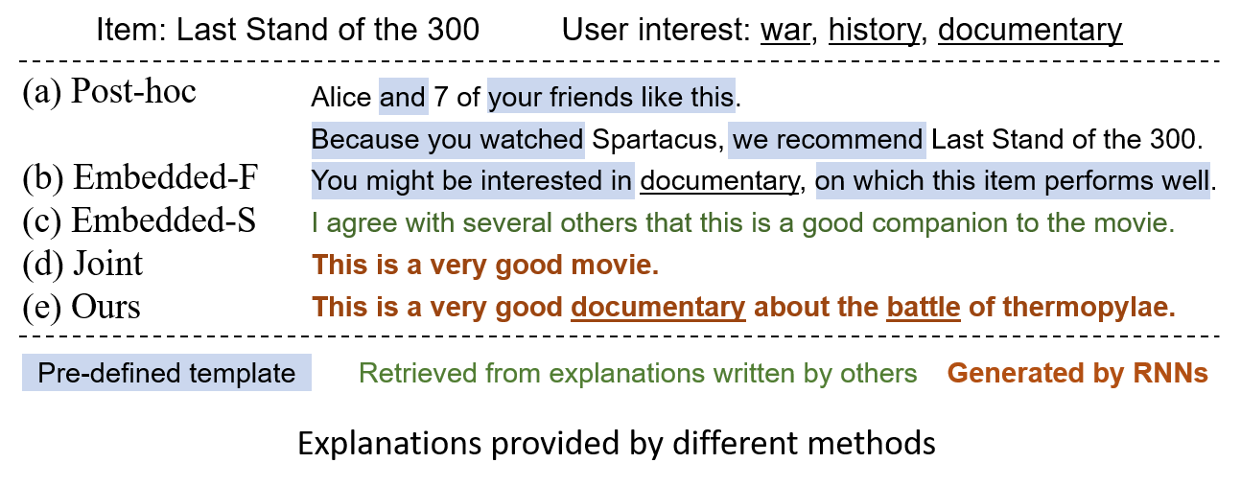







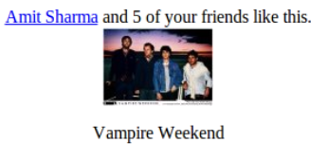
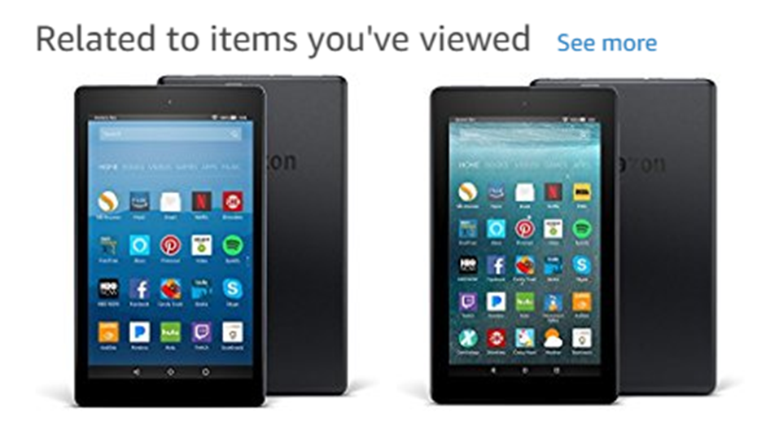
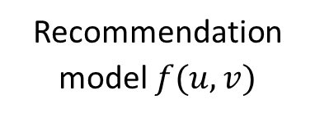
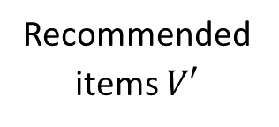



Related Works—Post-hoc
Users $U$
Recommendation model $f(u,v)$
Recommended items $V′$
Explanation Method
Explanation $z$
Items $V$
Notes:
the first one is post-hoc. Here at the upper right corner, we show the different explanations of the movie: last stand of the 300 generated by different methods. Post-hoc method explain a black-box model after it is trained.

Slide 5
Related Works—Post-hoc
Explain a black-box model after it is trained
  Separately consider accuracy and explainability
  Information embedded inside the recommendation models are ignored
Pros and cons
  Highly readable and persuasive
  Not reflect model’s actual reasoning
  Difficult to generate in non-social scenarios
  Limited diversity
Notes:
hey separately consider accuracy and explainability and information embedded inside the recommendation models are ignored. So such explanations may not reflect the models's actual reasoning, difficult to generate in non-social scenarios and have limited diversity.

Slide 6
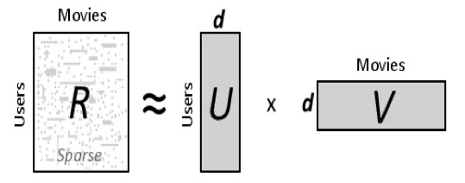
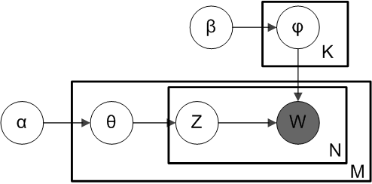
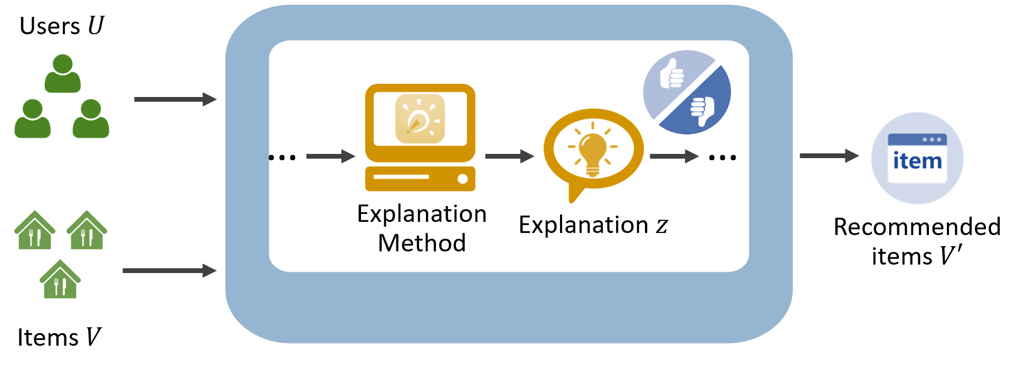
Related Works—Embedded
Notes:
The second is embedded methods, they integrate the explanation process into the construction of the recommendation model. Some latent representations are used to obtain explanations.

Slide 7
Related Works—Embedded
Integrate the explanation process into the construction of the recommendation model
  Retrieval-based
  Consist of features or sentences
  But only focus on recommendation accuracy
  Explainability is not included in the optimization goal
Issues
  Difficult to guarantee the quality of the explanations
  Fail to provide a highly personalized explanation when data is sparse
  Legal issues (copyright)
Notes:
They usually retrieve useful features or sentences to be the explanation. However, they only focus on recommendation accuracy and explainability is not included in the optimization goal. Thus they are difficult to guarantee the quality of the explanations.

Slide 8
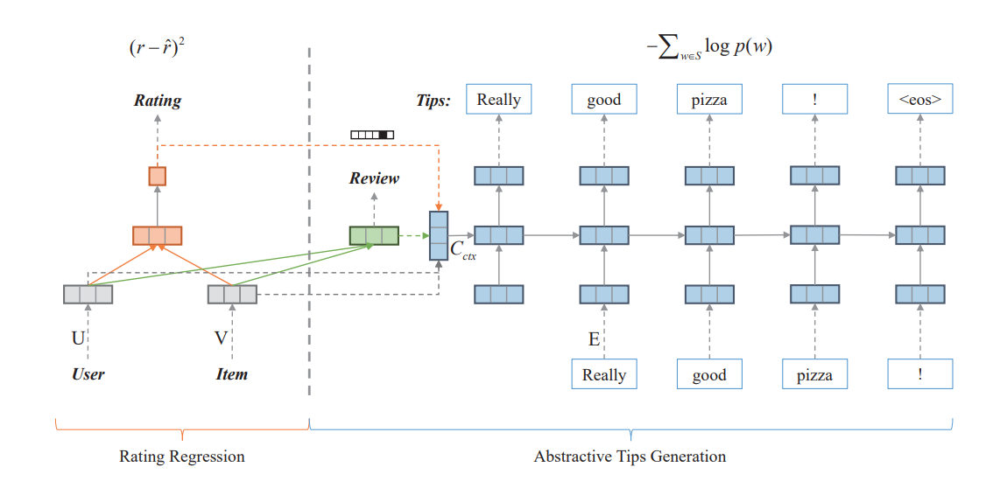
Related Works—Joint
Notes:
The last one is a simple jointly learning method that use a multi-task model to learn shared user/item representations for recommendation and explanation.

Slide 9
Related Works—Joint
A simple jointly learning method
  Only shares user/item latent representations
Issues
  The shared representations are not explainable and fail to provide explicit constraints on the explanations
  User/item embeddings do not contain sufficient information about deep user-item interactions
  Generated explanations are usually quite general
Notes:
However, the shared representations are not explainable and fail to provide explicit constraints on the explanations. This simple structure is not capable for generating informative explanations. Thus the generated explanations are usually quite general.

Slide 10
Contributions
We propose a Co-Attentive Multi-task Learning (CAML) model that tightly couples the recommendation task and the explanation task
  Design an encoder-selector-decoder architecture for multi-task learning based on cognitive psychology
  Propose a hierarchical co-attentive selector to effectively control the cross knowledge transferred from both tasks by incorporating multi-pointer networks
  Our method improves both explainability and accuracy
Notes:
o in this paper, we propose a Co-Attentive Multi-task Learning model that tightly couples both the recommendation and explanation task. We design an encoder-selector-decoder architecture for multi-task learning based on cognitive psychology. We propose a hierarchical co-attentive selector to effectively control the cross knowledge transfer for both tasks by incorporating multi-pointer networks. Experimental results show that our method improves both explainability and accuracy.

Slide 11
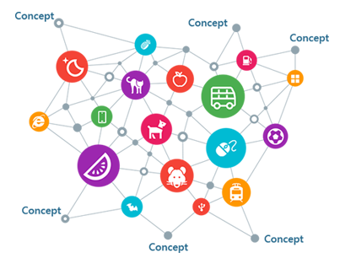
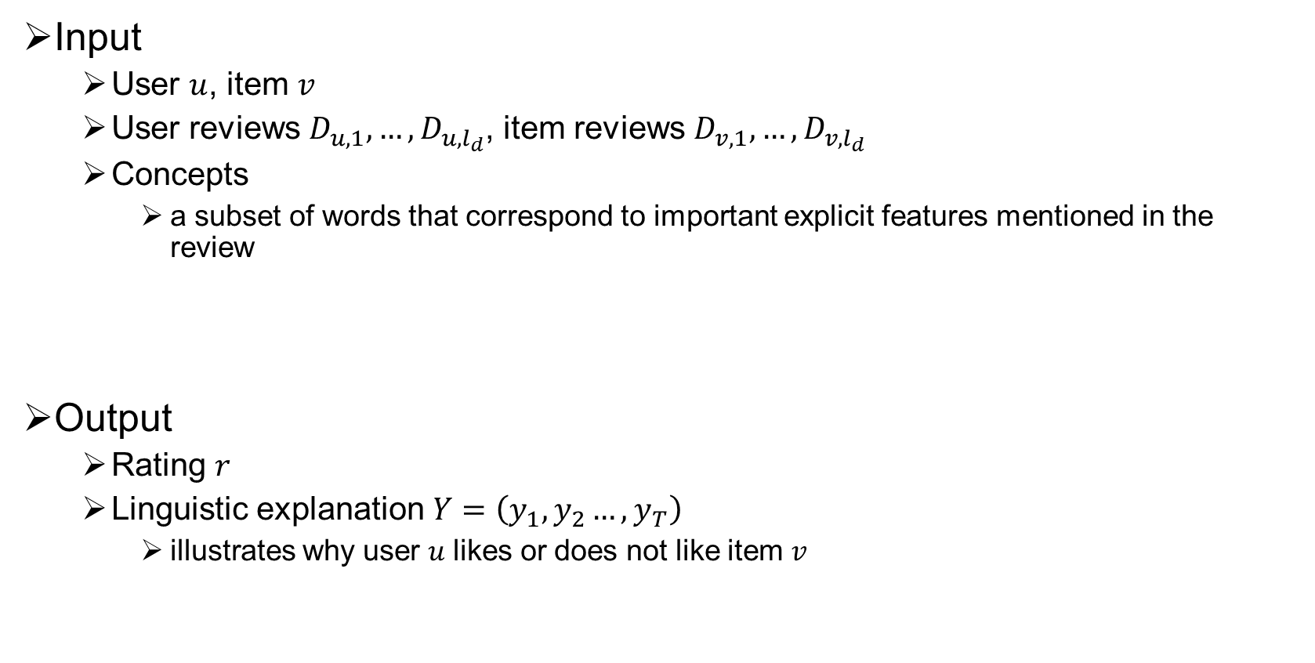
Problem Formulation
Input
  User $u$, item $v$
  User reviews $D_{u,1},…,D_{u,l_{d}}$, item reviews $D_{v,1},…,D_{v,l_{d}}$
  Concepts
    a subset of words that correspond to important explicit features mentioned in the review
Output
  Rating 𝑟
  Linguistic explanation $Y=\left(y_{1},y_{2}…,y_{T}\right)$
    illustrates why user 𝑢 likes or does not like item 𝑣
    This is a great little comedy with a catchy song.
Microsoft Concept Graph
Notes:
We first take a glance at the problem formulation. For each user and item , we have their corresponding historical reviews. We also extract some key words called concepts by Microsoft Concept Graph. The output is the rating and the corresponding explanation.

Slide 12
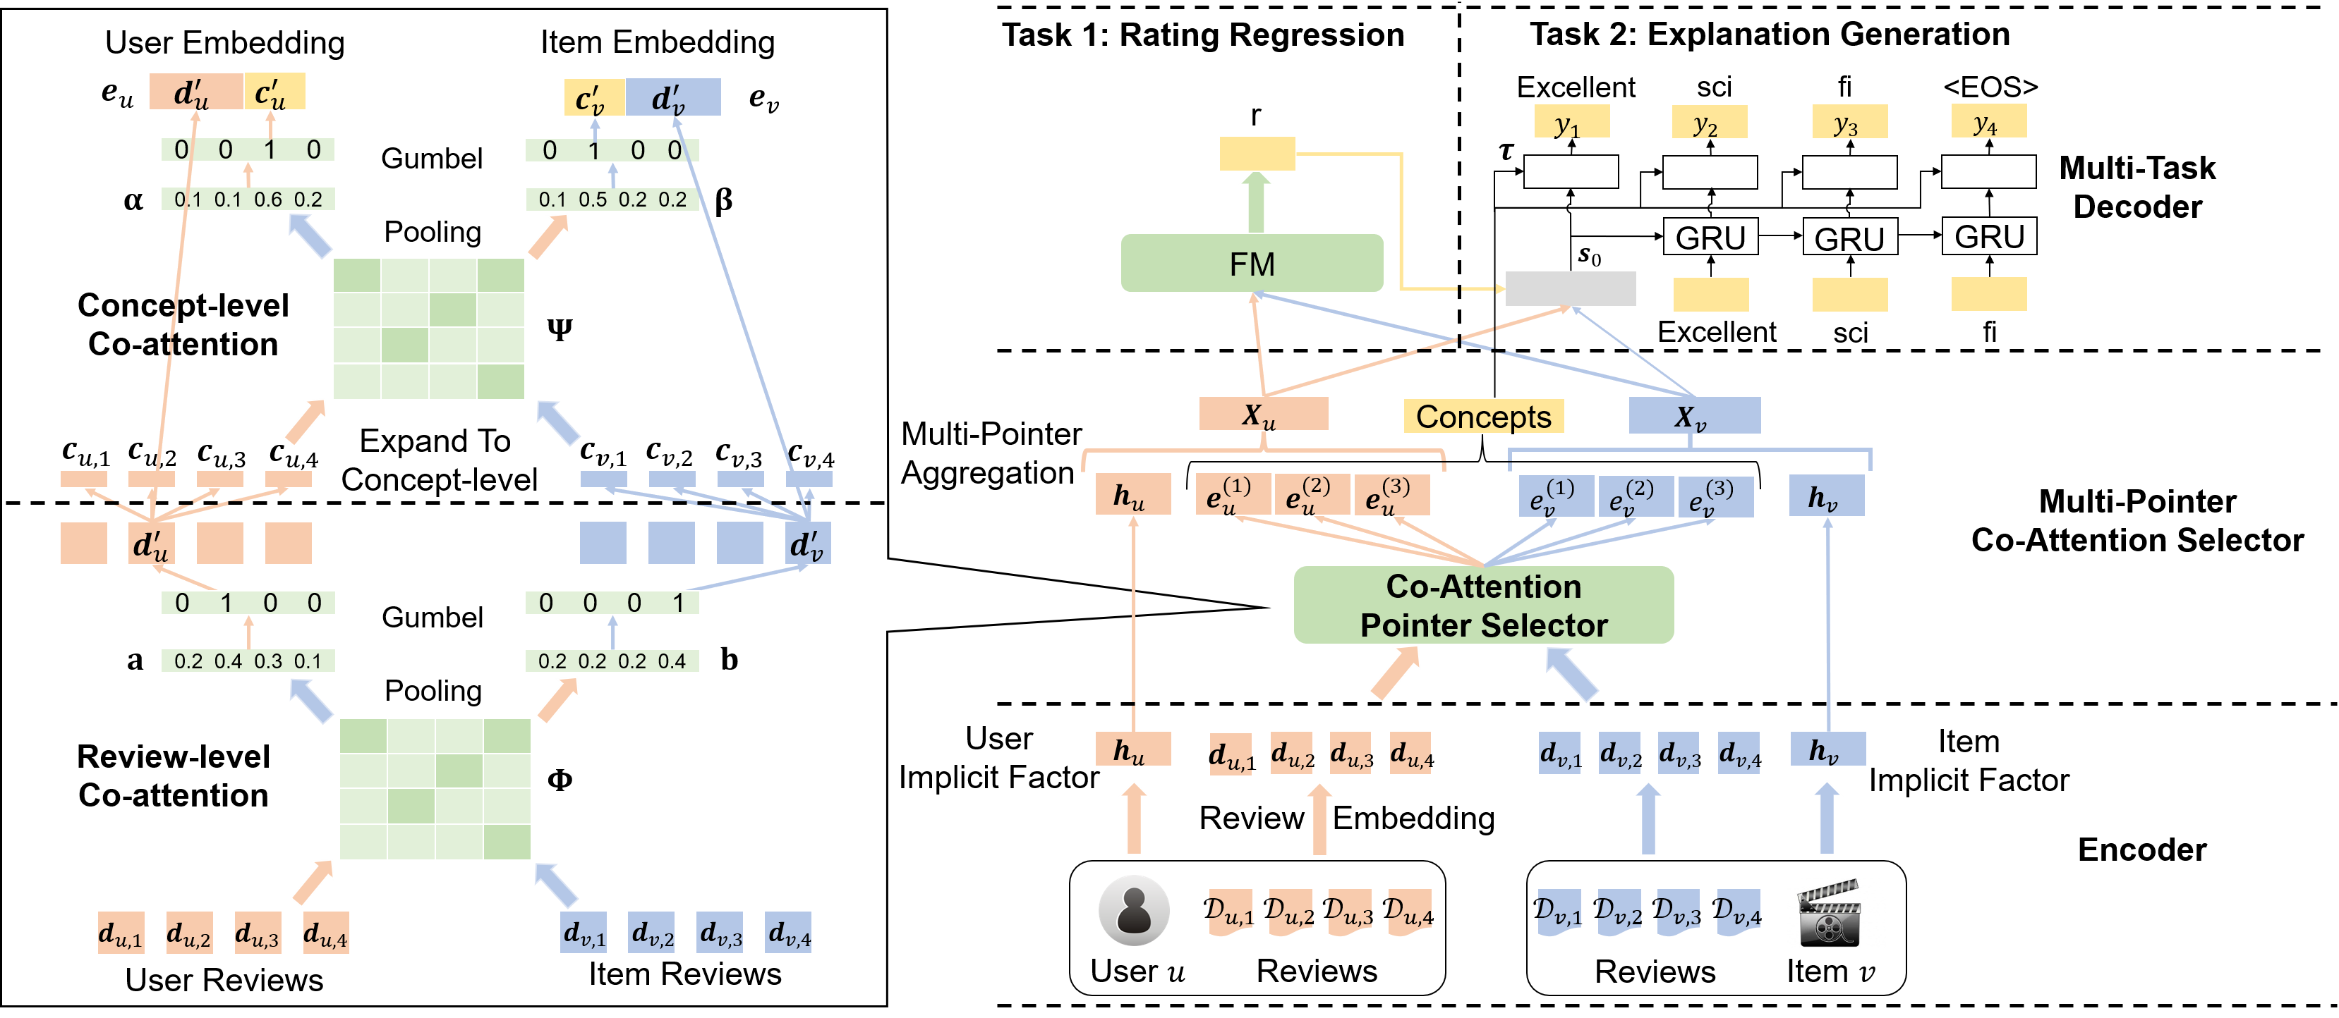



Method
(Retrieval)
(Storage)
(Encoding)
Notes:
Here is our model. The model jointly learning two tasks and consists of three components: encoder, slector and decoder. The idea comes from cognitive psychology. The human cognitive process has three parts: Encoding, that embedding the input information; Storage, select relative information to store; Retrieval, retrieve stored information for corresponding tasks. Let's see them in detail.

Slide 13
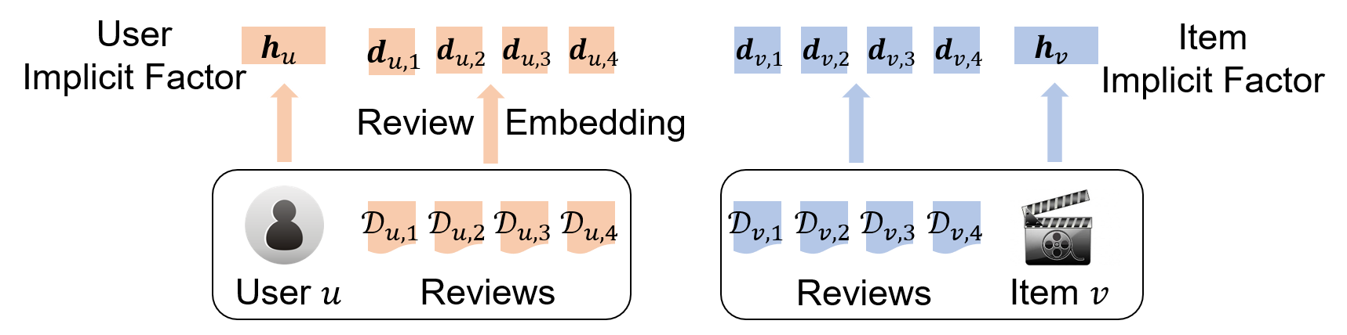

Encoder
Word Encoder
Review Encoder
  $d_{u,i}=\sum_{w∈D_{u,i}}{w}$
User/Item Implicit Factor Encoder
  Complement explicit factors of user/item
Notes:
the encoder consists of word encoder and user/item implicit factor encoder. The initial review embedding is the average of word embeddings in the review.

Slide 14
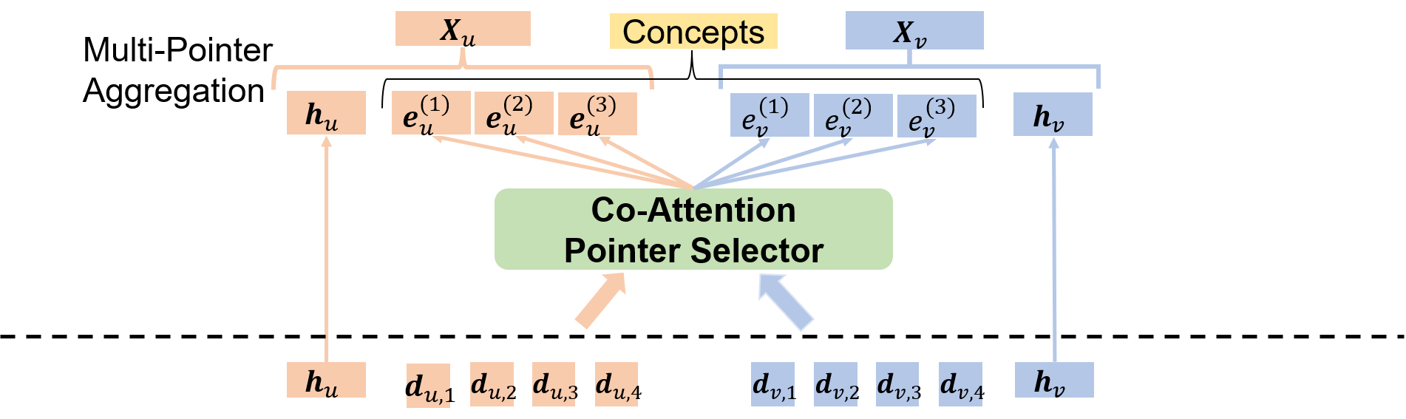
Multi-Pointer Co-Attention Selector
Model the cross knowledge transferred from the two tasks
Advantages of the multi-pointer co-attention networks (MPCN)
  Faster convergence than REINFORCE
  Model deep level user-item interactions
Extend the MPCN to hierarchically select reviews and then concepts
  Review-level co-attention pointer
  Concept-level co-attention pointer
  Multi-pointer aggregation
Notes:
The selector try to select the important information get from the encoder and model the cross knowledge transferred from the two tasks. We here choose multi-pointer co-attention networks considering both the cost and effectiveness. the selector contains both review level and concept level.

Slide 15
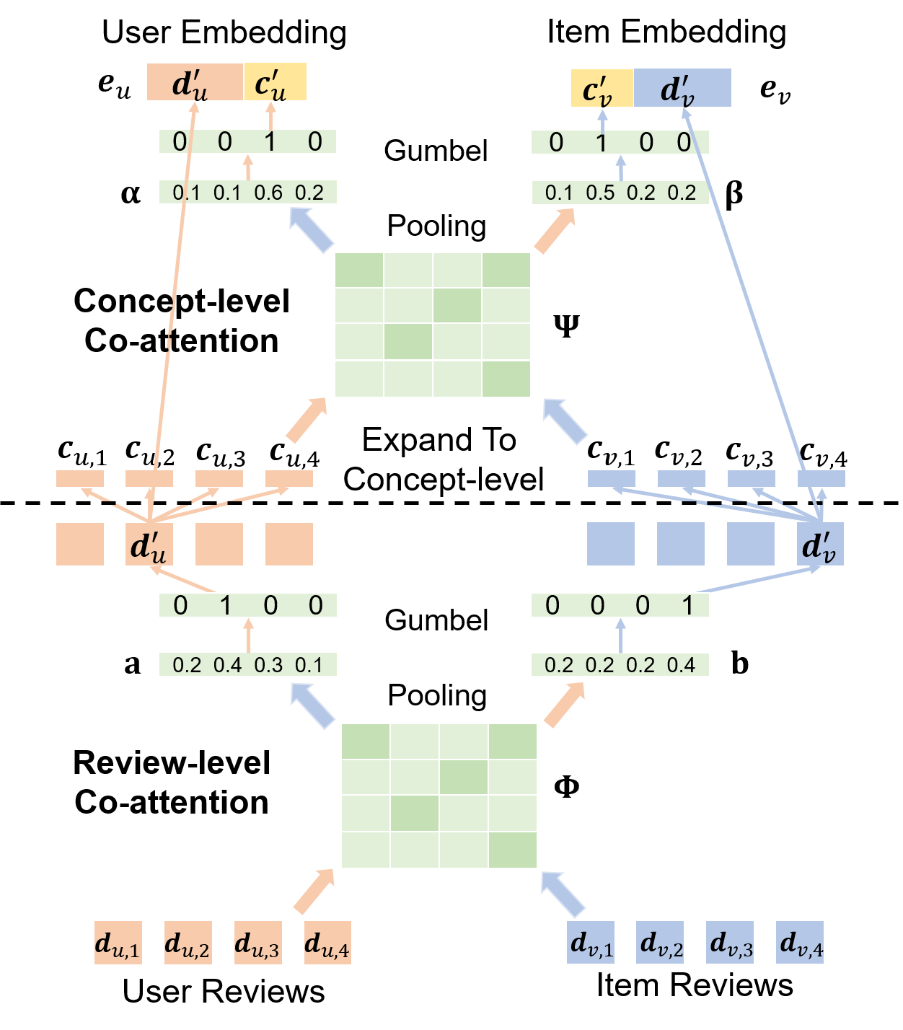

Review-Level Co-Attention Pointer
Review-level Co-attention
  $φ_{i,j}={F\left(d_{u,i}\right)}^{T}W_{d}F(d_{v,j})$
Max-Pooling
  $a_{i}=\max_{j=1,…,l_{d}}{φ_{i,j}}$
  $b_{j}=\max_{i=1,…,l_{d}}{φ_{i,j}}$
Issue on gradient back-propagation
Notes:
We use the bilinear function to calculate the co-attention between user and item reviews and use max-pooling to obtain the importances of each review. We want to select the most important user/item review. Directly using argmax function will cause an issue on gradient back-propagation.

Slide 16
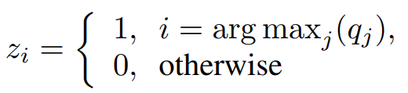

Review-Level Co-Attention Pointer
Gumbel-Softmax
  $q_{i}=\frac{exp⁡(\frac{a_{i}+g_{i}}{τ})}{\sum_{j=1}^{n_{m}}{exp⁡(\frac{a_{j}+g_{i}}{τ})}}$
  $g_{i}$ is the Gumbel noise
Forward pass: Hard attention
Backward pass: continuous gradients
Notes:
Thus we incorperate an advanced gumbel-softmax function to solve this problem.

Slide 17

Concept-Level Co-Attention Pointer
Expand review to concept level
Concept-level Co-attention
  $ψ_{i,j}={F\left(c_{u,i}\right)}^{T}W_{c}F(c_{v,j})$
Mean-Pooling and Gumbel-Softmax
Notes:
After we selected important reviews. We expand this two reviews to concept level to further select important concept in the reviews. The method is similar with the review-level co-attention.

Slide 18
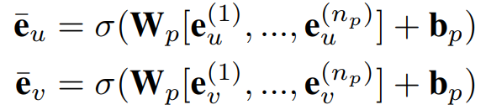
Multi-Pointer Aggregation
Run selector multiple times
Aggregate latent embeddings
  Non-linear layer
Collect selected concepts
Notes:
Finally it is intuitive that when user judge an item, not only one historical review should be taken into consideration, so we run selector multiple times and aggregate these latent embeddings to the final embeddings and collect all the selected concepts.

Slide 19

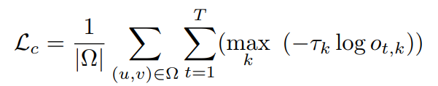
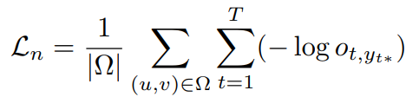

Multi-Task Decoder
Rating prediction
  Factorization machine
Explanation Generation
  RNN decoder
  Concept relevance loss
  Negative log-likelihood loss
Joint learning
Notes:
Then those embeddings are fed into the decoder. We choose FM model to do rating prediction and RNN decoder to generate the explanation. We propose a concept relevance loss to regularize the model tending to generate concept words in the explanation. We hope use this loss to avoid generating some general explanations.

Slide 20
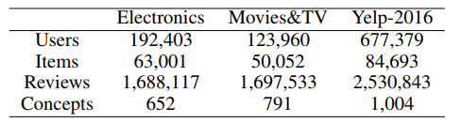
Experiments
Datasets
  Amazon Electronics, Movies&TV
  Yelp
Baselines
  Explainability
    Retrieval-based: Lexrank, NARRE, RLRec
    Generative: NRT
  Rating prediction
    CF: PMF, NMF, SVD++
    Neural: MPCN, NARRE, RLRec, NRT
Metrics
  Explainability: Bleu and ROUGE, Human evaluation
  Rating prediction: RMSE
Notes:
we did our experiments on Amazon datasets and Yelp dataset. We compare our model with several baselines on explainability and accuracy.

Slide 21
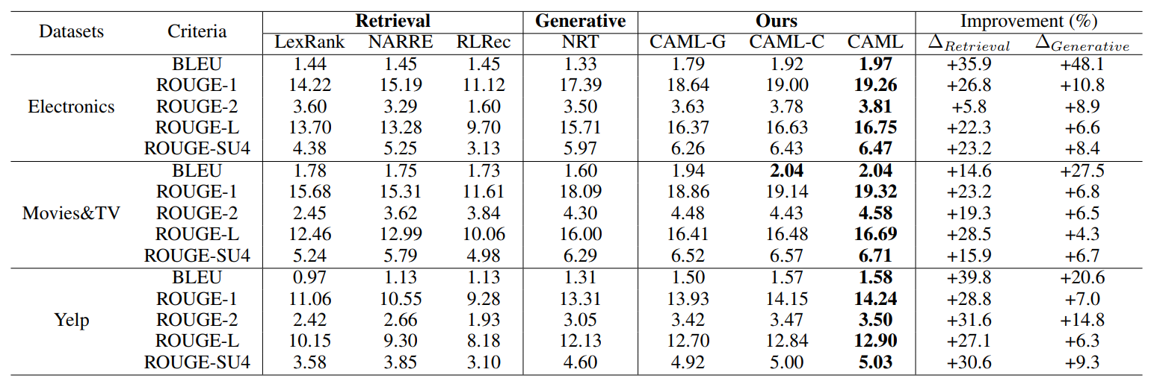
Explainability Results
Notes:
The result shows that our models outperform all the baselines on BLEU and ROUGE. We also did ablation analysis to prove that both multi-task learning and involving concept improve the generation performance.

Slide 22
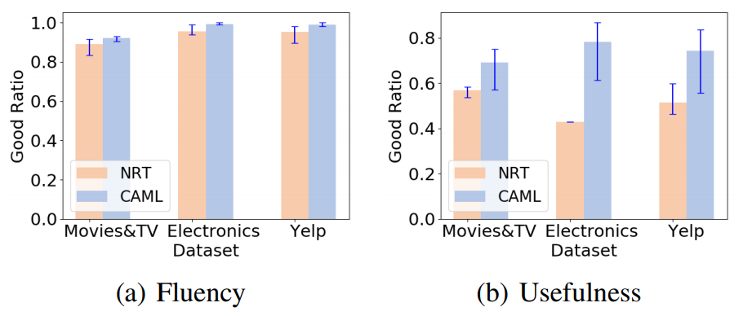
Explainability Results
Human Evaluation
  3 assessors, 100 test cases
Notes:
We also did human evaluation and it shows that our model can generate more fluent and useful explanations.

Slide 23
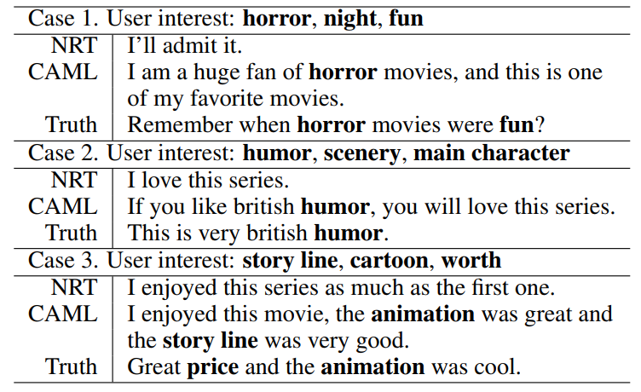
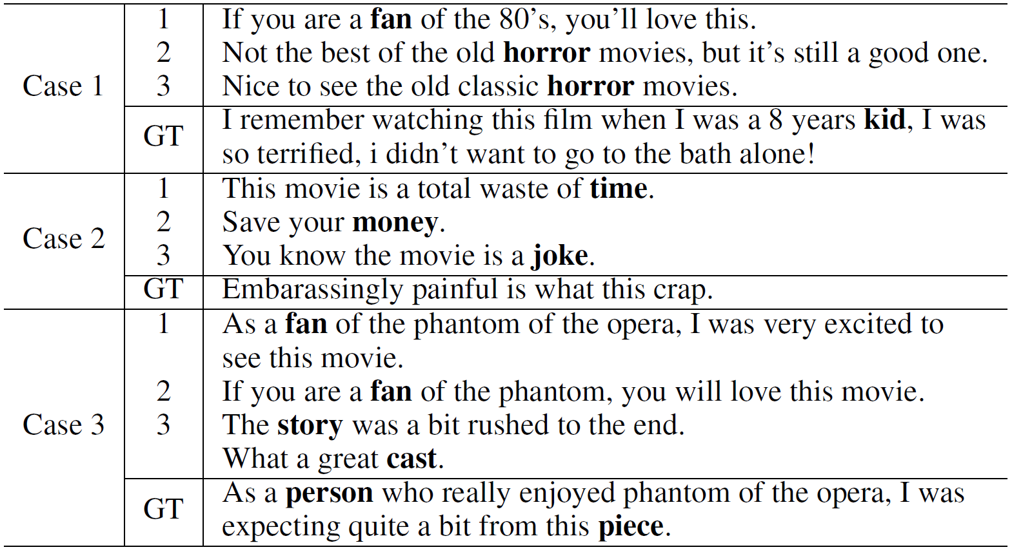
Explainability Results
Case study
Notes:
There are some real cases. From these we can see, our model can generate informative and diverse explanations which hit the user's real interests.

Slide 24
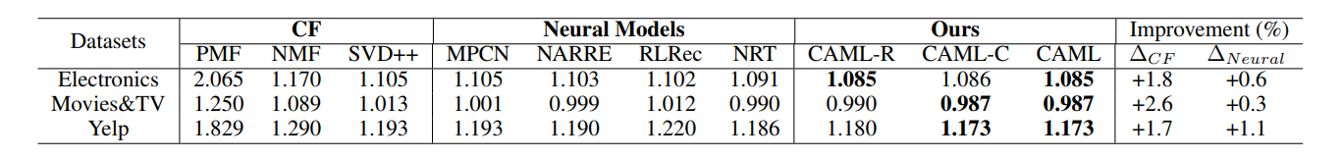
Accuracy Results
Notes:
We also evaluate the accuracy performance of our model. Our model also achieves the best. We also did some ablation analysis.

Slide 25
Conclusion
We propose a co-attentive multi-task learning method which fully exploits the correlations between the recommendation task and the explanation task
We propose an encoder-selector-decoder architecture and a hierarchical co-attentive selector to effectively control the cross knowledge transfer for both tasks
Experiments show that our approach outperforms state-of-the-art baselines on both the accuracy of rating prediction and the quality of generated explanations
Notes:
Here is the conclusion of this work. We propose a co-attentive multi-task learning method and an encoder-selector-decoder structure for explainable recommendation. Experiments show the effectiveness of our model. Thank you very much!

Slide 26
Q&A
Thank You!

