Slide 1

Microsoft Academic Services:
Behind the Scene
May 2021

Slide 2
Overall Architecture
Entity Knowledge
Information Extraction
Conflation & Disambiguation
Publication Data
Index & Serving (MAKES)
Microsoft Academic Graph
Knowledge Refinement & Learning
REST API

Slide 3
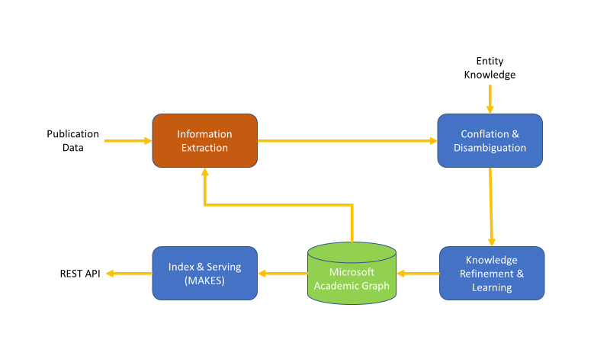
Information Extraction
Identify lexical expressions of entities
  Article titles
  Authors + Affiliations
  Topic keywords
  Citations and Citation Contexts
Lookup and embrace alt expressions
Left undone
  Funding acknowledgment
  Figure/table understanding
Publication/Citation Data
  Made easier by open access
  Crawling entire web becoming overkill

Slide 4
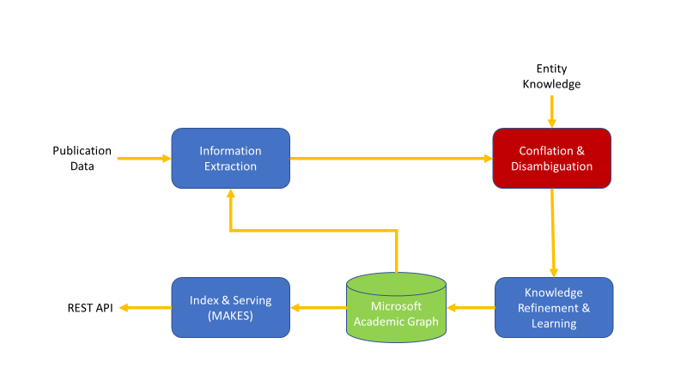
Conflation & Disambiguation
Paper & Paper family
  LSH on article title
  Author sequence
  DOI
Author
  Name key clustering
  Author profile (cf. Ext Knowledge)
  Affiliation and topic expertise
  Co-authorship and venue
External Knowledge
  Author CVs
  Institution homepages
  Journal/Conference homepages

Slide 5
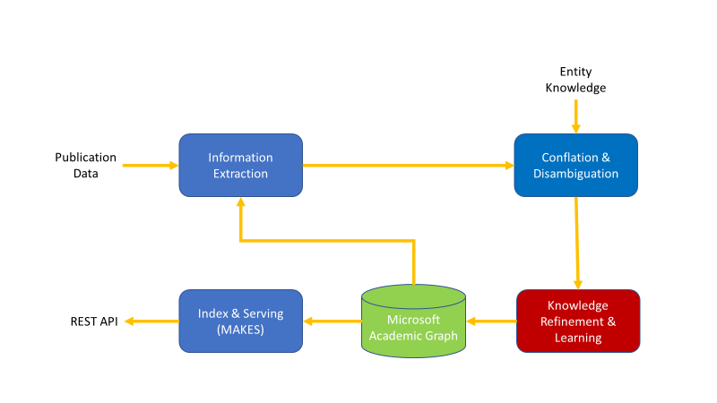
Knowledge Refinement & Learning
Entity creation and attrition
  New authors, journals, institutions
  Topic taxonomy adjustment
    Language/network similarity models
Link strength/missing link prediction
  Related entity recommendation
Saliency assessment
  Temporal eigenvector centrality
  Malicious content (e.g., fake paper/journal) detection

Slide 6
Q/A
Related articles:
https://doi.org/10.3389/FDATA.2019.00045
https://doi.org/10.1162/QSS_A_00021
[www-2021] MATCH: Metadata-Aware Text Classification in A Large Hierarchy (arxiv.org)

