Slide 1
Optimization from Structured Samples for Coverage and Influence Functions
Zhijie Zhang
School of Mathematics and Statistics, Fuzhou University
MSRA Data-Driven Optimization Workshop, 2022.11.26
Based on
W. Chen, X. Sun, J. Zhang and Z. Zhang. Optimization from Structured Samples for Coverage Functions. ICML 2020.
W. Chen, X. Sun, J. Zhang and Z. Zhang. Network Inference and Influence Maximization from samples. ICML 2021.

Slide 2
Introduction

Slide 3
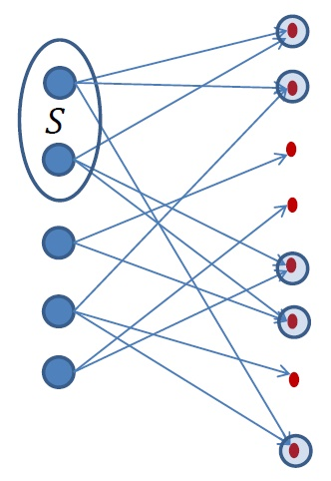


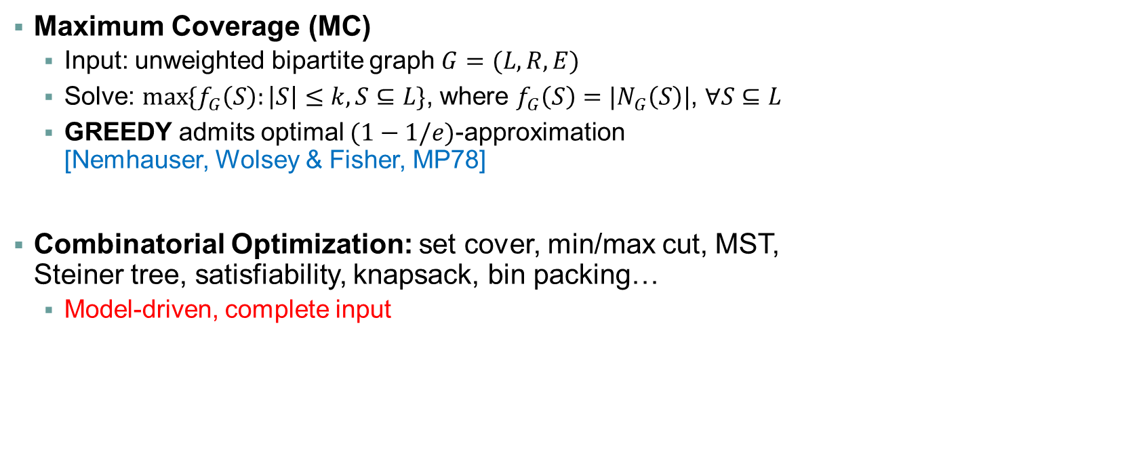

Maximum Coverage (MC)
$$R$$
$$L$$
Maximum Coverage (MC)
  Input: unweighted bipartite graph $G=(L,R,E)$
  Solve: $\max{\{f_{G}\left(S\right):\left|S\right|≤k, S⊆L\}}$, where $f_{G}\left(S\right)=|N_{G}\left(S\right)|$, $∀S⊆L$
  GREEDY admits optimal $(1−1/e)$-approximation
  [Nemhauser, Wolsey & Fisher, MP78]
Combinatorial Optimization: set cover, min/max cut, MST,
Steiner tree, satisfiability, knapsack, bin packing…
  Model-driven, complete input
$$f_{G}\left(S\right)=|N_{G}\left(S\right)|$$

Slide 4







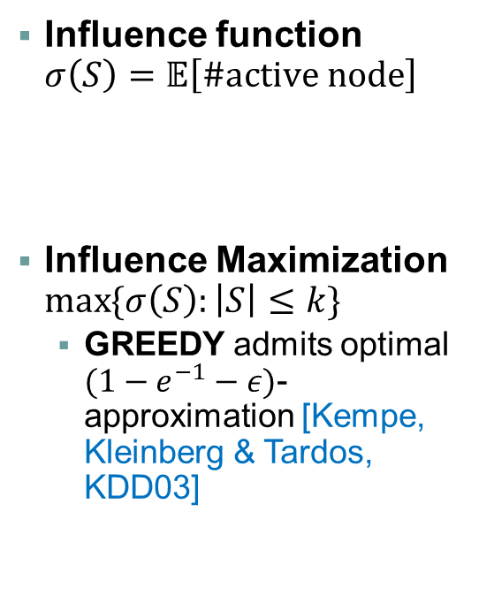







Influence Maximization (IM)
Word-of-mouth effect
$$0.6$$
Influence function $σ\left(S\right)=𝔼\left[\#active node\right]$
Influence Maximization $\max{\{σ\left(S\right):\left|S\right|≤k\}}$
  GREEDY admits optimal $(1−e^{−1}−ε)$-approximation [Kempe, Kleinberg & Tardos, KDD03]
$$0.3$$
$$0.9$$
$$0.7$$
$$0.3$$
$$0.05$$
$$0.95$$
$$0.8$$
$$0.45$$
Viral marketing
$$0.2$$
$$0.4$$
Active node
Seed node

Slide 5
Data-Driven Optimization
In reality, model parameters or input are often unknown
Two tracks in algorithm studies
Model-Driven Optimization (MDO) | Machine Learning (ML)
Known parameters, complete input | Learning parameters or functions from samples
Combinatorial problems like MC and IM | PAC-learning, PMAC-learning
?
?
?
?
?
?
?
?
?
?
Data-Driven Optimization (DDO)
Optimize functions from samples
?

Slide 6

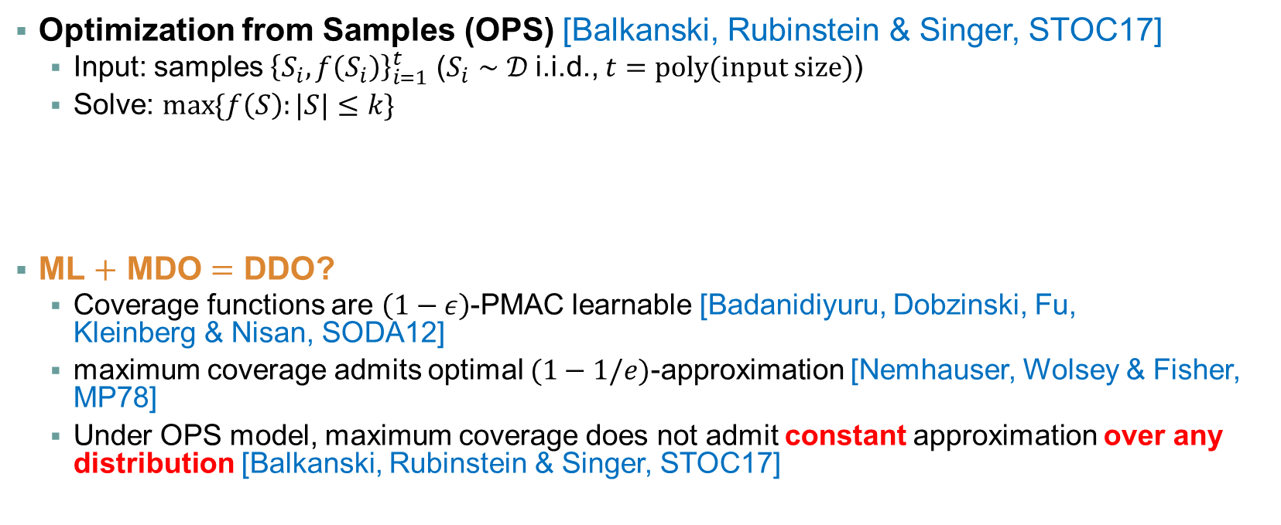
Optimization from Samples
Optimization from Samples (OPS) [Balkanski, Rubinstein & Singer, STOC17]
  Input: samples ${\left\{S_{i}, f\left(S_{i}\right)\right\}}_{i=1}^{t}$ ($S_{i}∼𝒟$ i.i.d., $t=poly(input size)$)
  Solve: $\max{\{f\left(S\right):|S|≤k\}}$
ML $+$ MDO $=$ DDO?
  Coverage functions are $\left(1−ε\right)$-PMAC learnable [Badanidiyuru, Dobzinski, Fu,
  Kleinberg & Nisan, SODA12]
  maximum coverage admits optimal $(1−1/e)$-approximation [Nemhauser, Wolsey & Fisher, MP78]
  Under OPS model, maximum coverage does not admit constant approximation over any distribution [Balkanski, Rubinstein & Singer, STOC17]
Samples
Model
Optimization
ML
MDO
NO!
Q : how to bypass the limitation of OPS?

Slide 7
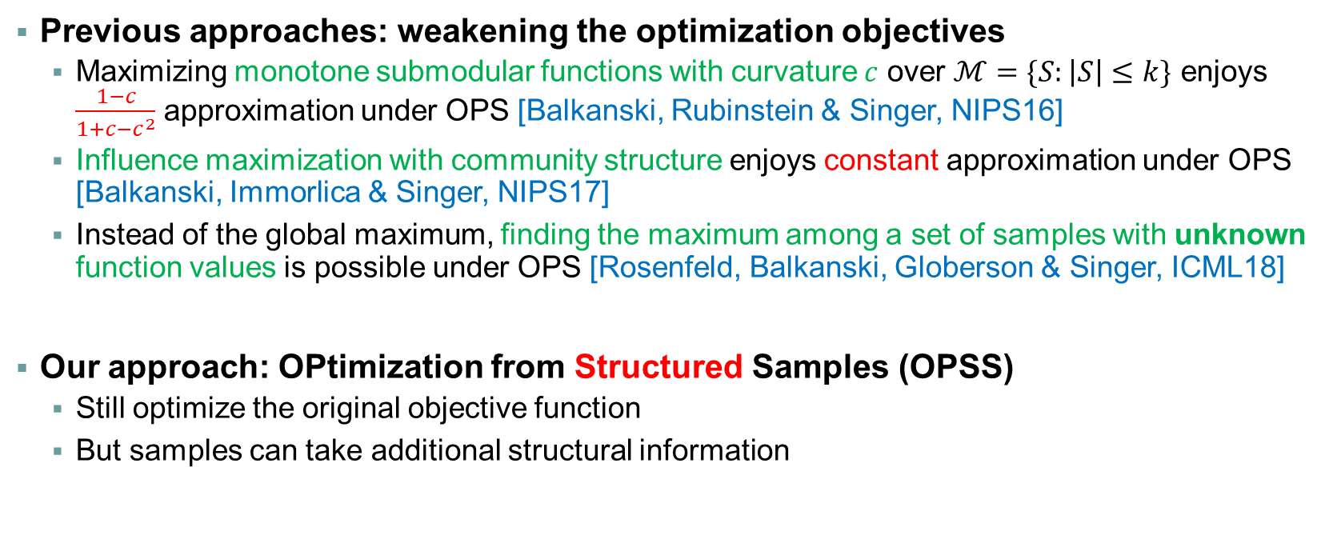
How to Bypass the Limitation?
Previous approaches: weakening the optimization objectives
  Maximizing monotone submodular functions with curvature $c$ over $ℳ=\{S:\left|S\right|≤k\}$ enjoys $\frac{1−c}{1+c−c^{2}}$ approximation under OPS [Balkanski, Rubinstein & Singer, NIPS16]
  Influence maximization with community structure enjoys constant approximation under OPS [Balkanski, Immorlica & Singer, NIPS17]
  Instead of the global maximum, finding the maximum among a set of samples with unknown function values is possible under OPS [Rosenfeld, Balkanski, Globerson & Singer, ICML18]
Our approach: OPtimization from Structured Samples (OPSS)
  Still optimize the original objective function
  But samples can take additional structural information
Our contribution: DDO is possible under OPSS model
Notes:
Curvature measures how close to linear functions
Linear functions have curvature $c=0$
Coverage functions have curvature $c=1$
The underlying social network can be partitioned into communities

Slide 8
Maximum Coverage under OPSS

Slide 9
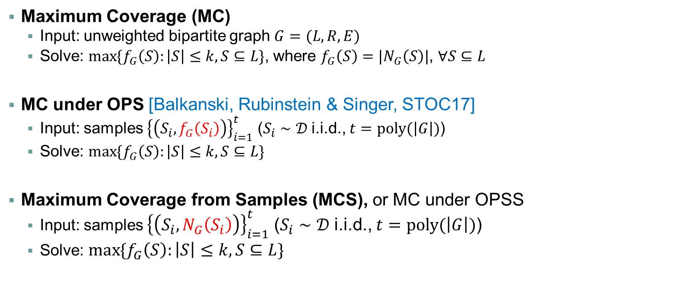
Maximum Coverage under OPSS
$$R$$
$$L$$
Maximum Coverage (MC)
  Input: unweighted bipartite graph $G=(L,R,E)$
  Solve: $\max{\{f_{G}\left(S\right):\left|S\right|≤k, S⊆L\}}$, where $f_{G}\left(S\right)=|N_{G}\left(S\right)|$, $∀S⊆L$
MC under OPS [Balkanski, Rubinstein & Singer, STOC17]
  Input: samples ${\left\{\left(S_{i}, f_{G}\left(S_{i}\right)\right)\right\}}_{i=1}^{t}$ ($S_{i}∼𝒟$ i.i.d., $t=poly(\left|G\right|)$)
  Solve: $\max{\{f_{G}\left(S\right):\left|S\right|≤k, S⊆L\}}$
Maximum Coverage from Samples (MCS), or MC under OPSS
  Input: samples ${\left\{\left(S_{i}, N_{G}\left(S_{i}\right)\right)\right\}}_{i=1}^{t}$ ($S_{i}∼𝒟$ i.i.d., $t=poly(\left|G\right|)$)
  Solve: $\max{\{f_{G}\left(S\right):\left|S\right|≤k, S⊆L\}}$
$$f_{G}\left(S\right)=|N_{G}\left(S\right)|$$

Slide 10

Our Results for MCS
Assumption 1. (for the sample distribution $𝒟$)
  Feasibility. The sample $S∼𝒟$ satisfies $\left|S\right|≤k$.
  Sufficiently large sample probability. Each node $u∈L$ can be sampled frequently.
  Negative correlation. The events that $u∈L$ is sampled are negatively correlated.
Theorem 1. If MC admits a $κ$-approximation, then
  For distributions satisfying Assumption 1, MCS admits a $κ/2$-approximation.
  For uniform distributions over $\{S:\left|S\right|≤K\}$, MCS admits a $(κ−ε)$-approximation.
Theorem 2.
  (Optimality of algorithm). There exists a distribution $𝒟$ satisfying Assumption 1 such that
  $(1/2+o(1))$-approximation is impossible for MCS.
  (Necessity of Assumption 1). By dropping any of the three conditions of Assumption 1, any constant approximation is impossible for MCS.

Slide 11



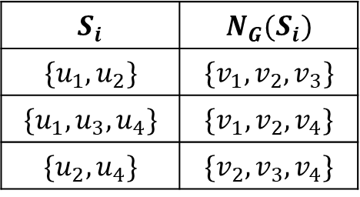
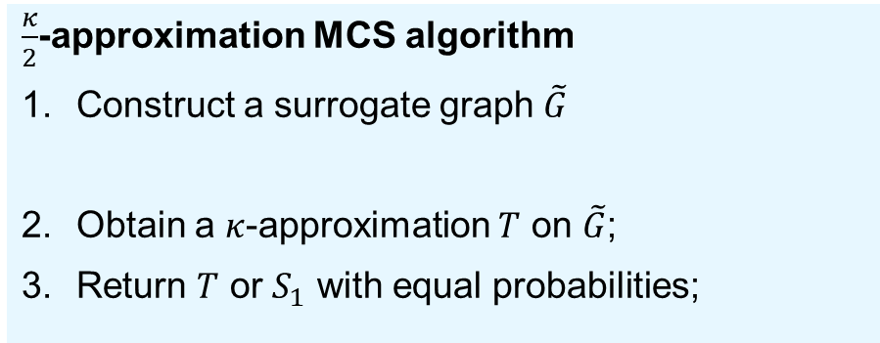

$κ/2$-Approx Algo for MCS
$\frac{κ}{2}$-approximation MCS algorithm
Construct a surrogate graph $\tilde{G}$
Obtain a $κ$-approximation $T$ on $\tilde{G}$;
Return $T$ or $S_{1}$ with equal probabilities;
Step 2: $T$ suffers from a learning error
$f_{\tilde{G}}\left(T\right)≥κ⋅f_{\tilde{G}}\left(S^{∗}\right)≥κ⋅f_{G}(S^{∗})$
$f_{\tilde{G}}\left(T\right)=|N_{G}\left(T\right)|+|N_{\tilde{G}}\left(T\right)∖N_{G}\left(T\right)|$
Step 3: any random sample can cover the error
$N_{\tilde{G}}\left(T\right)∖N_{G}\left(T\right)⊆N_{G}(S_{1})$ w.h.p.
$f_{G}\left(S_{1}\right)+f_{G}\left(T\right)≥κ⋅f_{G}(S^{∗})$
Proof sketch of step 3
Observe $N_{\tilde{G}}\left(T\right)∖N_{G}\left(T\right)⊆∪_{u∈T}N_{\tilde{G}}\left(u\right)∖N_{G}\left(u\right)$
It suffices to prove $N_{\tilde{G}}\left(u\right)∖N_{G}\left(u\right)⊆N_{G}(S_{1})$
Observe $v∈N_{\tilde{G}}\left(u\right)= ∩_{i:u∈S_{i}}N_{G}(S_{i})$ and $S_{i}$ i.i.d.
$∀ u∈L, N_{\tilde{G}}\left(u\right)= ∩_{i:u∈S_{i}}N_{G}(S_{i})$
How to make up for the error $|N_{\tilde{G}}\left(T\right)∖N_{G}\left(T\right)|$?
Step 1: an example
$$S_{i}$$ | $$N_{G}(S_{i})$$
$$\{u_{1},u_{2}\}$$ | $$\{v_{1},v_{2},v_{3}\}$$
$$\{u_{1},u_{3},u_{4}\}$$ | $$\{v_{1},v_{2},v_{4}\}$$
$$\{u_{2},u_{4}\}$$ | $$\{v_{2},v_{3},v_{4}\}$$
$$N_{\tilde{G}}\left(u_{1}\right)=\{v_{1},v_{2}\}$$
$N_{G}\left(u\right)⊆N_{\tilde{G}}\left(u\right)$; $G$ is a subgraph of $\tilde{G}$

Slide 12
Influence Maximization under OPSS

Slide 13



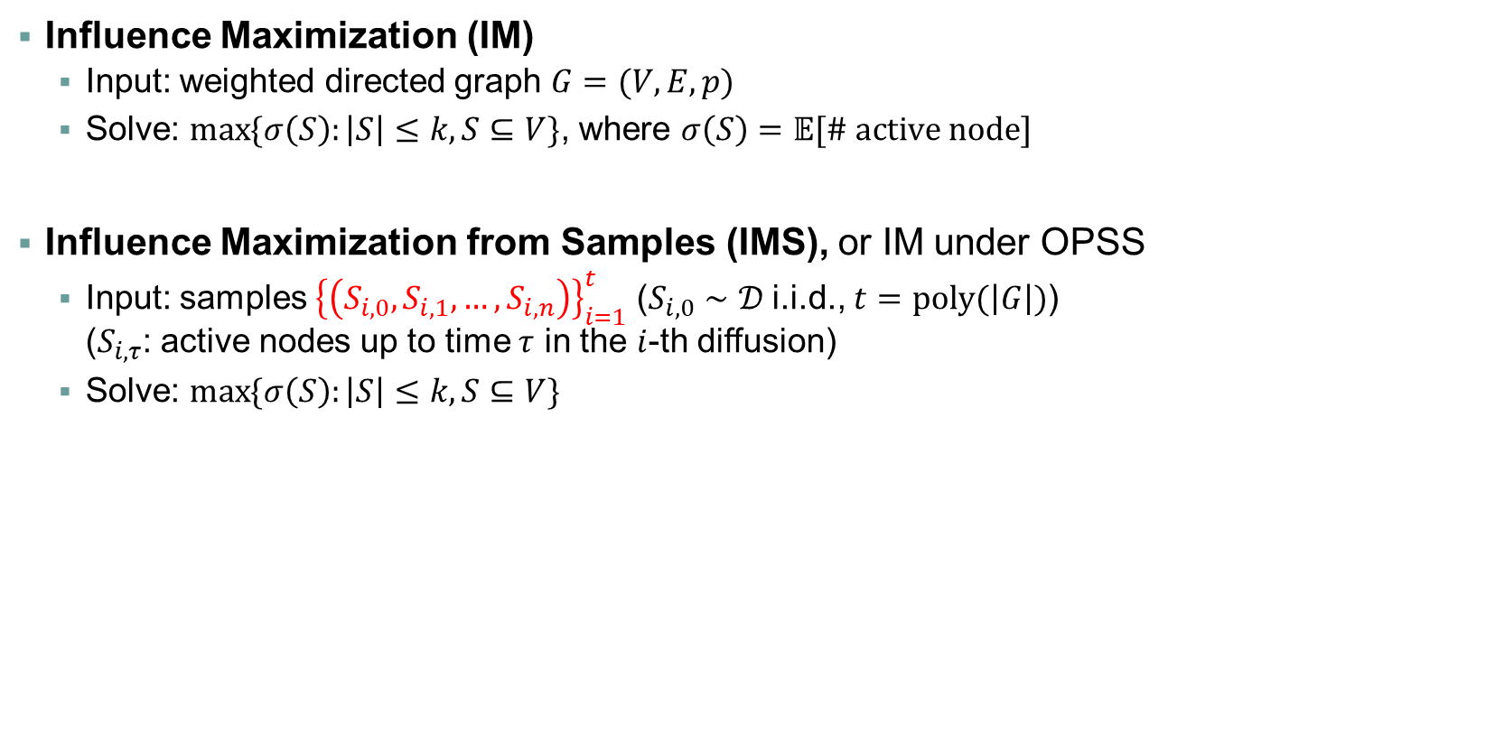












Influence Maximization under OPSS
Influence Maximization (IM)
  Input: weighted directed graph $G=(V,E,p)$
  Solve: $\max{\{σ\left(S\right):\left|S\right|≤k,S⊆V\}}$, where $σ\left(S\right)=𝔼[\# active node]$
Influence Maximization from Samples (IMS), or IM under OPSS
  Input: samples ${\left\{\left(S_{i,0},S_{i,1},…,S_{i,n}\right)\right\}}_{i=1}^{t}$ ($S_{i,0}∼𝒟$ i.i.d., $t=poly(\left|G\right|)$)
  ($S_{i,τ}$: active nodes up to time $τ$ in the $i$-th diffusion)
  Solve: $\max{\{σ\left(S\right):\left|S\right|≤k,S⊆V\}}$
$$0.6$$
$$0.3$$
$$0.9$$
$$0.7$$
$$0.3$$
Independent Cascade (IC)
diffusion model
$$S_{i,1}∖S_{i,0}$$
$$S_{i,0}$$
$$0.2$$
$$S_{i,2}∖S_{i,1}$$
$$0.1$$
$$0.8$$
$$0.45$$
$$S_{i,3}∖S_{i,2}$$
$$0.9$$

Slide 14

Our Results for IMS
Assumption 2. (for the sample distribution $𝒟$)
  Feasibility. The sample $S∼𝒟$ satisfies $𝔼\left[\left|S\right|\right]≤ck$ ($c$ is constant).
  Sufficiently large sample probability. Each node $u∈L$ can be sampled frequently.
  Product distribution. The events that $u∈V$ is sampled are independent.
Theorem 1. If IM admits a $κ$-approximation, then
  For distributions satisfying Assumption 2, IMS admits a $O(κ)$-approximation.
  If additionally $c=ε<1/3$, then IMS admits a $(κ−3ε)$-approximation.
Key points of algorithm design
Network inference:
how to learn network parameters from samples?
What if we cannot learn parameters well?
Can we further learn the influence function well?

Slide 15
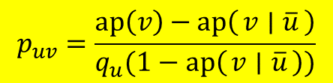
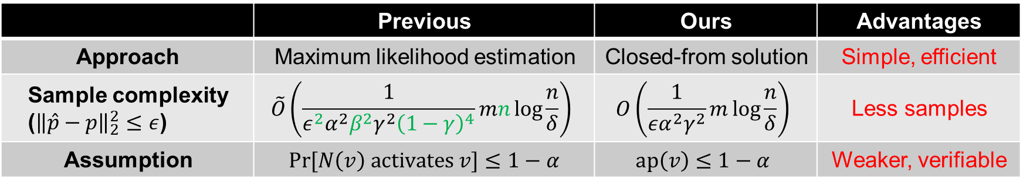




Network Inference
Network inference
  Input: samples ${\left\{\left(S_{i,0},S_{i,1},…,S_{i,n}\right)\right\}}_{i=1}^{t}$ ($S_{i,0}∼𝒟$ i.i.d., $t=poly(\left|G\right|)$).
  Output: an estimate $\hat{p}$ of $p$ s.t. $∀ u,v∈V, \left|{\hat{p}}_{uv}−p_{uv}\right|≤ε$.
Solution: a closed-form expression for $p_{uv}$
Assumption 3.
  Small one-step activation probability. $∃ α∈(0,1]$, $∀ v∈V$, $ap\left(v\right)≤1−α$.
  Sufficiently large sample probability. $∃ γ∈(0,1/2]$, $∀ u∈V$, $γ≤\underset{S∼𝒟}{Pr}{[u∈S]}≤1−γ$.
  Product distribution. The events that $u∈V$ is sampled are independent.
$$q_{u}=\operatorname{Pr}{[u∈S_{i,0}]}$$
$$ap\left(v\right)=\operatorname{Pr}{[v∈S_{i,1}]}$$
$$p_{uv}=\frac{ap\left(v\right)−ap\left(v ∣ \overline{u}\right)}{q_{u}(1−ap\left(v ∣ \overline{u}\right))}$$
$$ap\left(v ∣ \overline{u}\right)=\operatorname{Pr}{[v∈S_{i,1}∣u∉S_{i,0}]}$$
 | Previous | Ours | Advantages
Approach | Maximum likelihood estimation | Closed-from solution | Simple, efficient
Sample complexity (${\left\|\hat{p}−p\right\|}_{2}^{2}≤ε$) | $$\tilde{O}\left(\frac{1}{ε^{2}α^{2}β^{2}γ^{2}{\left(1−γ\right)}^{4}}mn\log{\frac{n}{δ}}\right)$$ | $$O\left(\frac{1}{εα^{2}γ^{2}}m\log{\frac{n}{δ}}\right)$$ | Less samples
Assumption | $\operatorname{Pr}{[N\left(v\right) activates v]}≤1−α$ | $$ap\left(v\right)≤1−α$$ | Weaker, verifiable
Previous works: [Netrapalli & Sanghavi, SIGMETRICS12; Narasimhan et al., NIPS15; Pouget-Abadie & Horel, ICML15]

Slide 16
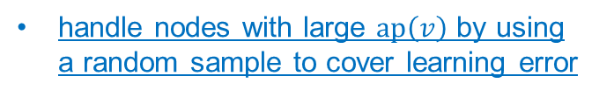
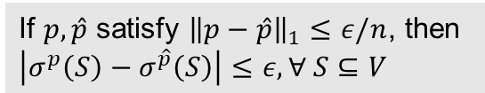



IMS Algorithm
Ingredients of Algorithm desgin
$O(κ)$-approximation IMS algorithm
Construct a surrogate graph $\hat{G}=(V,E,\hat{p})$
Obtain a $κ$-approximation $T$ on $\hat{G}$;
Return $T$ or $S_{1,0}$ with equal probabilities
(if $\left|S_{1,0}\right|>k$, then return a random subset of $S_{1,0}$ with size $k$)
Network inference
forall $v∈V$ do
  Estimate $\hat{ap}(v)$;
  if $\hat{ap}\left(v\right)$ is close to $1$ then
  $∀ u∈V$, set ${\hat{p}}_{uv}=1$;
  else
  $∀ u∈V$, ${\hat{p}}_{uv}=$ closed-form solution;
end for
A closed-form solution
Can we further learn the influence function well?
Lipschitz condition of influence functions
If $p,\hat{p}$ satisfy ${\left\|p−\hat{p}\right\|}_{1}≤ε/n$, then $\left|σ^{p}\left(S\right)−σ^{\hat{p}}\left(S\right)\right|≤ε, ∀ S⊆V$
What if we cannot learn parameters well?
handle nodes with large $ap\left(v\right)$ by using
a random sample to cover learning error
$$\operatorname{Pr}{[v∈S_{1,1}]}=ap\left(v\right)≈\hat{ap}(v)≈1$$

Slide 17
Conclusion

Slide 18
Conclusion
Take-away Message
Learnable does not imply optimizable from samples
Optimization from data may need structural information
Data-driven optimization may still be possible when learning is impossible
Future work
Relax the product-distribution condition for IMS
Investigate other objective functions under OPSS
Find a unified sample model making data-driven optimization possible
Thanks! Any Questions?

Slide 19
Appendix

Slide 20

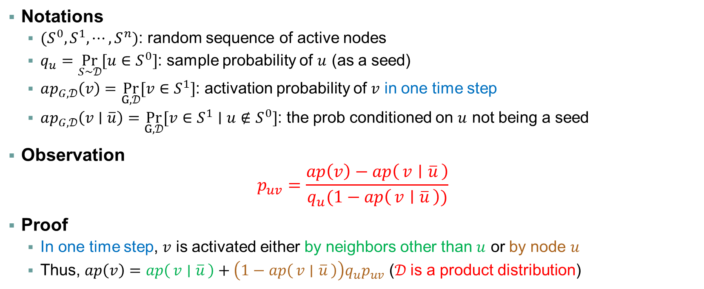


Network Inference Algorithm
Notations
  $(S^{0}, S^{1},⋯, S^{n})$: random sequence of active nodes
  $q_{u}=\underset{S∼𝒟}{Pr}{[u∈S^{0}]}$: sample probability of $u$ (as a seed)
  $ap_{G,𝒟}\left(v\right)=\underset{G,𝒟}{Pr}{[v∈S^{1}]}$: activation probability of $v$ in one time step
  $ap_{G,𝒟}\left(v∣\overline{u}\right)=\underset{G,𝒟}{Pr}{[v∈S^{1}∣u∉S^{0}]}$: the prob conditioned on $u$ not being a seed
Observation
$p_{uv}=\frac{ap\left(v\right)−ap\left(v ∣ \overline{u}\right)}{q_{u}(1−ap\left(v ∣ \overline{u}\right))}$
Proof
  In one time step, $v$ is activated either by neighbors other than $u$ or by node $u$
  Thus, $ap\left(v\right)=ap\left(v ∣ \overline{u}\right)+\left(1−ap\left(v ∣ \overline{u}\right)\right)q_{u}p_{uv}$ ($𝒟$ is a product distribution)
$$q_{u}$$
$$p_{uv}$$
$$v$$

Slide 21






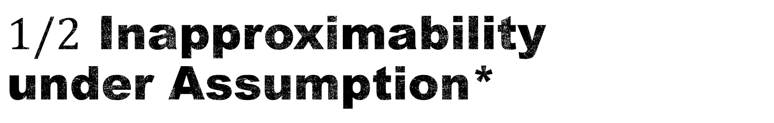









$1/2$ Inapproximability under Assumption*
Theorem
There exists a distribution $𝒟$ satisfying Assumption* such that
$(1/2+o(1))$-approximation is impossible if samples are drawn from $𝒟$
  The family of $k−1$ hard graphs consists of $G_{1},⋯,G_{k−1}$.
  For $S∼𝒟$, $\left\{u_{1},⋯,u_{k−1}\right\}⊆S$, the last node is randomly picked from $\{u_{k},⋯,u_{n}\}$
  $OPT=2\left(k−1\right)r$. $E\left[ALG\right]=kr$, since $G_{1},⋯,G_{k−1}$ cannot be distinguished from samples
$$u_{1}$$
$$u_{2}$$
$$u_{k−1}$$
$$u_{k}$$
$$u_{k+1}$$
$$u_{n}$$
$$L$$
……
……
$$R$$
In $G_{i}$, $|{N(u}_{i})|=(k−1)r$
$$|{N(u}_{1})|=(k−1)r$$
$$|{N(u}_{k})|=r$$
$$|{N(u}_{k+1})|=r$$
$$|{N(u}_{n})|=r$$
Figure. The description of $G_{1}$

